Slide 1
Sketching Massive Distributed Data Streams
Minos Garofalakis
Internet Management Research Department
Bell Labs, Lucent Technologies

Slide 2
Disclaimers
Personal, biased view of data-streaming world
  Revolve around own line of work, interests, and results
  Focus on one basic algorithmic tool
    A lot more out there (e.g., different sketch types) . . .
    Interesting research prototypes and systems work not covered
      Aurora, STREAM, Telegraph, . . .
Discussion necessarily short and fairly high-level
  More detailed overviews
    3-hour tutorial at VLDB’02, Motwani et al. [PODS’02], upcoming edited book (Springer-Verlag). . .
  Ask questions!
  Talk to me afterwards

Slide 3
Data-Stream Management
Traditional DBMS – data stored in finite, persistent data sets
Data Streams – distributed, continuous, unbounded, rapid, time varying, noisy, . . .
Data-Stream Management – variety of modern applications
  Network monitoring and traffic engineering
  Telecom call-detail records
  Network security
  Financial applications
  Sensor networks
  Manufacturing processes
  Web logs and clickstreams
  Massive data sets

Slide 4

Networks Generate Massive Data Streams
SNMP/RMON,
NetFlow records
Network Operations
Center (NOC)
Example NetFlow IP Session Data
Source Destination Duration Bytes Protocol
10.1.0.2 16.2.3.7 12 20K http
18.6.7.1 12.4.0.3 16 24K http
13.9.4.3 11.6.8.2 15 20K http
15.2.2.9 17.1.2.1 19 40K http
12.4.3.8 14.8.7.4 26 58K http
10.5.1.3 13.0.0.1 27 100K ftp
11.1.0.6 10.3.4.5 32 300K ftp
19.7.1.2 16.5.5.8 18 80K ftp
Peer
BGP
OSPF
Converged IP/MPLS
Network
Enterprise
Networks
PSTN
FR, ATM, IP VPN
DSL/Cable
Networks
Broadband
Internet Access
Voice over IP
SNMP/RMON/NetFlow data records arrive 24x7 from different parts of the network
Truly massive streams arriving at rapid rates
  AT&T collects 600-800 GigaBytes of NetFlow data each day!
Typically shipped to a back-end data warehouse (off site) for off-line analysis

Slide 5
Real-Time Data-Stream Analysis
Back-end Data Warehouse
What are the top (most frequent) 1000 (source, dest) pairs seen by R1 over the last month?
DBMS
(Oracle, DB2)
Off-line analysis – Data access is slow, expensive
Network Operations
Center (NOC)
How many distinct (source, dest) pairs have been seen by both R1 and R2 but not R3?
Set-Expression Query
BGP
R1
R2
Peer
R3
Converged IP/MPLS
Network
SELECT COUNT (R1.source, R1.dest)
FROM R1, R2
WHERE R1.source = R2.source
Enterprise
Networks
DSL/Cable
Networks
PSTN
SQL Join Query
Need ability to process/analyze network-data streams in real-time
  As records stream in: look at records only once in arrival order!
  Within resource (CPU, memory) limitations of the NOC
Critical to important NM tasks
  Detect and react to Fraud, Denial-of-Service attacks, SLA violations
  Real-time traffic engineering to improve load-balancing and utilization

Slide 6
Talk Outline
Introduction & Motivation
Data Stream Computation Model
A Basic Sketching Tool for Streams
  Linear-Projection (aka AMS) Sketches
    Applications: Join/Multi-Join Queries, Wavelets, Correlating XML streams
Tracking Queries over Distributed Streams
  Communication-efficient, sketch-based approach
Conclusions & Future Research Directions

Slide 7
Data-Stream Processing Model
Stream Synopses
(in memory)
(GigaBytes)
(KiloBytes)
Continuous Data Streams
R1
Stream
Processing
Engine
Approximate Answer
with Error Guarantees
“Within 2% of exact
answer with high
probability”
Rk
Query Q
Approximate answers often suffice, e.g., trend analysis, anomaly detection
Requirements for stream synopses
  Single Pass: Each record is examined at most once, in (fixed) arrival order
  Small Space: Log or polylog in data stream size
  Real-time: Per-record processing time (to maintain synopses) must be low
  Delete-Proof: Can handle record deletions as well as insertions
  Composable: Built in a distributed fashion and combined later

Slide 8
Synopses for Relational Streams
Conventional data summaries fall short
  Quantiles and 1-d histograms [MRL98,99], [GK01], [GKMS02]
    Cannot capture attribute correlations
    Little support for approximation guarantees
  Samples (e.g., using Reservoir Sampling)
    Perform poorly for joins [AGMS99] or distinct values [CCMN00]
    Cannot handle deletion of records
  Multi-d histograms/wavelets
    Construction requires multiple passes over the data
Different approach: Pseudo-random sketch synopses
  Only logarithmic space
  Probabilistic guarantees on the quality of the approximate answer
  Support insertion as well as deletion of records

Slide 9
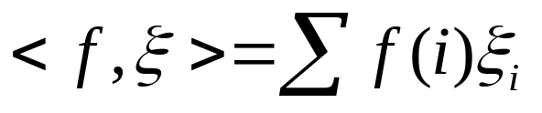


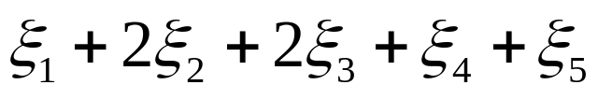
Linear-Projection (aka AMS) Sketch Synopses
Goal: Build small-space summary for distribution vector f(i) (i=1,..., N) seen as a stream of i-values
Basic Construct: Randomized Linear Projection of f() = project onto inner/dot product of f-vector
  Simple to compute over the stream: Add whenever the i-th value is seen
  Generate ‘s in small (logN) space using pseudo-random generators
  Tunable probabilistic guarantees on approximation error
  Delete-Proof: Just subtract to delete an i-th value occurrence
  Composable: Simply add independently-built projections
2
2
1
1
1
Data stream: 3, 1, 2, 4, 2, 3, 5, . . .
f(1) f(2) f(3) f(4) f(5)
where = vector of random values from an appropriate distribution
Data stream: 3, 1, 2, 4, 2, 3, 5, . . .

Slide 10


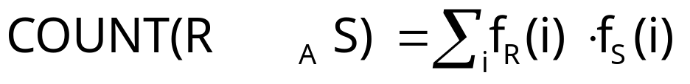
Example: Binary-Join COUNT Query
Problem: Compute answer for the query COUNT(R _{A} S)
Example:
3
2
Data stream R.A: 4 1 2 4 1 4
1
0
1
2
3
4
2
2
Data stream S.A: 3 1 2 4 2 4
1
1
1
2
3
4
= 10 (2 + 2 + 0 + 6)
Exact solution: too expensive, requires O(N) space!
  N = sizeof(domain(A))

Slide 11


Basic AMS Sketching Technique [AMS96]
Key Intuition: Use randomized linear projections of f() to define random variable X such that
  X is easily computed over the stream (in small space)
  E[X] = COUNT(R _{A} S)
  Var[X] is small
Basic Idea:
  Define a family of 4-wise independent {-1, +1} random variables
  Pr[ = +1] = Pr[ = -1] = 1/2
    Expected value of each , E[ ] = 0
  Variables are 4-wise independent
    Expected value of product of 4 distinct = 0
  Variables can be generated using pseudo-random generator using only O(log N) space (for seeding)!
Probabilistic error guarantees
(e.g., actual answer is 10±1 with
probability 0.9)

Slide 12
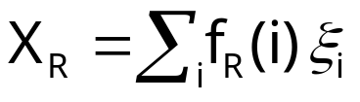
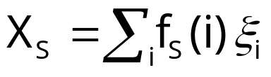




AMS Sketch Construction
Compute random variables: and
  Simply add to X_{R}(X_{S}) whenever the i-th value is observed in the R.A (S.A) stream
Define X = X_{R}X_{S} to be estimate of COUNT query
Example:
3
2
Data stream R.A: 4 1 2 4 1 4
1
0
1
2
3
4
2
2
Data stream S.A: 3 1 2 4 2 4
1
1
1
2
3
4

Slide 13

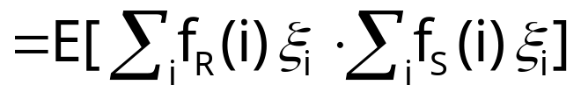
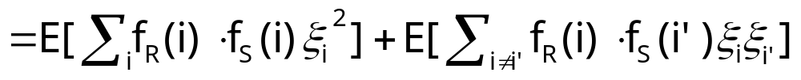
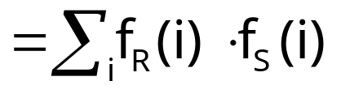


Binary-Join AMS Sketching Analysis
Expected value of X = COUNT(R _{A} S)
Using 4-wise independence, possible to show that
is self-join size of R
1
0

Slide 14
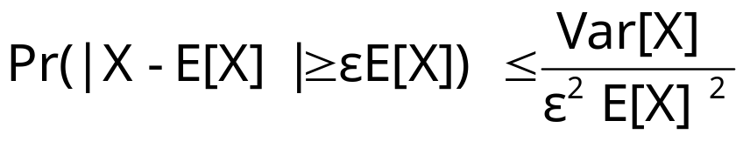

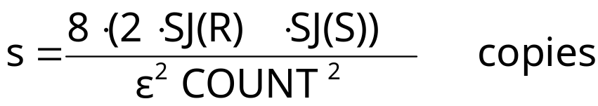

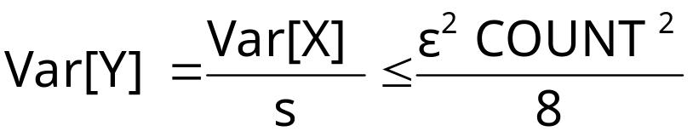
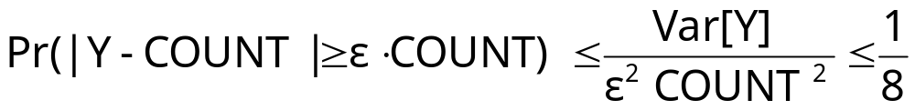
Boosting Accuracy
Chebyshev’s Inequality:
Boost accuracy to by averaging over several independent copies of X (reduces variance)
By Chebyshev:
x
x
x
Average
y

Slide 15










Boosting Confidence
Boost confidence to by taking median of 2log(1/ ) independent copies of Y
Each Y = Binomial Trial
“FAILURE”:
y
2log(1/ )
copies
y
median
y
Pr[|median(Y)-COUNT| COUNT]
= Pr[ # failures in 2log(1/ ) trials >= log(1/ ) ]
(By Chernoff Bound)

Slide 16
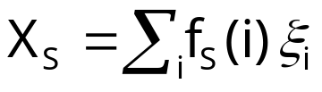
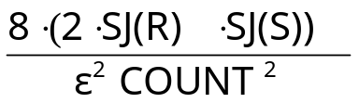



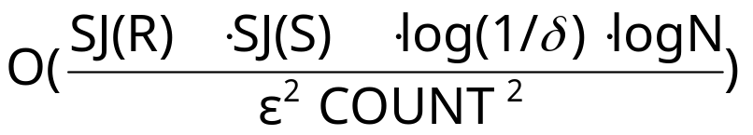
Summary of Binary-Join AMS Sketching
Step 1: Compute random variables: and
Step 2: Define X= X_{R}X_{S}
Steps 3 & 4: Average independent copies of X; Return median of averages
Main Theorem (AGMS99): Sketching approximates COUNT to within a relative error of with probability using space
  Remember: O(log N) space for “seeding” the construction of each X
copies
x
x
x
Average
y
2log(1/ )
copies
x
x
x
Average
y
median
x
x
x
Average
y

Slide 17
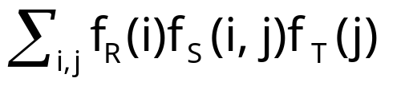
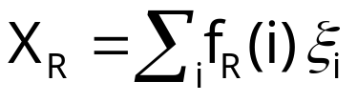


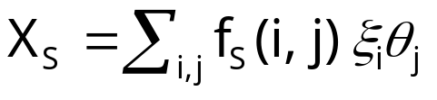
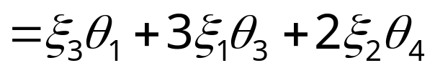
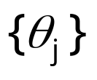

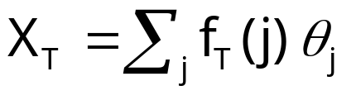

AMS Sketching for Multi-Join Aggregates [DGGR02]
Problem: Compute answer for COUNT(R _{A}S _{B}T) =
Sketch-based solution
  Compute random variables X_{R}, X_{S} and X_{T}
  Return X=X_{R}X_{S}X_{T} (E[X]= COUNT(R _{A}S _{B}T))
Stream R.A: 4 1 2 4 1 4
Independent families
of {-1,+1} random
variables
Stream S: A 3 1 2 1 2 1
B 1 3 4 3 4 3
Stream T.B: 4 1 3 3 1 4

Slide 18
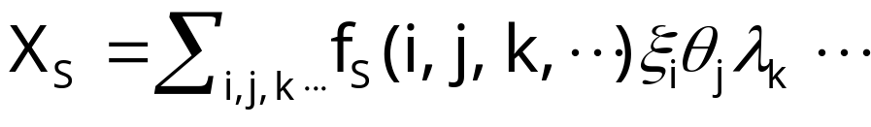


AMS Sketching for Multi-Join Aggregates
Sketches can be used to compute answers for general multi-join COUNT queries (over streams R, S, T, ........)
  For each pair of attributes in equality join constraint, use independent family of {-1, +1} random variables
  Compute random variables X_{R}, X_{S}, X_{T}, .......
  Return X=X_{R}X_{S}X_{T} ....... (E[X]= COUNT(R S T ........))
  Explosive increase with the number of joins!
Stream S: A 3 1 2 1 2 1
B 1 3 4 3 4 3
Independent
families of {-1,+1}
random variables
C 2 4 1 2 3 1

Slide 19
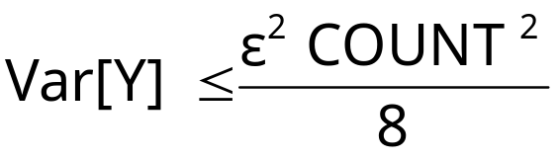
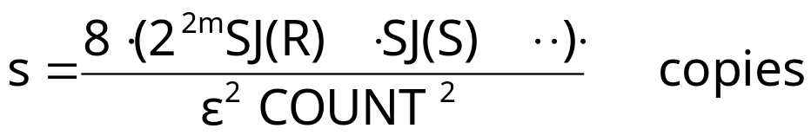
Boosting Accuracy by Sketch Partitioning: Basic Idea
For error, need
Key Observation: Product of self-join sizes for partitions of streams can be much smaller than product of self-join sizes for streams
  Reduce space requirements by partitioning join attribute domains
    Overall join size = sum of join size estimates for partitions
  Exploit coarse statistics (e.g., histograms) based on historical data or collected in an initial pass, to compute the best partitioning
x
x
x
Average
y

Slide 20












Sketch Partitioning Example: Binary-Join
COUNT Query
Without Partitioning
With Partitioning (P1={2,4}, P2={1,3})
10
10
10
10
2
1
2
1
1
3
2
4
1
3
2
4
SJ(R1)=5
SJ(R)=205
SJ(R2)=200
30
30
30
30
2
1
2
1
1
3
2
4
1
2
3
4
SJ(S1)=1800
SJ(S2)=5
SJ(S)=1805
X = X1+X2, E[X] = COUNT(R S)

Slide 21
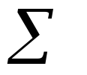


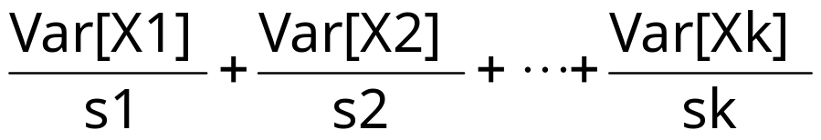

Overview of Sketch Partitioning
Maintain independent sketches for partitions of join-attribute space
Improved error guarantees
  Var[X] = Var[Xi] is smaller (by intelligent domain partitioning)
  “Variance-aware” boosting: More space to higher-variance partitions
Problem: Given total sketching space S, find domain partitions p1,…, pk and space allotments s1,…,sk such that sj S, and the variance
  Solved optimal for binary-join case (using Dynamic-Programming)
  NP-hard for joins
    Extension of our DP algorithm is an effective heuristic -- optimal for independent join attributes
Significant accuracy benefits for small number (2-4) of partitions
is minimized

Slide 22





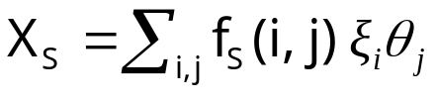









More Recent Results on Stream Joins
Better accuracy using “skimmed sketches” [GGR04]
  “Skim” dense items (i.e., large frequencies) from the AMS sketches
  Use the “skimmed” sketch only for sparse element representation
  Stronger worst-case guarantees, and much better in practice
    Same effect as sketch partitioning with no apriori knowledge!
Sharing sketch space/computation among multiple queries [DGGR04]
Naive
Sharing
R
S
T
A
A
B
B
S
T
A
B
B
R
T
A
T
A
B
R
A
B
Same family of
random variables

Slide 23


Other Applications of AMS Stream Sketching
Key Observation: |R1 R2| = = inner product!
General result: Streaming estimation of “large” inner products using AMS sketching
Other streaming inner products of interest
  Top-k frequencies [CCF02]
    Item frequency = < f, “unit_pulse” >
  Large wavelet coefficients [GKMS01]
    Coeff(i) = < f, w(i) >, where w(i) = i-th wavelet basis vector
1
1
N
1/N
w(0) =
1
N
w(i) =
1
N

Slide 24

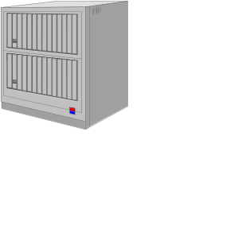
Processing XML Data Streams
XML: Much richer, (semi)structured data model
  Ordered, node-labeled data trees
Bulk of work on XML streaming: Content-based filtering of XML documents (publish/subscribe systems)
  Quickly match incoming documents against standing XPath subscriptions
XPath Subscriptions
(X/Yfilter, Xtrie, etc.)
Essentially, simple selection queries over a stream of XML records!
No work on more complex XML stream queries
  For example, queries trying to correlate different XML data streams

Slide 25


Processing XML Data Streams
Example XML stream correlation query: Similarity-Join
Web Source 1
T1
|SimJoin(S1, S2)| = |{(T1,T2) S1xS2: dist(T1,T2) }|
Web Source 2
T2
Degree of content similarity between
streaming XML sources
Different data representation for same
information (DTDs, optional elements)
Correlation metric: Tree-edit distance ed(T1,T2)
  Node relabels, inserts, deletes - also, allow for subtree moves
publication
delete
publication
book
paper
book
paper
title
author
title
authors
title
author
title
author
author
author
author

Slide 26
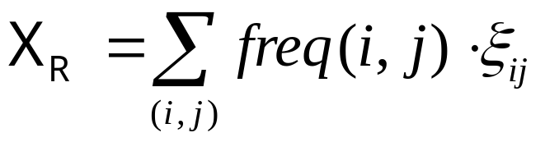


How About AMS Sketches?
Randomized linear projections (aka AMS sketches) are useful for points over a numeric vector space
  Not structured objects over a complex metric space (tree-edit distance)
N
Stream
R(A,B)
Atomic Sketch
O( )
N
O( )

Slide 27
Our Approach [GK03]
Key idea: Build a low-distortion embedding of streaming XML and the tree-edit distance metric in a multi-d normed vector space
ed(T1,T2)
Distances are (approximately)
preserved in the image vector space!!
ed(T2,T3)
V(T2)
map V()
V(T3)
V(T1)
ed(T1,T3)
Given such an embedding, sketching techniques now become relevant in the streaming XML context!
  E.g., use AMS sketches to produce synopses of the data distribution in the image vector space

Slide 28


Our Approach [GK03] (cont.)
Construct low-distortion embedding for tree-edit distance over streaming XML documents -- Requirements:
  Small space/time
  Oblivious: Can compute V(T) independent of other trees in the stream(s)
  Bourgain’s Lemma is inapplicable!
First algorithm for low-distortion, oblivious embedding of the tree-edit distance metric in small space/time
  Fully deterministic, embed into L1 vector space
  Bound of on distance distortion for trees with n nodes
Worst-case bound! Distortions much smaller over real-life data
  See TODS’05 paper…

Slide 29

Our Approach [GK03] (cont.)
Applications in XML stream query processing
  Combine our embedding with existing pseudo-random linear-projection sketching techniques
  Build a small-space sketch synopsis for a massive, streaming XML data tree
    Concise surrogate for tree-edit distance computations
  Approximating tree-edit distance similarity joins over XML streams in small space/time
First algorithmic results on correlating XML data in the streaming model
Other important algorithmic applications for our embedding result
  Approximate tree-edit distance in (near-linear) time

Slide 30
Talk Outline
Introduction & Motivation
Data Stream Computation Model
A Basic Sketching Tool for Streams
  Linear-Projection (aka AMS) Sketches
    Applications: Join/Multi-Join Queries, Wavelets, Correlating XML streams
Tracking Queries over Distributed Streams
  Communication-efficient, sketch-based approach
Conclusions & Future Research Directions

Slide 31












Tracking Distributed Data Streams
Network Operations
Center (NOC)
Coordinator
Track Q( ) =
BGP
Converged IP/MPLS
Network
DSL/Cable
Networks
PSTN
(k(R) = 3)
(k(S) = 3)
Large-scale event monitoring: Inherently distributed!
  Each stream is distributed across a (sub)set of remote sites
    , k(R) = |sites(R)|
    E.g., stream of UDP packets through a subset of edge routers
Goal is “Holistic” Monitoring: Effective tracking of a global quantity/query over the union of a distributed collection of streams
  Composability of sketches makes them ideal for distributed computation
  BUT, interested in continuous query tracking rather than “one-shot” computation
    Provide approximate answer (+ guarantees) at coordinator at all times!

Slide 32
Tracking Distributed Data Streams
Need solutions that are not only space/time-efficient, but also communication-efficient!
  Optimize communication overhead involved for a given accuracy guarantee
  Minimize monitoring overhead on network; Maximize node battery life (e.g., sensornets)
  Can use sketches at remote sites, but naïve schemes that “push” to coordinator on every update won’t work
Coordinator
Key Design Desiderata
  Minimal global information exchanges
    Avoid sharing global information and expensive “global resync” steps
  Summary-based information exhange
    Remote sites only communicate concise sketches on locally-observed streams
  Stability
    No communication as long as local-stream behavior is stable, or predictable

Slide 33




Our Query-Tracking Solution [CG05]
General approach: “In-Network” Processing
  “Push” part of the query tracking to individual remote sites
  Each site tracks local constraints on the deviation of its locally-observed stream(s) from the corresponding picture at the coordinator
  Contact coordinator with updated sketch information only if local constraints are violated
Overall error guarantee at coordinator is a function
  = error in local sketch summaries at each remote site
    Each site maintains -approximate AMS sketches on local stream(s)
  = upper bound on the local-stream deviation from the picture at the coordinator
    Local constraints tracked at each site specify a -deviation (in L2 norm) of the local stream sketch wrt the sketch at the coordinator
Exact form of depends on the specific query Q being tracked
    BUT, local site constraints remain the same (i.e., L2 deviation of local sketches)

Slide 34
Sketch-Prediction Models [CG05]
To ensure Stability, our solution relies on concise sketch-prediction models
  Try to predict how the local-stream distribution (and its sketch) will evolve over time
  Built locally at remote sites and communicated to coordinator
Prediction used at
coordinator for query answering
Predicted Distribution
Predicted Sketch
Prediction error tracked locally by sites (local constraints)
True Distribution (at site)
True Sketch (at site)

Slide 35
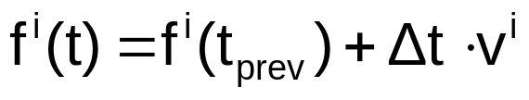

Sketch-Prediction Models
Sketch-prediction models are simple, concise models of local-stream behavior
  Information communicated to coordinator (in addition to local stream sketches) so that both site & coordinator are “in sync”
Different alternatives
  Empty model : Local stream does not change since last exchange (no additional information necessary)
  Velocity/Acceleration Models: Predict change in the distribution using “velocity” and “acceleration” vectors built on recent history
    Velocity model:
    Velocity vector based on window of recent updates at site i
    By linearity of sketching we only need to communicate a sketch of to the coordinator
      Only concise, sketch information is exchanged

Slide 36





Sketch-Based Distributed Join Tracking
Coordinator
Continuously track Q = (within specified error guarantees) at coordinator
Protocol
  Each remote site i sites(R)
    Build and maintain -approximate AMS sketch on
    On each update, check that the relative L2-norm deviation of the true local sketch from the predicted sketch is bounded by
    If not, send current sketch and (perhaps) model info to coordinator
  Similarly for each remote site j sites(S)
  Coordinator: Compute approximate answer using the predicted sketches
Key Result: Protocol guarantees a -approximate join size estimate at the coordinator at all times
Approach and results extend naturally to other queries and streaming models
  Distributed multi-join aggregates, wavelet/histogram maintenance, . . .
  Sliding window model, exponential-decay model

Slide 37




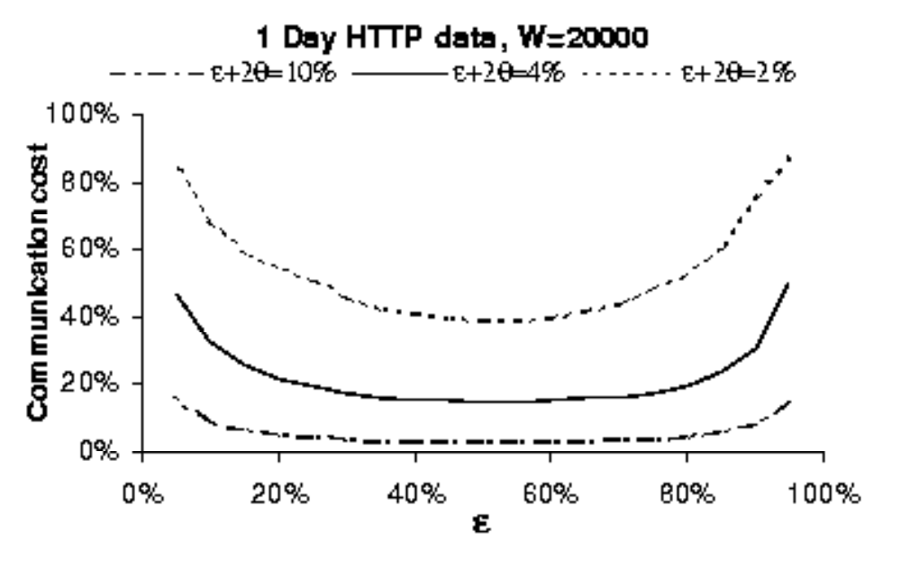
Accuracy Tradeoffs
Given an overall error requirement decide optimal “split” between
  E.g., larger , smaller => smaller sketches but communicate more frequently (smaller local-deviation tolerance)
  Analysis of optimal settings in restricted cases (e.g., Empty model)

Slide 38

Small-Time Updates: The Fast-AMS Sketch [CG05]
1
1
1
Update
0
0
Stream Synopsis
(AMS sketches)
1
0
1
1
Data stream
1
0
Synopsis-update times are typically -- fine as long as synopsis sizes are small (polylog), BUT . . .
  Small synopses are often impossible (strong communication-complexity lower bounds)
    E.g., join/multi-join aggregates
Synopsis size may not be the crucial limiting factor (PCs with Gigabytes of RAM)
Fast-AMS Sketch: Organize the atomic AMS counters into hash-table buckets
  Same space/accuracy tradeoff as basic AMS (in fact, slightly better☺)
  BUT, guaranteed logarithmic update times (regardless of synopsis size)
    Only touch a few counters per update

Slide 39
Conclusions
Analyzing massive data streams: Real problem with several real-world applications
  Fundamentally rethink data management under stringent constraints
  Single-pass algorithms with limited memory/CPU-time resources
Sketches based on pseudo-random linear projections are a viable technique for a variety of streaming tasks
  Limited-space randomized approximations
  Probabilistic guarantees on the quality of the approximate answer
  Delete-proof (supports insertion and deletion of records)
  Composable (computed remotely and combined later)
  General-purpose (join/multi-join aggregates, wavelets, histograms, XML similarity joins, . . .)
  Effective Query Tracking over Distributed-Streams

Slide 40
Future Work on Distributed-Stream Tracking
Stream tracking over different distributed architectures
  Our techniques and results extend naturally to general, multi-level hierarchies (tree structures, coordinator at the root)
  Other distributed models: fully distributed, P2P overlays, . . .
    Combine with ideas from gossip/epidemic protocols?
Fully Distributed
P2P DHT Ring
Foundations of distributed-streams model
  Lower bounds for different distributed-tracking problems?

Slide 41
Future Research Directions Laundry List
Sketches/synopses for richer types of streaming data and queries
  Spatial/temporal data streams, mining/querying streaming graphs, . . .
Other metric-space embeddings in the streaming model
Stream-data processing architectures and query languages
  Progress: Aurora, STREAM, Telegraph, . . .
Integration of streams and static relations
  Effect on DBMS components (e.g., query optimizer)
Novel, important application domains
  Sensor networks, financial analysis, security (network DDoS, virus/worm detection), . . .

Slide 42

Thank you!
http://www.bell-labs.com/~minos/
minos@research.bell-labs.com

Slide 43





Using Sketches to Answer SUM Queries
Problem: Compute answer for query SUM_{B}(R _{A} S) =
  SUM_{S}(i) is sum of B attribute values for records in S for whom S.A = i
Sketch-based solution
  Compute random variables X_{R} and X_{S}
  Return X=X_{R}X_{S} (E[X] = SUM_{B}(R _{A} S))
3
2
Stream R.A: 4 1 2 4 1 4
1
0
1
2
3
4
3
3
2
2
Stream S: A 3 1 2 4 2 3
B 1 3 2 2 1 1
1
2
3
4

Slide 44




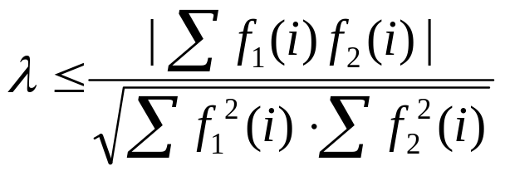

Stream Wavelet Approximation using AMS Sketches [GKMS01]
Single-join approximation with sketches [AGMS99]
  Construct approximation to |R1 R2| = within a relative error of with probability using space
, where
= |R1 R2| / Sqrt( self-join sizes)
Observation: |R1 R2| = = inner product!!
  General result for inner-product approximation using sketches
Other inner products of interest: Haar wavelet coefficients!
  Haar wavelet decomposition = inner products of signal/distribution with specialized (wavelet basis) vectors

Slide 45
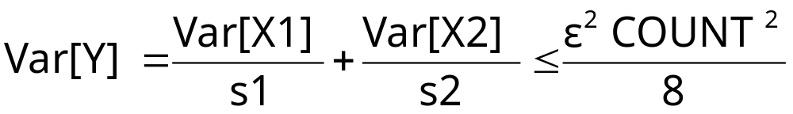
Space Allocation Among Partitions
Key Idea: Allocate more space to sketches for partitions with higher variance
Example: Var[X1]=20K, Var[X2]=2K
  For s1=s2=20K, Var[Y] = 1.0 + 0.1 = 1.1
  For s1=25K, s2=8K, Var[Y] = 0.8 + 0.25 = 1.05
X1
X1
X1
Average
Y1
s1 copies
+
Y
X2
X2
X2
Average
Y2
E[Y] = COUNT(R S)
s2 copies

Slide 46
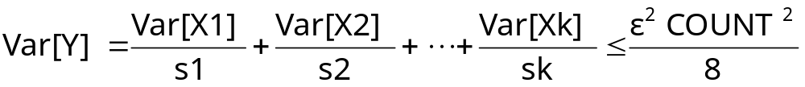
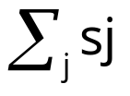
Sketch Partitioning Problems
Problem 1: Given sketches X1, ...., Xk for partitions P1, ..., Pk of the join attribute domain, what is the space sj that must be allocated to Pj (for sj copies of Xj) so that
and is minimum
Problem 2: Compute a partitioning P1, ..., Pk of the join attribute domain, and space sj allocated to each Pj (for sj copies of Xj) such that
and is minimum
Solutions also apply to dual problem (Min. variance for fixed space)

Slide 47
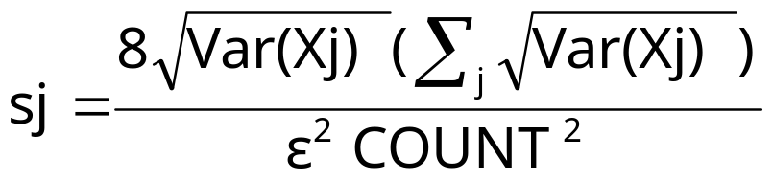
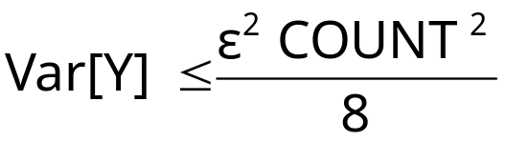

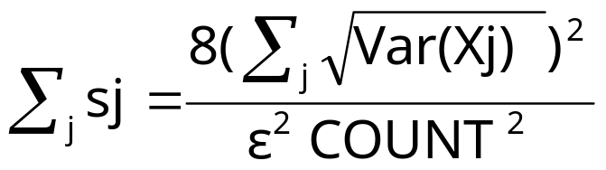
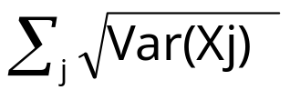
Optimal Space Allocation Among Partitions
Key Result (Problem 1): Let X1, ...., Xk be sketches for partitions P1, ..., Pk of the join attribute domain. Then, allocating space
to each Pj (for sj copies of Xj) ensures that and is minimum
Total sketch space required:
Problem 2 (Restated): Compute a partitioning P1, ..., Pk of the join attribute domain such that is minimum
  Optimal partitioning P1, ..., Pk minimizes total sketch space

Slide 48

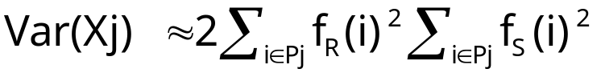
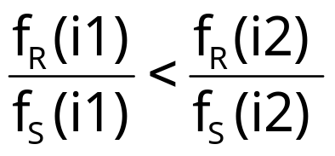

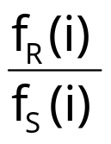
Binary-Join Queries: Binary Space
Partitioning
Problem: For COUNT(R _{A} S), compute a partitioning P1, P2 of A’s domain {1, 2, ..., N} such that is minimum
  Note:
Key Result (due to Breiman): For an optimal partitioning P1, P2,
Algorithm
  Sort values i in A’s domain in increasing value of
  Choose partitioning point that minimizes

Slide 49
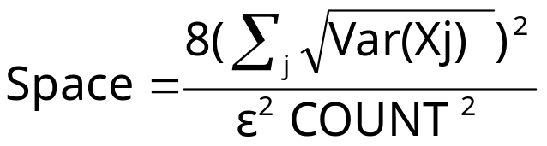
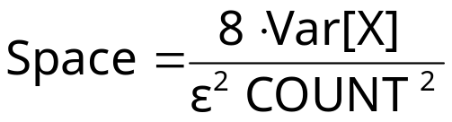
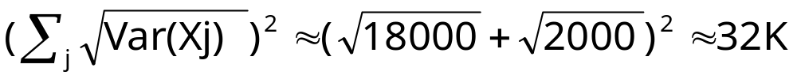


Binary Sketch Partitioning Example
Without Partitioning
With Optimal Partitioning
10
10
2
1
.03
.06
5
10
1
2
3
4
i
4
2
1
3
30
30
P1
Optimal
Point
P2
2
1
1
2
3
4

Slide 50

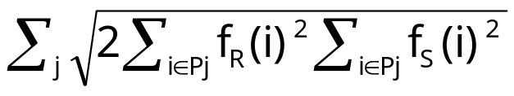
Binary-Join Queries: K-ary Sketch Partitioning
Problem: For COUNT(R _{A}S), compute a partitioning P1, P2, ..., Pk of A’s domain such that is minimum
Previous result (for 2 partitions) generalizes to k partitions
Optimal k partitions can be computed using Dynamic Programming
  Sort values i in A’s domain in increasing value of
  Let be the value of when [1,u] is split optimally into t partitions P1, P2, ...., Pt
Time complexity:O(kN² )
1
v
Pt=[v+1, u]
u

Slide 51
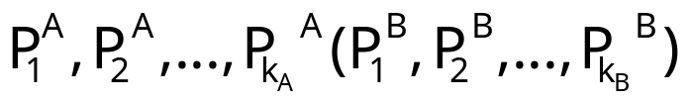
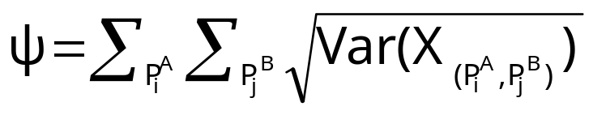

Sketch Partitioning for Multi-Join Queries
Problem: For COUNT(R _{A} S _{B}T), compute a partitioning
of A(B)’s domain such that k_{A}k_{B}<k, and the following is minimum
Partitioning problem is NP-hard for more than 1 join attribute
If join attributes are independent, then possible to compute optimal partitioning
  Choose k1 such that allocating k1 partitions to attribute A and k/k1 to remaining attributes minimizes
  Compute optimal k1 partitions for A using previous dynamic programming algorithm

Slide 52
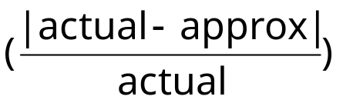
Experimental Study
Summary of findings
  Sketches are superior to 1-d (equi-depth) histograms for answering COUNT queries over data streams
  Sketch partitioning is effective for reducing error
Real-life Census Population Survey data sets (1999 and 2001)
  Attributes considered:
    Income (1:14)
    Education (1:46)
    Age (1:99)
    Weekly Wage and Weekly Wage Overtime (0:288416)
Error metric: relative error

Slide 53
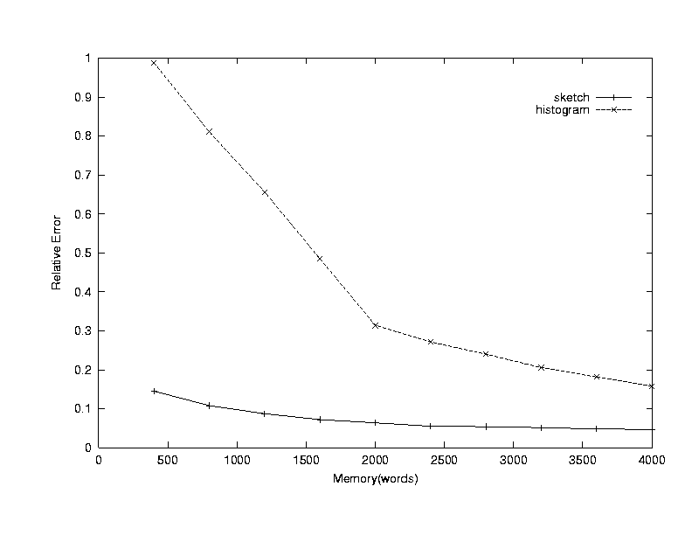
Join (Weekly Wage)

Slide 54

Join (Age, Education)

Slide 55

Star Join (Age, Education, Income)

Slide 56

Join (Weekly Wage Overtime = Weekly
Wage)

Slide 57
More work on Sketches...
Low-distortion vector-space embeddings (JL Lemma) [Ind01] and applications
  E.g., approximate nearest neighbors [IM98]
Wavelet and histogram extraction over data streams [GGI02, GIM02, GKMS01, TGIK02]
Discovering patterns and periodicities in time-series databases [IKM00, CIK02]
Quantile estimation over streams [GKMS02]
Distinct value estimation over streams [CDI02]
Maintaining top-k item frequencies over a stream [CCF02]
Stream norm computation [FKS99, Ind00]
Data cleaning [DJM02]

Slide 58



Sketching for Multiple Standing Queries
Consider queries Q1 = COUNT(R _{A} S _{B}T) and Q2 = COUNT(R _{A=B}T)
Naive approach: construct separate sketches for each join
  , , are independent families of pseudo-random variables
A
A
B
B
R
S
T
A
B
R
T

Slide 59
Sketch Sharing
Key Idea: Share sketch for relation R between the two queries
  Reduces space required to maintain sketches
Same family of
random variables
A
B
B
S
T
A
A
B
R
T
BUT, cannot also share the sketch for T !
  Same family on the join edges of Q1

Slide 60
Sketching for Multiple Standing Queries
Algorithms for sharing sketches and allocating space among the queries in the workload
  Maximize sharing of sketch computations among queries
  Minimize a cumulative error for the given synopsis space
Novel, interesting combinatorial optimization problems
  Several NP-hardness results :-)
Designing effective heuristic solutions

Slide 61
Talk Outline
Introduction & Motivation
Data Stream Computation Model
Two Basic Sketching Tools for Streams
  Linear-Projection (aka AMS) Sketches
    Applications: Join/Multi-Join Queries, Wavelets
  Hash (aka FM) Sketches
    Applications: Distinct Values, Set Expressions
Extensions
  Correlating XML data streams
Conclusions & Future Research Directions

Slide 62

Distinct Value Estimation
Problem: Find the number of distinct values in a stream of values with domain [0,...,N-1]
  Zeroth frequency moment , L0 (Hamming) stream norm
  Statistics: number of species or classes in a population
  Important for query optimizers
  Network monitoring: distinct destination IP addresses, source/destination pairs, requested URLs, etc.
Example (N=64)
Hard problem for random sampling! [CCMN00]
  Must sample almost the entire table to guarantee the estimate is within a factor of 10 with probability > 1/2, regardless of the estimator used!
Data stream: 3 0 5 3 0 1 7 5 1 0 3 7
Number of distinct values: 5

Slide 63
Hash (aka FM) Sketches for Distinct Value Estimation [FM85]
Assume a hash function h(x) that maps incoming values x in [0,…, N-1] uniformly across [0,…, 2^L-1], where L = O(logN)
Let lsb(y) denote the position of the least-significant 1 bit in the binary representation of y
  A value x is mapped to lsb(h(x))
Maintain Hash Sketch = BITMAP array of L bits, initialized to 0
  For each incoming value x, set BITMAP[ lsb(h(x)) ] = 1
BITMAP
5 4 3 2 1 0
x = 5
h(x) = 101100
lsb(h(x)) = 2
0
0
0
1
0
0

Slide 64





Hash (aka FM) Sketches for Distinct Value Estimation [FM85]
By uniformity through h(x): Prob[ BITMAP[k]=1 ] = Prob[ ] =
  Assuming d distinct values: expect d/2 to map to BITMAP[0] , d/4 to map to BITMAP[1], . . .
Let R = position of rightmost zero in BITMAP
  Use as indicator of log(d)
[FM85] prove that E[R] = , where
  Estimate d =
  Average several iid instances (different hash functions) to reduce estimator variance
BITMAP
L-1
0
0
0
0
0
0
0
1
0
1
0
1
1
1
1
1
1
1
1
fringe of 0/1s around log(d)
position >> log(d)
position << log(d)

Slide 65


Hash Sketches for Distinct Value Estimation
[FM85] assume “ideal” hash functions h(x) (N-wise independence)
  [AMS96]: pairwise independence is sufficient
    h(x) = , where a, b are random binary vectors in [0,…,2^L-1]
  Small-space estimates for distinct values proposed based on FM ideas
Delete-Proof: Just use counters instead of bits in the sketch locations
  +1 for inserts, -1 for deletes
Composable: Component-wise OR/add distributed sketches together
  Estimate |S1 S2 … Sk| = set-union cardinality

Slide 66


Processing Set Expressions over Update Streams [GGR03]
Estimate cardinality of general set expressions over streams of updates
  E.g., number of distinct (source,dest) pairs seen at both R1 and R2 but not R3? | (R1 R2) – R3 |
2-Level Hash-Sketch (2LHS) stream synopsis: Generalizes FM sketch
  First level: buckets with exponentially-decreasing probabilities (using lsb(h(x)), as in FM)
  Second level: Count-signature array (logN+1 counters)
    One “total count” for elements in first-level bucket
    logN “bit-location counts” for 1-bits of incoming elements
insert(17)
lsb(h(17))
+1
+1
+1
TotCount
count7
count6
count5
count4
count3
count2
count1
count0
17 = 0 0 0 1 0 0 0 1

Slide 67

Processing Set Expressions over Update Streams: Key Ideas
Build several independent 2LHS, fix a level l, and look for singleton first-level buckets at that level l
Singleton buckets and singleton element (in the bucket) are easily identified using the count signature
Singletons discovered form a distinct-value sample from the union of the streams
  Frequency-independent, each value sampled with probability
Determine the fraction of “witnesses” for the set expression E in the sample, and scale-up to find the estimate for |E|
level l
Singleton bucket count signature
Total=11
0
0
0
0
11
0
11
0
Singleton element = 1010 = 10
2

Slide 68




Example: Set Difference, |A-B|
Parallel (same hash function), independent 2LHS synopses for input streams A, B
Assume robust estimate for |A B| (using known FM techniques)
Look for buckets that are singletons for A B at level
  Prob[singleton at level l] > constant (e.g., 1/4)
  Number of singletons (i.e., size of distinct sample) is at least a constant fraction (e.g., > 1/6) of the number of 2LHS (w.h.p.)
“Witness” for set difference A-B: Bucket is singleton for stream A and empty for stream B
  Prob[witness | singleton] = |A-B| / |A B|
Estimate for |A-B| =

Slide 69




Estimation Guarantees
Our set-difference cardinality estimate is within a relative error of with probability when the number of 2LHS is
Lower bound of space, using communication-complexity arguments
Natural generalization to arbitrary set expressions E = f(S1,…,Sn)
  Build parallel, independent 2LHS for each S1,…, Sn
  Generalize “witness” condition (inductively) based on E’s structure
  estimate for |E| using 2LHS synopses
Worst-case bounds! Performance in practice is much better [GGR03]

Slide 70
Application: Detecting TCP-SYN-Flooding DDoS Attacks
Monitor potential DDoS activity over large ISP network – cannot maintain state for each potential destination/victim
Top-k based on traffic volume gives high traffic destinations (e.g., Yahoo!)
  Attack traffic may not be high
  Cannot distinguish attacks from “flash crowds”
“Right” metric: Top-k destinations wrt number of distinct connecting sources
  Deletions to remove legitimate TCP connections from synopses
Novel, space/time efficient, hash-based streaming algorithm – 2LHS used as a component for distinct-value estimation
Attacker
DDoS
Monitor
Spoofed
IP sources
Flow update
streams
Attack Mechanism
Flood of small SYN packets to victim from spoofed source addrs
SYN-ACK responses to spoofed IP sources
Many “half-open” connections Resources exhausted
Victim
Server
Notes:
Say something about prior work on tracking high volume sites

Slide 71


Set Expressions to Sketch Expressions
Given set expression E = f(S1,…,Sn), level of inference l
  Again, look for buckets that are singletons for the union of S1,…, Sn at level l
“Witness” Condition for E: Create boolean expression B(E) over parallel sketches inductively
  Replace Si by isSingleton(sketch(Si), l)
  Replace E1 E2 by B(E1) AND B(E2)
  Replace E1-E2 by B(E1) AND (NOT B(E2))
  Replace E1 E2 by B(E1) OR B(E2)
Then, Prob[witness | singleton] = |E| / |S1 … Sn|

Slide 72
Application: Robust, Real-Time DDoS Attack Detection
Key Ideas
  Provide declarative interface for specifying DDoS/anomaly queries over large ISP network
    E.g., top-k destinations with respect to number of distinct connecting sources
  Continuously track these queries over network-measurement data streams in small space/time
Declarative Query Interface (eg, SQL)
Real-time data-stream analysis
Network Operations
Center (NOC)
SNMP,RMON,
Netflow streams
BGP
R1
R2
Innovations
  Small-footprint, hash-based synopses for approximate DDoS query tracking
  Small update time per network-stream tuple
    Log/poly-log space & time tracking
  Strong, probabilistic approximation guarantees
    “within 2% of exact answer with high probability”
  Robust, real-time detection of DDoS anomaly conditions in the network
    E.g., tracking “half-open” connections to distinguish DDoS attacks from flash-crowds
Peer
R3
Converged IP/MPLS
Network
Enterprise
Networks
DSL/Cable
Networks
PSTN
bucket signature
hash function
(source, dest)
Hash-Sketch Synopsis

Slide 73



Embedding Algorithm
Key Idea: Given an XML tree T, build a hierarchical parsing structure over T by intelligently grouping nodes and contracting edges in T
  At parsing level i: T(i) is generated by grouping nodes of T(i-1) ( T(0) = T )
  Each node in the parsing structure ( T(i), for all i = 0, 1, ... ) corresponds to a connected subtree of T
  Vector image V(T) is basically the characteristic vector of the resulting multiset of subtrees (in the entire parsing structure)
V(T)[x] = no. of times subtree x appears in the parsing structure for T
Our parsing guarantees
  O(log|T|) parsing levels (constant-fraction reduction at each level)
  V(T) is very sparse: Only O(|T|) non-zero components in V(T)
    Even though dimensionality = ( = label alphabet)
    Allows for effective sketching
  V(T) is constructed in time

Slide 74

Embedding Algorithm (cont.)
Node grouping at a given parsing level T(i): Create groups of 2 or 3 nodes of T(i) and merge them into a single node of T(i+1)
  1. Group maximal sequence of contiguous leaf children of a node
  2. Group maximal sequence of contiguous nodes in a chain
  3. Fold leftmost lone leaf child into parent
Grouping for Cases 1,2: Deterministic coin-tossing process of Cormode and Muthukrishnan [SODA’02]
  Key property: Insertion/deletion in a sequence of length k only affects the grouping of nodes in a radius of from the point of change

Slide 75
Embedding Algorithm (cont.)
Example hierarchical tree parsing
T(0) = T
T(1)
T(2)
T(3)
y =
“empty” label
x =
V(T)[y] += 1
V(T)[x] += 1
O(log|T|) levels in the parsing, build V(T) in time

Slide 76



Main Embedding Result
Theorem: Our embedding algorithm builds a vector V(T) with O(|T|) non-zero components in time ; further, given trees T, S with n = max{|T|, |S|}, we have:
Upper-bound proof highlights
  Key Idea: Bound the size of “influence region” (i.e., set of affected node groups) for a tree-edit operation on T (=T(0)) at each level of parsing
    We show that this set is of size at level i
  Then, it is simple to show that any tree-edit operation can change by at most
    L1 norm of subvector at level i changes by at most O(|influence region|)

Slide 77

Main Embedding Result (cont.)
Lower-bound proof highlights
  Constructive: “Budget” of at most tree-edit operations is sufficient to convert the parsing structure for S into that for T
    Proceed bottom up, level-by-level
    At bottom level (T(0)), use budget to insert/delete appropriate labeled nodes
    At higher levels, use subtree moves to appropriately arrange nodes
See PODS’03 paper for full details . . .

Slide 78




Sketching a Massive, Streaming XML Tree
Input: Massive XML data tree T (n = |T| >> available memory), seen in preorder (e.g., SAX parser output)
Output: Small space surrogate (vector) for high-probability, approximate tree-edit distance computations (to within our distortion bounds)
Theorem: Can build a -size sketch vector of V(T) for approximate tree-edit distance computations in space and time per element
  d = depth of T, = probabilistic confidence in ed() approximation
  XML trees are typically “bushy” (d<<n or d = O(polylog(n)))

Slide 79



Sketching a Massive, Streaming XML Tree (cont.)
Key Ideas
  Incrementally parse T to produce V(T) as elements stream in
  Just need to retain the influence region nodes for each parsing level and for each node in the current root-to-leaf path
  While updating V(T), also produce an L1 sketch of the V(T) vector using the techniques of Indyk [FOCS’00]
T(2)
T(O(logn))
T=T(0)
T(1)
Influence
Regions
. . .

Slide 80




Approximate Similarity Joins over XML Streams
S1:
|SimJoin(S1, S2)| = |{(T1,T2) S1xS2: ed(T1,T2) }|
S2:
Input: Long streams S1, S2 of N (short) XML documents ( b nodes)
Output: Estimate for |SimJoin(S1, S2)|
Theorem: Can build an atomic sketch-based estimate for |SimJoin(S1, S2)| where distances are approximated to within in space and time per document
  = probabilistic confidence in distance estimates

Slide 81

Approximate Similarity Joins over XML Streams (cont.)
Key Ideas
  Our embedding of streaming document trees, plus two distinct levels of sketching
    One to reduce L1 dimensionality, one to capture the data distribution (for joining)
    Finally, similarity join in lower-dimensional L1 space
    Some technical issues: high-probability L1 dimensionality reduction is not possible, sketching for L1 similarity joins
    Details in the paper . . .
V(T)
L1 sketch (dim. reduction)
Join Sketch
(distribution)
TreeEmbed
X(S)
dimensions

Slide 82

Future Work: Tracking Continuous Streams in Small Time
1
1
1
Query
Update
0
Stream
Synopsis
0
1
0
1
1
Data stream
1
0
Update/Query times are typically -- fine as long as synopsis sizes are small (polylog), BUT…
  Small synopses are often impossible (strong communication-complexity lower bounds)
    E.g., set expressions, joins, . . .
Synopsis size may not be the crucial limiting factor (PCs with Gigabytes of RAM)
Guaranteed small (polylog) update/query times are critical for high-speed streams
  Time-efficient streaming algorithms -- times are not adequate!
  Have some initial results for small-time tracking of set expressions and joins

