Slide 1
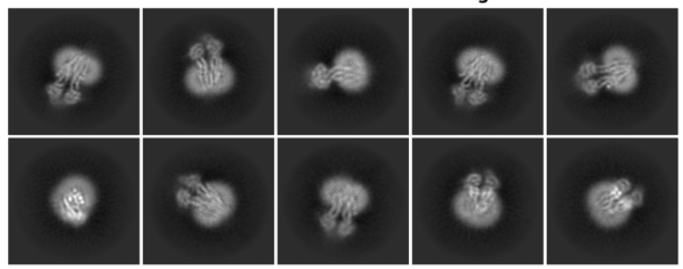
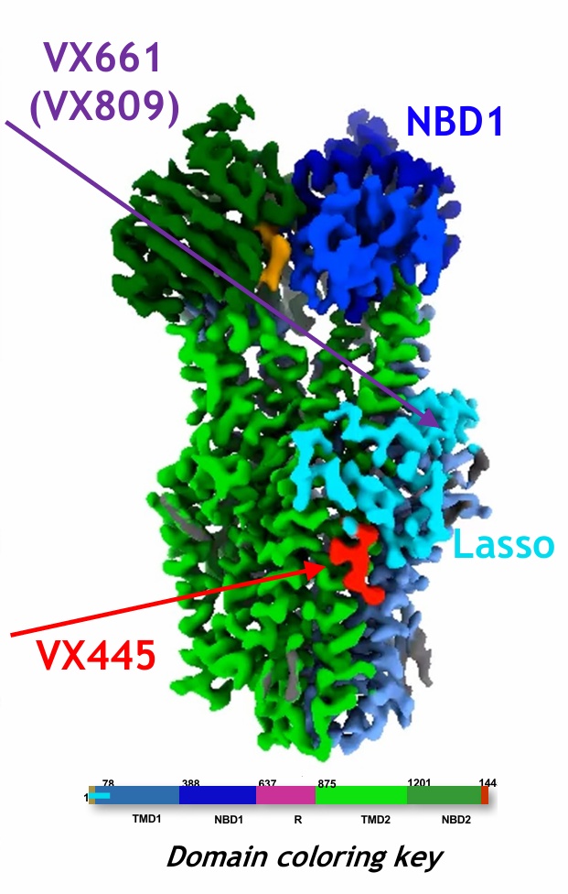
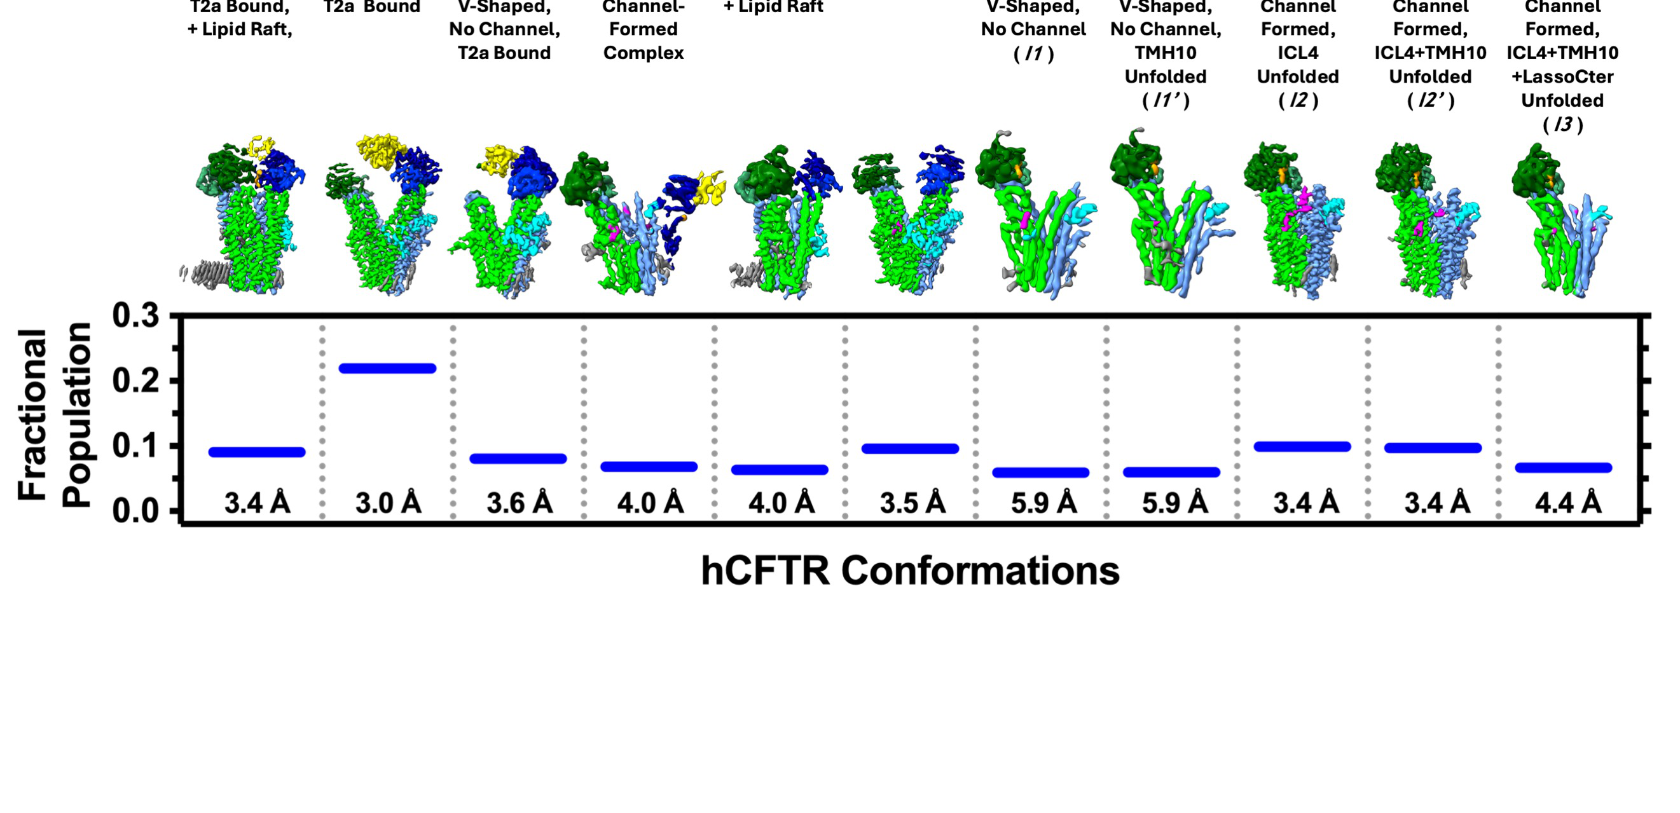
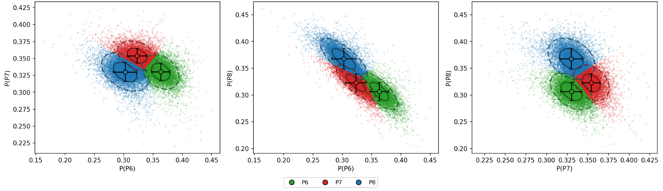
How does Trikafta reshape CFTR conformations?
CF variants
Cryo-EM
Corrected populations
Class confusion
Particle assignment uncertain near class boundaries
P6
P7
P8
Fit GMM
Trikafta corrects CFTR folding in cystic fibrosis
Flatiron Institute (2025)
Correcting cryo-EM class errors → accurate CFTR drug-response mapping

