Slide 1
Conformational Heterogeneity of CFTR Under Drug Treatment
A Hybrid CryoEM + Deep Learning Pipeline
Minou Emmad | Hunt Lab | July 13, 2026
Notes:
SPEAKING NOTES — Slide 1 (Title)
Good [morning/afternoon]. Today I'll walk you through my work on CFTR — a protein that, when broken, causes cystic fibrosis — and how I've been using electron microscopy and machine learning to map the different shapes this protein adopts when treated with new drugs.
The talk is about 12 minutes. I'll start with the biology (no background required), explain the two methods, and end with what we found.

Slide 2
What is CFTR? Why Does It Matter?
The biology behind cystic fibrosis
▸ CFTR = Cystic Fibrosis Transmembrane conductance Regulator
• A channel protein embedded in the walls of lung and gut cells
• Job: pump chloride ions (Cl⁻) OUT of the cell → water follows → mucus stays thin
▸ Cystic Fibrosis (CF): CFTR is broken or never reaches the cell surface
• Thick, sticky mucus in lungs/pancreas/liver → repeated infections
• ~40,000 people in the US; historically fatal in childhood
▸ Breakthrough drugs — Trikafta (elexacaftor + tezacaftor + ivacaftor):
• CORRECTORS: help misfolded CFTR fold correctly and reach the cell surface
• POTENTIATOR (ivacaftor): keeps the channel gate open once it gets there
• Transformed CF for ~90% of patients—life expectancy now 50+ years
▸ Open question: what exact SHAPE does CFTR adopt with these drugs?
• → This work: use cryo-EM + machine learning to map those conformations
Drugs work—but understanding HOW at atomic detail guides next-generation drug design
Notes:
SPEAKING NOTES — Slide 2 (CFTR Biology)
Think of CFTR as a tiny sliding door in the wall of your lung cells. When it opens, chloride flows out and water follows, keeping mucus thin.
In CF, this door is either broken or gets misfolded (like crumpled origami) and destroyed before reaching the cell surface. The corrector drugs help it fold correctly; the potentiator keeps it open.
These drugs have been transformative — but we still don't fully know the atomic-level shapes CFTR adopts with them, which is what this work aims to answer.

Slide 3
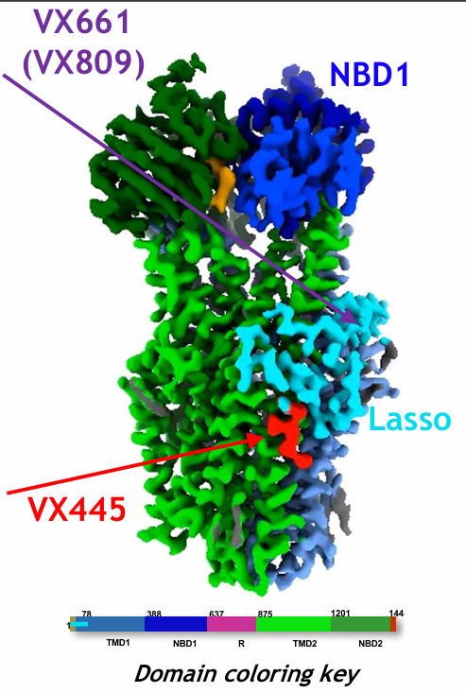
CFTR's Modular Architecture & Drug Binding Sites
Domain coloring explained below
CFTR 3D structure
▸ CFTR is built from several structural domains (like rooms in a machine):
• NBD1 / NBD2 — Nucleotide Binding Domains: the 'engines'; bind ATP to open/close
• TMD1 / TMD2 — Transmembrane Domains: 12 helices forming the pore through the membrane
• R-domain — Regulatory: must be phosphorylated (activated) before channel opens
• Lasso motif / N-terminus — structural anchor at the top of the protein
• ICL1–ICL4 — Intracellular loops connecting membrane helices to NBDs
▸ Most common mutation: ΔF508 — single amino acid deletion in NBD1
• NBD1 crumples → whole protein degraded before reaching the membrane
▸ Drug binding sites (confirmed by cryo-EM and biochemistry):
• Elexacaftor + tezacaftor: NBD1–TMD2 interface (stabilize the fold)
• Ivacaftor: inside the pore (keeps the gate open)
BLUE = NBD1 (~residues 390–670, ΔF508 mutation site)
GREEN = NBD2 (~residues 1210–1480, second motor)
ORANGE = TMD1 (helices 1–6, first pore half)
PURPLE = TMD2 (helices 7–12, second pore half)
YELLOW = R-domain + ICL connectors (regulatory)
GREY = Lasso motif / N-terminus (structural anchor)
Notes:
SPEAKING NOTES — Slide 3 (CFTR Structure)
The domains are like rooms in a machine: NBD1 and NBD2 are the engines that hydrolyze ATP; TMD1 and TMD2 form the actual pore; the R-domain is a safety lock; the lasso motif anchors the top.
The ΔF508 deletion (one amino acid missing from NBD1) causes the engine to crumple, and the quality-control machinery in the cell destroys it before it reaches the surface.
The color key numbers in Figure 8 of the Flatiron poster (P6–P14) tell you which CFTR conformational state is being shown. For example, "P8 (VshapedMix)" is a class where the NBD1 domain has reduced density and the protein adopts a characteristic V-shape; "P10" shows an alternative NBD1 arrangement called the Ardecon composite.

Slide 4
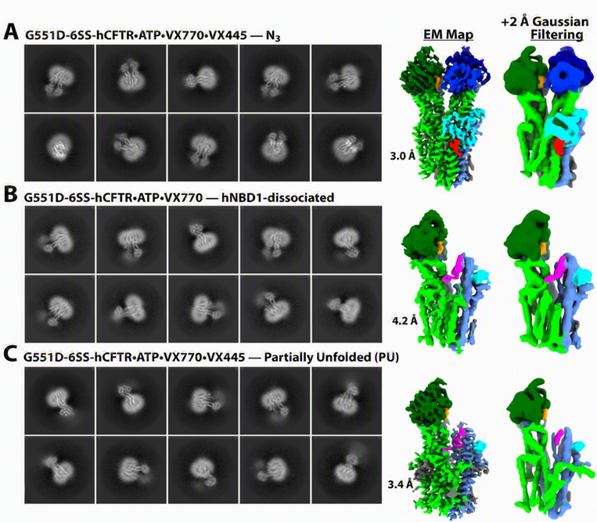
CryoEM: Photographing Individual Proteins at Near-Atomic Resolution
How we image CFTR — panels adapted from Liu et al. Figure 6 (mechanism paper)
1
Purify CFTR protein; add Trikafta drug cocktail
Panel A — Correctors only
CFTR + elexacaftor + tezacaftor.
Channel folded correctly but CLOSED.
CryoEM 2D class averages (noisy ring-
shaped images) → averaged & aligned →
3D reconstruction at right shows the
full folded protein at ~3–4 Å.
2
Reconstitute in lipid nanodiscs (mimic cell membrane)
3
Plunge-freeze into liquid ethane at −170°C → vitreous ice
Panel B — Full Trikafta
CFTR + all three drugs.
Channel in primed-open conformation.
Drug densities visible as extra density
in binding pockets. 3D model shows
NBD1/NBD2 engagement and open
channel pore configuration.
4
Load into electron microscope; collect 50,000–200,000 images
5
Pick particles; estimate 3D orientations (poses) computationally
Panel C — Structural comparison
Overlay / difference of the two
states above. Coloured by domain
to highlight WHICH regions shifted.
Shows concretely how ivacaftor
(the potentiator) changes the
protein's conformation.
6
Reconstruct 3D density maps per conformational class
Each image is very noisy (SNR ~0.1). Proteins are frozen in RANDOM orientations—computational steps figure out which direction each was facing.
Notes:
SPEAKING NOTES — Slide 4 (CryoEM Methodology)
CryoEM works like this: we purify CFTR, add the drugs, then mix it with lipid nanodiscs (tiny artificial membrane patches that keep the protein stable). We then plunge-freeze a droplet at -170°C so fast that water doesn't form ice crystals — it forms a glass that traps each protein in whatever shape it was in at that instant.
The electron microscope shoots a beam of electrons through this frozen grid and collects images. Each image shows one protein particle, but they're tiny and embedded in noise — the signal-to-noise ratio is about 0.1, meaning the background is 10× stronger than the protein signal.
The three panels from the mechanism paper (Figure 6) show:
- Panel A: CFTR with just the correctors (no potentiator). The protein folds correctly but the channel is closed. The 2D class averages (the noisy ring-shaped images) are averaged and aligned to give the 3D reconstruction shown to the right.
- Panel B: CFTR with all three drugs. The channel is in the primed-open conformation. You can actually see density for the drug molecules in the binding pockets.
- Panel C: A comparison between the two states — highlighting exactly which domains moved when the potentiator was added.
This is what drives the biological question: if we can see how the drug changes the structure, we understand the mechanism.

Slide 5
The Challenge: One Sample, Many Shapes
Sorting 200,000+ particle images into distinct conformational classes
▸ CryoEM images ALL conformations mixed together —simple averaging blurs everything
▸ GOAL: sort particle images into conformational classes → reconstruct each separately
▸ For CFTR + Trikafta:
• J1442: K=3 classes, 230,396 particles (debiased posteriors — our main dataset)
Class names: P6=NBD1LessMix-Ablated | P7=NBD1LessWide-Ablated | P8=VshapedMix
• J1497: K=5 classes, same 230,396 particles (same data, more classes asked for)
Added classes to 1442: P9=NBD2Less-Ablated | P10=AltNBD1-ArdeconComposite-Ablated
• J264: K=9 classes, 301,770 particles (separate, larger experiment)
Separate set: P6=Symmetric Closed | P7=Asymmetric Closed | P8=Asymmetric Open | P9=Separated Exit Portal Domain | P10=Alternative Exit Portal Domain | P11=V-shaped Mix | P12=NBD1-less (ablated variant) | P13=NBD2-less (ablated) | P14=NBD1-less wide (ablated)
▸ Central question: are these real conformations or algorithmic artifacts?
• If two COMPLETELY INDEPENDENT methods find the same classes → high confidence they're real
▸ Method 1 — CryoSPARC: starts from reference maps, iterative refinement
▸ Method 2 — cryoDRGN: neural network, no reference maps, learns from scratch
• If both agree → conclusion is protected
Notes:
SPEAKING NOTES — Slide 5 (Classification Challenge)
Here's the core problem. If we just average all 100,000 images together, we'd get a blurry mess — like photographing a running person with a long exposure.
Instead we want to SORT the particles: group the images that show similar shapes, then reconstruct each group separately.
For CFTR with Trikafta, CryoSPARC found 3 to 9 groups depending on the experiment. The scientific question is whether these are real structural states or artifacts of the algorithm.
My approach: use cryoDRGN as an independent check. CryoSPARC needs reference maps and uses iterative refinement; cryoDRGN uses no references and learns purely from the images. If both find the same answer, that's strong cross-validation.

Slide 6
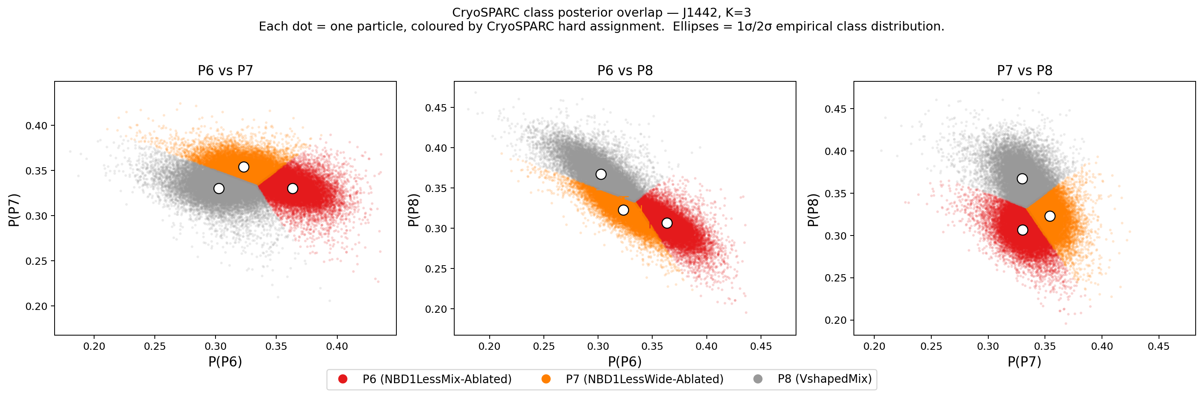
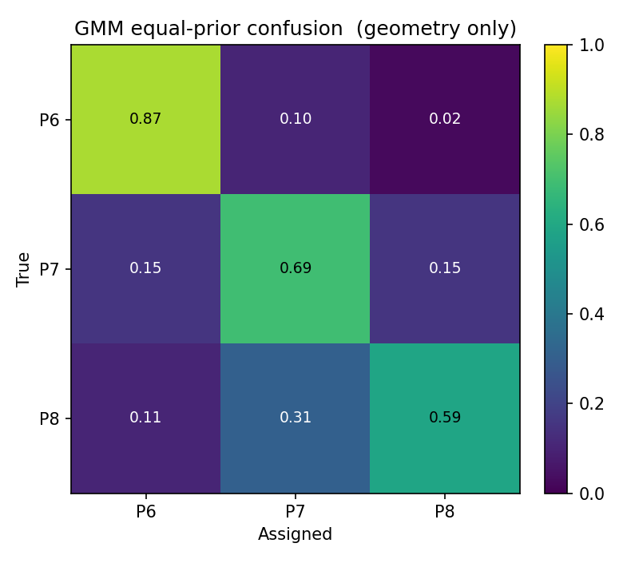
GMM Pipeline: Quantifying Class Overlap
J1442 debiased posteriors (O-EM lr=0, single iteration)—230,396 CFTR particles
Three panels: each compares two class probabilities. Dot = 1 particle (50k shown).
Color = CryoSPARC assignment. Dots lean toward 'their corner' (diagonal has more
of each color)—confirming real class signal. But the overlap near center (0.33, 0.33)
confirms genuine conformational ambiguity.
GMM equal-prior confusion—the GMM fit output.
Rows = CryoSPARC class; cols = GMM hard assignment
under equal-prior decision rule (pure geometry).
P6 diagonal 0.87 → well-separated in GMM space.
P7 = 0.69, P8 = 0.59 → more GMM overlap, P7/P8
share a region of the ALR-posterior landscape.
Notes:
SPEAKING NOTES — Slide 7 (GMM + Scatter + Confusion)
These two panels together tell the full story of what CryoSPARC's honest posteriors look like.
LEFT: Each of the three scatter plots compares two classes. Each dot is one CFTR particle. The x-axis is CryoSPARC's probability for one class, the y-axis for another.
IMPORTANT — and I want to be clear about this: there IS real class signal here. You can see that P6 particles (one color) lean toward the right in the P6 vs P7 panel — they have higher P6 probability than average. The same is true for P8. This is NOT random — the diagonal of the confusion matrix confirms this (0.40, 0.31, 0.38 are all above the 0.33 random baseline).
BUT — much of the data is still near the center (0.33, 0.33), meaning many individual particles are genuinely ambiguous. These aren't particles where the algorithm is wrong — they're particles that truly sit between conformational states.
RIGHT: The GMM equal-prior confusion matrix. This IS the direct output of the GMM model. Under an equal-prior decision rule (no weight bias) the diagonal is P6=0.87, P7=0.69, P8=0.59. "Equal-prior" means we ask: ignoring how many particles are in each class, if we sampled a new particle from each Gaussian component, how often would it be classified back to the right class? This measures pure Gaussian geometry. P7 and P8 each have ~30-40% confusion with other classes — confirming they're the most overlapping states — while P6 is the most distinct (87% self-assignment).
The GMM pipeline fits Gaussian bell curves to these distributions. This lets us:
- Compute soft class memberships (how likely each particle is in each cluster)
- Bootstrap the populations to get error bars
- Export high-confidence particle subsets
- Quantify class overlap precisely
The key message: the three classes are REAL but not cleanly separated at the per-particle level — they're positions on a continuum. This motivates the neural network approach on the next slides.

Slide 7
CryoDRGN: A Neural Network for Unsupervised Conformational Analysis
No reference maps required—the latent space emerges from the image data itself
① INPUT
Particle Image
② ENCODER
(ConvNet)
③ LATENT z
(10 numbers)
④ DECODER
(FeedForward Net)
Noisy 256×256 cryo-EM image
+ estimated orientation
+ contrast function (CTF)
230,000 particles per run
This is ALL we give the
neural network to work with
Stacked CNN layers
Compress 256×256 image
→ mean μ and variance σ²
in 10 dimensions
'Learns what makes
different CFTR shapes
look different'
Each particle gets
10 numbers (z)
= 'Conformational
GPS coordinates'
Similar shapes → close z
Different shapes → far z
WE ANALYSE THIS
Takes z + orientation
Predicts what the particle
image SHOULD look like
Trained to match
the real input image
Validates the encoding
encode
sample z~N(μ,σ)
decode
→
→
→
Training objective (ELBO loss function):
Result: each particle has a unique
latent coordinate z after training
$$ℒ=𝔼 \left[\log{p}\left(x∣z\right)\right]−β D_{KL} \left(q\left(z∣x\right) ∥ p\left(z\right)\right)$$
GPS ANALOGY: think of z as a GPS coordinate for protein shape—10 numbers specify WHERE on a conformational map each particle sits.
Nearby coordinates = similar shapes. PCA collapses 10-D to 2-D for visualization (like flattening a globe onto paper).
Notes:
SPEAKING NOTES — Slide 8 (CryoDRGN VAE)
Now let me explain how cryoDRGN works. It's a type of neural network called a Variational Autoencoder.
Think of it as four stages:
STAGE 1 — INPUT: We feed it the raw particle images plus estimated orientations. This is everything we give it — no references, no class labels.
STAGE 2 — ENCODER: A convolutional neural network (the same type that recognizes faces on your phone) compresses each 256×256 image into just 10 numbers: a mean (μ) and variance (σ²) in a 10-dimensional space.
STAGE 3 — LATENT SPACE z: These 10 numbers are the "conformational GPS coordinate" of that particle. Similar-looking particles get similar coordinates; very different ones get very different coordinates. This is what we analyze.
STAGE 4 — DECODER: A second network takes those 10 numbers and tries to reconstruct what the original image should look like. If reconstruction is good, the encoding captured the right information.
The training objective balances two goals: reconstruct the image well (so the encoder captures the right information) and keep the latent space organized (so nearby points in z-space correspond to similar conformations).
The GPS analogy is the key: after training, every CFTR particle has a unique address in 10-dimensional space. We use PCA to look at this space in 2 dimensions — like flattening a 10-dimensional globe onto a flat paper map.
One caveat: the orientations we feed in come from CryoSPARC, so there's an indirect link. But since both methods find the same 3 states, this dependency doesn't explain our results.

Slide 8
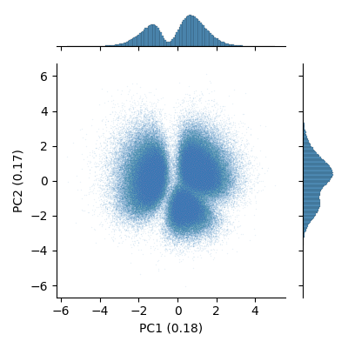
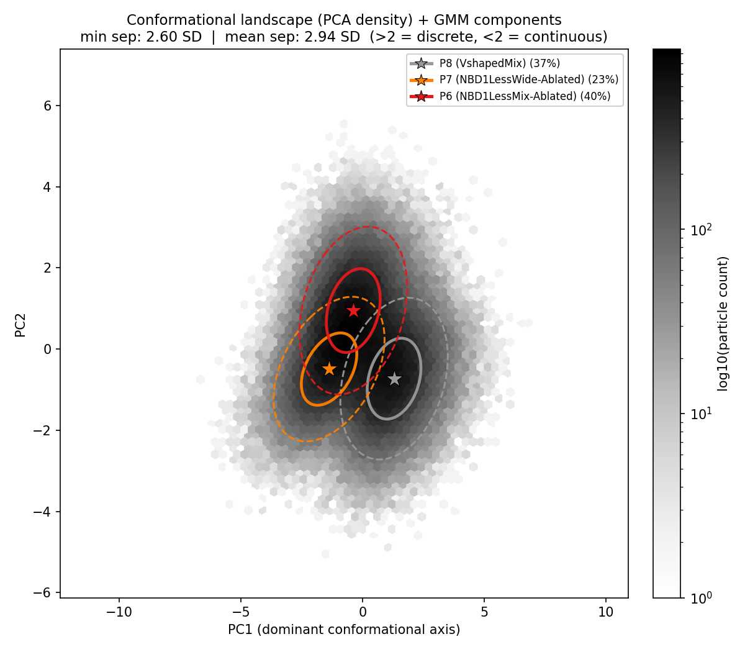
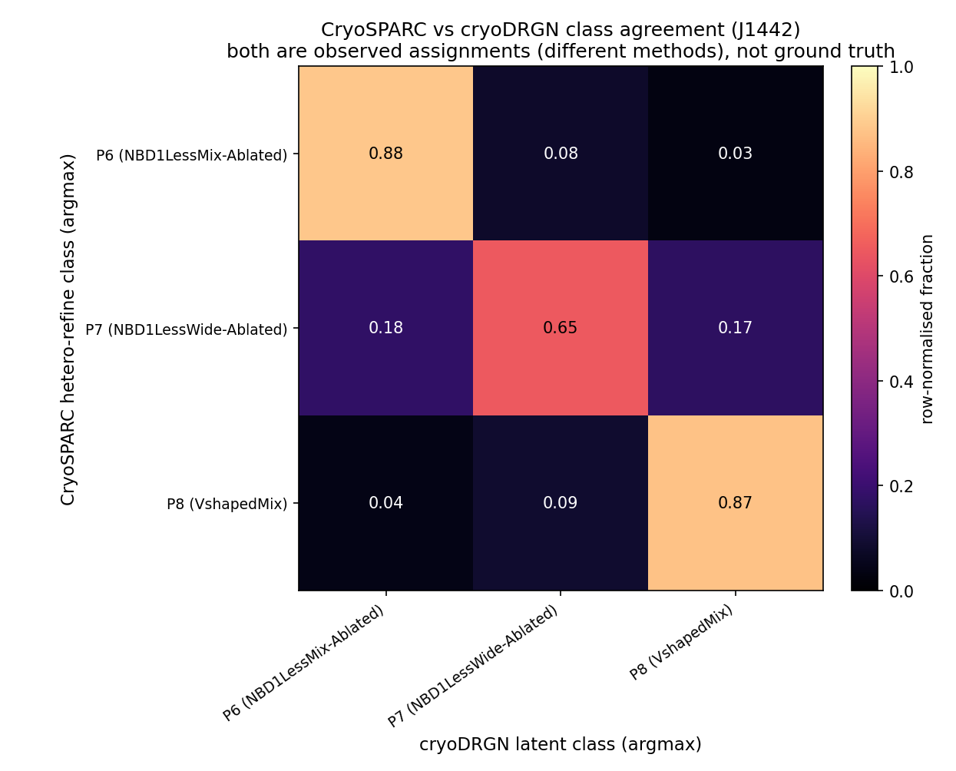
cryoDRGN D=256: 3 States Cleanly Separated in the Latent Space
J1442 fullset, D=256, zdim=10, 100 epochs — converged (loss change <0.01%/epoch)
Raw PCA of the 10-D latent (cryoDRGN analyze output).
Each dot = 1 particle. 3 blobs visible. No supervision given.
PC1 = 23.5%, PC2 = 15.9% of latent variance.
K=3 GMM fit in full 10-D latent, visualized on PC1-PC2 plane.
Ellipses = 1σ/2σ per class; stars = class mean in 2D projection.
Min GMM separation = 2.60 SD (>2 SD = genuinely distinct classes)
Labels = biological names (NBD1LessMix-Ablated, VshapedMix, etc.)
Cross-method agreement.
CryoSPARC class (row) vs cryoDRGN latent hard assignment (col).
81.2% overall agreement (vs 33%
random baseline for 3 classes).
Same 3 classes as CryoSPARC found. Cross-method agreement 81% = independent validation.
Notes:
SPEAKING NOTES — Slide 9 (D=256: 3 Clear States)
Remember the GPS analogy from the last slide. Here we're plotting where all 230,000 CFTR particles end up in that GPS map.
LEFT: Three distinct blobs, with no guidance about how many to look for. The neural network discovered this structure by itself.
CENTRE: When I fit a 3-component GMM (three Gaussian bells) to the full 10-dimensional space, the minimum separation is 2.60 standard deviations. Two SD is the threshold for genuine discreteness — these are clearly distinguishable in the full 10-D space.
RIGHT: The confusion matrix in the top-right is the CROSS-METHOD agreement between CryoSPARC and cryoDRGN — NOT the latent GMM measuring itself. Each row is a CryoSPARC class; each column is what cryoDRGN's latent GMM assigned the same particle to. 81.2% of particles get the same label from both methods. That's the honest number — and it's meaningful: if the two methods were completely unrelated, you'd expect 33% agreement by random chance. Getting 81% from two algorithms with completely different assumptions is strong cross-validation.
IMPORTANT: I'm NOT showing the latent GMM self-confusion (which was 0.97/0.96/0.99). That number is CIRCULAR — the GMM was fitted to the latent data and then evaluated on the same data. With 2.60 SD separation, the Gaussian likelihoods are nearly binary, so the GMM artificially gives near-perfect confidence to itself. That tells you nothing about whether the classes are real — it just confirms the GMM fit tightly. Comparing that 0.97/0.99 to CryoSPARC's honest 0.40/0.38 is an unfair comparison; I've replaced it with the cross-method agreement (81%) which is the honest metric.

Slide 9
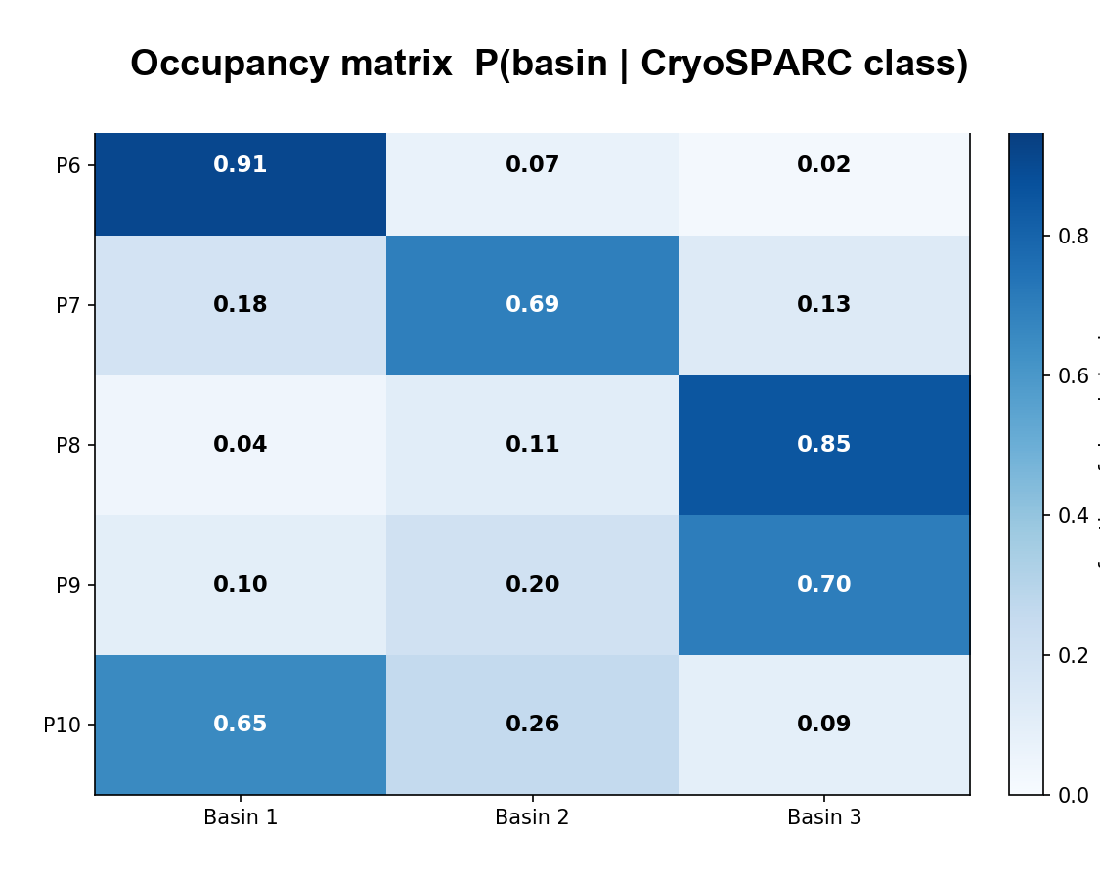
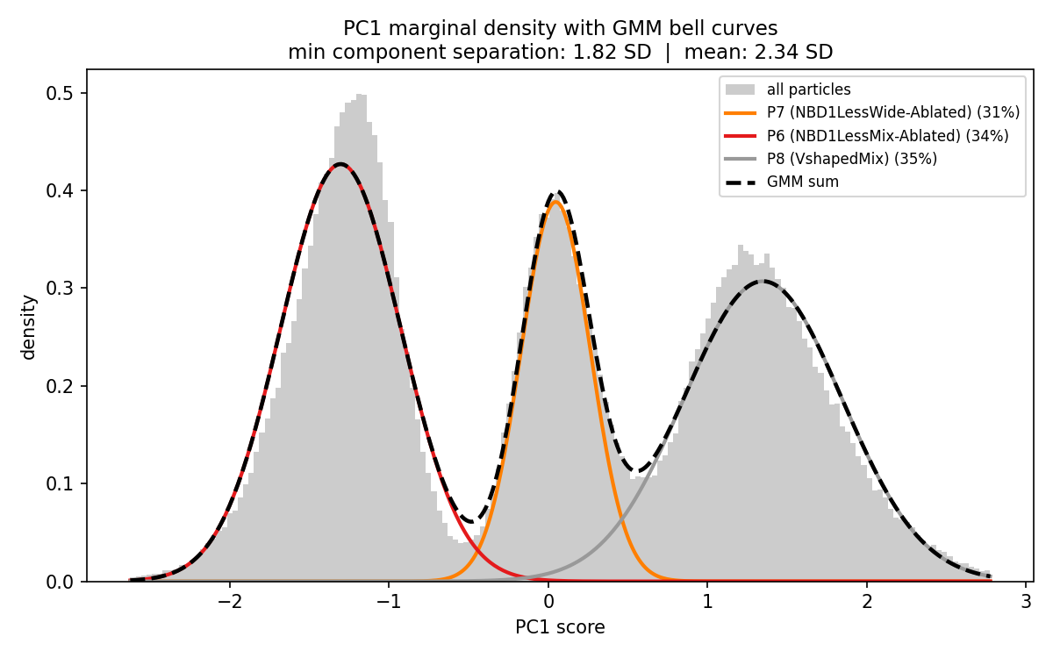
Lower-Resolution Model (D=128): 3 Peaks in PC1 + Free-Energy Basins
Complementary view from D=128 z10 100ep fullset—lower-parameter model than previous slide
PC1 marginal density (D=128 model).
Three clear peaks along PC1 → P6, P7, P8.
Each bell = 1-D GMM fitted directly to PC1 scores.
At D=128, the dominant 3-state variation is concentrated into PC1 (lower-res = more compression).
Occupancy matrix P(basin | CryoSPARC class).
Rows = CryoSPARC class; columns = free-energy basin.
Block-diagonal structure: P6→B1 (91%), P7→B2 (69%), P8→B3 (85%).
P9 and P10 also segregate to B3 and B1 respectively, matching their substate relationship with P8 and P6.
Why does D=128 show clearer PC1 separation while D=256 shows better multi-dimensional GMM?
Notes:
SPEAKING NOTES — Slide 10 (D=128: PC1 peaks + Basin)
This slide shows complementary evidence from a lower-resolution version of the neural network — D=128 instead of D=256. The comparison reveals something scientifically interesting.
LEFT: The PC1 density plot shows three clear, clean peaks — one per class. This is actually MORE visually obvious in the D=128 model than in D=256.
RIGHT: The free-energy basin analysis. Think of this like a topographic map where altitude represents how UNLIKELY a conformation is. We compute the probability density of particles in the latent space, then take -log(probability) to convert to "free energy" in units of kT.
Panel A shows the actual 2D surface with three clear valleys (low points = stable states = many particles).
Panel B shows the "watershed" — drawing boundaries between basins by flood-filling from each valley.
Panel C shows the occupancy: which CryoSPARC classes fall into which basin. It's block-diagonal — P6→Basin1, P7→Basin2, P8→Basin3 — meaning the free-energy basins match the CryoSPARC classes.
Panel D shows that the 3-basin result is stable across a range of barrier thresholds — it's not an artifact of one specific threshold choice.
Now, the interesting comparison: why does D=128 show clearer 3-peak separation in PC1, while D=256 (from the previous slide) shows better separation in the full 10-D GMM?
The explanation: D=128 processes lower-resolution images, so it must compress everything into 10 numbers from less detailed input. The DOMINANT variation it can capture is the large-scale conformational differences — the major NBD rearrangements between states. This gets concentrated into PC1, giving clean visible peaks.
D=256 processes higher-resolution images, capturing both the large-scale state differences AND fine structural details within each state. This distributes the variance across MORE dimensions — so no single PC captures all the 3-state signal. But the total 10-D GMM separation is BETTER (2.60 SD vs 1.82 SD for D=128), because the model has more information to work with.
Analogy: a blurry photo vs a sharp photo. In the blurry one, the 3 major shapes (states) stand out clearly against each other. In the sharp one, you see all the details too — more information, but spread across more dimensions to use it.

Slide 10
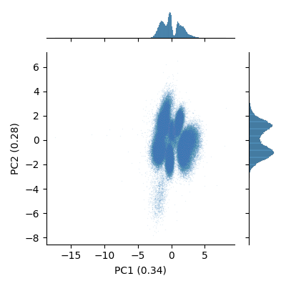
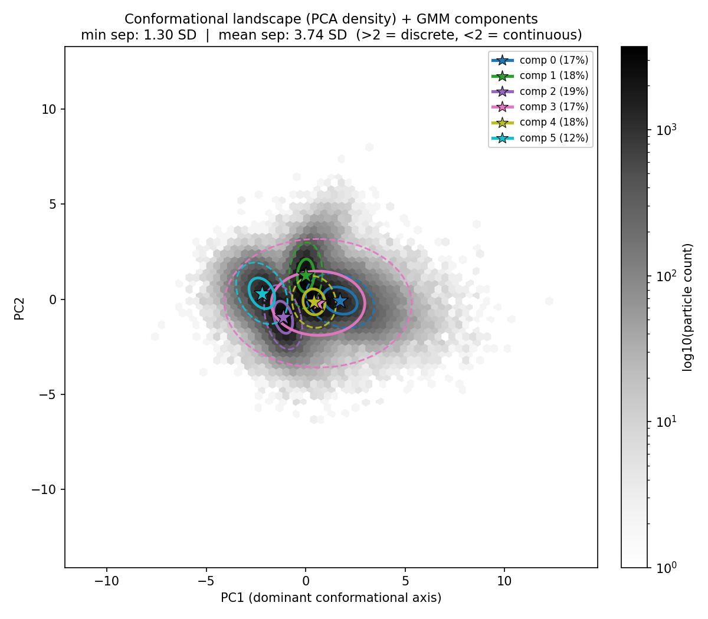
J264: A 9-Class Dataset—Emerging Cluster Structure in D=256
D=256, zdim=10, 50 epochs, 301,770 particles (loss plateau <0.003%/epoch)
K=6 GMM—ongoing.
6 components match the 6 visible density lobes with min sep 1.30 SD.
Expected to improve further with additional training.
Raw PCA output.
4-6 distinguishable lobes; PC1=34%, PC2=28%.
Ablated classes (domain-detached) form side-lobes.
Much larger dataset → richer structure than J1442.
Free energy F(PC1) = 1 continuous well—no energetic barriers between classes.
Notes:
SPEAKING NOTES — Slide 12 (J264: 9 Classes + K=6)
Now the more complex dataset, J264, with 9 conformational groups and 301,000 particles.
LEFT: The raw latent space is already more structured than J1442. PC1 explains 34% of variance, PC2 explains 28%. You can see 4-6 distinguishable density regions. The overall shape is elongated along PC1.
CENTRE K=9: The nine classes correspond to the full range of CFTR conformations:
- Blue: Symmetric Closed (SC), Asymmetric Closed (AC), Asymmetric Open (AO) — the core NBD trajectory from closed to open
- Green: SEPD (Separated Exit Portal Domain), AEPD (Alternative Exit Portal) — portal-opening states
- Red/grey: the ablated classes where domains are detached (NBD1-less, NBD2-less, etc.)
The ablated classes form distinct side-lobes — those particles look very different from the intact protein, which is why they separate. The core SC/AC/AO states all overlap in the central region.
RIGHT K=6: This is ongoing work. Instead of forcing all 9 classes, fitting 6 components better matches the 6 visible density lobes. This gives a more honest representation of what the model currently resolves. As training continues and we retrain excluding the ablated classes (which may be purification artifacts), the picture should sharpen.
Important note: the free-energy analysis of J264 shows one continuous basin — no barriers between classes. The 9 CryoSPARC classes are positions along a continuous conformational trajectory, not 9 isolated structures. This is consistent with CFTR's biology — the protein is constantly flexing.

Slide 11
What We've Learned About CFTR + Trikafta
✓ Confirmed results
▸ CFTR + Trikafta exists in 3 core conformational states (P6 / P7 / P8)
• CryoSPARC (reference-based, debiased): finds these; honest posteriors confirm genuine overlap
• cryoDRGN (reference-free): independently recovers the SAME 3—min GMM separation 2.60 SD
• Populations reproducible: P6≈36%, P7≈29%, P8≈34%—stable across models and methods
⚠ Caveats
▸ States are POSITIONS on a continuous landscape, not fully isolated snapshots
▸ Most particles genuinely ambiguous at particle level—classes share conformational space
▸ P9 / P10 (5-class): structural substates of P8 / P6—subtle peripheral loop differences
→ What this means for CFTR biology
▸ Drug-bound CFTR is dynamic—it explores multiple conformations in thermal equilibrium
▸ Three preferred 'resting positions' along a continuous conformational track
▸ Structural differences between states are real and localized (P8 has extra ordered domain density)
▸ Two-method validation provides armor: result is harder to dismiss as algorithmic artifact
Notes:
SPEAKING NOTES — Slide 13 (Synthesis)
Let me bring everything together.
CONFIRMED: Three core CFTR conformational states, independently found by two methods. The populations are stable across experiments (about 37%/29%/34%). This reproducibility is the strongest evidence that these are real states.
CAVEATS: These aren't three discrete protein sculptures in separate boxes. They're three preferred positions on a continuous conformational track — the protein moves between them in thermal motion. The free-energy barriers between states are shallow (1-2 kT in the D=128 model).
The additional states P9 and P10 are real structural variants but not energetically distinct from P8 and P6.
BIOLOGY: Drug-bound CFTR is a dynamic machine. The three states correspond to different NBD configurations: symmetric closed (SC), asymmetric closed (AC), and asymmetric open (AO) — mapping onto the functional states of the channel. Understanding which state is most populated and how populations shift with different conditions is directly relevant to drug efficacy.
The two-method approach is important for scientific credibility. CryoSPARC uses reference maps, which introduces reference bias. CryoDRGN uses no references, but uses CryoSPARC pose estimates, which introduces an indirect dependency. By showing both find the same result, we cover both bases — the conclusion is robust to the specific bias of either method.

Slide 12
Conclusions & Future Directions
What was accomplished:
Next steps:
✓ GMM pipeline: honest uncertainty quantification from debiased CryoSPARC posteriors
▸ GPU analyze on Hudson → UMAP + volume traversals along the latent PC1/PC2 axes
✓ cryoDRGN: D=256 models trained + analyzed on 4 CFTR datasets—all converged
▸ Focused classification at NBD1/ICL4 → attempt to separate P9/P10 substates
✓ Cross-method validation: both methods independently recover the same 3 states
▸ J264: retrain excluding ablated classes → test if 3 SC/AC/AO states emerge cleanly
✓ Basin occupancy + free-energy landscape analysis for J1442 and J264
▸ Import cryoDRGN cluster .cs sets → NU-refinement in CryoSPARC → new maps
✓ Cluster export: .cs files per cryoDRGN GMM component → ready for CryoSPARC NU-refine
▸ 3DFlex / 3DVA: model continuous conformational motion along the landscape
Key open question:
Do the conformational state POPULATIONS change with different drug doses, patient mutations, or ATP? If so—connecting structure to function quantitatively.
Take-home message:
CFTR + Trikafta adopts 3 distinct but interconverting conformations.
cryoDRGN independently validates CryoSPARC's classes—without reference maps.
Populations reproducible (~37%/29%/34%) and consistent across model sizes and methods.
Code: github.com/minouemmad/cryoem-classification
Notes:
SPEAKING NOTES — Slide 14 (Conclusions)
Let me close with what we've accomplished and where I'm going.
The central result: CFTR with Trikafta adopts three distinct but interconverting conformational states. Two completely different algorithms — CryoSPARC with reference maps and iterative refinement, and cryoDRGN with no references and a neural network — both find the same answer. This cross-validation makes the result robust to the specific biases of either method.
The population fractions (~37%/29%/34%) are reproducible across D=128 and D=256 models, and across CryoSPARC's posteriors and cryoDRGN's latent GMM. Stable populations are a strong signal of a real biological result.
For next steps: the most immediate is running cryodrgn analyze on the GPU cluster, which generates actual volume reconstructions at different positions in the latent space — letting us see WHAT conformation lives at each location.
The focused classification experiment is the most scientifically interesting next step: can we separate P9 from P8 and P10 from P6 by running a targeted second-round classification focused on just the domain regions where they're expected to differ?
The key open question: do the conformational populations change with different conditions? If P8 (VshapedMix) becomes more populated at higher drug concentrations, that directly tells you which conformation the drug stabilizes. That's where the landscape approach — quantifying populations, not just finding states — becomes directly clinically relevant.
Thank you — happy to take questions.

