Slide 1
Configuração MGB-AS
Release

Slide 2
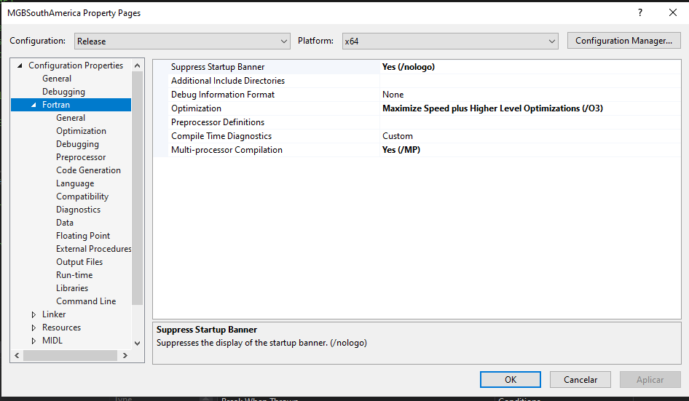
Fortran-General

Slide 3
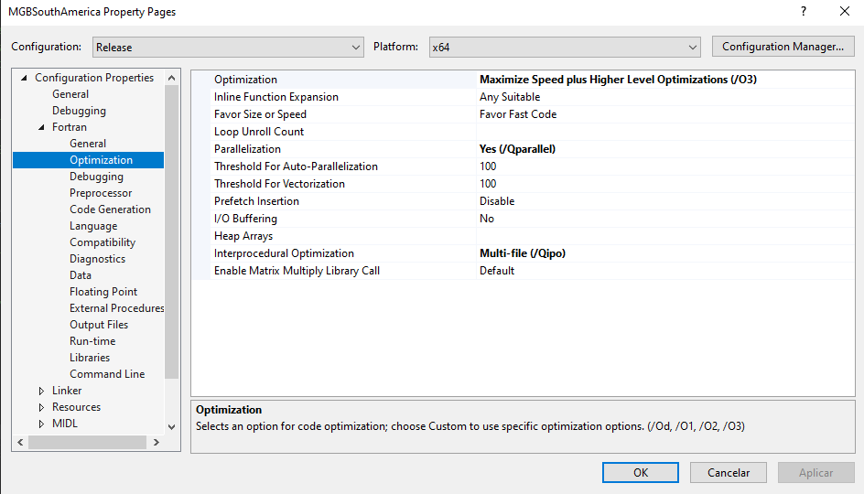
Fortran-Optimization

Slide 4
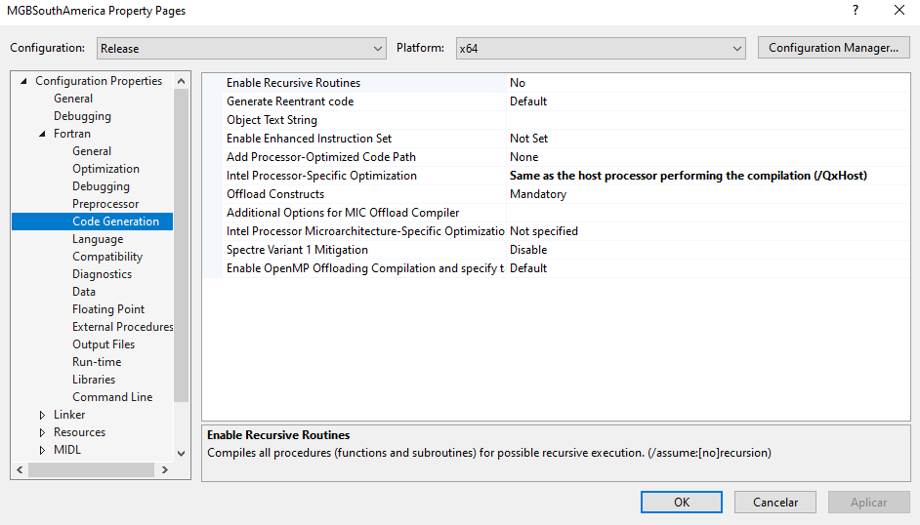
Fortran-Code Generation

Slide 5
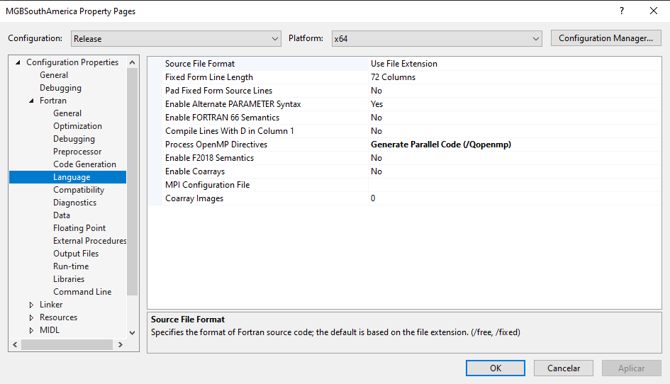
Fortran-Language

Slide 6
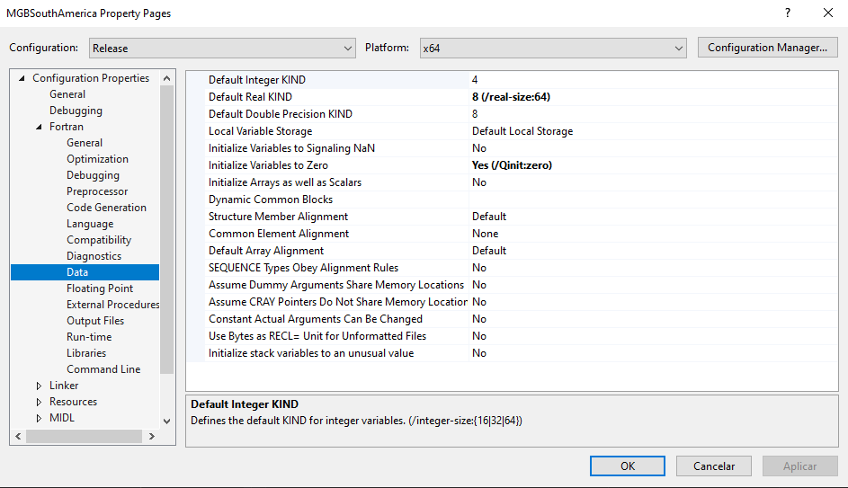
Fortran-Data

Slide 7
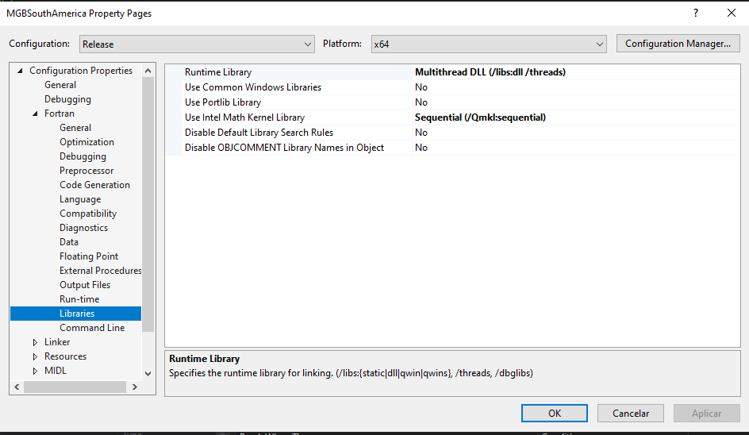
Fortran-Libraries

Slide 8
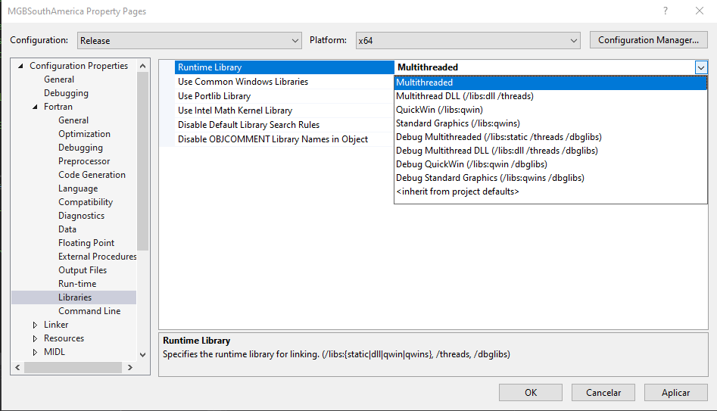
Fortran-Libraries (alternativa de runtime)
Acopla o multithread no executável
o que resolve problemas em
computadores sem a DLL do fortran

Slide 9
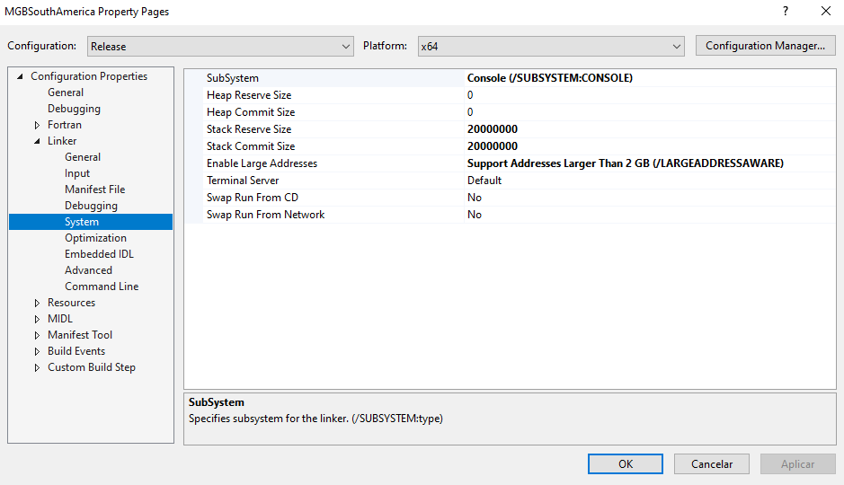
Linker-System

