Slide 1
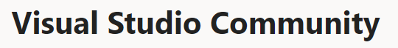
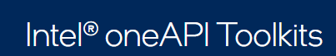
Guia de Instalação Visual Studio + Intel OneAPIBase + HPC

Slide 2

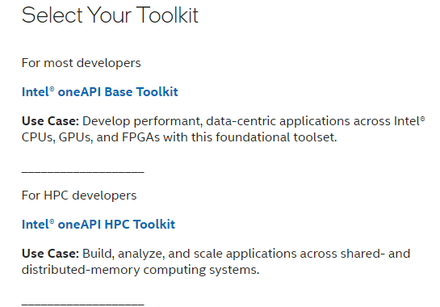
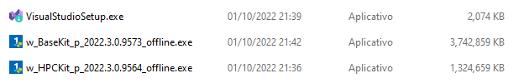
Download
1
https://visualstudio.microsoft.com/pt-br/vs/community/
https://www.intel.com/content/www/us/en/developer/tools/oneapi/toolkits.html
2

Slide 3
Visual Studio Community 2022

Slide 4

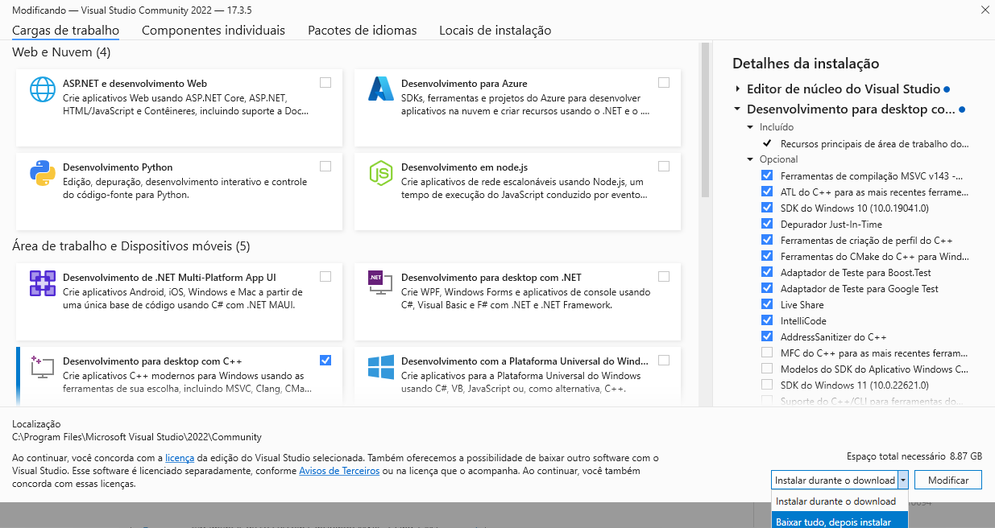
1
2

Slide 5
Intel oneAPI Base Toolkit

Slide 6

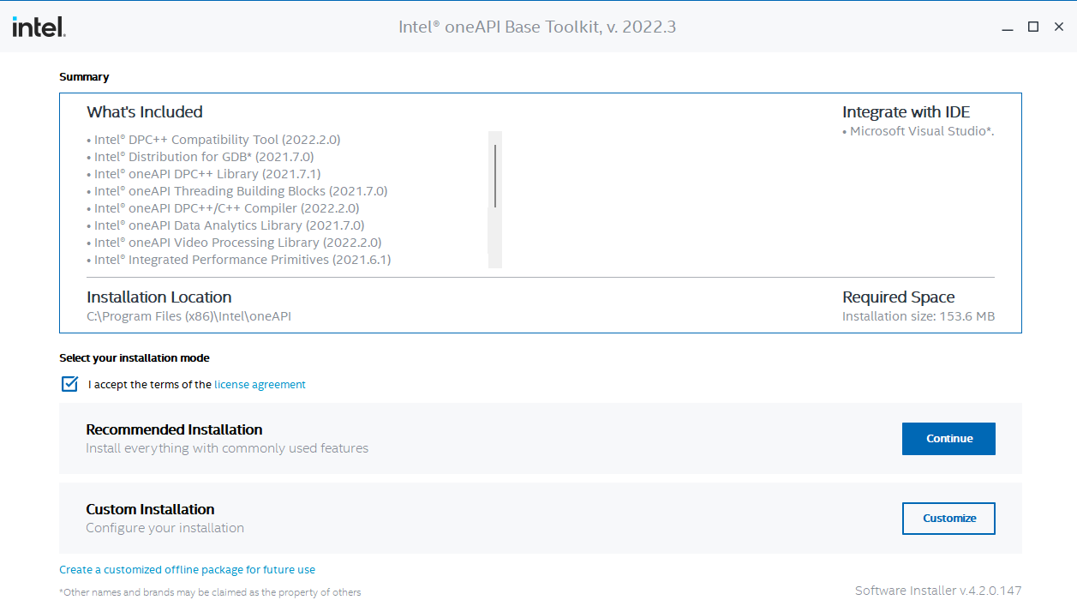

Slide 7
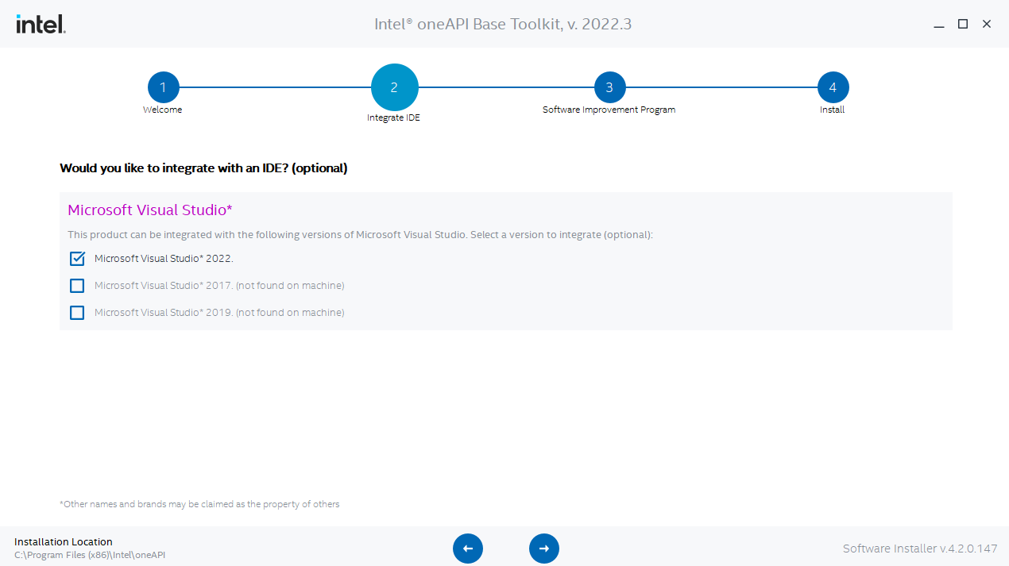

Slide 8
Intel oneAPI HPC Toolkit

Slide 9
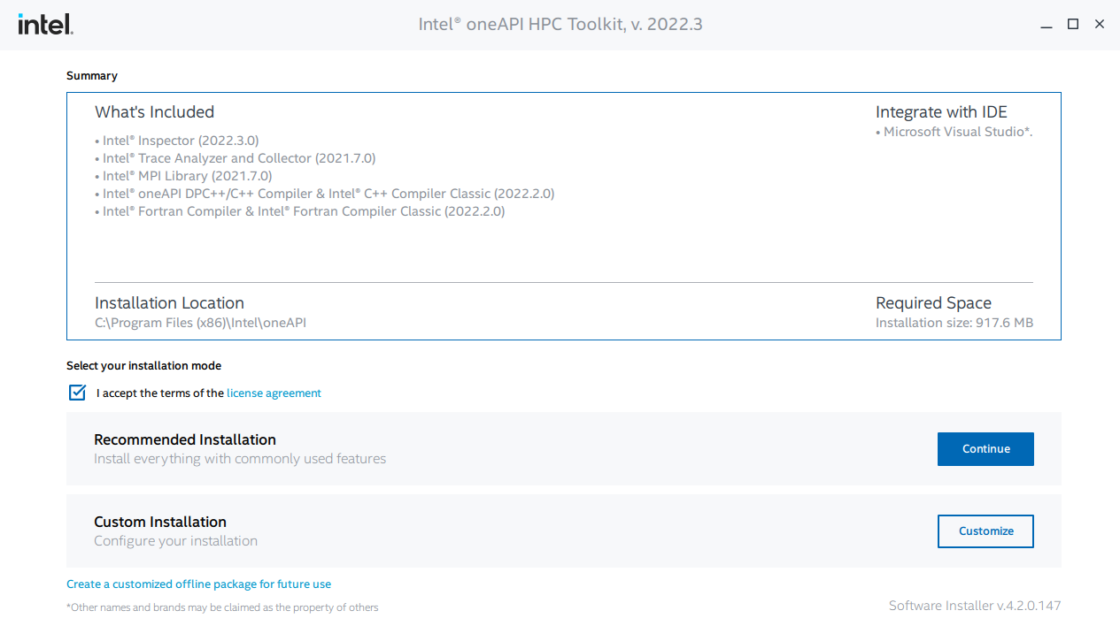

Slide 10
Projeto de teste

Slide 11
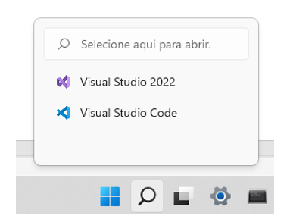
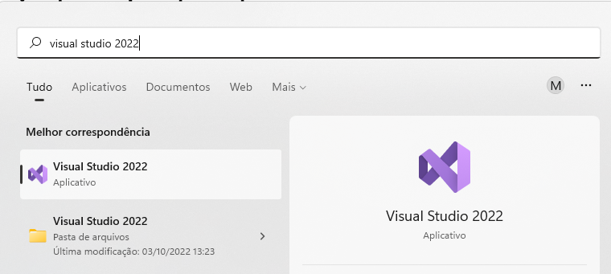
Abrindo o VS 2022
Menu Iniciar

Slide 12
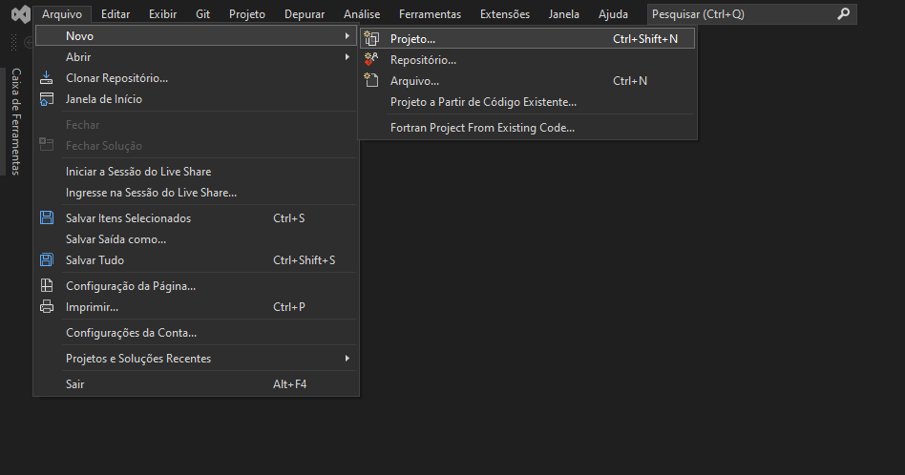
Novo Projeto...

Slide 13
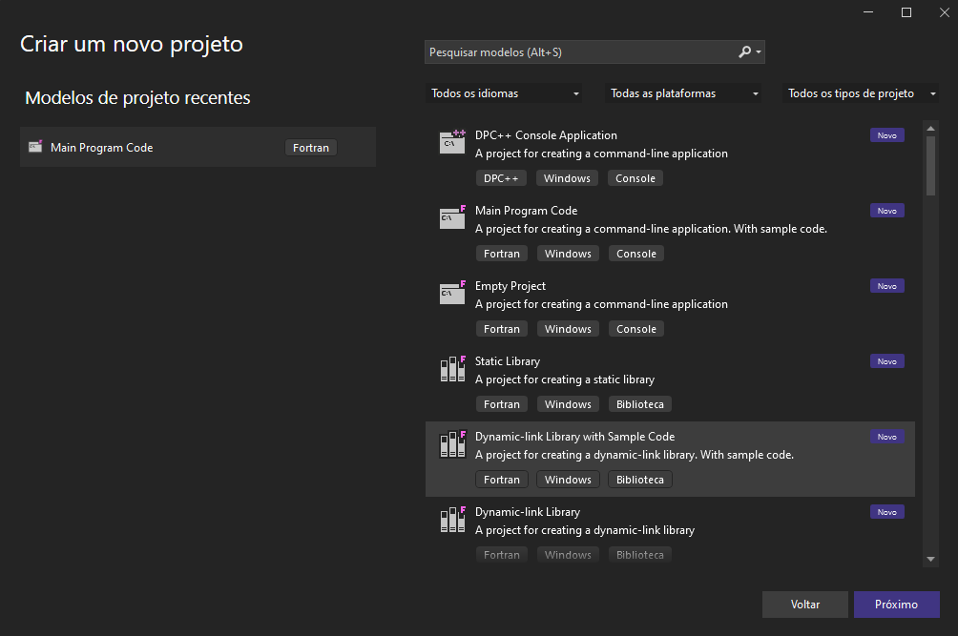

Slide 14
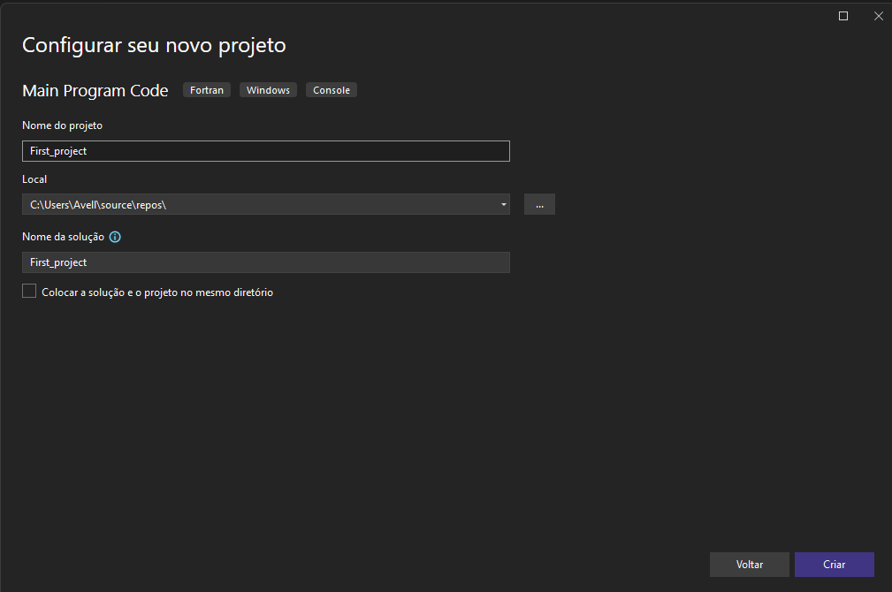

Slide 15
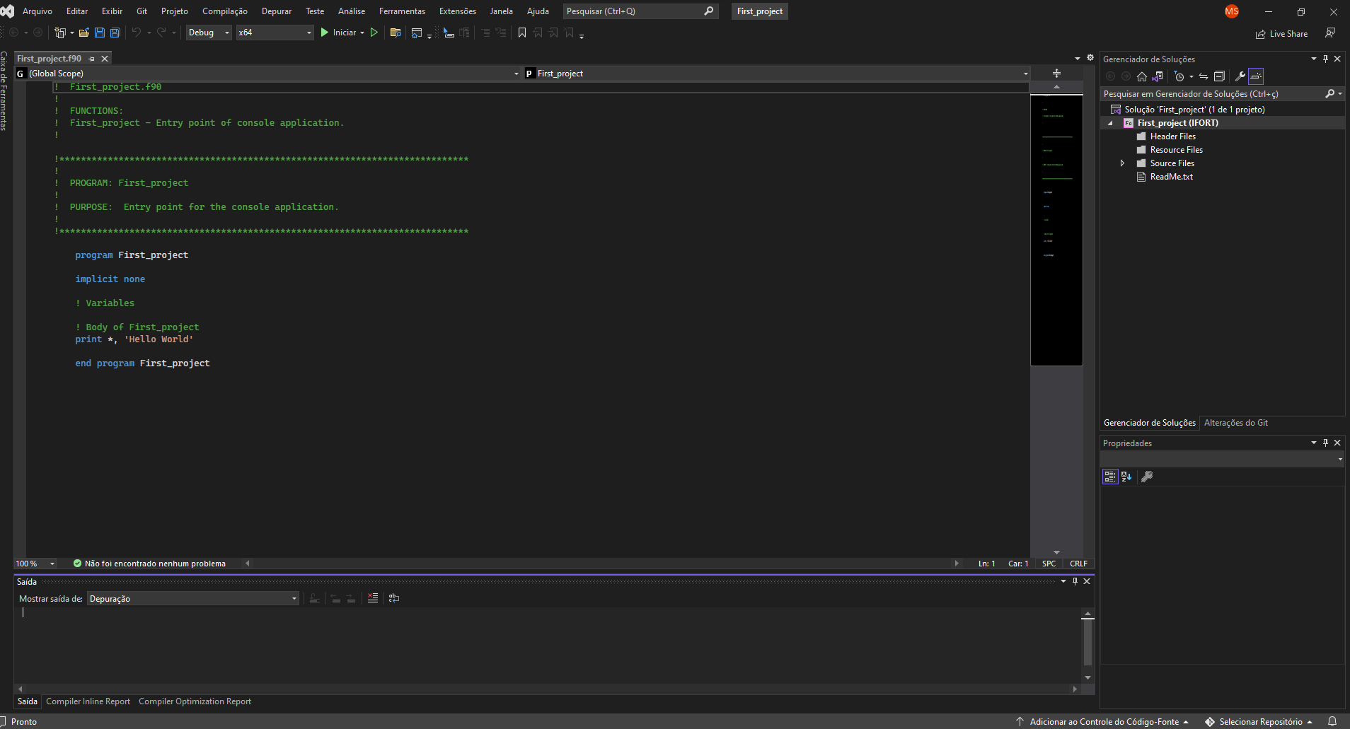

Slide 16
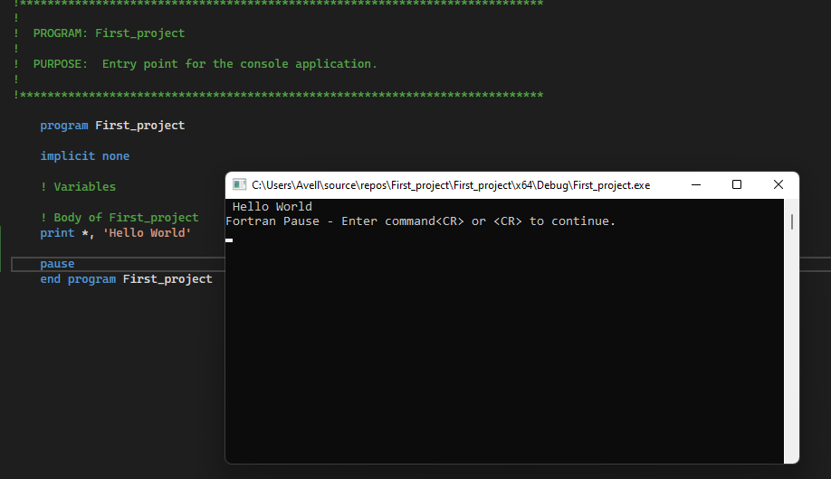
2
3
1

