Slide 1
NWEN241 –
Systems Programming
Python!

Slide 2
NWEN241 and Python
Ryan Chard
  ryan@ecs.vuw.ac.nz
  AM406 (ish)
Introduction to Python (3.5, not 2.7)
Lectures will be a combination of slides + notebooks (ipython) once we get through the easy stuff
No tutorial this week
Assignment + lab project will be out this week.

Slide 3
Resources
Book:
  Think Python: How to think like a Computer Scientist
  Allen Downey, Green Tea Press
  Get the Python 3.x version at
  http://interactivepython.org/runestone/static/thinkcspy/toc.html
Websites:
  How to Think Like a Computer Scientist
  Learning with Python: Interactive Edition 2.0 (Using Python 3.x)
  Brad Miller and David Ranum, Luther College
  http://interactivepython.org/courselib/static/thinkcspy/index.html
  UC Berkley Fall 2013 Bootcamp:
  http://www.pythonbootcamp.info/
  PEP8:
  https://www.python.org/dev/peps/pep-0008/

Slide 4
Using Python at home
Install it:
https://www.python.org/downloads/windows/
  Get 3.5.1
Follow those instructions.
There will comments about adding it to your path
Python comes with its own little shell you can use interactively
Pick a nice IDE.
  PyCharm
  Eclipse (plugin)
  Sublime Text

Slide 5
Today
Python overview
How do you use it
Debugging
Basics!

Slide 6
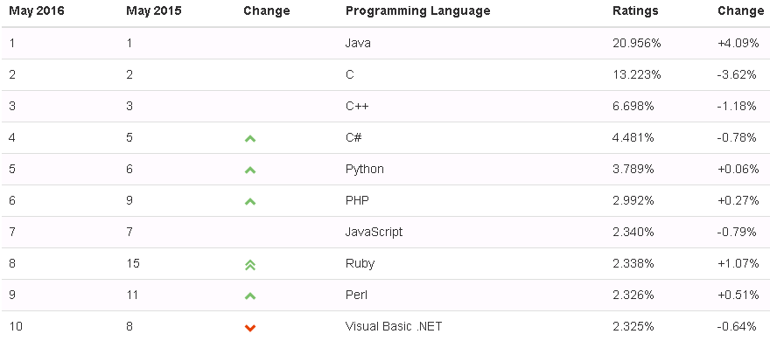
Why these languages?

Slide 7
Python is:
An *interpreted* language
Object oriented
High level (like C++/Java) – has many data types and structures
Dynamically typed – set variables on the fly
Designed for rapid application development
Great as a scripting language – easy and fast
Simple/easy to read and learn– no brackets/semicolons etc.
Leverages modules and packages – code reuse
Both interactive AND scriptable

Slide 8
The Python programming language
Python is an interpreted, object-oriented, high-level programming language with dynamic semantics. Its high-level built in data structures, combined with dynamic typing and dynamic binding, make it very attractive for Rapid Application Development, as well as for use as a scripting or glue language to connect existing components together. Python's simple, easy to learn syntax emphasizes readability and therefore reduces the cost of program maintenance. Python supports modules and packages, which encourages program modularity and code reuse. The Python interpreter and the extensive standard library are available in source or binary form without charge for all major platforms, and can be freely distributed.
http://www.python.org/doc/essays/blurb/

Slide 9
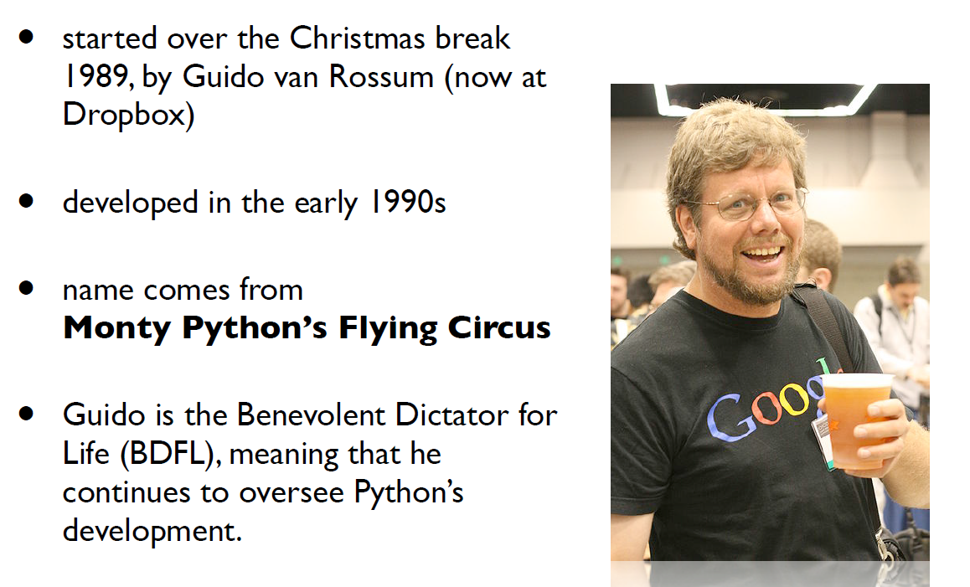
Development History

Slide 10
Development History
Open-sourced development from the start (BSD-compatible licensed now)
  http://www.opensource.org/licenses/bsd-license.php
Relies on large community input (bugs, patches) and 3rd party add-on software.
Version 2.0 (2000), 2.6 (2008), 2.7 (2010).
Version 3.X (2008) is not backward compatible with 1.X & 2.X. But 2.7 code is “easily” migrated to 3.X
  We will use this one (mostly).
Notes:
BSD licence imposes minimal restrictions on software you develop that uses Python.
Also called “copycentre” unlike “copyright”, you can make as many copies as you want.

Slide 11
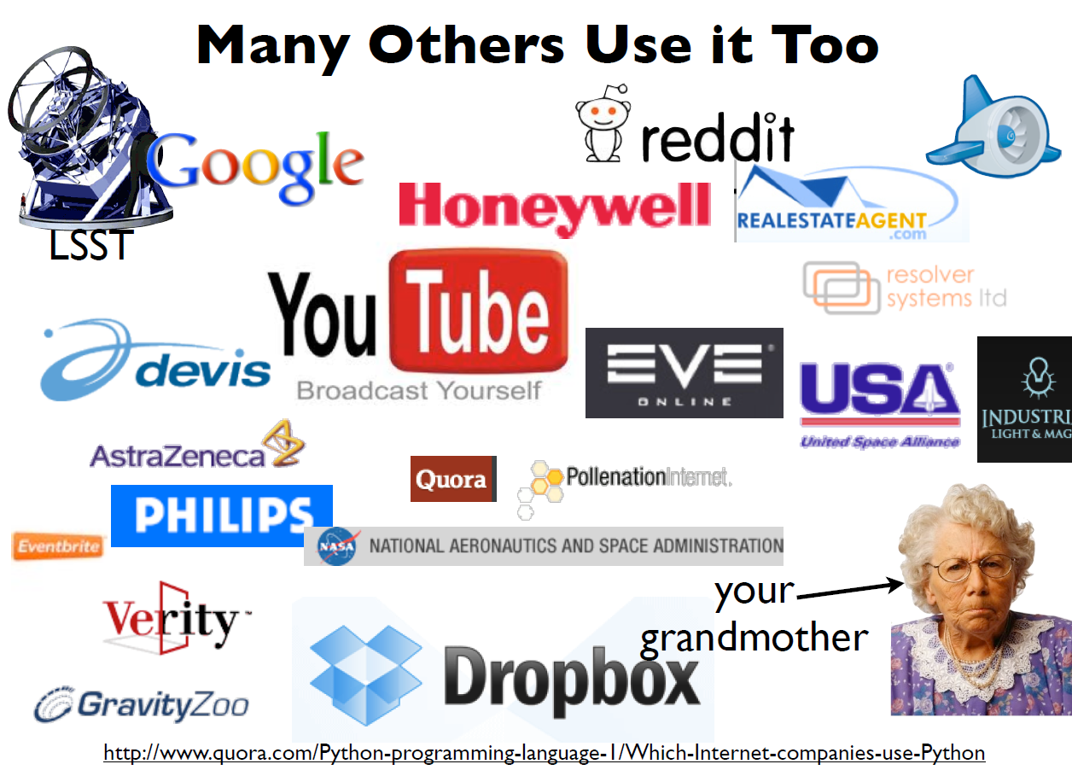
Who uses Python?

Slide 12
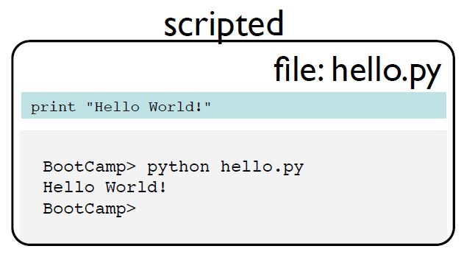
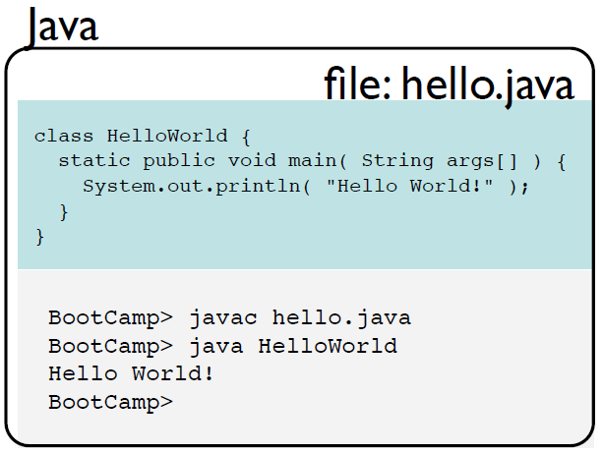
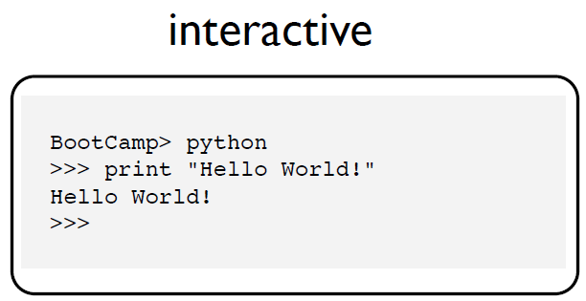
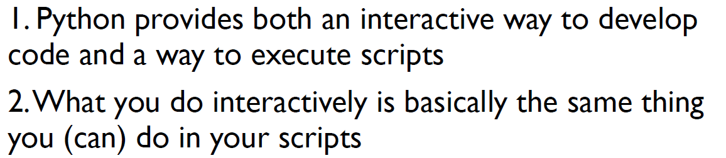
Notes:
This is python 2.7 – note no brackets around the print statement.

Slide 13
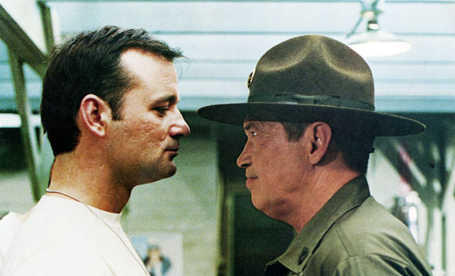
Up next … basic training

Slide 14
Using Python: Interpreter mode
$ python3
Python 3.5.1 (default, Dec 20 2015, 10:41:17)
[GCC 5.3.0] on linux
Type "help", "copyright", "credits" or "license" for more
>>> 2 + 3
5
>>> print(‘hello’)
hello
Notes:
We use 3.5 now

Slide 15
Using Python: Script mode
Create a file called firstprogram.py containing:
#!/usr/bin/env python3
print("My first program adds two numbers, 2 and 3:")
print(2 + 3)
$ python3 firstprogram.py
My first program adds two numbers, 2 and 3:
5

Slide 16
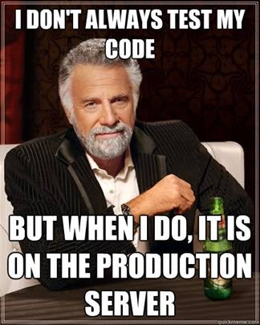
Firstly…

Slide 17


What is debugging?
Syntax errors
  The “code” can’t be read by the interpreter
Semantic errors
  The *valid* code doesn’t do what you want
Runtime errors
  Issues during execution, e.g. index out of bounds
Experimental debugging

Slide 18
Some bugs are hard!
Of all my programming bugs, 80 percent are syntax errors. Of the remaining 20 percent, 80 percent are trivial logical errors. Of the remaining 4 percent, 80 percent are pointer errors. And the remaining 0.8 percent are hard.
  Marc Donner
  IBM T. 1. Watson Research Center

Slide 19
Designing for Test/Debug
Think about how you are going to test/debug it
  lack of thought always translates into bugs
Write test cases when you write your code
Design for testing/debugging from the start
Test early, test often
Test at abstraction boundaries

Slide 20
Python basics: Values and Types
Some values
  1, 2.0, 'Hello, World!‘,True,None
  What type are these?
In Python, we have a type operator
  type ('Hello, World!')
  <class 'str'>
  type (17)
  <class 'int'>
Notes:
Int, float, string, Boolean, NoneType

Slide 21
Python basics: Variables
>>> message = 'And now for something completely different'
>>> n = 17
>>> pi = 3.1415926535897931
>>> print (pi)
3.141592653589793
>>> type (pi)
<class 'float'>

Slide 22
Python basics: Variable names
Variable names can be arbitrarily long.
They can contain both letters and digits, but they have to begin with a letter or an underscore
It is a good idea to begin variable names with a lowercase letter (you’ll see why later).
The underscore character (_) can appear in a name.
A hyphen (-) cannot be in the name.
Variable names cannot be key words (for, while, etc.)

Slide 23
Python basics: Keywords
Python has thirty-something keywords
and | del | from | not | while
as | elif | global | or | with
assert | else | if | pass | yield
break | except | import | print | True
class | exec | in | raise | False
continue | finally | is | return | None
def | for | lambda | try | nonlocal

Slide 24
Python basics: Variable names
Legal or not legal?
  recvbuf
  2rows
  totalNumber1
  total_number2
  total-number3
  BigCounter
  lambda
Notes:
Yes
No – no number to start with
Yes
Yes
No – no hyphens
Yes
No – no key words

Slide 25
Variables and maths
variables are assigned on the fly
  unlike Java where must declare first
  type can be changed explicitly using type conversion function or leave it up to the interpreter
multiplication, division, exponents as you expect
logical bitwise operators and comparison operators

Slide 26
More on variables and types
booleans are another type
  True, False and None
type(obj) returns the type of the object
isinstance(obj, type) allows you to check if obj is of type type

Slide 27
Strings
Strings are a sequence of characters
  they can be indexed and sliced up as if they were an array
  you can glue strings together with + signs
  use ' or “ to delimit strings
Strings are immutable (just like Java)
  - But you can change what the variable points to freely.
Strings can be formatted and compared
  For example, is x a substring of y … 'x'in 'y'

