Slide 1
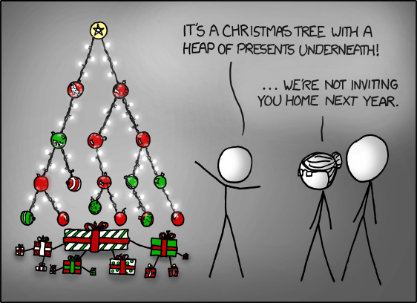
NWEN241 –
Python Data Structures (Lecture 4)

Slide 2
Firstly: The assignment
The assignment will be (mostly) automatically marked
Please test the doctests on a lab machine before submitting
You can ssh from home to barretts/greta-pt etc. and run them from there.

Slide 3
Using Test Cases
python3 -m doctest assignment1_test.txt
you need to program for this, we will use these and other tests for marking
some marks for style and readability (10%)

Slide 4
Style
Use comments
# this is a comment
""" this is a multiple line one """
Don't put commands on same line separated by semicolons
bad; bad; bad
better
better
better

Slide 5
Style
Naming
module_name, package_name, ClassName, method_name, ExceptionName, function_name, GLOBAL_CONSTANT_NAME, global_var_name, instance_var_name, function_parameter_name, local_var_name."

Slide 6
Secondly: Python sort()
The Python sort() function uses 'Timsort' - a sorting algorithm written by Tim Peters.
It is a hybrid sorting algorithm that combines merge sort and insertion sort.
It looks through the set to find things already in order then uses that to improve the efficiency of sorting.
https://en.wikipedia.org/wiki/Timsort

Slide 7
Outline
There are four main types of collections of data ("Sequence objects")
Lists: a mutable array of data
Tuples: ordered, immutable list
Dictionaries: keyword/value lookups
Sets: unordered collection of unique elements

Slide 8
Tuples
Ordered, immutable list.
Tuples are used behind the scenes in Python to implement basic functionality.
Don't support all the methods/operations of lists so are more efficient to declare and manipulate than lists.
Python uses tuples to quickly stuff multiple variables into a container (e.g. returning multiple values).

Slide 9
Tuples vs Lists
Some see it as:
Tuples should be heterogenous (like a c struct)
Lists should be of the same type (like an array)
This is not enforced though!
The main difference is tuples are fixed length (immutable) whereas lists are not (mutable)
Tuples are faster.

Slide 10
Dictionaries
Unordered, hashtables associating keys with values.
Efficient lookup, can nest other structures inside the hashtable.
Diverse use cases.

Slide 11
Sets
Unordered, mutable list, doesn't allow duplicates.
Faster to check membership than lists. (uses a hashtable like dicts)
Can do set “maths” that requires use of iterators and extra programming when working with lists.
There is also a collection.Counter type that increments a count when you add duplicates to sets.

Slide 12
Overall:
Lists keep order. Sets and Dicts do not. If you care about order, use a list.
Dicts associate keys and values. Lists and Sets just store values in a container
Sets are faster for checking than Lists

