Slide 1

NWEN241 -
Python Lecture 5
Function s & Modules

Slide 2
Notices
Project + windows
select.select does not handle file streams on windows (stdin)
New assignment (files)
Previous assignment marking…
Today:
Quickly recap sets
Look into functions
Start modules

Slide 3
Sets
Unordered, mutable list, doesn't allow duplicates.
Faster to check membership than lists. (uses a hashtable like dicts)
Can do set “maths” (unions, intersections, difference) that requires use of iterators and extra programming when working with lists.
There is also a collection.Counter type that increments a count when you add duplicates to sets.

Slide 4
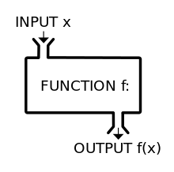
Functions
Functions:
Basic idea
Scope
Keyword arguments
Default arguments
Variable arguments
Pass by value
Documentation

Slide 5
Modules
Modules:
Importing
Importing into namespace
Built-in modules
Making scripts executable

