Slide 1
NWEN241
Python Tutorial 1

Slide 2
Today:
Firstly:
Assignment 2 is out
The project is due the same day...
Today:
Pretty brief and informal. Feel free to ask questions
Go over the project
Go over the assignment
Random python stuff?

Slide 3
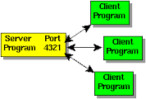
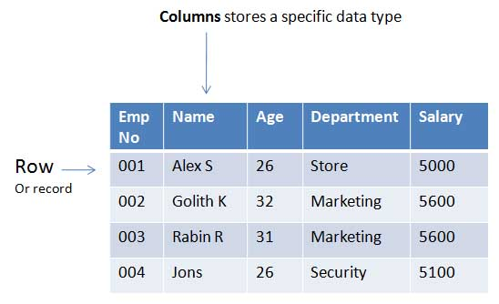
Python Project
Overview:
A chat program
Clients send messages to a server which then forwards them to all clients
Uses sockets -- a way to communicate over the network. You can listen for incoming messages (select.select) and send/recv data.
Uses SQLite3 database -- a database in a single text file. You can use SQL to query it. Data is stored in ‘tables’, a table has columns of types and rows of data.

Slide 4
Python Project
Core:
Allow a client to send a message to the server. Then have the server send that message to every other client.
Make clients print received messages out
Let the client enter /commands: /NICK /MSG /WHO
Handle errors
Completion:
Use sqlite to enable chat rooms
Challenge:
Allow multiple servers (clients on different servers can communicate with one another)

Slide 5
Project - Getting Started
1. Read from stdin and send the message:
msg = sys.stdin.readline()
client_socket.send(msg.encode())
3. Broadcast it back to everyone
for send_sock in socket_list:
# check it isn’t the recv socket first.
send_sock.send(data.encode())
5. Start allowing / commands
if ‘/WHO’ in data:
names = ‘’
for k,v in names.items():
names = names + k + ‘\n’
sock.send(names).encode()
2. Read the message on the server
data = sock.recv(1024).decode()
4. Recv and print it on the client
msg = sock.recv(1024).decode()
print (msg)

Slide 6
Important things
Socket port number can be used as id:
# the addr is a tuple of (ip,port), aka: (‘127.0.0.1’, 54343) etc.
sockfd, addr = server_socket.accept()
# you can get the address straight from a socket too:
addr = sock.getpeername(), meaning: sock.getpeername()[1] = 54354 etc.
The database should mostly do what you want it to. You just need to put the commands in the right place. This isn’t a database course.
.strip() is a useful function for making things look nice. Removes blank space and new lines etc.
‘ hi ‘.strip() == ‘hi’

Slide 7
Assignment 2
Implement four functions:
add_vectors(list1, list2) -- Create a summed list from two lists of ints
Error check, create new list, iterate over a list, add values at each index, store in list
print_frequency(string) -- count the number of times each letter appears
Error check, create dict, iterate, use .isalpha() and .lower(), store if not exists, increment
verbing(string) -- add ‘ing’ or ‘ly’ to every word in a string depending on len
Error check, split(), iterate/enumerate, check len(), add ing/ly, join result back together
add_vectors_file(filename) -- read a csv file, extract two columns (lists) and call add_vectors on them
Error check, splitlines(), use header to find index of pay/bonus, iterate over lines, split(‘,’), append to new lists, call add_vectors()
Use doctest to check their functionality

Slide 8
Python problems
mylist=[]
for i in range(10,0,-1):
if (i%3 == 0) or (i%5 == 0):
mylist.append(str(i))
print (mylist)
Notes:
['10', '9', '6', '5', '3']
It does not include the last value, so 0 is not evaluated.

Slide 9
Python problems: lists
Assume the list: mylist = [1,2,50,’hello’,’bob’,6]
What is printed:
print (mylist[1])
print (mylist[2:])
print (mylist[2:4])
print (mylist[-1])
print (mylist[-3:-1])
print (mylist.reverse()[1])
Notes:
>>> print (mylist[1])
2
>>> print (mylist[2:])
[50, 'hello', 'bob', 6]
>>> print (mylist[2:4])
[50, 'hello']
>>> print (mylist[-1])
6
>>> print (mylist[-1:])
[6]
>>> print (mylist[-3:-1])
['hello', 'bob']

Slide 10
Python problems: dicts
stuff = {'name': 'Zed', 'age': 39, 'height': 2 * 12 + 2}
print (stuff['name'])
print (stuff['height'])
# make a new dict with dict comprehension
newdict = {n: n**2 for n in range(5)}
print (newdict[2])
Notes:
Zed
26
4
# it creates: {0: 0, 1: 1, 2: 4, 3: 9, 4: 16}

Slide 11
Python problems: functions
def sum_lists (list1, list2=[1,1,1]):
mysum = sum(list1) + sum(list2)
mymax = [max(list1), max(list2)]
mymin = [min(list1), min(list2)]
return mysum, mymax, mymin
print (sum_lists([1,2,3],[1,2,3])[0])
print (sum_lists([1,2,3],[4,5,6]))
print (sum_lists([1,2,3])[1])
Notes:
print (sum_lists([1,2,3],[1,2,3])[0])
12
-----
print (sum_lists([1,2,3],[4,5,6]))
(21, [3, 6], [1, 4])
------
print (sum_lists([1,2,3])[0])
[3,1]

Slide 12
Python problems: files
What is printed?
mylist = []
with open(‘file.txt’) as f:
for line in f.readlines():
mylist.append(line.split(‘,’)[1])
print (mylist)
file.txt =
1,2,3
4,5,6
7,8,9
Notes:
[‘2’,’5’,’8’]

