Slide 1
COMP 261 Lecture 13
3D Graphics 1 of 2

Slide 2
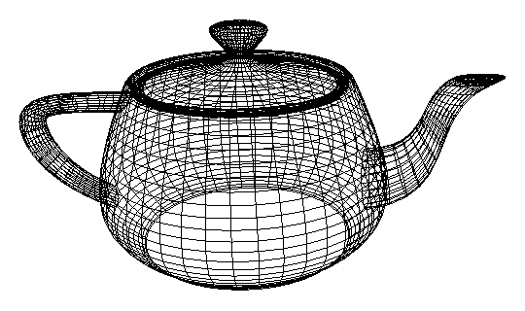

3D graphics
Different business from 2D images!
Model of 3d objects
- shape
- surface properties
- material/mass/..
- movement/animation
- light sources
…
Image
to
display
Rendering

Slide 3
Assignment 3
Outline
Polygons
Move them
Lighting
Hiding
Scan conversion (“filling in…”)
Difficult bits:
Scan conversion
Overall program structure
Approximate effort: maybe 600 lines of code

Slide 4
Modelling shapes
Lots of schemes:
Polygon meshes
vertices, edges, polygon faces
Common in computer games because enables fast rendering, especially with high end video cards
Mathematical functions defining surfaces
Point clouds / particle clouds
Voxel based (MRI)
3D pixels: full or empty
CSG Constructive Solid Geometry
shapes made out of primitive shapes, scaled, rotated, translated, skewed, added, subtracted, intersected
…………..

Slide 5
Polygons
z
Coordinate system:
Right-hand rule
Represent polygon faces:
vertices
v₁ = (x₁,y₁,z₁),
v₂ = (x₂,y₂,z₂),
…
v₃ = (x_{n},y_{n},z_{n})
In order
flat or twisted?
not an issue if a triangle!!
which is the outside?
facing you, if the vertices are anti-clockwise
surface normal is a unit vector facing outwards
= (v₂-v₁) × (v₃-v₂) / | (v₂-v₁) × (v₃-v₂)|
x
y
v₅
v₄
v₃
(x₃,y₃,z₃)
v₁
(x₁,y₁,z₁)
v₂
(x₂,y₂,z₂)
direction of normal:
right-hand rule!
cross product

Slide 6
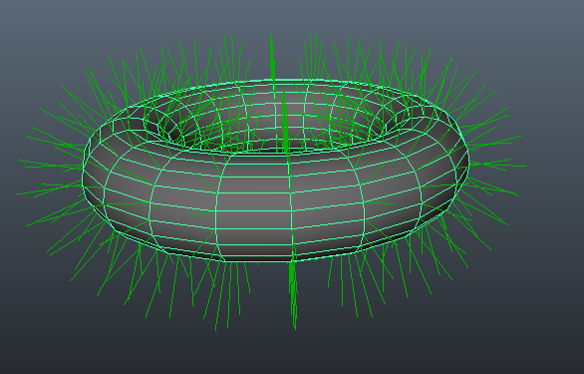
Normal vector

Slide 7
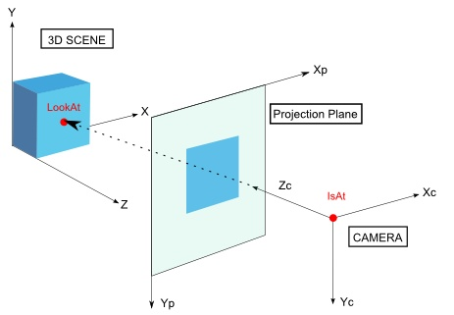
Forward and backward facing polygons
Pda-fx.net

Slide 8
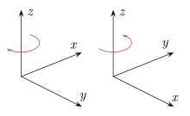

Right (or left) hand rule
wiki

Slide 9
Polygon Rendering
Given the model of the shape, Work out what a viewer would see:
Issues
representation of polygons
changing to the viewer's perspective: rotation, translation, perspective
hidden parts and objects obscuring others
illumination and surface effects
[shadows and reflections from other objects]

Slide 10
Simple Z-buffer Rendering Pipeline
z
z
input: set of polygons (position, colour)
viewing direction
direction of light source(s)
size of window.
output: an image
Actions
rotate polygons and light source so viewing along z axis
translate & scale to fit window / clip polygons out of view
remove any polygons facing away from viewer (normal_{z}> 0)
for each polygon
compute shading
work out which image pixels it will affect
for each pixel write shading and depth to z-buffer (retains only the shading of the closest surface)
convert z-buffer to image
x
x
y
y
Notes:
A new topic
fwd fwd fwd: from Grandma, on polygons., was created to a board you are watching.
Tony Butler-Yeoman wrote Today at 2:07pm the following message:
=====================
Hey all,
Here's a post I made last year on how to rotate the polygons so that you're looking down the positive Z-axis. Do note that there are lots of ways to think about this, so ignore this if it's nothing like what you've got going. Anyway, here goes.
Figuring out how to rotate, translate, and scale the scene is probably the hardest part of the assignment seeing as you're not given much guidance on it.
It's much easier to think of this in 2D and then generalise it to 3D, so I'm going to use 2D examples here, where we're working in the XZ plane. When working in 3D you pretty much do this whole process over again except in the YZ plane.
So the goal of this part of the renderer is to get us looking down the Z-axis. We want this because it makes working out hidden polygons and doing the edge-list and z-buffer algorithms much simpler. Let's say we have a situation like this:
[img]http://i.imgur.com/X5hGxYI.png[/img]
Interlude: what's wrong with the above picture? We aren't doing perspective rendering, so things appear the same size no matter how far away they are. So the 'rays' coming out of the eye (that represent what you can see) shouldn't widen outwards, instead we have something like:
[img]http://i.imgur.com/TfQa426.png[/img]
Great, so now how do we get ourselves looking down the Z-axis? Well we just rotate the eye however much it needs to be rotated, here I've called the angle T:
[img]http://i.imgur.com/A3b38Pk.png[/img]
But we wouldn't accomplish anything by just rotating the eye, we've got to take the polygons with it of course. But we've already figured out the angle to rotate by, T, and so we just rotate the polygon around the origin by that amount. The result:
[img]http://i.imgur.com/Rxs0M1R.png[/img]
Notes:
[list][*] When I say rotate around the origin, I mean rotate around the Y-axis in 3D space.
[*] In your program you'll want your user to be away from the origin, but looking at it. like this:
燵img]http://i.imgur.com/4DJjxrV.png[/img]
營n this case we first need to translate the eye and all polygons so that the eye is at the origin, and then do exactly as above.
[*] Be careful not to confuse the two types of movement in your program. Part of the assignment (completion?) is to allow the user to move the eye around in order to get different views of scene. This is very different to what we're doing above, which is the first step of the actual rendering process.[/list]
(in response to a question about what the 'eye' is and how to represent it)
First keep in mind that all the image files you've got are (more or less) centred around the origin. So what is the 'eye', how do you represent it, and how do you work with it?
The key is that, because the scenes are at the origin, we can get away with a 'pretty good' direction of view by just looking at the origin. So let's decide that the eye will always be pointed towards the origin, much like in the last picture above.
But where is it pointing at the origin from? The trick is to think of it backwards, not as the eye pointing at the origin, but as something at the origin pointing at the eye. If we're in 2D space, we can describe this as a single angle! In the last picture, if the +ve Z-axis is 0 degrees than the angle the eye is at is about 45 degrees.
What about in 3D space? Well much like doing the polygon rotation, you just do this process twice. You can point at any point in 3D space using two angles; you can point anywhere in your room by defining how far to swivel around in your office chair, and how far up or down to tilt your arm. So we use two angles to fully describe everything we need to know about the eye, one in the XZ-plane (like T above), and one in the YZ-plane.
You'll notice that there isn't even a vector here, really, just two angles. Furthermore these angles are exactly the angles you'll want to use for rotating the scene (as long as you measure them with your +ve Z-axis as 0).
=====================
You can also see this message by visiting the following link.
http://ecs.victoria.ac.nz/cgi-bin/yabb/YaBB.pl?num=1429927664
Regards,
The ECS Forums team

Slide 11
Polygon transformations
Affine transformations:
Translating
Scaling
Rotating
Shearing
linear transformations,
preserve colinearity and ratios of distances along a line
may NOT preserve angles, lengths, areas
Can be represented using vectors & matrices

Slide 12
Linear transformations
Translation:
Scale:
Rotation:
Problem: different kinds of operations
x
y
z
+
∆x
∆y
∆z
⇒
x+∆x
y+∆y
z+∆z
s_{x} | 0 | 0
0 | s_{y} | 0
0 | 0 | s_{z}
×
x
y
z
⇒
x ∙ s_{x}
y ∙ s_{y}
z ∙ s_{z}
matrix multiplication
matrix multiplication
1 | 0 | 0
0 | cosθ | -sinθ
0 | sinθ | cosθ
×
x
y
z
⇒
1x + 0y + 0z
0x + cosθy – sinθz
0x + sinθy + cosθz

Slide 13
Linear transformations
Translation:
Scale:
Rotation:
+
⇒
5 | 0 | 0
0 | 1 | 0
0 | 0 | 1
×
1
2
3
⇒
5
2
3
×
⇒

Slide 14
Matrix multiplication
Size checking rules
(4 x 3) * (3 x 1) = (4 x 1)
Inner dimensions compatible (3,3), and contracted away
Outer dimensions retained (4,1)

Slide 15
Linear transformations
Translation:
Scale:
Rotation:
Problem: different kinds of operations
x
y
z
+
∆x
∆y
∆z
⇒
x+∆x
y+∆y
z+∆z
s_{x} | 0 | 0
0 | s_{y} | 0
0 | 0 | s_{z}
×
x
y
z
⇒
x ∙ s_{x}
y ∙ s_{y}
z ∙ s_{z}
matrix multiplication
matrix multiplication
1 | 0 | 0
0 | cosθ | -sinθ
0 | sinθ | cosθ
×
x
y
z
⇒
1x + 0y + 0z
0x + cosθy – sinθz
0x + sinθy + cosθz

