Slide 1
COMP 261 Lecture 14
3D Graphics 2 of 2

Slide 2
Doing better than 3x3?
Translation, scaling, rotation are different.
Awkward to combine them.
Use homogeneous coordinates :
Convert 3D vectors to 4D vectors
use 1 for the value in the 4th dimension
express transformations by a 4 x 4 matrix.
Lets us combine a sequence of transformations into a single transformation
See more here: http://www.essentialmath.com/AffineXforms.pps

Slide 3
Affine transformations: 4D
1 | 0 | 0 | ∆x
0 | 1 | 0 | ∆y
0 | 0 | 1 | ∆z
0 | 0 | 0 | 1
x
y
z
1
⇒
x+∆x
y+∆y
z+∆z
1
Translation:
Scale:
Rotation:
sx | 0 | 0 | 0
0 | sy | 0 | 0
0 | 0 | sz | 0
0 | 0 | 0 | 1
x
y
z
1
x ∙ sx
y ∙ sy
z ∙ sz
1
⇒
1 | 0 | 0 | 0
0 | cosθ | -sinθ | 0
0 | sinθ | cosθ | 0
0 | 0 | 0 | 1
x
y
z
1
⇒
1x + 0y + 0z
0x + cosθy – sinθz
0x + sinθy + cosθz
1

Slide 4
Transformations
Apply transformation
input: point (x, y, z, 1)
transform T (4x4 array)
initialise newpoint to (0,0,0,1)
for row ← 0 to 3
for col ← 0 to 3
newpoint[row] += T[row, col] * point[col]
Consistent pattern for all transformations.
To transform polygon,
apply transform to each vertex.

Slide 5
Combining transformations:
Translation followed by Rotation:
Matrix multiplication is associative:
1 | 0 | 0 | 0
0 | sinθ | -cosθ | 0
0 | cosθ | sinθ | 0
0 | 0 | 0 | 1
1 | 0 | 0 | ∆x
0 | 1 | 0 | ∆y
0 | 0 | 1 | ∆z
0 | 0 | 0 | 1
x
y
z
1
1 | 0 | 0 | ∆x
0 | sinθ | -cosθ | sinθ∆y-cosθ∆z
0 | cosθ | sinθ | cosθ∆y+sinθ∆z
0 | 0 | 0 | 1
x
y
z
1

Slide 6
Rendering
Viewing perspective:
Assume viewer looks along z-axis
Rotate and translate object to make this the desired view
Remove polygons facing away from viewer

Slide 7
Remove hidden polygons
Compute normal to surface:
(vector perpendicular to surface, pointing out of the face)
facing away from viewer if z-component of normal is +ve
normal = edge1 × edge2 (cross product of the vectors)
n = (n_{x}, n_{y}, n_{z})
= (a_{y}b_{z} – a_{z}b_{y} , a_{z}b_{x} – a_{x}b_{z} , a_{x}b_{y} – a_{y}b_{x} )
Remove if
a_{x}b_{y} > a_{y}b_{x}
or
(x₂-x₁)(y₃-y₂) > (y₂-y₁)(x₃-x₂)
b = (b_{x}, b_{y}, b_{z}) =
(x₃-x₂, y₃-y₂, z₃-z₂ )
a = (a_{x}, a_{y}, a_{z}) =
(x₂-x₁, y₂-y₁, z₂-z₁)

Slide 8
Simple Z-buffer Rendering Pipeline
z
z
input: set of polygons
viewing direction
direction of light source(s)
size of window.
output: an image
Actions
rotate polygons and light source so viewing along z axis
translate & scale to fit window / clip polygons out of view
remove any polygons facing away from viewer (normal_{z}> 0)
for each polygon
compute shading
work out which image pixels it will affect
for each pixel write shading and depth to z-buffer (retains only the shading of the closest surface)
convert z-buffer to image
x
x
y
y

Slide 9
Illumination
Light reflected from a surface depends on
light sources
reflectivity
matte vs shiny → diffuse or specular reflection
color, texture, pattern, … (variation in reflectivity)
Simple option:
assume matte, uniform reflectance for red, green, blue:
(R_{r}, R_{g}, R_{b})
assume some ambient light
light ← reflectance × ambient light level
diffuse reflection depends on light source direction:
light ← reflectance × light source × cos(angle of incidence)
cos(θ) = normal ∙ lightdirection
(if both unit vectors: length 1)
light source
θ
dot product

Slide 10
Computing Illumination
Matte or Diffuse material, “Lambert law”:
Amount of light reflected is proportional to the cosine of the angle between the incoming light direction, and the surface normal
We’re given the light direction
Need to calculate the surface normal

Slide 11

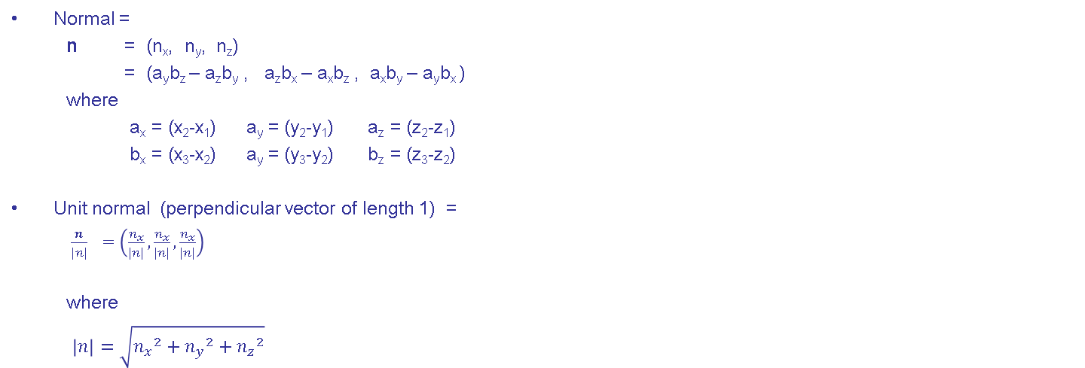
Unit Normal to surface
b = (b_{x}, b_{y}, b_{z}) =
(x₃-x₂, y₃-y₂, z₃-z₂ )
Normal =
n = (n_{x}, n_{y}, n_{z})
= (a_{y}b_{z} – a_{z}b_{y} , a_{z}b_{x} – a_{x}b_{z} , a_{x}b_{y} – a_{y}b_{x} )
where
a_{x} = (x₂-x₁) a_{y} = (y₂-y₁) a_{z} = (z₂-z₁)
b_{x} = (x₃-x₂) a_{y} = (y₃-y₂) b_{z} = (z₃-z₂)
Unit normal (perpendicular vector of length 1) =
$\frac{n}{|n|}$ $=\left(\frac{n_{x}}{|n|},\frac{n_{x}}{|n|},\frac{n_{x}}{|n|}\right)$
where
$\left|n\right|=\sqrt{{n_{x}}^{2}+{n_{y}}^{2}+{n_{z}}^{2}}$
Cross product
a = (a_{x}, a_{y}, a_{z}) =
(x₂-x₁, y₂-y₁, z₂-z₁)

Slide 12
Computing Illumination
input: n = (n_{x}, n_{y}, n_{z} ) surface normal unit vector
d = (d_{x}, d_{y}, d_{z} ) light direction unit vector
(a_{r}, a_{g}, a_{b}) ambient light level
(R_{r}, R_{g}, R_{b}) reflectance in each colour
(I_{r}, I_{g}, I_{b}) intensity/colour of incident light
output: (O_{r}, O_{g}, O_{b})
actions
costh ← n ∙ d [ = (n_{x} d_{x} + n_{y} d_{y} + n_{z} d_{z} ) ]
for c in red, green, blue:
O_{c} ← (a_{c} + I_{c} × costh) × R_{c}

Slide 13
Further reading…for geeks!
Shading languages:
Renderman shading language
GLSL
Adobe Pixel Bender
Playstation Shader Language
Etc…

Slide 14
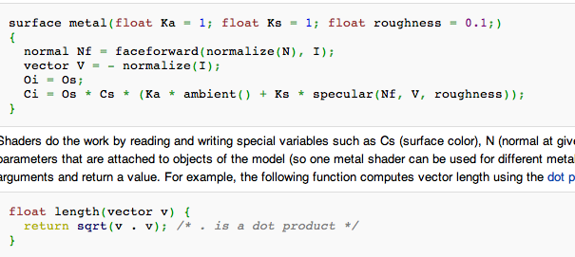
Further reading…for geeks!
Shading languages:
Syntax similar to C or Java
Built in variables like N (= normal), I (= eye)
Special operations like . (= dot product)

Slide 15
Shading
Light reflected from a polygon:
could be uniform (if assume each polygon is a flat, uniform surface)
⇒ compute once for whole polygon
could vary across surface (if polygons approximate a curved surface)
Can interpolate from the vertices:
use "vertex normals" (average of surfaces at vertex)
either interpolate shading from vertices
or interpolate normals from vertices and compute shading
What about shadows and reflected light from other sources
ray tracing!! expensive, we will ignore it
×

