Slide 1
B Trees and B+ Trees

Slide 2
Storing large amounts of Data
B Trees, B+ Trees: data structures and algorithms for
large data
stored on disk (ie, slow access)
File systems:
Lots of files, each file stored as lots of blocks.
Databases:
large tables of data
each indexed by a key (or perhaps multiple alternative keys)
Problem:
How do we access the data efficiently:
individual items (given key)
sequence of all items (preferably in order)
assume data is stored in files on hard drives (slow access time)
Use some kind of index structure
assume the index is also stored in a file

Slide 3
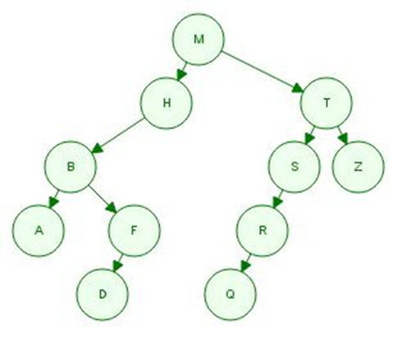
COMP103 approaches:
Efficient Set and Map implementations:
Hash Tables.
Binary Search Tree
http://www.cs.usfca.edu/~galles/visualization
Binary search tree
Add M H T S R Q B A F D Z
Search: Log(n)

Slide 4
Problems with Binary Search
Unbalanced trees are inefficient
⇒ must keep the tree balanced
AVL trees: self-balanced by tree rotations
red-black trees: node with a color bit
splay trees: move recently access node to the root
B trees
lots of pointer following
⇒ if each node is stored in a file, this will be slow!
B
A
C
F
H
G
K
P
N
M

Slide 5
Balanced trees
Balancing:
"rotate" nodes in tree if unbalanced.
AVL trees
red-black trees
splay trees
(B trees)
always add levels at the top!
B trees ( and B+ trees,…)
Too many Pointers
More data in each node
More children of each node
⇒ "bushier" trees, fewer steps to leaves
B
A
C
F
F
C
H
G
K
P
N
M

Slide 6
B Trees
Like binary search trees, but
non-leaf nodes have up to m children, and m-1 data values
non-leaf, non-root nodes always have at least ⌈m/2⌉ children and ⌈m/2⌉-1 data values (ie, at least half full)
leaf nodes contain up to m-1 data values and no children
adding is done "at the top" rather than "at the bottom"
B tree example:
m=3, ("2-3 tree")
3 children, 2 values
2 children, 1 value
N
V
E
J
R
X
A
C
G
K
M
P
Q
S
T
W
Y
Z

Slide 7
2-3 trees
Every internal node is a 3-node or a 2-node
3-node: 3 children, 2 values
2-node: 2 children, 1 value
All leaves are at the same level
Leaf node has 1 or 2 values
All data is kept in sorted order

Slide 8
B Trees: Search
Data values might be
single items (set of values)
key:value pairs (map)
Search(key, node):
Just like binary search, but more comparisons at each node:
if node is null
return fail
for i = 0 to k-1 (k is number of keys in node)
if key < keys[i]
return search(key, children[i])
if key == keys[i]
return value[i]
return search(key, children[k])
E
J
A
C
G
K
M

Slide 9
B Trees: Insert
To insert item (eg key:value pair):
Search for leaf where the item should be.
If leaf is not full, add item to the leaf.
If leaf is full:
Identify the middle item (existing item or the new item)
Create a new leaf node:
retain items before middle key in original node
put items after middle key in new leaf node,
push item up to parent, along with pointer to new node
To add new item to parent:
if parent is not full:
add new item to parent, and add new child pointer just right of new item
else: split parent node into two nodes (like leaf)
push middle item up to grandparent.
add pointer to new child just right of pushed up item

Slide 10
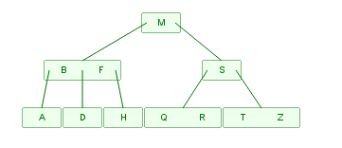
2-3 B Tree: Inserting values
Add M H T S R Q B A F D Z
http://www.cs.usfca.edu/~galles/visualization/BTree.html

Slide 11
2-3 B Tree: Inserting values
Add 8, 5, 1, 7, 3,12, 9, 6
http://www.cs.usfca.edu/~galles/visualization/BTree.html

Slide 12
2-3 BTree: Deletion
Opposite of inserting:
if a node becomes empty,
if possible, rotate a value from a sibling through the parent to ensure minimum number of values per node.
if two siblings, require >= 5 keys in parent and siblings
if one sibling, require >=3 keys in parent and siblings
else merge nodes:
if two siblings, merge
Easier at a leaf.
Harder if at an internal node.

Slide 13
Deleting from leaves
E
J
E
J
A
C
G
K
M
A
C
G
M
C
J
C
J
A
E
M
A
J
A
C
M
Only reduce levels
at the root
A
C

Slide 14
More deletions:
When internal node becomes too empty
propagate the deletion up the tree
N
V
E
J
R
X
A
C
G
K
P
S
W
Y
Z

Slide 15
More deletions:
Deletion from internal node ⇒
rotate key and child from sibling
J
V
E
N
X
A
C
G
K
R
S
W
Y
Z

Slide 16
Analysis
B trees are balanced:
A new level is introduced only at the top
A level is removed only from the top
Therefore:
all leaves are at the same level.
Cost of search/add/delete:
O(log_{⌈m/2⌉}(n)) (at worst) = depth of tree with all half full nodes
O(log_{m}(n)) (at best) = depth of tree with full nodes
if 100 million items in a B tree with m = 20,
log₁₀(100,000,000) = ? 8
log₂₀(100,000,000) = ? 6.14
if billion items in a B tree with m = 100,
log₅₀(1,000,000,000) = ? 5.3
log₁₀₀(1,000,000,000) = ? 4.5

