Slide 1
Simple
Online Messenger
Team 12
소프트웨어학과 201835486 이민서
소프트웨어학과 201833299 허서윤
응용통계학과 201731814 남궁다비

Slide 2
Overview
Storyline through Screenshots
Architecture of Application
Structure Design
- JDBC/GUI
SOCKET

Slide 3
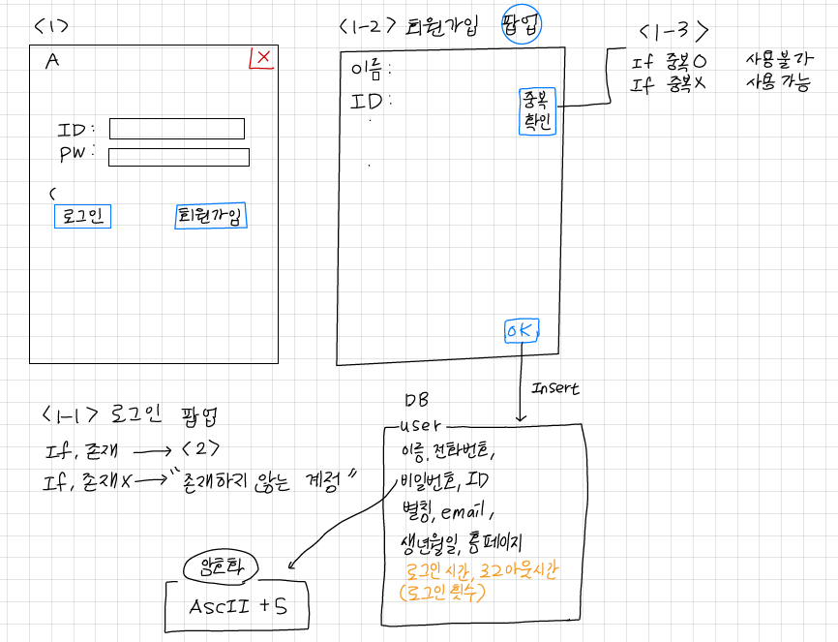
Structure Design
#1. <Login>
Access / Membership Login

Slide 4
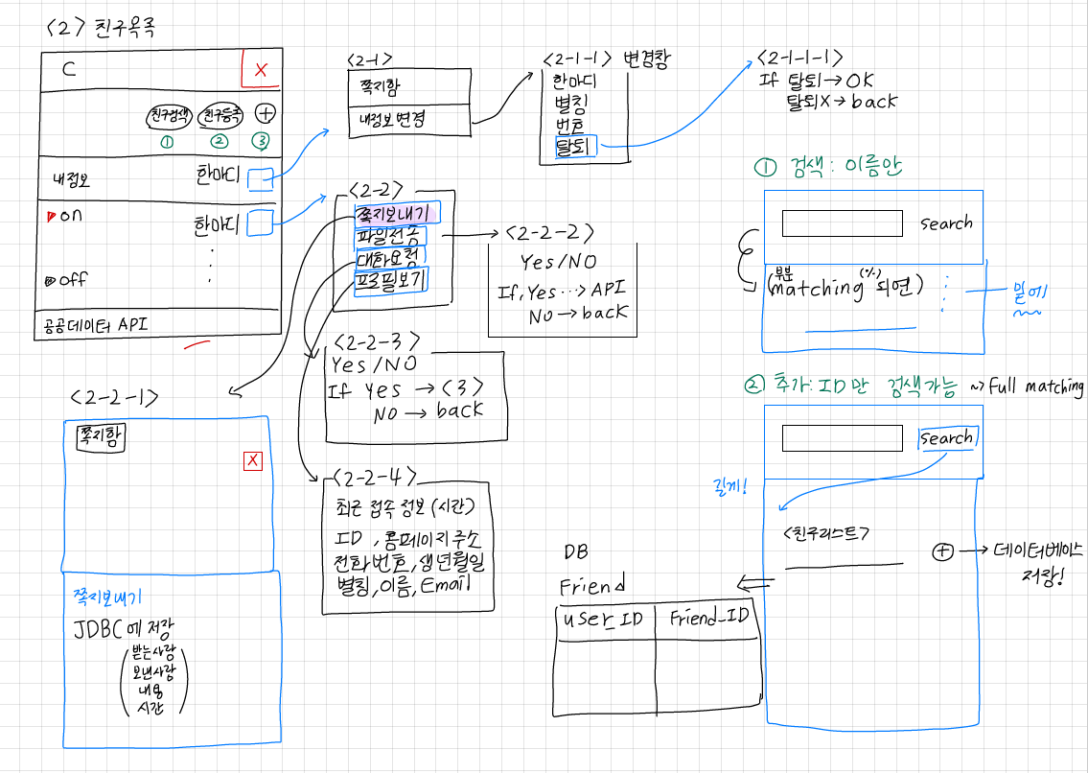
Structure Design
#2. <Friend List>
Manage Users/Friends Public Data Usage

Slide 5
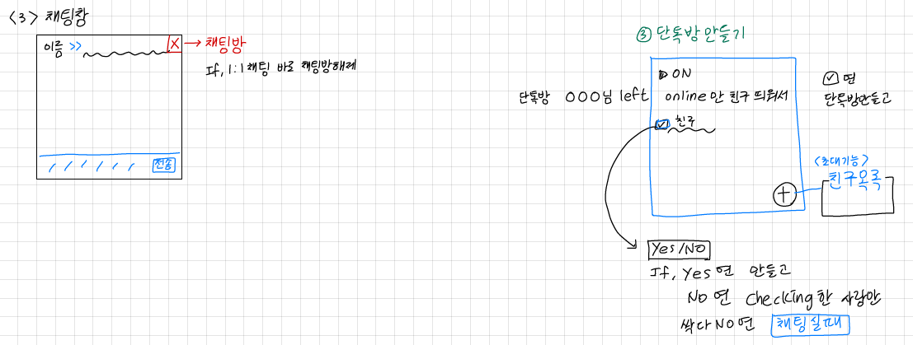
Structure Design
#3. <Chatting Room>
One to One chat
Multiple chat

Slide 6
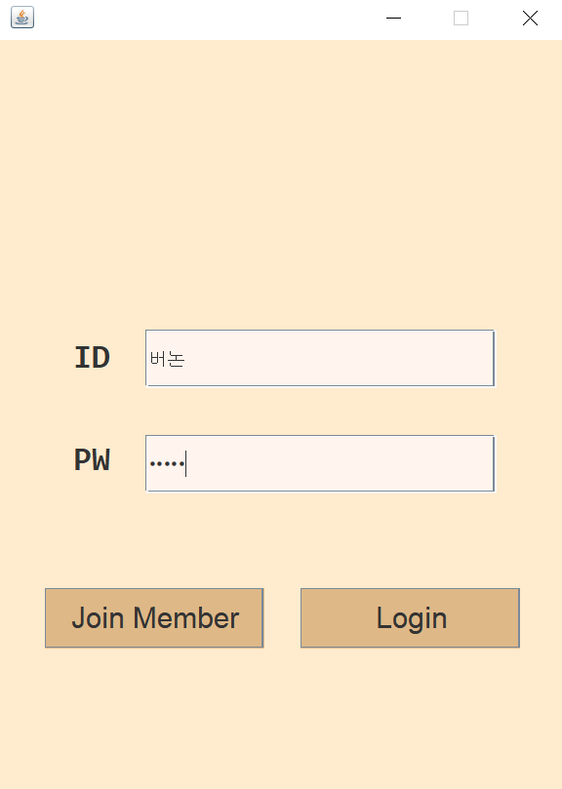
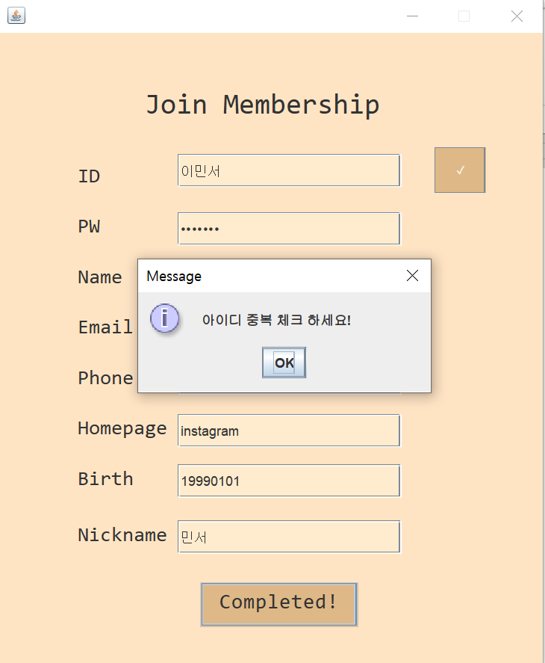
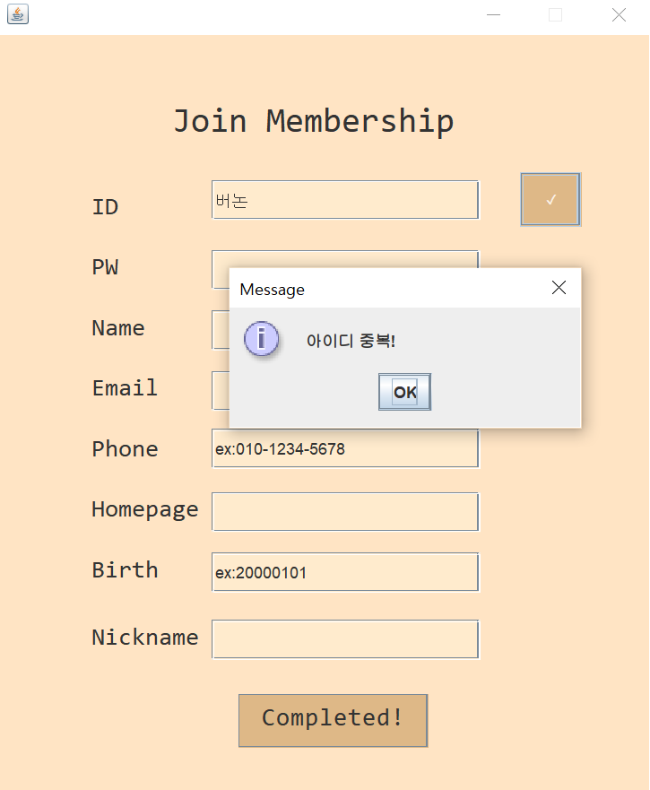
Storyline through Screenshots
#1. <Login page>
Click the
Join Member button

Slide 7
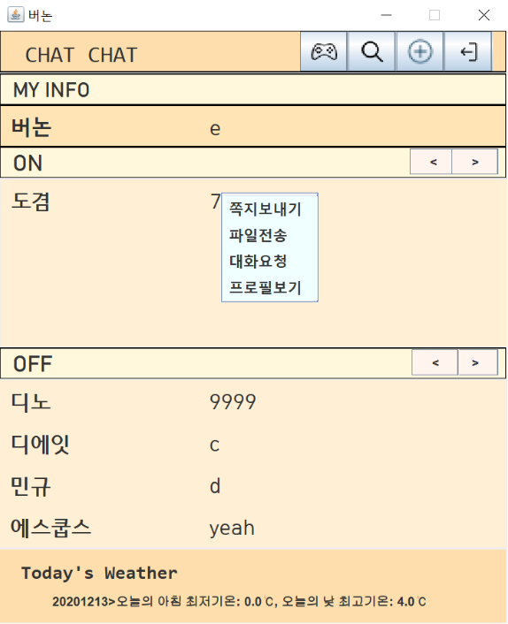
Storyline through Screenshots
#1. <Login page>
2) Click the
Login button

Slide 8
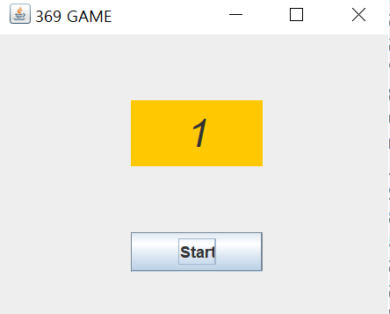
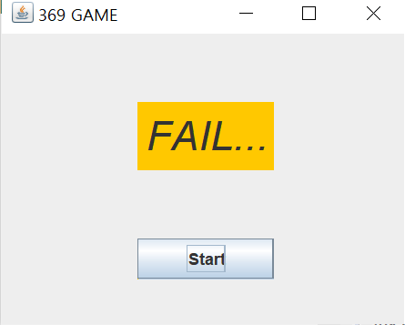
Storyline through Screenshots
#2. <Friend List>
Click
Game button
<369 Game>
Click on every multiple of 3, 6, and 9. If you double-click, you're exited.

Slide 9
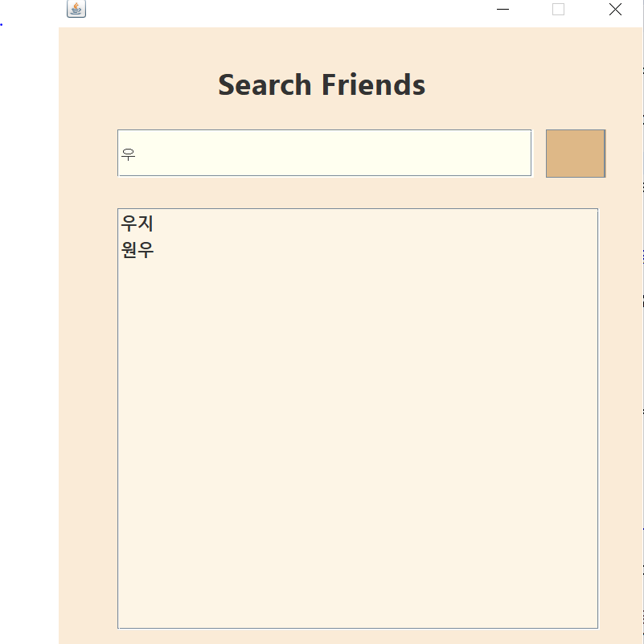
Storyline through Screenshots
#2. <Friend List>
2) Click
Search button

Slide 10
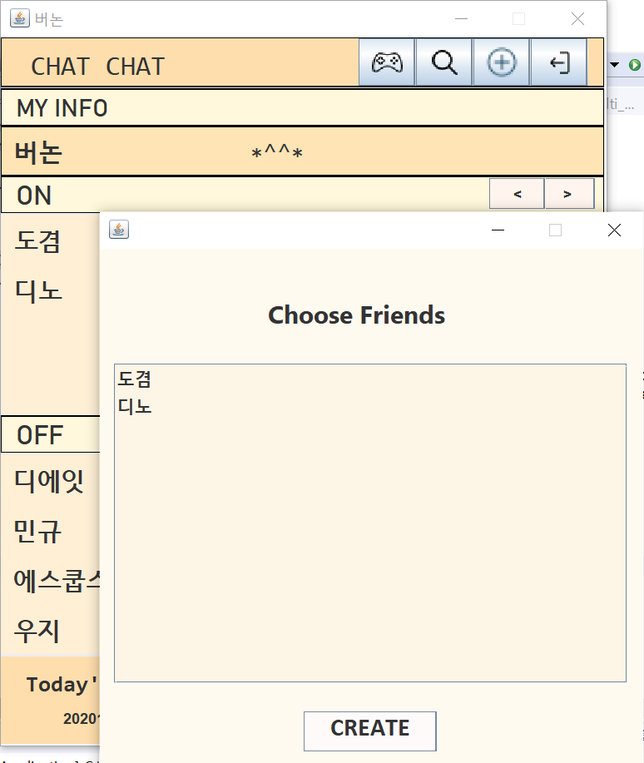
Storyline through Screenshots
#2. <Friend List>
3) Click
plus button

Slide 11
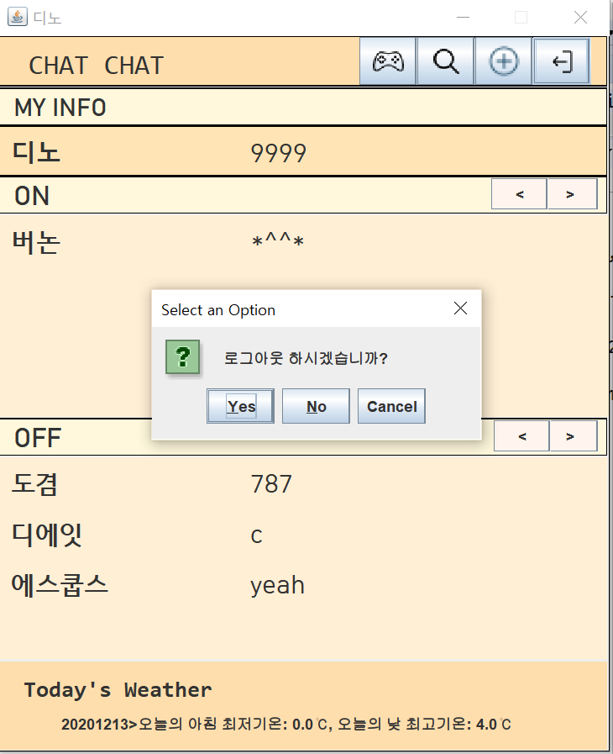
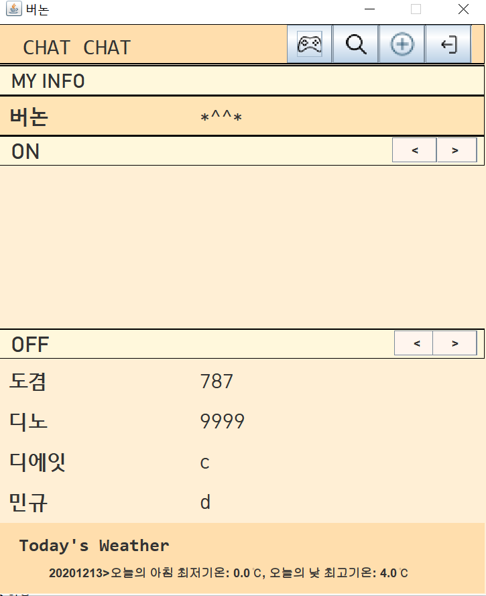
Storyline through Screenshots
#2. <Friend List>
4) Click
Exit button

Slide 12
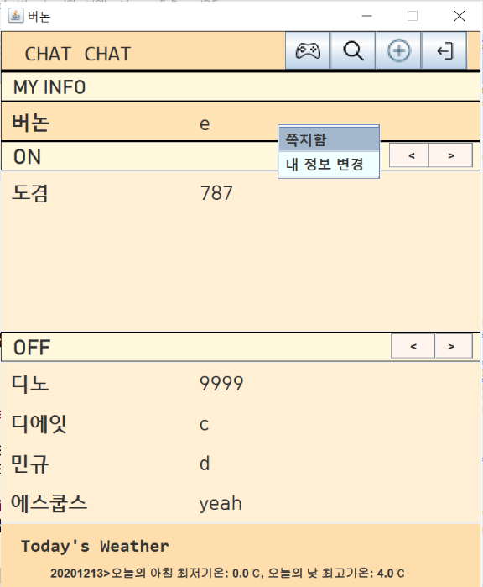
Storyline through Screenshots
#2. <Friend List>
5) Right Click
Note box button

Slide 13
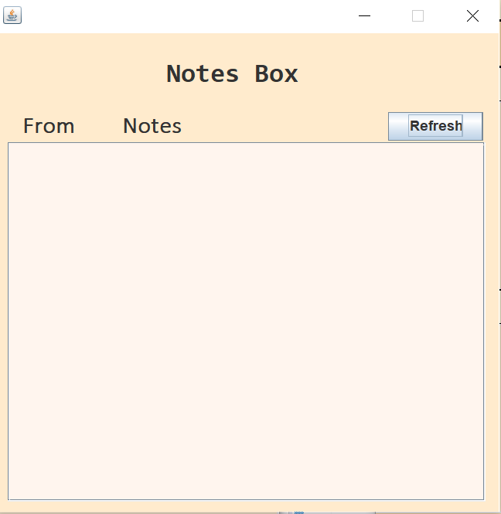
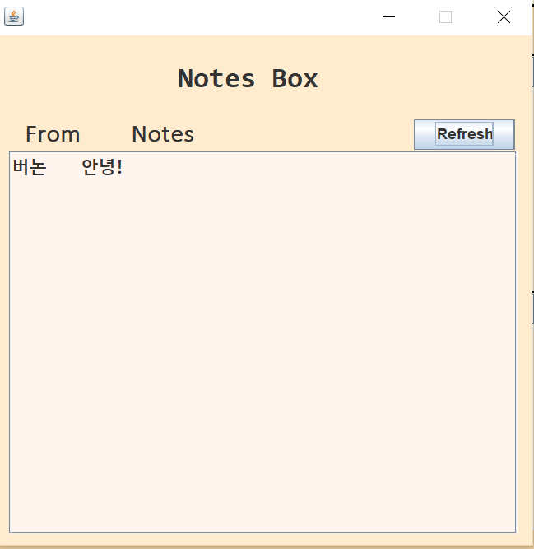
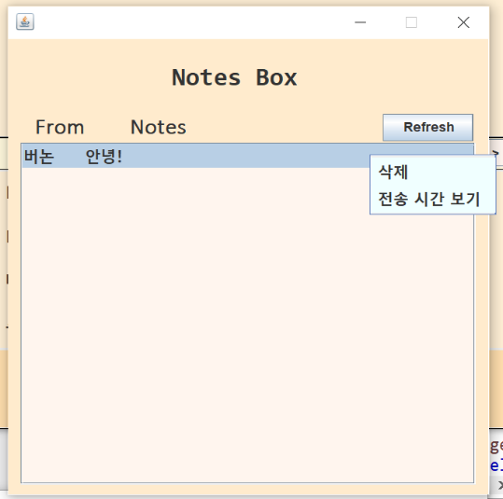
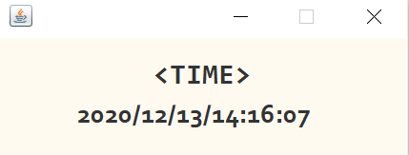
Storyline through Screenshots
#2. <Friend List>
5) Right Click
Note box button

Slide 14
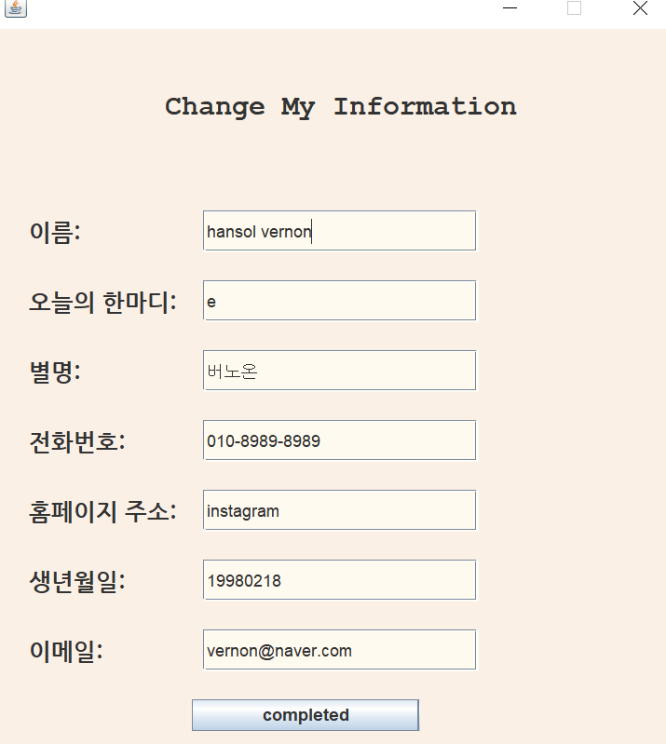
Storyline through Screenshots
#2. <Friend List>
6) Click changing my info button

Slide 15
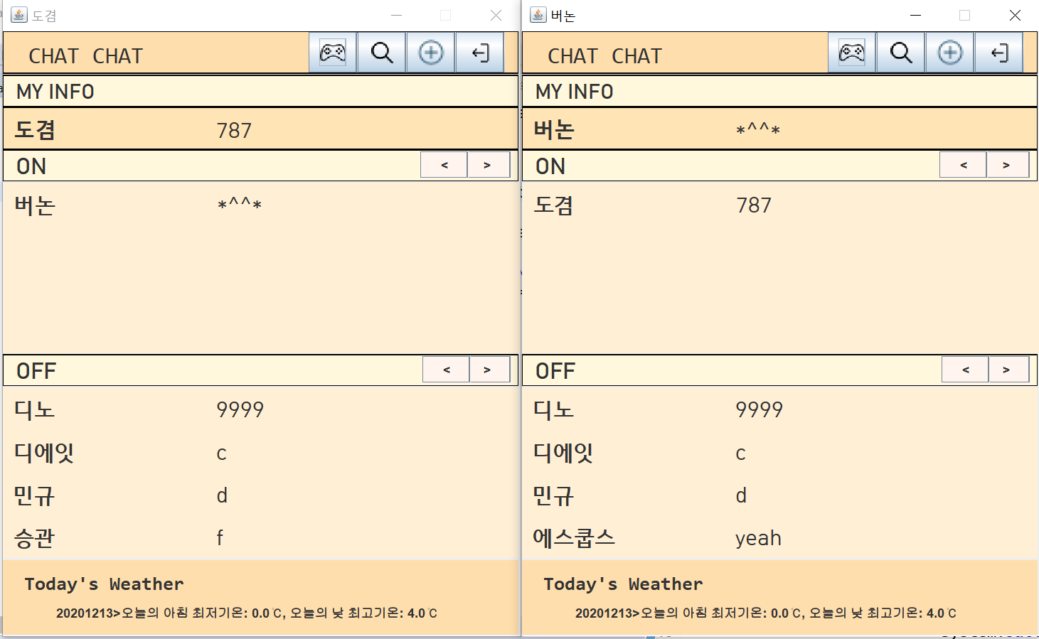
Storyline through Screenshots
#2. <Friend List>
6) Click changing my info button
- Change my information immediately!

Slide 16
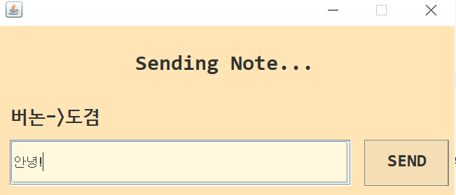
Storyline through Screenshots
#2. <Friend List>
7) Click sending a note

Slide 17
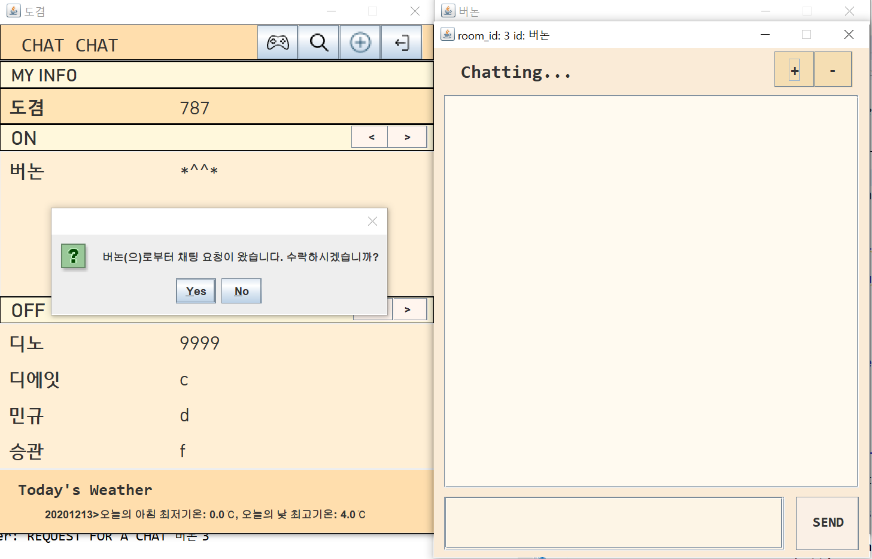
Storyline through Screenshots
#2. <Friend List>
8) Click Request for Conversation

Slide 18
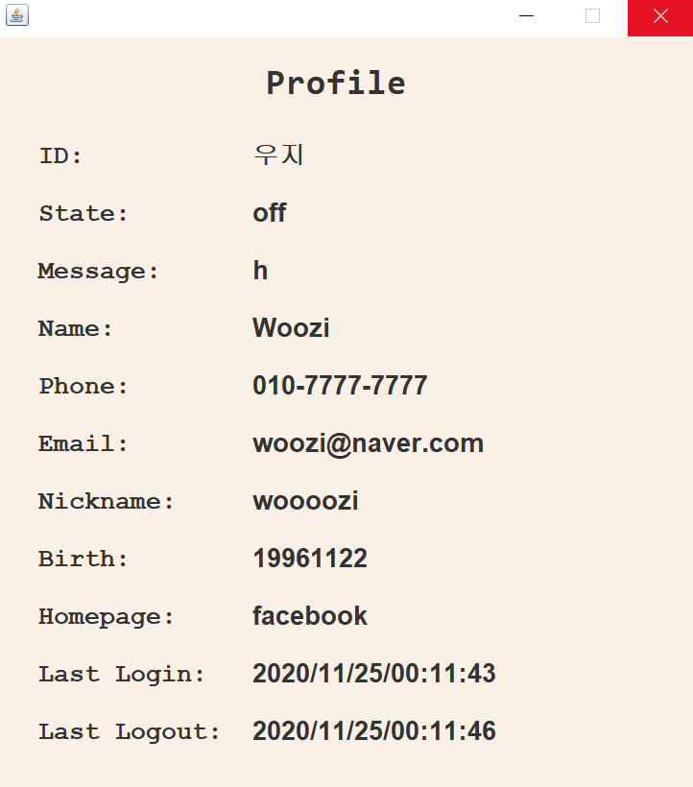
Storyline through Screenshots
#2. <Friend List>
7) Click view profile

Slide 19
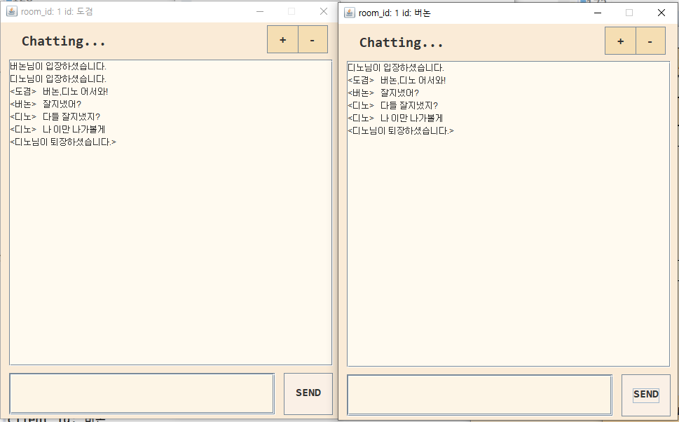
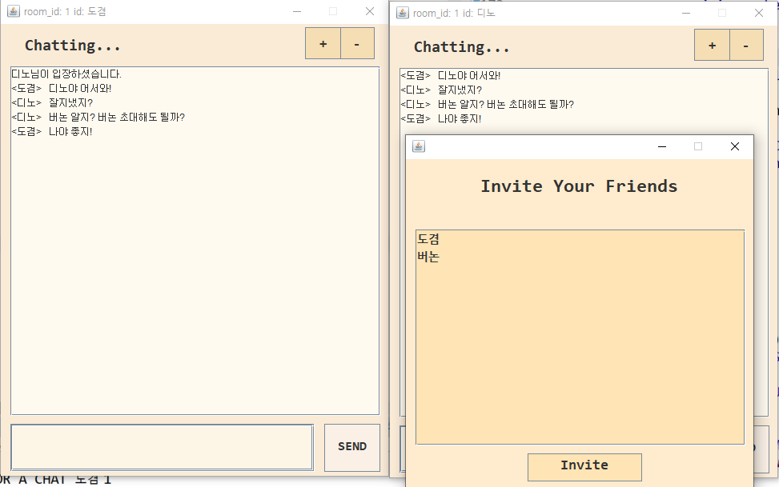
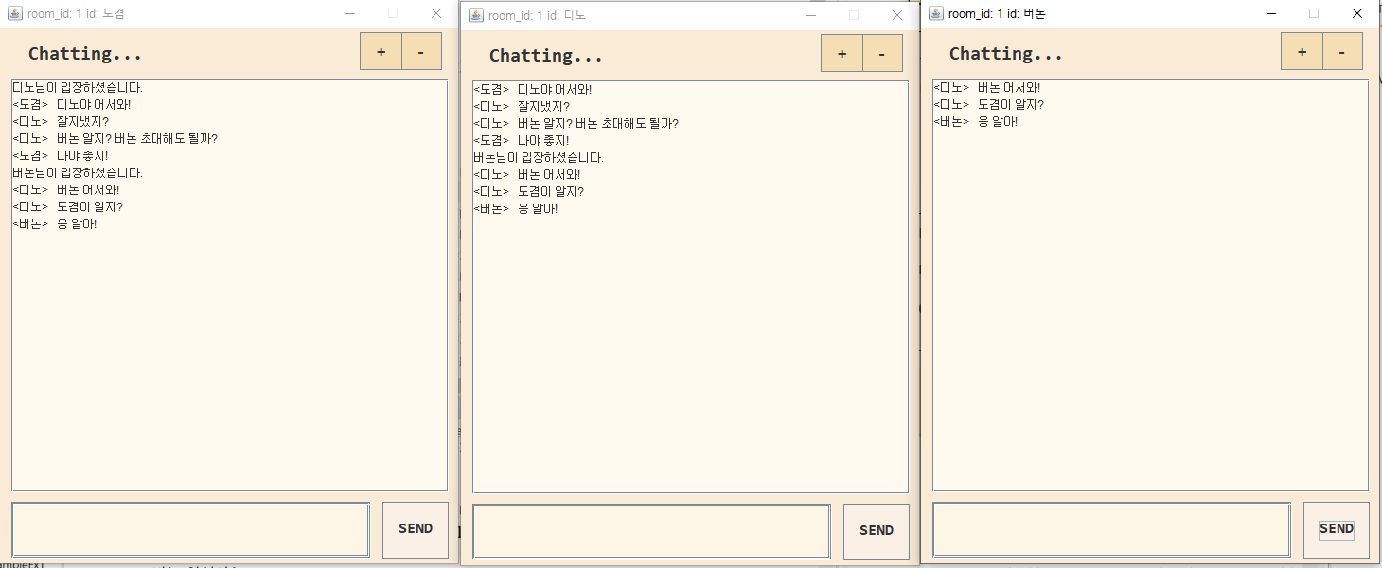
Storyline through Screenshots
#3. <Chatting room> - Invite a Friend / Exit

Slide 20
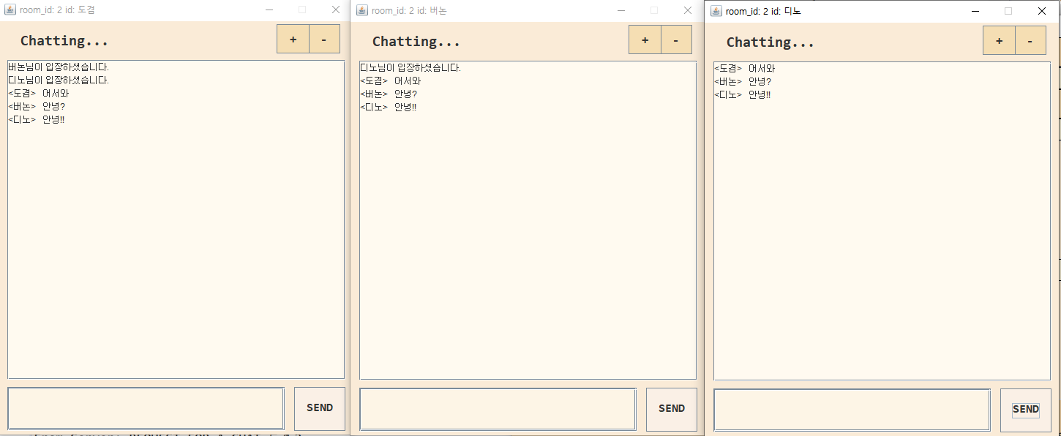
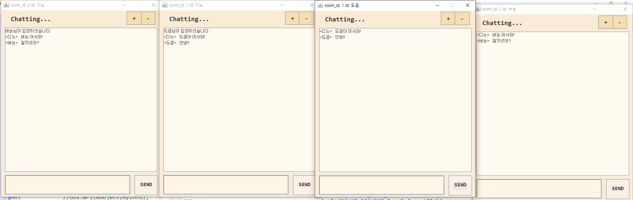
Storyline through Screenshots
#3. <Chatting room> - one to one chatting room / multiple chatting room

Slide 21
Architecture of Application - #1 Login
Using password Field

Slide 22
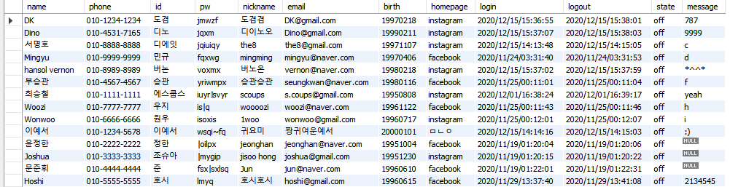
Architecture of Application - #1 Login
Member information is stored in the DB
-ID is the primary key
-PW is encryption

Slide 23
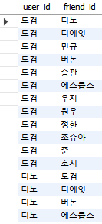
Architecture of Application - #2 Friend List
The list of friends is stored in the DB.
Display
Each friend
Status
Alter status message

Slide 24
Architecture of Application - #2 Friend List
If you send a note, it is saved in DB.
Using the right click of the mouse to derive the pop-up Menu
Using
Opendata

Slide 25
Architecture of Application - #3 Chatting Room (invite friends)
SERVER
CLIENT
Create a room and adds room information
Finds (a) friend(s)
and sends the accept/reject protocol.
<User>
Send a chatting room creation protocol
and a list of
friends to invite.
<Friend(s)>

Slide 26
Architecture of Application - #3 Chatting Room (invite friends)
SERVER
CLIENT
Updates the room information.
<User>
The chat window is inactive until more than one person accepts it.
<Friend(s)>
Select accept or decline to send the corresponding protocol to the server.

Slide 27
Architecture of Application - #3 Chatting Room (invite friends)
SERVER
CLIENT
If everyone refuses, delete the room information.
Else, maintain room information until everyone leaves the room.
<User>
If more than one person accepts, chat room will be activated.
Else, Exit the chat window with a message that all users have declined
<Friend(s)>
If click accept,
a chat room will be opened to start the chat.

Slide 28
Architecture of Application - #3 Chatting Room (chat)
SERVER
CLIENT
Send a message to all users in the room.
<User>
Type a message to
send in the input window
<All User
in chatting room>
Write the message you received in the chat window.
=> The same way is for entering and leaving the chat room.

Slide 29
Github
이민서 https://github.com/minseo300
허서윤 https://github.com/seoyoon130
남궁다비https://github.com/NAMKUNGDABI/Simple_Online_Messenger

Slide 30
Youtube
https://youtu.be/8CVbcSVyzO4

Slide 31
Thank you

