Slide 1
Hash Function

Slide 2
TODAY
What Makes a Good Hash Function?
Basic Hash Functions

Slide 3
What Makes a Good Hash Function?
Efficiency of Computation
Minimizing Collisions

Slide 4
Efficiency of Computation
Integer vs Floating-Point Operations
Arithmetic and Bitwise Operations

Slide 5
Integer vs Floating-Point Operations
Integer
int, unsigned int, long long, unsigned long long
Floating-Point
float, double

Slide 6
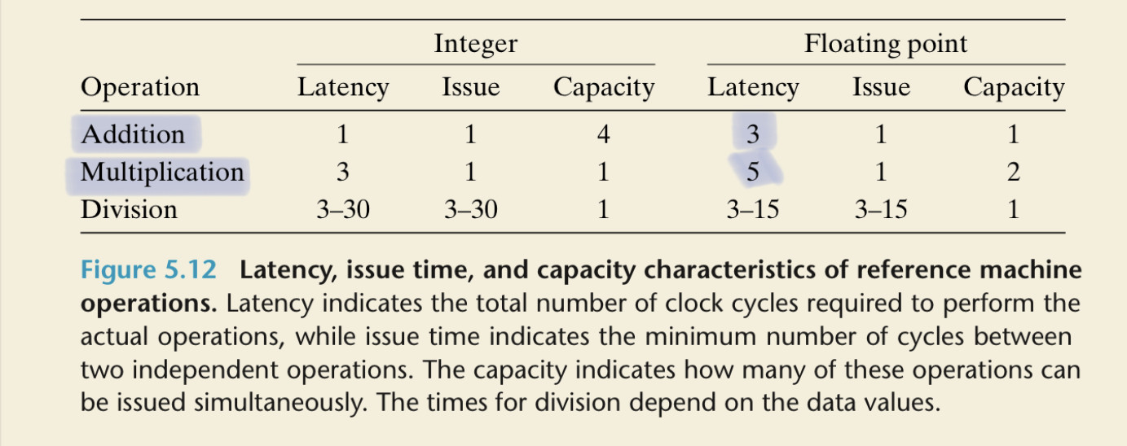
Integer vs Floating-Point Operations

Slide 7












Integer vs Floating-Point Operations
Integer
Let’s assume positive numbers
ex) 12 = (1 * 2^3) + (1 * 2^2)
31
30
29
28
27
26
5
4
3
2
1
0
0
0
0
0
0
0
…
0
0
1
1
0
0
$$2^{31}$$
$$2^{30}$$
$$2^{29}$$
$$2^{28}$$
$$2^{27}$$
$$2^{26}$$
$$2^{5}$$
$$2^{4}$$
$$2^{3}$$
$$2^{2}$$
$$2^{1}$$
$$2^{0}$$

Slide 8
Integer vs Floating-Point Operations
Floating-Point
Let’s assume positive numbers
ex) 12.375 = (1 * 2^3) + (1 * 2^2) + (1 * 2^-2) + (1 * 2^-3)
=> 2^3 * {(1 * 2^0) + (1 * 2^-1) + (1 * 2^-5) + (1 * 2^-6)}
3 + 127 = 130
1.100011
10000010
100011
Sign (1bit)
Exponent (8bit)
Mantissa (23bit)

Slide 9
Efficiency of Computation
Integer vs. Floating-Point Operations
Arithmetic and Bitwise Operations

Slide 10
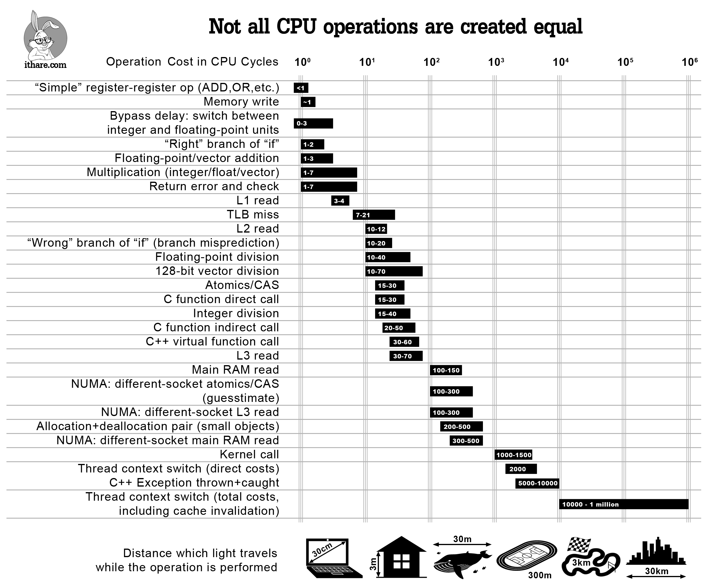
Arithmetic and Bitwise Operations

Slide 11
What Makes a Good Hash Function?
Efficiency of Computation
Minimizing Collisions

Slide 12
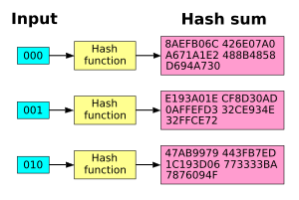
Minimizing Collisions
Random Distribution of Hash Values
Avalanche Effect

Slide 13
TODAY
What Makes a Good Hash Function?
Basic Hash Functions

Slide 14
Basic Hash Functions
Division Hashing
Multiplicative Hashing

Slide 15
Division Hashing
index = K % M
0
ex) K = 125, M = 6
=> index = 125 % 6 = 5
1
Hash
2
K = 125
5
M = 6
3
4
5

Slide 16
Impact of Bin Count (M)
Multiple of 2
Power of 2
Composite Number
Prime Number

Slide 17
Impact of Bin Count (M)
Multiple of 2
Even keys map to even bins
Odd keys map to odd bins
ex) M is 6
0
0
1
1
2, 4, 6, 8, 10, 12, 14, 16, …
2
1, 3, 5, 7, 9, 11, 13, 15, …
2
3
3
4
4
5
5

Slide 18
Impact of Bin Count (M)
Power of 2
Similar to multiples of 2, bins can become biased
But the modulo operation (%) can be replaced by the bitwise AND operation (&)
ex) K = 13, M = 2^2
=> K % M = 13 % 2^2 = 13 & (2^2 – 1)

Slide 19
Impact of Bin Count (M)
Power of 2
ex) K = 13, M = 2^2
=> 13 = (1 * 2^3) + (1 * 2^2) + (1 * 2^0)
31
30
29
28
27
26
5
4
3
2
1
0
0
0
0
0
0
0
…
0
0
1
1
0
1
$$2^{31}$$
$$2^{30}$$
$$2^{29}$$
$$2^{28}$$
$$2^{27}$$
$$2^{26}$$
$$2^{5}$$
$$2^{4}$$
$$2^{3}$$
$$2^{2}$$
$$2^{1}$$
$$2^{0}$$

Slide 20



















Impact of Bin Count (M)
Power of 2
13 = (1 * 2^3) + (1 * 2^2) + (1 * 2^0)
31
30
29
28
27
26
5
4
3
2
1
0
0
0
0
0
0
0
…
0
0
1
1
0
1
$$2^{31}$$
$$2^{30}$$
$$2^{29}$$
$$2^{28}$$
$$2^{27}$$
$$2^{26}$$
$$2^{5}$$
$$2^{4}$$
$$2^{3}$$
$$2^{2}$$
$$2^{1}$$
$$2^{0}$$
>> 2
13 / 2^2 = (1 * 2^1) + (1 * 2^0) + (1 * 2^-2)
31
30
29
28
27
26
5
4
3
2
1
0
0
0
0
0
0
0
…
0
0
0
0
1
1
$$2^{31}$$
$$2^{30}$$
$$2^{29}$$
$$2^{28}$$
$$2^{27}$$
$$2^{26}$$
$$2^{5}$$
$$2^{4}$$
$$2^{3}$$
$$2^{2}$$
$$2^{1}$$
$$2^{0}$$

Slide 21
Impact of Bin Count (M)
Power of 2
13 / 2^2 = (1 * 2^1) + (1 * 2^0) + (1 * 2^-2) = 3
31
30
29
28
27
26
5
4
3
2
1
0
0
0
0
0
0
0
…
0
0
0
0
1
1
$$2^{31}$$
$$2^{30}$$
$$2^{29}$$
$$2^{28}$$
$$2^{27}$$
$$2^{26}$$
$$2^{5}$$
$$2^{4}$$
$$2^{3}$$
$$2^{2}$$
$$2^{1}$$
$$2^{0}$$
<< 2
(13 / 2^2) * 2^2 = (1 * 2^3) + (1 * 2^2)
31
30
29
28
27
26
5
4
3
2
1
0
0
0
0
0
0
0
…
0
0
1
1
0
0
$$2^{31}$$
$$2^{30}$$
$$2^{29}$$
$$2^{28}$$
$$2^{27}$$
$$2^{26}$$
$$2^{5}$$
$$2^{4}$$
$$2^{3}$$
$$2^{2}$$
$$2^{1}$$
$$2^{0}$$

Slide 22
























Impact of Bin Count (M)
Power of 2
c.f) a % n = a − (⌊$\frac{a}{n}$​⌋ × n)
13 % 2^2 = 13 - (13 / 2^2) * 2^2
31
30
29
28
27
26
5
4
3
2
1
0
0
0
0
0
0
0
…
0
0
1
1
0
1
13
$$2^{31}$$
$$2^{30}$$
$$2^{29}$$
$$2^{28}$$
$$2^{27}$$
$$2^{26}$$
$$2^{5}$$
$$2^{4}$$
$$2^{3}$$
$$2^{2}$$
$$2^{1}$$
$$2^{0}$$
subtract
31
30
29
28
27
26
5
4
3
2
1
0
0
0
0
0
0
0
…
0
0
1
1
0
0
(13 / 2^2) * 2^2
= (13 >> 2) << 2
$$2^{31}$$
$$2^{30}$$
$$2^{29}$$
$$2^{28}$$
$$2^{27}$$
$$2^{26}$$
$$2^{5}$$
$$2^{4}$$
$$2^{3}$$
$$2^{2}$$
$$2^{1}$$
$$2^{0}$$

Slide 23
Impact of Bin Count (M)
Power of 2
c.f) a % n = a − (⌊$\frac{a}{n}$​⌋ × n)
13 % 2^2 = 13 - (13 / 2^2) * 2^2
31
30
29
28
27
26
5
4
3
2
1
0
0
0
0
0
0
0
…
0
0
1
1
0
1
13
$$2^{27}$$
$$2^{26}$$
$$2^{5}$$
$$2^{31}$$
$$2^{29}$$
These bits become zero
$$2^{1}$$
$$2^{0}$$
subtract
$$2^{30}$$
$$2^{28}$$
$$2^{4}$$
$$2^{3}$$
$$2^{2}$$
31
30
29
28
27
26
5
4
3
2
1
0
0
0
0
0
0
0
…
0
0
1
1
0
0
(13 / 2^2) * 2^2
= (13 >> 2) << 2
$$2^{31}$$
$$2^{30}$$
$$2^{29}$$
$$2^{28}$$
$$2^{27}$$
$$2^{26}$$
$$2^{5}$$
$$2^{4}$$
$$2^{3}$$
$$2^{2}$$
$$2^{1}$$
$$2^{0}$$

Slide 24
Impact of Bin Count (M)
Power of 2
13 % 2^2 = 13 - (13 / 2^2) * 2^2 = 13 – (13 >> 2) << 2 = 13 & (2^2 – 1)
31
30
29
28
27
26
5
4
3
2
1
0
0
0
0
0
0
0
…
0
0
1
1
0
1
13
$$2^{31}$$
$$2^{30}$$
$$2^{29}$$
$$2^{28}$$
$$2^{27}$$
$$2^{26}$$
$$2^{5}$$
$$2^{4}$$
$$2^{3}$$
$$2^{2}$$
$$2^{1}$$
$$2^{0}$$
bitwise AND
31
30
29
28
27
26
5
4
3
2
1
0
0
0
0
0
0
0
…
0
0
0
0
1
1
2^2 - 1
$$2^{31}$$
$$2^{30}$$
$$2^{29}$$
$$2^{28}$$
$$2^{27}$$
$$2^{26}$$
$$2^{5}$$
$$2^{4}$$
$$2^{3}$$
$$2^{2}$$
$$2^{1}$$
$$2^{0}$$

Slide 25
Impact of Bin Count (M)
Power of 2
Similar to multiples of 2, bins can become biased
But the modulo operation (%) can be replaced by the bitwise AND operation (&)
if) M is power of 2
=> K % M = K & (M – 1)

Slide 26
Impact of Bin Count (M)
Composite Number
0
0
ex) M is 15
1
1
2
2
3
3
4
4
5
5
3, 6, 9, 12, 15, 18, 21, 24, 27, …
6
5, 10, 15, 20, 25, 30, 35, 40, 45, …
6
7
7
8
8
9
9
10
10
11
11
12
12
13
13
14
14

Slide 27
Impact of Bin Count (M)
Prime Number
ex) M is 7
0
0
3, 6, 9, 12, 15, 18, 21, 24, 27, …
1
5, 10, 15, 20, 25, 30, 35, 40, 45, …
1
2
2
3
3
4
4
5
5
6
6

Slide 28
Basic Hash Functions
Division Hashing
Multiplicative Hashing

Slide 29
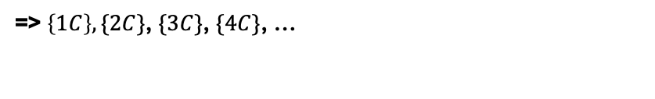
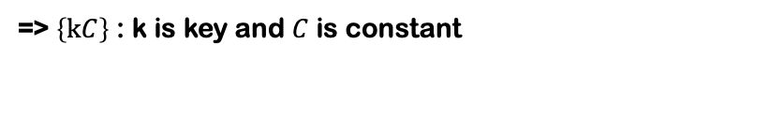
Multiplicative Hashing
{x} = x - ⌊x​⌋
Circumference is 1
Divide the circle into M segments and mark the following points.
ex) M = 8
bin 2
bin 1
bin 3
bin 0
=> $\left\{1C\right\},\{2C\}$, $\{3C\}$, $\{4C\}$, …
=> $\left\{kC\right\}$ : k is key and $C$ is constant
bin 4
bin 7
=> Select the bin corresponding to the segment
bin 5
bin 6

Slide 30
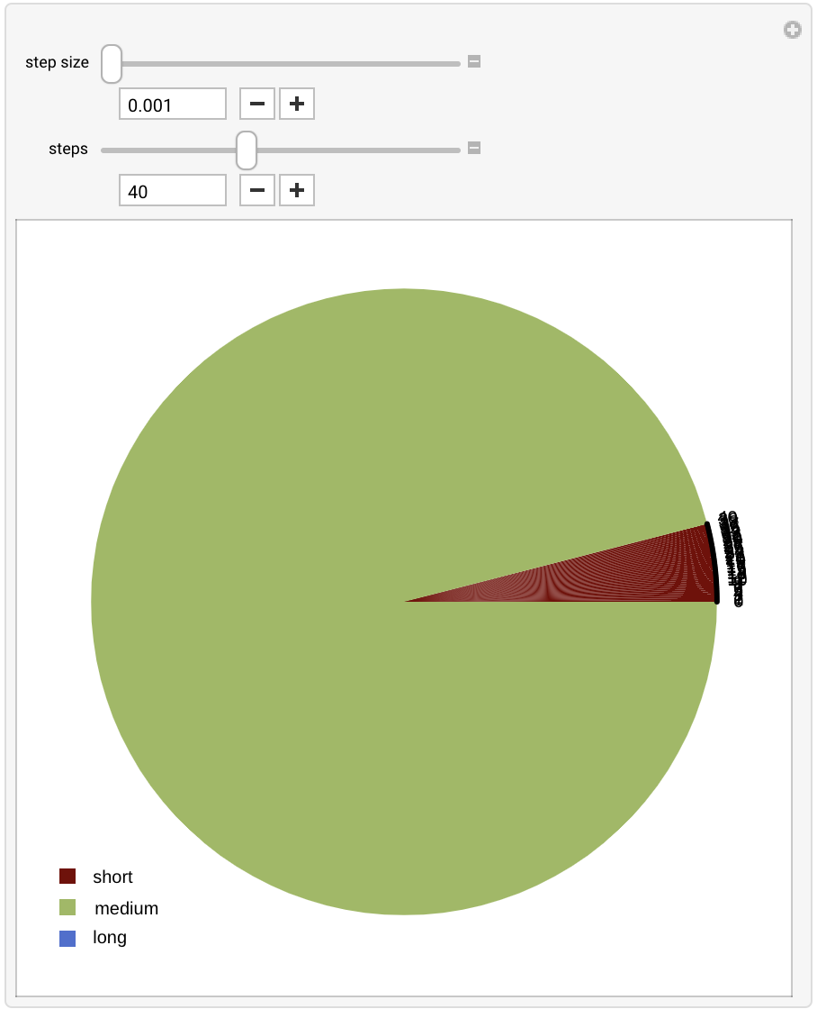
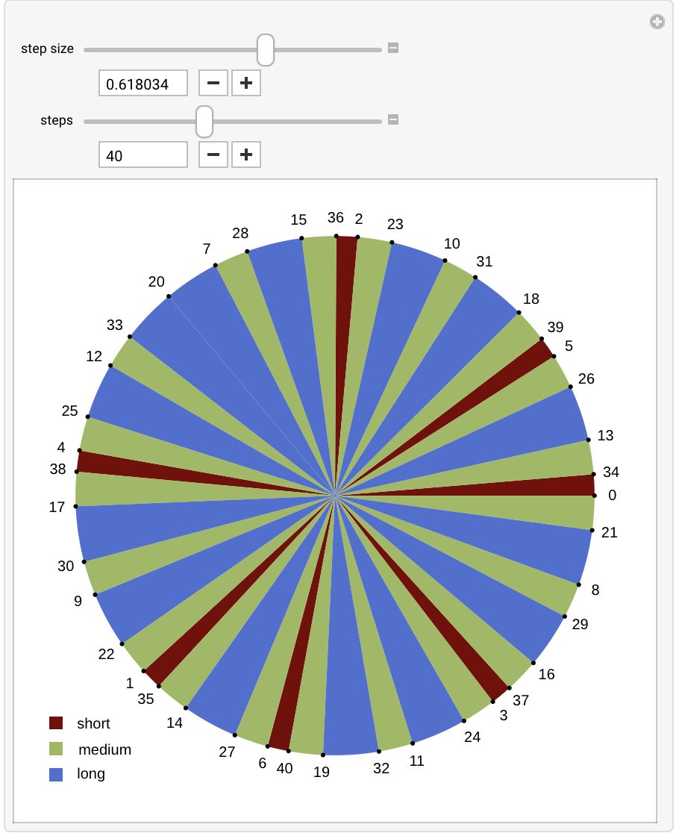
Multiplicative Hashing
https://demonstrations.wolfram.com/ThreeDistanceTheorem/
ex) {C} is Fibonacci Ratio

Slide 31
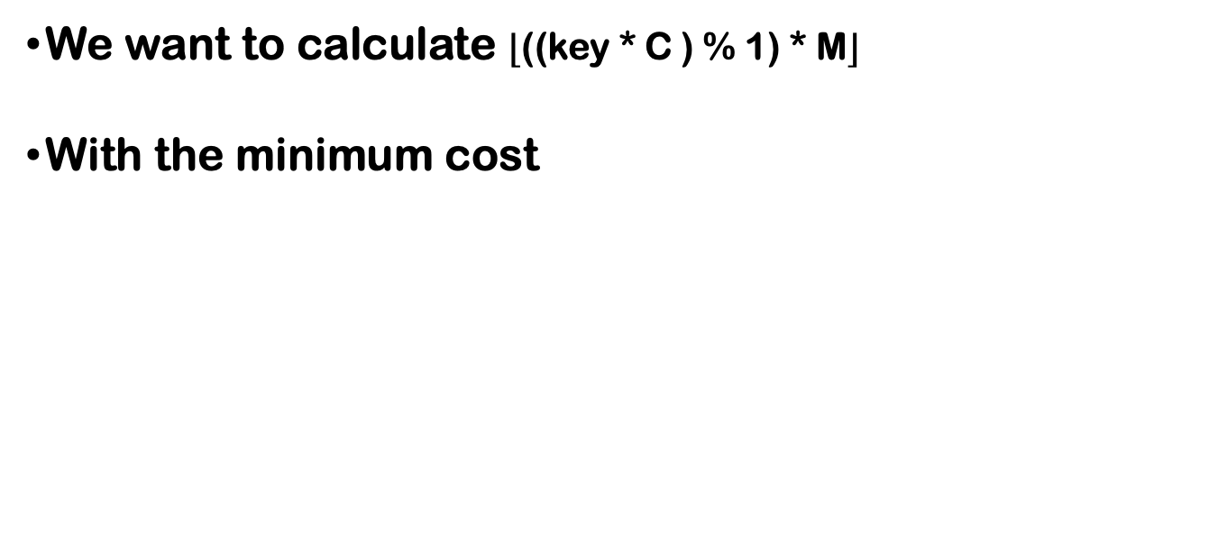
Multiplicative Hashing
We want to calculate ⌊((key * C ) % 1)​ * M⌋
With the minimum cost

Slide 32












Multiplicative Hashing
Let’s define a decimal number as an integer variable
Greater error compared to floating-point
Faster computation
31
30
29
28
27
26
5
4
3
2
1
0
1
0
0
1
1
1
…
1
1
1
0
0
1
$$2^{−1}$$
$$2^{−2}$$
$$2^{−3}$$
$$2^{−4}$$
$$2^{−5}$$
$$2^{−6}$$
$$2^{−27}$$
$$2^{−28}$$
$$2^{−29}$$
$$2^{−30}$$
$$2^{−31}$$
$$2^{−32}$$
ex) 0.6180339887
= (1 * 2^-1) + (1 * 2^-4) + (1 * 2^-5) + … + (1 * 2^-28) + (1 * 2^-29) + (1 * 2^-32)

Slide 33


















Multiplicative Hashing
Imagine there’s an integer part
But in reality, only the fractional part is stored as an int (32bit)
5
4
3
2
1
0
31
30
29
28
27
26
5
4
3
2
1
0
0
0
0
0
1
1
1
0
0
1
1
1
…
1
1
1
0
0
1
$$2^{5}$$
$$2^{4}$$
$$2^{3}$$
$$2^{2}$$
$$2^{1}$$
$$2^{0}$$
$$2^{−1}$$
$$2^{−2}$$
$$2^{−3}$$
$$2^{−4}$$
$$2^{−5}$$
$$2^{−6}$$
$$2^{−27}$$
$$2^{−28}$$
$$2^{−29}$$
$$2^{−30}$$
$$2^{−31}$$
$$2^{−32}$$
ex) 3.6180339887

Slide 34
Multiplicative Hashing
Let's multiply the constant by a key
The integer part of the result automatically disappears
=> ((key * C ) % 1)​
5
4
3
2
1
0
31
30
29
28
27
26
5
4
3
2
1
0
0
0
0
0
0
0
1
0
0
1
1
1
…
1
1
1
0
0
1
$$2^{5}$$
$$2^{4}$$
$$2^{3}$$
$$2^{2}$$
$$2^{1}$$
$$2^{0}$$
$$2^{−1}$$
$$2^{−2}$$
$$2^{−3}$$
$$2^{−4}$$
$$2^{−5}$$
$$2^{−6}$$
$$2^{−27}$$
$$2^{−28}$$
$$2^{−29}$$
$$2^{−30}$$
$$2^{−31}$$
$$2^{−32}$$

Slide 35

Multiplicative Hashing
Let's multiply the constant by a key
The integer part of the result automatically disappears
=> ((key * C ) % 1)​
ex) K = 2
5
4
3
2
1
0
31
30
29
28
27
26
5
4
3
2
1
0
0
0
0
0
0
0
1
0
0
1
1
1
…
1
1
1
0
0
1
$$2^{5}$$
$$2^{4}$$
$$2^{3}$$
$$2^{2}$$
$$2^{1}$$
$$2^{0}$$
$$2^{−1}$$
$$2^{−2}$$
$$2^{−3}$$
$$2^{−4}$$
$$2^{−5}$$
$$2^{−6}$$
$$2^{−27}$$
$$2^{−28}$$
$$2^{−29}$$
$$2^{−30}$$
$$2^{−31}$$
$$2^{−32}$$
x 2
x 2
x 2
x 2
x 2
x 2
x 2
x 2
x 2
x 2
x 2
x 2

Slide 36
Multiplicative Hashing
Let's multiply the constant by a key
The integer part of the result automatically disappears
=> ((key * C ) % 1)​
ex) K = 5 = 2^2 + 2^0
5
4
3
2
1
0
31
30
29
28
27
26
5
4
3
2
1
0
0
0
0
0
0
0
1
0
0
1
1
1
…
1
1
1
0
0
1
$$2^{5}$$
$$2^{4}$$
$$2^{3}$$
$$2^{2}$$
$$2^{1}$$
$$2^{0}$$
$$2^{−1}$$
$$2^{−2}$$
$$2^{−3}$$
$$2^{−4}$$
$$2^{−5}$$
$$2^{−6}$$
$$2^{−27}$$
$$2^{−28}$$
$$2^{−29}$$
$$2^{−30}$$
$$2^{−31}$$
$$2^{−32}$$
x K
x K
x K
x K
x K
x K
x K
x K
x K
x K
x K
x K

Slide 37

Multiplicative Hashing
Let's multiply the M
The integer part of the result automatically disappears (?)
=> ⌊((key * C ) % 1)​ * M⌋
ex) M = 9
5
4
3
2
1
0
31
30
29
28
27
26
5
4
3
2
1
0
0
0
0
0
0
0
1
1
1
0
1
0
…
1
0
0
1
0
0
$$2^{5}$$
$$2^{4}$$
$$2^{3}$$
$$2^{2}$$
$$2^{1}$$
$$2^{0}$$
$$2^{−1}$$
$$2^{−2}$$
$$2^{−3}$$
$$2^{−4}$$
$$2^{−5}$$
$$2^{−6}$$
$$2^{−27}$$
$$2^{−28}$$
$$2^{−29}$$
$$2^{−30}$$
$$2^{−31}$$
$$2^{−32}$$
x 9
x 9
x 9
x 9
x 9
x 9
x 9
x 9
x 9
x 9
x 9
x 9

Slide 38
Multiplicative Hashing
Let's set M as a power of 2 (M = 2^m)
ex) M = 2^6
These bits become the integer part
5
4
3
2
1
0
31
30
29
28
27
26
5
4
3
2
1
0
0
0
0
0
0
0
1
1
1
0
1
0
…
1
0
0
1
0
0
$$2^{5}$$
$$2^{4}$$
$$2^{3}$$
$$2^{2}$$
$$2^{1}$$
$$2^{0}$$
$$2^{−1}$$
$$2^{−2}$$
$$2^{−3}$$
$$2^{−4}$$
$$2^{−5}$$
$$2^{−6}$$
$$2^{−27}$$
$$2^{−28}$$
$$2^{−29}$$
$$2^{−30}$$
$$2^{−31}$$
$$2^{−32}$$
x 2^6
x 2^6
x 2^6
x 2^6
x 2^6
x 2^6
x 2^6
x 2^6
x 2^6
x 2^6
x 2^6
x 2^6
left shift (6bit)

Slide 39
Multiplicative Hashing
Let's set M as a power of 2 (M = 2^m)
Then we can calculate the formula as (Key * C) >> (32 – m)
ex) M = 2^6
These bits become the integer part
5
4
3
2
1
0
31
30
29
28
27
26
5
4
3
2
1
0
0
0
0
0
0
0
1
1
1
0
1
0
…
1
0
0
1
0
0
$$2^{5}$$
$$2^{4}$$
$$2^{3}$$
$$2^{2}$$
$$2^{1}$$
$$2^{0}$$
$$2^{−1}$$
$$2^{−2}$$
$$2^{−3}$$
$$2^{−4}$$
$$2^{−5}$$
$$2^{−6}$$
$$2^{−27}$$
$$2^{−28}$$
$$2^{−29}$$
$$2^{−30}$$
$$2^{−31}$$
$$2^{−32}$$
x 2^6
x 2^6
x 2^6
x 2^6
x 2^6
x 2^6
x 2^6
x 2^6
x 2^6
x 2^6
x 2^6
x 2^6
>> (32 – 6)
left shift (6bit)

Slide 40
Hash Functions
MurmurHash
CityHash
CRC32
etc…

Slide 41
Thank You

