Slide 1
K-means and K-Nearest Neighbor
Kwangwoon University MI:RU Machine Learning Study
Team B

Slide 2
Contents
K-means
Algorithms
How to find the optimal K
Ploblems
K-nearest neighbor
Algorithms
How to find the optimal K
Ploblems

Slide 3
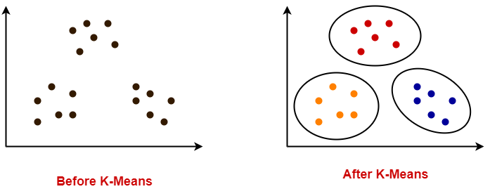
What algorithms is K-means?
Clustering
Unsupervised Learning

Slide 4
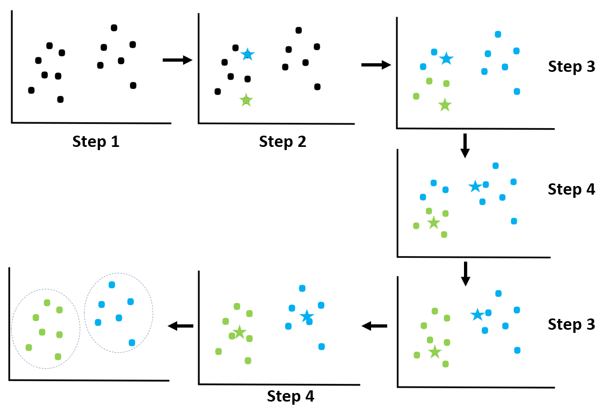
K-Means Clustering Algorithms
Step 1. Choose the number of clusters (K = 2)
Step 2. mark 2 data points randomly for 2 clusters.
[1]Kmeans_algorithms

Slide 5
K-Means Clustering Algorithms
Step 3. Assign each data points to the nearest centroid.
[1]Kmeans_algorithms

Slide 6
K-Means Clustering Algorithms
Step 4. Calculate the average of the data points belonging to each cluster and move its cluster centroid to the average location.
[1]Kmeans_algorithms

Slide 7
K-Means Clustering Algorithms
Step 5. Repeat Step 3 and Step 4 until cluster centroids do not change.
[1]Kmeans_algorithms

Slide 8
[1]Kmeans_algorithms

Slide 9
[2]kmeansAlgorithms

Slide 10
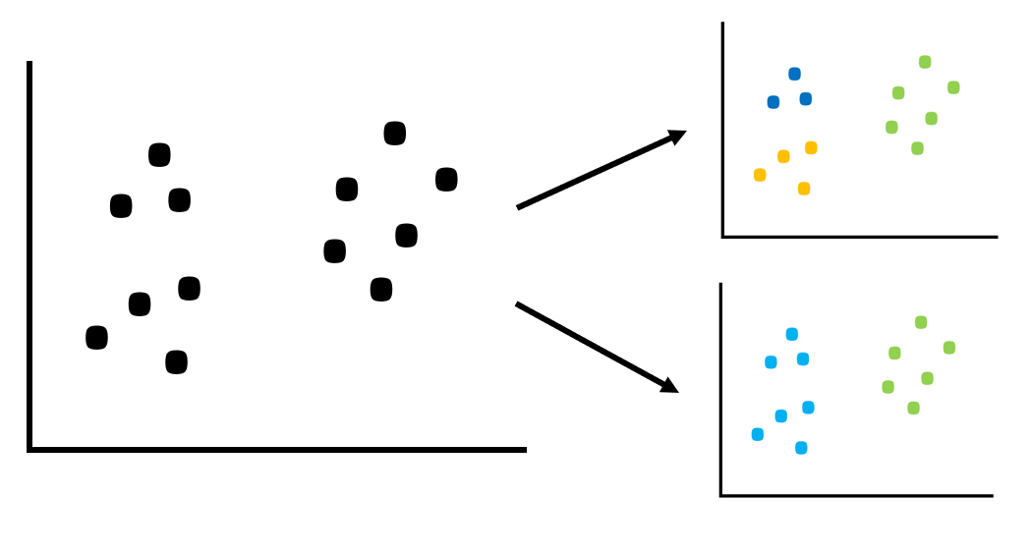
Problem How to choose the right number of Clusters

Slide 11
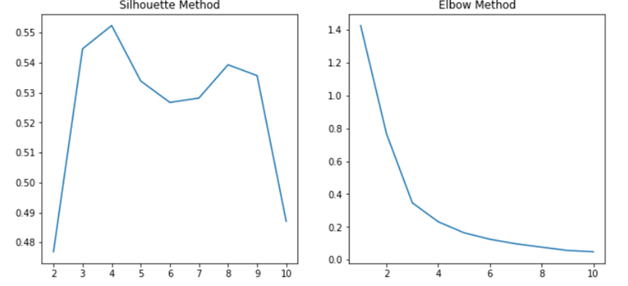
Elbow method
The sum of the squares of the distances of the points in the centroid of the cluster.
The sum is the minimum -> optimal K
But… ambiguous
[6]optimalK
Notes:
클러스터 중심에서 클러스터 내의 데이터들의 거리의 제곱합 (밀집도를 나타냄)

Slide 12
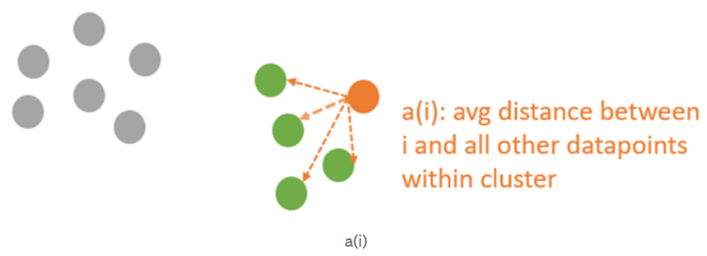
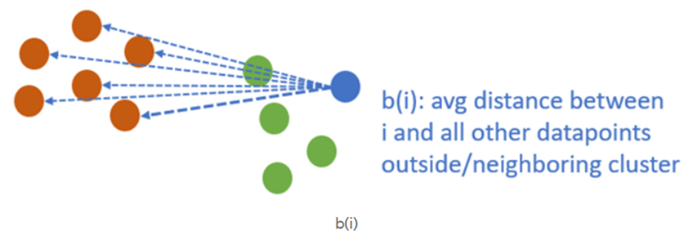



Silhouette method
-1 <= S(I) <= 1
*CI = number of data in cluster
d(i,j) = distance from i to j
[6]optimalK

Slide 13
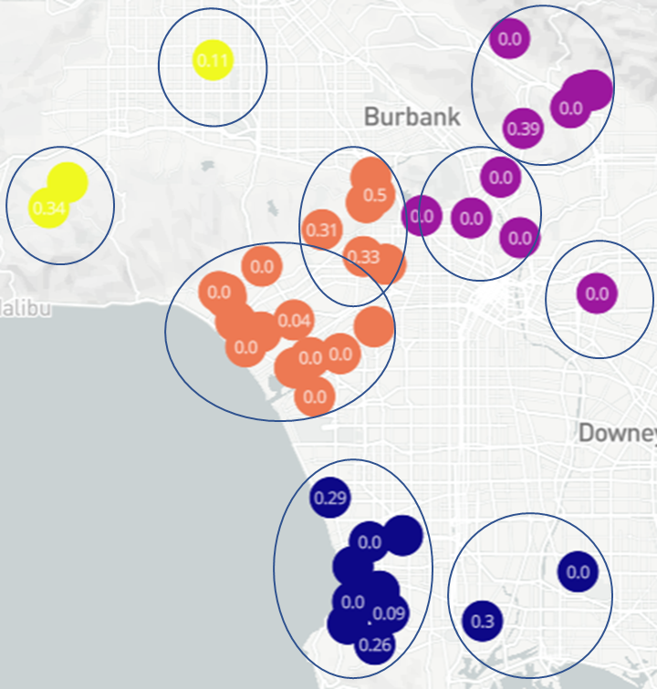
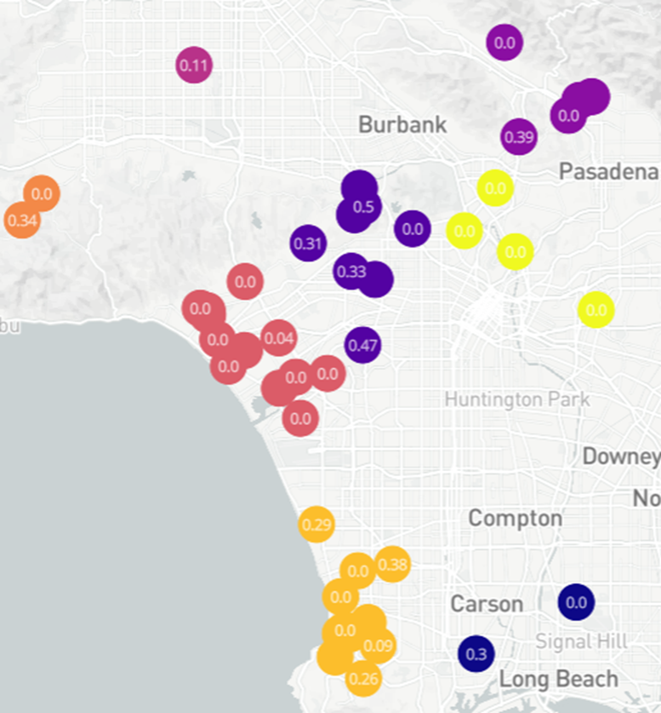
[6]optimalK

Slide 14
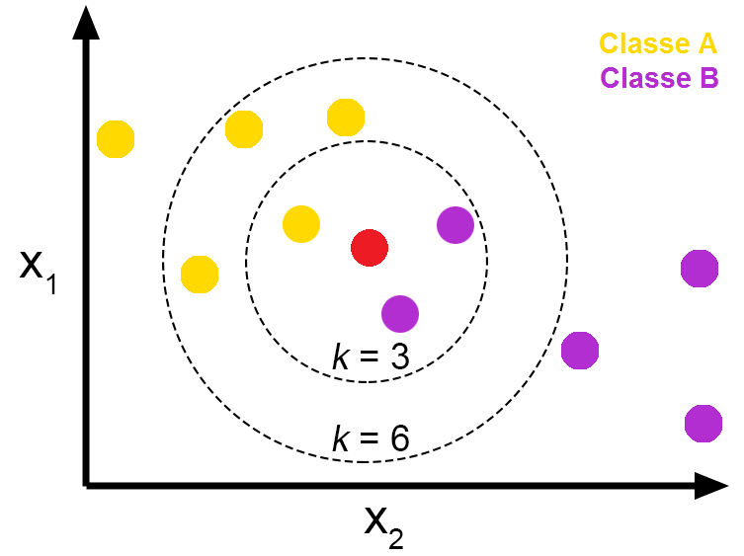
What algorithms is K-NearestNeighbor?
Classification: Predict by majority vote
Regression: Predict by mean value

Slide 15
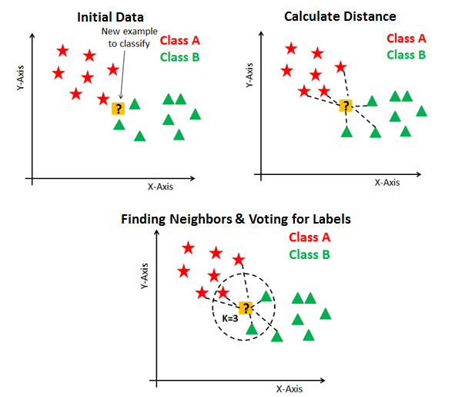
[4]K-NN_algorithm

Slide 16
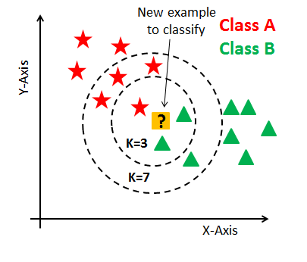
Problem How to choose the optimal K
[4]K-NN_algorithm

Slide 17
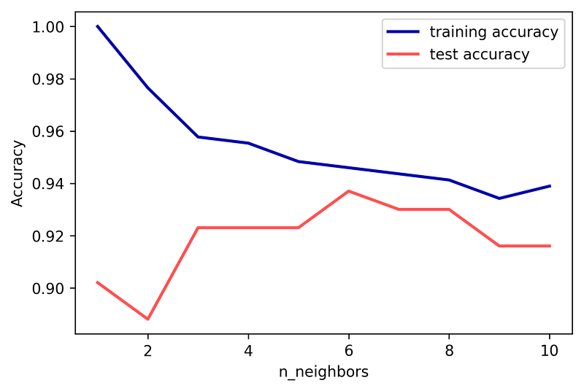
Find optimal K : Parameter tuning
[4]K-NN_algorithm

Slide 18
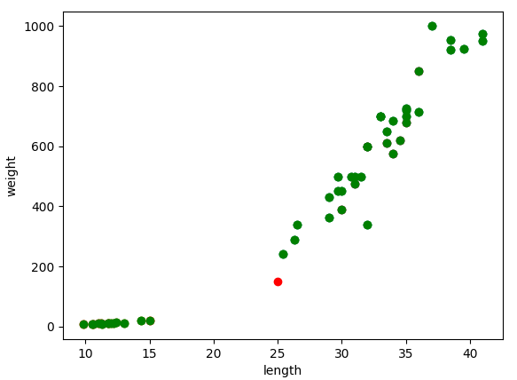
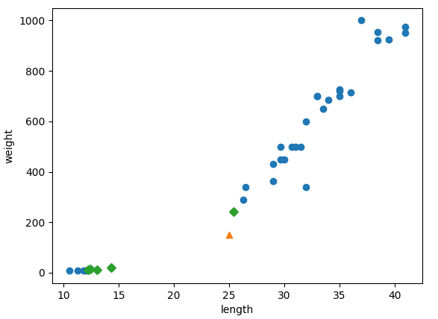
Problem2
(K=5)
Class B
Class A
[4]K-NN_algorithm

Slide 19
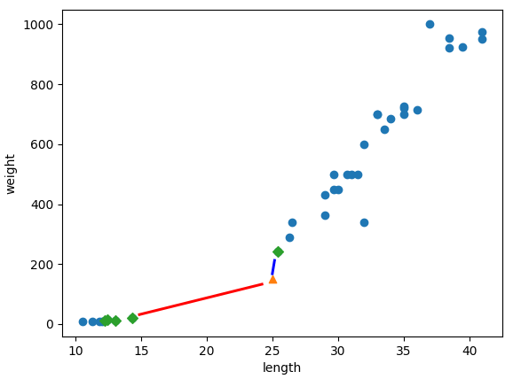
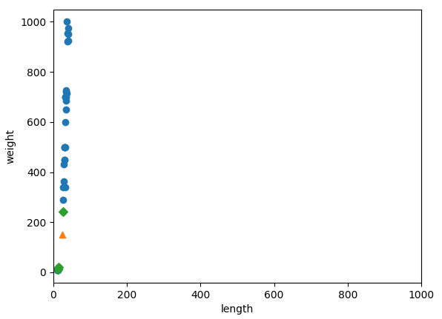
[4]K-NN_algorithm

Slide 20
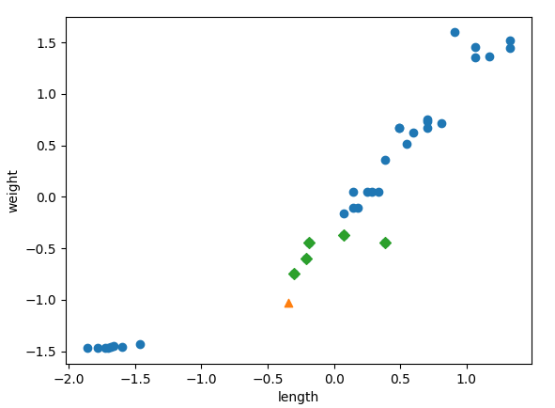
[4]K-NN_algorithm

Slide 21
Thanks!
Any questions?

