Slide 1
This file includes:
Simulation Results (Figure 1 Replication)
distribution of | RT – RT_g |

Slide 2
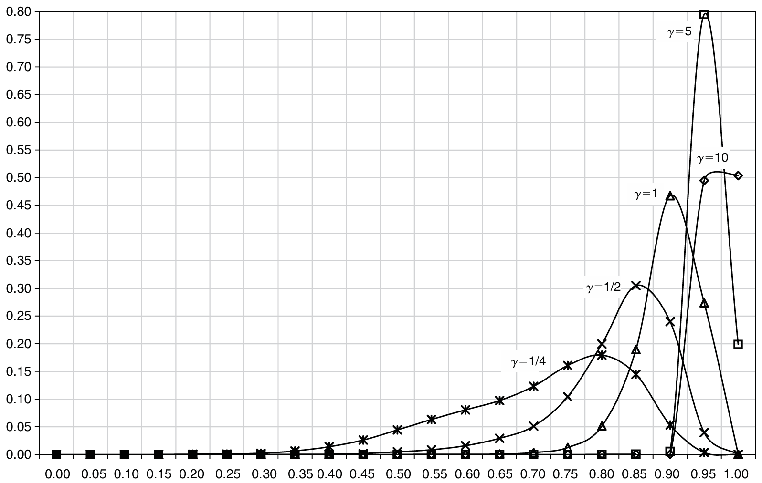
Simulation
25,000 subjects makes 50 choices

Slide 3
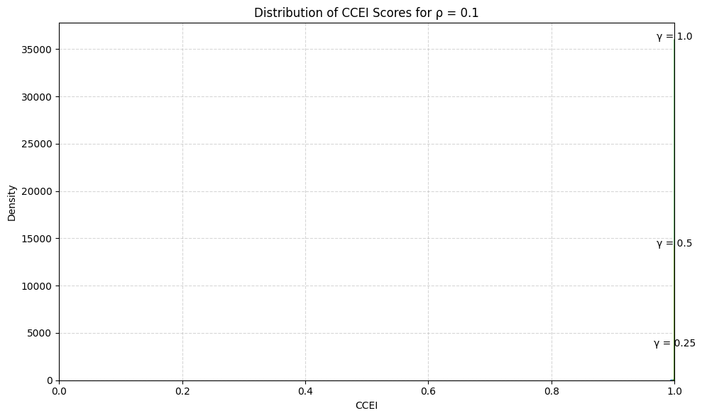
Simulation

Slide 4
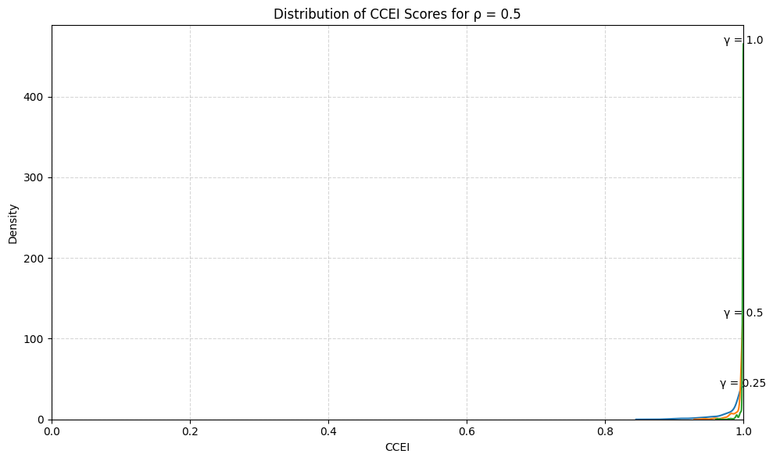
Simulation

Slide 5
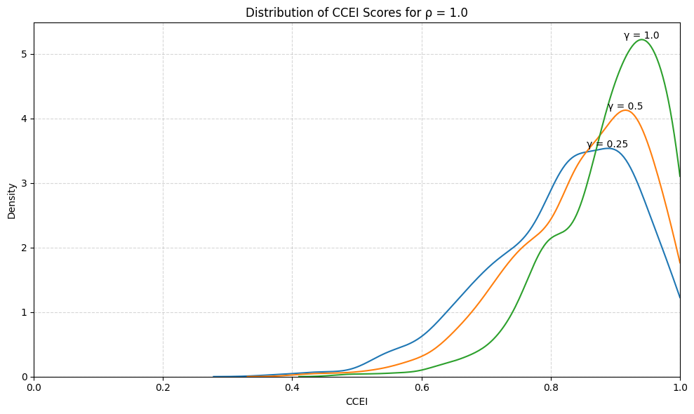
Simulation

Slide 6
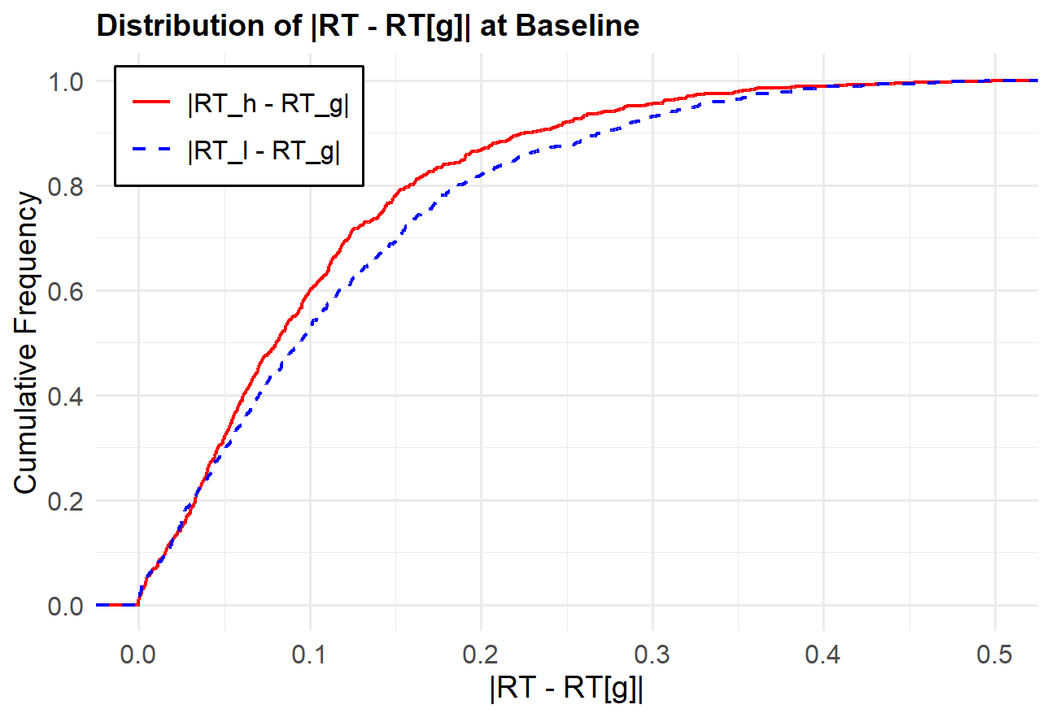
Graphs
high = RT 가 큰 사람을 의미

Slide 7
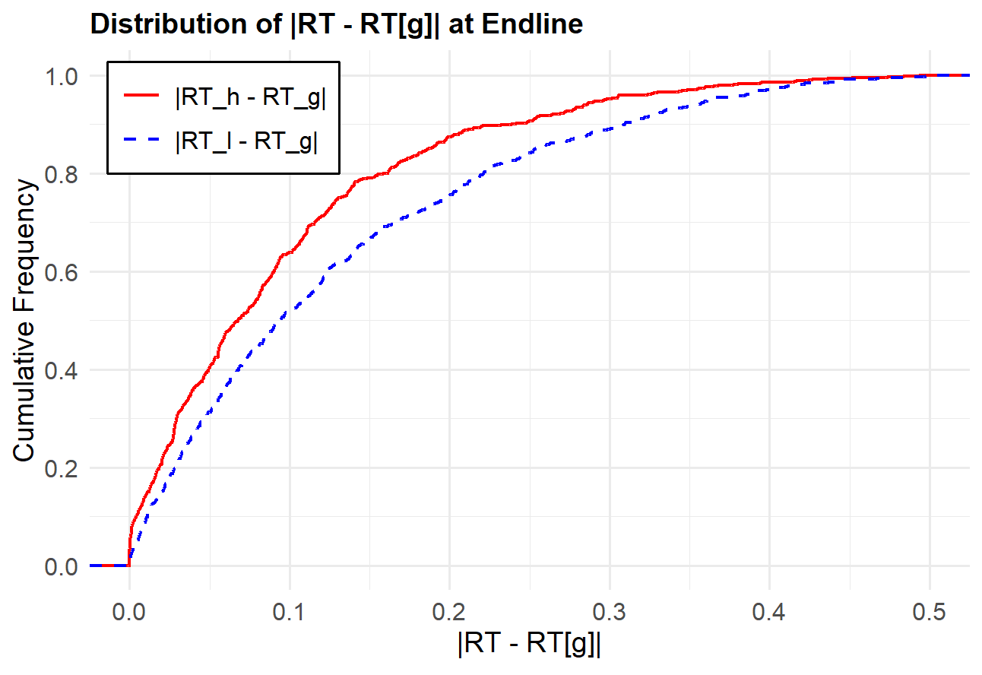
Graphs
high = RT 가 큰 사람을 의미

Slide 8
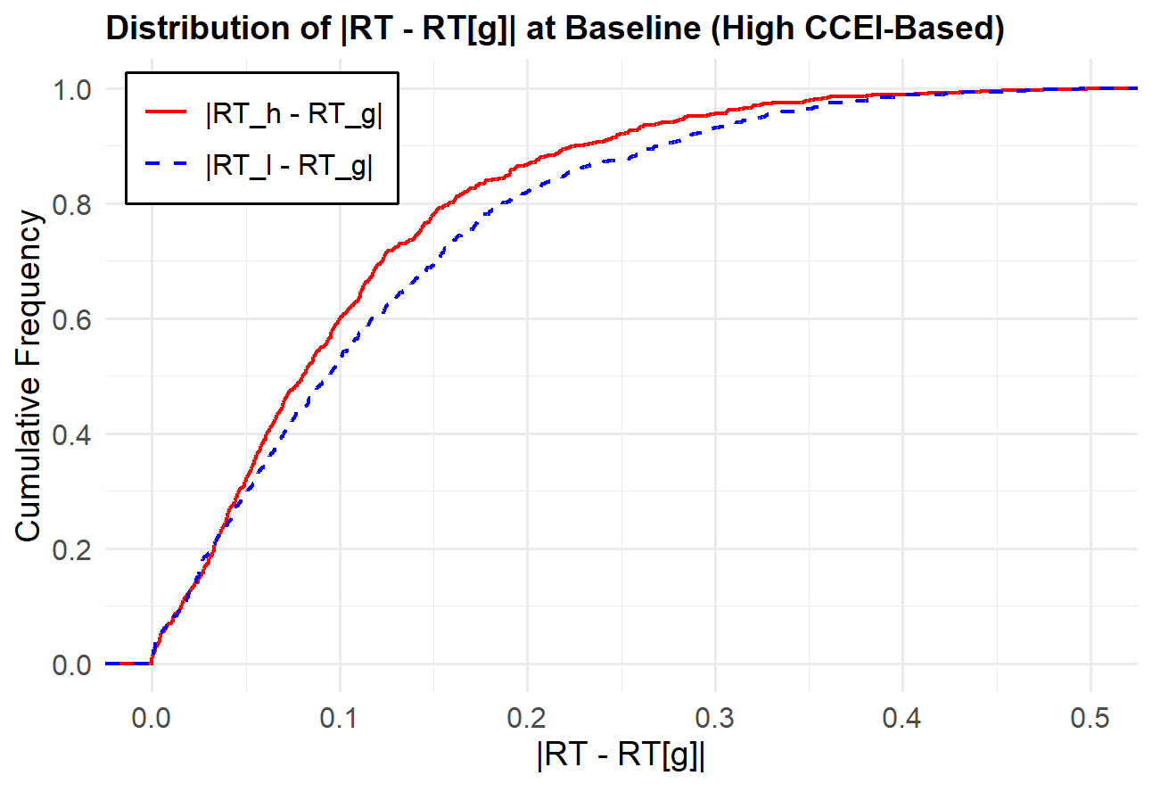
Graphs
high = CCEI 기준 high

Slide 9
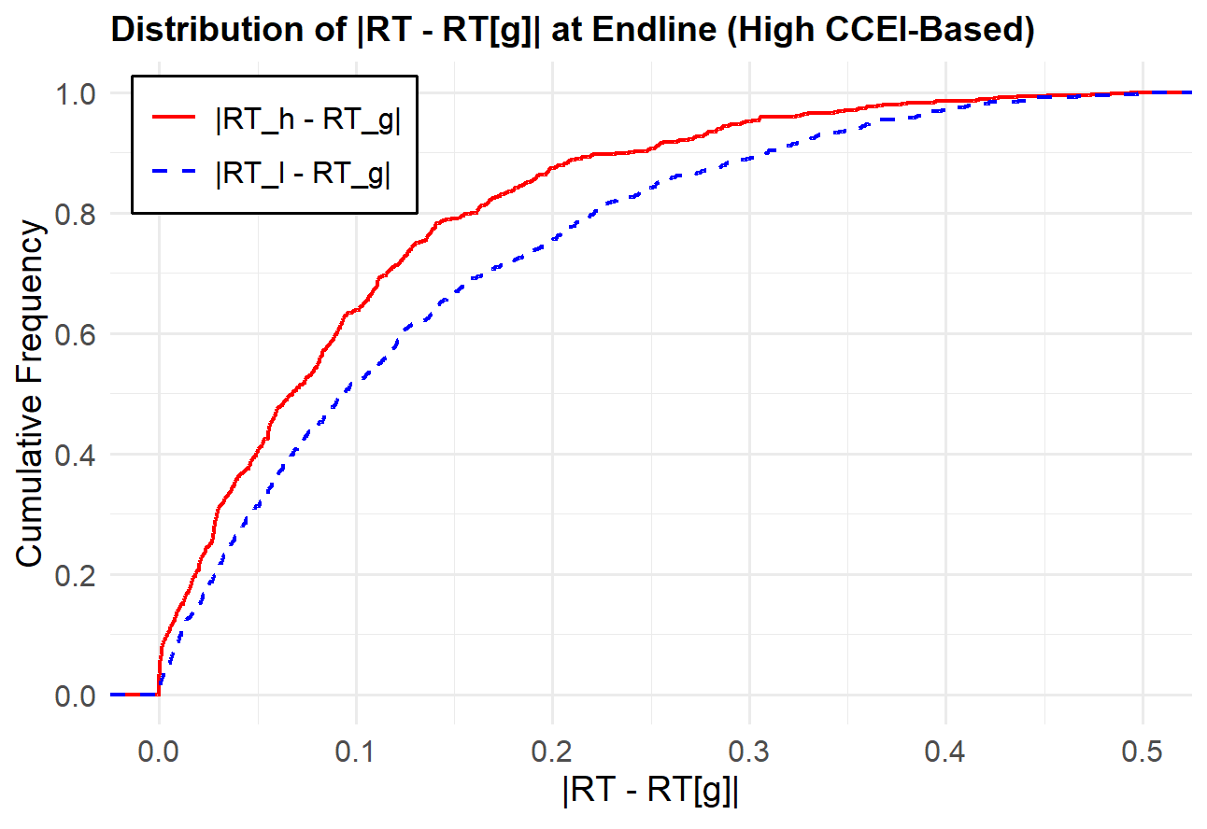
Graphs
high = CCEI 기준 high

