Slide 1
This file includes:
Balance Test
Reg CCEI_g on CCEI_max, CCEI_dist (Risk Tolerance 로 이름만 통일)
Reg CCEI_ig on High_Dummy
Reg I_ig on High_Dummy
Graphs (I_hg I_lg 이질성, CCEI_hg CCEI_lg 이질성)
Reg RT_ig on High_Dummy

Slide 2
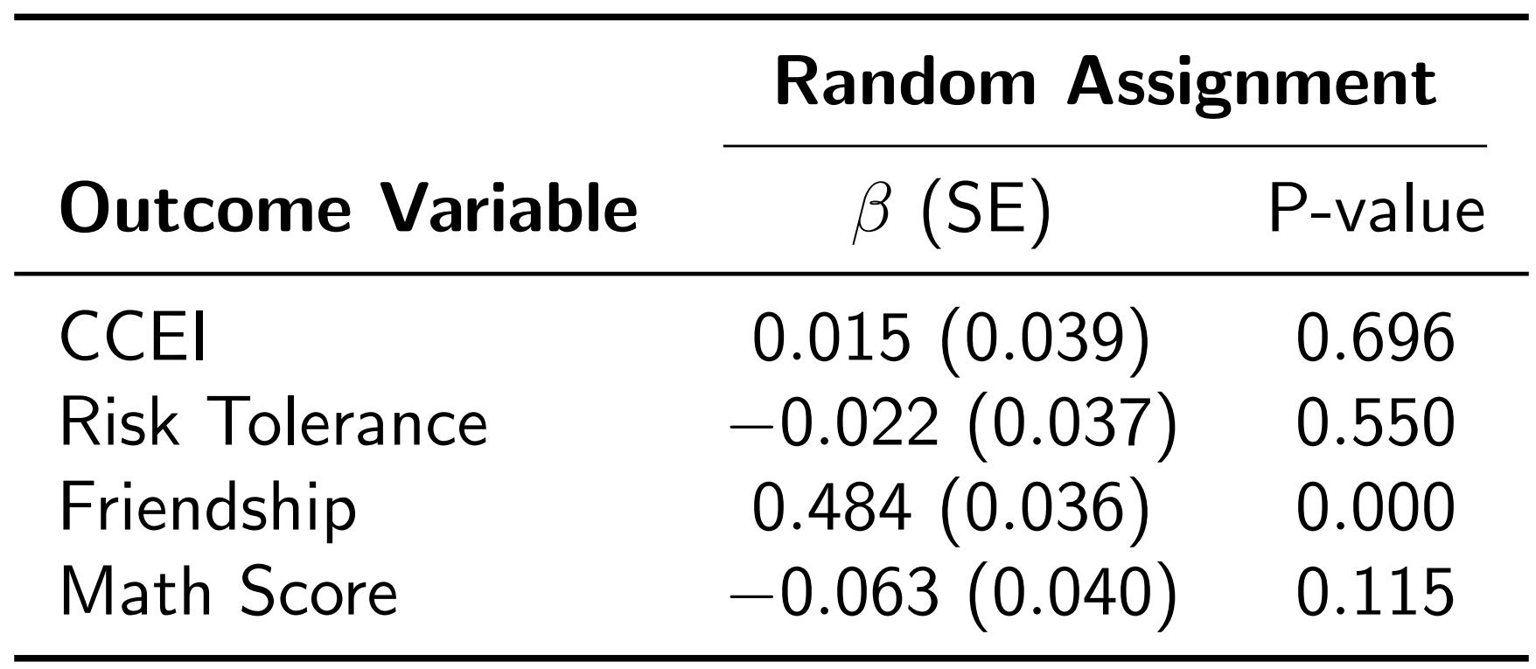
Balance Test

Slide 3
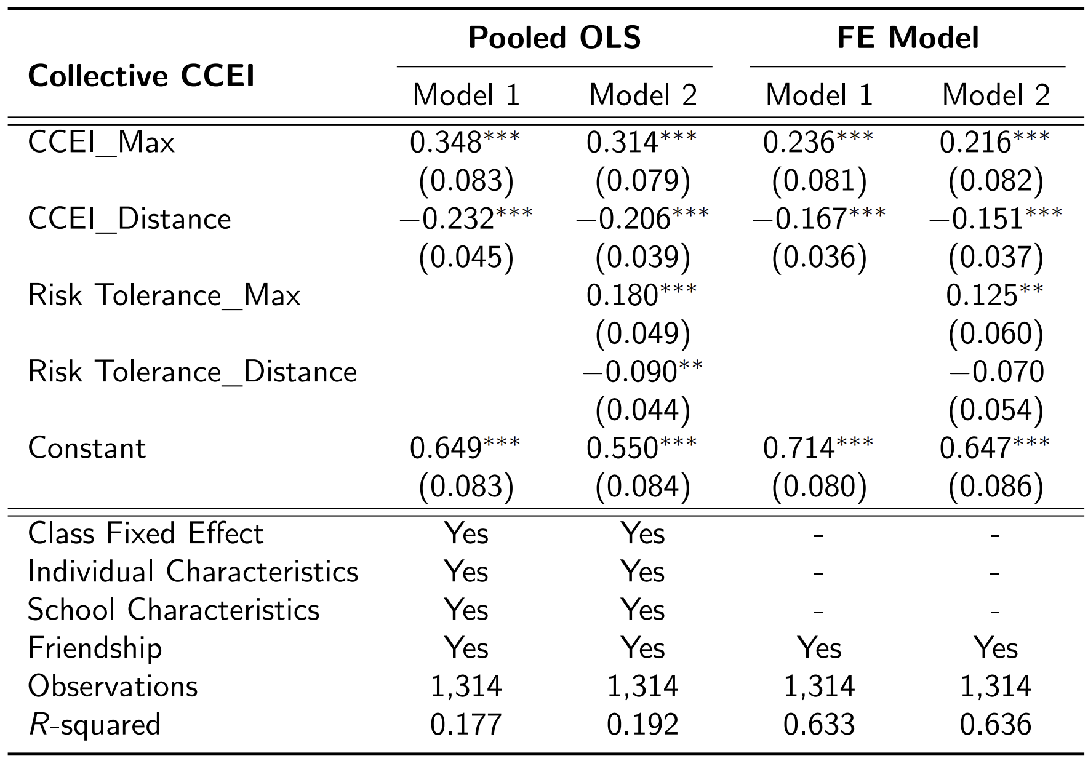
Risk Tolerance 로 용어만 수정

Slide 4
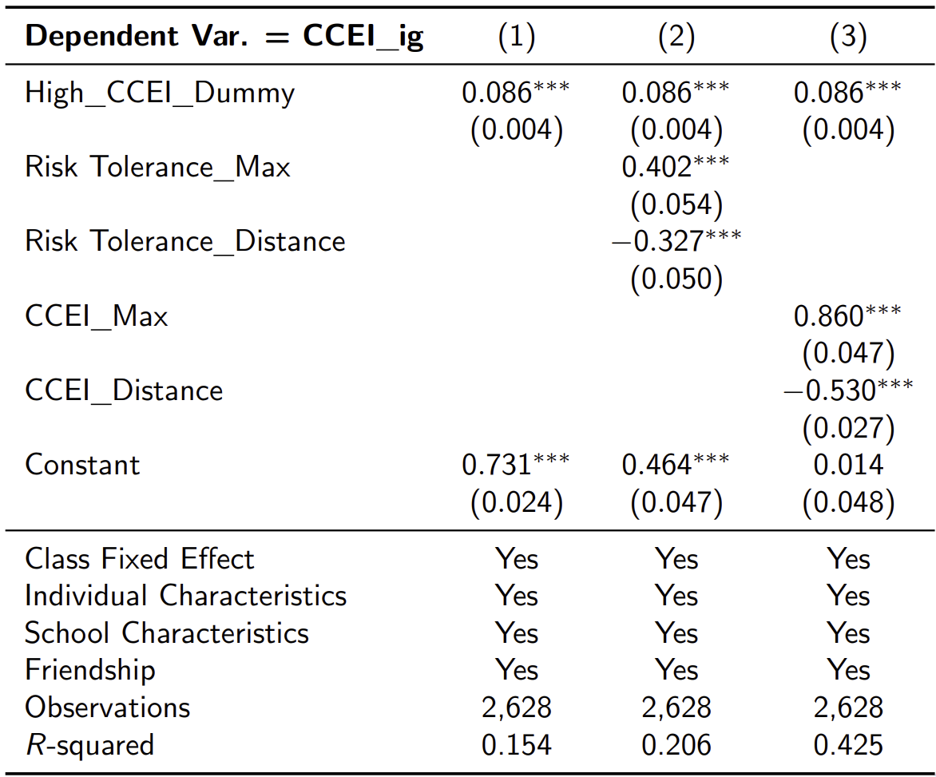
Reg CCEI_ig on High_Dummy

Slide 5
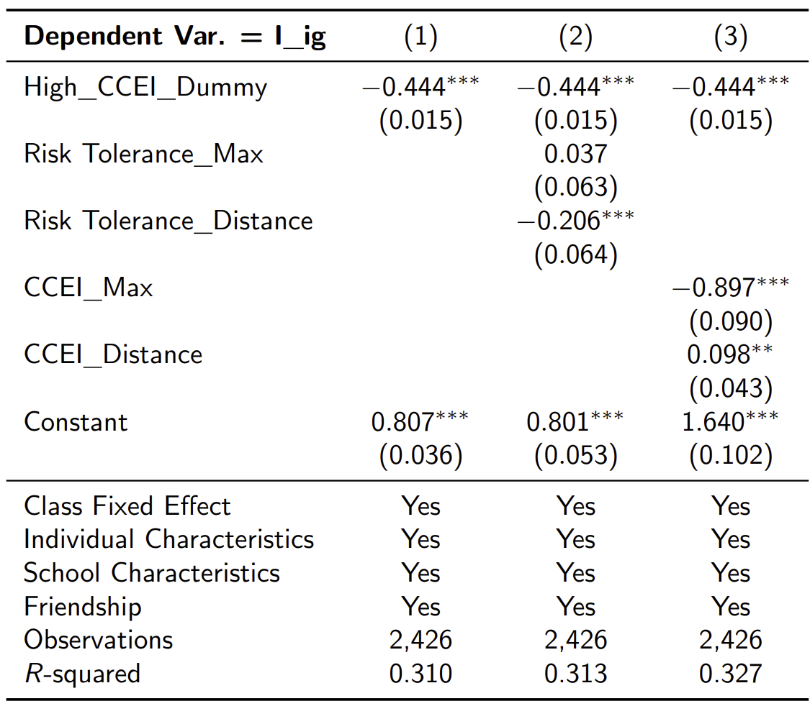
Reg I_ig on High_Dummy

Slide 6
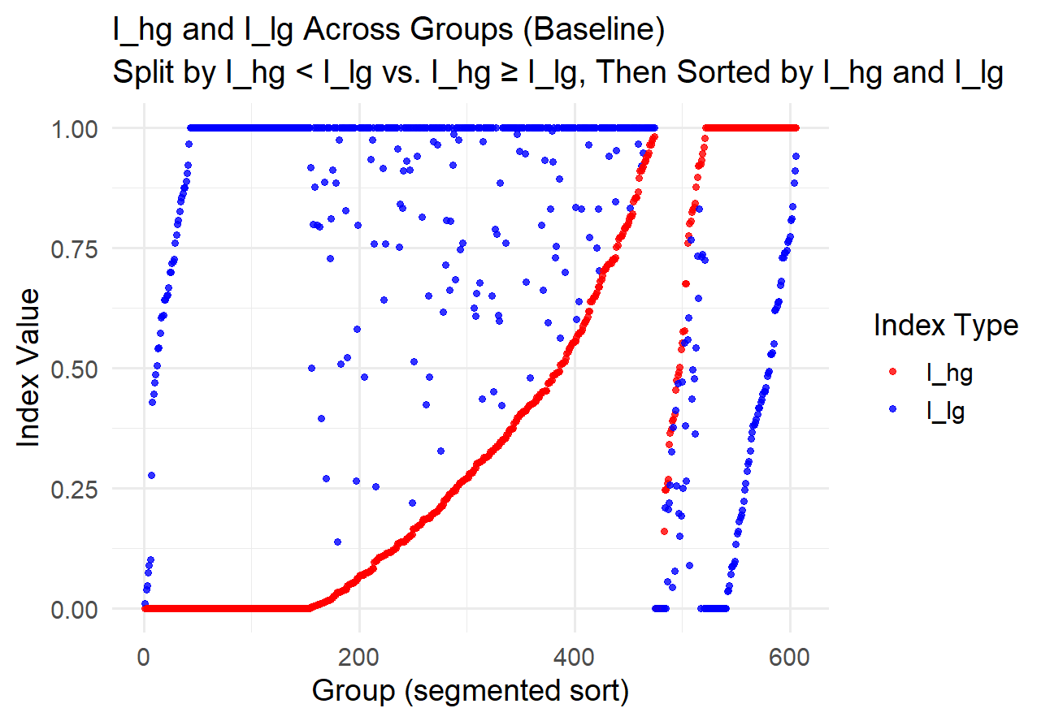
Graphs

Slide 7
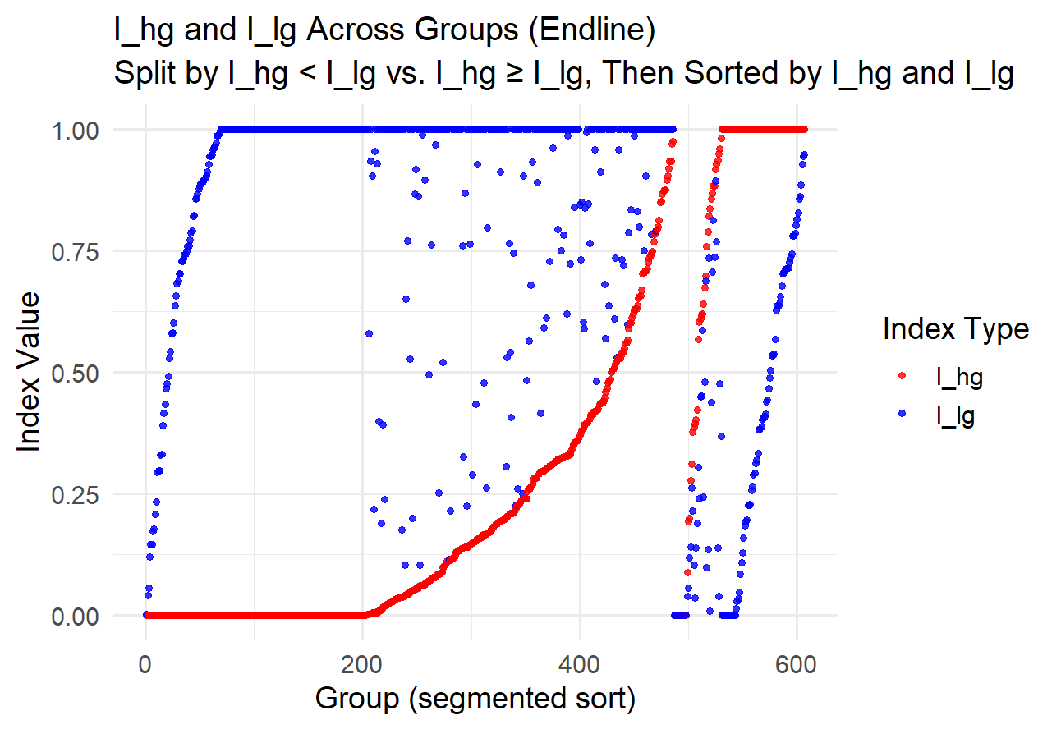
Graphs

Slide 8
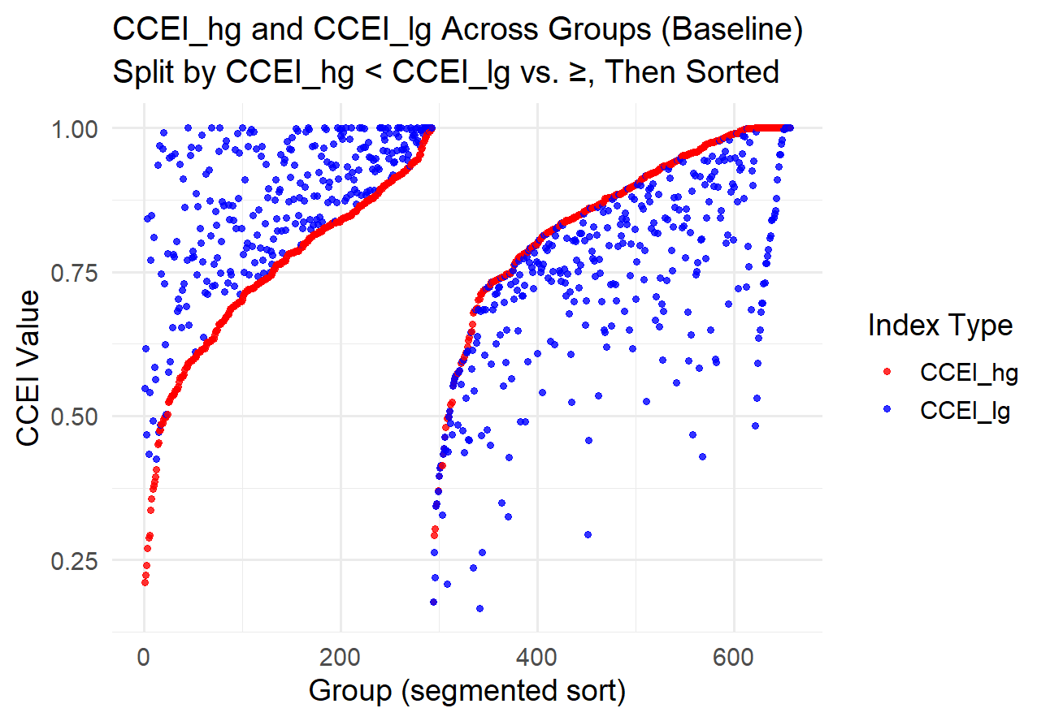
Graphs

Slide 9
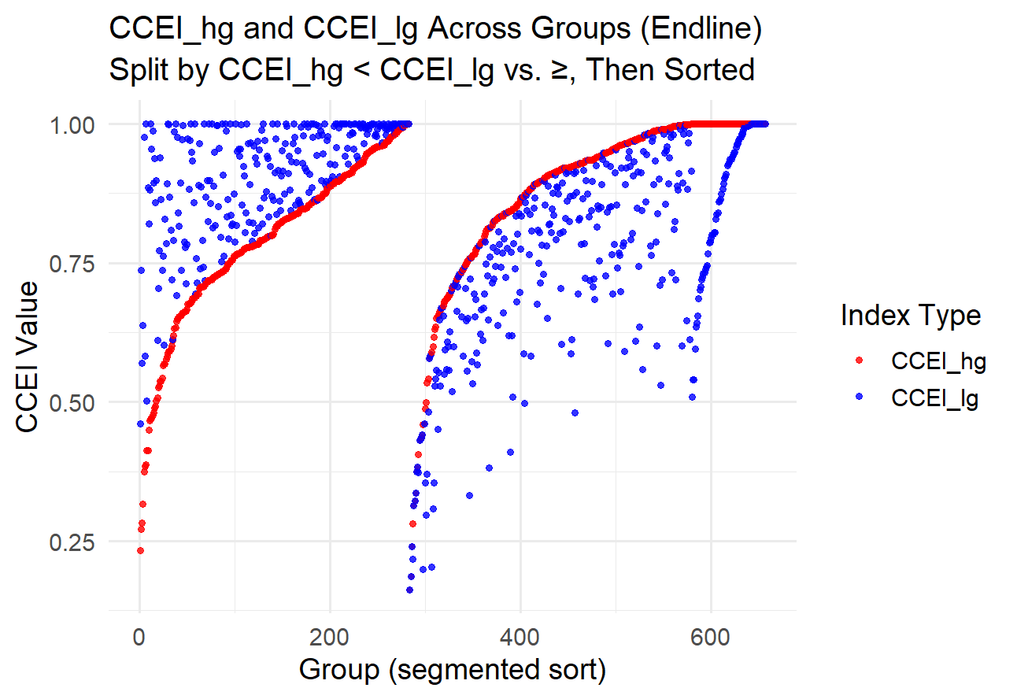
Graphs

Slide 10
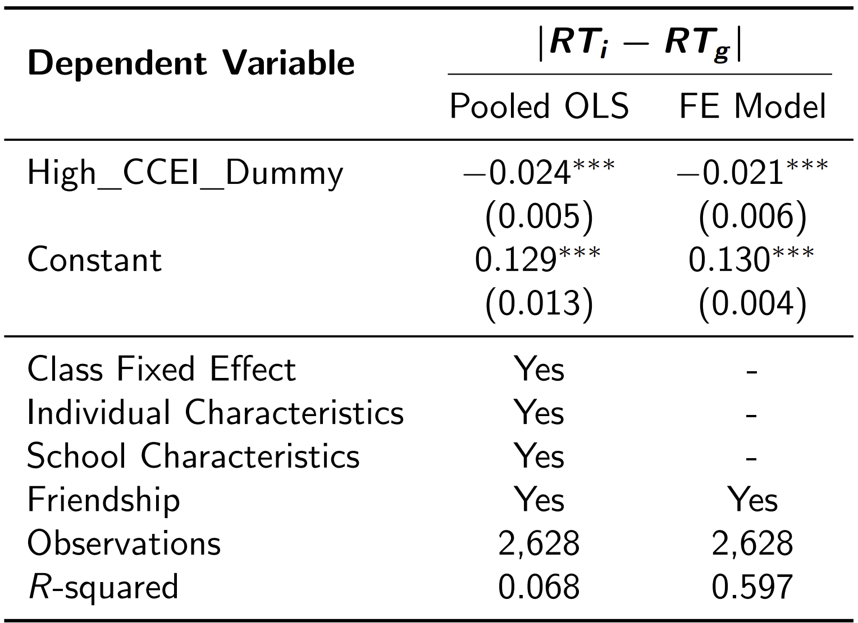
Reg RT_ig on High_Dummy

