Slide 1
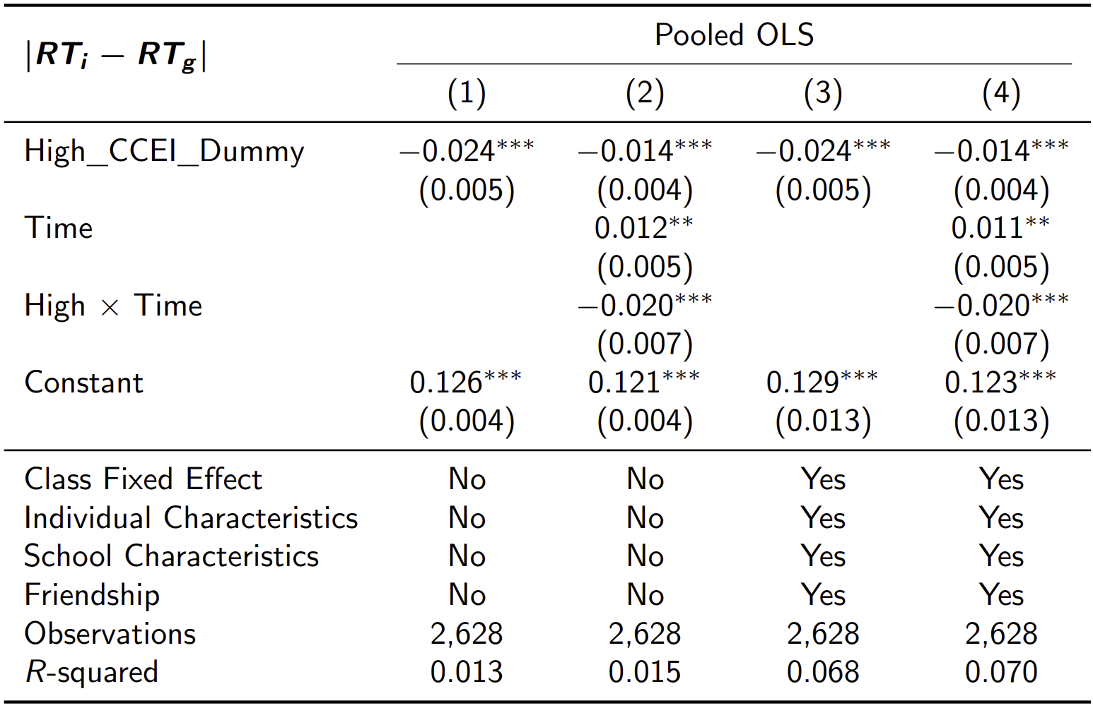
Risk Aversion

Slide 2
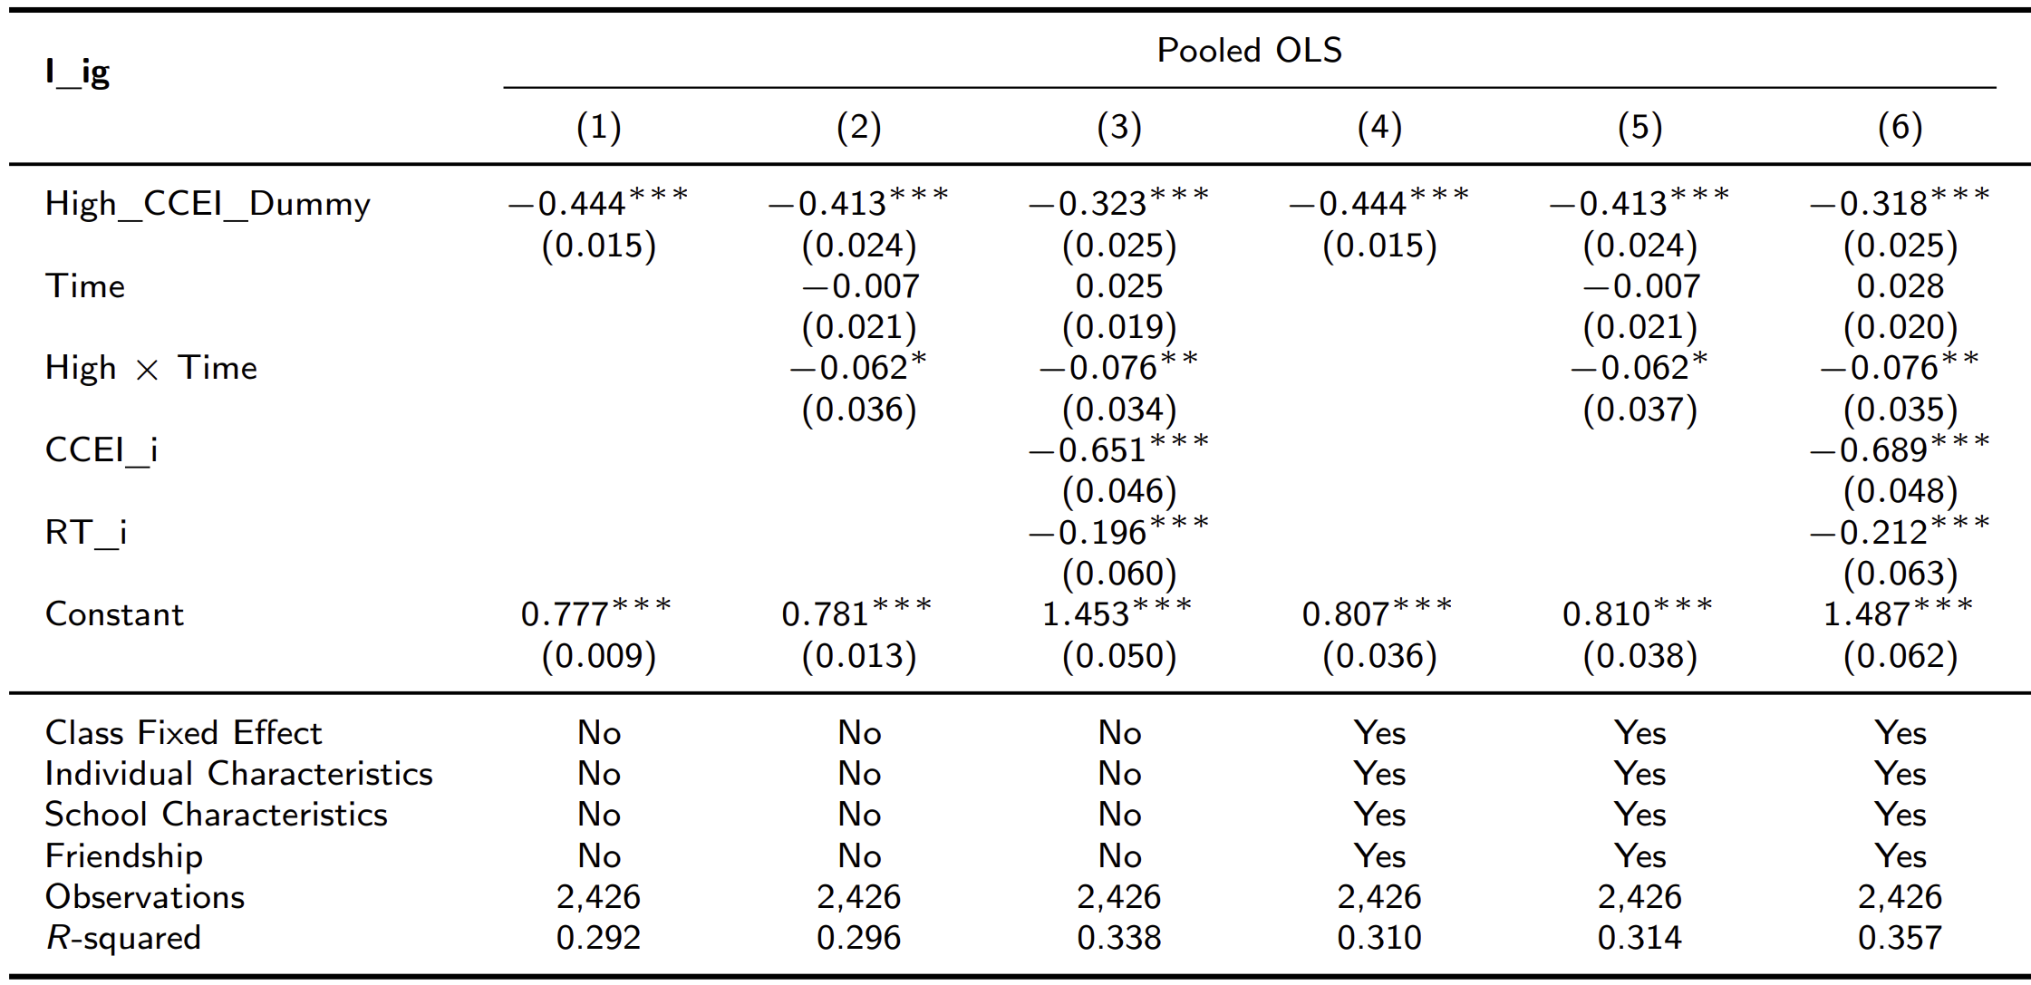
Revealed Influence of More Rational Individuals

Slide 3
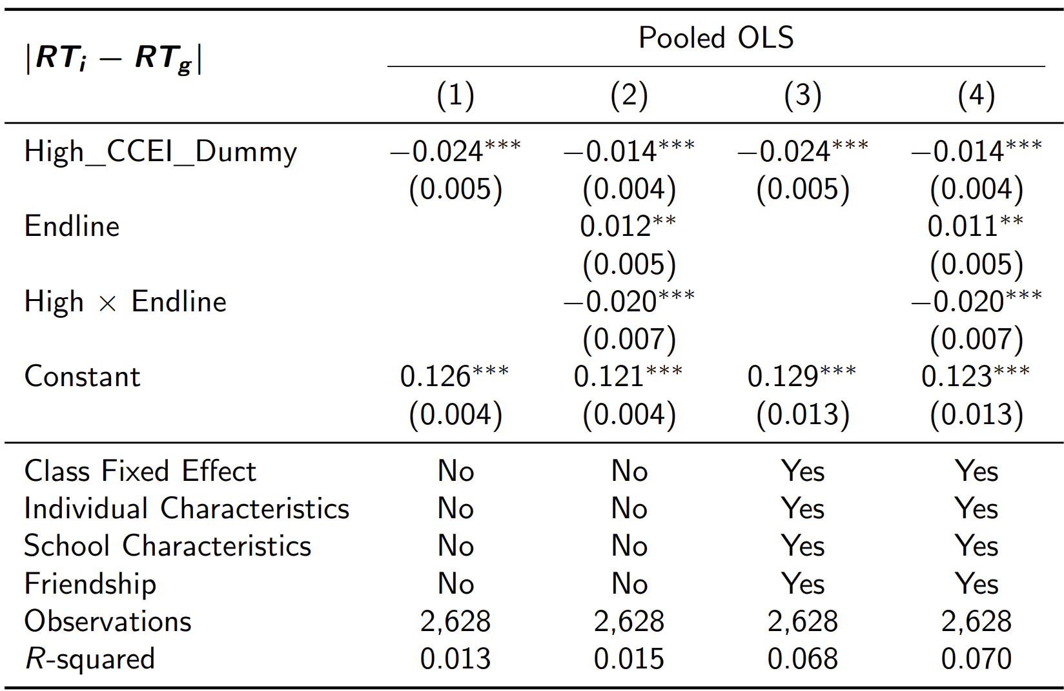
(Notation) Endline instead of Time

Slide 4
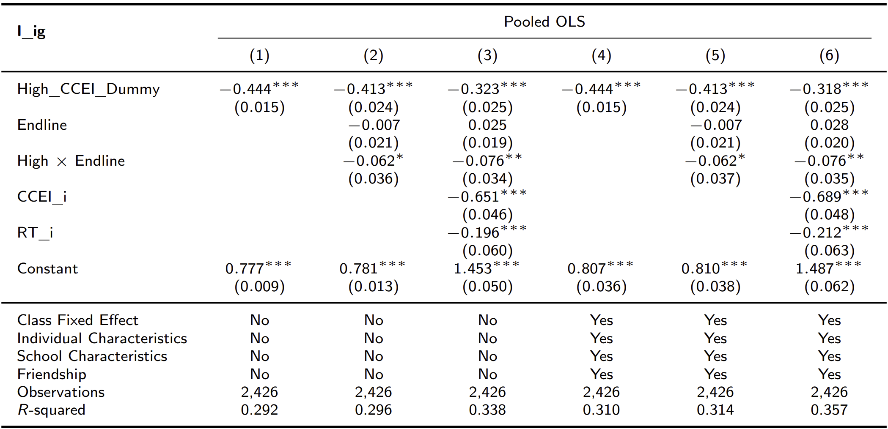
(Notation) Endline instead of Time

