Slide 1
Contents
This File Includes:
Pooled Regression Results (collective CCEI를 종속변수로, CCEI_max와 CCEI_dist를 독립변수로)
2) Random Effects, Fixed Effects Results
3) Hausman Test Results : 검정량이 크면, 모형이 Fixed Effects 쪽을 지지하고 있음을 의미합니다.
- FE 가 RE보다 더 적합하다는 Test 결과가 나왔습니다.

Slide 2
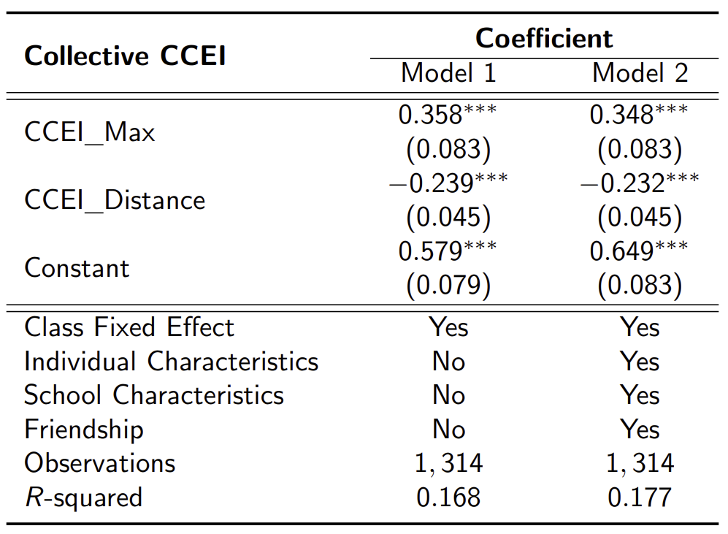
Regression Results

Slide 3
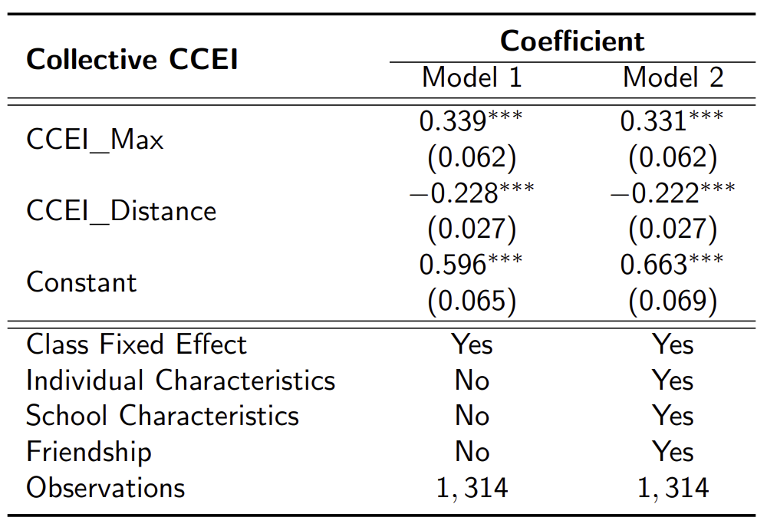
Regression Results

Slide 4
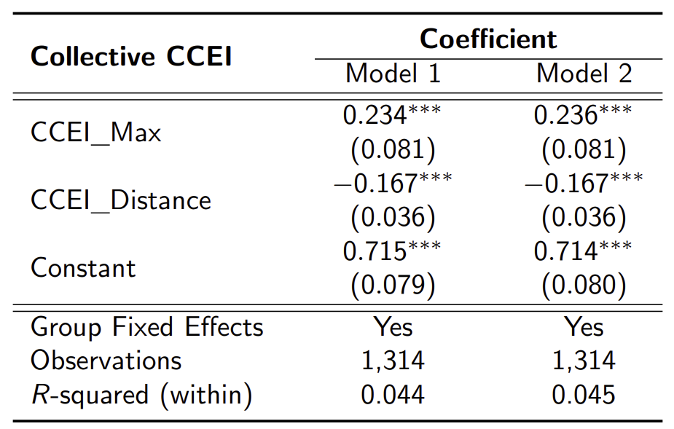
Regression Results

Slide 5

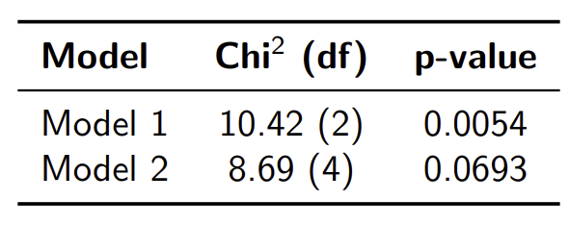
Regression Results
Note: Hausman tests compare fixed and random effects estimators. A significant result (low p-value) suggests that the random effects assumptions are violated, favoring the use of fixed effects.

