Slide 1
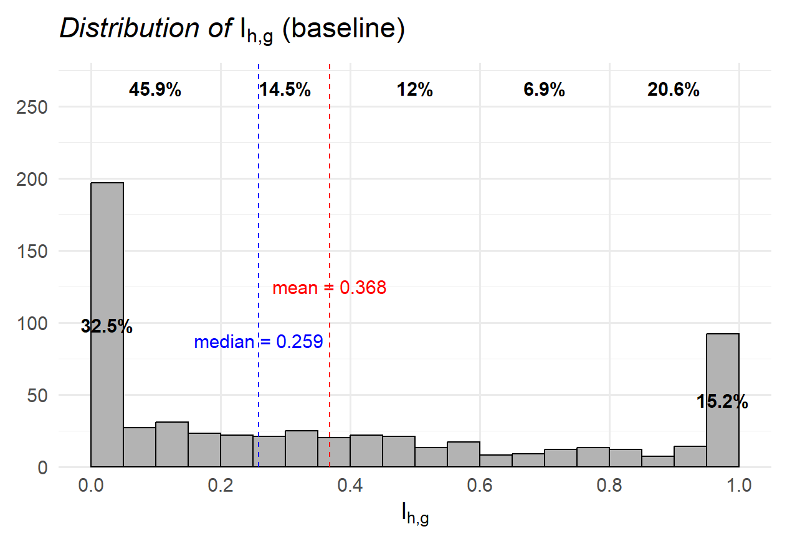
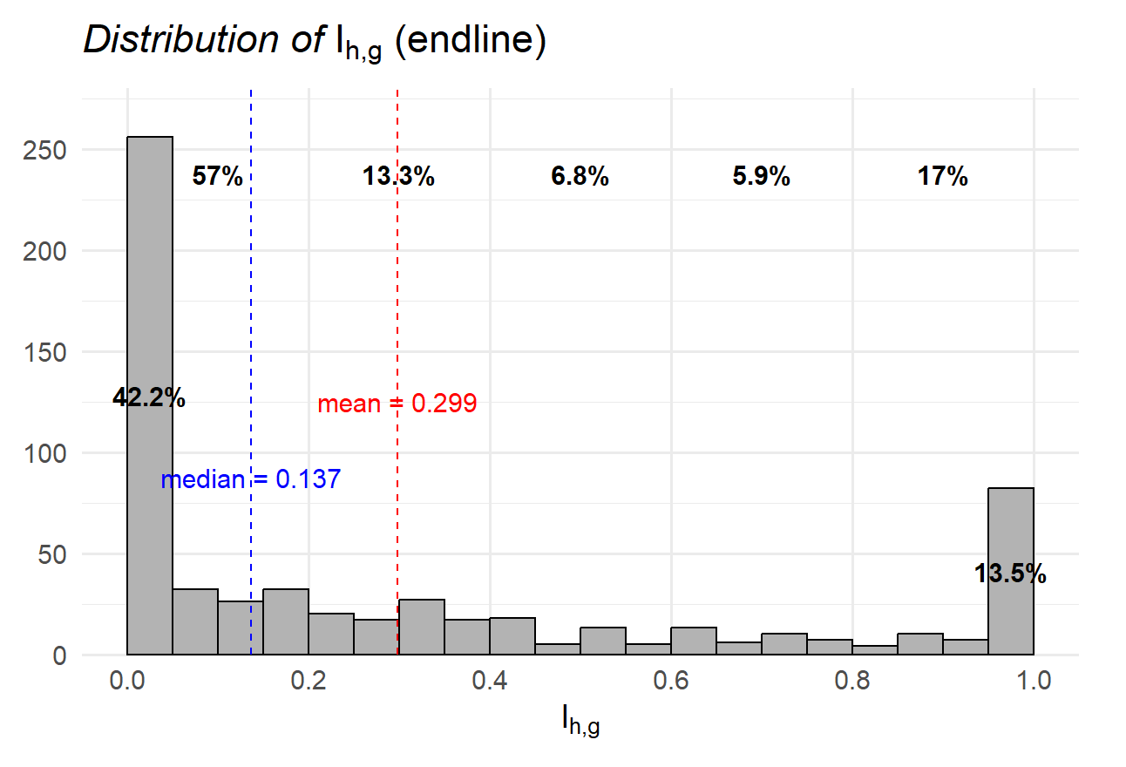
Revealed Preference Distance: More Rational Individual
기존 슬라이드 (비교를 위해)
The average of $I_{hg}$ is 0.368 in the baseline and 0.299 in the endline.

Slide 2
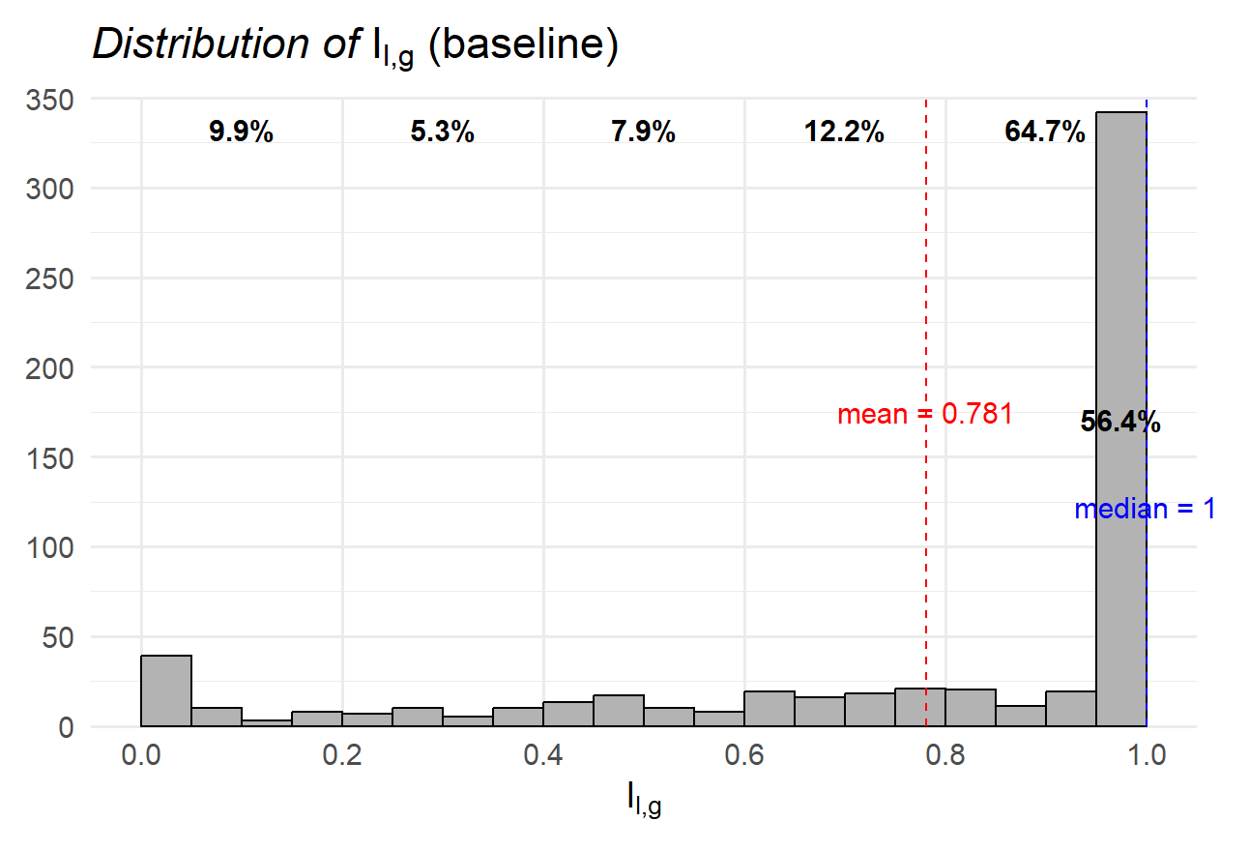
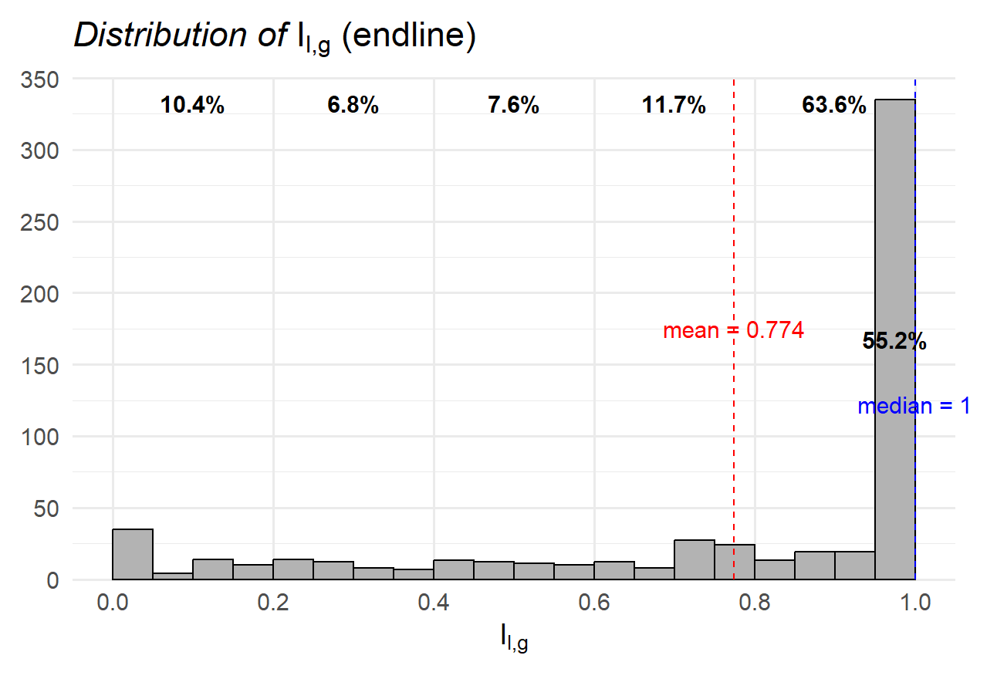
Revealed Preference Distance: Less Rational Individual
기존 슬라이드 (비교를 위해)
The average of $I_{lg}$ is 0.781 in the baseline and 0.774 in the endline.

Slide 3
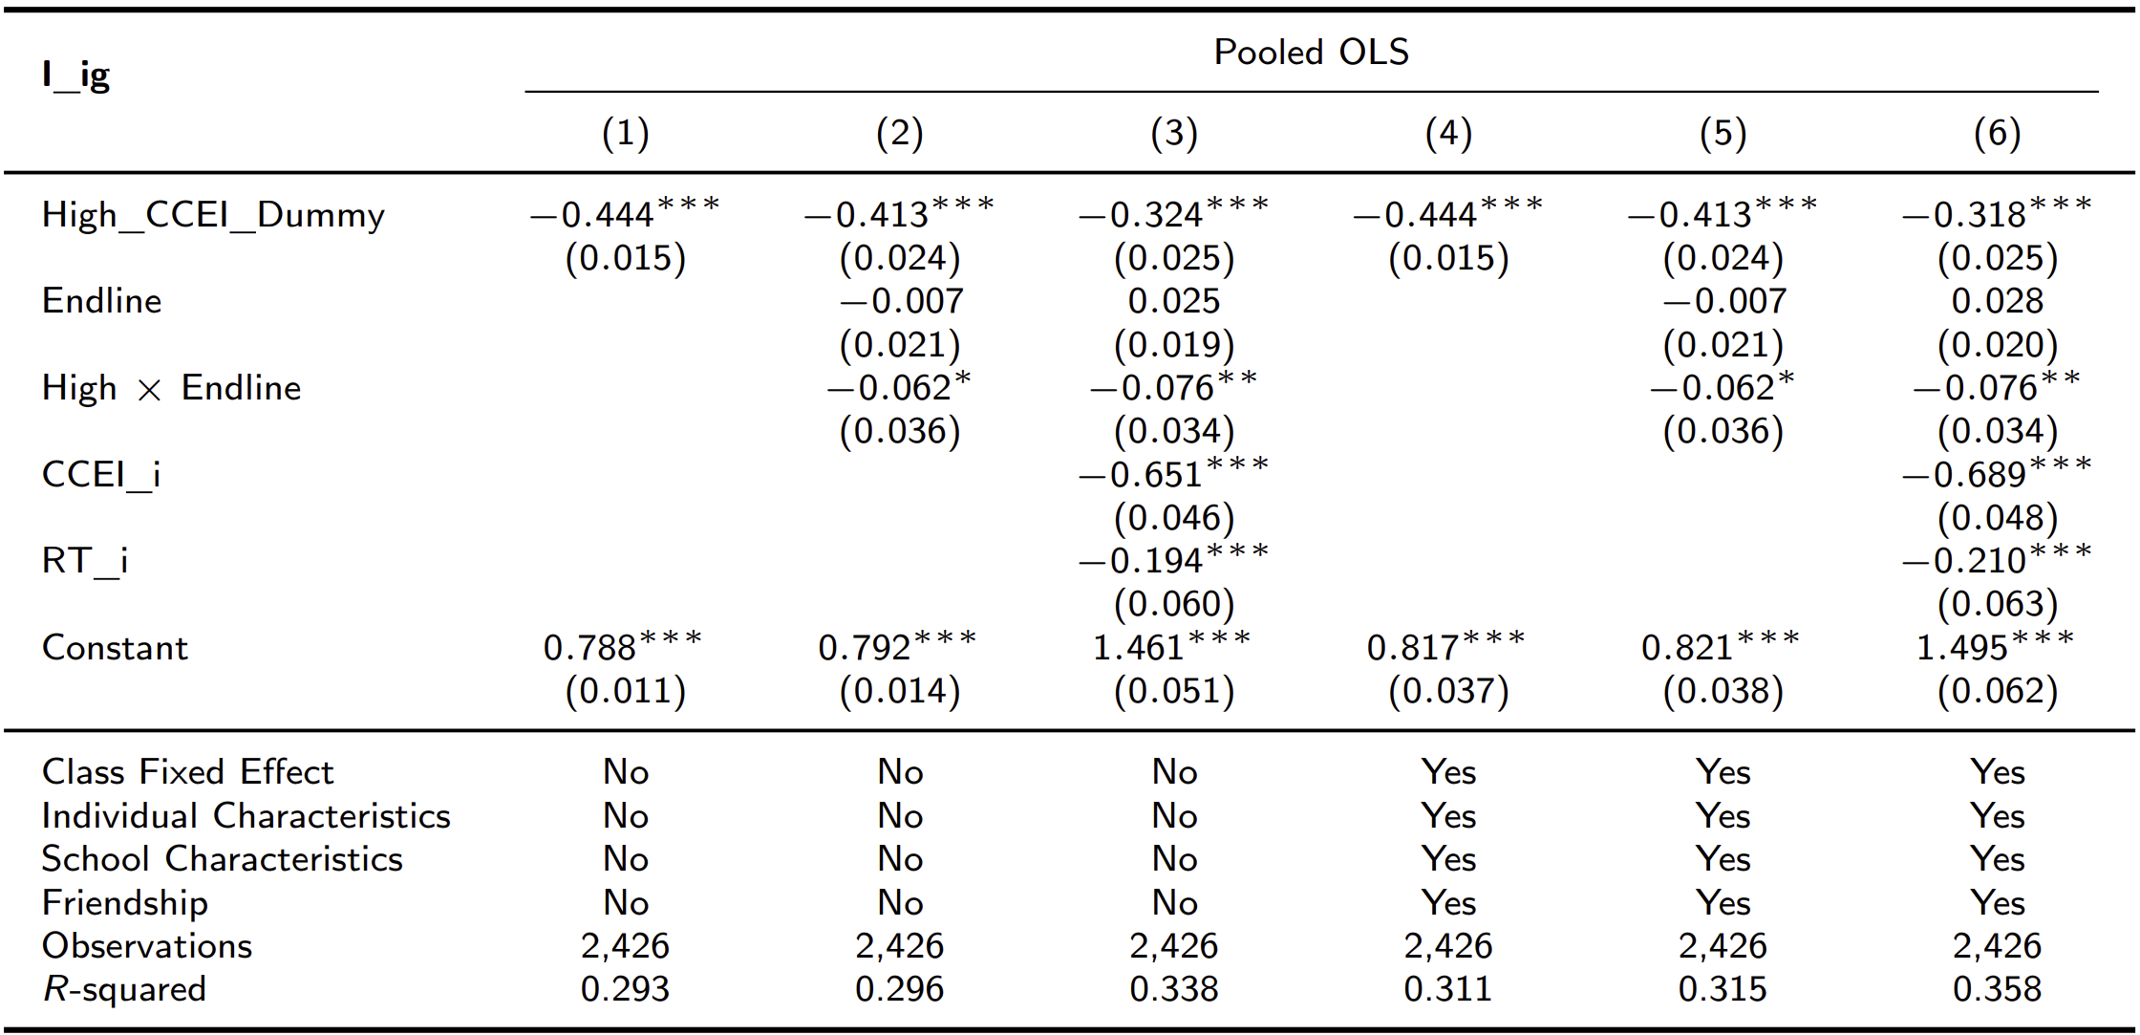
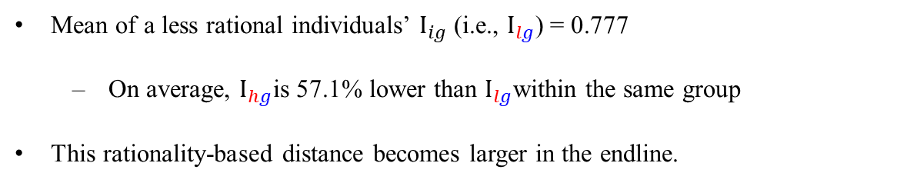
Revealed Preference Distance
Mean of a less rational individuals’ $I_{ig}$ (i.e., $I_{lg}$) = 0.777
  On average, $I_{hg}$is 57.1% lower than $I_{lg}$within the same group
This rationality-based distance becomes larger in the endline.
기존 슬라이드 (비교를 위해)

Slide 4
(방법 1) I_hg 그대로, New I_lg = 1 – I_hg
위 두 그림은 기존 슬라이드와 동일합니다.

Slide 5
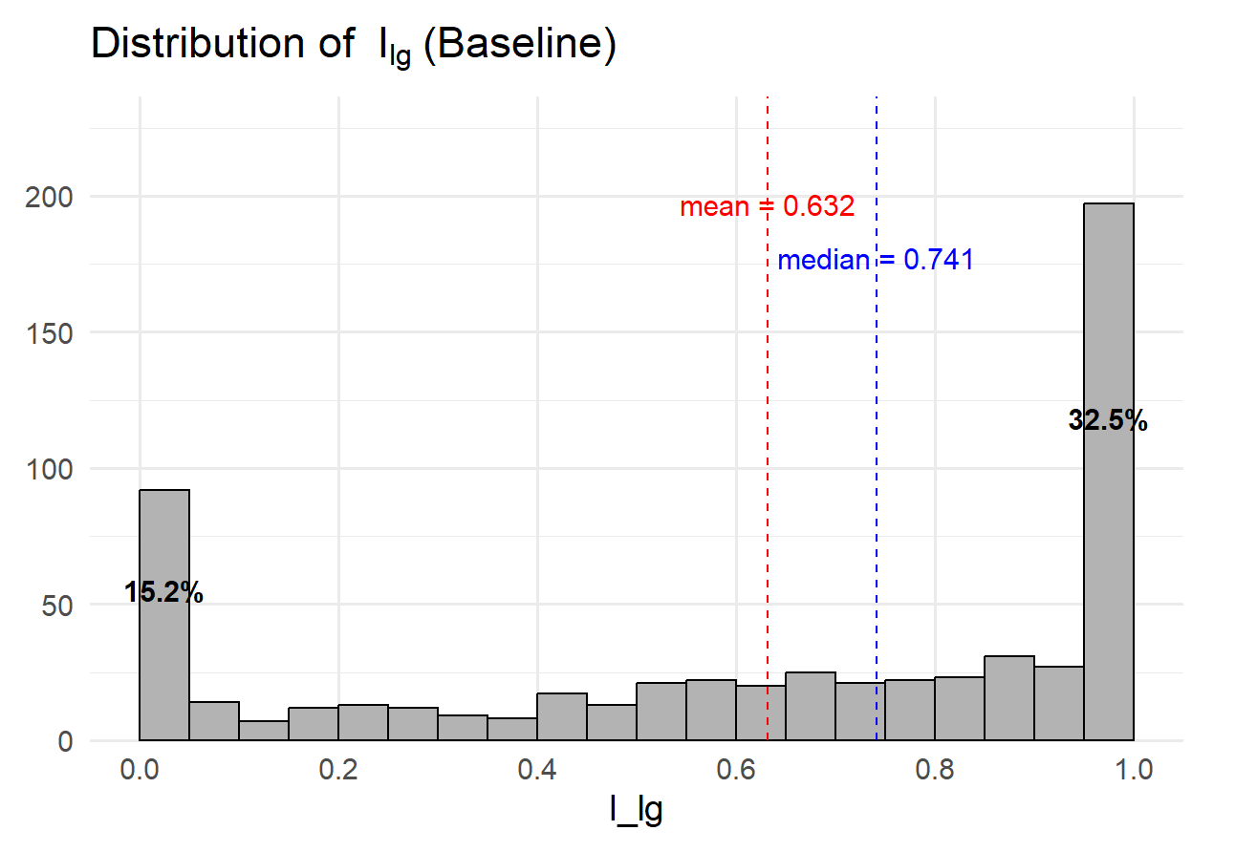
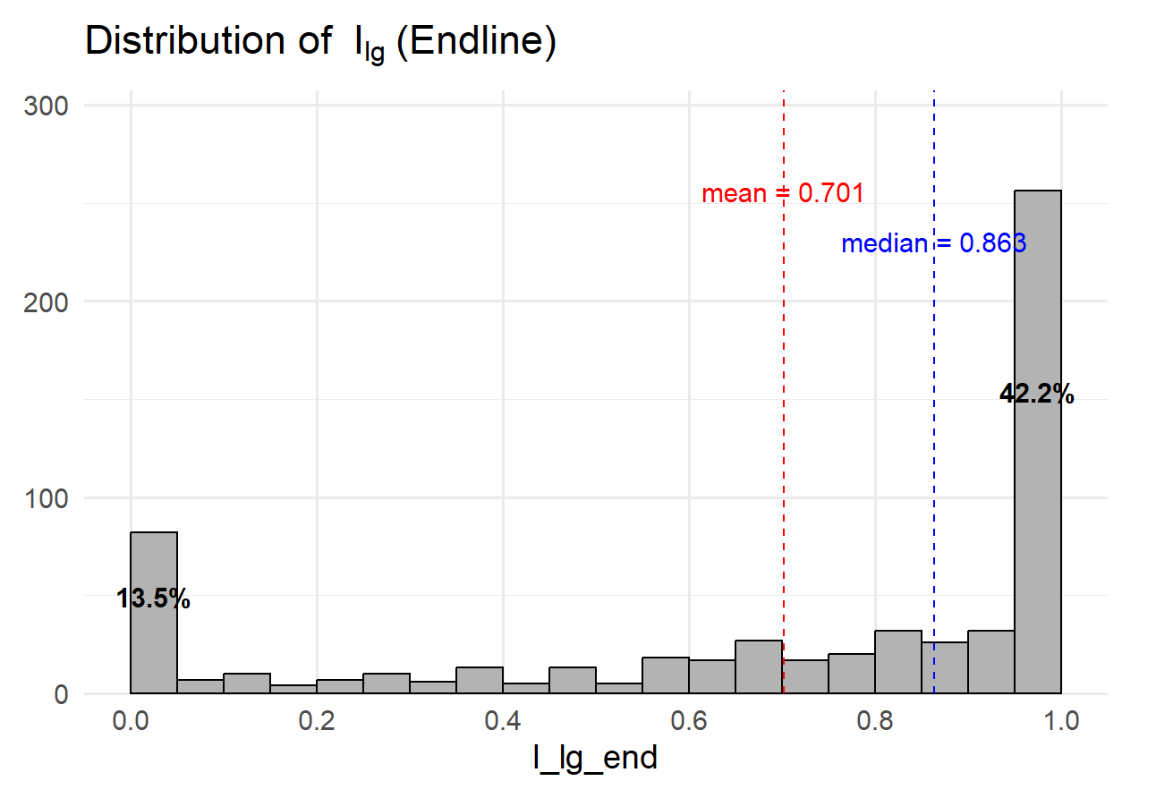
(방법 1) I_hg 그대로, New I_lg = 1 – I_hg
(New)
(New)

Slide 6
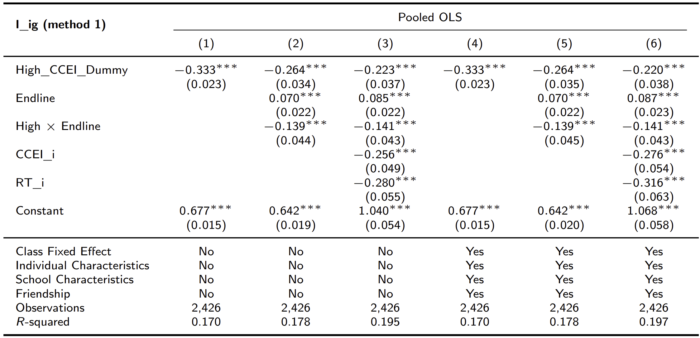
(방법 1) I_hg 그대로, New I_lg = 1 – I_hg

Slide 7
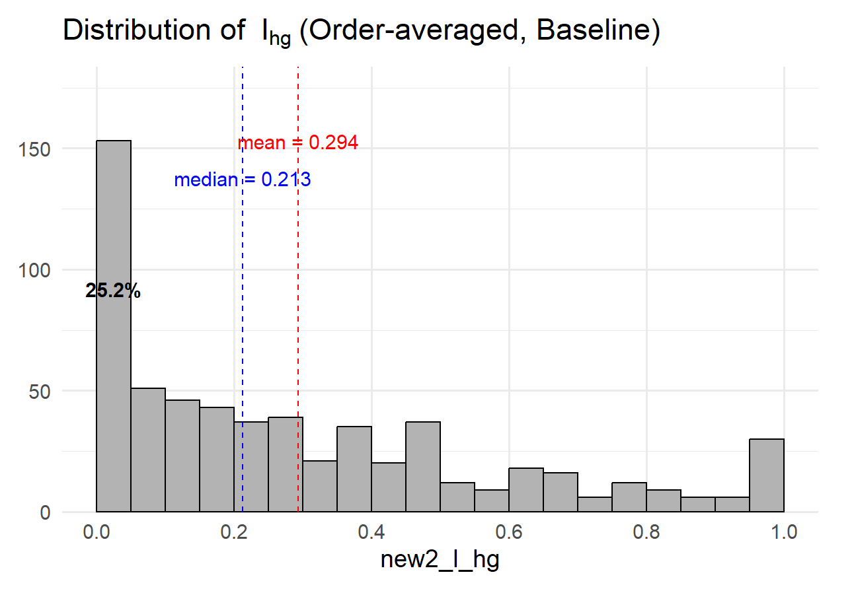
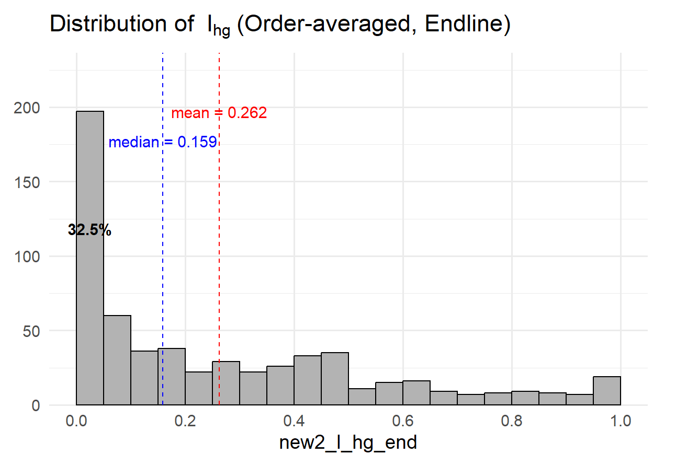
(방법 2) New Index = Average of two order-dependent Indices

Slide 8
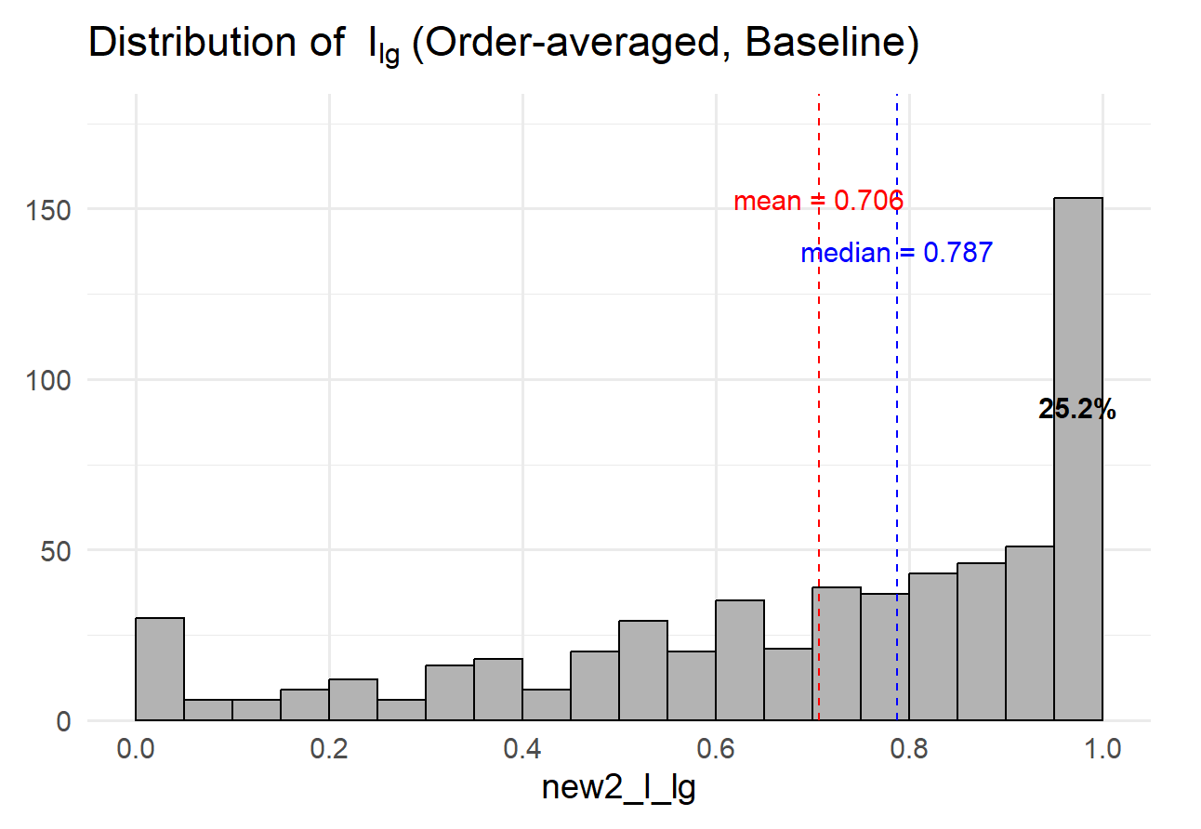
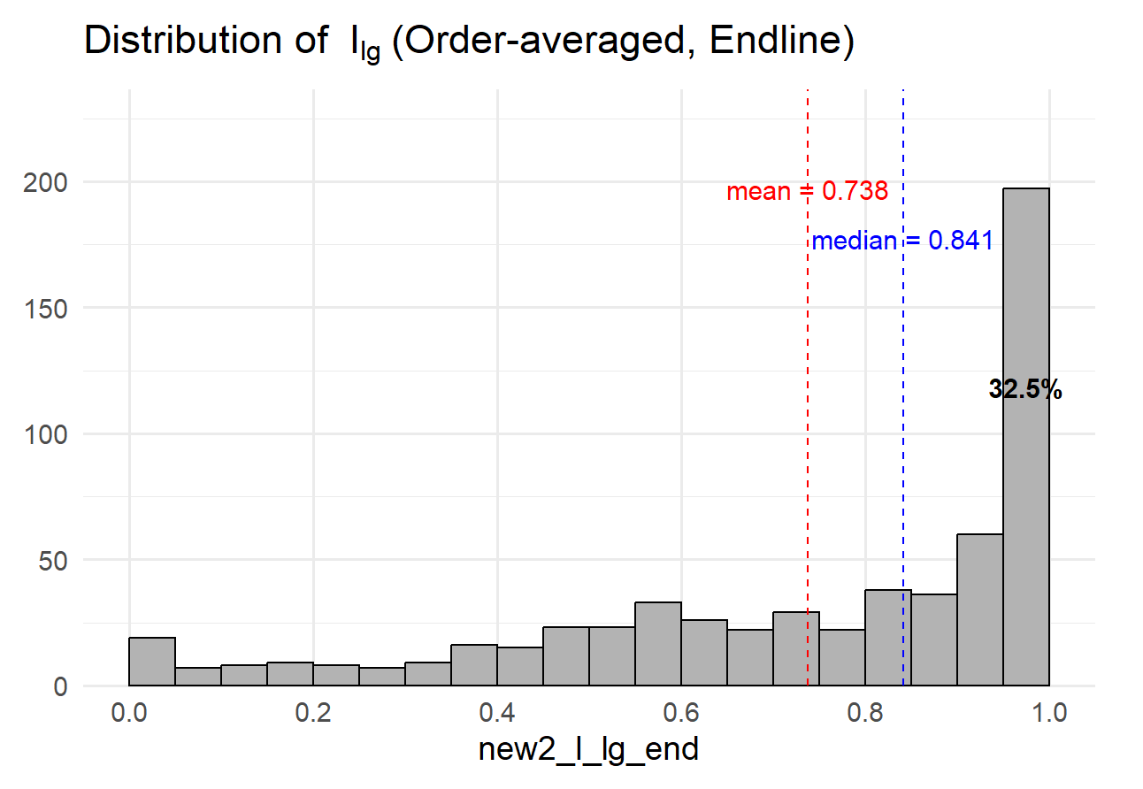
(방법 2) New Index = Average of two order-dependent Indices

Slide 9
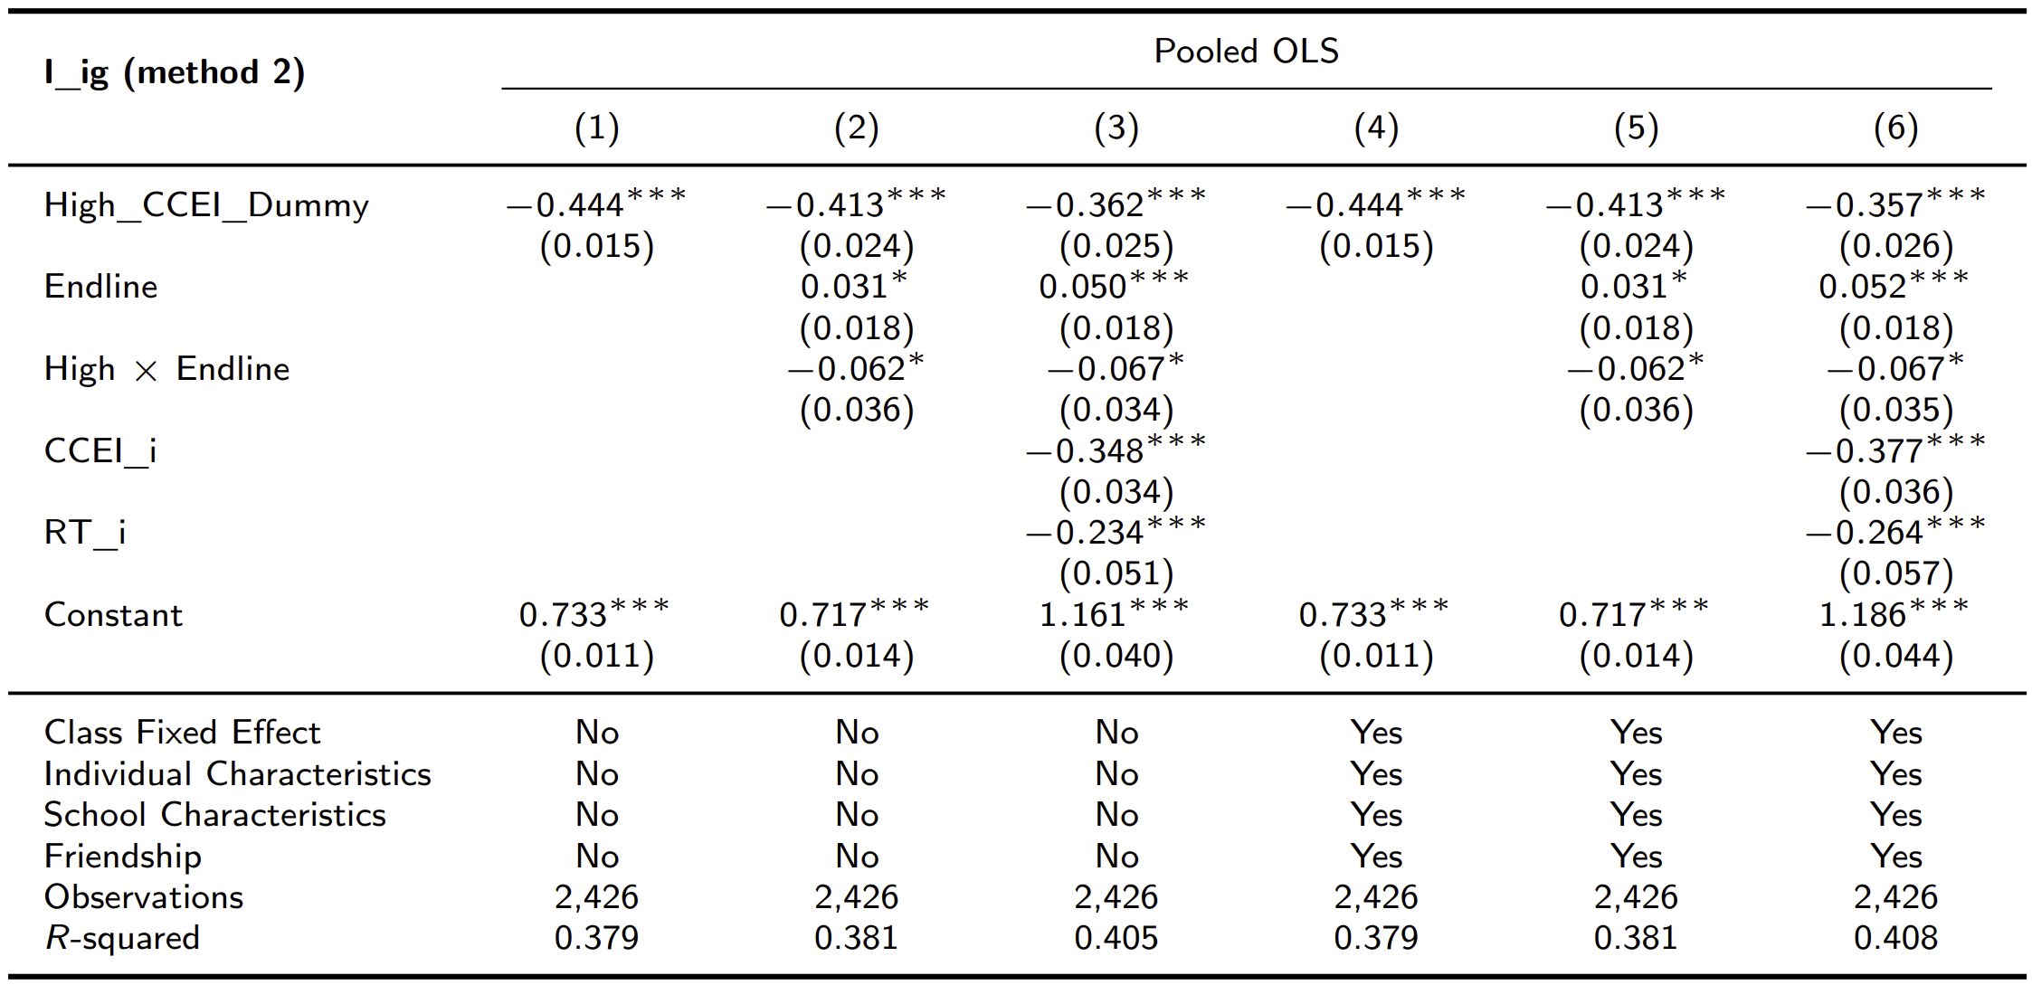
(방법 2) New Index = Average of two order-dependent Indices

