Slide 1
RP Simulation
Byunghun Hahn
2025-06-20

Slide 2
Simulation
This file includes:
Frequency of CCEI_hg vs CCEI_lg
Distributions of I_hg and I_lg
Counts of CCEI_hg > CCEI_lg and I_hg > I_lg
distributions of CCEI_A (=High), CCEI_B (=Low), CCEI_G
of 4 Cases
Case 1: (rho_h = 0.1, rho_g = 0.3, rho_l = 1) and (gamma_h = 1, gamma_g = 1, gamma_l = 0.5)
Case 2: (rho_h = 1, rho_g = 0.8, rho_l = 0.1) and (gamma_h = 1, gamma_g = 1, gamma_l = 0.5)
Case 3: (rho_h = 0.1, rho_g = 0.3, rho_l = 1) and (gamma_h = 0.5, gamma_g = 0.5, gamma_l = 0.25)
Case 4: (rho_h = 1, rho_g = 0.8, rho_l = 0.1) and (gamma_h = 0.5, gamma_g = 0.5, gamma_l = 0.25)

Slide 3
Case 1 (rho_h = 0.1, rho_g = 0.3, rho_l = 1) and (gamma_h = 1, gamma_g = 1, gamma_l = 0.5)
Case 1: (rho_h = 0.1, rho_g = 0.3, rho_l = 1) and (gamma_h = 1, gamma_g = 1, gamma_l = 0.5)
Frequencies of CCEI_hg vs CCEI_lg:
CCEI_hg > CCEI_lg: 99.239%
CCEI_hg = CCEI_lg: 0.609%
CCEI_hg < CCEI_lg: 0.152%

Slide 4
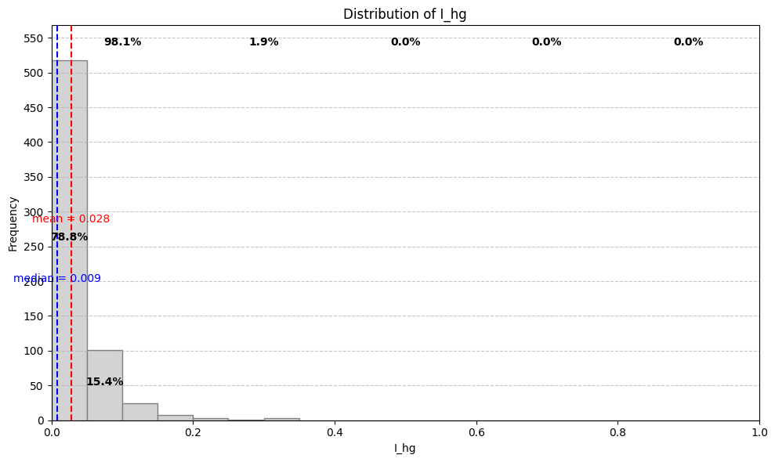
Case 1 (rho_h = 0.1, rho_g = 0.3, rho_l = 1) and (gamma_h = 1, gamma_g = 1, gamma_l = 0.5)

Slide 5
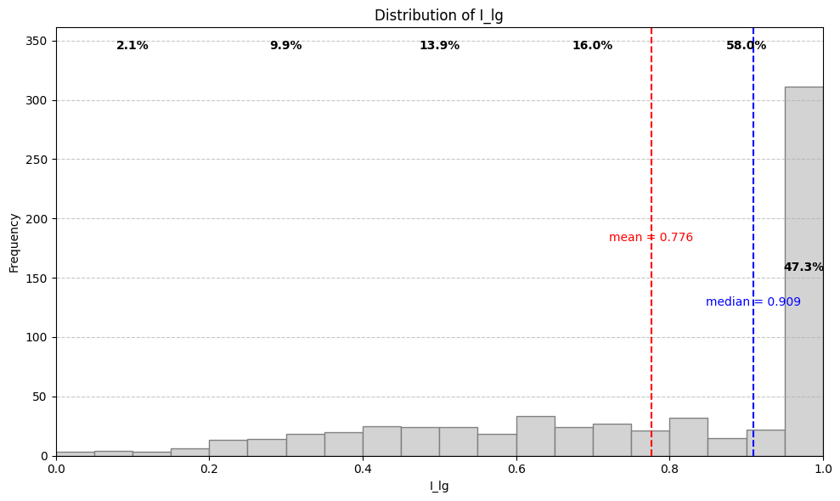
Case 1 (rho_h = 0.1, rho_g = 0.3, rho_l = 1) and (gamma_h = 1, gamma_g = 1, gamma_l = 0.5)

Slide 6
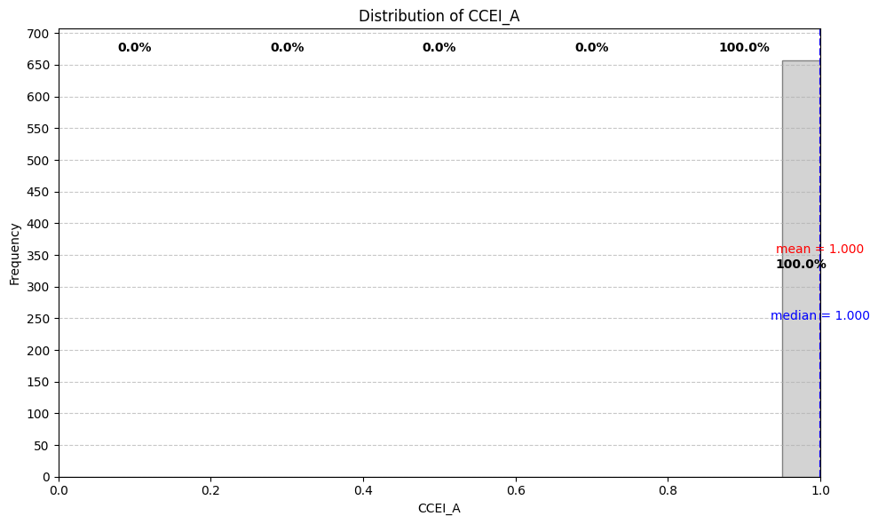
Case 1 (rho_h = 0.1, rho_g = 0.3, rho_l = 1) and (gamma_h = 1, gamma_g = 1, gamma_l = 0.5)

Slide 7
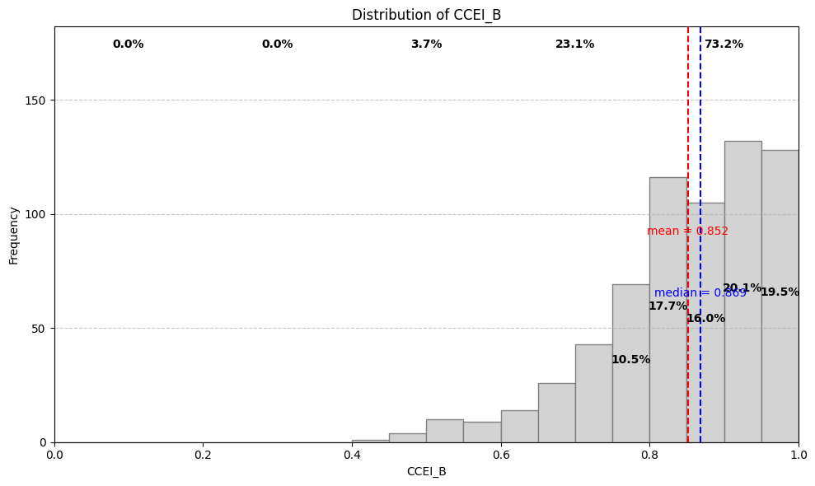
Case 1 (rho_h = 0.1, rho_g = 0.3, rho_l = 1) and (gamma_h = 1, gamma_g = 1, gamma_l = 0.5)

Slide 8

Case 1 (rho_h = 0.1, rho_g = 0.3, rho_l = 1) and (gamma_h = 1, gamma_g = 1, gamma_l = 0.5)

Slide 9
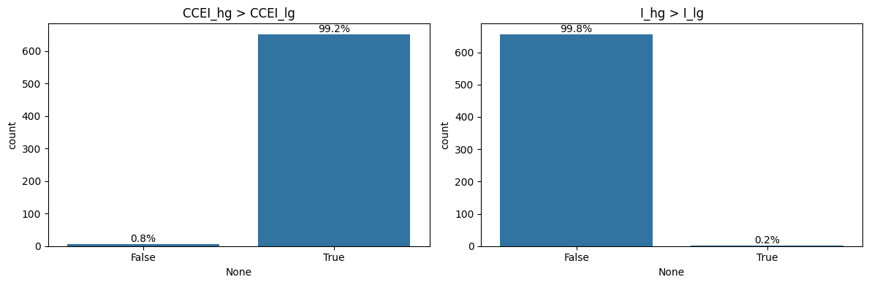
Case 1 (rho_h = 0.1, rho_g = 0.3, rho_l = 1) and (gamma_h = 1, gamma_g = 1, gamma_l = 0.5)

Slide 10
Case 2 (rho_h = 1, rho_g = 0.8, rho_l = 0.1) and (gamma_h = 1, gamma_g = 1, gamma_l = 0.5)
Case 2: (rho_h = 1, rho_g = 0.8, rho_l = 0.1) and (gamma_h = 1, gamma_g = 1, gamma_l = 0.5)
Frequencies of CCEI_hg vs CCEI_lg:
CCEI_hg > CCEI_lg: 6.088%
CCEI_hg = CCEI_lg: 93.912%
CCEI_hg < CCEI_lg: 0.000%

Slide 11
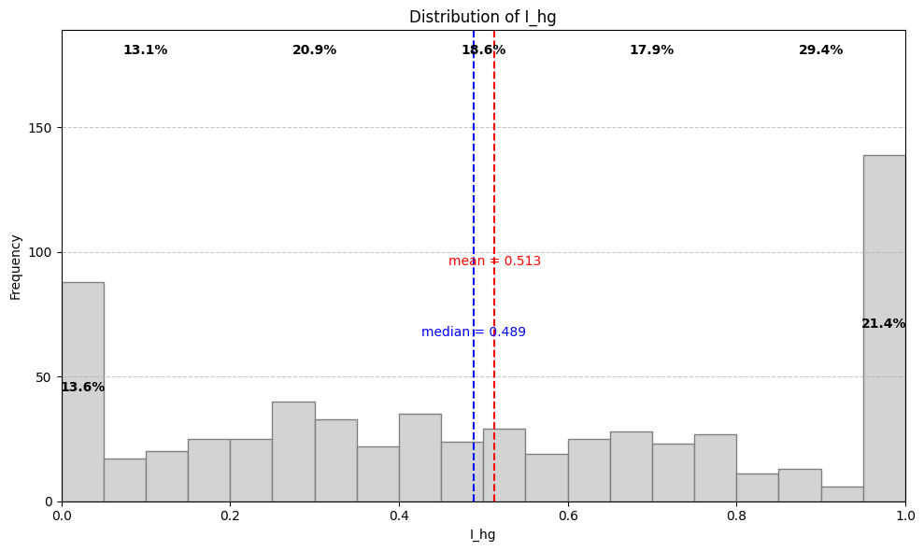
Case 2 (rho_h = 1, rho_g = 0.8, rho_l = 0.1) and (gamma_h = 1, gamma_g = 1, gamma_l = 0.5)

Slide 12
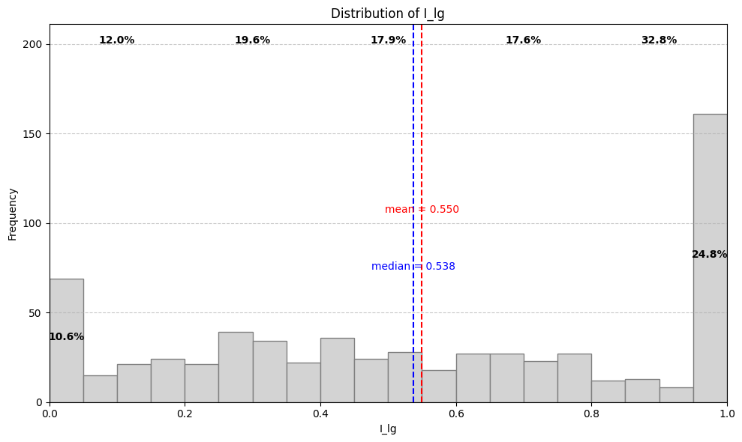
Case 2 (rho_h = 1, rho_g = 0.8, rho_l = 0.1) and (gamma_h = 1, gamma_g = 1, gamma_l = 0.5)

Slide 13
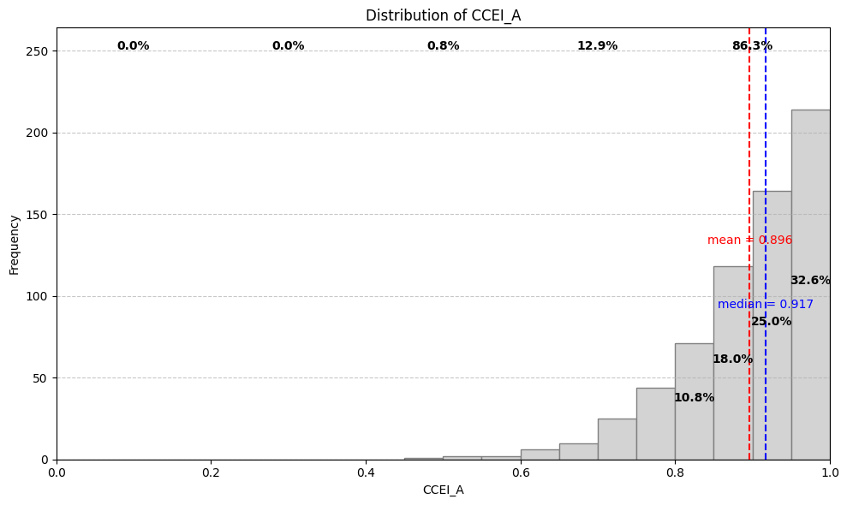
Case 2 (rho_h = 1, rho_g = 0.8, rho_l = 0.1) and (gamma_h = 1, gamma_g = 1, gamma_l = 0.5)

Slide 14

Case 2 (rho_h = 1, rho_g = 0.8, rho_l = 0.1) and (gamma_h = 1, gamma_g = 1, gamma_l = 0.5)

Slide 15
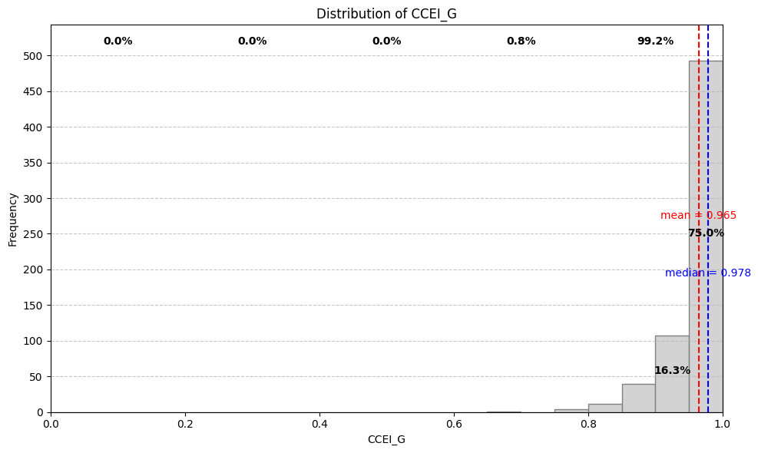
Case 2 (rho_h = 1, rho_g = 0.8, rho_l = 0.1) and (gamma_h = 1, gamma_g = 1, gamma_l = 0.5)

Slide 16
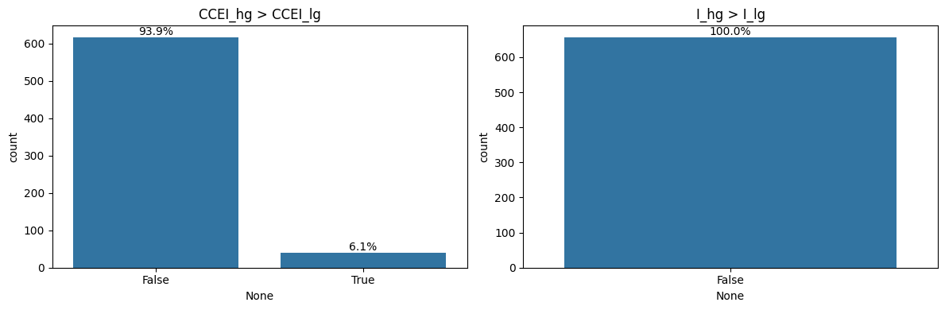
Case 2 (rho_h = 1, rho_g = 0.8, rho_l = 0.1) and (gamma_h = 1, gamma_g = 1, gamma_l = 0.5)

Slide 17
Case 3 (rho_h = 0.1, rho_g = 0.3, rho_l = 1) and (gamma_h = 0.5, gamma_g = 0.5, gamma_l = 0.25)
Case 3: (rho_h = 0.1, rho_g = 0.3, rho_l = 1) and (gamma_h = 0.5, gamma_g = 0.5, gamma_l = 0.25)
Frequencies of CCEI_hg vs CCEI_lg:
CCEI_hg > CCEI_lg: 99.543%
CCEI_hg = CCEI_lg: 0.304%
CCEI_hg < CCEI_lg: 0.152%

Slide 18
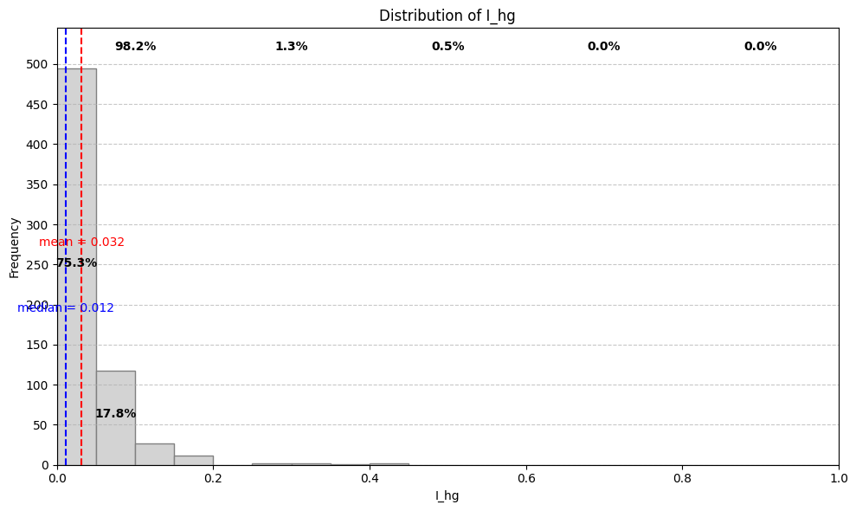
Case 3 (rho_h = 0.1, rho_g = 0.3, rho_l = 1) and (gamma_h = 0.5, gamma_g = 0.5, gamma_l = 0.25)

Slide 19
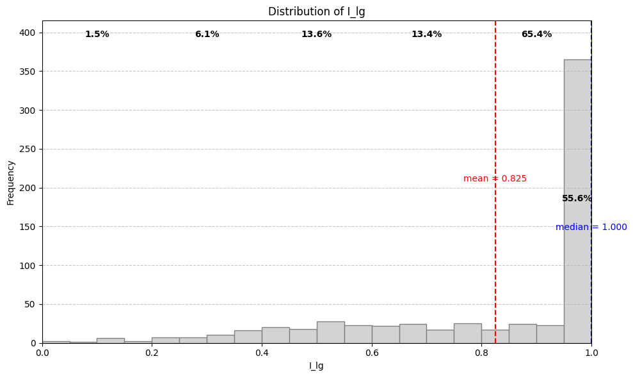
Case 3 (rho_h = 0.1, rho_g = 0.3, rho_l = 1) and (gamma_h = 0.5, gamma_g = 0.5, gamma_l = 0.25)

Slide 20
Case 3 (rho_h = 0.1, rho_g = 0.3, rho_l = 1) and (gamma_h = 0.5, gamma_g = 0.5, gamma_l = 0.25)

Slide 21
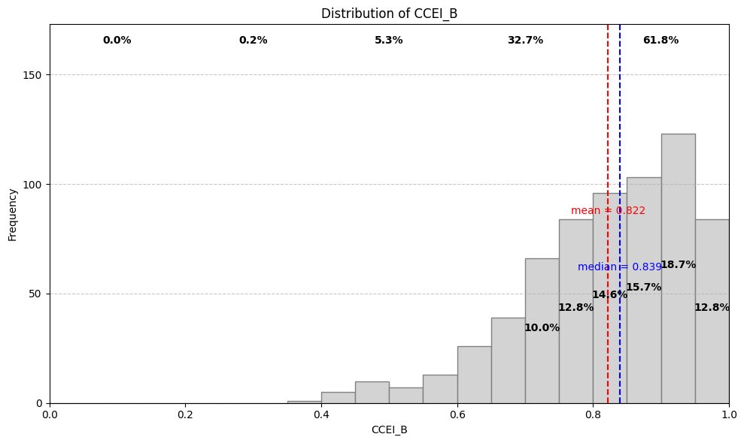
Case 3 (rho_h = 0.1, rho_g = 0.3, rho_l = 1) and (gamma_h = 0.5, gamma_g = 0.5, gamma_l = 0.25)

Slide 22
Case 3 (rho_h = 0.1, rho_g = 0.3, rho_l = 1) and (gamma_h = 0.5, gamma_g = 0.5, gamma_l = 0.25)

Slide 23
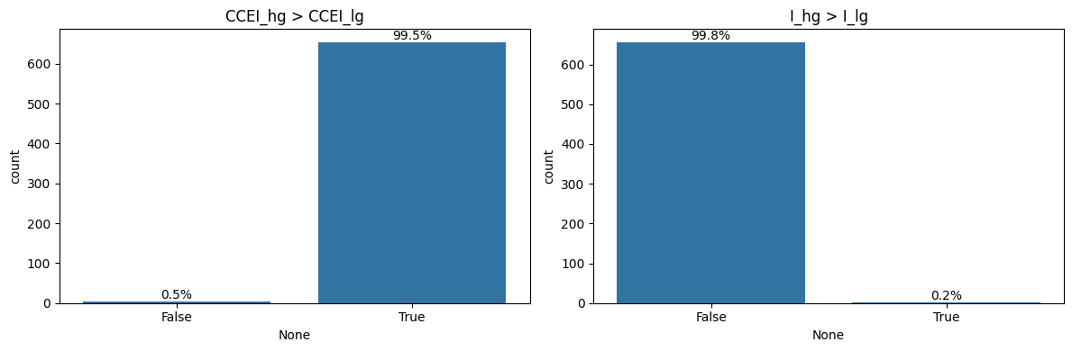
Case 3 (rho_h = 0.1, rho_g = 0.3, rho_l = 1) and (gamma_h = 0.5, gamma_g = 0.5, gamma_l = 0.25)

Slide 24
Case 4 (rho_h = 1, rho_g = 0.8, rho_l = 0.1) and (gamma_h = 0.5, gamma_g = 0.5, gamma_l = 0.25)
Case 4: (rho_h = 1, rho_g = 0.8, rho_l = 0.1) and (gamma_h = 0.5, gamma_g = 0.5, gamma_l = 0.25)
Frequencies of CCEI_hg vs CCEI_lg:
CCEI_hg > CCEI_lg: 2.588%
CCEI_hg = CCEI_lg: 97.412%
CCEI_hg < CCEI_lg: 0.000%

Slide 25
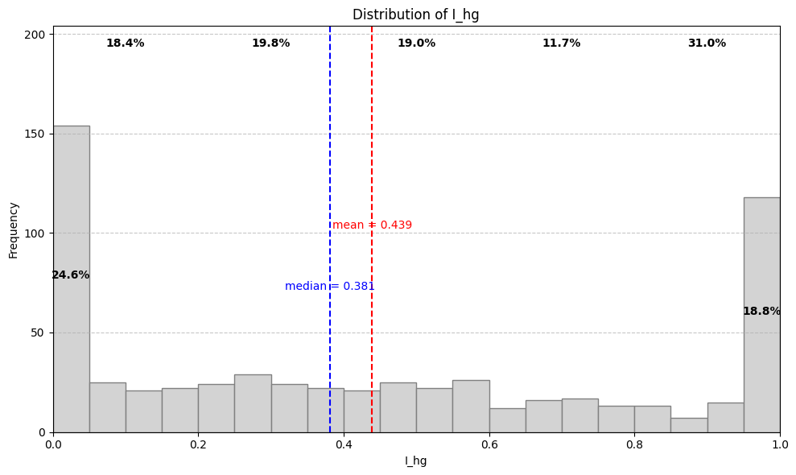
Case 4 (rho_h = 1, rho_g = 0.8, rho_l = 0.1) and (gamma_h = 0.5, gamma_g = 0.5, gamma_l = 0.25)

Slide 26
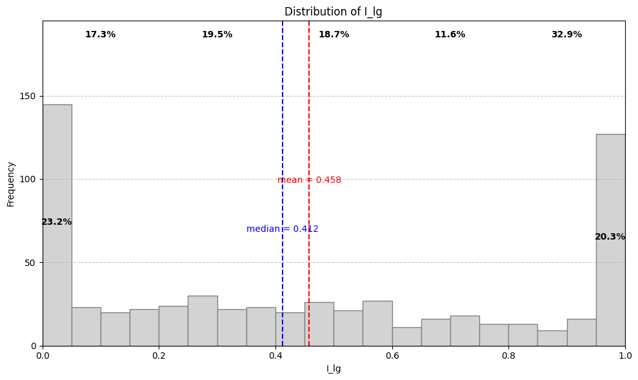
Case 4 (rho_h = 1, rho_g = 0.8, rho_l = 0.1) and (gamma_h = 0.5, gamma_g = 0.5, gamma_l = 0.25)

Slide 27

Case 4 (rho_h = 1, rho_g = 0.8, rho_l = 0.1) and (gamma_h = 0.5, gamma_g = 0.5, gamma_l = 0.25)

Slide 28
Case 4 (rho_h = 1, rho_g = 0.8, rho_l = 0.1) and (gamma_h = 0.5, gamma_g = 0.5, gamma_l = 0.25)

Slide 29
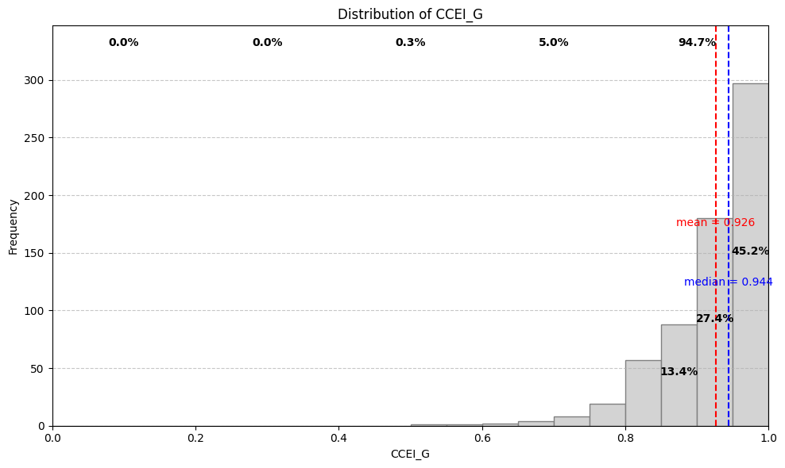
Case 4 (rho_h = 1, rho_g = 0.8, rho_l = 0.1) and (gamma_h = 0.5, gamma_g = 0.5, gamma_l = 0.25)

Slide 30
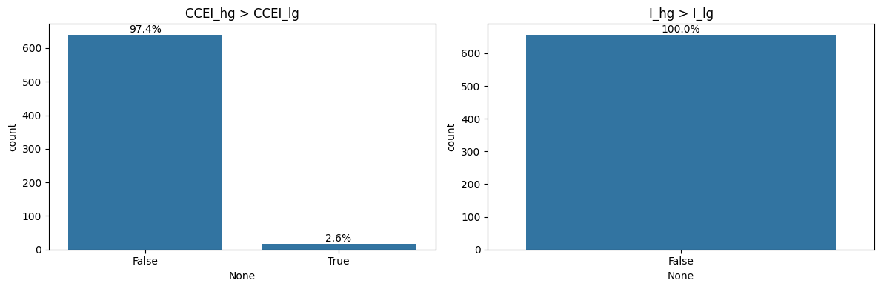
Case 4 (rho_h = 1, rho_g = 0.8, rho_l = 0.1) and (gamma_h = 0.5, gamma_g = 0.5, gamma_l = 0.25)

