Slide 1
Rationality-Based
Preference Aggregation
Syngjoo Choi (SNU) | Byunghun Hahn (SNU) | Booyuel Kim (SNU)
Minseon Park (Michigan) | Yoonsoo Park (SMU) | Euncheol Shin (KAIST)
August 15, 2025
9th BEET Workshop

Slide 2
Introduction
Long-standing interests in group decision making (DM)
  Households (e.g., McEloy and Horney, 1981; Chiappori, 1992; Lundberg and Pollak, 1996);
  Committees (e.g,, Austen-Smith and Banks, 1996; Feddersen and Pesendorfer, 1998))
  Social choice theory (e.g., Arrow, 1951; Sen, 1970), etc.
Individual rationality is a foundational assumption in understanding group decision making.
Growing evidence on the role of individual DM ability, proxied by education, cognitive ability, or financial literacy, in household outcomes
  e.g., Behrman et al. (2012), Yilmazer et al. (2015), Guiso et al. (2023), Gu et al. (2023)

Slide 3
In This Paper
We argue that lack of individual rationality is an important source of (1) the quality of and (2) individual (bargaining) power on group decision-making.
Conduct large-scale panel experiments over two periods with a four-month interval
Propose a nonparametric, revealed preference measure of individual power on group decision making
Make a causal inference on the effect of individual rationality on group outcomes.

Slide 4
Sampling
1,573 students from 12 middle schools in South Korea in the baseline study (in August); 1,468 revisited in the endline study (in December)
In each study, they completed two stages of decision making under risk at the individual level and at the collective level.
  Pairs were randomly formed within classroom for collective choices in the baseline
  They were kept unchanged in the endline
  Due to attrition or group mismatching, the final sample consists of 652 groups (1,304 individuals) in both studies.
We also collected their individual characteristics (height, gender, math score, personality, etc) and friendship information.

Slide 5
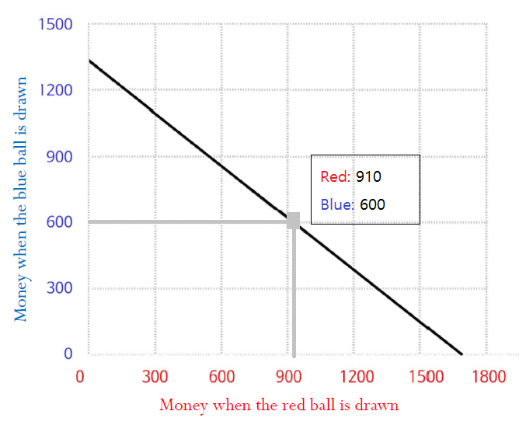

Decision Problem
Follow Choi et al. (2007)
  Allocate an income over two Arrow securities (associated with equally probably two states): choose $\left(x_{1},x_{2}\right)$ subject to $p_{1}x_{1}+p_{2}x_{2}=1$

Slide 6
Experimental Procedures
Participants: students from 12 middle schools in South Korea
Stage 1
(Individual DM)
Random matching within classroom
Stage 2
(Group DM)
18 rounds of individual choices with exogenous price variations
1 randomly selected round for payoffs
Randomly matched students in pair sit side by side
1 min 30 sec of discussion
18 rounds of collective choices with exogenous price variations
1 randomly selected round for payoffs (doubled and divided equally)
No feedback is given during the experiment, and subjects are informed only the sum of payoffs from the two stages at the end of the study.

Slide 7
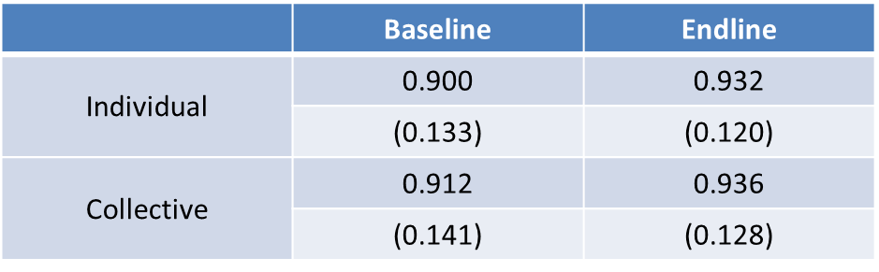
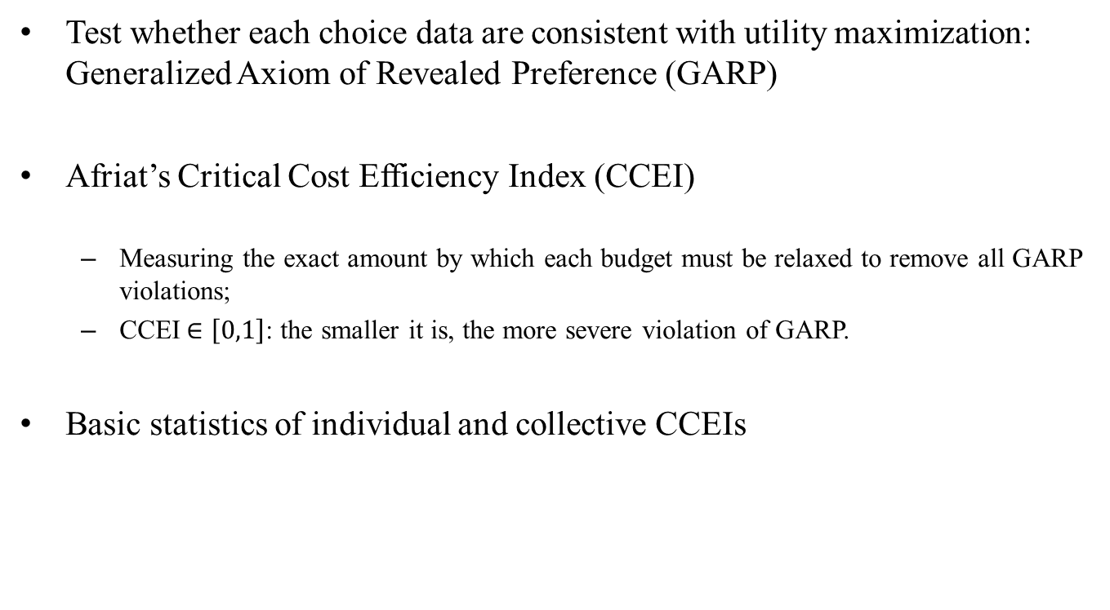
Measuring Rationality
Test whether each choice data are consistent with utility maximization: Generalized Axiom of Revealed Preference (GARP)
Afriat’s Critical Cost Efficiency Index (CCEI)
  Measuring the exact amount by which each budget must be relaxed to remove all GARP violations;
  CCEI$∈\left[0,1\right]$: the smaller it is, the more severe violation of GARP.
Basic statistics of individual and collective CCEIs

Slide 8
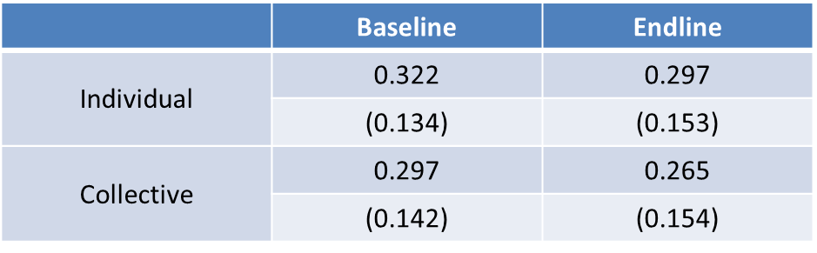
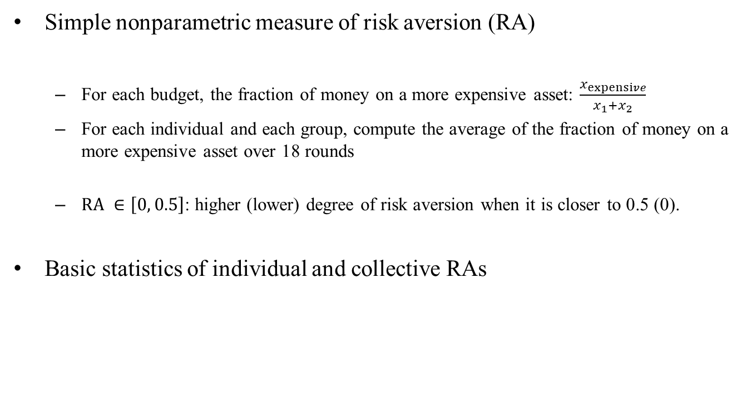
Measuring Risk Preferences
Simple nonparametric measure of risk aversion (RA)
  For each budget, the fraction of money on a more expensive asset: $\frac{x_{expensive}}{x_{1}+x_{2}}$
  For each individual and each group, compute the average of the fraction of money on a more expensive asset over 18 rounds
  $RA ∈\left[0, 0.5\right]$: higher (lower) degree of risk aversion when it is closer to 0.5 (0).
Basic statistics of individual and collective RAs

Slide 9
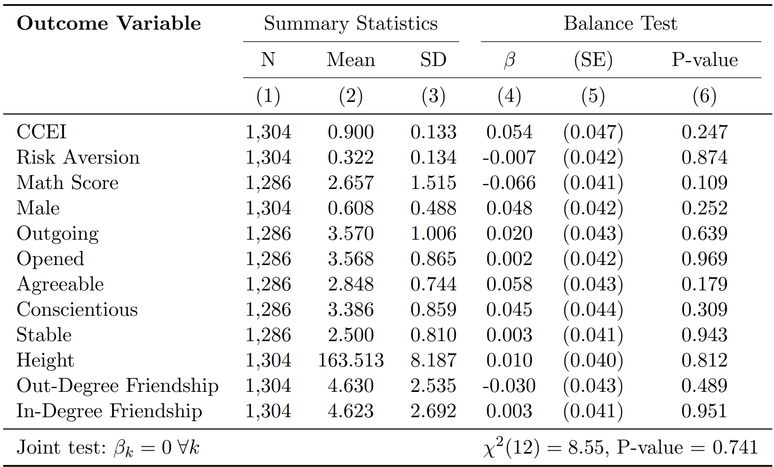
Balance Test
Random group formation makes an individual’s CCEI / RA / other variables not correlated with those of the other individual in the same group.

Slide 10
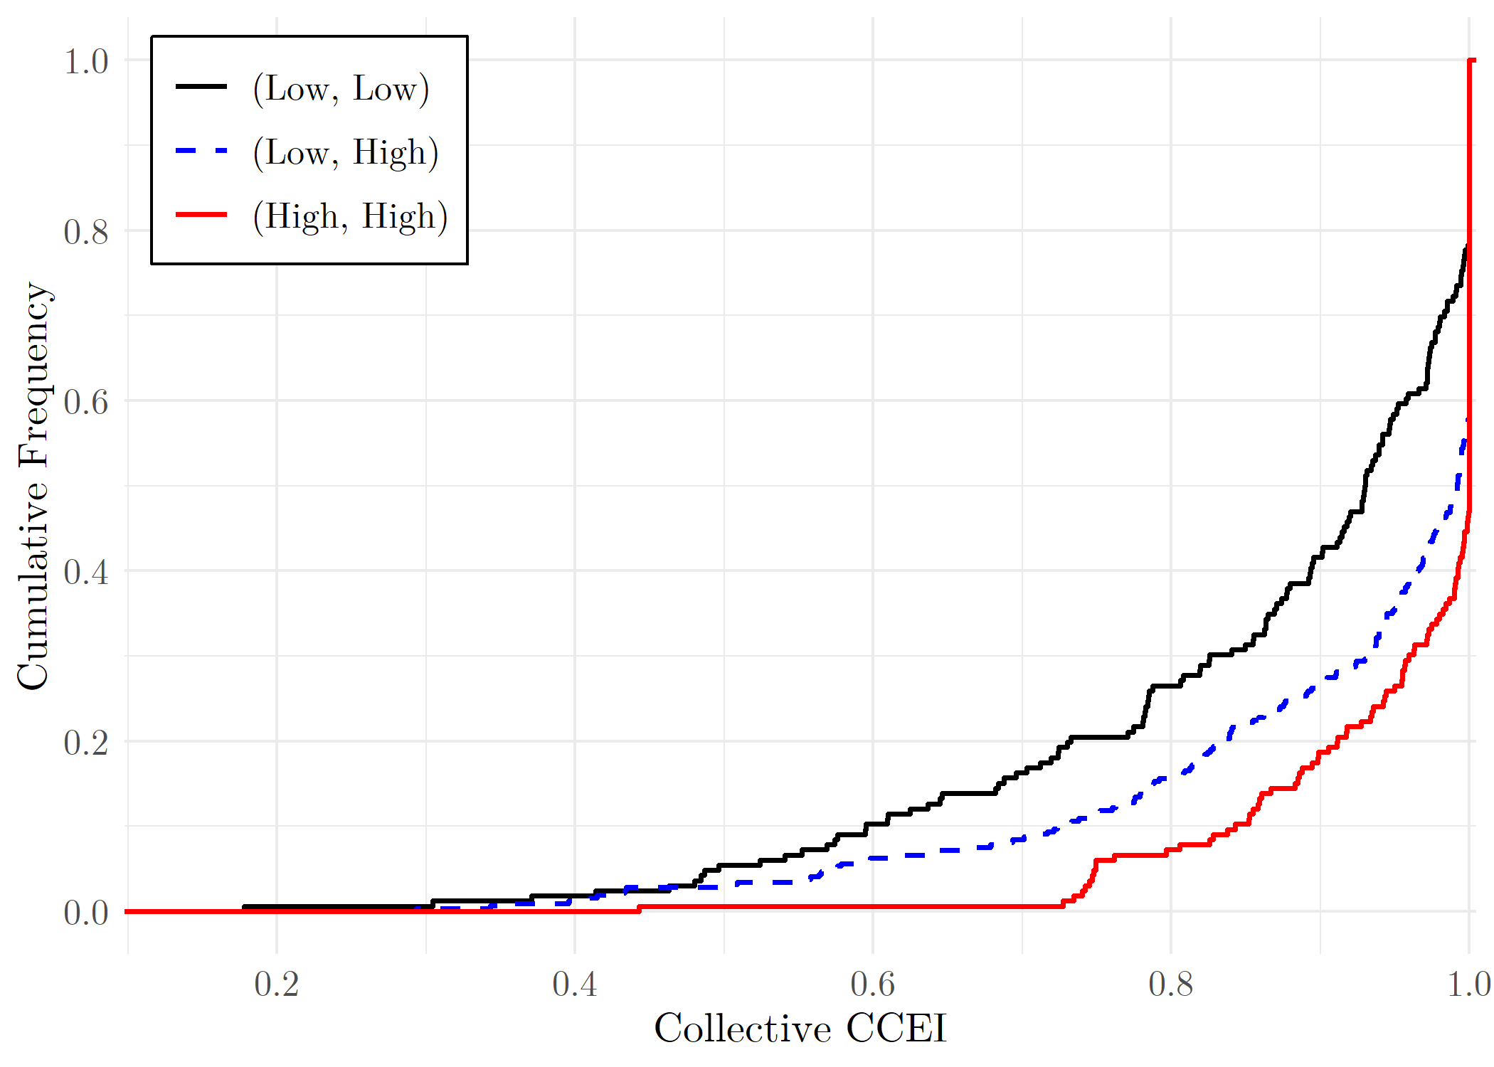
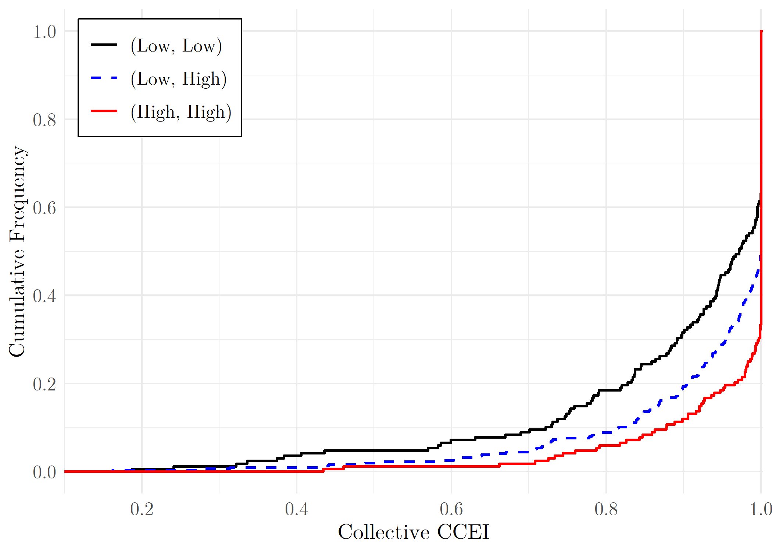
Rationality Extension
Q1: Do more rational individuals make group decisions more rational?
Divide subjects into two groups w.r.t. individual CCEIs
  High (Low) group: above (below) the median of CCEI
Baseline
Endline

Slide 11
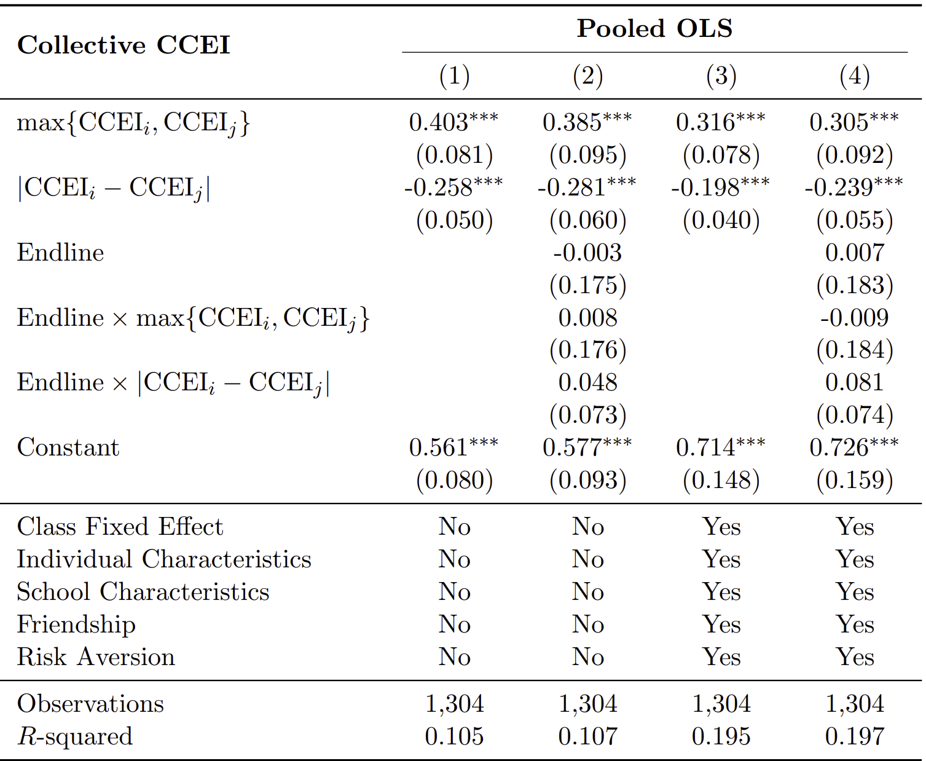
Rationality Extension
The CCEI of the group increases with the CCEI of more rational individual and decreases with the difference between the CCEIs of the two individuals, even after controlling for confounds.

Slide 12
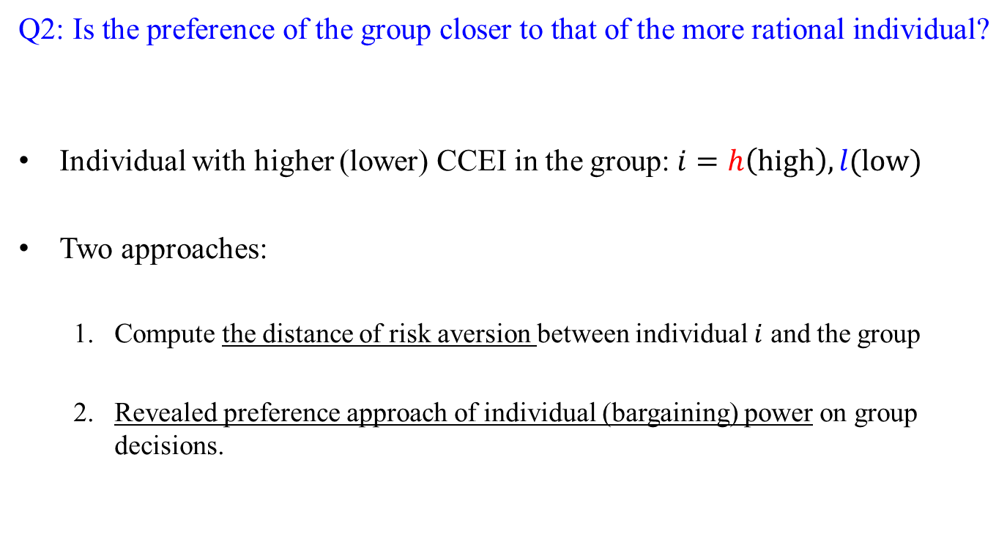
Does Preference Aggregation Depend on Rationality?
Q2: Is the preference of the group closer to that of the more rational individual?
Individual with higher (lower) CCEI in the group: $i=h\left(high\right), l(low)$
Two approaches:
  Compute the distance of risk aversion between individual $i$ and the group
  Revealed preference approach of individual (bargaining) power on group decisions.

Slide 13
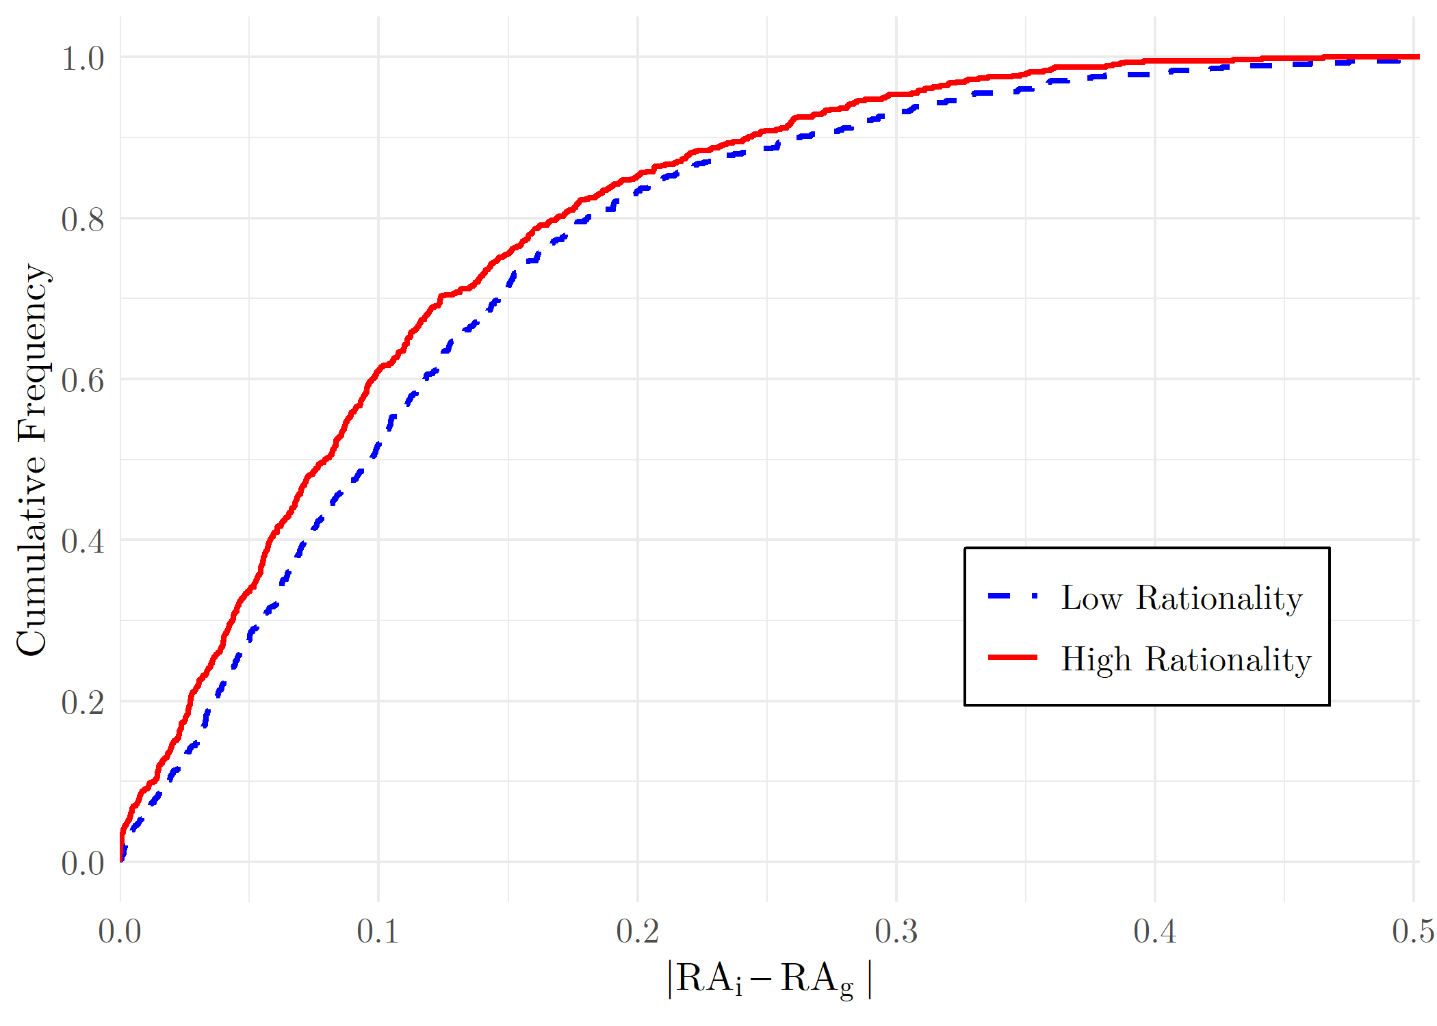
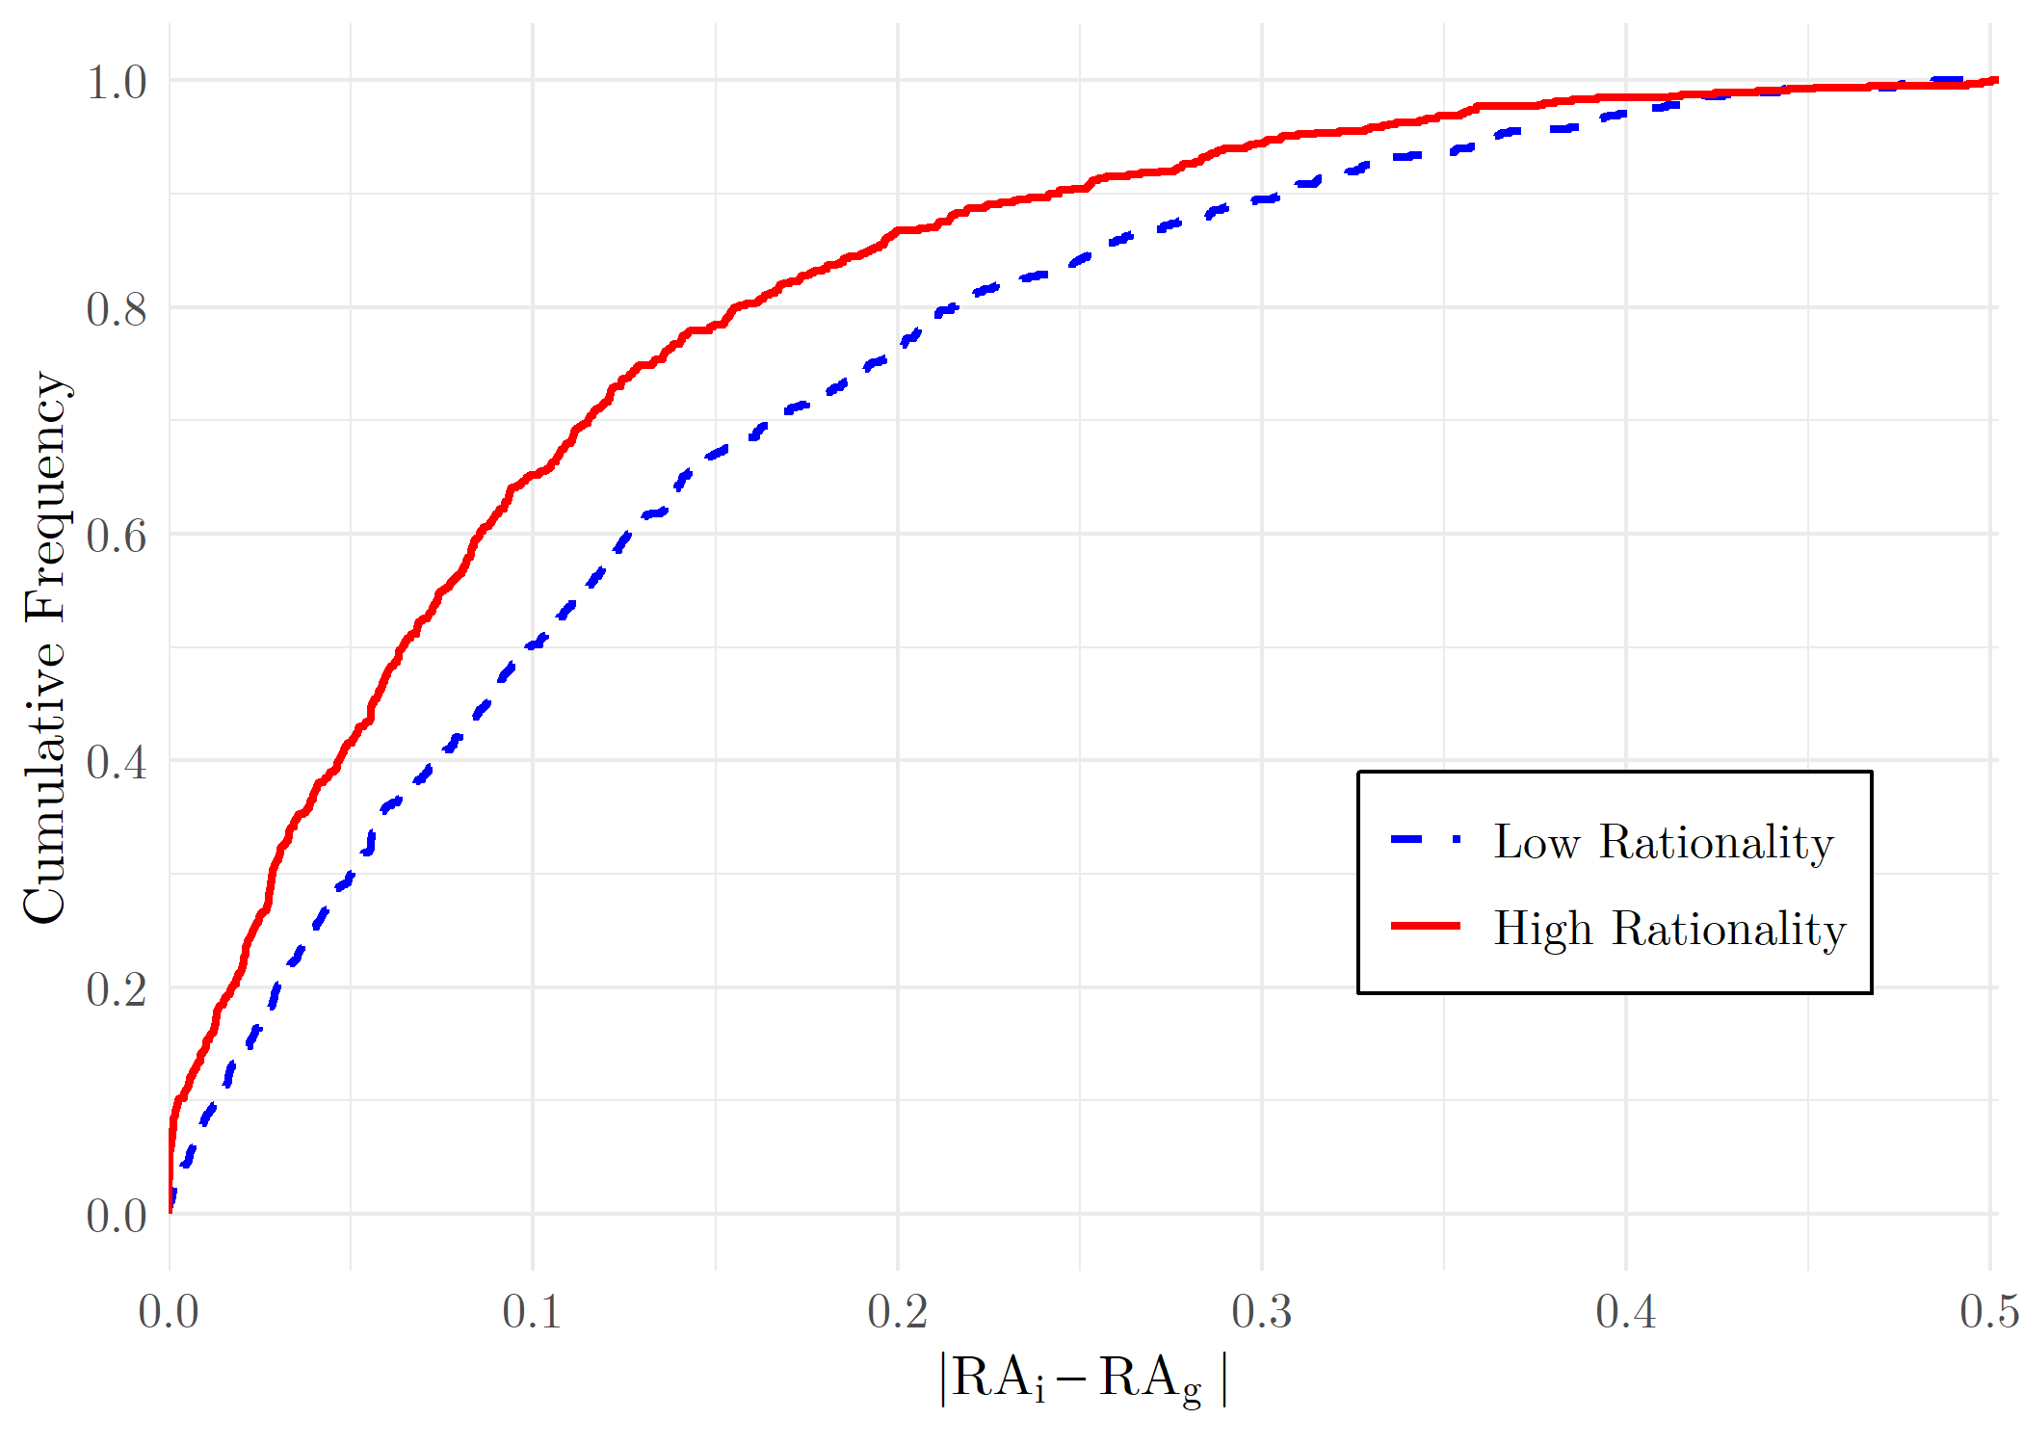
Does Preference Aggregation Depend on Rationality?
Draw the distributions of $|{RA}_{i}−{RA}_{g}|$ for $i=h, l$.
Baseline
Endline
The preference gap between a more rational individual and the group is smaller than that between a less rational individual and the group.

Slide 14
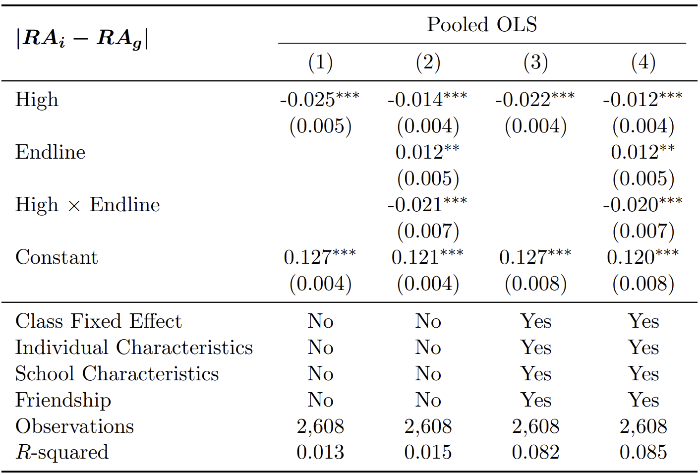
Does Preference Aggregation Depend on Rationality?
Collective risk preference is closer to the individual risk preference of the more rational individual.
This becomes stronger in the endline study.

Slide 15
Revealed (Bargaining) Power
Revealed preference approach
  Revealed preference distance between an individual’s choice data and the group choice data
  How close are an individual’s choices to group choices?
An individual is said to make a larger revealed (bargaining) power if her choice data is “closer” to the data of group choices.

Slide 16
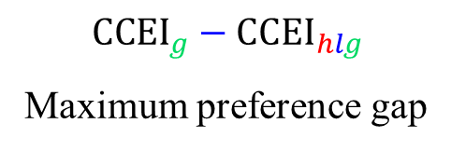


Revealed Preference Distance
Group choices
$${CCEI}_{g}$$
$${CCEI}_{g}−{CCEI}_{hlg}$$
Maximum preference gap
Group choices +
Choices of two individuals
$${CCEI}_{hlg}$$

Slide 17
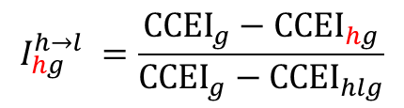

Revealed Preference Distance
Group choices
$$I_{hg}^{h→l} =\frac{{CCEI}_{g}−{CCEI}_{hg}}{{CCEI}_{g}−{CCEI}_{hlg}}$$
Group choices
+
Choices of more rational individual
Adding first the choice data of more rational individual
$$I_{lg}^{h→l} =1−I_{hg}^{h→l}$$
Group choices +
Choices of two individuals

Slide 18

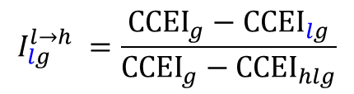
Revealed Preference Distance
Group choices
$$I_{hg}^{h→l} =\frac{{CCEI}_{g}−{CCEI}_{hg}}{{CCEI}_{g}−{CCEI}_{hlg}}$$
$$I_{lg}^{l→h} =\frac{{CCEI}_{g}−{CCEI}_{lg}}{{CCEI}_{g}−{CCEI}_{hlg}}$$
Group choices
+
Choices of more rational individual
Group choices
+
Choices of less rational individual
$$I_{hg}^{l→h} =1−I_{lg}^{l→h}$$
$$I_{lg}^{h→l} =1−I_{hg}^{h→l}$$
Group choices +
Choices of two individuals

Slide 19

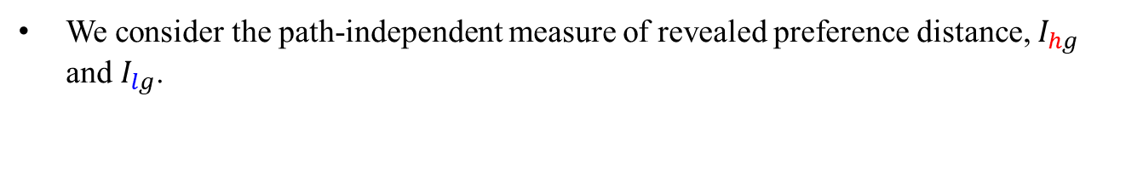
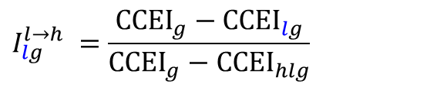





Revealed (Bargaining) Power
We consider the path-independent measure of revealed preference distance, $I_{hg}$ and $I_{lg}$.
$$I_{hg}^{h→l} =\frac{{CCEI}_{g}−{CCEI}_{hg}}{{CCEI}_{g}−{CCEI}_{hlg}}$$
$$I_{lg}^{h→l} =1−I_{hg}^{h→l}$$
${I_{hg}= \frac{1}{2} I}_{hg}^{h→l}$ + $\frac{1}{2} I_{hg}^{l→h}$
${I_{lg}= \frac{1}{2} I}_{lg}^{h→l}$ + $\frac{1}{2} I_{lg}^{l→h}$
$$I_{hg}^{l→h} =1−I_{lg}^{l→h}$$
$$I_{lg}^{l→h} =\frac{{CCEI}_{g}−{CCEI}_{lg}}{{CCEI}_{g}−{CCEI}_{hlg}}$$
(${Note: I}_{hg}+I_{lg}=1)$

Slide 20
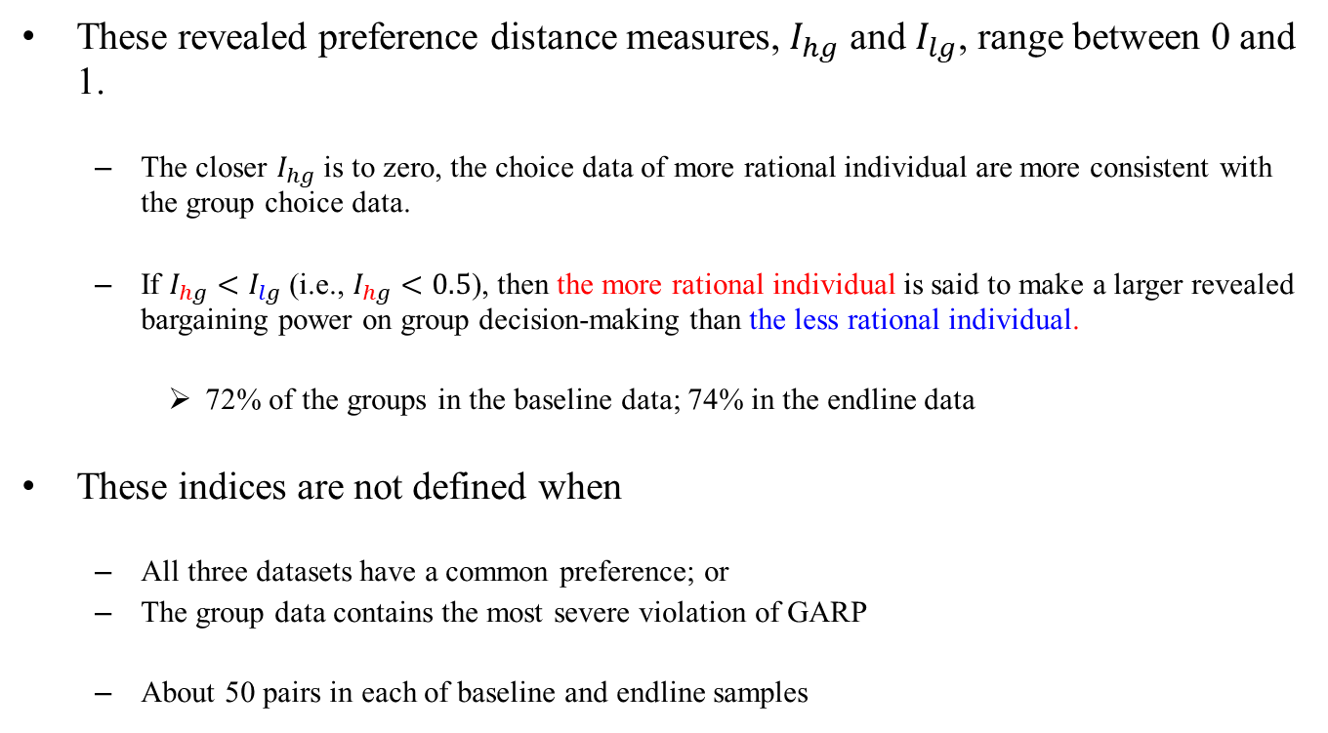
Revealed (Bargaining) Power
These revealed preference distance measures, $I_{hg}$ and $I_{lg}$, range between 0 and 1.
  The closer $I_{hg}$ is to zero, the choice data of more rational individual are more consistent with the group choice data.
  If $I_{hg}<I_{lg}$ (i.e., $I_{hg}<0.5$), then the more rational individual is said to make a larger revealed bargaining power on group decision-making than the less rational individual.
    72% of the groups in the baseline data; 74% in the endline data
These indices are not defined when
  All three datasets have a common preference; or
  The group data contains the most severe violation of GARP
  About 50 pairs in each of baseline and endline samples

Slide 21
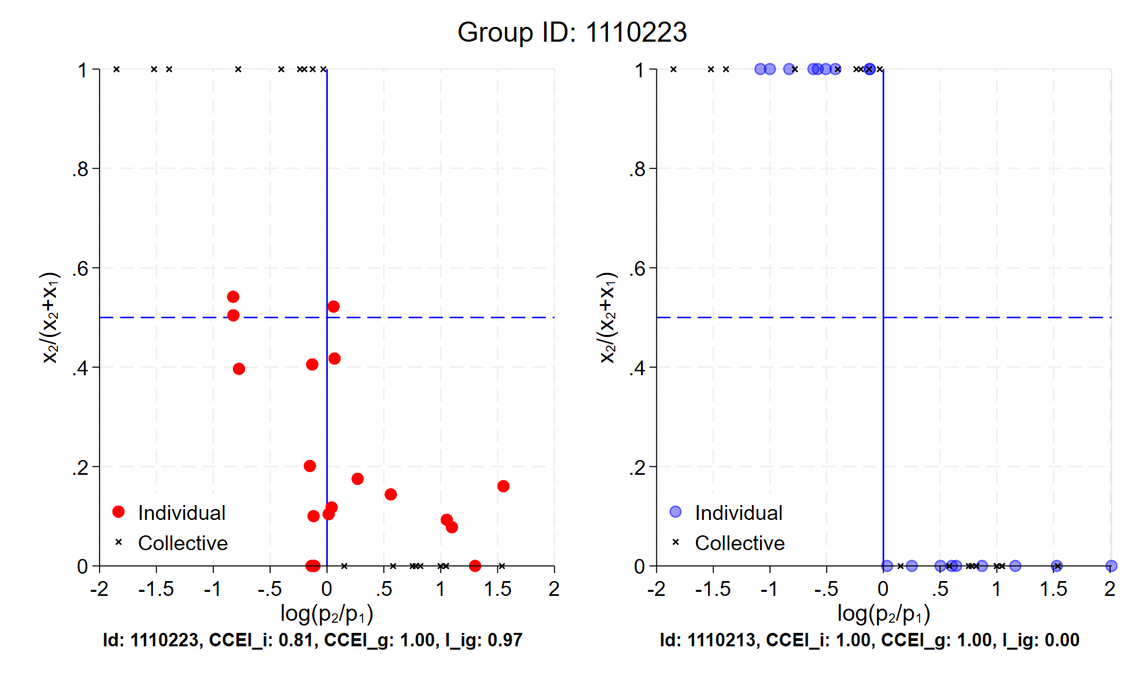
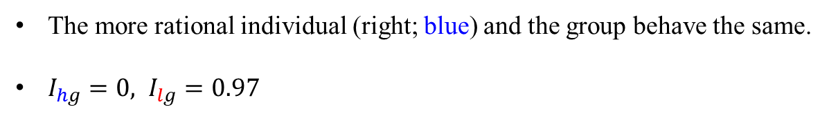
Selective Group 1
The more rational individual (right; blue) and the group behave the same.
$I_{hg}=0, I_{lg}=0.97$

Slide 22
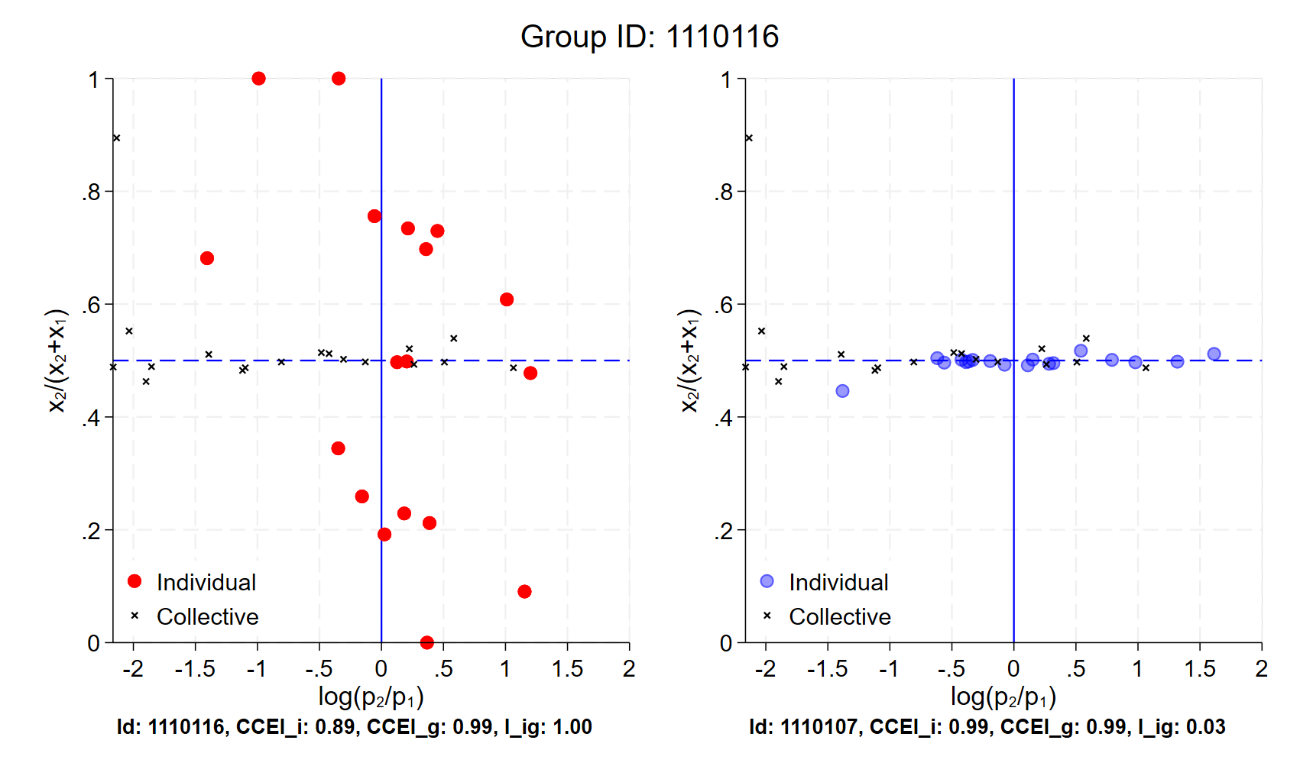

Selective Group 2
$I_{hg}=0.03, I_{lg}=1.00$

Slide 23
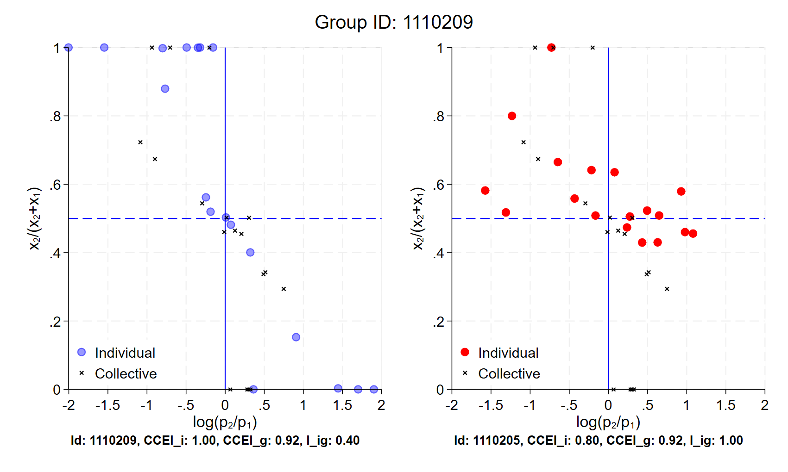

Selective Group 3
$I_{hg}=0.40, I_{lg}=1.00$

Slide 24
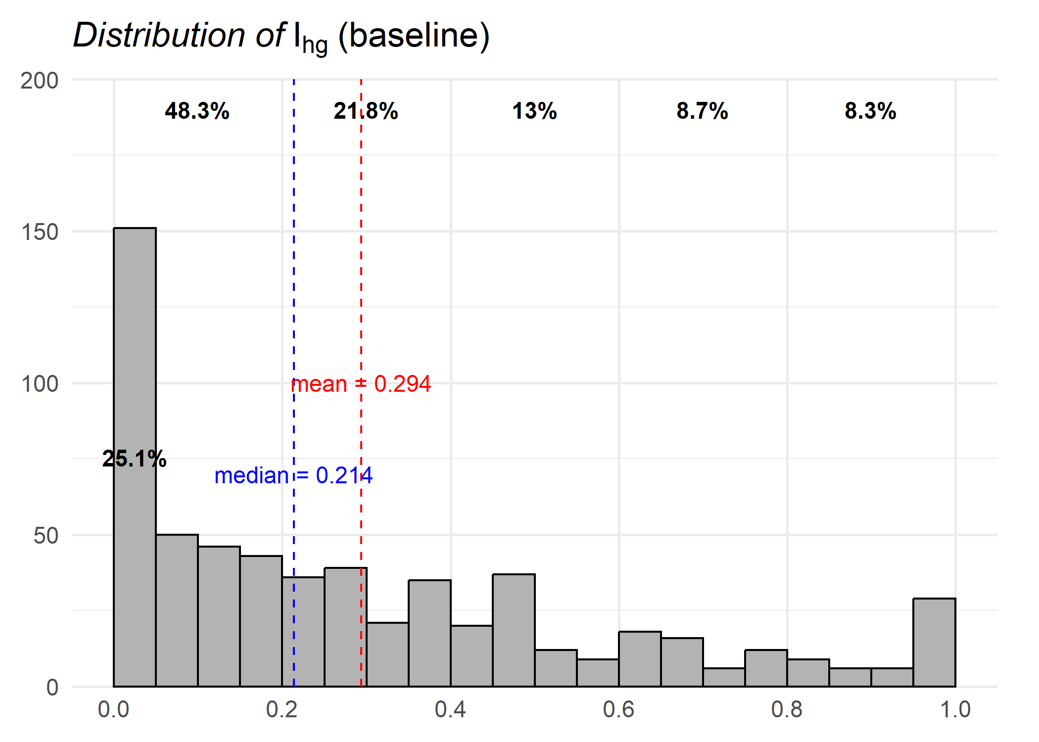
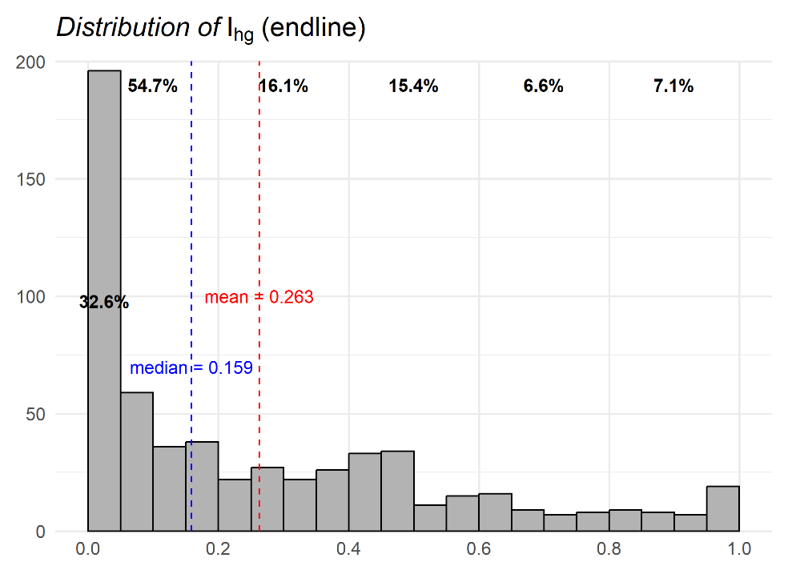
Revealed Preference Distance: More Rational Individual
The average of $I_{hg}$ is 0.294 in the baseline and 0.263 in the endline.

Slide 25
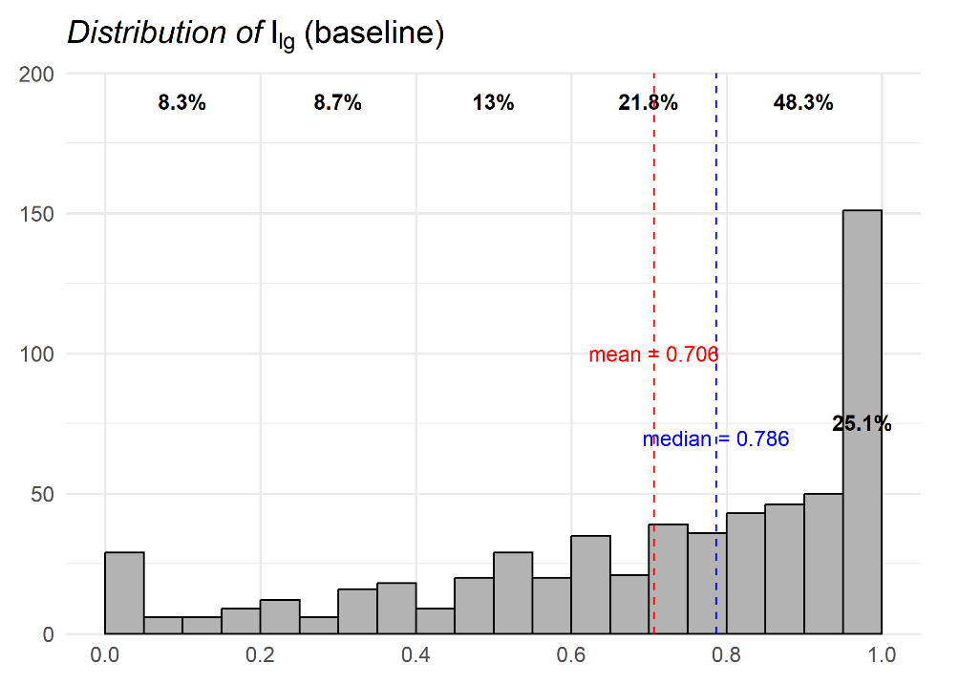
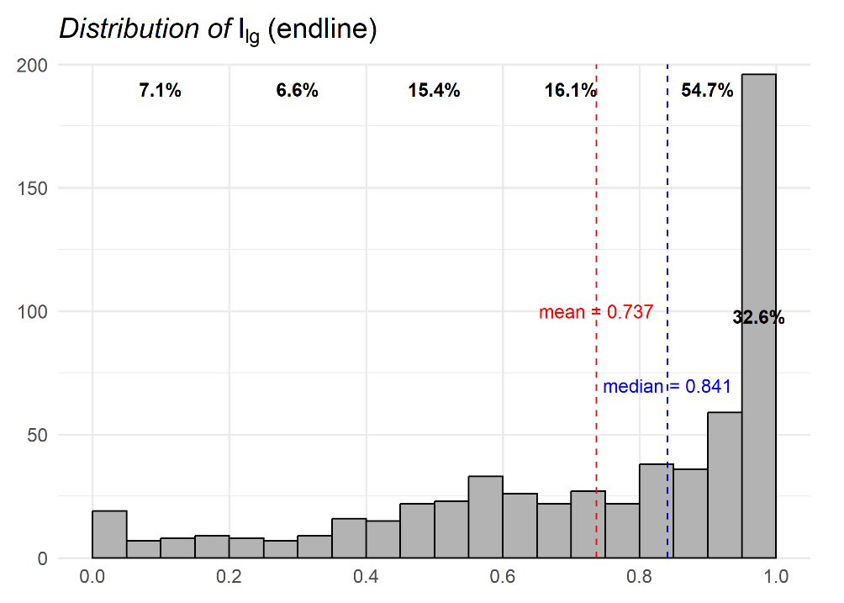
Revealed Preference Distance: Less Rational Individual
The average of $I_{lg}$ is 0.706 in the baseline and 0.737 in the endline.

Slide 26
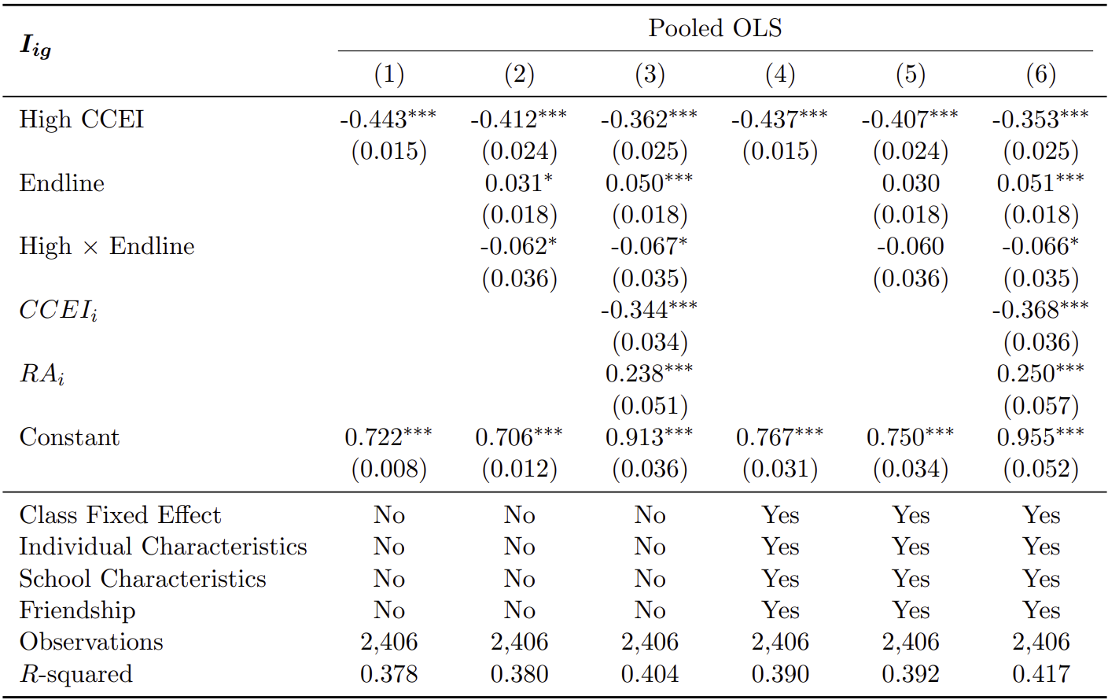
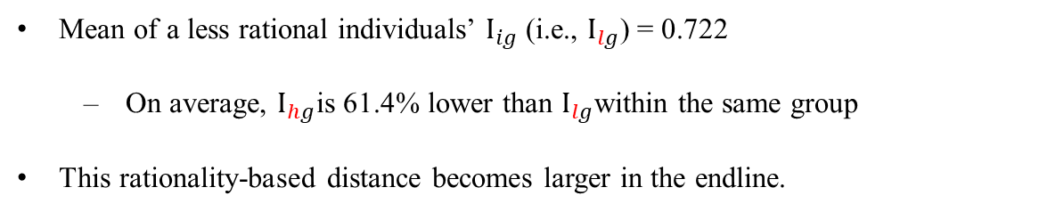
Revealed Preference Distance
Mean of a less rational individuals’ $I_{ig}$ (i.e., $I_{lg}$) = 0.722
  On average, $I_{hg}$is 61.4% lower than $I_{lg}$within the same group
This rationality-based distance becomes larger in the endline.

Slide 27
Conclusion
Large-scale, panel experiments about individual and group decision-making
  Random group formation leads to infer the effects of individual rationality on the quality of group decision-making and individual power on group decision-making.
Provide a nonparametric, revealed preference measure of individual (bargaining) power on group decisions.
Findings
  The quality of group decisions increases with the CCEI of more rational one and decreases with the gap of CCEIs between two individuals.
  The more rational individual makes a larger revealed (bargaining) power on group decision-making.

