Slide 1
Aggregation of Rationality and Preferences in Group Decisions: A Panel Experiment
June 28, 2025
The Science of Decision Making Conference

Slide 2
Introduction
Long-standing interests in group decision making
  Households (e.g., McEloy and Horney, 1981; Chiappori, 1992; Lundberg and Pollak, 1996);
  Committees (e.g,, Austen-Smith and Banks, 1996; Feddersen and Pesendorfer, 1998))
  Social choice theory (e.g., Arrow, 1951; Sen, 1970), etc.
Individual rationality is a foundational assumption in understanding group decision making.
  Various determinants of group decision-making: outside options, information and resources controlled, rules of interaction, etc.
We claim that the degree of individual rationality is one source of (1) the quality of group decision-making and (2) individual influences on group decision making.

Slide 3
In This Paper
Conduct large-scale panel experiments over two periods with a four-month interval
  Over 1,300 (final sample) individuals are randomly paired to make individual and group decisions in a portfolio allocation problem
  Collect rich individual- and collective-level data suited to applying revealed preference analysis
Propose a nonparametric, revealed preference measure of individual influences on group decision making
Make a causal inference on the effect of individual rationality on group outcomes.

Slide 4
Sampling
1,572 students from 12 middle schools in South Korea in the baseline study (in August); revisited in the endline study (in December)
In each study, they completed two stages of decision making under risk at the individual level and at the collective level.
  Pairs were randomly formed within classroom for collective choices in the baseline
  They were kept unchanged in the endline
  Due to attrition, the final sample consists of 657 groups (1,314 individuals) in both studies.
We also collected their individual characteristics (height, gender, math score, etc) and friendship information.

Slide 5
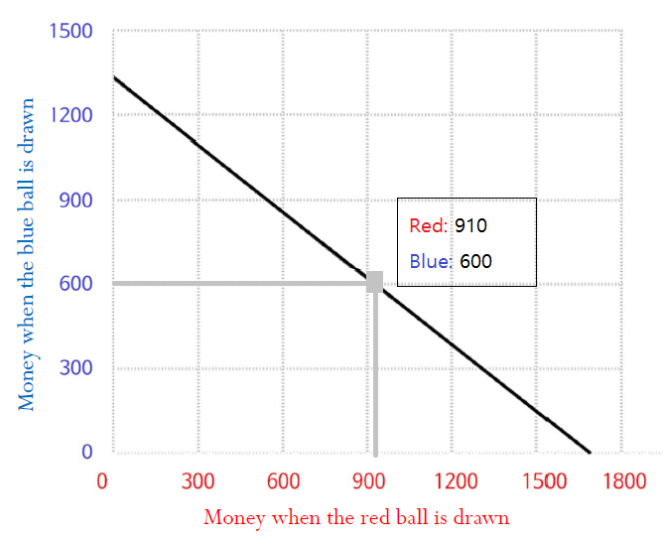

Decision Problem
Follow Choi et al. (2007)
  Allocate an income over two Arrow securities (associated with equally probably two states): choose $\left(x_{1},x_{2}\right)$ subject to $p_{1}x_{1}+p_{2}x_{2}=1$

Slide 6
Experimental Procedures
Participants: students from 12 middle schools in South Korea
Stage 1
(Individual DM)
Random matching within classroom
Stage 2
(Group DM)
18 rounds of individual choices with exogenous price variations
1 randomly selected round for payoffs
Randomly matched students in pair sit side by side
1 min 30 sec of discussion
18 rounds of collective choices with exogenous price variations
1 randomly selected round for payoffs (doubled and divided equally)
No feedback is given during the experiment, and subjects are informed only the sum of payoffs from the two stages at the end of the study.

Slide 7
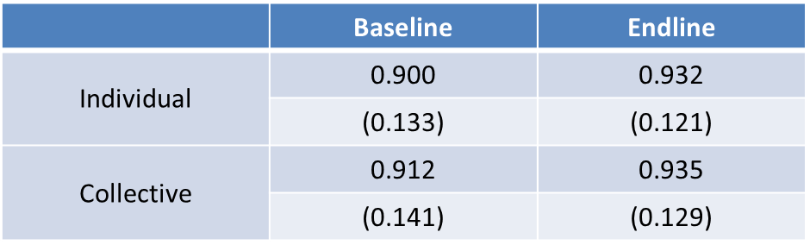
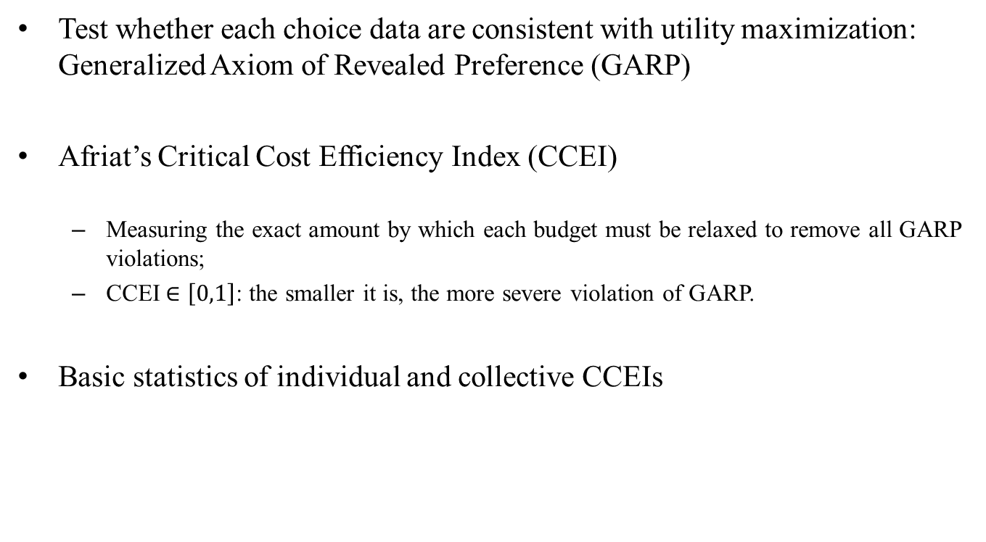
Measuring Rationality
Test whether each choice data are consistent with utility maximization: Generalized Axiom of Revealed Preference (GARP)
Afriat’s Critical Cost Efficiency Index (CCEI)
  Measuring the exact amount by which each budget must be relaxed to remove all GARP violations;
  CCEI$∈\left[0,1\right]$: the smaller it is, the more severe violation of GARP.
Basic statistics of individual and collective CCEIs

Slide 8
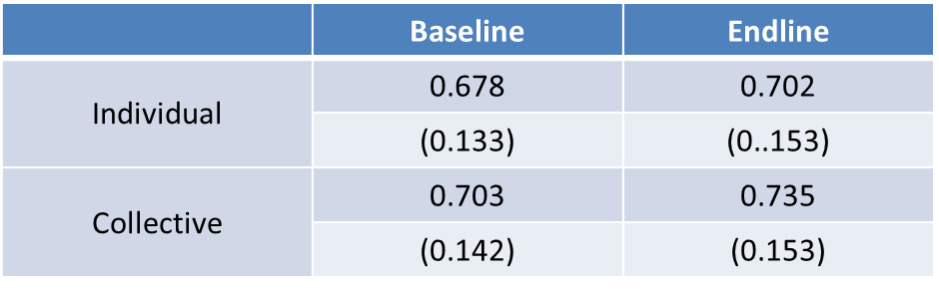
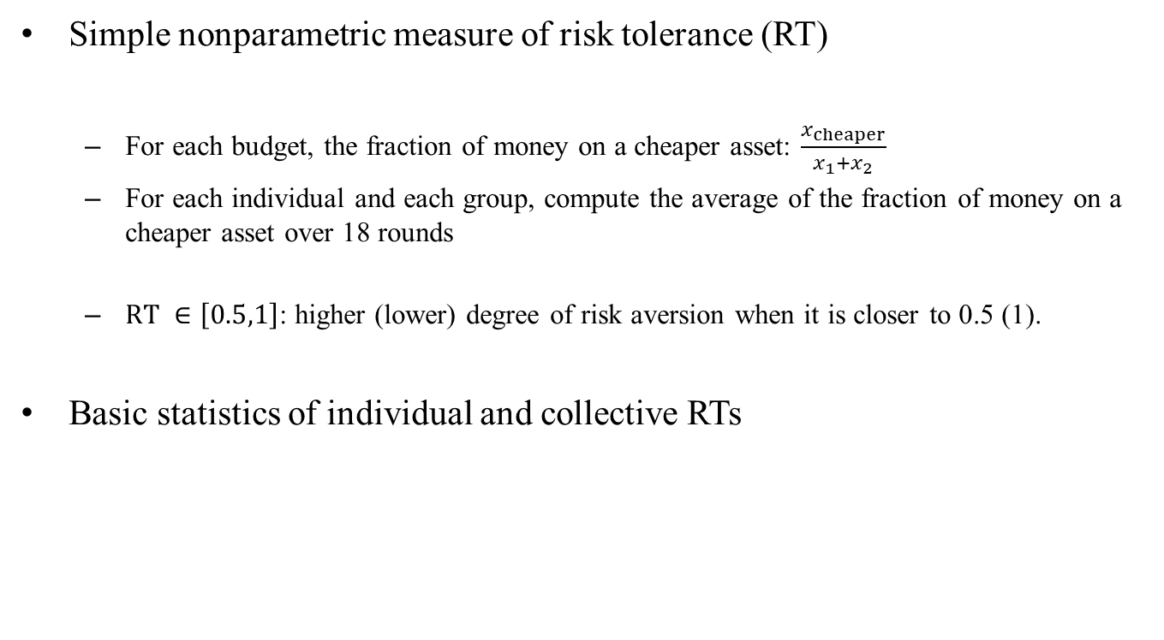
Measuring Risk Preferences
Simple nonparametric measure of risk tolerance (RT)
  For each budget, the fraction of money on a cheaper asset: $\frac{x_{cheaper}}{x_{1}+x_{2}}$
  For each individual and each group, compute the average of the fraction of money on a cheaper asset over 18 rounds
  $RT ∈\left[0.5,1\right]$: higher (lower) degree of risk aversion when it is closer to 0.5 (1).
Basic statistics of individual and collective RTs

Slide 9
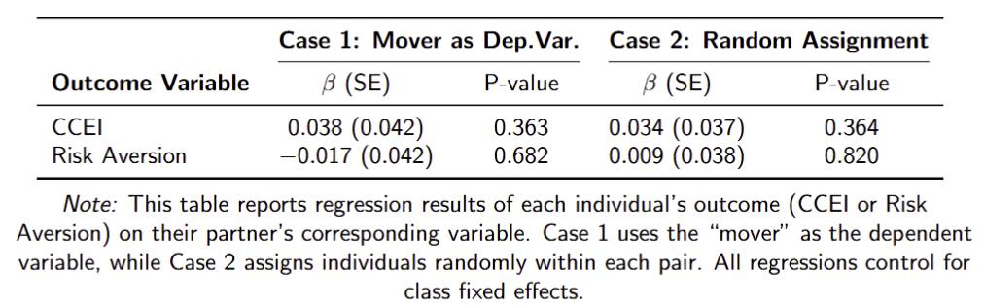
Balance Test
Random group formation makes an individual’s CCEI and risk aversion not correlated with those of the other in the same group.

Slide 10
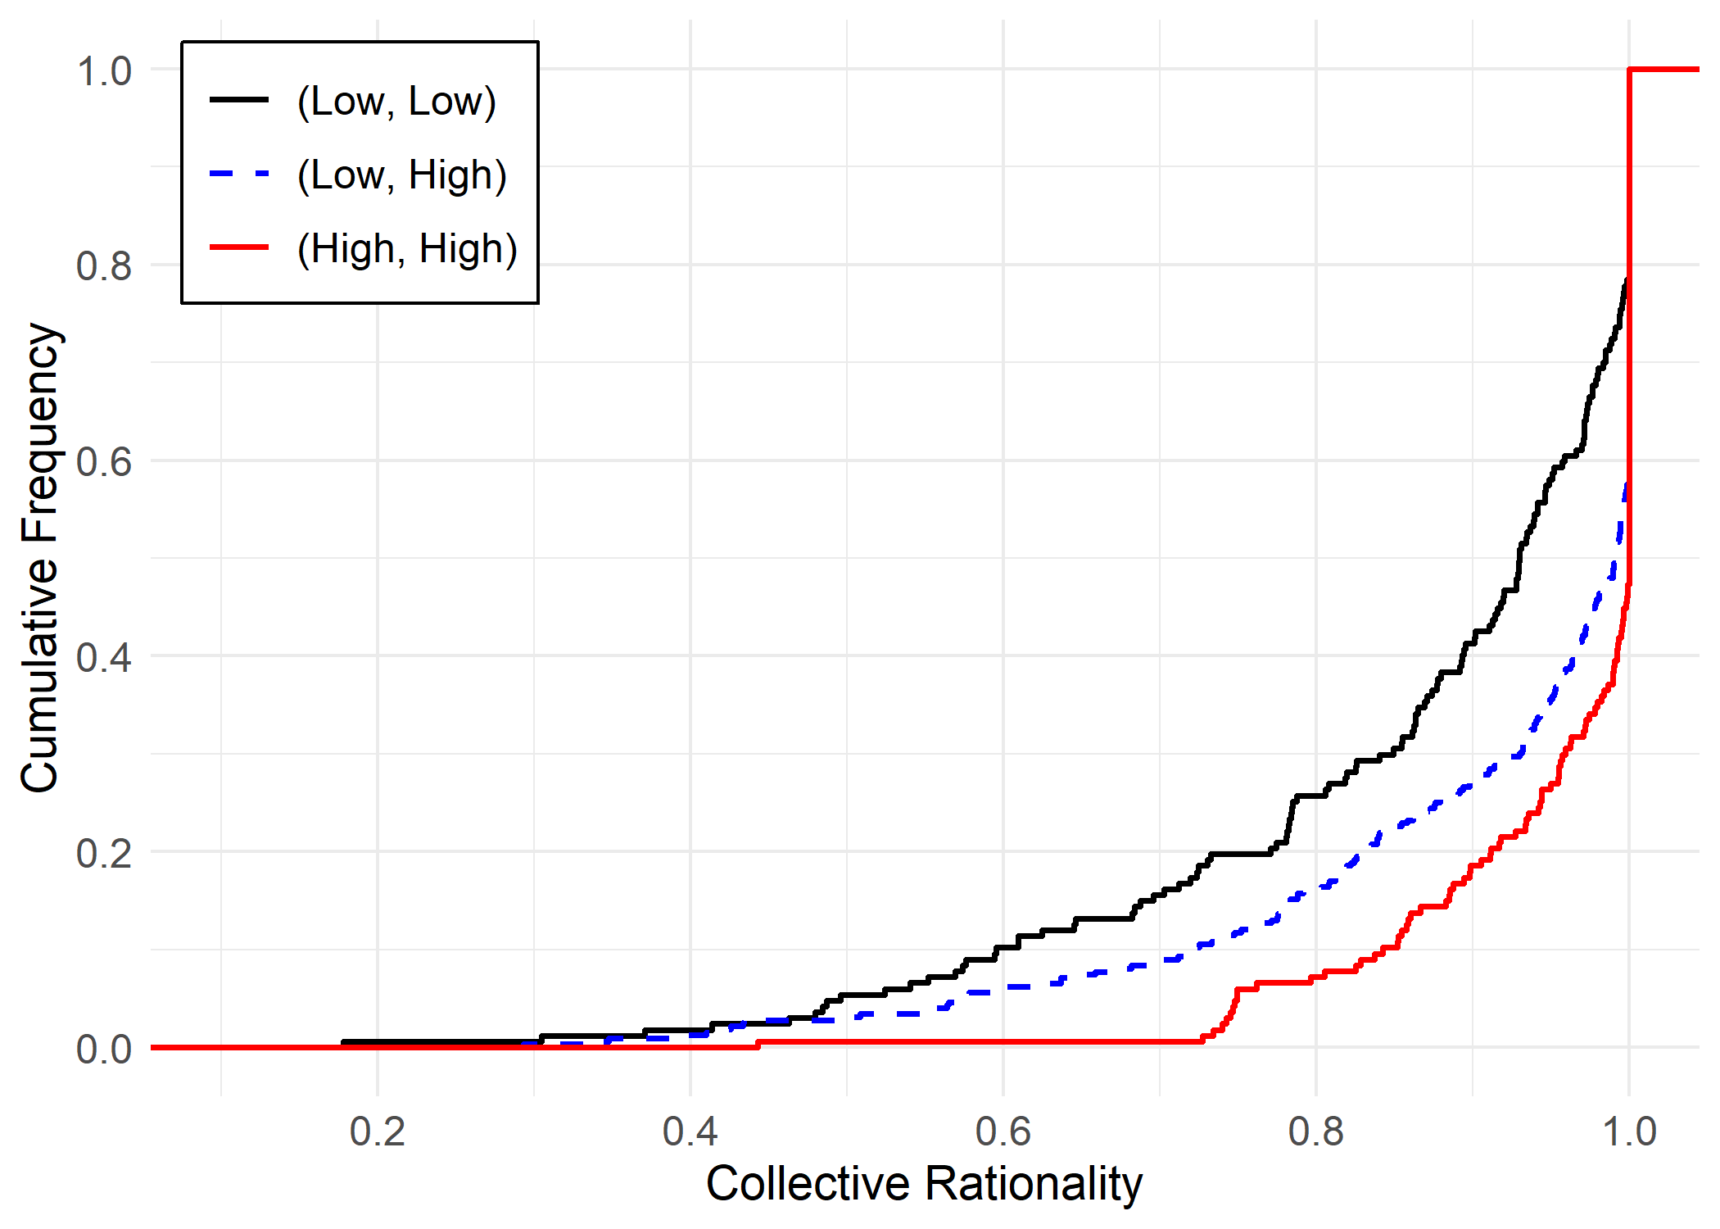
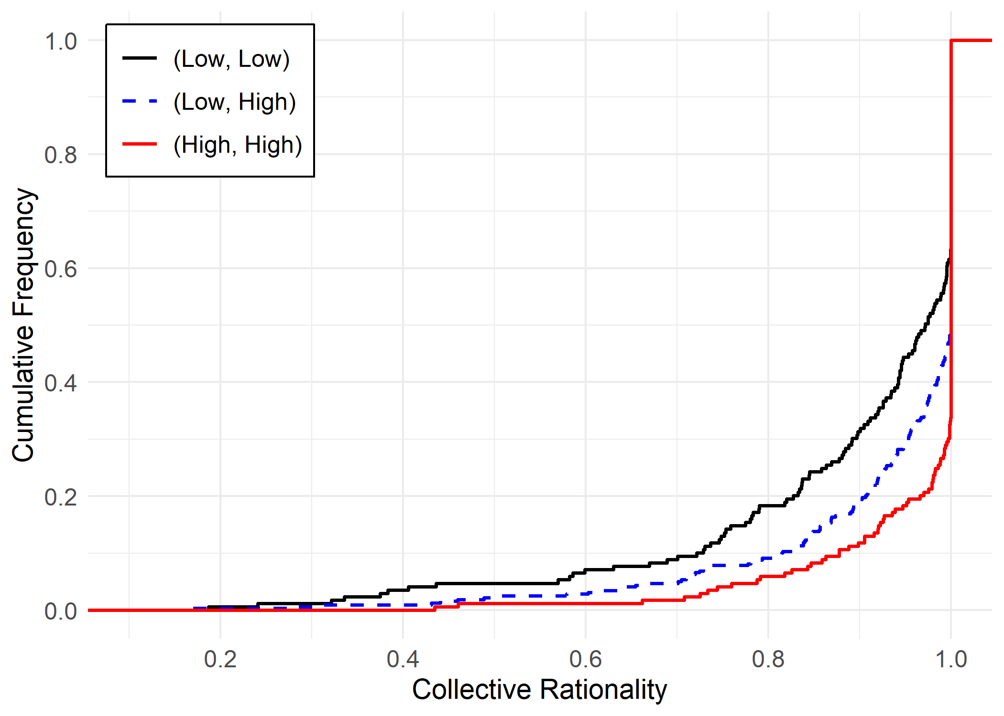
Rationality Extension
Q1: Do more rational individuals make group decisions more rational?
Divide subjects into two groups w.r.t. individual CCEIs
  High (Low) group: above (below) the median of CCEI
Baseline
Endline

Slide 11
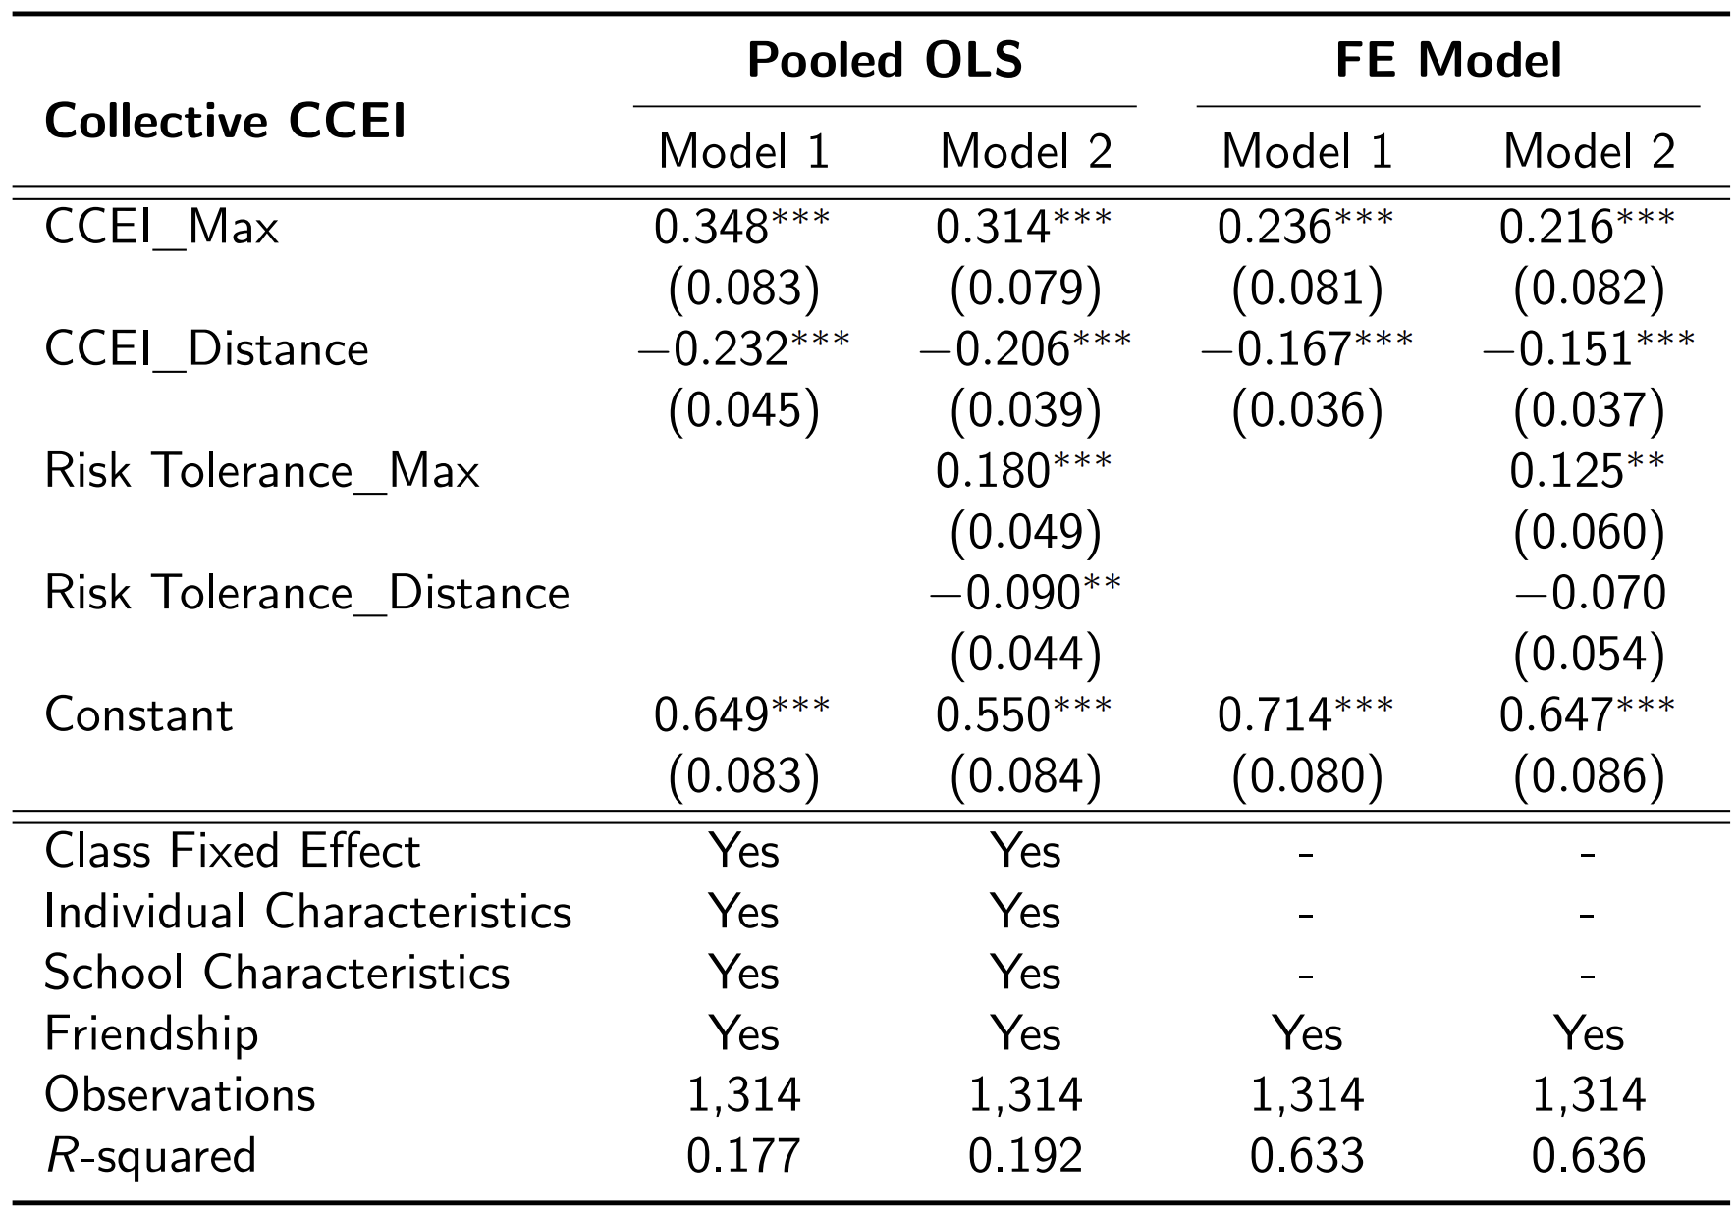
Rationality Extension
Collective CCEI increases in CCEI of a more rational individual and decreases in the difference between CCEIs of two individuals, even after controlling for preferences.

Slide 12

Rationality-based Preference Aggregation
Q2: Is the preference of the group closer to that of a more rational individual?
Individual with higher (lower) CCEI in the group: $i=h\left(high\right), l(low)$
Compute the distance of risk tolerance between individual $i$ and the group

Slide 13
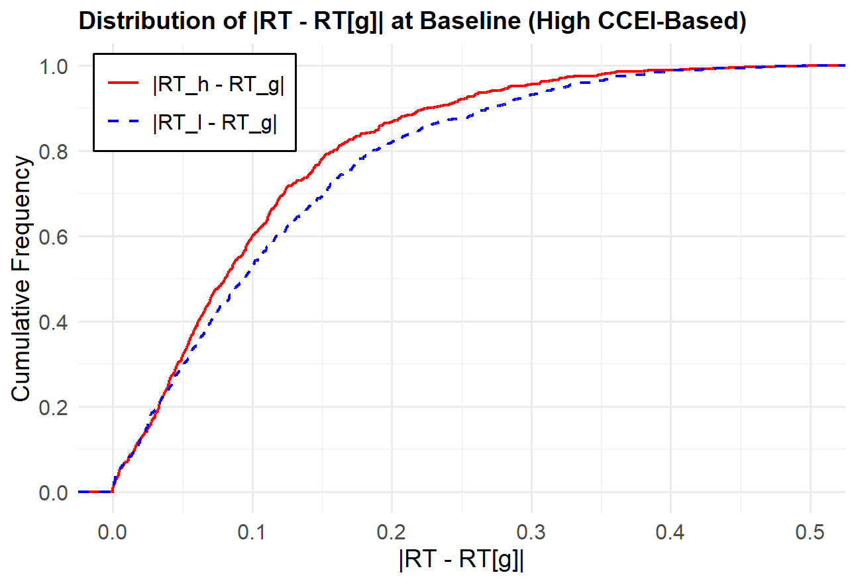
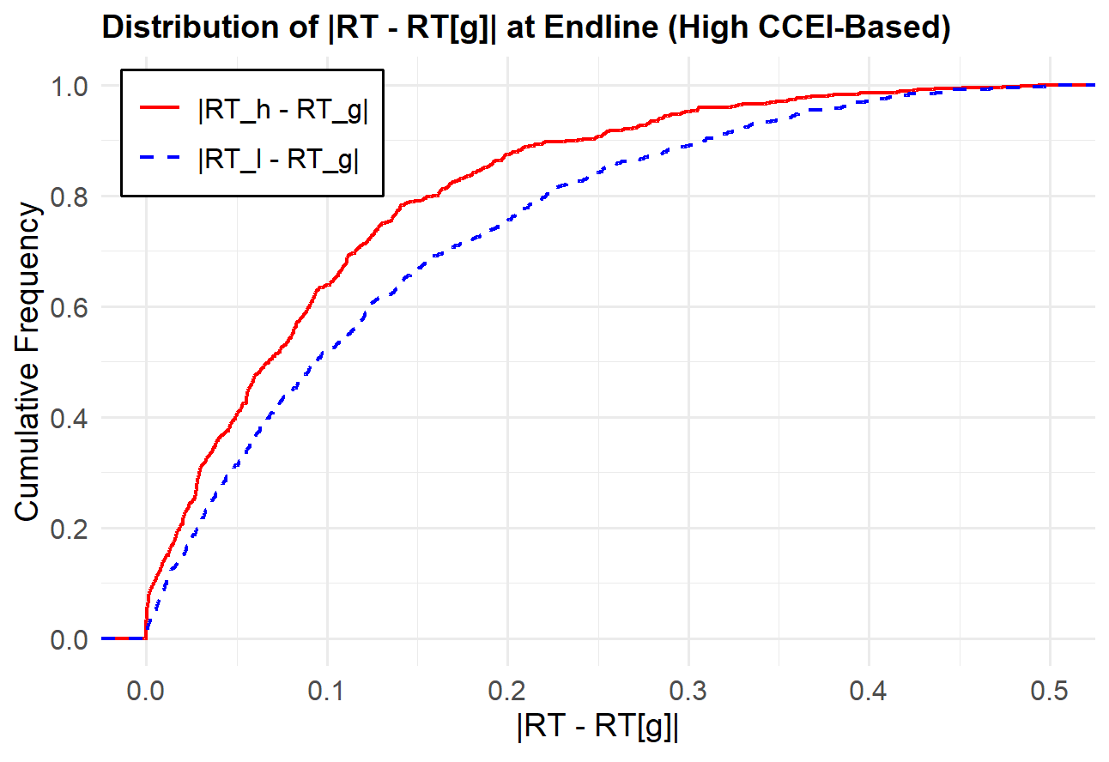
Rationality-based Preference Aggregation
Baseline
Endline
The preference gap between a more rational individual and the group is smaller than that between a less rational individual and the group.

Slide 14
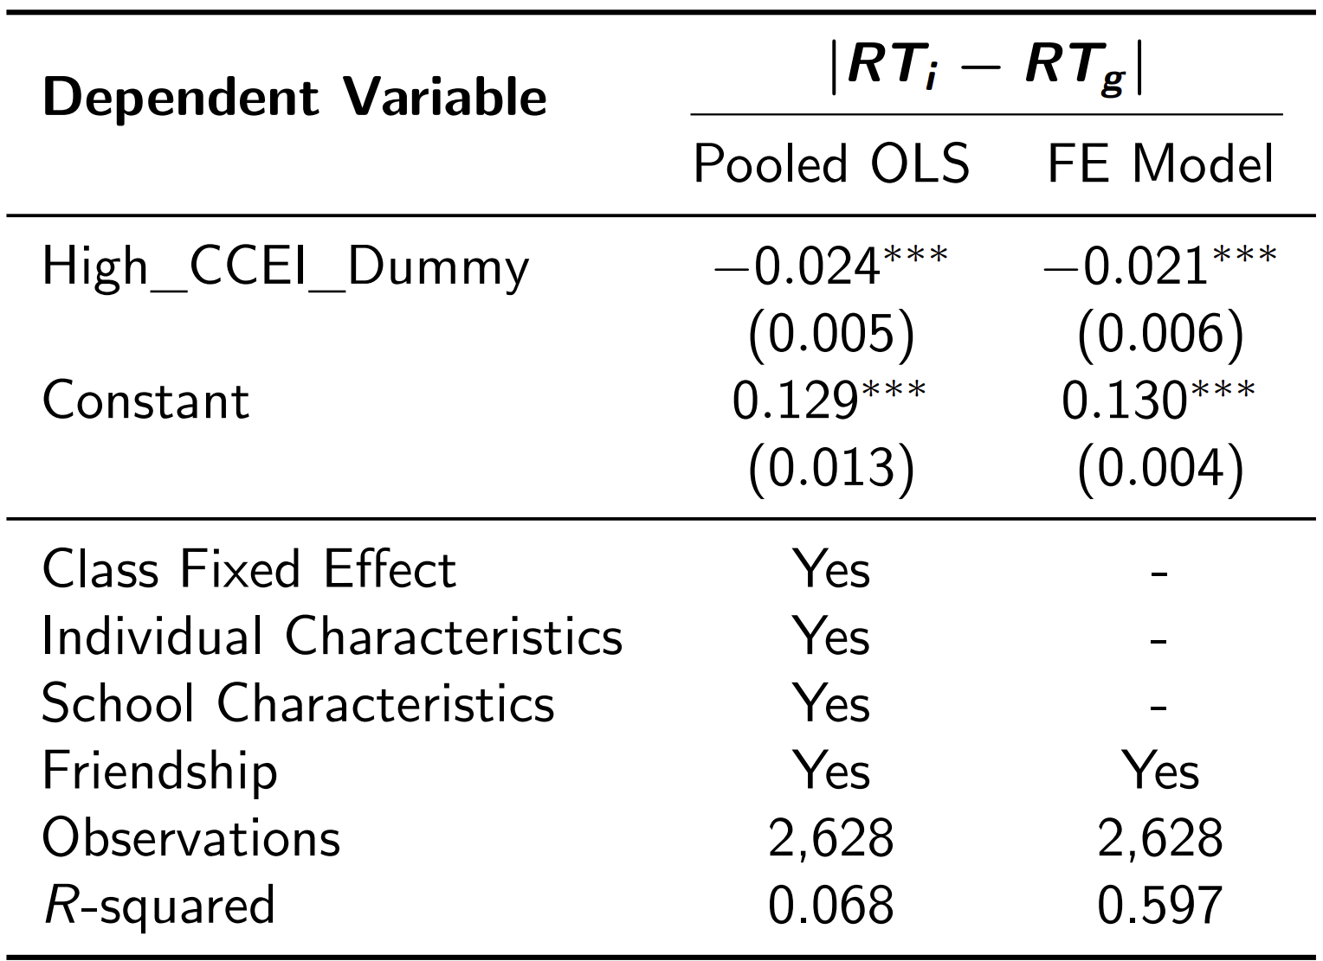
Rationality-based Preference Aggregation
Collective risk preference is closer to the individual risk preference of a more rational individual.

Slide 15

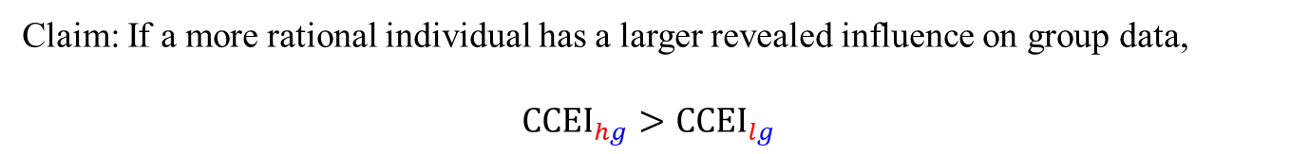

Revealed Influence on Group Decisions
Revealed preference approach: how close an individual’s choices are to group choices
An individual is said to have a larger revealed influence on group data if her choice data is “closer” to the data of group choices.
Group choices
Choices of more rational individual
$${CCEI}_{hg}$$
Group choices
Choices of
less rational individual
$${CCEI}_{lg}$$
Claim: If a more rational individual has a larger revealed influence on group data,
$${CCEI}_{hg}>{CCEI}_{lg}$$

Slide 16

Validating the Concept of Revealed Influence
Suppose a portfolio $x=\left(x_{1},x_{2}\right)$ is evaluated:
$$U\left(x\right)=\frac{1}{2}\frac{x_{1}^{1−ρ}}{1−ρ}+\frac{1}{2}\frac{x_{2}^{1−ρ}}{1−ρ}$$
Stochastic choice function
$$Pr\left(x^{∗}\right)=\frac{e^{γU\left(x^{∗}\right)}}{\int_{\left\{x:p∙x=1\right\}}{e^{γU\left(x\right)}}}$$
Simulate choice data with different values of $ρ$ and $γ$

Slide 17
Validating the Concept of Revealed Influence

Slide 18
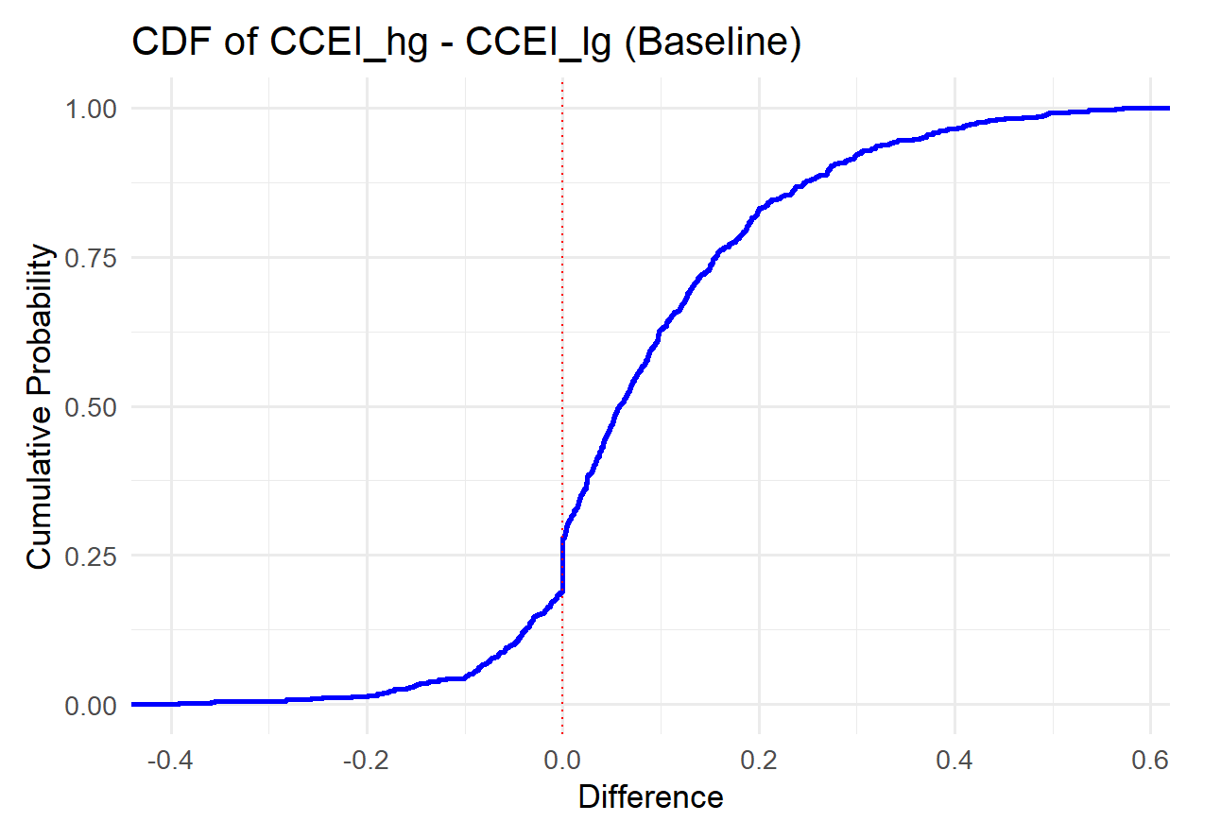
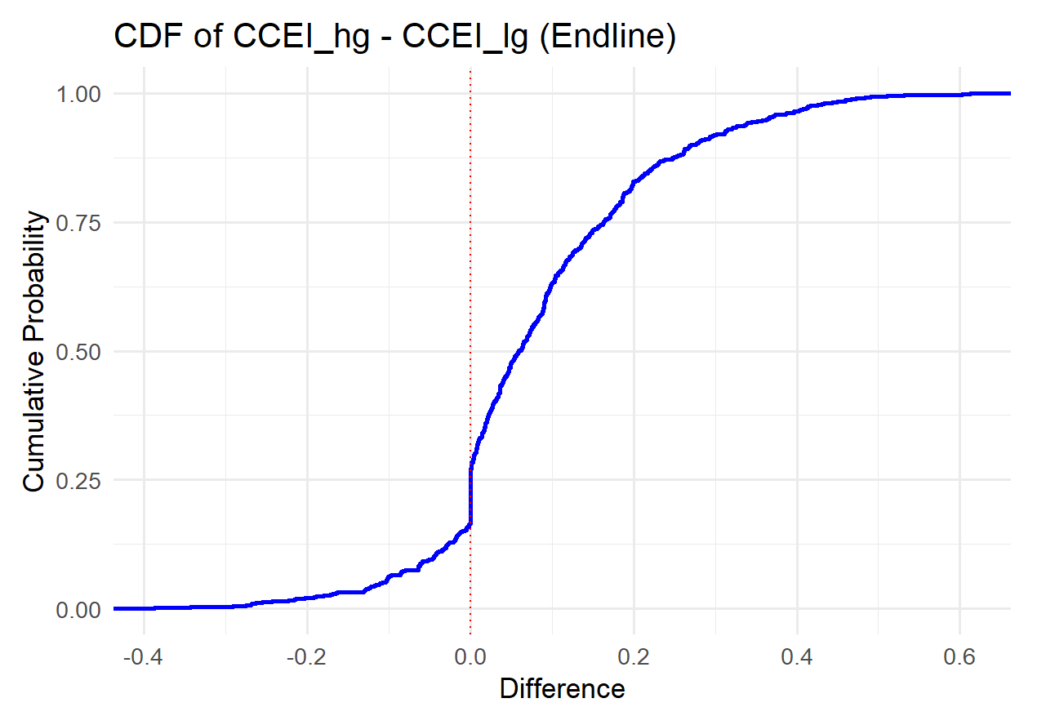
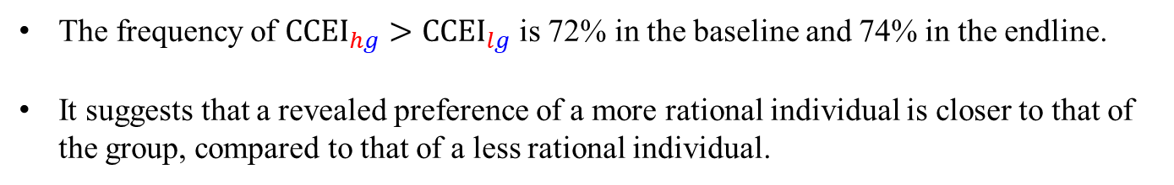
Revealed Influence on Group Decisions
The frequency of ${CCEI}_{hg}>{CCEI}_{lg}$ is 72% in the baseline and 74% in the endline.
It suggests that a revealed preference of a more rational individual is closer to that of the group, compared to that of a less rational individual.

Slide 19
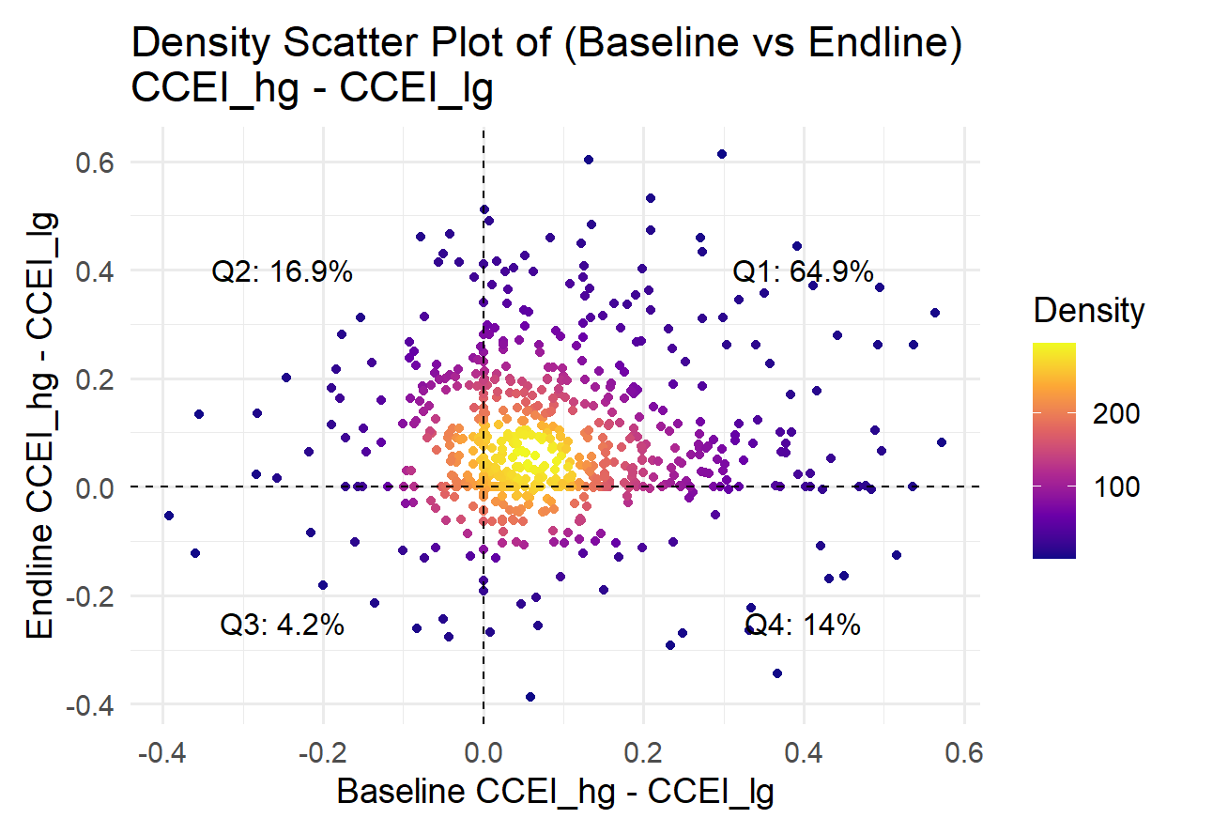
Individual Influence on Group Decisions

Slide 20
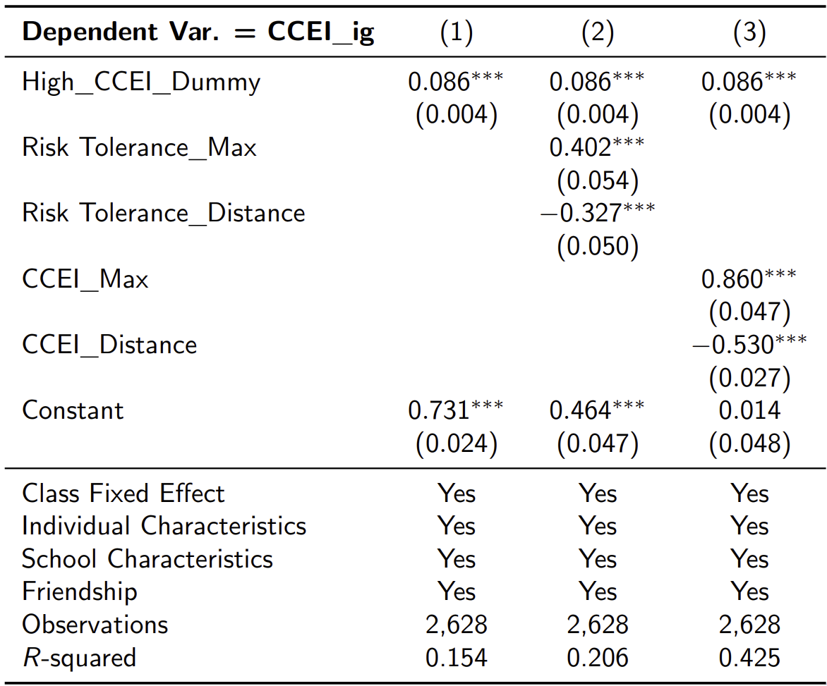
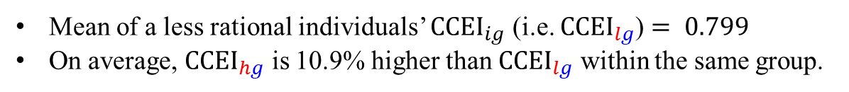
Revealed Influence of More Rational Individuals
Mean of a less rational individuals’ ${CCEI}_{ig}$ (i.e. ${CCEI}_{lg}$) $= 0.799$
On average, ${CCEI}_{hg}$ is 10.9% higher than ${CCEI}_{lg}$ within the same group.

Slide 21
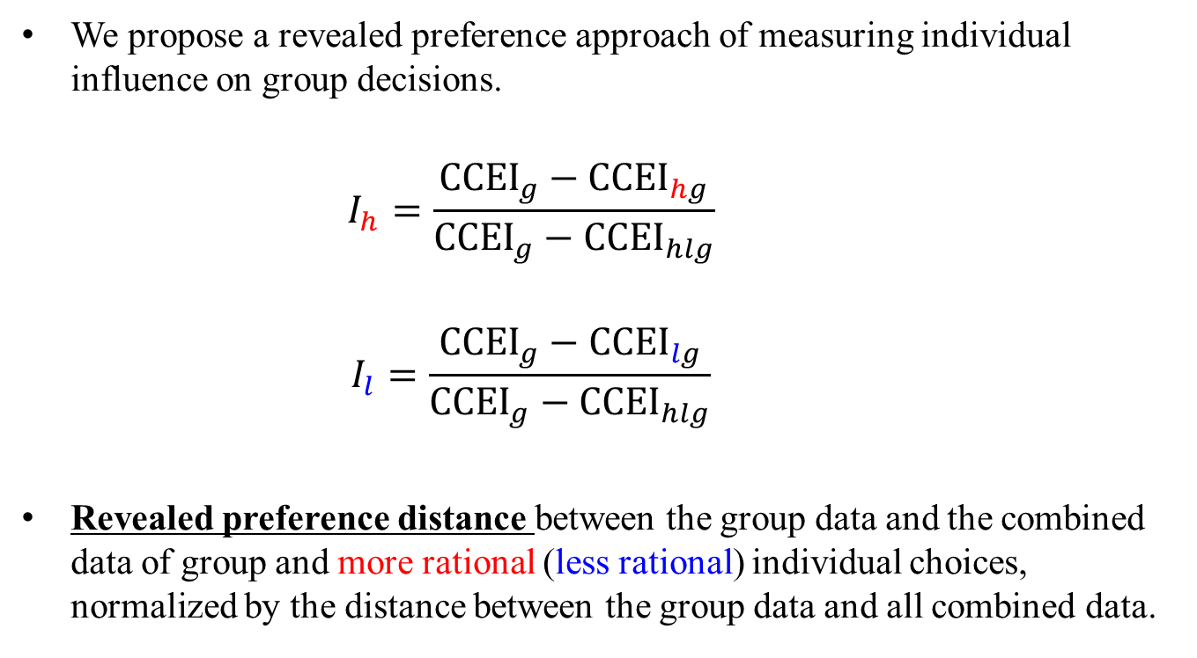
Revealed Individual Influence
We propose a revealed preference approach of measuring individual influence on group decisions.
$$I_{h}=\frac{{CCEI}_{g}−{CCEI}_{hg}}{{CCEI}_{g}−{CCEI}_{hlg}}$$
$$I_{l}=\frac{{CCEI}_{g}−{CCEI}_{lg}}{{CCEI}_{g}−{CCEI}_{hlg}}$$
Revealed preference distance between the group data and the combined data of group and more rational (less rational) individual choices, normalized by the distance between the group data and all combined data.
more rational individual
less rational individual

Slide 22
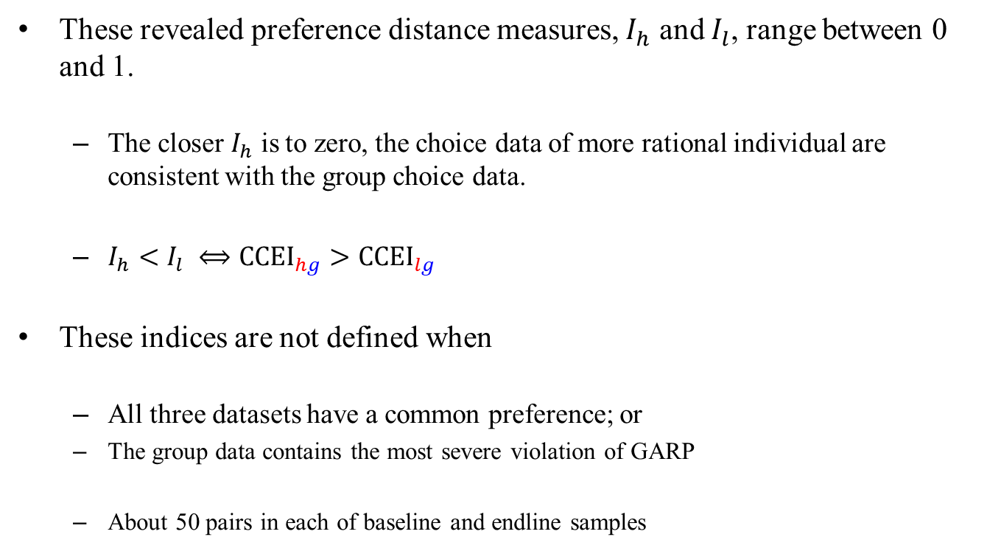
Revealed Individual Influence
These revealed preference distance measures, $I_{h}$ and $I_{l}$, range between 0 and 1.
  The closer $I_{h}$ is to zero, the choice data of more rational individual are consistent with the group choice data.
  $I_{h}<I_{l} ⟺{CCEI}_{hg}>{CCEI}_{lg}$
These indices are not defined when
  All three datasets have a common preference; or
  The group data contains the most severe violation of GARP
  About 50 pairs in each of baseline and endline samples

Slide 23
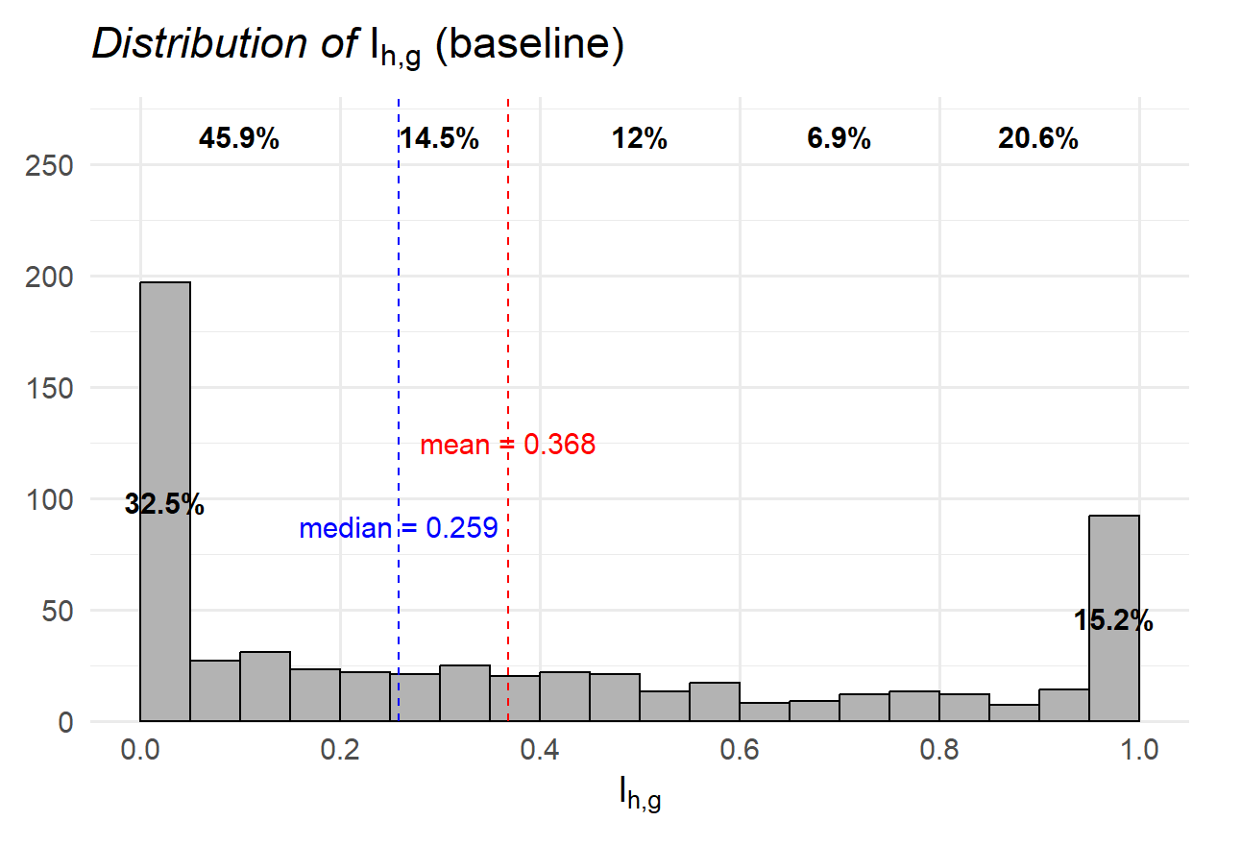
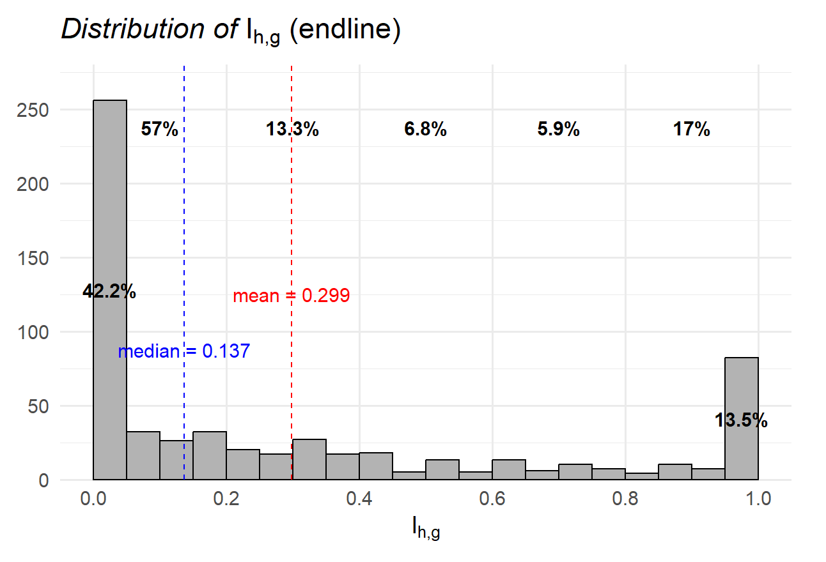
Revealed Influence of More Rational Individual
The average of $I_{hg}$ is 0.368 in the baseline and 0.299 in the endline.

Slide 24
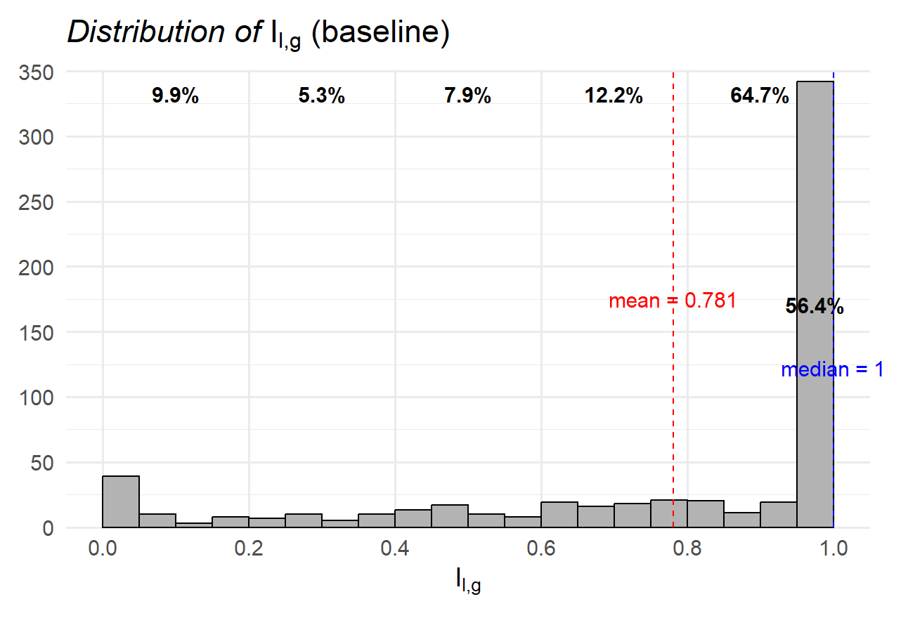
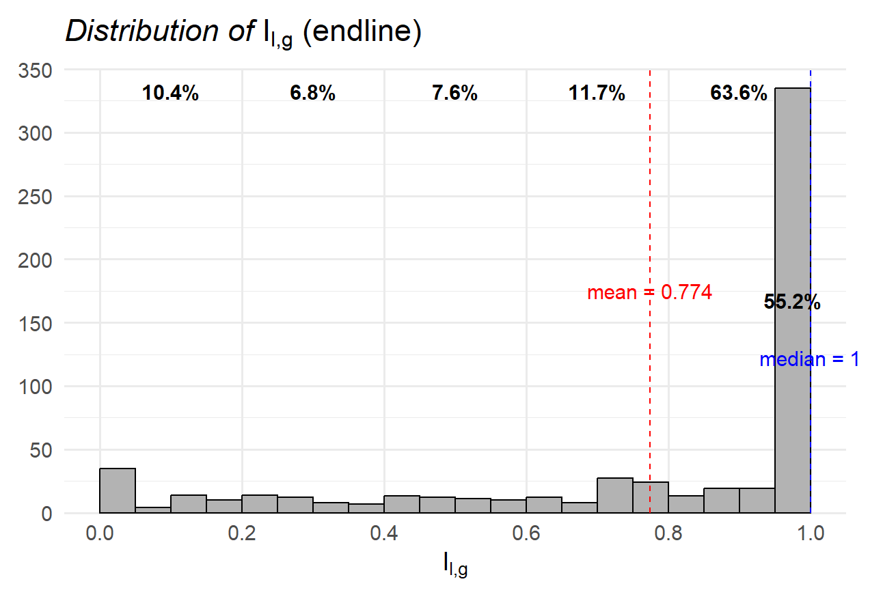
Revealed Influence of Less Rational Individual
The average of $I_{lg}$ is 0.781 in the baseline and 0.774 in the endline.

Slide 25
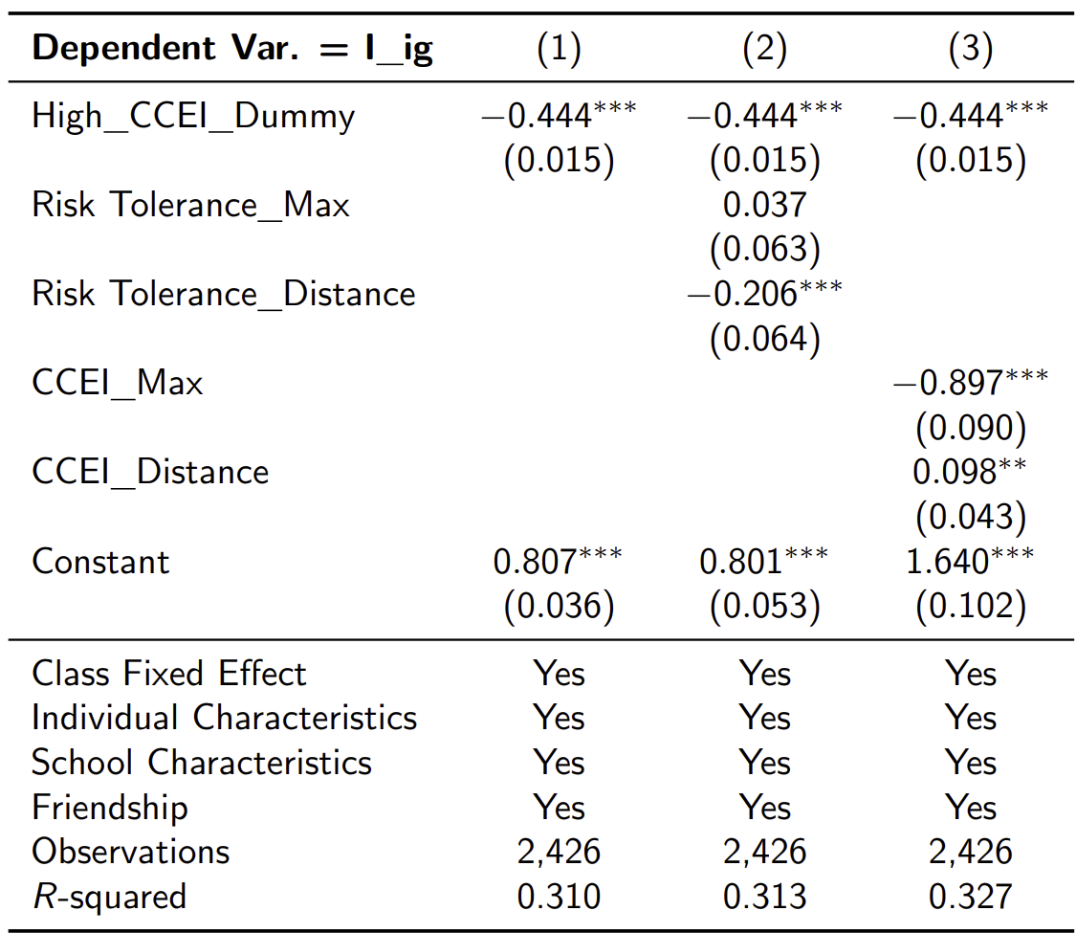
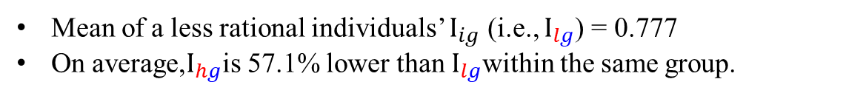
Revealed Influence of More Rational Individuals
Mean of a less rational individuals’ $I_{ig}$ (i.e., $I_{lg}$) = 0.777
On average,$I_{hg}$is 57.1% lower than $I_{lg}$within the same group.

Slide 26
Conclusion
Large-scale, panel experiments about individual and group decision-making
  Random group formation leads to infer the effects of individual rationality on the quality of and individual influences on group decisions.
Provide a nonparametric, revealed preference measure of individual influences on group decisions.
Findings
  The quality of group decisions increases in individual rationality and decreases in the difference in individual rationalities
  A more rational individual has a larger revealed influence on group decision-making.

