Slide 1
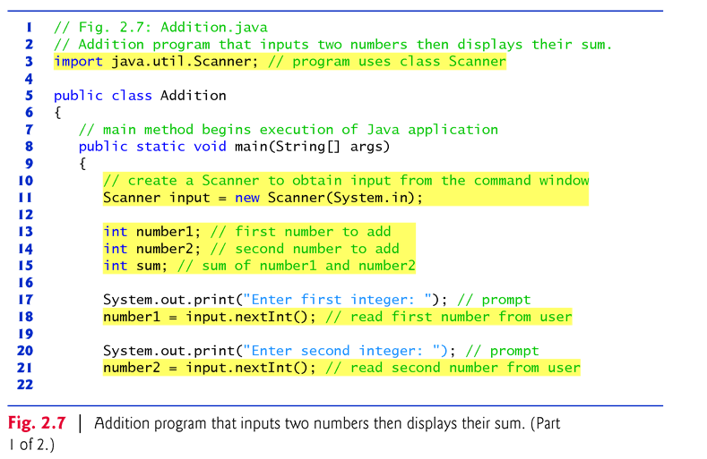
Program to add two integers

Slide 2
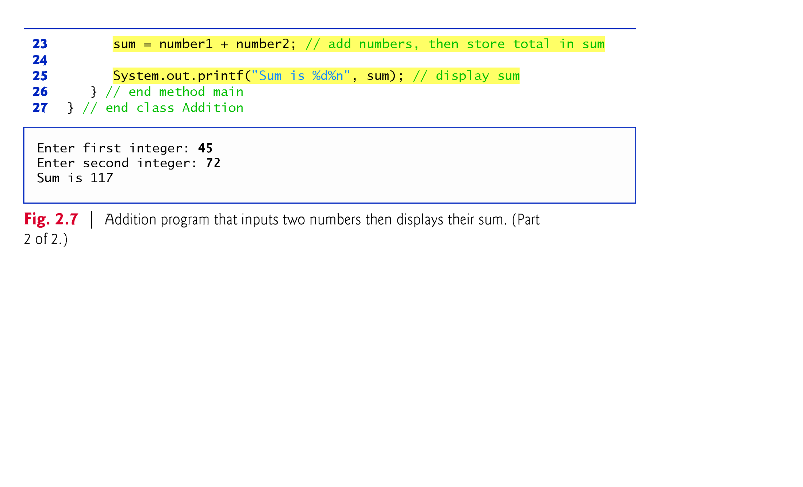
Program to add two integers Contd

