Slide 1
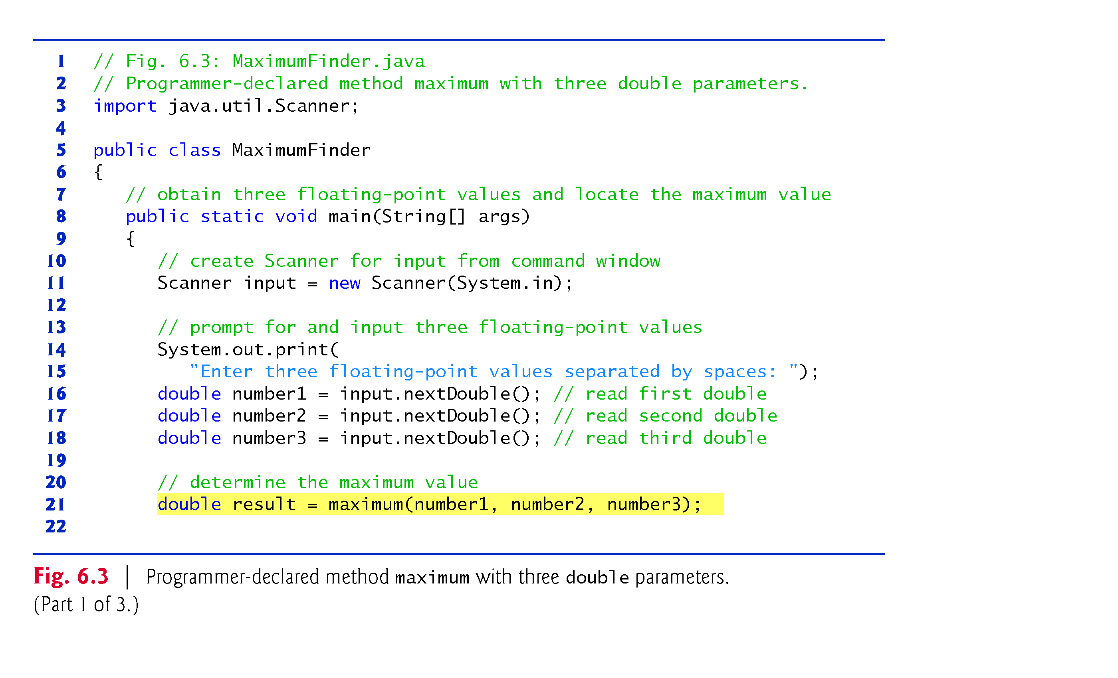
Program to find Maximum of 3 numbers

Slide 2
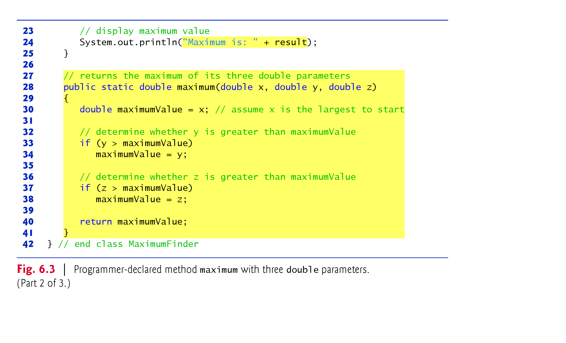
Program to find Maximum of 3 numbers … continued

Slide 3
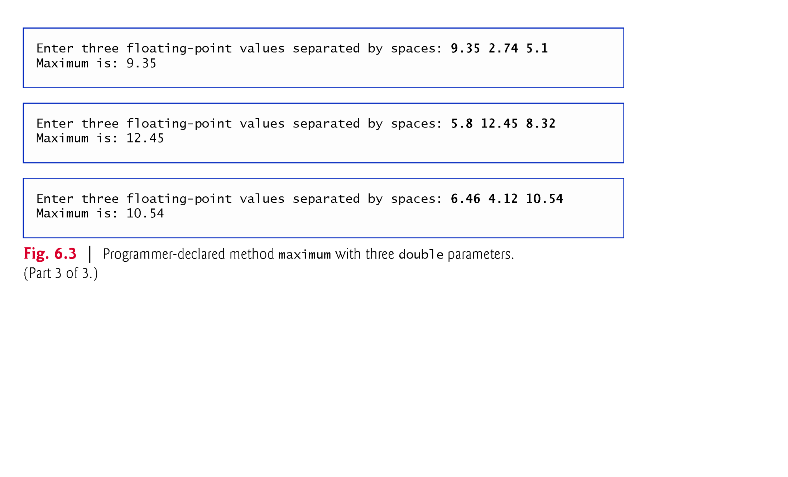
Program to find Maximum of 3 numbers … continued

