Slide 1
Ch 08: Generic Programming
Generic classes are added in Java SE 5.0.
Generic classes are desirable because they enable us to write code that is safer and
easier to read than the code that uses “Object” variables and casting Operation
collection classes such as “ArrayList” are generic classes
In C++, generic classes are called templates
8.1. Why Generic Programming?
Generic programming means writing code that can be reused for objects of many
different types.
For example, we don’t write two different classes to store array of “String” objects
and array of “File” objects because a single “ArrayList” class store array of objects of
any type of class.
This is one example of generic programming.

Slide 2
8.1. Why Generic Programming ? cont’d.
Before generic classes were added to Java API (before Java 5.0), generic
programming was achieved with inheritance.
Example: The “ArrayList” class simply contains an array of “Object” references.
public class ArrayList // before Java SE 5.0
{
private Object[] elementData;
. . .
public Object get(int i) { . . .}
public void add(Object o) { . . . }
}
The above approach has two problems:
The need of down casting operation when we retrieve an element from the ArrayList( see next slide)
lack of compile-time error checking when an element is added to the ArrayList ( see next slide)

Slide 3
8.1. Why Generic Programming? cont’d.
Example:
ArrayList AL = new ArrayList(); // create an array with default size.
AL.add(“Kim”);
String filename = AL.get(0); // Error
String filename = (String) AL.get(0); // ok
AL.add(new File(“abc.txt")); // ok. no compile error because we can add any class
String filename = (String) AL.get(1); // class cast exception occurs
// because “File” class is not
// superclass of “String ” class.
File filename = (File) AL.get(1); // ok
Note: We must write many if( instanceof) blocks to do down casting operation for different subclasses of an “Object” class.

Slide 4
8.1. Why Generic Programming? cont’d.
To address the above two problems, Generic class is added in java SE 5.0
Hence, generic class solves this problem by using Type parameters as follows
Case 1 : ArrayList<String> files = new ArrayList<String >(); // SE 5.0 and SE 6.0
Case 2 : ArrayList<String> files = new ArrayList<>(); // since SE 7.0
Note 1 : Element type T supplied inside angle brackets <...>
Note 2: No cast required in get() method as follows
ArrayList<String> files = new ArrayList<>(); // since SE 7.0
String filename = files.get(0); // compiler knows that return type is
// String, not Object:
Note 3: Illegal argument to add() caught at compile time as follows:
ArrayList<String> files = new ArrayList<>(); // since SE 7.0
files.add(new File(“abc.txt")); // compiler error because the type is T is String N
Note 4: compiler error is better than class cast exception at runtime.
Question 1: what is the similarity between ArrayList<String> and String[] ?
Question 2: what is the difference between ArrayList<String> and String[]?

Slide 5
8.1.2. Who Wants to Be a Generic Programmer?
It is easy to use generic classes such as ArrayList
However, if you are asked to write ArrayList class by yourself , it is not easy because
The ArrayList class has to work for all element types.
The ArrayList class has addAll() method.
Assume we want to add all elements from ArrayList<Manager> to an ArrayList<Employee>
However, we do not want to add all elements from ArrayList<Employee > to an
ArrayList<Manager>
Hence, it is difficult to write code that allow that call and disallow the opposite
To address this problem, Java language designers use” wildcard Type”.
Generic programming skills fall into three levels
1. Basic level: Using existing generic classes in Java API such as ArrrayList
2. Intermediate level: Understanding enough about type parameters to debug problems.
3. Advanced level: Writing your own generic classes that can be used by other programmers.

Slide 6
Example: Using a Generic Class
// revise chapter 5: Listing 5.11: ArrayListTest (section 5.3).
public class ArrayListTest
{
public static void main(String[] args)
{
ArrayList<Employee> staff = new ArrayList<>();
staff.add(new Employee("Carl Cracker", 75000, 1987, 12, 15));
staff.add(new Employee("Harry Hacker", 50000, 1989, 10, 1));
staff.add(new Employee("Tony Tester", 40000, 1990, 3, 15));
for (Employee e : staff)
e.raiseSalary(5);
for (Employee e : staff)
System.out.println("name=" + e.getName() + ",salary=" + e.getSalary() + ",hireDay=" + e.getHireDay());
}
}

Slide 7
8.2.Defining your own Simple Generic Class
A generic class is a class with one or more type variables.
Example: see Pair as a generic class as follows
public class Pair<T> // parameter type T is introduced inside <> at the end of class name
{
private T first; // T is used to declare instance fields
private T second;
public Pair() { first = null; second = null; }
public Pair(T first, T second) { this.first = first; this.second = second; } // T is used as argument
public T getFirst() { return first; } // T is used as return type
public T getSecond() { return second; }
public void setFirst(T newValue) { first = newValue; }
public void setSecond(T newValue) { second = newValue; }
}
A generic class can have more than one type variable as follows:
publicclass Pair<T, U> { . . . }
A generic provides a means for describing the concept of a stack in a type-independent manner.

Slide 8
8.2.Defining your own Simple Generic Class
Remarks on Type variables
The T in public class Pair<T> is a type variable.
we can instantiate the generic type by substituting a type for the variable:
Pair<String>
We can think of generic class as an ordinary class with constructors and methods:
Pair<String>() // constructor
Pair<String>(String, String) // constructor
String getFirst() // method
String getSecond()
void setFirst(String)
void setSecond(String)
A class can have multiple type variables: public class Pair<T, U>
{
T first;
U second;
. . .
}

Slide 9
Listing 8.1: Pair1/PairTest1.java (1/2)
package pair1
public class PairTest1
{
public static void main(String[] args)
{
String[] words = { "Mary", "had", "a", "little", "lamb" };
// instantiate pair<T>
Pair<String> mm = ArrayAlg.minmax(words);
System.out.println("min = " + mm.getFirst());
System.out.println("max = " + mm.getSecond());
}
}
class ArrayAlg
{
public static Pair<String> minmax(String[] a)
{
if (a == null || a.length == 0) return null;
String min = a[0];
String max = a[0];
for (int i = 1; i < a.length; i++)
{
if (min.compareTo(a[i]) > 0) min = a[i];
if (max.compareTo(a[i]) < 0) max = a[i];
}
return new Pair<>(min, max); // constructor
}
}

Slide 10
Listing 8.1: Pair1/Pair.java (2/2)
package pair;
public class Pair<T> // generic class
{
private T first; private T second; // generic field
public Pair() { first = null; second = null;
public Pair(T first, T second)
{ this.first = first; this.second = second; }
public T getFirst() { return first; } // generic method
public T getSecond() { return second; }
public void setFirst(T newValue)
{ first = newValue; }
public void setSecond(T newValue)
{ second = newValue; }
}

Slide 11
8.3. Defining Generic Methods
Generic method is a method with type variables T:
class ArrayAlg
{
// generic method defined inside normal class (non-generic class)
public static <T> T getMiddle(T... a) // T is after modifier and before return type
{
return a[a.length / 2];
}
}
When we call a generic method, the actual type comes before the method name:
String middle = ArrayAlg.<String>getMiddle("John", "Q.", "Public");
But we rarely have to do that. Usually, the compiler infers the type from the argument types:
String middle = ArrayAlg.getMiddle("John", "Q.", "Public");

Slide 12
8.4. Bounds for Type Variables
Sometimes, a type variable cannot be instantiated with arbitrary types as follows:
class ArrayAlg
{
public static <T> T min(T[] a) // looks like correct, but not
{
if (a == null || a.length == 0) return null;
T smallest = a[0];
for (int i = 1; i < a.length; i++)
if (smallest.compareTo(a[i]) > 0) smallest = a[i];
return smallest;
}
}
Question: How do we know that T has a compareTo() method?

Slide 13
8.4. Bounds for Type Variables cont’d
Hence, we need to restrict T in the method declaration:
public static <T extends Comparable> T min(T[] a) ...
Now min() method can be called with arrays of String, LocalDate,
and so on, but not with array of Rectangle class
Why? because Rectangle class did not implement compareTo() method of Comparable interface
Note 1: A type variable can have multiple bounds as follows:
T extends Comparable & Cloneable
Note 2: “extends” does not means T is a subclass of bounding classes,
but a subtype.
Note 3: Syntax: <T extends BoundingType >

Slide 14
Listing 8.2: Pairs2/PairTest2.java(1/2)
package pair2;
import java.time.*;
public class PairTest2
{
public static void main(String[] args)
{
LocalDate[] birthdays =
{
LocalDate.of(1906, 12, 9), // G. Hopper
LocalDate.of(1815, 12, 10), // A. Lovelace
LocalDate.of(1903, 12, 3), // J. von Neumann
LocalDate.of(1910, 6, 22), // K. Zuse
};
Pair<LocalDate> mm = ArrayAlg.minmax(birthdays);
System.out.println("min = " + mm.getFirst());
System.out.println("max = " + mm.getSecond());
}
}
class ArrayAlg
{
public static <T extends Comparable> Pair<T> minmax(T[] a)
{
if (a == null || a.length == 0) return null;
T min = a[0];
T max = a[0];
for (int i = 1; i < a.length; i++)
{
if (min.compareTo(a[i]) > 0) min = a[i];
if (max.compareTo(a[i]) < 0) max = a[i];
}
return new Pair<>(min, max);
}
}

Slide 15
Listing 8.2: Pair2/Pair.java (2/2)
package pair;
public class Pair<T> // generic class
{
private T first; private T second; // generic field
public Pair() { first = null; second = null;
public Pair(T first, T second)
{ this.first = first; this.second = second; }
public T getFirst() { return first; } // generic method
public T getSecond() { return second; }
public void setFirst(T newValue)
{ first = newValue; }
public void setSecond(T newValue)
{ second = newValue; }
}

Slide 16
8.5. Generic Code and Virtual machine
The Java virtual machine has no notion of generic types or methods.
For JVM, all objects belongs tom normal class(non-generic class).
Hence, generic classes and methods turn into normal classes and methods.
When we define a generic type, its corresponding raw type is
automatically provided
Type variables are “erased” and generate a raw type.
Type variables are replaced by their bounding types if they have bound
Type variables are replaced by Object type if they have no bound
(see next slide)

Slide 17
8.5.1 Type Erasure
public class Pair<T> // generic class
{
private T first;
private T second;
public Pair() { first = null; second = null; }
public Pair(T first, T second)
{ this.first = first; this.second = second; }
public T getFirst() { return first; }
public T getSecond() { return second; }
public void setFirst(T newValue)
{ first = newValue; }
public void setSecond(T newValue)
{ second = newValue; }
}
The corresponding raw type for Pair<T> is
given below:
public class Pair
{
private Object first;
private Object second;
public Pair() { first = null; second = null; }
public Pair(Object first, Object second)
{ . . . }
public Object getFirst() { return first; }
public Object getSecond()
{ return second; }
public void setFirst(Object newValue)
{ first = newValue; }
public void setSecond(Object newValue)
{ second = newValue; }
} // After erasure, it is a normal class.

Slide 18
8.5.1 Type Erasure cont’d
If Type parameter has many bounds, replace by first.
Example: Suppose we declare a slightly different type:
public class Interval<T extends Comparable & Serializable>
implements Serializable
{
private T lower;
private T upper;
. . .
public Interval(T first, T second)
{
if (first.compareTo(second) <= 0)
{ lower = first; upper = second; }
else { lower = second; upper = first; }
}
}
public class Interval implements Serializable
{
private comparable lower;
private Comparable upper;
. . .
public Interval(Compatable first, Comparable second)
{
if (first.compareTo(second) <= 0)
{ lower = first; upper = second; }
else { lower = second; upper = first; }
}
}

Slide 19
8.5.2. Translating Generic Expressions
When a generic method is invoked , the compiler inserts casts when the return type has been erased.
For example, consider the sequence of the following statements
Pair<Employee> buddies = . . .; //⇒ Pair buddies = . . . ;
Employee buddy = buddies.getFirst(); // ⇒ Employee buddy = (Employee) buddies.getFirst();
The return type of getFirst() after erasure is Object type.
Hence, compiler translate (down cast) into Employee Type.
This shows that the compiler translates the method call into two virtual machine
instructions, namely :
A call to the raw method Pair.getFirst();
A cast of the returned Object to the type Employee
Hence, Explicit down casting is not needed for erased parameter types:

Slide 20
12.5.3. Translating Generic Methods
Type erasure also happens for generic methods.
Programmers usually think of a generic method such as a whole family of methods.
However, after erasure, only a single method is left as shown below :
public static <T extends Comparable> T min(T[] a) {…}
public static Comparable min(Comparable[] a) {…..}
This example shows that the type parameter T has been erased, leaving only its
bounding type Comparable.
In summary, we need to remember these facts about translation of Java generics:
There are no generics in the virtual machine, only ordinary classes and methods.
All type parameters are replaced by their bounds.
Casts are inserted as necessary to preserve type safety.

Slide 21
8.5.4 Calling Legacy Code
When generics were added to Java, a major goal was to interoperate with legacy code.
Example: Assume a legacy “Department” class with the following methods
*************************************************************************************************
Public class Department
{
ArrayList getEmployees(); // return type is non-generic
void addAll(ArrayList employees) // employees is non-generic
}
Department d= new Department() ;
ArrayList<Employee> newHires = ArrayList<Employee>(); // generic
d.addAll(newHires); // This call generates a warning because we pass an
// object of a generic class instead of non-generic class
@SuppressWarnings("unchecked") // to disable warning
ArrayList<Employee> result = d.getEmployees();
***************************************************************************************************

Slide 22
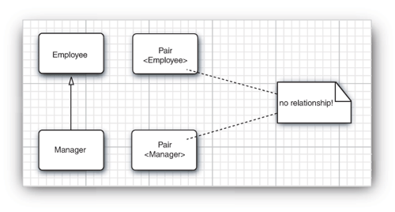
8.7. Inheritance Rules for Generic Types
Normal Manager class is a subclass of normal Employee class.
Question: Is Pair<Manager> a subclass of Pair<Employee>? NO
There is no subtype relationship between GenericType<Type1> and GenericType<Type2> although Type1 and Type2 are related.
The following is not correct for the sake of type safety
Pair<Manager> managerBuddies = new Pair<>(ceo, cfo);
Pair<Employee> employeeBuddies = managerBuddies; // illegal
*******************************************************
Manager[] managerBuddies = {ceo,cfo) };
Employee [] employeebuddies = managerBuddies;// OK
****************************************************

Slide 23
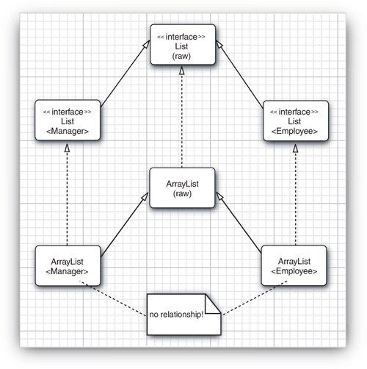
8.7. Inheritance Rules for Generic Types cont’d
A parameterized type can be converted to a raw type.
Pair<Manager> is a subtype of the raw type Pair
*******************************************************
Pair<Manager> managerBuddies = new Pair<>(ceo,cfo);
Pair rawBuddies = managerBuddies; // OK
generic classes can extend or implement other
generic classes. In this regard, they are no
different from ordinary classes.
For example, the class ArrayList<T> implements the iinterface List<T>.
Hence, ArrayList<Manager> can be converted to a
List<Manager>.
However, an ArrayList<Manager> is not an
ArrayList<Employee> or List<Employee>.

Slide 24
8.8. Wildcard Types(?)
Wildcard types allow type variance as shown in the following example :
Pair<? extends Employee> p; // this denotes upper bounded generic Pair type
P can hold a Pair<Employeer> or Pair<Manager>.
P cannot hold Pair<String>.
Useful to implement methods that work for different kinds of pairs as shown below :
public static void printBuddies( Pair<? extends Employee> p )
{ // P can receive pair<Employeee> reference or pair<Employeee> reference from its caller
Employee first = p.getFirst();
Employee second = p.getSecond();
System.out.println(first.getName() + " and " + second.getName() + " are buddies.");
}
********************************************************************************************************
public static void printBuddies( Pair<Employee> p )
{ // copy the body of the above method
// However, p cannot receive Pair<Manager> reference from its caller( see next slide)
} // P receives only Pair<Employee> reference from its caller(see diagrammed next slide)

Slide 25
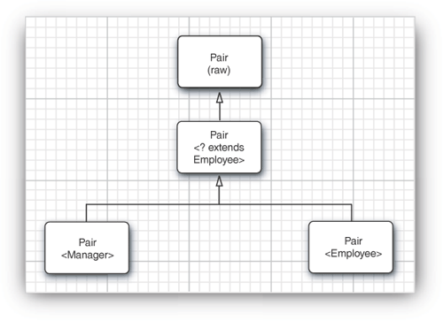
8.8. Wildcard Types(?) cont’d
Can we use wildcards to corrupt a Pair<Manager>
through a Pair<? extends Employee> reference? NO
***********************************************************
Employee e =new Employee();
Pair<Manager> managerBuddies = new Pair<>(ceo, cfo);
Pair<? extends Employee> wildcardBuddies;
wildcardBuddies = managerBuddies; // OK
wildcardBuddies.setFirst(e); // compile-time error
because the methods of Pair<? extends Employee>
look like this:
? extends Employee getFirst() // ok.
// getFirst() can return and assign Employee type
b) void setFirst(? extends Employee) // error
// SetFirst() cannot accept Employee type but it can
// accept Manager type.
Note: The key idea of wildcard type is distinguishing safe accessor and unsafe mutator methods.

Slide 26
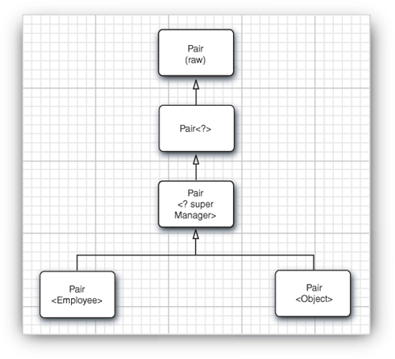
8.8.2. Supertype Bounds for Wildcards
Both Wildcard type and parameter type has subtype bound.
However, only wildcard type has supertype bound as shown below.
Pair <? super Manager >
{
void SetFirst( ?super Manager);
?super Manager getFirst();
}
The wildcard is restricted to all supertypes of Manager as shown below
public static void minmaxBonus( Manager[] a, Pair<? super Manager> result)
{
if(a.length==0) return;
Manager min = a[0];
Manager max = a[0];
for(int i=0; i<a.length; i++)
{
if( min.getBonus() > a[i].getBonus() ) min = a[i];
if (max.getBonus() > a[i].getBonus() ) max = a[i];
}
result.setFirst(min);
result.setSecond(max);
}
// Note: from the diagram, result reference will accept Pair<Employee > ,
Pair<Object > and Pair<Manager> object references.
Pair
<Manager>

Slide 27
8.8.2. Supertype Bounds for Wildcards cont’d
Another use of supertype bounds is as follows;
Note: Comparable interface is itself a generic type and declared as follows.
public interface Comparable<T>
{
public int compareTo(T other);
}
The minmax() method in Listing 8.1 and 8.2, can be modified as follows.
public static < T extends Comparable <T> > Pair<T> minmax(T[] a) {…}
This method works for String class because String is a subtype of Comparable<String>
How about LocalDate? It does not work!
LocalDate class implements ChronoLocalDate interface and ChronoLocalDate interface extends Comparable<ChronoLocalDate> interface, thus LocalDate class is a subtype Comparable<ChronoLocalDate>, but not a subtype of Comparable<LocalDate>
Hence, we use supertype bound to solve this problem:
public static <T extends Comparable < ? super T> > Pair<T> minmax(T[] a) {…}
Public int compareTo(? Super T); // method of Comparable interface

Slide 28
8.3.Unbounded Wildcards
Pair<?> looks identical to the raw Pair type; But, they are very different.
The Pair<?> has methods such as:
a) ? getFirst() // as return type
b) void setFirst( ? ) // as argument type
The return value of getFirst() can only be assigned to an Object type
The setFirst() method can never be called, even with an Object type.
However, setFirs() method of raw Pair can be called using Object argument.
This is the main difference between raw pair type and Pair<?>.
Is pair<?> useful ? Yes, when the code uses methods in the generic class that don't depend on the type parameter.
public static void printList(List<Object> list)
{
for (Object elem : list)
System.out.println(elem + " ");
System.out.println();
}
public static void printList(List<?> list)
{
for (Object elem: list)
System.out.print(elem + " ");
System.out.println();
}

Slide 29
Listing 8.3: pairs3 /Pairs3Test.java(1/3)
package pair3;
public class PairTest3
{
public static void main(String[] args)
{
Manager ceo = new Manager("Gus Greedy", 800000, 2003, 12, 15);
Manager cfo = new Manager("Sid Sneaky", 600000, 2003, 12, 15);
Pair<Manager> buddies = new Pair<Manager>(ceo, cfo);
printBuddies(buddies); // go to next slide
ceo.setBonus(1000000); cfo.setBonus(500000);
Manager[] managers = { ceo, cfo };
Pair<Employee> result = new Pair<Employee>(); // go to next slide
minmaxBonus(managers, result); // go to next slide
System.out.println("first:"+result.getFirst().getName()+ ",second:"+result.getSecond().getName());
maxminBonus(managers, result); // go to next slide
System.out.println("first:"+ result.getFirst().getName()+" second"+ result.getSecond().getName());
} end of main

Slide 30
Listing 8.3: pairs3 /Pairs3Test.java(2/3)
public static void printBuddies(Pair< ? extends Employee > p) {
Employee first = p.getFirst();
Employee second = p.getSecond();
System.out.println(first.getName() + " and " + second.getName() + " are buddies.");
}
public static void minmaxBonus(Manager[] a, Pair< ? super Manager > result) {
if (a.length == 0) return;
Manager min = a[0]; Manager max = a[0];
for (int i = 1; i < a.length; i++)
{
if (min.getBonus() > a[i].getBonus()) min = a[i];
if (max.getBonus() < a[i].getBonus()) max = a[i];
}
result.setFirst(min);
result.setSecond(max);
}

Slide 31
Listing 8.3: pairs3 /Pairs3Test.java(3/3)
public static void maxminBonus(Manager[] a, Pair<? super Manager> result)
{
minmaxBonus(a, result);
PairAlg.swapHelper(result); // OK--swapHelper captures wildcard type
}
} // end of PairTest3 class
class PairAlg
{
public static <T> void swapHelper(Pair<T> p)
{
T t = p.getFirst();
p.setFirst(p.getSecond());
p.setSecond(t);
}
} // end of PairAlg class

Slide 32
Listing 8.3: pairs3 /Pair.java
package pair3;
public class Pair<T>
{
private T first;
private T second;
public Pair() { first = null; second = null; }
public Pair(T first, T second) { this.first = first; this.second = second; }
public T getFirst() { return first; }
public T getSecond() { return second; }
public void setFirst(T newValue) { first = newValue; }
public void setSecond(T newValue) { second = newValue; }
}

Slide 33
Listing 8.3: pairs3 /Employee.java
package pair3;
import java.time.*;
public class Employee
{
private String name;
private double salary;
private LocalDate hireDay;
public Employee(String name, double salary,
int year, int month, int day)
{
this.name = name;
this.salary = salary;
hireDay = LocalDate.of(year, month, day);
}
public String getName() { return name;}
public double getSalary() {return salary; }
public LocalDate getHireDay() {return hireDay;}
public void raiseSalary(double byPercent)
{
double raise = salary * byPercent / 100;
salary += raise;
}
} // end of Employee class

Slide 34
Listing 8.3: pairs3 /Manager.java
package pair3;
public class Manager extends Employee
{
private double bonus;
public Manager(String name,
double salary, int year,
int month, int day)
{
super(name, salary, year, month, day);
bonus = 0;
} // end of Manager() contuctor
public double getSalary() {
double baseSalary = super.getSalary();
return baseSalary + bonus;
}
public void setBonus(double b)
{
bonus = b;
}
public double getBonus()
{
return bonus;
}
} // end oaf Manager class

