Slide 1
Ch 04: Objects and Classes: Part 1
Core Java, Volume I

Slide 2
4.1. Introduction to OOP
In 1970s: Structured(procedural) programming technique was dominant
First, a set of procedures (algorithms) to solve a problem are designed.
Second, find appropriate ways to store the data.
Hence, Program =Algorithms + Data Structures (Niklaus Wirth, 1975)
This implies that algorithms come first, and data structures come second
First, Programmers decided on the procedures for manipulating the data.
Then, they decided what structure to impose on the data to make the manipulations easier.
Hence, procedures operate on shared data in structured programming
However, OOP reverses the order because puts the data first, then looks at the algorithms to
operate on the data.

Slide 3
4.1. Introduction to OOP
Structured-Orientation programming paradigm views a real world as a set of collaborating procedures
Object-Oriented programming paradigm views a real world problem as a
set of collaborating objects
object-oriented programs are often easier to understand, correct and modify.
data
structure
procedure
object-oriented program
procedural program

Slide 4
4.1. Introduction to OOP
A Software Object represents a physical or conceptual entity of real world application domains
Example 1: a book, an author, a publisher, a rental (Library Domain)
Example 2: a sale item, an account, an employee, a sales person (Sales Domain)
A software object is a self-contained software structure which contains two parts
An object = data(attributes) + methods(behaviors)
Classes define the common behavior of their objects.
OO program = a set of classes
Encapsulation (information hiding): only methods of the same class can access object data by hiding implementation details from
an object
attributes
behaviors

Slide 5
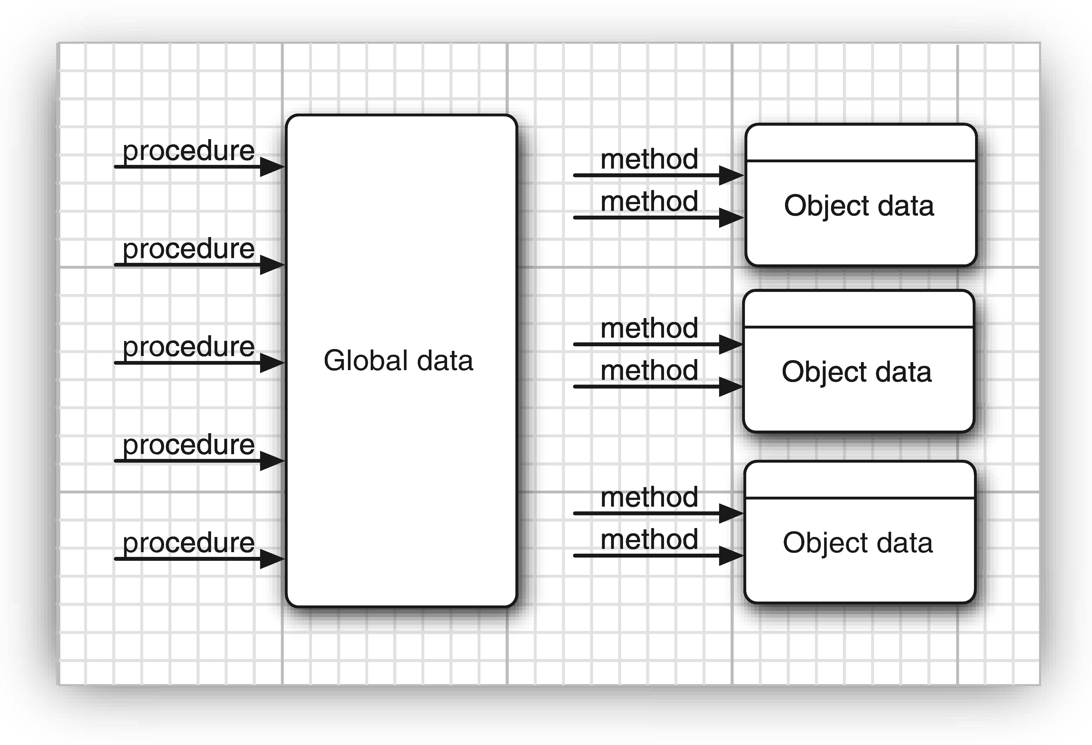
4.1. Introduction to OOP
Assume an application needs
2,000 procedures that access
global data.
In OOP, we need 100 classes
with 20 methods per class.
Q: Which is easy for a
programmer to grasp and to
find bugs if a particular object
has incorrect attribute values?.
A: In OPP, it is easy to search
20 methods instead of 2,000
procedures
Procedural Vs OO programming Paradigm

Slide 6
4.1.1. Classes
Note: In java, all code that we write is inside a class
A class is the template or blueprint from which objects are made
We create an object( instance) from a class using “ new” operator and
constructor of a class
A class encapsulates data and behavior in one package and hides
the implementation details from the users of the object.
The bits of data in an object are called its instance fields and
The procedures that operate on the data are called its methods.
A specific object that is an instance of a class will have specific values of its instance fields(current state of the object).
Whenever you invoke a method on an object, its state may change
See the diagraming the next slide.

Slide 7
4.1.1. Classes cont’d
ClassName
Class a describes its data and methods
An object is an instance of a class.
An object of a class has:
a) methods shared from its class
b) States ( value of Instance Variables)
c) Identity
State (Data)
Methods
(Behavior)
anObject(Id)
instance variables
anotherObject(ID)
instance variables
different states

Slide 8
4.1.1 Classes cont’d
Due to encapsulation, methods of one class cannot access directly instance fields of other class
Programs should interact with object data only through
method calls.
Due to Encapsulation, an object is “black box” reliability.
This implies that when one class( Server class ) changes how
it stores its data, other classes (clients ) does not know the
change because the client classes access the data of server
class by calling the public methods of the server class.
( see the next slide)

Slide 9
4.1.1 Classes cont’d
Encapsulation(Information Hiding)
class A
class B
instance variables/current state of object
Indirect
access via public inter-face
instance variables/current
state of object
affect
change
affect
Change
method
Implementations
method
implementations
Call
return

Slide 10
4.1.2. Objects
In OOP, we must identify three key characteristics of objects
a) The object’s behavior: what operations(methods) can we apply to the object?
All objects that are instances of the same class share same behavior.
b) The object’s state: How does the object react when you invoke those methods?
An object’s state may change over time
A change in the state of an object must be a consequence of method calls.
c) The object’s identity—How is the object distinguished from others that may have
the same behavior and state ?
Note 1: the state of an object can change its behavior
Note 2: The behavior of an object can change its state.

Slide 11
4.1.3. Identifying Classes
In Structured programming, we start the process at the top with main() function.
In OOP, there is no top. Simply identify your classes and then add methods to each class.
How to start object-oriented programming ?
By identify classes
By identify data
By identify methods
To identifying Classes and methods, look for nouns and verbs in problem analysis
Nouns are often classes
Verbs are often methods
Example : description of order-processing system
Items are added to orders
Orders are shipped or canceled
Payments are applied to orders
………………………………………………………………………………………..
Classes : Item, Order, Payment, etc.
Methods : add an item, ship an order, cancel an order, apply a payment to order

Slide 12
4.1.4. Relationship between Classes
The most common relationships between classes
a) Dependence (“ use-a ”): class A depend on another class B if methods of
class A uses or manipulates objects of class B.
In software engineering, we have to minimize the coupling between classes.
b) Aggregation (“ has-a ”): Class A is an instance field of class B
c) Inheritance (“ is-a ”): Class B is a child class of class A.
Examples
an Order object uses an Account object to check credit status (---->)
an Order object has Item objects ( )
a RushOrder object is an Order object ( )
Programmers use UML (Unified Modeling Language) to draw Class Diagrams as shown in next slide

Slide 13
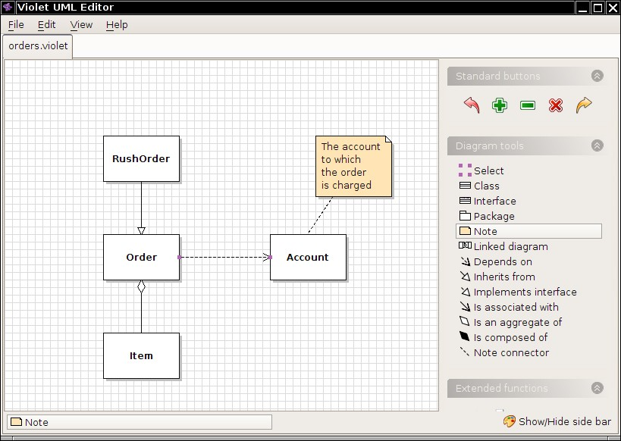
4.1.4. Relationship between Classes
IS-A
Use-A
HAS-A

Slide 14
4.2. Using Predefined Classes
Example 1: Consider the Math class(java.lang.Math)
We can call sqrt() method without creating an object of a Math class:
Math.sqrt(x); // we call the method by class name.
We do not need to create object and to initialize instance fields.
We know only the method of the name and its parameters.
We do not know how sqrt() method is implemented.
Math Class encapsulates only methods, not data because it has no data

Slide 15
4.2.1 objects Vs object Variables of a class
To work with objects:
first we must construct them and specify their initial state.
Then w apply methods to the objects.
In the Java, we use constructors to construct new instances of a class
A constructor is a special method whose purpose is to construct and initialize objects by using “new” operator.
Example 2: The Date class (java.util.Date)
a) Creating(instantiating) a Date object as follows:
Date birthday = new Date() ; // birthday is an object variable
b) Apply a method to data object(method calling):
String s = birthday.toString() ; // Converts this Date object to a String
See diagram on the next slide

Slide 16
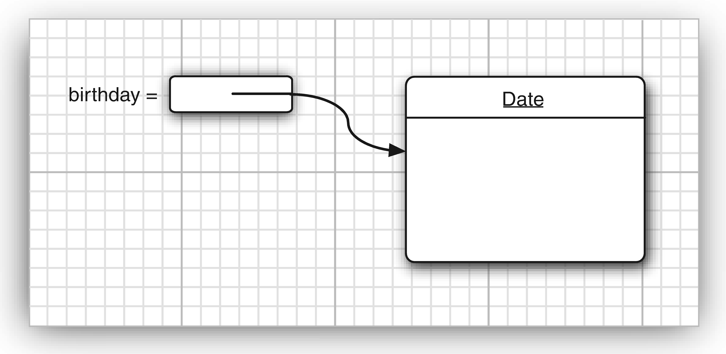
4.2.1 objects Vs object Variables of a class
Object variable in stack area and actual object in heap area
Fig: How to creating a new object.

Slide 17
4.2.1 objects Vs object Variables of a class
Example:
Date deadline; // deadline does not refer to any actual object
String s= deadline.toString(); // ERROR because deadline is null
null : runtime error
uninitialized : compile-time error
Caution: Don't call a method on null reference or uninitialized variable
Hence, an object variable holds a reference to an object.
Correction:
Approach 1: Date deadline = new Date();
Approach 2: Date deadline; // date * deadline (in c/c++);
deadline = new Date();

Slide 18
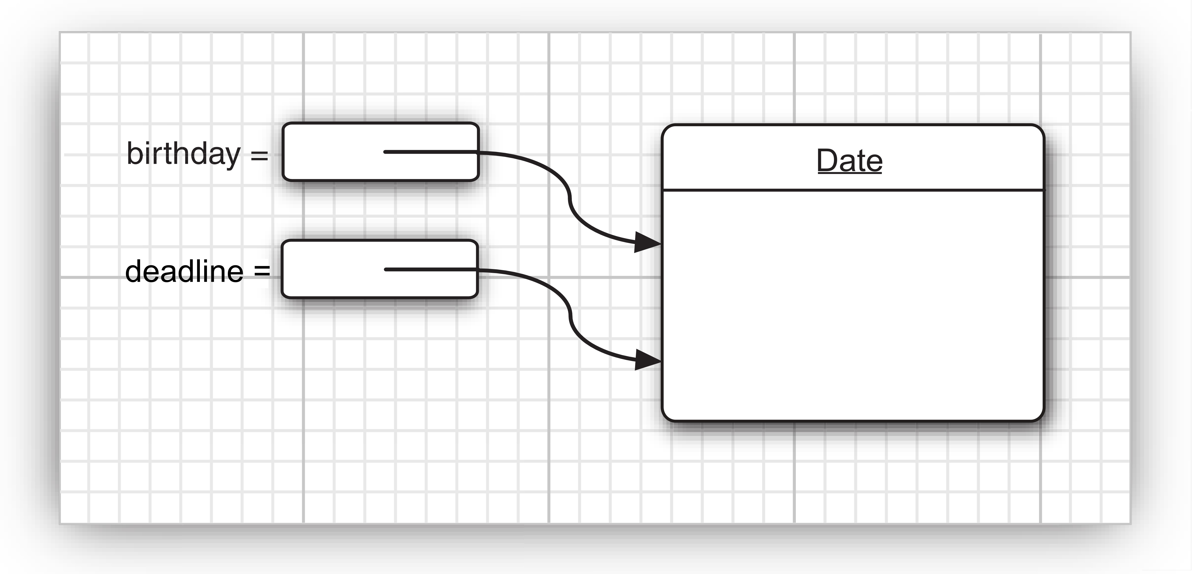
How to copy Object Variables
Copying a variable makes a copy of the reference as follows
Date birthday = new Date() ; // new operator return reference.
Date deadline = birthday; // refer to the existing object
Note: both object variables refer to the same object
Object variable
doesn’t actually contain an object. It only refers to an object
The value of any object variable is a reference to an object that is stored elsewhere.

Slide 19
Example: Working with “LocalDate” class
java.time package is the main API for dates, times, instants, and durations.
LocalDate class : A date without a time-zone such as 2007-12-03.
A LocalDate (java.time.LocalDate) is a date (year-month-day) in a particular location.
Factory methods to create instances:
//Obtains the current date from the system clock in the default time-zone.
LocalDate rightNow = LocalDate.now();
//Obtains an instance of LocalDate from a year, month and day.
LocalDate newYearsEve = LocalDate.of(1999, 12, 31);
now, apply methods of LocalDate class on refrence objects :
// Returns a copy of this LocalDate with the specified number of days added
LocalDate aThousandDaysLater = newYearsEve.plusDays(1000);
year = aThousandDaysLater.getYear(); // 2002
month = aThousandDaysLater.getMonthValue(); // 09
day = aThousandDaysLater.getDayOfMonth(); // 26
Q: How is a LocalDate stored? How do these methods do their job?
A: You don't know, and you don't care. That's encapsulation.

Slide 20
Accessor and Mutator Methods of a class
Accessor method doesn't modify object state.
All LocalDate methods are accessors.
Example:
LocalDate aThousandDaysLater = newYearsEve.plusDays(1000);
Older version of calendar date class has mutator methods:
GregorianCalendar someDay = new GregorianCalendar(1999, 11, 31);
someDay.add(Calendar.DAY_OF_MONTH, 1000);
// someDay has been mutated
int year = someDay.get(Calendar.YEAR); // 2002

Slide 21
Example: Displaying a local date using “LocalDate” class
import java.time.*;
public class CalendarTest
{
public static void main(String[] args)
{
LocalDate date = LocalDate.now();
int month = date.getMonthValue();
int today = date.getDayOfMonth();
date = date.minusDays(today - 1);
// Set to start of month
DayOfWeek weekday = date.getDayOfWeek();
int value = weekday.getValue();
// 1 = Monday, ... 7 = Sunday
System.out.println("Mon Tue Wed Thu Fri Sat Sun");
for (int i = 1; i < value; i++)
System.out.print(" ");
while (date.getMonthValue() == month)
{
System.out.printf("%3d", date.getDayOfMonth());
if (date.getDayOfMonth() == today)
System.out.print("*");
else
System.out.print(" ");
date = date.plusDays(1);
if (date.getDayOfWeek().getValue() == 1)
System.out.println();
}
if (date.getDayOfWeek().getValue() != 1)
System.out.println();
}
}

Slide 22
4.3. Defining Your Own Classes
In Chapter 3, we wrote simple classes with a single main() method.
Now, we write classes without a main() with their own instance fields and methods.
Hence, to build a complete program, we combine many classes.
A java application can contain both user-defined and library classes such as String, Scanner, Math, etc
Skeleton of java class
class ClassName
{
field-1
field-2
………………….
constructor-1
constructor-2
…………………..
method-1
method-2
………………
}

Slide 23
Example : an Employee class to write a payroll application
class Employee // no public key word. Why?
{
// three private Fields
private String name; // Has-A relationship
private double salary;
private LocalDate hireDay; // HAS-A Relationship
// one Constructor
public Employee(String n, double s, int year, int month, int day)
{
name = n;
salary = s;
hireDay = LocalDate.of (year, month, day);
}
// 4 public Methods (3 accessors and 1 mutator)
public String getName()
{
return name;
}
public double getSalary()
{
return salary;
}
public LocalDate getHireDay()
{
return hireDay;
}
public void raiseSalary(double byPercent)
{
double raise = salary * byPercent / 100;
salary += raise;
}
}

Slide 24
Example : Employee Test
import java.time.*;
public class EmployeeTest // save as EmployeeTest.java
{
public static void main(String[] args)
{
// fill the staff array with three Employee objects
Employee[] staff = new Employee[3];
staff[0] =
new Employee("Carl Cracker", 75000, 1987, 12, 15);
staff[1] =
new Employee("Harry Hacker", 50000, 1989, 10, 1);
staff[2] =
new Employee("Tony Tester", 40000, 1990, 3, 15);
// raise everyone's salary by 5%
for (Employee e : staff)
e.raiseSalary(5);
// print out information about all Employee objects
for (Employee e : staff)
System.out.println("name=" + e.getName() + ",salary="
+ e.getSalary() + ",hireDay=“ + e.getHireDay());
}
}
Note 1: The source file contain two user defined classes but only one of them has public modifier
Note 2: compiler generate two byte codes(.class) files, namely: EmployeeTest.class and Employee.class.
Note 3: to run ,use EmployeeTest.class

Slide 25
4.3.3. Detail Analysis of Employee Class
Constructor: the name of the constructor is the same as the name of the class
constructor runs when it is invoked by “new” operator.
public Employee(String n, double s, int year, int month, int day)
{
name = n;
salary = s;
hireDay = LocalDate.of(year, month, day);
}
The following call sets the fields as follows.
Employee number007 = new Employee("James Bond", 100000, 1950, 1, 1);
// instance fields are initialized as follows.
name = "James Bond“ ;
salary = 100000 ;
hireDay = LocalDate.of(1950, 1, 1);
Note : a constructor has no return value and it is invoked with “new” operator

Slide 26
4.3.5. Implicit parameter(this) and Explicit Parameters
// Assume in main() method of EmployeeTest class do the following.
Employee number007 = new Employee("James Bond", 100000, 1950, 1, 1);
number007.raiseSalary(5); // number007 is implicit and 5 is explicit parameter
// the following are executed in the raiseSalary() method of Employee class
double raise = number007.salary * 5 / 100;
number007.salary += raise;
// The object on which the method is invoked is called the implicit parameter.
public void raiseSalary(double byPercent) // implicitly, “this” reference of type Employee is passed
{
double raise = salary * byPercent / 100;
salary += raise;
}
// in all methods, the key word “ this” refers to the implicit parameter and we can write the following
public void raiseSalary(double byPercent) // optional to use “this”refrence
{
double raise = this.salary * byPercent / 100;
this.salary += raise;
}

Slide 27
4.3.6. Benefits of Encapsulation
Why we mark data fields private, accessor and mutator methods public ?
Benefit 1: we can change internal representation without changing the code of any method except accessor and mutator methods of the class
Example: we change the “name” of the Employee class as follows;
private String firstName;
private String lastName;
Hence, only the code of the getName() is changed as follows.
public string getName() { return firstName + " " + lastName; } ;
Benefit 2: mutator methods can do error checking(validated)
Example: setSalary() method can check if the salary is less than 0.

Slide 28
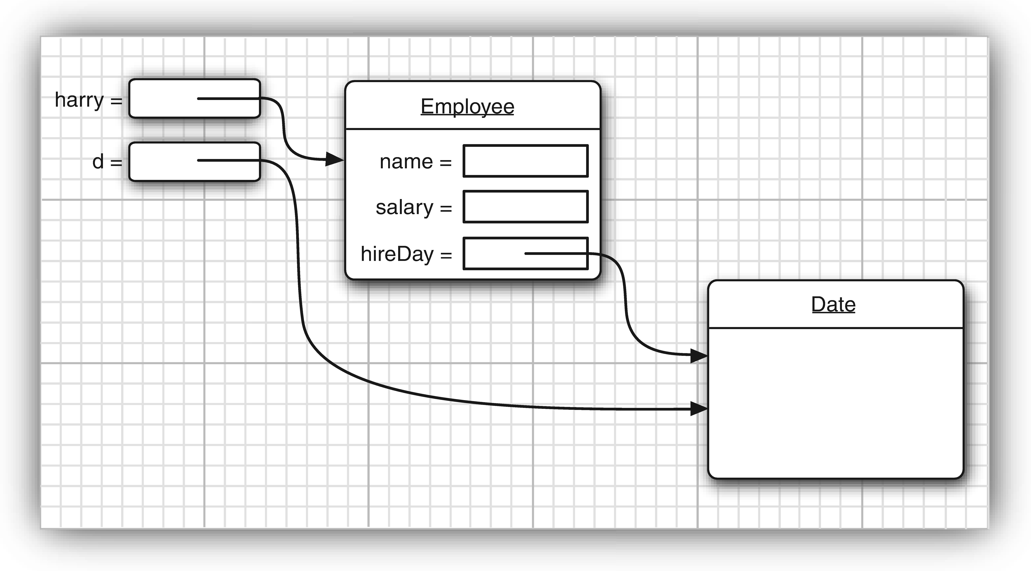
4.3.6. Benefits of Encapsulation
Caution: do not write accessor methods that return a reference to mutable objects
Example.
class Employee
{
private Date hireDay;
.............................................
public Date getHireDay()
{
return hireDay;
// return.hierday.clone();
}
………………………………
}
Note : SetTime() is mutator
method which is applied to
mutable object. Hence ,clone it.
Employee harry = new Employee(….) ;
Date d = harry.getHireday(); //return d which is mutable
doule tenYearsInMillisSeconds = 10*365.25*24*60*1000;
d.setTime (d.getTime() – (long) tenYearsInMilliSeconds );

Slide 29
4.3.7. Class-Based Access Privileges
a method can access the private data of the object on which it is invoked
a method can access the private data of all objects of its class
example: write equals() method to compares two employee objects as follows:
class Employee
{
……………………………………….
public boolean equals(Employee other)
{
return name.equals(other.name);
}
}
Assume a typical call: if (e1.equals(e2); // method accesses private fields of e1 and e2
Note: e1 is implicit parameter and e2 is explicit parameter

Slide 30
4.3.9. Final Instance Fields
public class X
{
private final int a;
private final int b;
private final int c = 10; // declaration
{
b = 20; // block
}
public X(final int val)
{
a = val; // constructor
}
}
A final instance field cannot change:
Final instance fields must be initialized
at the declaration
at constructor
at the object initialization block
Note 1: “final” is good for immutable class.
Note 2: A class is immutable if none of its methods
cannot mutate its objects(e.g. String class)
Note 3: for mutable classes, final keyword implies that
reference variable cannot be modified. However,
the object on heap can be modified.
Example:
Employee
{
private final StringBuilder evaluations; // field
public Employee() { evaluations = new StringBuilder() ; } // constructor
public void giveGoldStar() { evaluations.append("Gold star"); }
// append mutate the object on heap that is referenced by the object reference (evalautions)
}

Slide 31
4.4.1 Static Variables Fields
A static field exists once per class and they are called class fields
class Employee
{
private static int nextId; // one field per class
private int id; // one field per object
public void setId()
{
id = nextId;
nextId++; } // next Id is zero by default
}
Employee e = new Employee();
e.setId();
// Now the following instructions are executed.
harry.id = Employee.nextId;
Employee.nextId++;

Slide 32
4.4.2 Static Constants Fields
A static final field is a shared constant.
Example 1: math class defines a static constant
public class Math
{
……………………………………………………………………………………….
public static final double PI = 3.14159265358979323846;
// we can this constant in our code as Math.PI;
………………………………………………………………………………………………
}
Example 2: System.out is another example of static constant in System class
public System
{
…………………………………………………………………………
public static final PrintStream out = ……………; // why public filed?
………………………………………………………………………….
}
System.out = new PrintStream(. . .) ; // ERROR--out is final

Slide 33
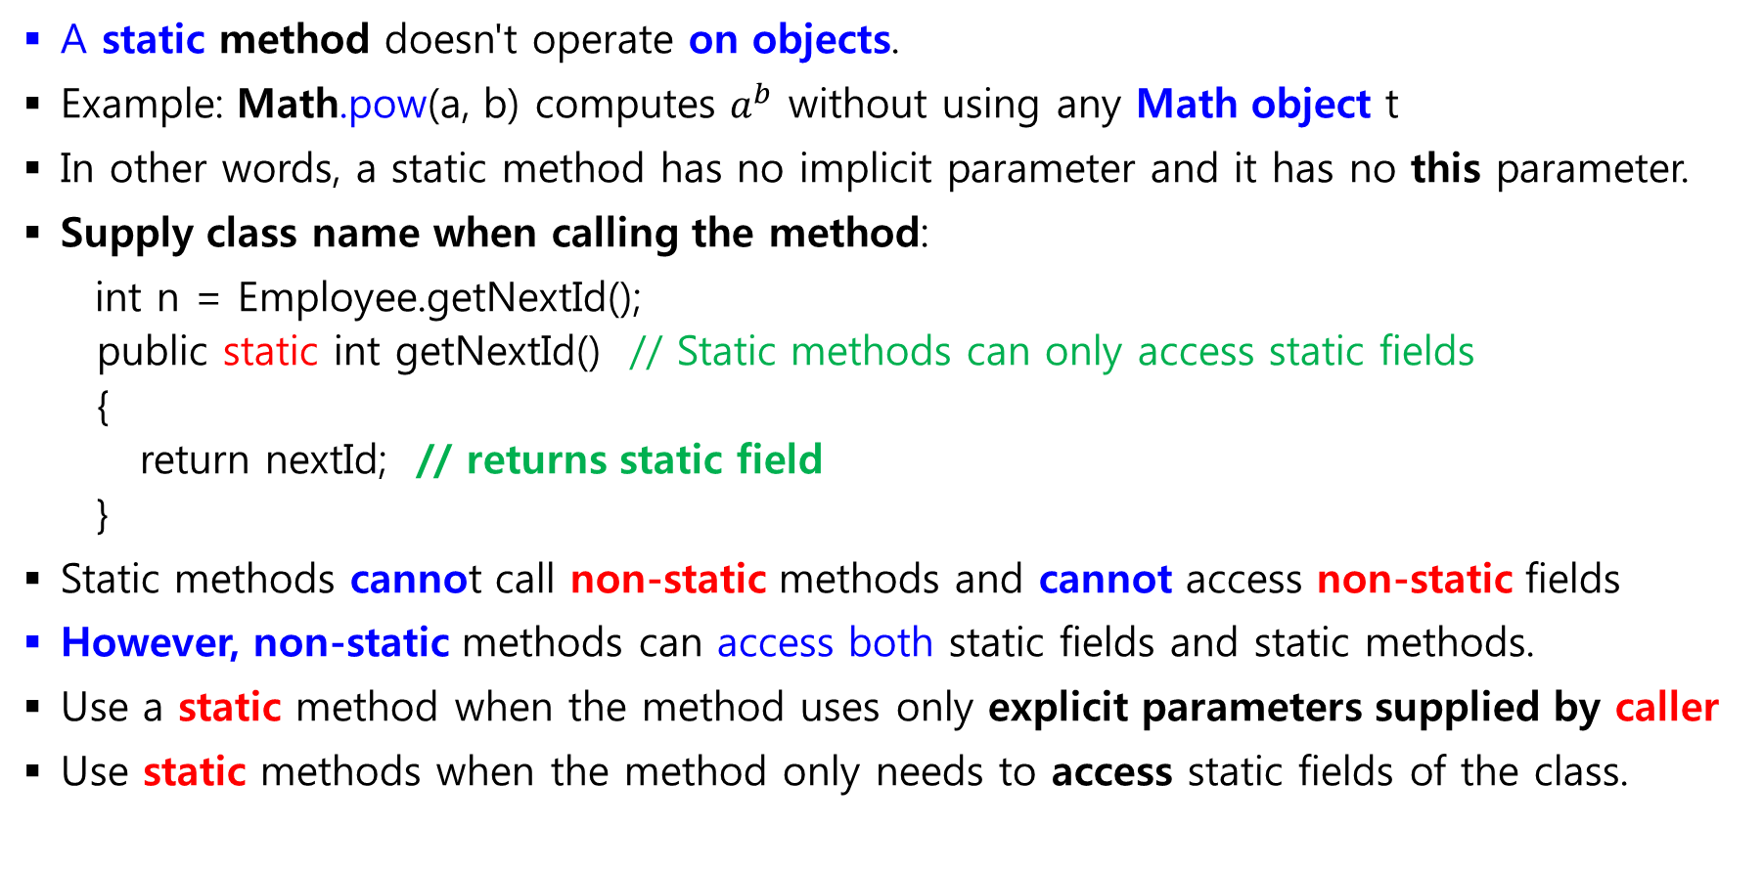
4.4.2. Static Methods
A static method doesn't operate on objects.
Example: Math.pow(a, b) computes $a^{b}$ without using any Math object t
In other words, a static method has no implicit parameter and it has no this parameter.
Supply class name when calling the method:
int n = Employee.getNextId();
public static int getNextId() // Static methods can only access static fields
{
return nextId; // returns static field
}
Static methods cannot call non-static methods and cannot access non-static fields
However, non-static methods can access both static fields and static methods.
Use a static method when the method uses only explicit parameters supplied by caller
Use static methods when the method only needs to access static fields of the class.

Slide 34
4.4.5. The static main() Method
We can call static methods without having any objects.
For example, we did not construct any objects of the Math class to call Math.pow.
public class Application
{
public static void main(String[] args)
{
// construct objects here
……………………………………..
}
}
Note 1: The main() method does not operate on any objects.
Note 2: when a program starts, there is no any objects yet.
Note 3: The static main() executes, and constructs the objects that the program needs.

Slide 35
Example of Static methods and static fields (1/2)
public class StaticTest
{
public static void main(String[] args)
{
Employee[] staff = new Employee[3]; // fill the staff array with three Employee objects
staff[0] = new Employee("Tom", 40000);
staff[1] = new Employee("Dick", 60000);
staff[2] = new Employee("Harry", 65000);
// print out information about all Employee objects
for (Employee e : staff)
{
e.setId();
System.out.println("name=" + e.getName() + ",id=" + e.getId() + ",salary="
+ e.getSalary());
}
int n = Employee.getNextId(); // calls static method
System.out.println("Next available id=" + n);
}
}

Slide 36
Example of Static methods and static fields(2/2)
class Employee
{
private static int nextId = 1; // static field
private String name;
private double salary;
private int id;
public Employee(String n, double s)
{
name = n;
salary = s;
id = 0;
}
public String getName()
{ return name; }
public double getSalary()
{
return salary;
}
java Employee ; // to test in Isolation
java java StaticTes; // main () method of Employee is never executed
public int getId()
{
return id;
}
public void setId()
{
id = nextId; // set id to next available id
nextId++;
}
public static int getNextId() // static method
{
return nextId; // returns static field
}
public static void main(String[] args) // unit test
{
Employee e = new Employee("Harry", 50000);
System.out.println(e.getName() + " " + e.getSalary());
}
}

Slide 37
4.5. Method Parameters
How parameters can be passed to a method in a programming language?
a) “call by value”: the method gets just the value that the caller provides.
“call by reference”: the method gets the location of the variable that
the caller provides.
Thus, a method can modify the value stored in a variable passed by
reference but not in one passed by value.
The Java uses only call by value so that the method gets a copy of all
parameter values.
Hence, the method cannot modify the contents of any parameter variables passed to it.
Note : two kinds of method parameters: primitive type, and Object references

Slide 38
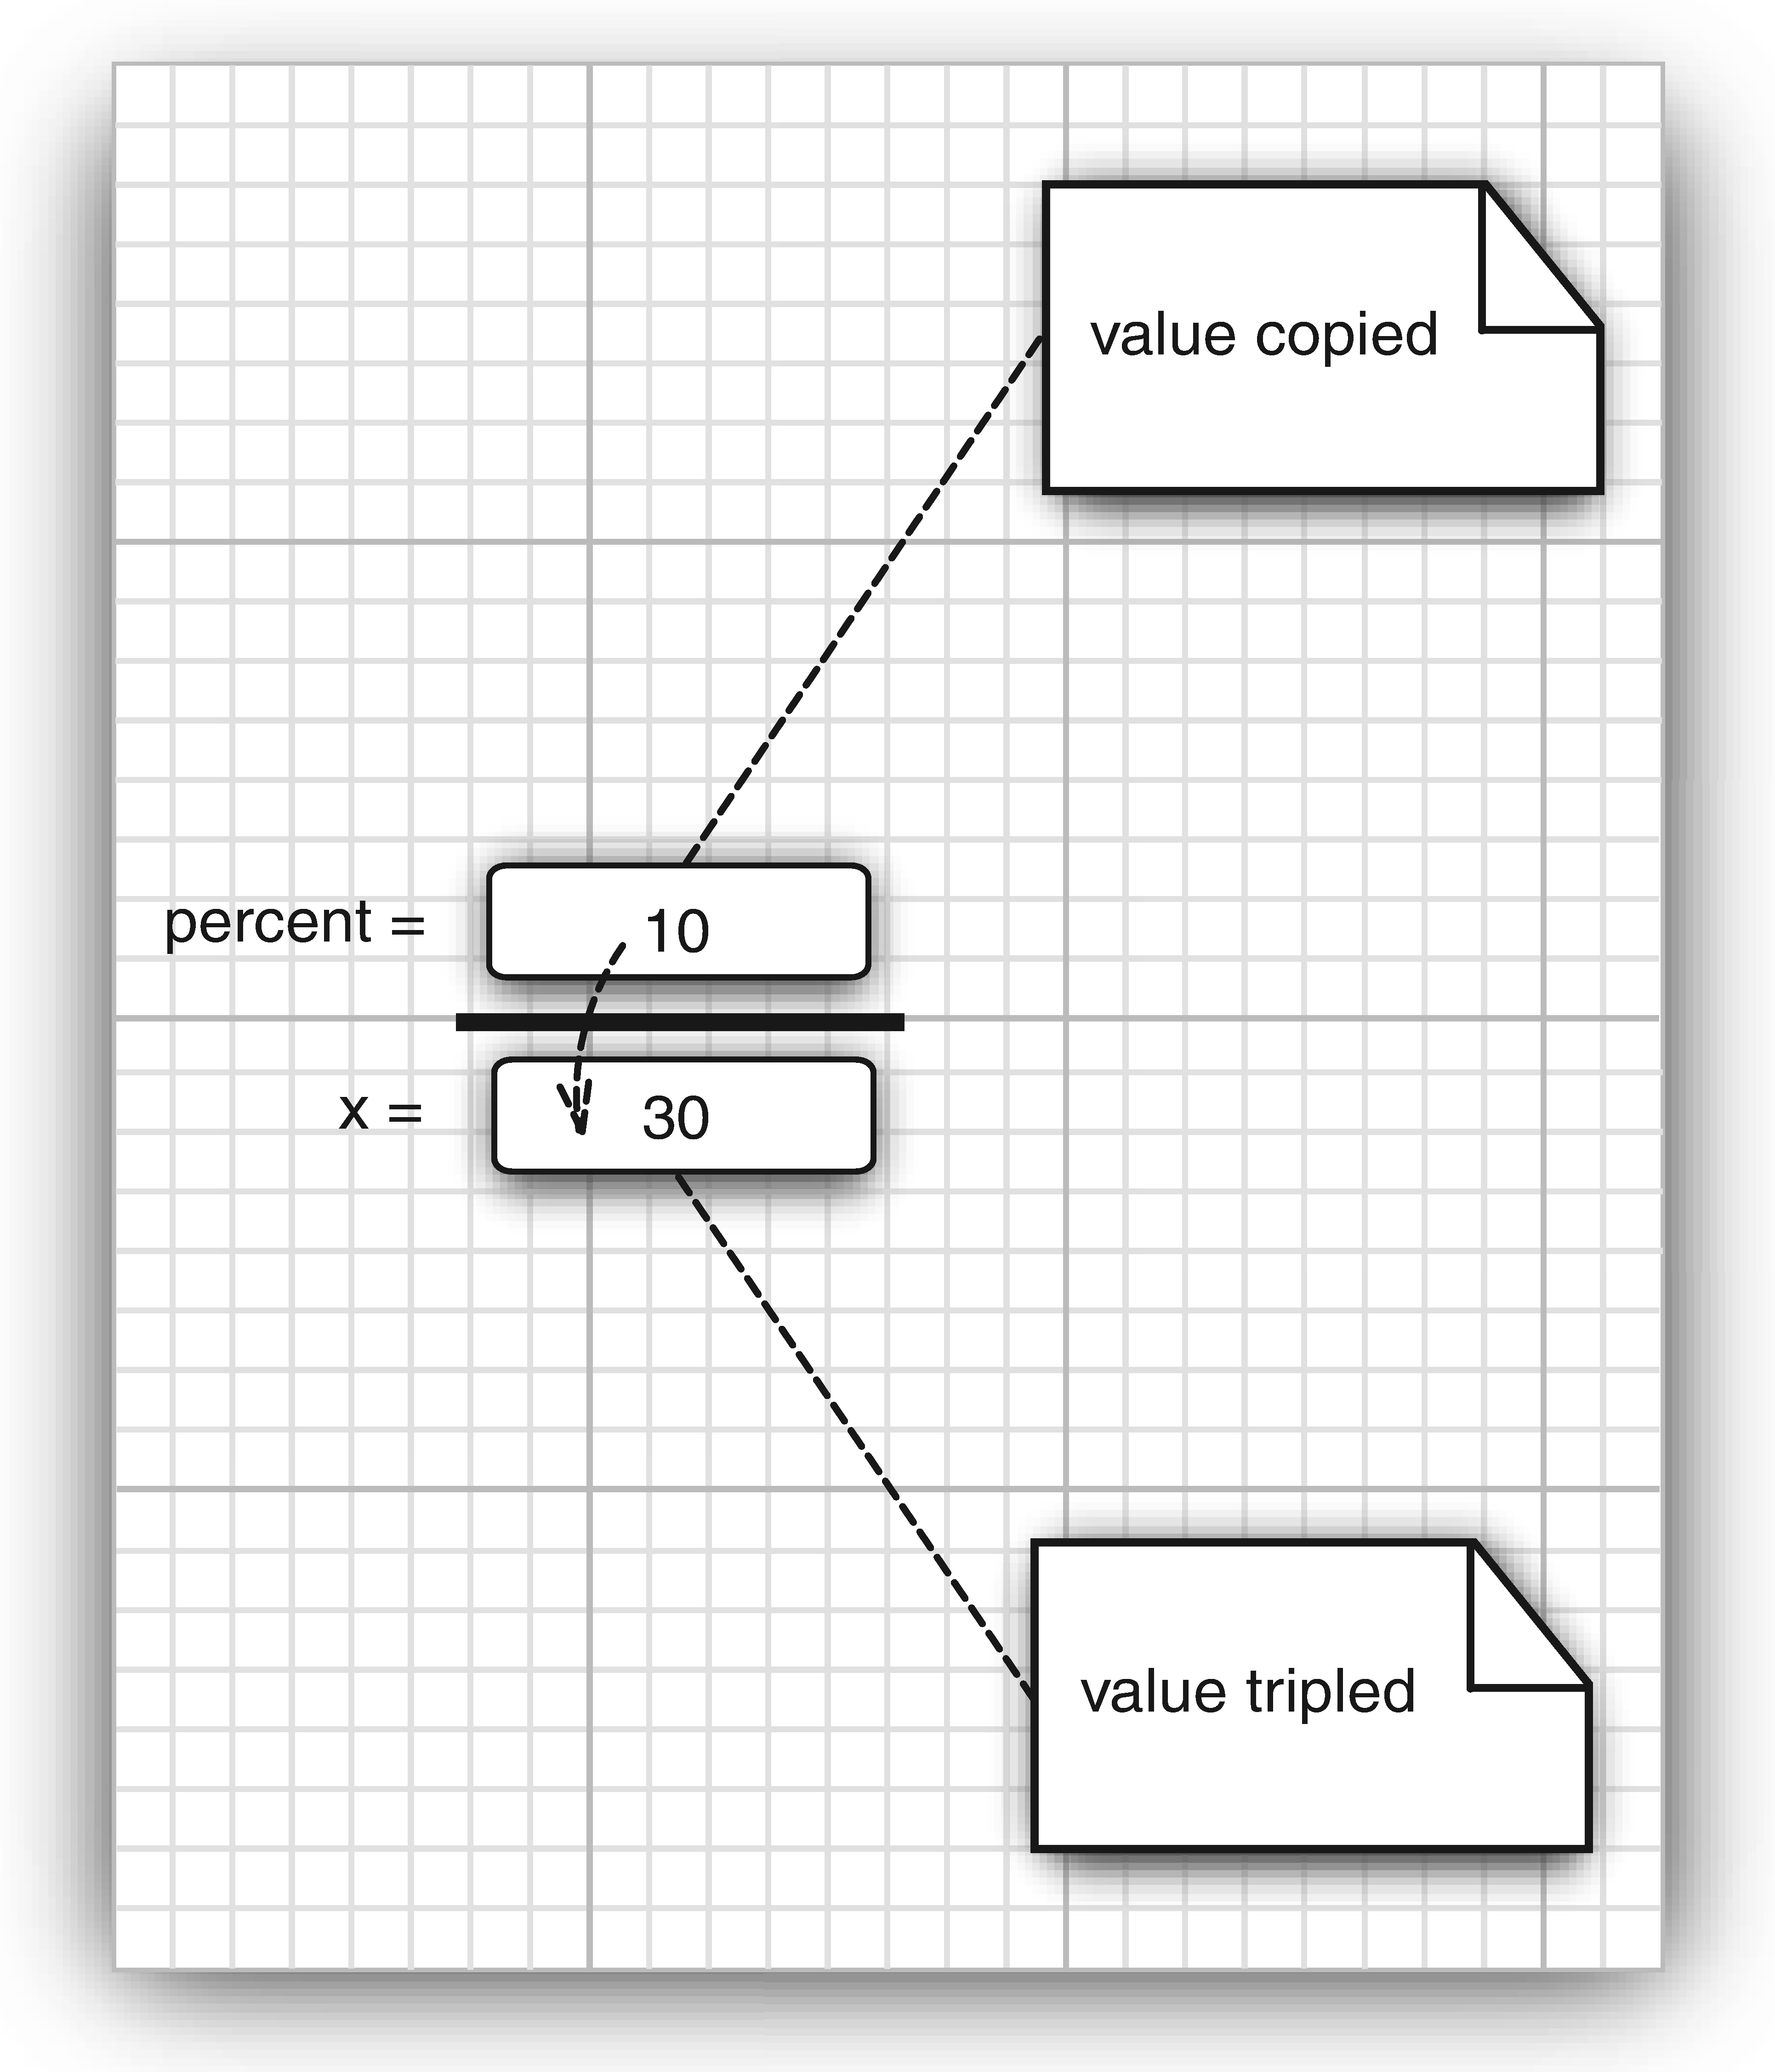
Example of Call by Value via primitive parameter
// We want to triple the value of a method parameter x as follows:
public static void tripleValue(double x) // doesn't work
{
x = 3 * x;
}
//Let call the above methods as follows:
double percent = 10;
tripleValue(percent);
// after method call, percent variable is not changed
a) x is initialized by copy of the value of percent
b) x is tripled to30. But percent is still 10
c) The method ends, and parameter X is lost.
Hence, the above program cannot do our need

Slide 39
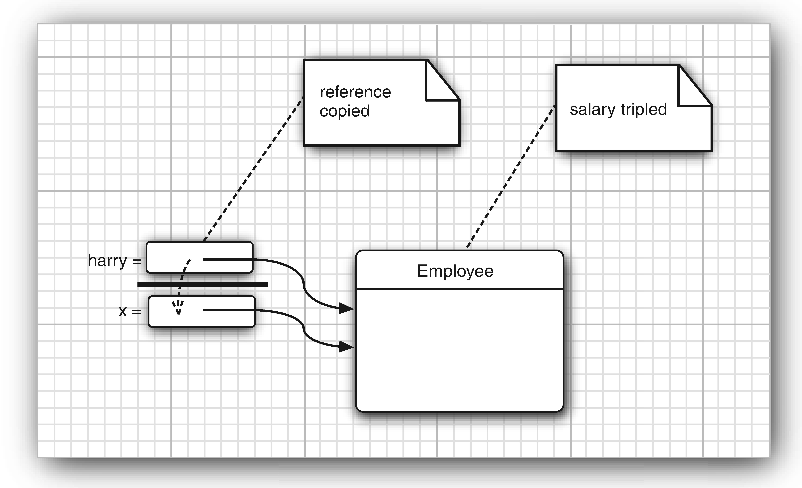
Example of Call by Value via Object Reference parameters
A method can mutate objects:
public static void tripleSalary(Employee x) // works fine
{
x.raiseSalary(200);
}
//Let call the above method:
harry = new Employee(. . .) ;
tripleSalary(harry);
// output: the salary is changed
x is initialized by copy of harray
x and harry point to same object
c) The method ends, reference X is lost
Hence, the above program is correct

Slide 40
Example: Justification for call by value , not call by reference
Some people say: In Java, primitives are passed by value and objects are passed by reference. This is wrong because in Java, everything is passed by value.
Hence, Object references are also passed by value.
If objects were passed by reference, you could swap them: 04_08
//We want to write code to swap two Employee Objects as follows:
public static void swap(Employee x, Employee y) // doesn't work
{
Employee temp = x ; x = y; y = temp;
}
// Let call the above method
Employee alice = new Employee("Alice", . . .);
Employee bob = new Employee("Bob", . . .);
swap(alice, bob);
// output: a and b are not swapped and the above program cannot do our need

Slide 41
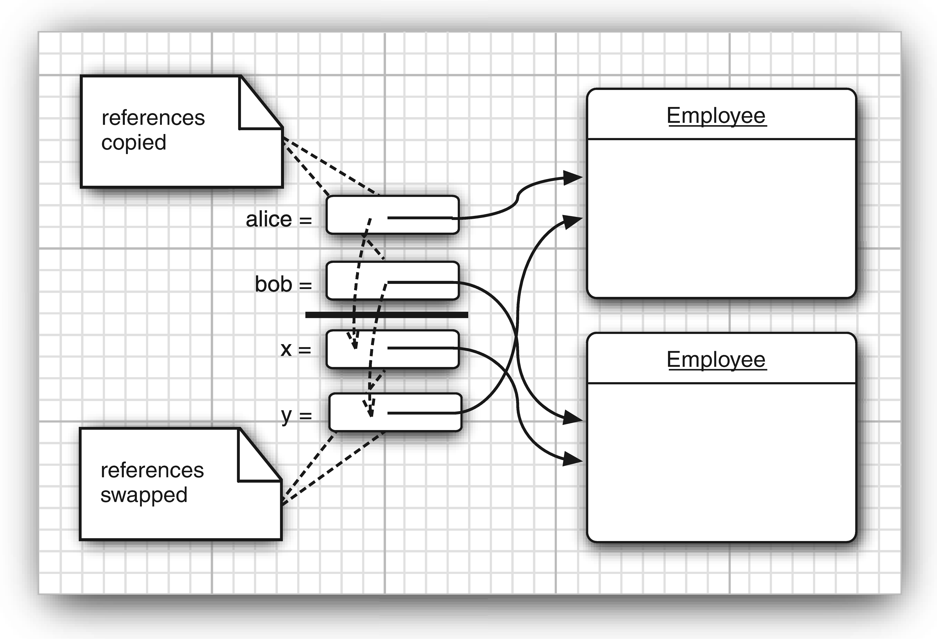
Example: Justification for call by value , not call by reference

Slide 42
Example: Parameter Passing that tests three cases
public class ParamTest
{
public static void main(String[] args)
{
// Test 1: Methods can't modify numeric parameters
System.out.println("Testing tripleValue:");
double percent = 10;
System.out.println("Before: percent=" + percent);
tripleValue(percent);
System.out.println("After: percent=" + percent);
// Test 2: Methods can change the state of object parameters
System.out.println("\nTesting tripleSalary:");
Employee harry = new Employee("Harry", 50000);
System.out.println("Before: salary=" + harry.getSalary());
tripleSalary(harry);
System.out.println("After: salary=" + harry.getSalary());
// Test 3: Methods can't attach new objects to object parameters
System.out.println("\nTesting swap:");
Employee a = new Employee("Alice", 70000);
Employee b = new Employee("Bob", 60000);
System.out.println("Before: a=" + a.getName());
System.out.println("Before: b=" + b.getName());
swap(a, b);
System.out.println("After: a=" + a.getName());
System.out.println("After: b=" + b.getName());
}
public static void tripleValue(double x) // doesn't work
{ x = 3 * x;
System.out.println("End of method: x=" + x);
}
public static void tripleSalary(Employee x) // works
{ x.raiseSalary(200);
System.out.println("End of method: salary=" + x.getSalary());
}
public static void swap(Employee x, Employee y)
{ Employee temp = x;
x = y;
y = temp;
System.out.println("End of method: x=" + x.getName());
System.out.println("End of method: y=" + y.getName());
}
}

Slide 43
Output of the previous program
Testing tripleValue:
Before: percent=10.0
End of method: x=30.0
After: percent=10.0
Testing tripleSalary:
Before: salary=50000.0
End of method: salary=150000.0
After: salary=150000.0
After the method, the state of t
Testing swap:
Before: a=Alice
Before: b=Bob
End of method: x=Bob
End of method: y=Alice
After: a=Alice
After: b=Bob

