Slide 1
Exception Handling Part 2 :
Java How to Program, 10/e

Slide 2
Exception Handling
A systematic way of error handling
Exception Class Hierarchy
Checked Exception and Unchecked Exception
Throwing Exception
Catching Exception
Stack Trace – information to debug a program

Slide 3
Implementation of Error Handling in Java
M1: Calling method
{
try {
1: code ;
2: M2(); // error
3. code ;
}
catch( Exception e) {
4. // code to catch and display // error message
}
finally {
// 5. code to free resource
}
# 6. extra code
} // end of M1
M2() throws Exception ; // advertisement
{
7: if ( exception condition happen){
throw new Exception();
}
8: else : code
// an object of “Exception” class is thrown, // and the catch block catches the object.
}
// Flow of control:
//Case 1: M2 succeeds : 1,2,8,3, 5,6
//Case 2: M2 throws Exception: 1, 2,7,4, 5,6 .
Exception Object
e:100
100
In java, the called method M2 inform its failure to the calling method M1 by throwing an instance object of the subclass of “Exception” class

Slide 4
Implementation of Error Handling in Java
Analogy: to cook, first turn-on the oven
If you complete your cook, turn-off the oven
If you receive urgent call before finishing cooking, turn-off the oven before you left your home.
try
{
1: turnOnOven();
2. bake()
3. turnoffOven() ;
}
catch( Exception e)
{
4. e.printStackTrace() ;
5. turn OffOven();
}
try
{
1: turnOnOven();
2. bake()
}
catch( Exception e)
{
4. e.printStackTrace() ;
}
finally
{
turn OffOven();
}

Slide 5
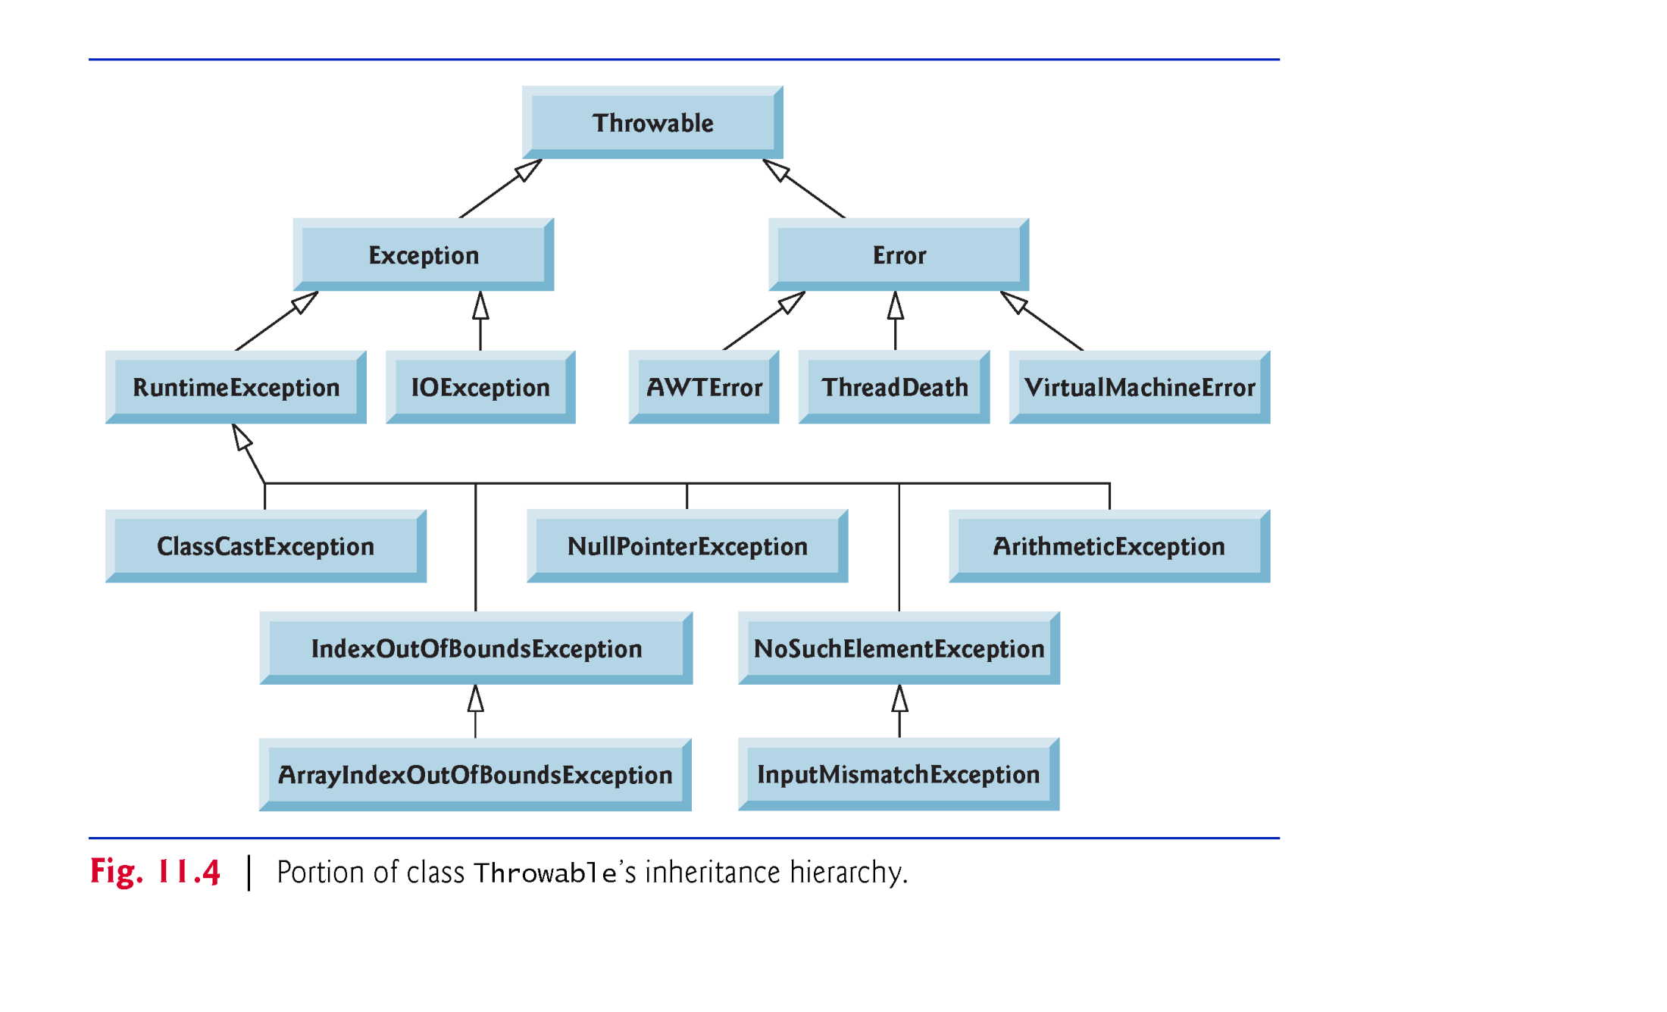
Java Exception Hierarchy
Object
In Java, since every thing is class, we have hierarchy of exception classes (see: java.lang)
Exception: compile time versus runtime
Exception: checked versus unchecked
Using this hierarchy, related exceptions can be handled polymorphically

Slide 6
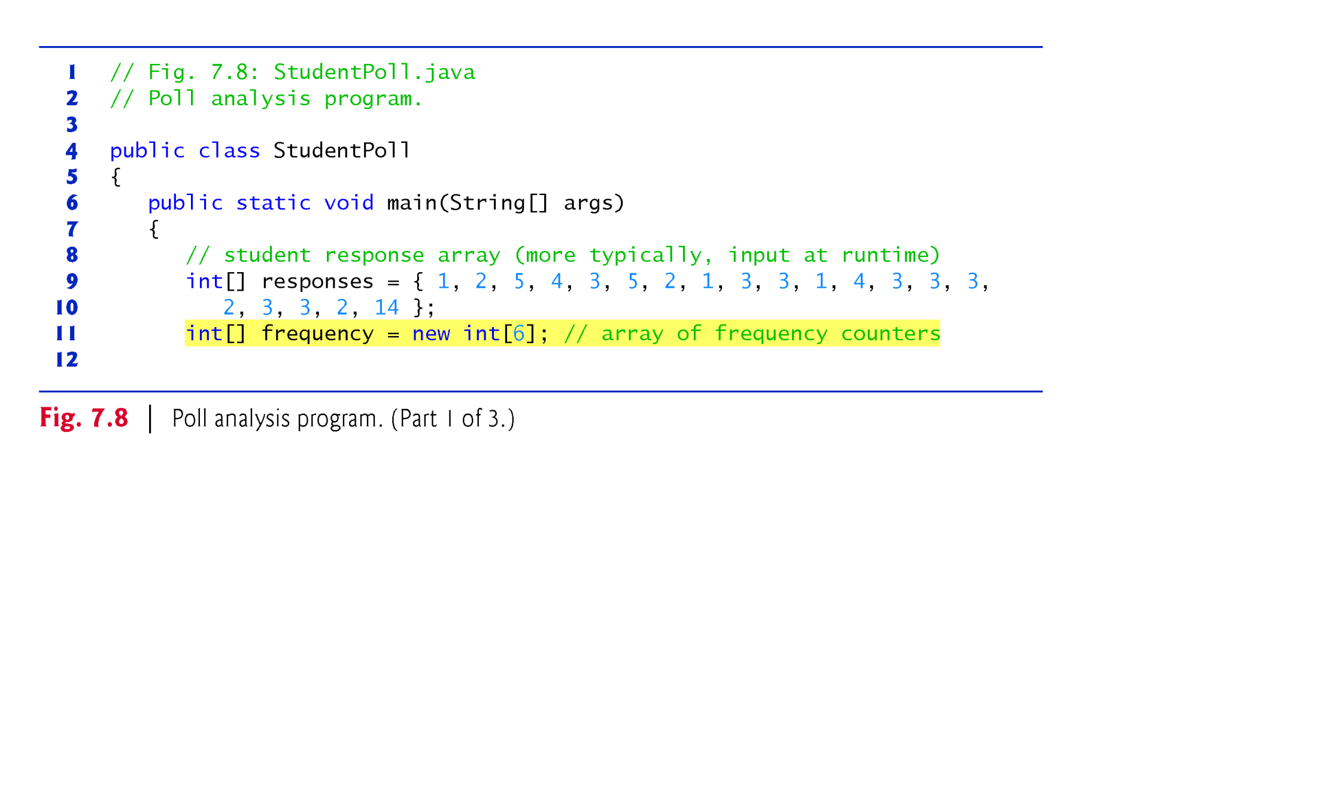
Example 1: Exception Handling: Fig.7.8 (1/3)
20 students rate on a scale of 1 to 5 about the quality of the food
Frequency[] array counts the number of occurrences of each response (1 to 5).
By default : F[0]=F[1]=F[2]=F[3]=F[4]=F[5]=0.
We ignore frequency[0].

Slide 7
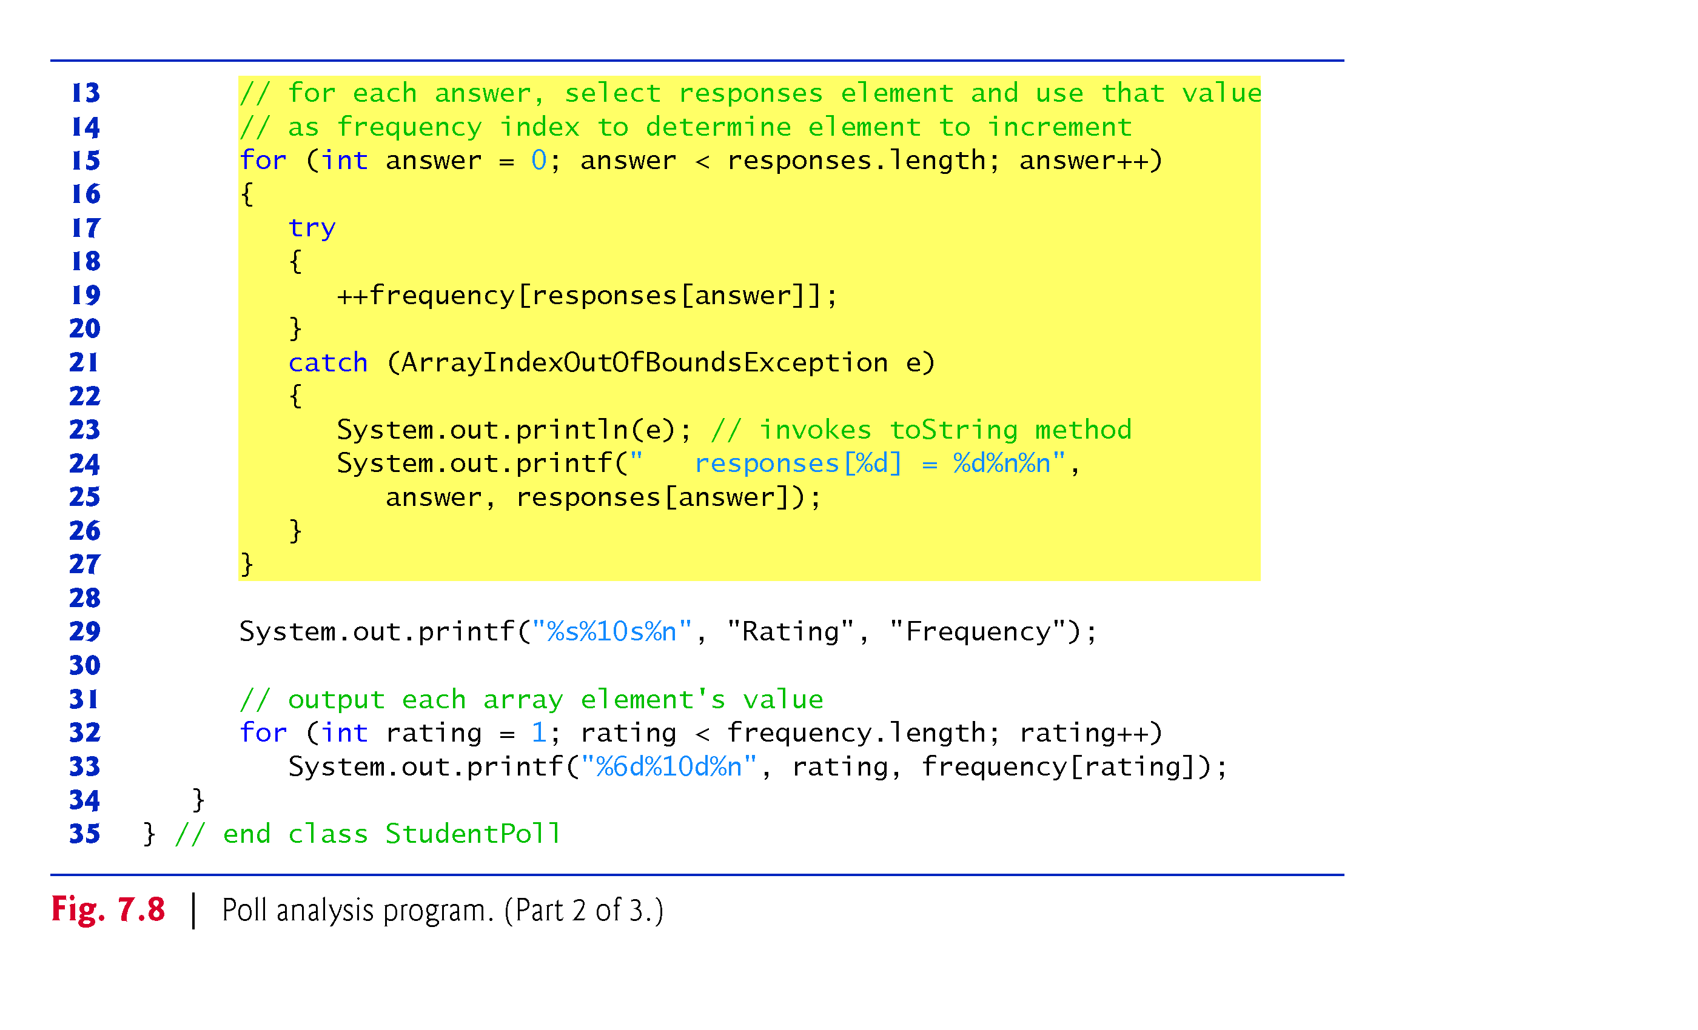
Example 1: Exception Handling: Fig.7.8 (2/3)
Line 19: no compiler error, but JVM generate error

Slide 8
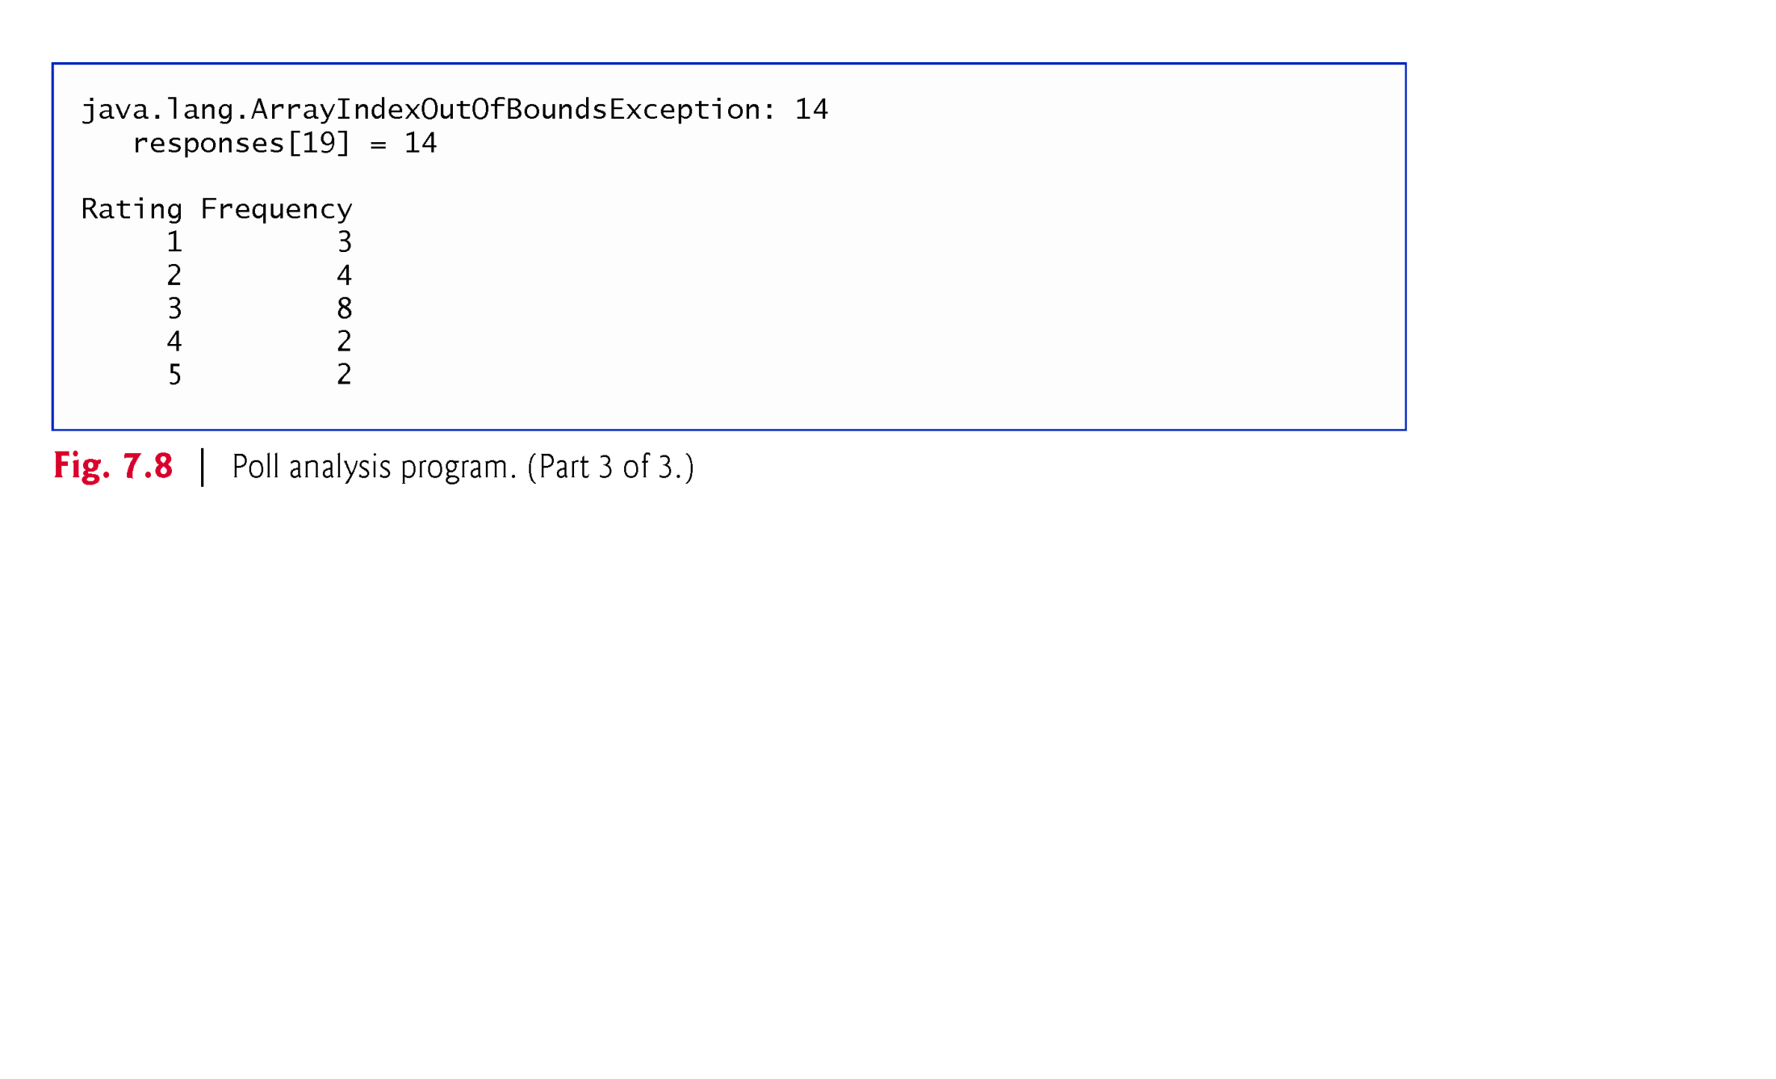
Example 1: Exception Handling: Fig.7.8 (3/3)
frequency[responses[answer]];
0 ≤ answer ≤ 19
1 ≤ responses[answer] ≤ 5
1 ≤ frequency[responses[answer]] ≤ 20
Frequency[14]: JVM generate error after bound checking
See : Fig .8.1/Fig. 8.2, and Fig. 8.5/ Fig. 8.6.

Slide 9
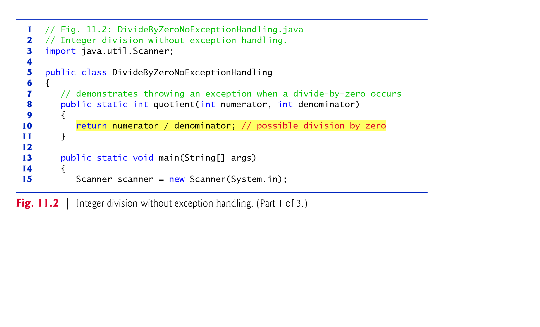
Example 2: Division by Zero without Exception Handling: (1/3)
Line 10: There is no compiler error , but JVM generates error
Exception is thrown because after detecting the problem, the method did not handle the problem

Slide 10
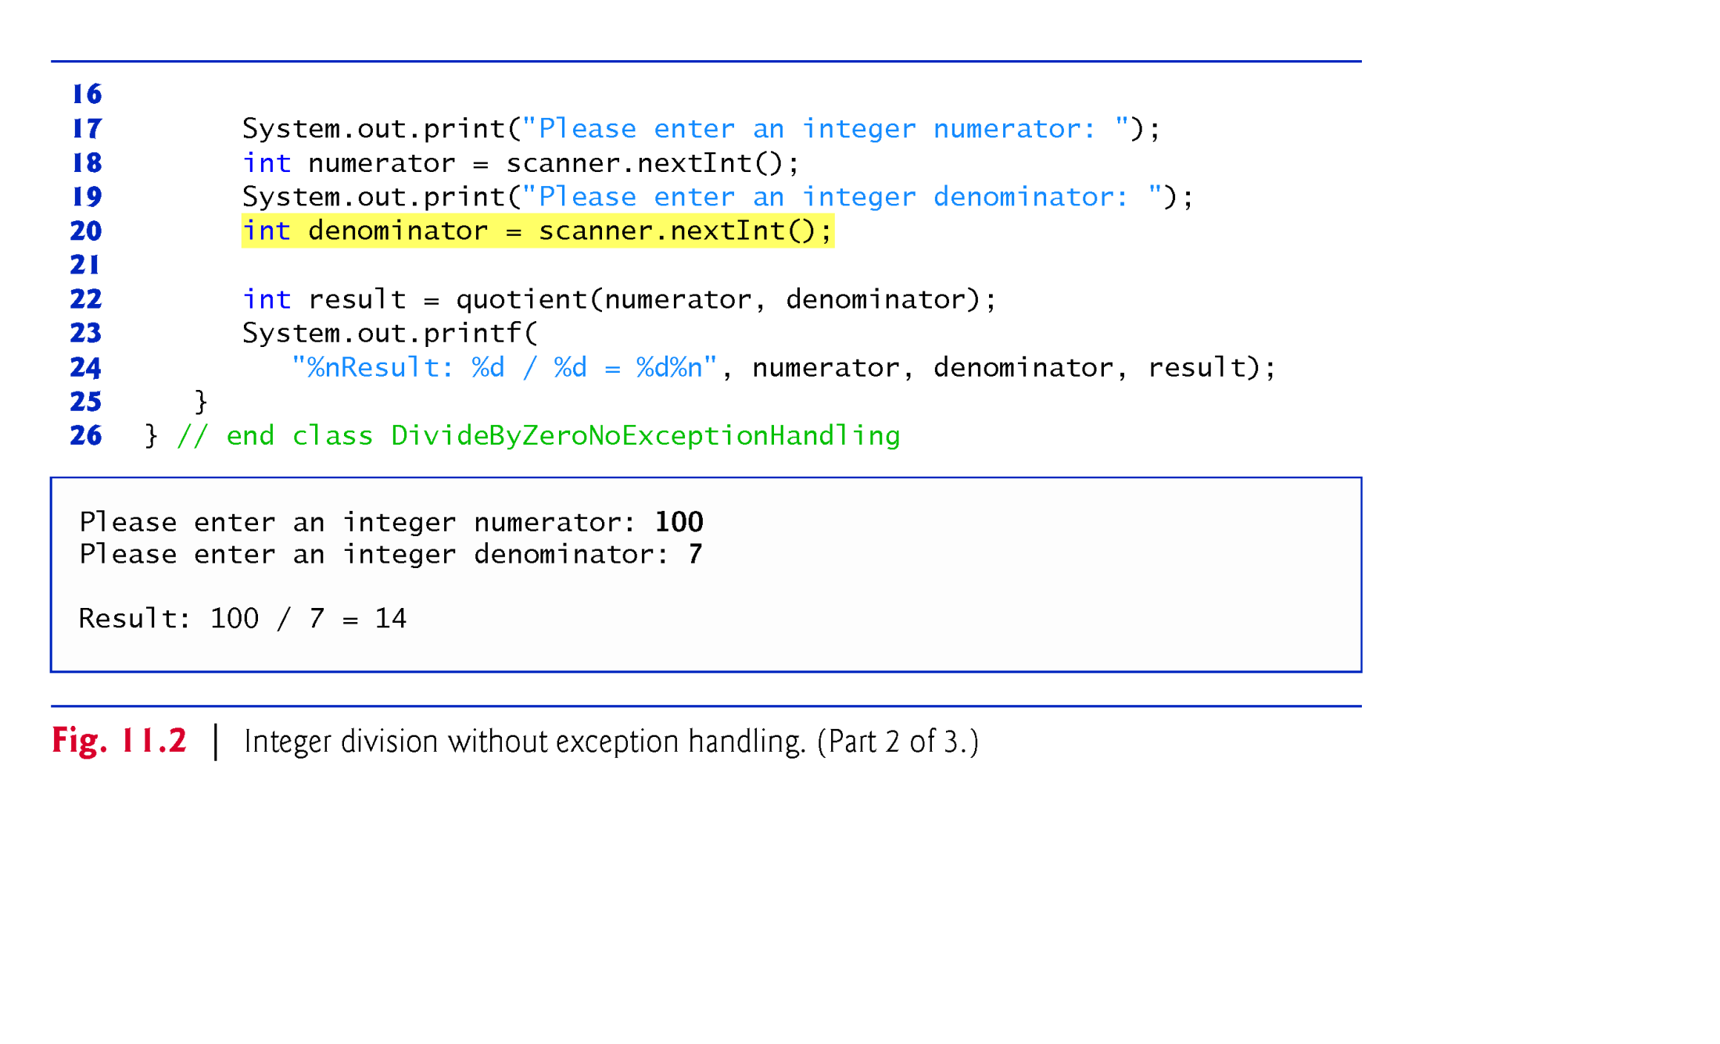
Example 2: Division by Zero without Exception Handling: (2/3)
The division is successful

Slide 11
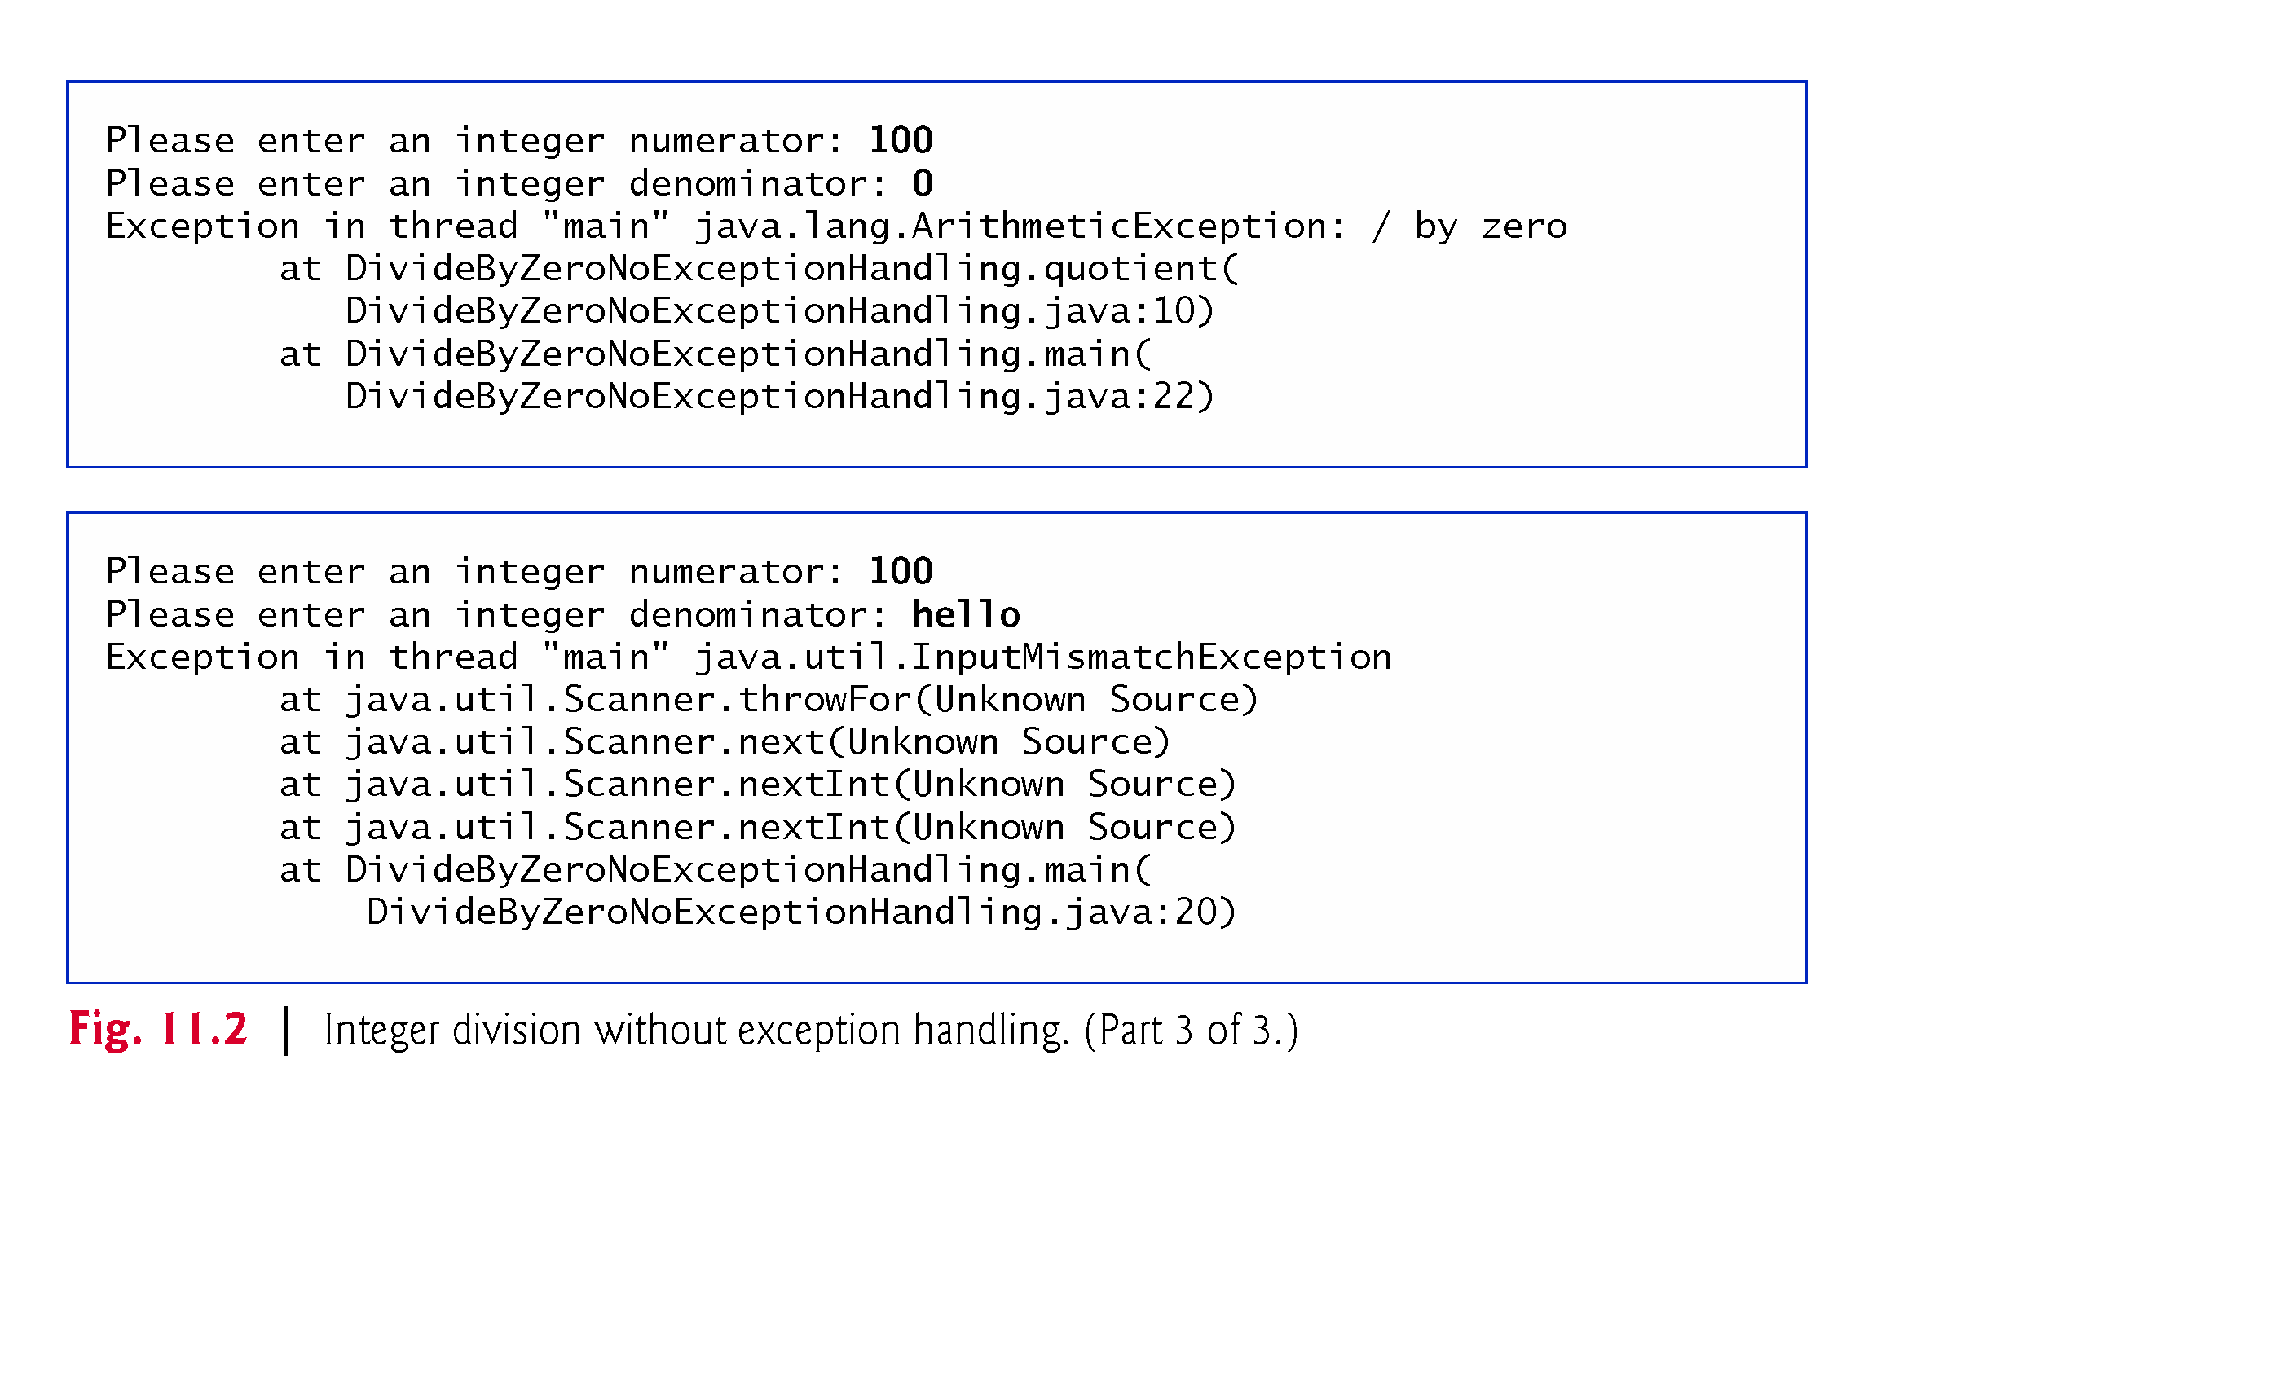
Example 2: Division by Zero without Exception Handling: (3/3)
Line 10: Initial throw point
File name and line number are called debugging symbols
Stack trace: call stack(call chain) when there is no error handling mechanism
* Exception type and its cause
* ClassName.methodName(FileName.java, line number)
* For built-in-classes, filenames were not access by JVM

Slide 12
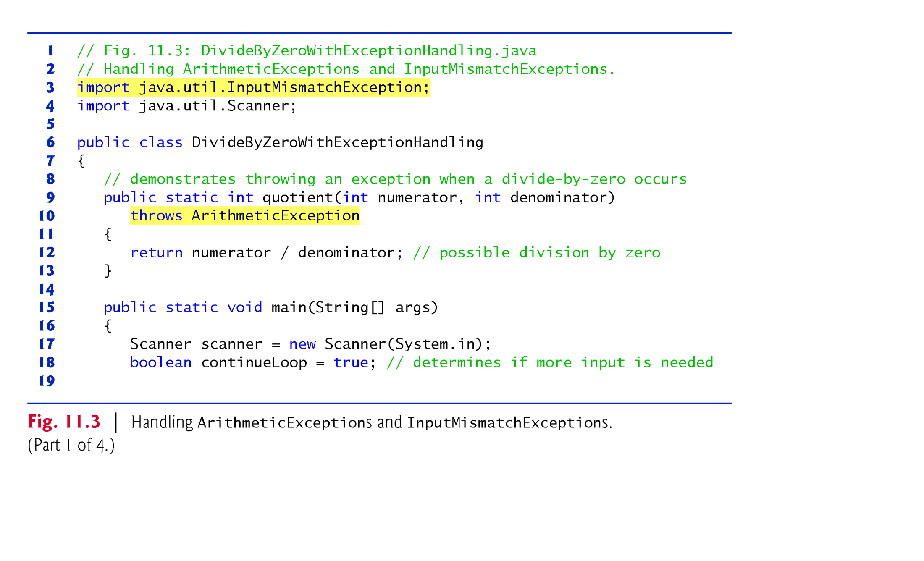
Example 3 : Division by Zero with exception handling: (1/4)
Line 3: java.lang.ArithemeticException: imported automatically
Line 9: quotient() is user defined method

Slide 13
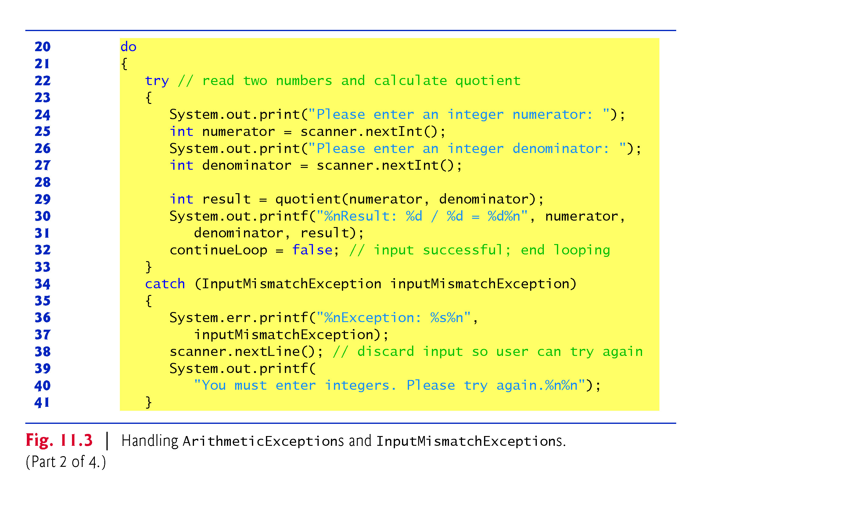
Example 3 : Division by Zero with exception handling: (2/4)
Line 38 : The invalid input is still in buffer. Read it to clean it.

Slide 14
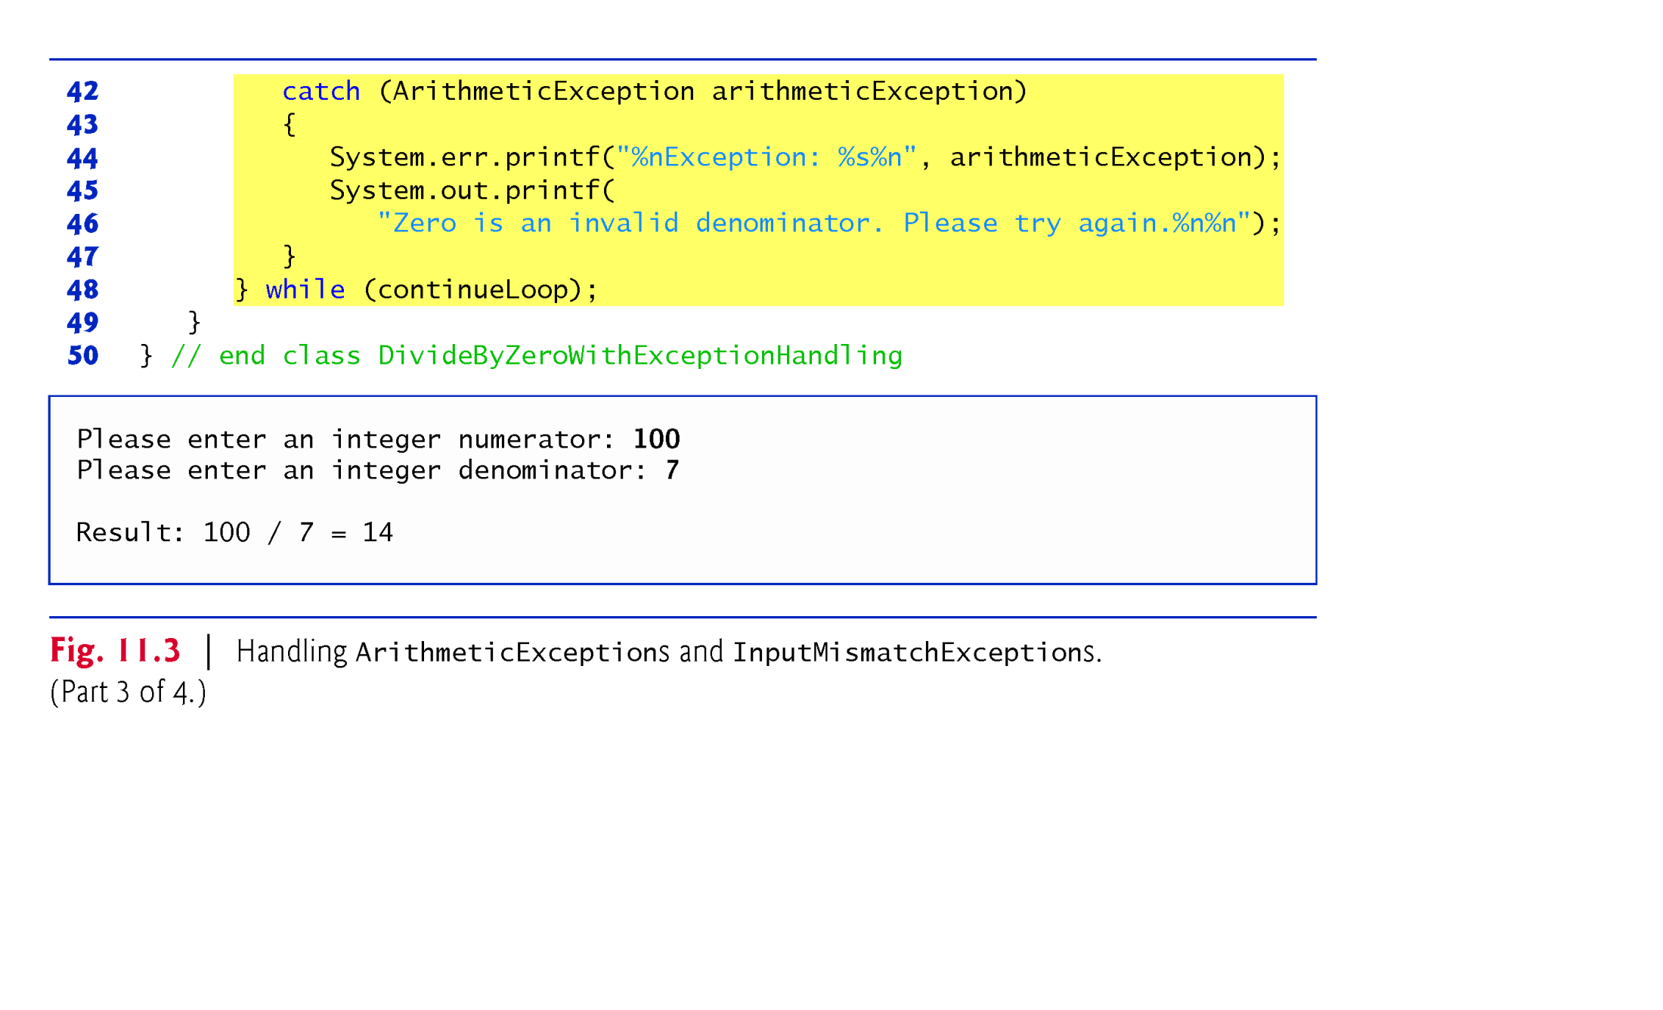
Example 3 : Division by Zero with exception handling: (3/4)
Line 36 and 44 : catch block uses object reference to manipulate the object in heap. Example. To invoke its tostring() method implicitly or explicitly.
Example: arithemeticExcpetion .tostring()
arithemeticExcpetion. message()

Slide 15
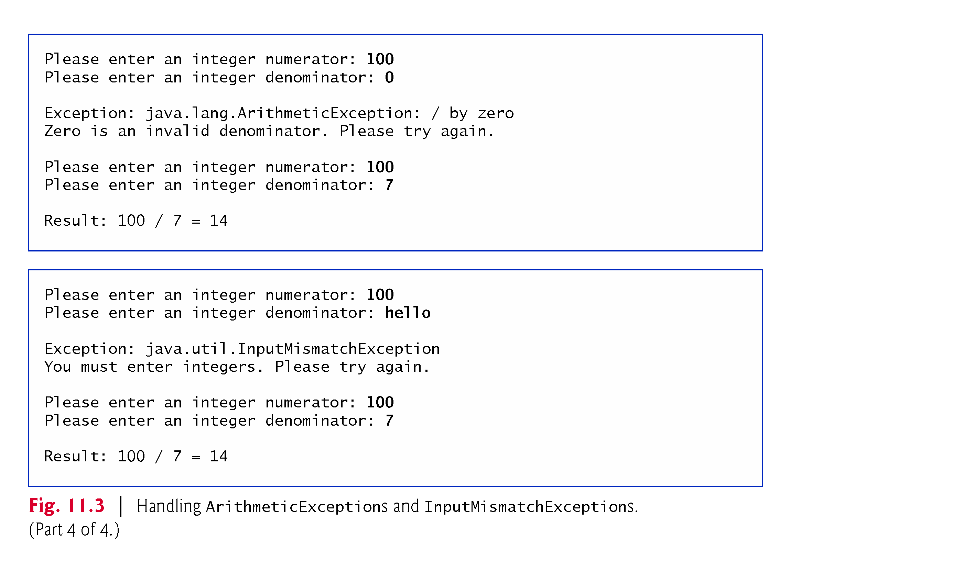
Example 3 : Division by Zero with exception handling: (4/4)

Slide 16
Catch-or-Declare : Required by Checked Exceptions
Checked exceptions must be explicitly caught or explicitly specified with throw clause
public void save(String name) { // Caller method
try {
FileOutputStream out = new FileOutPutStream(name); // Called method
}
catch(FileNotFoundException e)
{ … }
…
}
OR
public void save(String name)
throws FileNotFoundException {
FileOutputStream out = new FileOutPutStream(name);
…
} // When compiler detects throw clause at the called method, it forces the caller method to have try/catch block or throw clause.

Slide 17
Catch-or-Declare: Not required by unchecked Exceptions
Unchecked exceptions do not have this requirement.
They don't have to be caught or declared thrown
The code can compile, but error occurs at runtime by JVM
public static int quotient( int numerator, int denominator )
throws ArithmeticException
{
return numerator / denominator;
}
OR
public static int quotient( int numerator, int denominator )
{
return numerator / denominator;
}

Slide 18
Catch-or-Declare Requrement (Summary)
To satisfy the catch part of the catch-or-declare requirement, the code that generates the exception must be wrapped in a try block and must provide a catch handler for the checked-exception type (or one of its superclasses).
To satisfy the declare part of the catch-or-declare requirement, the method must provide a throws clause containing the checked-exception type after its parameter list and before its method body.
If the catch-or-declare requirement is not satisfied, the compiler will issue an error message.

Slide 19
Exception Handling and Inheritance
Catching Subclass Exceptions
A catch parameter of a superclass-type can also catch all of that exception type’s subclass types.
Enables catch to handle related errors with a concise notation
Allows polymorphic processing of related exceptions
Catching related exceptions in one catch block makes sense only if the handling behavior is the same for all subclasses.
We can also catch each subclass type individually if those exceptions require different processing.

Slide 20
Exception Handling and Inheritance(Cont.)
Multiple Catch Blocks
If multiple catch blocks match a particular exception type, only the first matching catch block executes.
It’s a compilation error to catch the exact same type in two different catch blocks associated with a particular try block.
catch ( ArithmeticException ae ) { … }
catch (RuntimeException re) { … }
√
catch (RuntimeException re) { … }
catch (ArithmeticException ae ) { … }
X
catch (RuntimeException re1) { … }
catch (RumtimeException re2 ) { … }
X

Slide 21
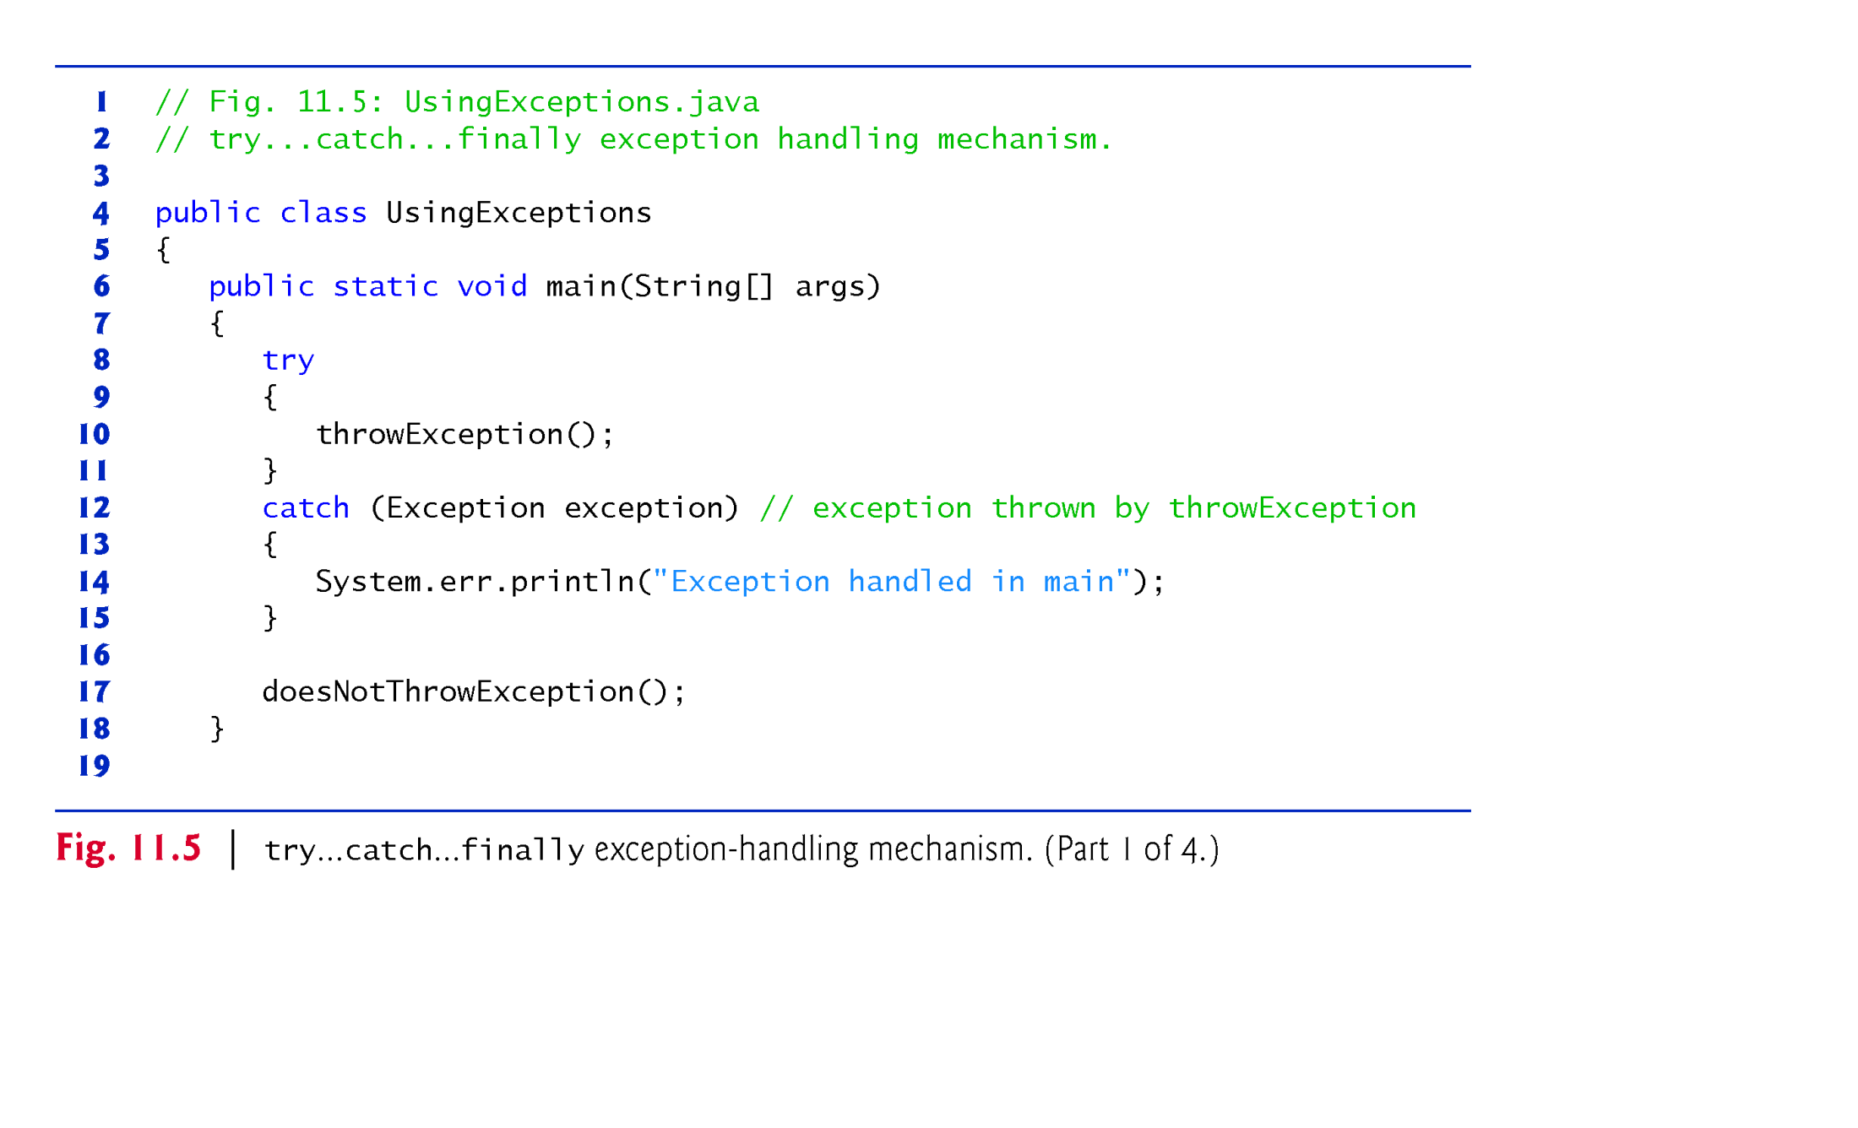
Example 4: try/catch/finally Block (1/4)
This program contain 3 methods: main(), throwException(), doesNotThrowException().

Slide 22
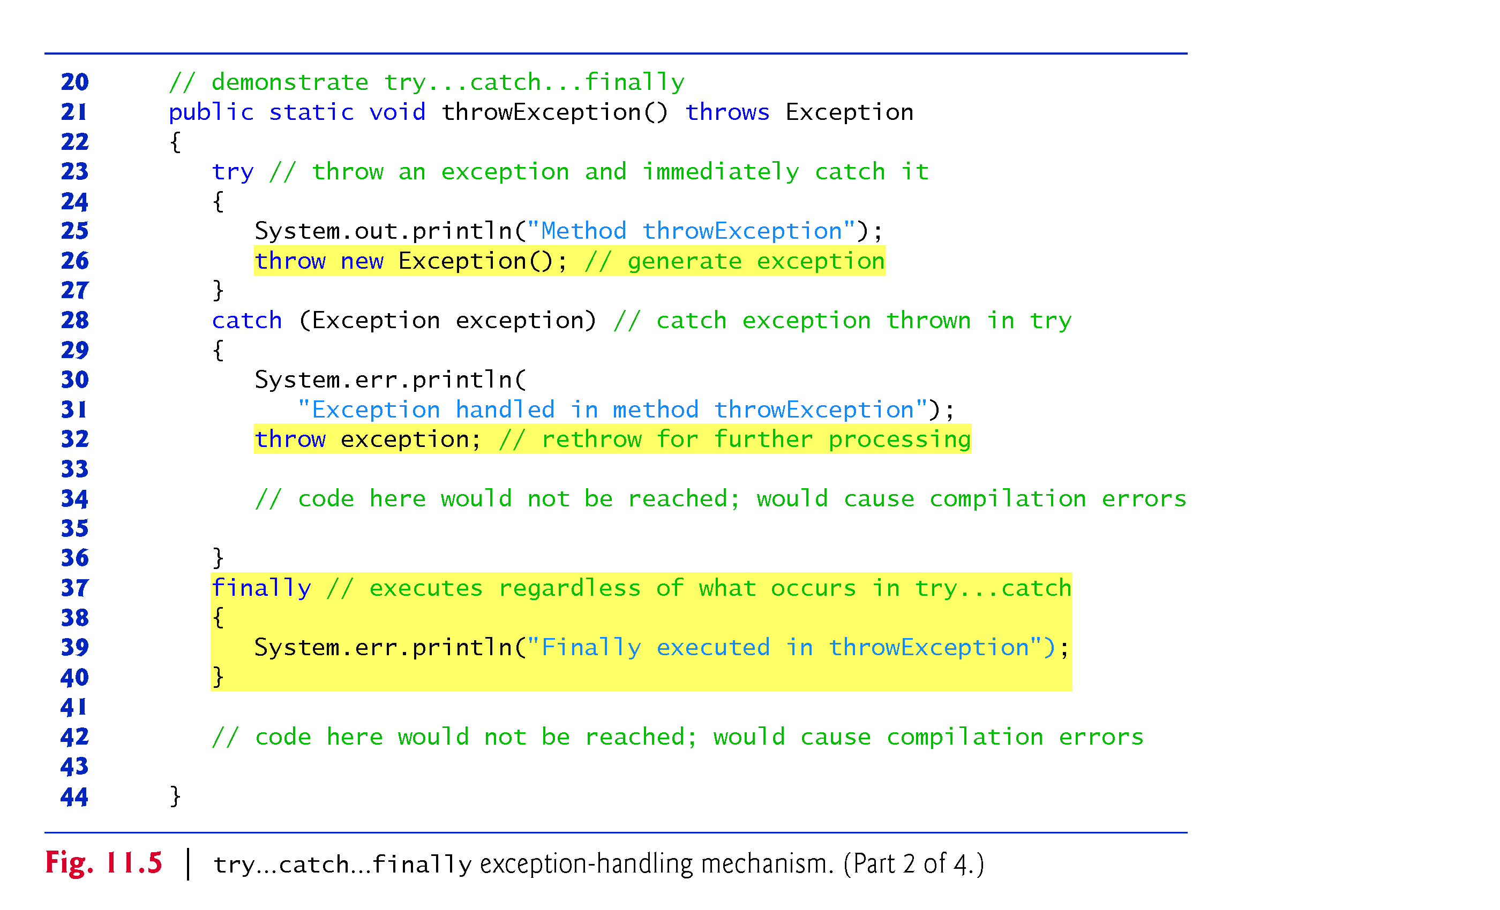
Example 4: try/catch/finally Block (2/4)
Line 26: throw statement
Line 32: re-throw error
Line 26: operand of throw: subclass of “throwable” class.

Slide 23
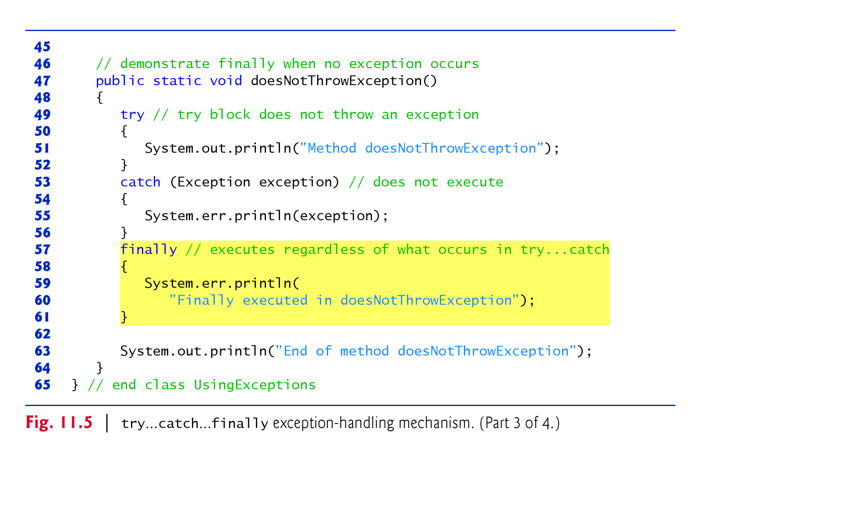
Example 4: try/catch/finally Block (3/4)

Slide 24
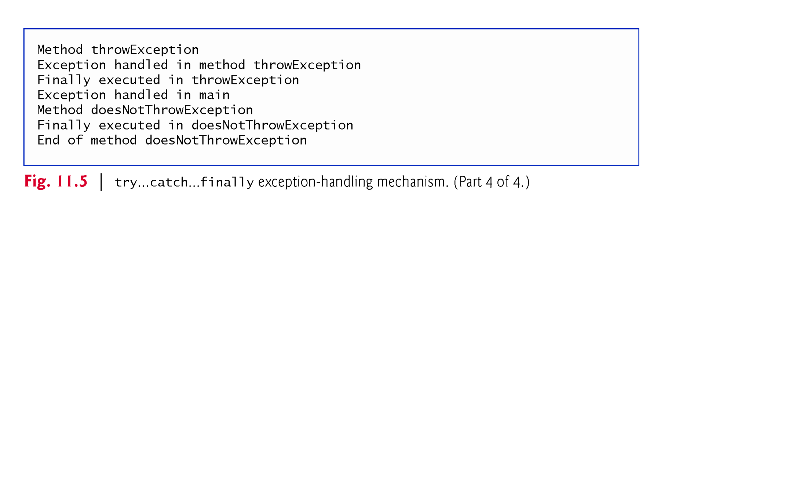
Example 4: try/catch/finally Block (4/4)

Slide 25
Analysis of Example 4: try/catch/ finally Block
throw statement—indicates that an exception has occurred.
Used to throw exceptions.
Indicates to client code that an error has occurred.
Specifies an object to be thrown.
The operand of a throw can be of any class derived from Throwable class

Slide 26
Analysis of Example 4: try/catch/ finally Block
Re-throw an exception
It is done when a catch block decides that it cannot process the exception or it can only process the exception partially.
It defers the exception handling (or a portion of it) to another catch block associated with an outer try statement.
An exception is re-throw by using the throw keyword, followed by a reference to the exception object that was just caught.
When a re-throw occurs, the next enclosing try block detects the exception, and that try block’s catch blocks attempt to handle it.
Since the re-thrown exception is handled by outer block, the finally block in the inner block is executed before the handling of the re-thrown error by the outer block.

Slide 27
Stack Unwinding
When an exception is thrown but not caught in a particular scope, the method-call stack is “unwound.”
After stack unwounding, an attempt is made to catch the exception in the next outer try block.
Hence, all local variables in the unwound method go out of scope and control returns to the statement that originally invoked that method.
If a try block encloses that statement, an attempt is made to catch the exception.
If a try block does not enclose that statement or if the exception is not caught, stack unwinding occurs again.

Slide 28
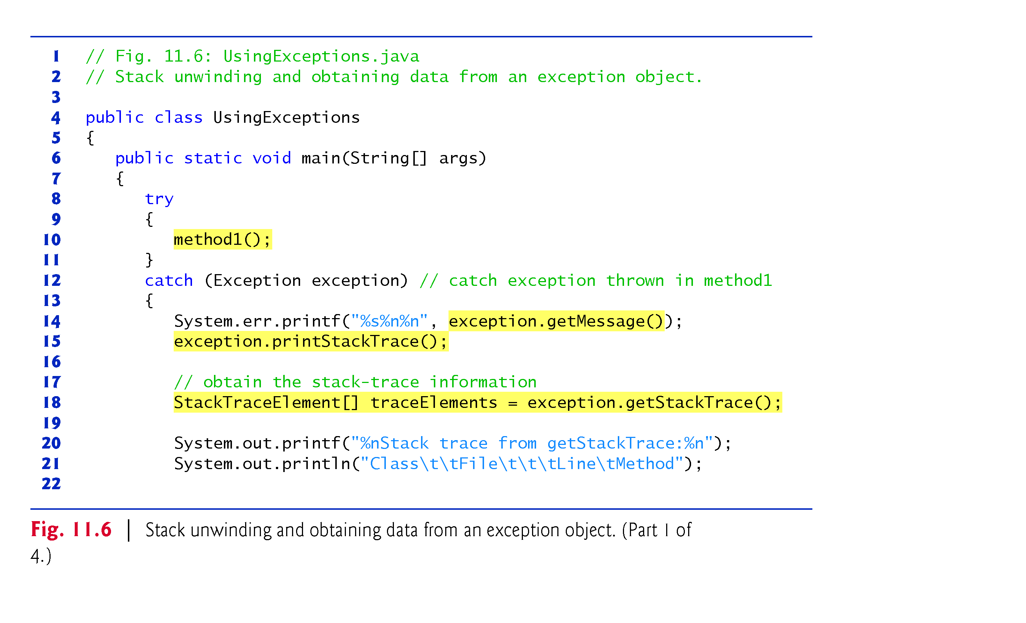
Example 5: Stack Unwinding (1/4)
Line 18: the method generates an array of StackTraceElements objects
Line 26-29: This class has 4 methods to obtain 4 specific information

Slide 29
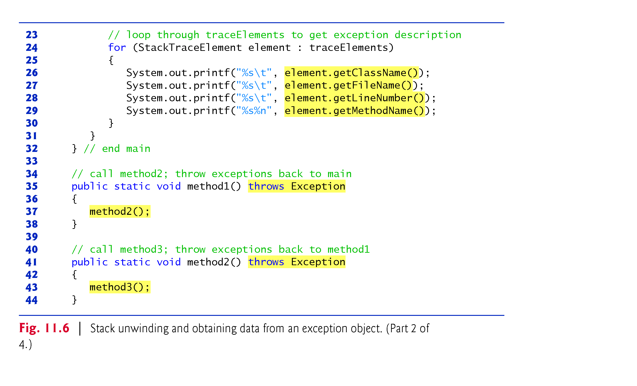
Example 5: Stack Unwinding (2/4)

Slide 30
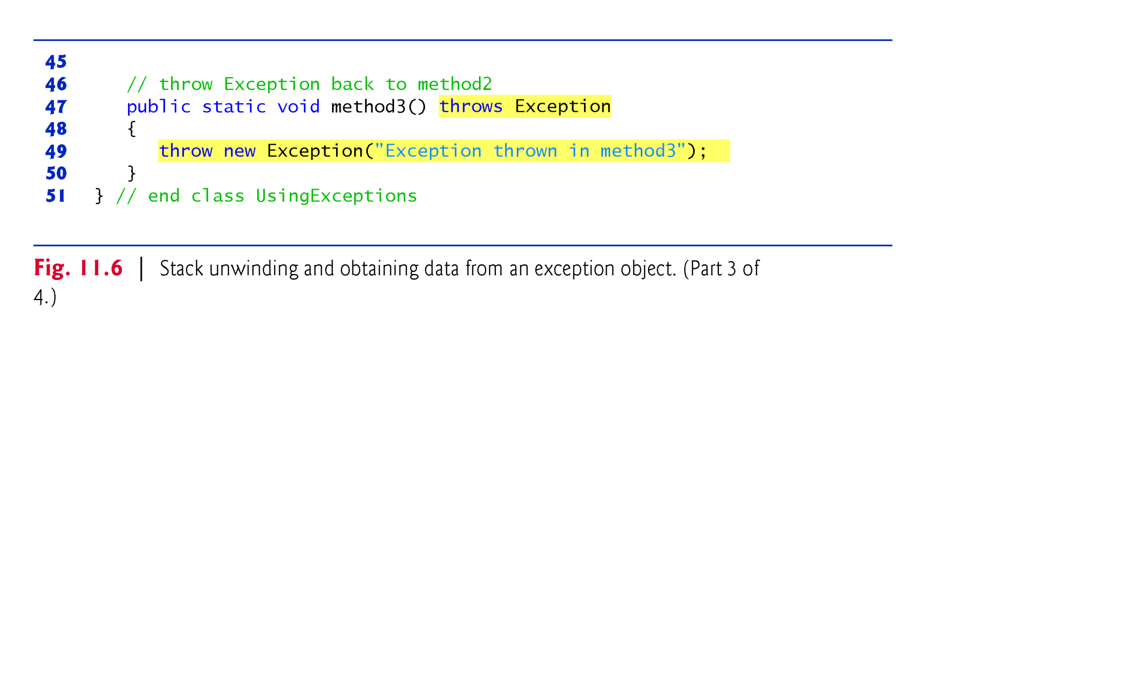
Example 5: Stack Unwinding (3/4)

Slide 31
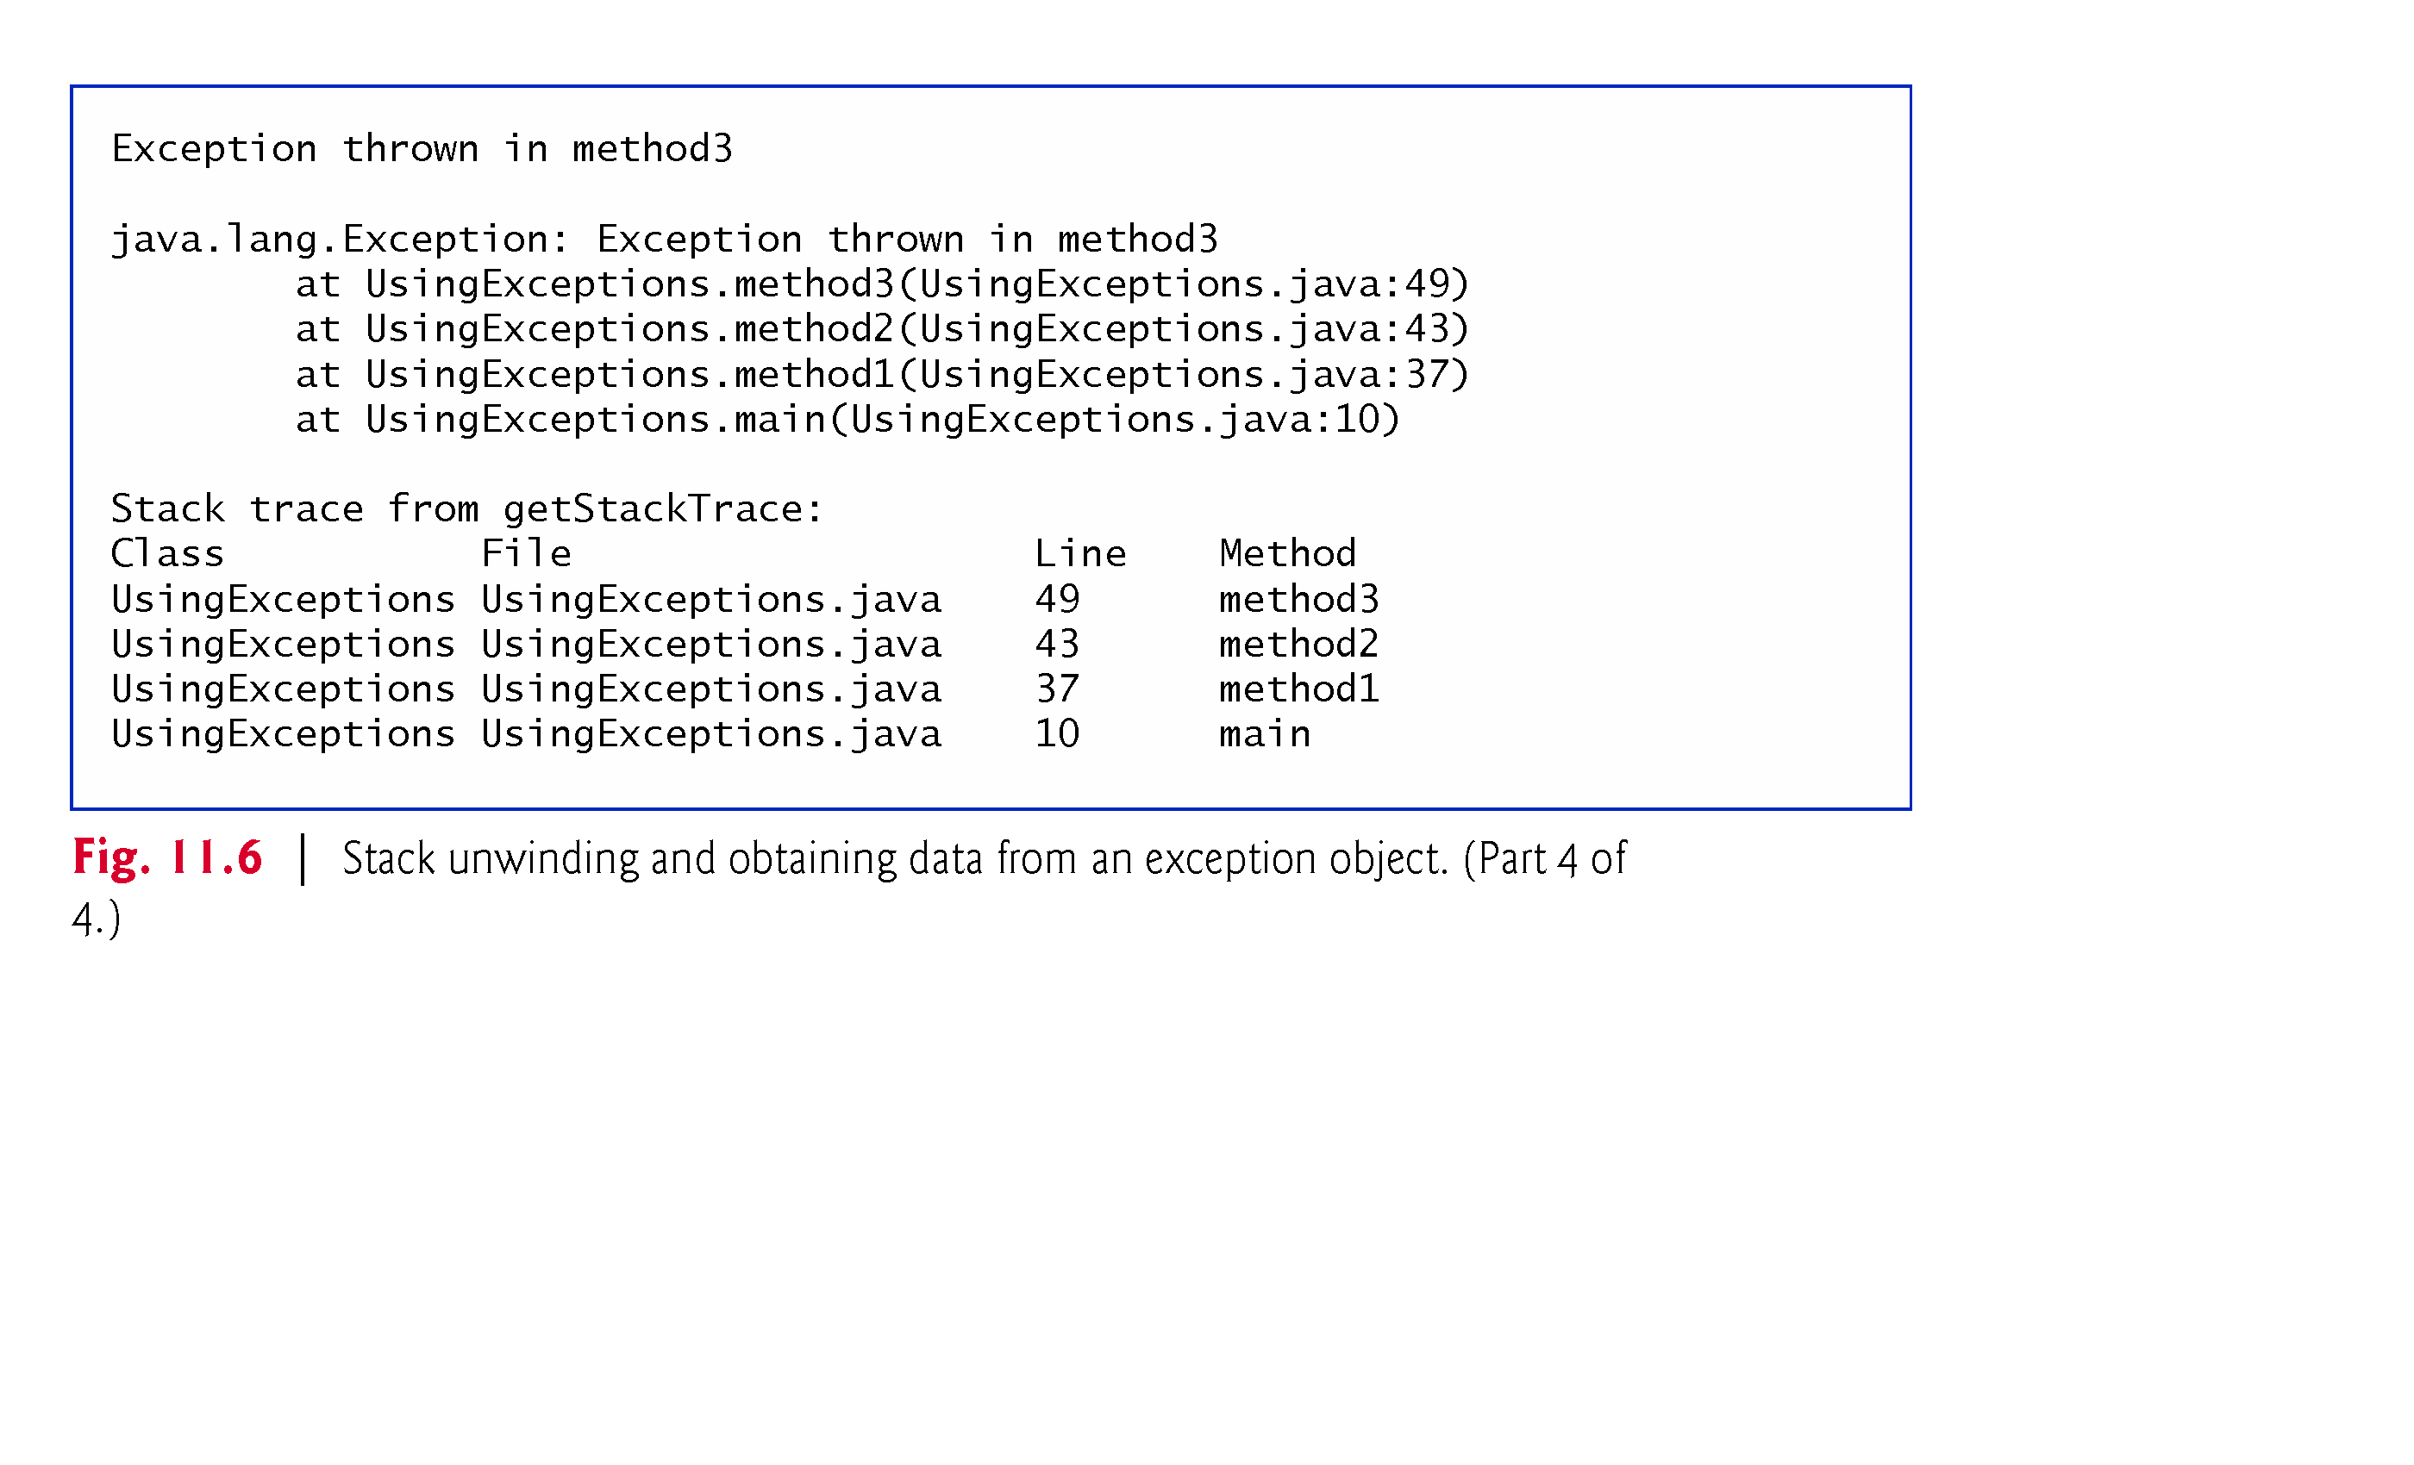
Example 5: Stack Unwinding (4/4)
Get information using the object reference and methods of throwable class
getMessage(): descriptive string stored in an exception object by constructor
printStackTrace(): display stack trace to screen( standard error stream)
getStackTrace() : to output stack trace to other streams
The 4 methods of “StackTraceElemnet” class: getClassName(),getMethodName(),getFileName() and getLineNumber():

Slide 32
11.9 Chained Exceptions
A method responds to an exception by throwing a different exception type that is specific to the current application.
In old java versions, if a catch block throws a new exception, the original exception’s information and stack trace are lost
In recent java versions, chained exceptions
provide mechanism to wrap the original exception information with the new exception’s information.
Hence, it enable an exception object to maintain the complete stack-trace information from the original exception.

Slide 33
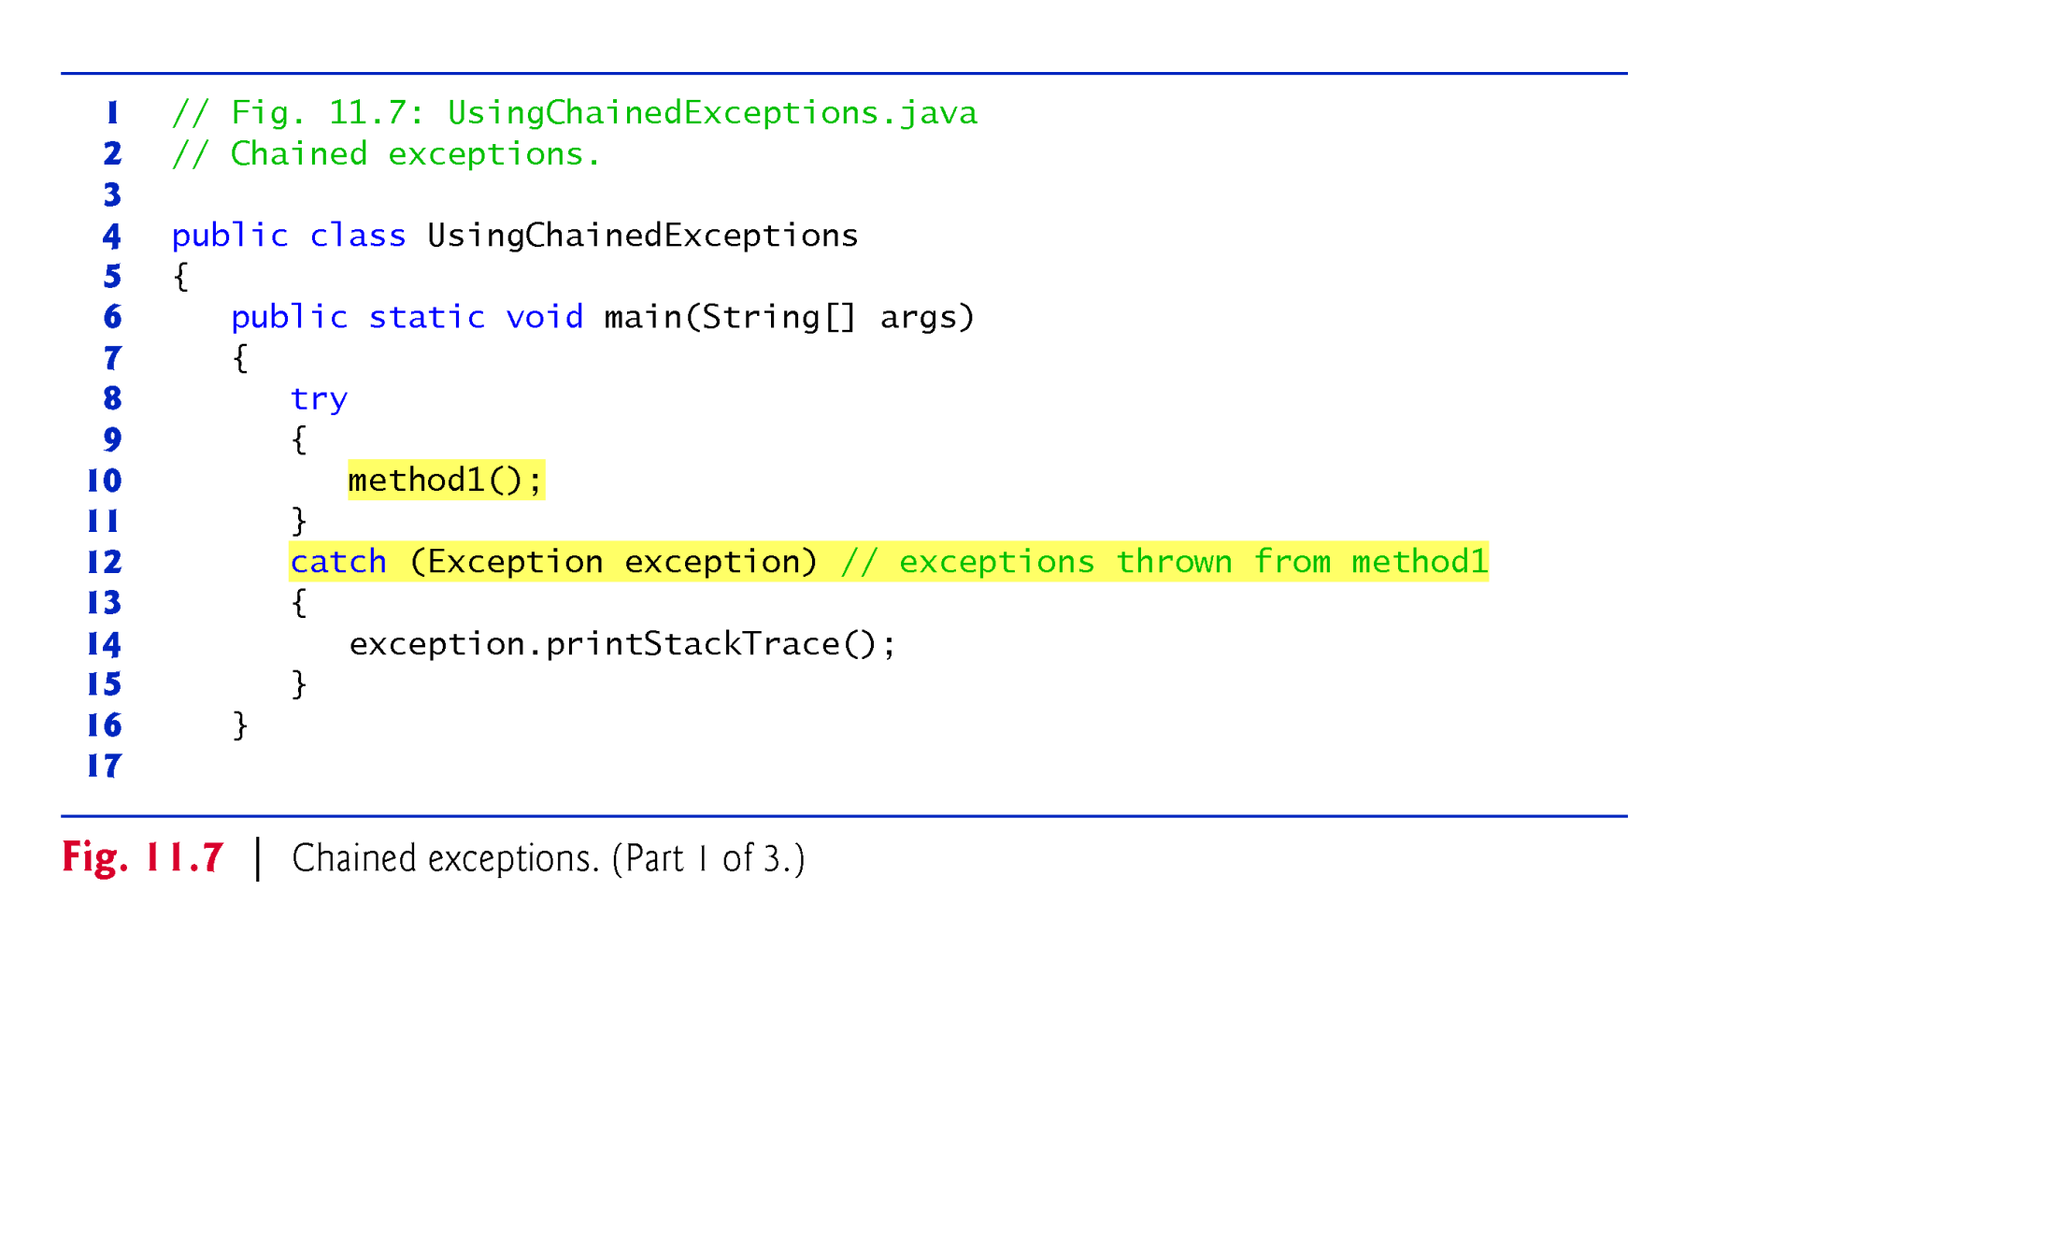
Example 6: Chained Exceptions (1/3)
The program contains 4 methods.
main() call m1;
m1 call m2;
m2 call m3
m3 throw new exception without try/catch block

Slide 34
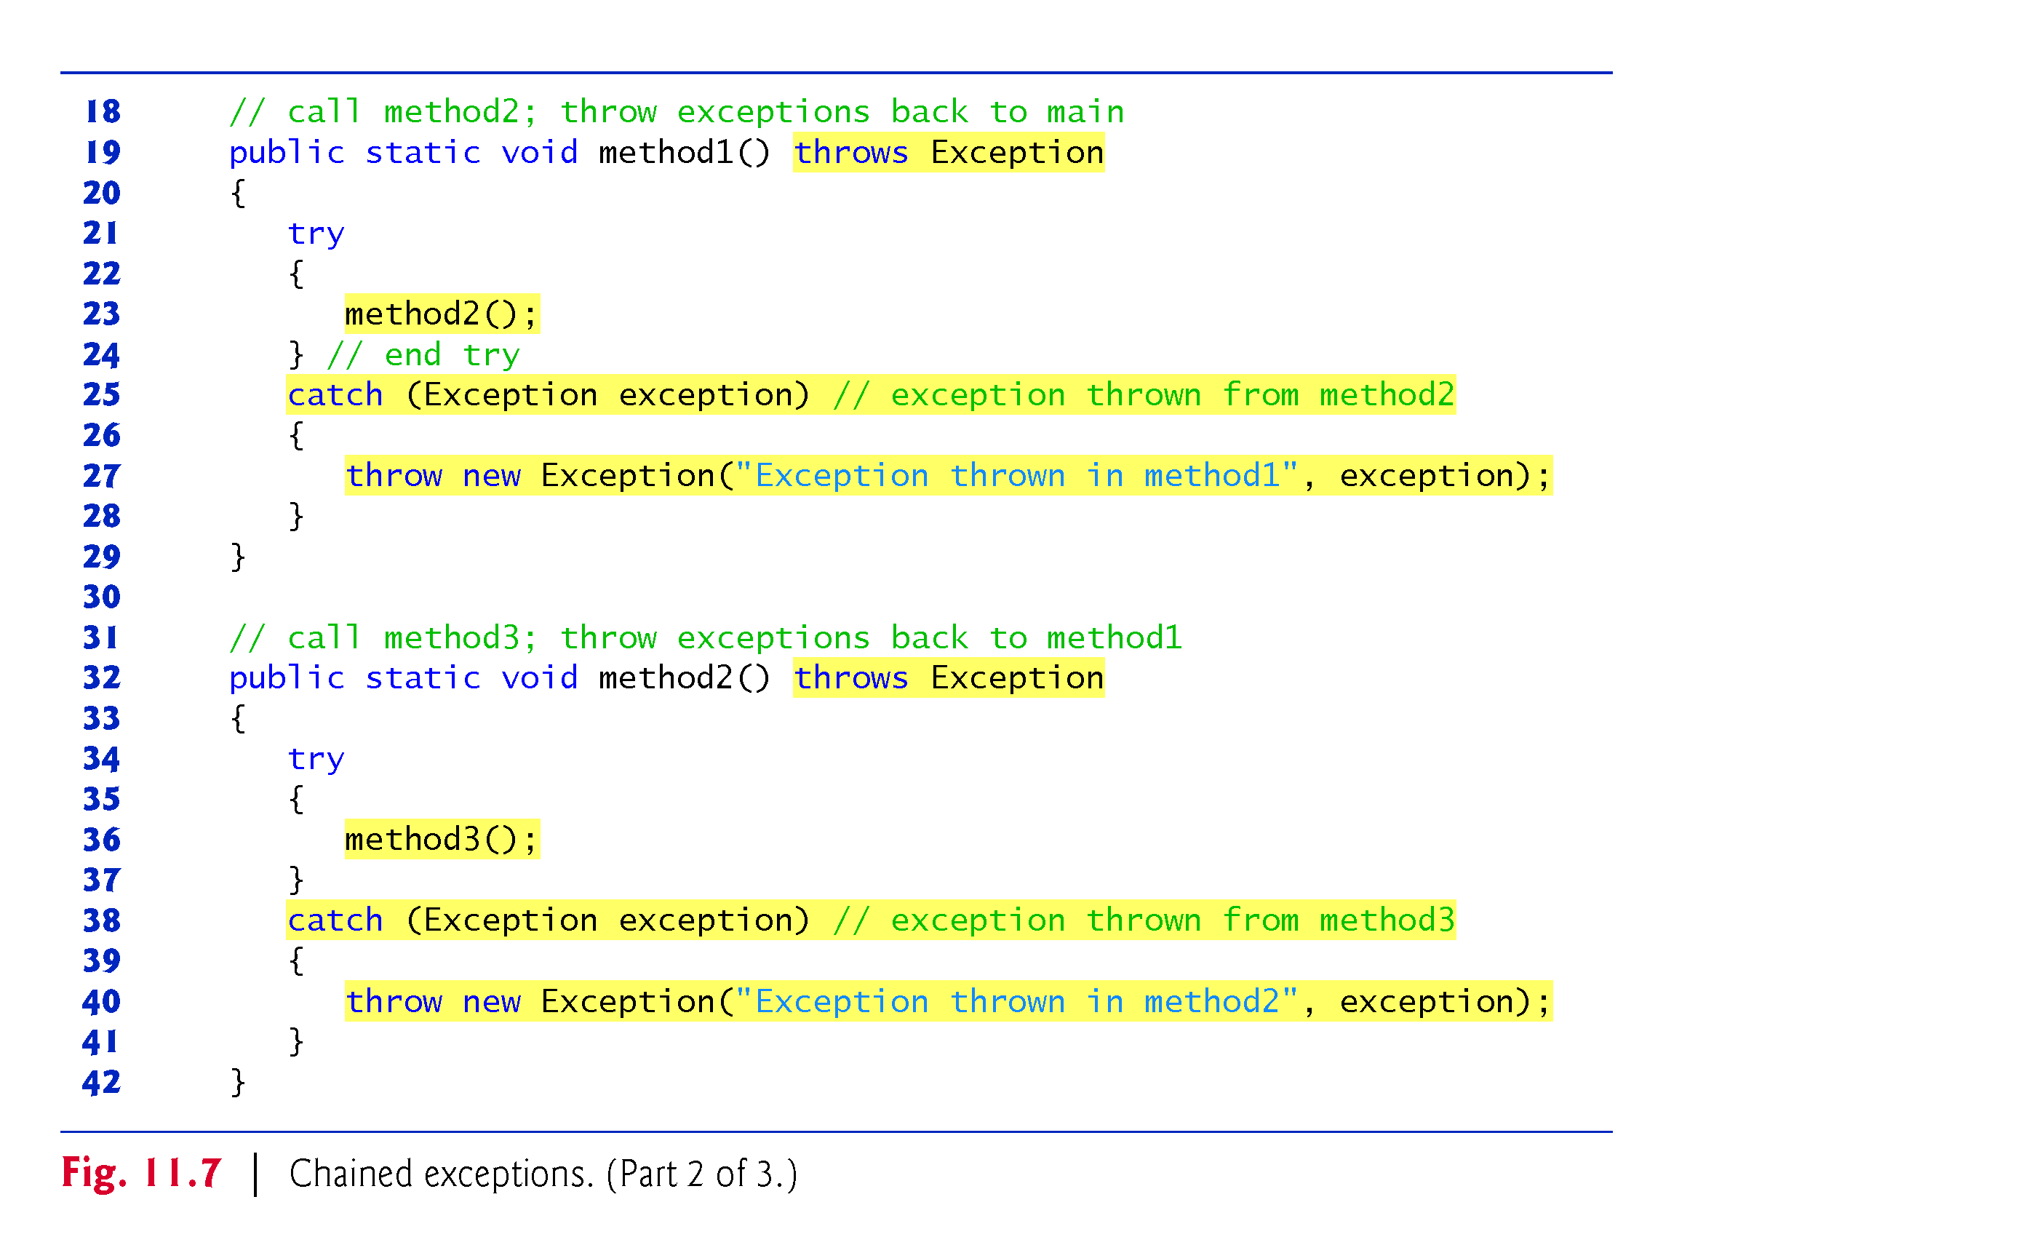
Example 6: Chained Exceptions (2/3)
Line 40: second argument is the original cause of the problem at line 47

Slide 35
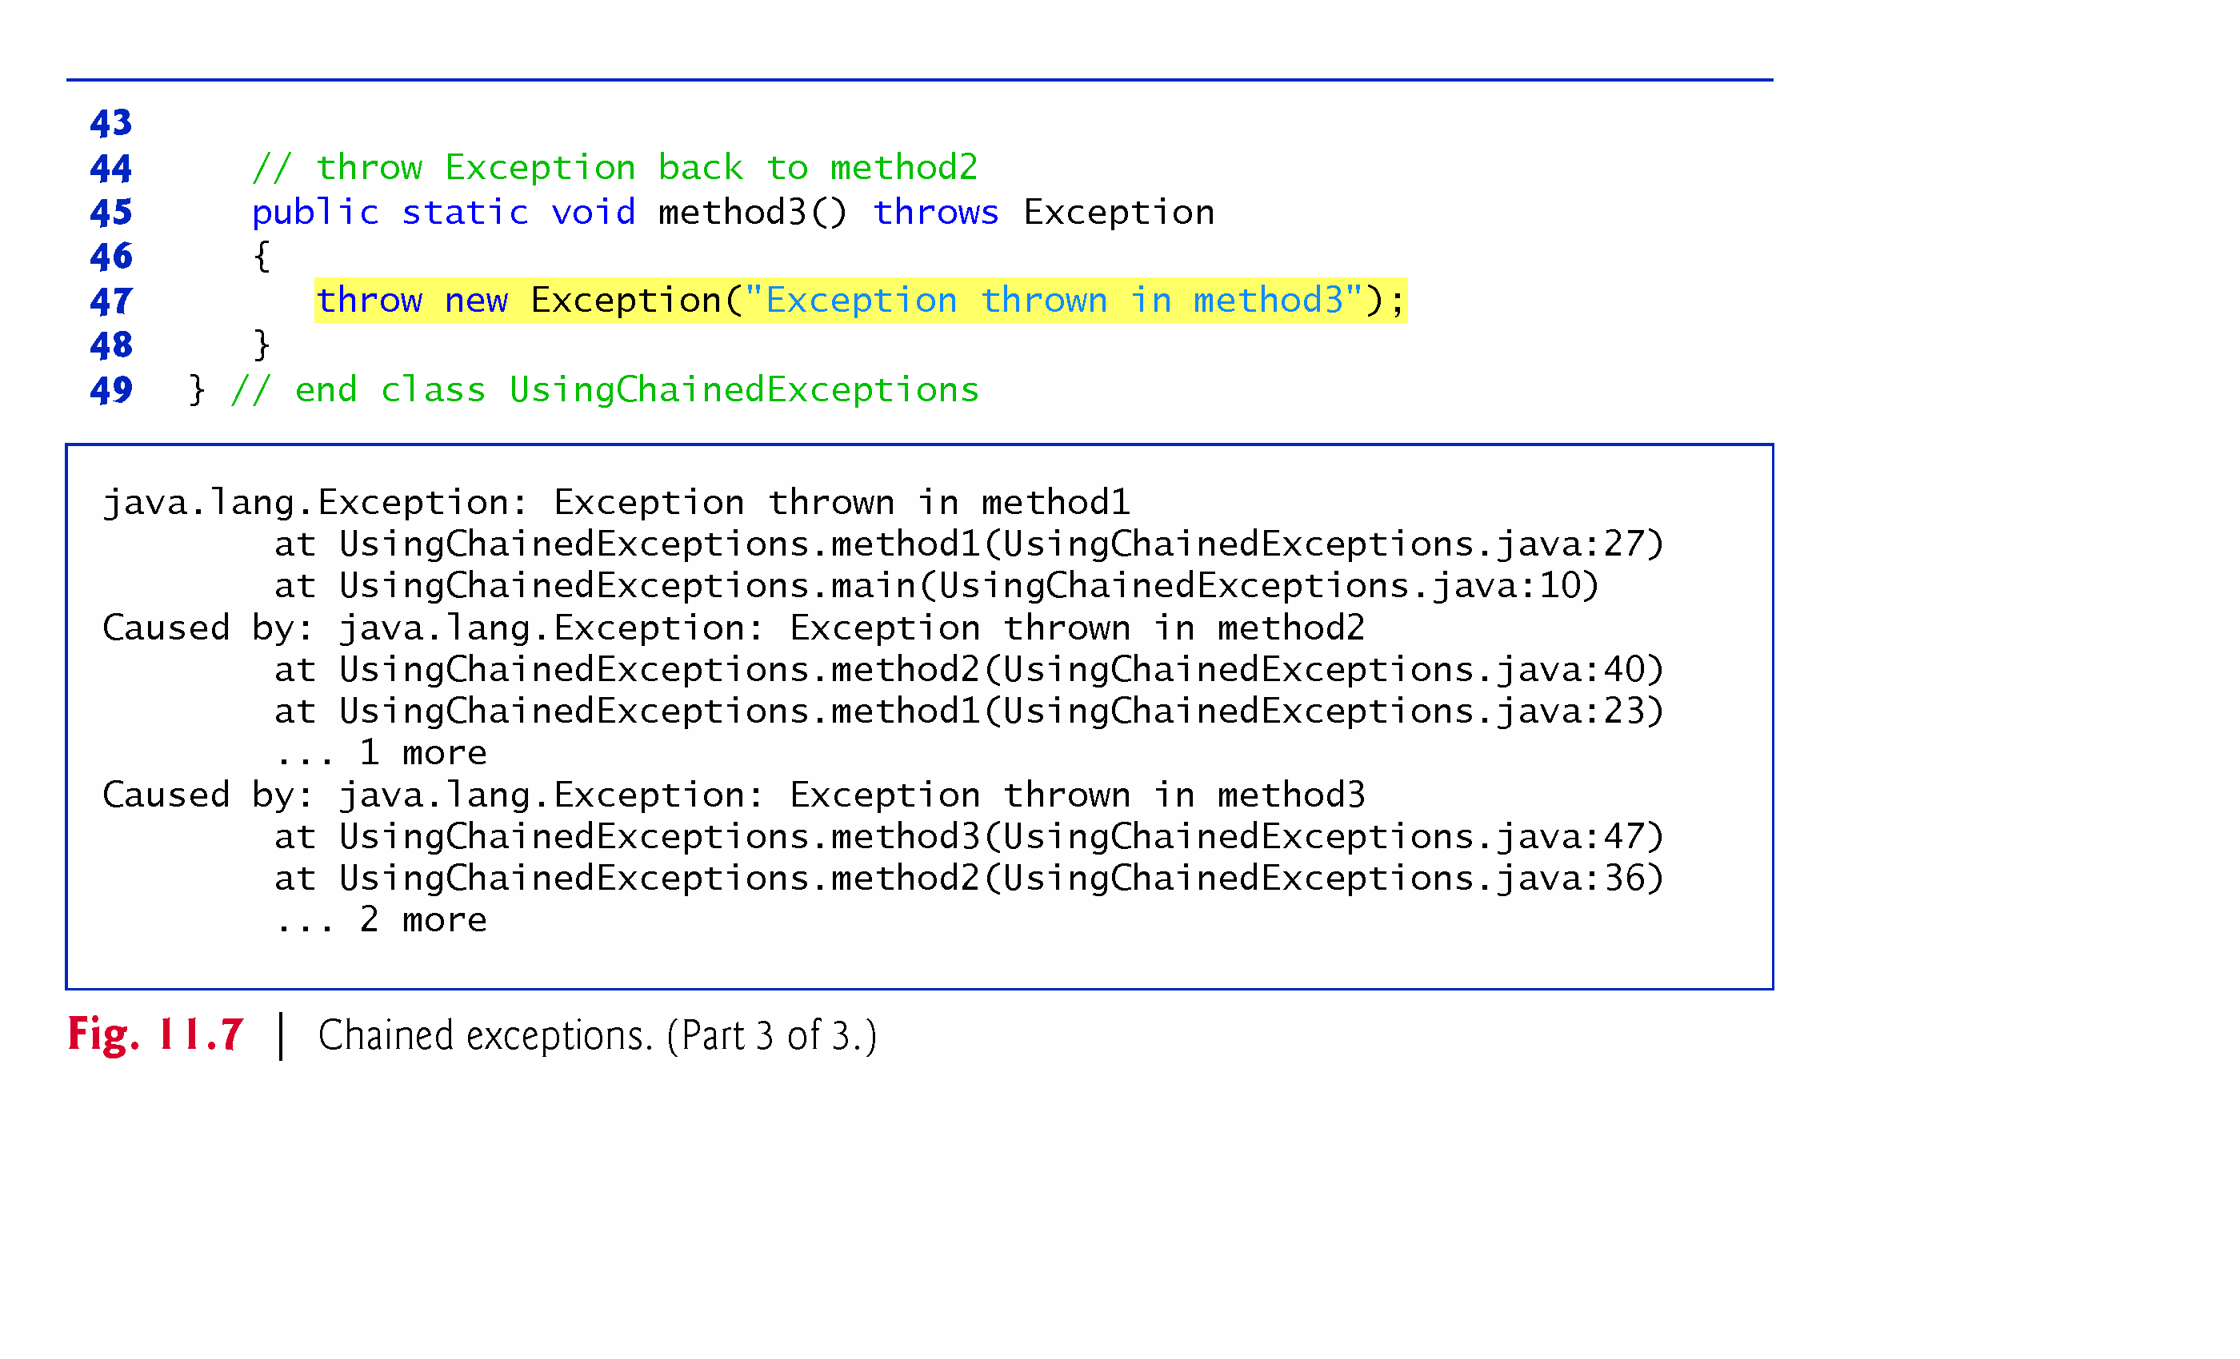
Example 6: Chained Exceptions (1/3)
Example 6: Chained Exceptions (3/3)
Output: first three lines: recent exception thrown from method 1 at line 27
The next four lines: exception thrown from method 2 at line 40
The last four lines: exception thrown from method 3 at line 47

