Slide 1
Ch 09: Collections
In this chapter, you will learn how to use collection classes that implement
different types of data structures.
The type of data structure affects the performance of an algorithm.
Do you need to search a key quickly through thousands of sorted items?
Do you need to rapidly insert and remove elements in the middle of an ordered sequence?
Do you need to establish associations between keys and values?
Java collection API enables programmers to re-use existing data structuring

Slide 2
9.1 : Java Collections Framework
Java collections framework( java.util package)
a unified architecture for representing and manipulating data structure libraries
enables them to be manipulated independently of the details of their representation
provides interfaces and their implementations for manipulating those collections
reduces programming effort
The initial release of Java API contain a small set of classes for basic data structures, namely, Vector class , Stack class , Hashtable class and Enumeration interface that provides an abstract mechanism for visiting elements in an arbitrary container.

Slide 3
Need of Wrapper Classes for Primitive Types
Methods of collection classes cannot manipulate variables of primitive types.
Hence, each primitive type should be wrapped into their corresponding wrapper class (in package java.lang).
Boolean, Byte, Character, Double, Float, Integer, Long and Short.
Each type-wrapper class enables you to manipulate primitive-type values as objects.
Each of the numeric type-wrapper classes—Byte, Short, Integer, Long, Float and Double—extends Number class .

Slide 4
Autoboxing and Auto-Unboxing (after java 5.0)
Autoboxing conversion converts a value of a primitive type to an object of the corresponding wrapper class.
An unboxing conversion converts an object of wrapper class to a value of the corresponding primitive type.
These conversions can be performed automatically (called autoboxing and auto-unboxing after java SE 5.0).
Example:
// create integerArray
Integer[] integerArray = new Integer[ 5 ];
// assign Integer 10 to integerArray[ 0 ]
integerArray[ 0 ] = 10;
// get int value of Integer
int value = integerArray[ 0 ];

Slide 5
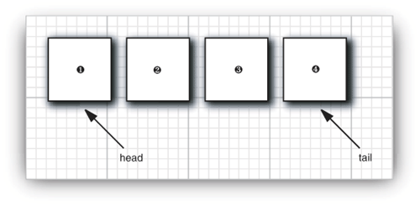
9.1.1 Separating Collection Interfaces and Implementation
Java data structure library (java Collections library) separates interfaces and implementations.
Example, consider queue data structure
queue interface specifies that we can add elements at the tail end of the queue, remove
them at the head, and find out how many elements are in the queue
We use a queue to insert objects and retrieve objects in “first in, first out” fashion
Hence, the queue interface can be declared as follows:
public interface Queue<E> // a simplified form of the interface in the standard library
{
void add(E element);
E remove();
int size();
}

Slide 6
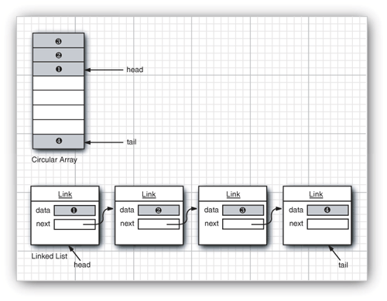
Collection Classes
// not an actual library class
class CircularArrayQueue<E> implements Queue<E>
{
CircularArrayQueue(int capacity) { . . . }
public void add(E element) { . . . }
public E remove() { . . . }
public int size() { . . . }
private E[] elements;
private int head;
private int tail;
}
// see next slide

Slide 7
9.1.1 Separating Collection Interfaces and Implementation
class LinkedListQueue<E> implements Queue<E>
{
LinkedListQueue() { . . . }
public void add(E element) { . . . }
public E remove() { . . . }
public int size() { . . . }
private Link head;
private Link tail;
}
Note: use concrete collection class to create collection object and use the interface type to hold the collection reference.
queue<Customer> Ref= new CircularArrayQueue<>(100);
Ref.add(new customer(“Harry”);

Slide 8
9.1.1 Separating Collection Interfaces and Implementation
When we study the collection API documentation, we will find set of classes whose name begins with Abstract, such as AbstractQueue.
These classes are intended for library implementers.
If you want to implement your own queue class, it is easy to extend AbstractQueue than to implement all the methods of the Queue interface from scratch .

Slide 9
9.1.2. Collection interface: root interface in Collection API(java.util).
Collection<E> interface is the root interface from which Set<E> interface , Queue<E> interface and List<E> interface are drived.
Collection<E> interface contains bulk operations for adding, clearing and comparing objects in a collection.
int size()
boolean isEmpty()
contains(Object)
boolean add(Object)
boolean addAll(Collection<? extends E> other)
boolean remove(Object)
Iterator<E> iterator(); // this method returns an object that implements Iterator interface
… etc
The Collection<E> interface provides a method that returns an Iterator<E> object.
Note that we can use the iterator object to visit the elements in the collection one by one.

Slide 10
9.1.3. Iterator Interface(java.util )
Iterator interface is a generic interface belongs to collection framework(API)
It allows us to traverse the collection and access the data element of collection without bothering the user about specific implementation of the collection.
The java.util.Iterator<T> interface provides for one-way traversal
java.util.ListIterator<T> provides two-way traversal
Basically a Collection interface provides Iterator by the iterator() method
Iterator<E> interface has 4 methods:
public interface Iterator<E>
{
E next(); // by repeatedly calling next() method, we can visit elements one by one.
boolean hasNext(); // before calling next(), call hasNext() to avoid NoSuchElementException.
void remove();
default void forEachRemaining(Consumer<? super E> action); // after java SE 8.0
}

Slide 11
Using Iterators
Typical example:
Collection<String> C = . . . ;
Iterator<String> iter = c.iterator();
while (iter.hasNext())
{
String element = iter.next();
// do something with element
}
More concisely:
for (String element : C) // the enhanced loop works for any object that implements Iterable interface
{
// do something with element
}
The Collection<E> interface extends the Iterable<E> interface.
Public interface Iterable<E>
{
Iterator<E> iterator(); // has only one abstract method
}

Slide 12
More about Iterators
Traversal order(the order in which the elements are visited depends on collection type
In java, think of iterator position as being between elements.
When we call next(), the iterator jumps over the next element, and it returns a reference
to the element that it just passed
remove() of Iterator interface removes the element that was just returned by next():
Iterator<String> it = c.iterator();
it.next(); // skip over the first element
it.remove(); // now remove it
Caution: Calling remove () twice to remov two adjacent elements without calling next() in between is an error.
it.remove();
it.remove(); // error because it throws IllegalStateException
**********************************************************
it.remove();
it.next(); // jump to next element
it.remove(); // ok

Slide 13
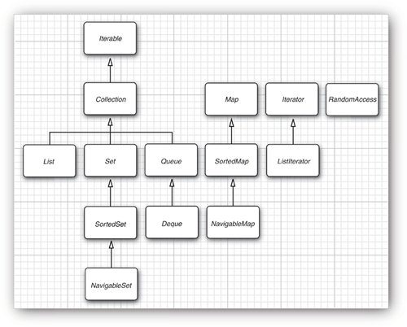
9.1.5. Interfaces in the Collection Framework
Collection(I) holds elements.
It is root interface e
Map(I) holds key/value pairs.
It is a root interface
List(I): Ordered collection.
Set(I): Unordered collection without duplicates.
SortedSet/SortedMap(I): Traversed in sorted order.
NavigableSet/NavigableMap(I): Additional methods for sorted sets/maps.

Slide 14
9.2. Concrete Collections
ArrayList - An indexed sequence that grows and shrinks dynamically
LinkedList - An ordered sequence that allows efficient insertion and removal at any location
ArrayDeque - A double-ended queue that is implemented as a circular array
HashSet - An unordered collection that rejects duplicates
TreeSet - A sorted set
EnumSet - A set of enumerated type values
LinkedHashSet - A set that remembers the order in which elements were inserted
PriorityQueue - A collection that allows efficient removal of the smallest element
HashMap - A data structure that stores key/value associations
TreeMap - A map in which the keys are sorted
EnumMap - A map in which the keys belong to an enumerated type
…

Slide 15
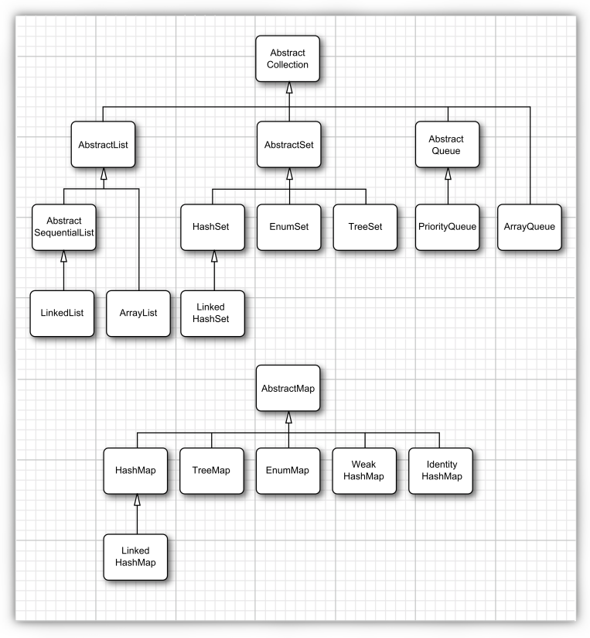
9.2. Concrete Collections cont’d

Slide 16
Lists
List interface supports sequential traversal with iterators
List interface also provides methods to access elements randomly with integer indexes.
List<E> interface provides methods for random access :
void add(int index, E element)
void remove(int index)
E get(int index)
E set(int index, E element)
ListIterator<E>interface extends Iterator<E> // provides the following methods:
{
void add(E element) // add an element before iterator position
E previous()
boolean hasPrevious();
}
Note: ArrayList and LinkedList(implicitly doubly linked List) implement List interface

Slide 17
Example: ArrayList and Iterator
import java.util.List;
import java.util.ArrayList;
import java.util.Collection;
import java.util.Iterator;
public class CollectionTest
{
public static void main(String[] args)
{
String[] colors = {"MAGENTA", "RED", "WHITE", "BLUE", "CYAN"};
List<String> list = new ArrayList<String>();
for (String color : colors)
list.add(color); // adds color to end of list
String[] removeColors = {"RED", "WHITE", "BLUE"};
List<String> removeList = new ArrayList<String>();
for (String color : removeColors)
removeList.add(color);
// output list contents
System.out.println("ArrayList: ");
for (int count = 0; count < list.size(); count++)
System.out.printf("%s ", list.get(count));
// remove from list the colors contained in removeList
removeColors(list, removeList);
// output list contents
System.out.printf
("%n%nArrayList after calling removeColors:%n");
for (String color : list)
System.out.printf("%s ", color);
}

Slide 18
Example: ArrayList and Iterator
// remove colors specified in collection2 from collection1
private static void removeColors(Collection<String> collection1, Collection<String> collection2)
{
// get iterator
Iterator<String> iterator = collection1.iterator();
// loop while collection has items
while (iterator.hasNext())
{
if (collection2.contains(iterator.next()))
iterator.remove(); // remove current element
}
}
} // end class CollectionTest

Slide 19
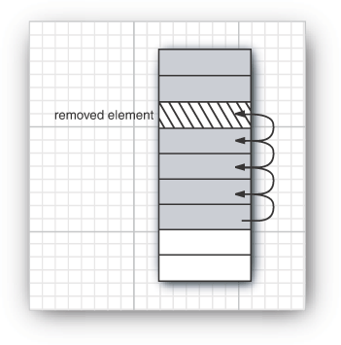
9.2.1 Linked Lists
ArrayList class manage an array that can grow or shrink.
what is the drawback of ArrayList class?
Inserting and removing elements at the middle location of array is slow because it needs several shift operations as shown below.
LinkedList class solves this problem.

Slide 20
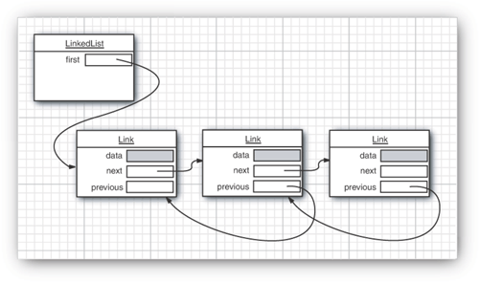
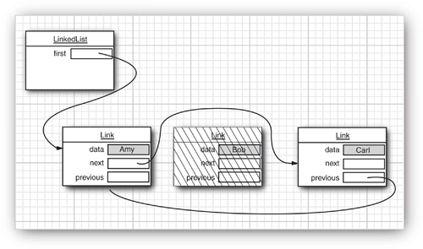
9.2.1 Linked Lists
Linked list is a chain of “links”:
Removing an element
from the middle of the a
LinkedList is very fast.

Slide 21
9.2.1 Linked Lists cont’d
Example 1: to illustrate “LinkedList” Operations and Iterators
List<String> staff = new LinkedList<String>();
staff.add(“Amy”); // add method adds an element at the end of the list
staff.add(“Bob”);
staff.add(“Carl”);
Iterator<String> iter = staff.iterator();//
String first = iter.next();
String second = iter.next();
iter.remove(); // remove last visited element (i.e. second element)
*************************************************************************************
The LinkedList.add() method adds the object to the end of the list.
to add objects in the middle of a list use add() method of ListIterator(I)
interface ListIterator<E> extends Iterator<E>
{
void add(E element); // see next slide
}

Slide 22
9.2.1 Linked Lists cont’d
Example 2: The following code adds three elements.
List<String> staff = new LinkedList<>();
staff.add(“Amy”);
staff.add(“Bob”);
staff.add(“Carl”);
ListIterator<String> iter = staff.ListIterator();
iter.next(); // skip the first element
iter.add(“Juliet”);
// adds “Juliet” before the second element
When you can add multiple times, the elements are simply added in turn before the current iterator positions.
If you add an element with a new list iterator, it is added to the beginning of the list.
If you call previous() method and then remove() method, the skipped (right) element is removed.

Slide 23
9.2.1 Linked Lists cont’d
If the LinkedList has n elements, there are n + 1 spots for adding a new
element.
These spots correspond to the n + 1 possible positions of the iterator.
For example, if a linked list contains three elements, A, B, and C, there
are four possible positions (marked as |) for inserting a new element :
|ABC
A|BC
AB|C
A|C

Slide 24
ConcurrentModificationException
Suppose one iterator traverses a collection.
At the same time, another iterator modifies the collection by removing or adding elements.
Linked list iterators is designed to detect concurrent modifications as shown below
List<String> list = . . .;
ListIterator<String> iter1 = list.listIterator();
ListIterator<String> iter2 = list.listIterator();
iter1.next();
iter1.remove();
iter2.next(); // throws ConcurrentModificationException because iter2 detects the
// modification
The list and all iterators keep a “modification count”.
Ok to have multiple readers and no writer.
Ok to have one writer and no reader.

Slide 25
Listing 9.1 LinkedList /LinkedListTest.java
public class LinkedListTest
{
public static void main(String[] args)
{
List<String> a = new LinkedList<>();
a.add("Amy");
a.add("Carl");
a.add("Erica");
List<String> b = new LinkedList<>();
b.add("Bob");
b.add("Doug");
b.add("Frances");
b.add("Gloria");
// merge the words from b into a
ListIterator<String> aIter = a.listIterator();
Iterator<String> bIter = b.iterator();
while (bIter.hasNext())
{
if (aIter.hasNext()) aIter.next();
aIter.add(bIter.next());
}
System.out.println(a);
// remove every second word from b
bIter = b.iterator();
while (bIter.hasNext())
{
bIter.next(); // skip one element
if (bIter.hasNext())
{
bIter.next(); // skip next element
bIter.remove(); // remove that element
}
}

Slide 26
Listing 9.1 LinkedList /LinkedListTest.java
System.out.println(b);
// bulk operation: remove all words in b from a
a.removeAll(b);
System.out.println(a);
}
}
//initial data
a = A C E
b = B D F G
//after merging
a = A B C D E F G
b = B D F G
//after removing every second element from b
b = B F
//after remove all words in b from a
a = A C D E G
b = B F

Slide 27
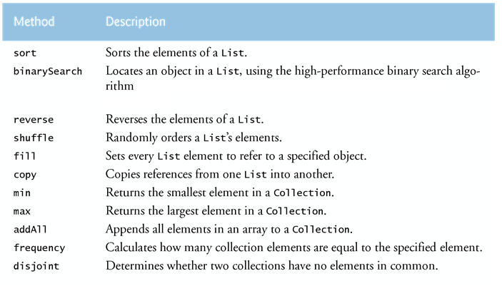
9.5. Algorithms
Class Collections provides several high-performance algorithms for manipulating collection elements.
The algorithms are implemented as static methods.

Slide 28
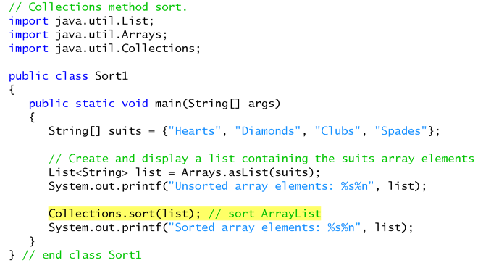
Sorting
Collections.sort() sorts the elements of a List
The elements must implement the Comparable interface.

Slide 29
9.5.1.Sorting and shuffling
Using sort method in List interface and comparators
List<Employee> staff = LinkedList<>();
//filling collection
staff.sort(Comparator.reverseOrder);
stsff.sort(Comparator.comparingDouble(Employee::getSalary));

Slide 30
Listing 9.7: suffle /ShuffleTest.java
package shuffle;
Importjava.util.*
public class ShuffleTest
{
public static void main(String[] args)
{
List<Integer> numbers = new ArrayList<>();
for (int i = 1; i <= 49; i++)
numbers.add(i); // autoboxing
Collections.shuffle(numbers);
List<Integer> winningCombination = numbers.subList(0, 6);
Collections.sort(winningCombination);
System.out.println(winningCombination);
}
}

