Slide 1
Chapter 10: Graphics Programming

Slide 2
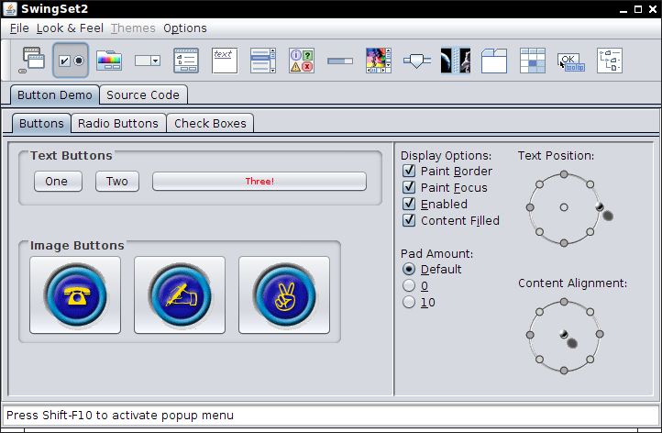
10.1 Introducing Swing GUI components

Slide 3
History of Java GUI Technology
AWT(Abstract windows toolkit): Platform Specific
Swing: platform independent and support desktop applications. Currently, it is widely used.
javaFX: it supports Desktop, websites and handheld devices applications. Currently, it is not matured and it will be future Java’s GUI library.
AWT GUI Library( java SE 1.1)
SWING GUI Library(java SE 1.2)
JavaFX GUI Library

Slide 4
10.1 Introducing Swing GUI components
Java 1.0 had AWT class library for basic GUI programming
The creation and behavior of user interface elements is delegated to the native GUI toolkit
on each target platform: Worked on Windows, Mac OS, X11.
“Lowest common denominator” of the target platforms.
Inconsistent in look and feel
Write once, debug everywhere.
Java SE 1.2, new UI toolkit( Swing) on top of the AWT foundations.
When you write a Swing GUI program, you use event AWT API for event handling
a) “Swing” refers to the “painted” user interface
b) “AWT” refers to underlying mechanisms of windowing toolkit( e.g. event handling).
Note: In Swing, all UI widgets are painted from scratch.

Slide 5
10.1 Introducing Swing GUI components cont’d
Swing GUI applications start with a window
A Jframe is the object that represents a window on screen
JFrame is the place where we put all component
A component : a user sees and interacts with it such as
Jbutton, JRadioButton, JCheckBox, Jlabel ,Jlist,JScrollPane,
Jslider,JTextArea,JTextField, Jtable.
Practically, we add interactive components like
button into background components(frame and panel)

Slide 6
10.1 Introducing Swing GUI components cont’d
Most Swing components are not tied to actual GUI components of the underlying OS’s windowing system..
They are written in java and they are lightweight components.
AWT components are tied to the local platform and they are heavyweight components, because they rely on the local platform’s windowing system to determine their functionality and their look-and-feel.
Component class( java.awt) declares many of the attributes and behaviors which are common for java.awt and javax.swing
Most GUI components extend “Component” class directly or indirectly

Slide 7
10.1 Introducing Swing GUI components: Hierarchy of the “Component” Class

Slide 8
Swing GUI Applications and AWT eventQueue Thread
Multitasking: ability of OS to run many processes concurrently on one CPU by sharing time.
Each process has a complete set of its own variables( no sharing of variables)
Multithreading: Ability of OS to run many threads of one process concurrently by one CPU by sharing time.
Many threads share the same data in memory.
However, they have their own call-stack and program counter.
a Java program can have multiple threads of execution.
All swing GUI applications have a separate thread called event dispatch thread to handle
interactions with the GUI elements of an application.
All threads that require interaction with GUI elements of an application are placed in an
event queue and they are executed sequentially by the event dispatch thread.
This thread is used to gather user interface events from the host operating environment.
The AWT event dispatch thread is running in parallel with other treads to run user
interface events.
Note: If an action takes a long time, do it in a separate thread and never in the event dispatch
thread because the application seems dead without response.

Slide 9
Four Steps to Create a GUI in Java Application
In java, frame class is a Top-level window with a title bar.
The AWT library has a class called Frame
The Swing version of this class is called JFrame and extends the Frame class
Jframe is not painted by Swing because window decorations (button, title bar icons)
come from host OS
1) Create a window(a Jframe) as top level container (outer class)
JFramen frame=new JFrame();
2) Create a GUI component(element) like button,text field;
e.g. JButton button=new JButton(“click Here”);
3) Add the GUI component(element) to the outer frame
frame.add(button,FlowLayout.EAST);
4) Dispaly the frame by giving it a size and enabling it visible
frame.setSize(300x300); // default size is 0x0
frame.setVisible(true); // by default, it is invisble
Note: Put interactive components (Jbutton, JCheckBox, JTextField) into background
components (Jframe, JPanel)

Slide 10
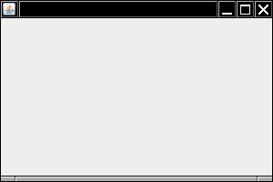
10.2. Creating a Frame
class SimpleFrame extends JFrame { public SimpleFrame()
{
setSize(300, 200);
} }
Set the “default close operation” and display the frame:
JFrame frame = new SimpleFrame(); frame.setDefaultCloseOperation(JFrame.EXIT_ON_CLOSE); frame.setVisible(true);
Add that code to the event queue:
EventQueue.invokeLater ( () -> { // frame initialization code using lambda expression } );
All code that updates Swing components must run in the event thread.
Note: the title bar and resize corners, are drawn by the OS and not by the Swing library.

Slide 11
Listing 10.1: simpleFrame/SimpleFrameTest.java(1/2)
package simpleFrame;
import java.awt.*; // java.awt.EventQueue
import javax.swing.*; // Swing class is contained in this package
public class SimpleFrameTest
{
public static void main(String[] args)
{ // Writing GUI application in a separate thread using lambda expression
EventQueue.invokeLater
(
( ) ->
{
SimpleFrame frame = new SimpleFrame();
// what happen when user clicks close button.
frame.setDefaultCloseOperation(JFrame.EXIT_ON_CLOSE); // this method is inherited.
frame.setVisible(true); // inherited method
}
) ; // end of event dispatcher thread
}// end of main()
} // First, place the code of a Swing component into the run method of a class that implements runnable interface. Second, create an object of that class and pass it to the invokeLater()

Slide 12
Listing 10.1: simpleFrame/SimpleFrameTest.java(2/2)
class SimpleFrame extends Jframe
{
private static final int DEFAULT_WIDTH = 300;
private static final int DEFAULT_HEIGHT = 200;
public SimpleFrame()
{
// default ,size of frame is 0x0 pixels
setSize(DEFAULT_WIDTH, DEFAULT_HEIGHT);
}
}
After scheduling the initialization statements, the main () method can exit.
When main method exits, program does not terminate because only main thread will be terminated
The invoker thread keeps the program alive until it is terminated, either by closing
the frame or by calling the System.exit () method.

Slide 13
Explanation of Listing 10.1: EvenetQueue class (1/2)
public class EventQueue extends Object
{
/* java.awt.EventQueue
causes runnable to invoke its run() method after all pending events are processed
*/
public static void invokeLater(Runnable r);
//------------------------------------------;
}
public interface Runnable // java.lang.runnable
{
void run();
}
/*concrete class that implements runnable interface is executed by a new thread */
/*The invokeLater () method returns immediately when the event is posted to the event queue, and hence, the run() method is executed asynchronously*/
Case 1 : GUI application running in a thread using non-static inner class
1. public class MyRunnable implements Runnable
2. {
3. public void run()
4. {
// write specific code
5. }
6. }
7. Runnable r = new MyRunnable( );
8. EventQueue.invokeLater (r) ;
**********************************************************
// Case 2: replace line 7 and 8 by Lambda expression
7. Runnable r = ( )->
{
// task code
}
8. EventQueue.invokeLater (r) ;

Slide 14
Explanation of Listing 10.1: EvenetQueue class(2/2)
package simpleFrame ; // Case 3: GUI application running in a thread Using anonymous inner class
import java.awt.*; import javax.swing.*; // java.awt.EventQueue
public class SimpleFrameTest {
public static void main(String[] args) {
EventQueue.invokeLater ( new Runnable()
{
public void run()
{
SimpleFrame frame = new SimpleFrame();
// what happen when user clicks close button.
frame.setDefaultCloseOperation(JFrame.EXIT_ON_CLOSE);
frame.setVisible(true); // inherited method
}
}
) ; // end of local anonymous inner class
} // end of main
} // end of outer class

Slide 15
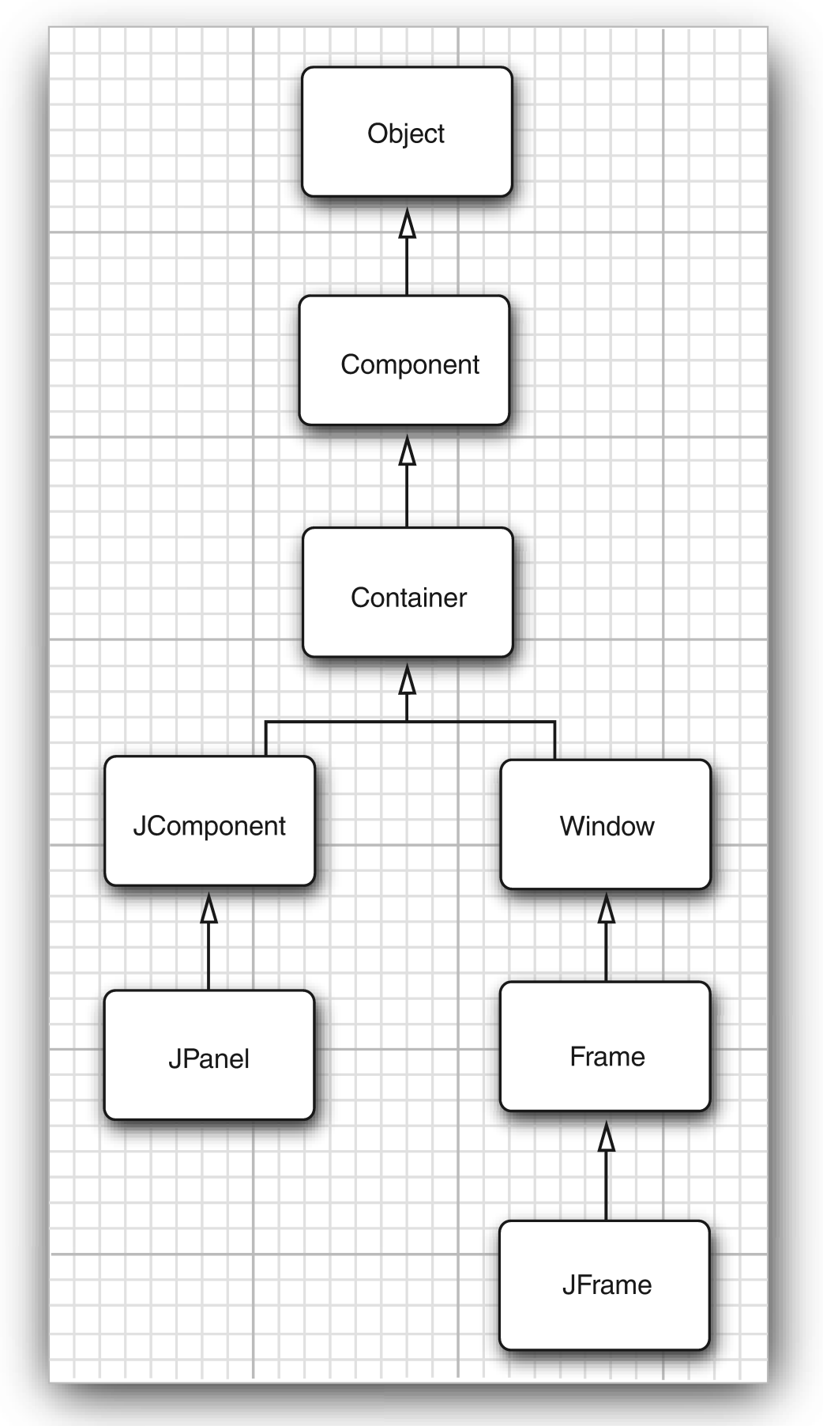
Frame Properties
Change position and appearance
( inherited from Component class)
setLocation(x,y): to set he position of the top left of frame
setBounds(x,y,w,h): move top-left corner by w and h
setIconImage():to tells the OS which icon to display in title bar
setTitle():to change the text in the title bar
setResizable(): flag if a frame will be resizeable by the user
We can get screen dimensions from Toolkit object
as follows:
Toolkit kit = Toolkit.getDefaultToolkit();
Dimension screenSize = kit.getScreenSize();
int wscreen= screenSize.width
int hScreen= screenSize.height
Alternatively, fill frame with UI elements, and then call:
frame.pack() to set size of frame.

Slide 16
Listing 10.2: sizedFrame/SizedFrameTest.java(1/2)
package sizedFrame;
import java.awt.*;
import javax.swing.*;
public class SizedFrameTest
{
public static void main(String[] args)
{
EventQueue.invokeLater( () ->
{
JFrame frame = new SizedFrame();
frame.setTitle("SizedFrame");
frame.setDefaultCloseOperation(JFrame.EXIT_ON_CLOSE);
frame.setVisible(true);
} ); // end of method call
}
}

Slide 17
Listing 10.2: sizedFrame/SizedFrameTest.java(2/2)
class SizedFrame extends JFrame
{
public SizedFrame()
{
// get screen dimensions
Toolkit kit = Toolkit.getDefaultToolkit();
Dimension screenSize = kit.getScreenSize();
int screenHeight = screenSize.height;
int screenWidth = screenSize.width;
// set frame width, height and let platform pick screen location
setSize(screenWidth / 2, screenHeight / 2);
setLocationByPlatform(true);
// set frame icon
Image img = new ImageIcon("icon.gif") .getImage();
setIconImage(img);
}
}

Slide 18
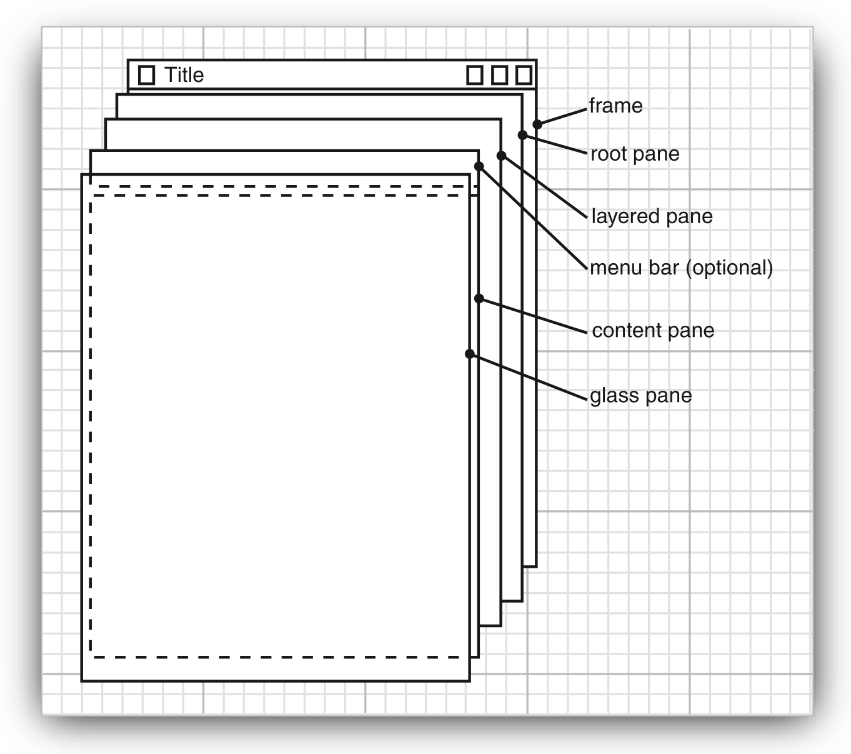
10.4. Drawing on a Component.
In java, frame is a container of GUI components(elements)
such as menu bar, check box, radio button.
Hence, we can draw patterns, images and text onto
a Swing component, not directly onto a frame.
Add one or more GUI elements inside a frame:
frame.add(comp);
A GUI element extends the JComponent class:
class MyComponent extends JComponent
{
public void paintComponent(Graphics g)
{
@override code for drawing
}
}
Use the Graphics object for drawing:
g.drawString("Not a Hello World program", 75, 100);
A component should tell how big it wants to be:
public Dimension getPreferredSize() { return new Dimension(300, 200); }

Slide 19
Listing 10.3. notHelloWorld/NotHelloWorld.java(1/3)
package notHelloWorld; // this program draws string on a user defined component
import javax.swing.*;
import java.awt.*;
public class NotHelloWorld
{
public static void main(String[] args)
{
EventQueue.invokeLater( ( ) ->
{
JFrame frame = new NotHelloWorldFrame();
frame.setTitle("NotHelloWorld");
frame.setDefaultCloseOperation(JFrame.EXIT_ON_CLOSE);
frame.setVisible(true);
});
}
}

Slide 20
Listing 10.3. notHelloWorld/NotHelloWorld.java(2/3)
/* A frame that contains a message panel */
class NotHelloWorldFrame extends JFrame
{
public NotHelloWorldFrame()
{
add(new NotHelloWorldComponent());
pack(); // to resize the window using preferred size of the component
}
}

Slide 21
Listing 10.3. notHelloWorld/NotHelloWorld.java(3/3)
/* A component that displays a message */
class NotHelloWorldComponent extends JComponent
{
public static final int MESSAGE_X = 75;
public static final int MESSAGE_Y = 100;
private static final int DEFAULT_WIDTH = 300;
private static final int DEFAULT_HEIGHT = 200;
public void paintComponent(Graphics g) // @override
{
g.drawString("Not a Hello, World program", MESSAGE_X, MESSAGE_Y);
}
// @override
public Dimension getPreferredSize() {
return new Dimension(DEFAULT_WIDTH, DEFAULT_HEIGHT);
}
} // Note: Graphics is an abstract class and its subclass is implemented on a specific OS.
// Graphics is platform-independent but its concrete subclass is platform-dependent.
// parameter g receives a reference to an instance of system-specific sub class of Graphics to repaint GUI component.
// when the application begins execution ,paintComponet() method of “NotHelloWorldComponent” class is invoked automatically
// to paint

Slide 22
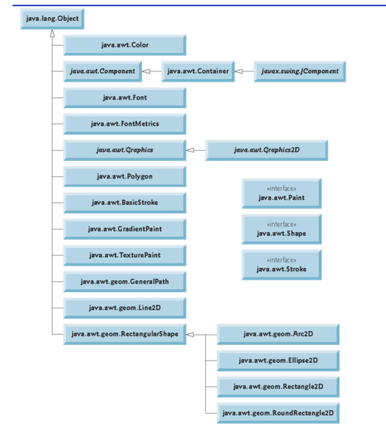
Fig:
Classes and interfaces
for graphics programming

Slide 23
19.5. Java 2D API : To display Geometrical Shapes
You can use the Graphics object to draw shapes:
g.drawRect(75, 100, 200, 150);
However, Java 2D library provides advanced 2-D graphics capabilities for programmers.
We use Graphics2D: it is abstract subclass of Graphics class
Rectangle2D has public static inner lasses: Rectangle2D.Float and Rectangle2D.Double.
We can choose between float and double coordinates:
Rectangle2D rect1 = new Rectangle2D.Double(7.5, 10.0, 200, 150); // static inner class
Rectangle2D rect2 = new Rectangle2D.Float(7.5F, 10.0F, 200, 150);
Point2D class is a point, Line2D class is a line:
Point2D start = new Point2D.Double(10, 20);
Point2D end = new Point2D.Double(100, 110);
Line2D line = new Line2D.Double(start, end);
Use draw() method of Graphics2D class to draw any shape after down casting
Graphics2D g2 = (Graphics2D) g;
g2.draw(line);

Slide 24
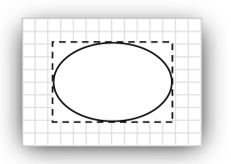
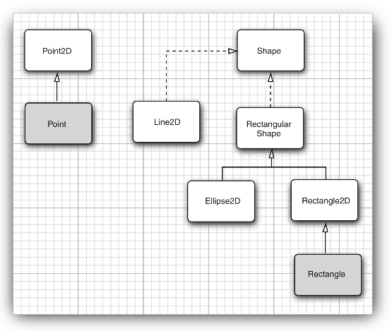
19.5. Display Geometrical Shapes
Rectangle2D and Ellipse2D are “rectangular” shapes.
An ellipse is specified by its bounding box:
Java.awt.geom.RectangularShape class
has methods:
getX/getY
getWidth/getHeight
getCenterX/getCenterY
getMaxX/getMaxY
setFrame

Slide 25
Listing 10.4: draw/DrawTest.java(1/3)
package draw;
import java.awt.*; //see: java.awt.Graphics
import java.awt.geom.*;
import javax.swing.*;
public class DrawTest
{
public static void main(String[] args)
{
EventQueue.invokeLater ( ( ) ->
{
JFrame frame = new DrawFrame();
frame.setTitle("DrawTest");
frame.setDefaultCloseOperation(JFrame.EXIT_ON_CLOSE);
frame.setVisible(true);
} );
}
}

Slide 26
Listing 10.4: draw/DrawTest.java(2/3)
/* A frame that contains a panel with drawings */
class DrawFrame extends JFrame
{
public DrawFrame()
{
add(new DrawComponent() ); // see next slide
pack(); // to fit the window into the preferred size
}
}
/* java.lang.Object
java.awt.Component
java.awt.Container
java.awt.Window // window class has pack() method
java.awt.Frame
javax.swing.Jframe */

Slide 27
Listing 10.4: draw/DrawTest.java(3/3)
/* A component that displays rectangles and ellipses */
class DrawComponent extends JComponent
{
private static final int DEFAULT_WIDTH = 400;
private static final int DEFAULT_HEIGHT = 400;
//@ overide
public void paintComponent(Graphics g)
{
Graphics2D g2 = (Graphics2D) g; // down casting to use advanced capabilities of 2D API
// draw a rectangle
double leftX = 100;
double topY = 100;
double width = 200;
double height = 150;
Rectangle2D rect = new Rectangle2D.Double(leftX, topY, width, height);
g2.draw(rect);
// draw eclipse on the next slide

Slide 28
Listing 10.4: draw/DrawTest.java
// draw the enclosed ellipse
Ellipse2D ellipse = new Ellipse2D.Double();
ellipse.setFrame(rect);
g2.draw(ellipse);
// draw a diagonal line
g2.draw(new Line2D.Double(leftX, topY, leftX + width, topY + height));
// draw a circle with the same center
double centerX = rect.getCenterX();
double centerY = rect.getCenterY();
double radius = 150;
Ellipse2D circle = new Ellipse2D.Double();
circle.setFrameFromCenter(centerX, centerY, centerX + radius, centerY + radius);
g2.draw(circle);
} //@ override
public Dimension getPreferredSize() { return new Dimension(DEFAULT_WIDTH, DEFAULT_HEIGHT); }
}

Slide 29
Display colors, fonts, and images
10.6. Using color
We have to set the “paint” before drawing:
g2.setPaint(Color.RED);
g2.drawString("Warning!", 100, 100);
Use fill() method instead of draw() method to fill a shape:
g2.fill(rect); // fills rect with current paint
Color constants: java.awt.color class has 13 pedefinded color constants.
BLACK, BLUE, CYAN ,DARK_GRAY ,GRAY ,GREEN , LIGHT_GRAY ,
MAGENTA, ORANGE ,PINK ,RED, WHITE, YELLOW
Custom RGB colors:
g2.setPaint( new Color(0, 128, 128)); // a dull blue-green
Set background color:
comp.setBackground(Color.PINK);

Slide 30
Listing : fill/FillTest.java(1/4)
package fill;
import java.awt.*;
import java.awt.geom.*;
import javax.swing.*;
public class FillTest
{
public static void main(String[] args)
{
EventQueue.invokeLater ( ( ) ->
{
JFrame frame = new FillFrame();
frame.setTitle("FillTest");
frame.setDefaultCloseOperation(JFrame.EXIT_ON_CLOSE);
frame.setVisible(true);
} );
}
}

Slide 31
Listing : fill/FillTest.java(2/4)
/* A frame that contains a component with drawings */
class FillFrame extends JFrame
{
public FillFrame()
{
add(new FillComponent()); // see next slide
pack();
.
}
}

Slide 32
Listing : fill/FillTest.java(3/4)
/** A component that displays filled rectangles and ellipses */
class FillComponent extends JComponent
{
private static final int DEFAULT_WIDTH = 400;
private static final int DEFAULT_HEIGHT = 400;
public void paintComponent(Graphics g)
{
Graphics2D g2 = (Graphics2D) g;
// draw a rectangle
double leftX = 100;
double topY = 100;
double width = 200;
double height = 150; // continue next slide

Slide 33
Listing : fill/FillTest.java(4/4)
Rectangle2D rect = new Rectangle2D.Double(leftX, topY, width, height);
g2.setPaint(Color.BLACK);
g2.draw(rect);
g2.setPaint(Color.RED);
g2.fill(rect); // Note that the right and bottom edge are not painted over
// draw the enclosed ellipse
Ellipse2D ellipse = new Ellipse2D.Double();
ellipse.setFrame(rect);
g2.setPaint(new Color(0, 128, 128)); // a dull blue-green
g2.fill(ellipse);
}
public Dimension getPreferredSize() {
return new Dimension(DEFAULT_WIDTH, DEFAULT_HEIGHT); }
}

Slide 34
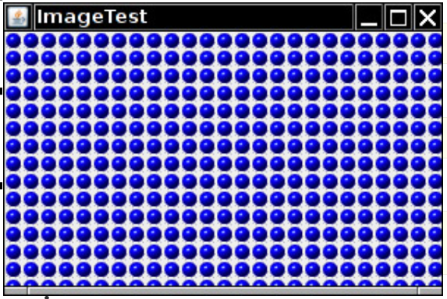
10.8. displaying Images
Easiest way to load an image:
Image image = new ImageIcon(filename).getImage();
An image isn't a shape, so you need to draw
it like this:
g.drawImage(image, x, y, null);
we get image dimensions like this:
int imageWidth = image.getWidth(null);
int imageHeight = image.getHeight(null);
The null arguments are archaic “image observers” that were used for monitoring incremental loading over a dialup internet connection.
Image tiling:
for (int i = 0; i * imageWidth <= getWidth(); i++)
for (int j = 0; j * imageHeight <= getHeight(); j++)
if (i + j > 0)
g.copyArea(0, 0, imageWidth, imageHeight, i * imageWidth, j * imageHeight);

Slide 35
Listing 10.6: image/ImageTest.java
package image;
import java.awt.*;
import javax.swing.*;
public class ImageTest
{
public static void main(String[] args)
{
EventQueue.invokeLater( () ->
{
JFrame frame = new ImageFrame();
frame.setTitle("ImageTest");
frame.setDefaultCloseOperation(JFrame.EXIT_ON_CLOSE);
frame.setVisible(true);
} );
}
}

Slide 36
Listing 10.6: image/ImageTest.java
/**A frame with an image component */
class ImageFrame extends JFrame
{
public ImageFrame()
{
add(new ImageComponent());
pack();
}
}

Slide 37
Listing 10.6: image/ImageTest.java
/* A component that displays a tiled image */
class ImageComponent extends JComponent
{
private static final int DEFAULT_WIDTH = 300;
private static final int DEFAULT_HEIGHT = 200;
private Image image;
public ImageComponent()
{
image = new ImageIcon("blue-ball.gif").getImage();
}
// continue next slide

Slide 38
Listing 10.6: image/ImageTest.java
public void paintComponent(Graphics g)
{
if (image == null) return;
int imageWidth = image.getWidth(null);
int imageHeight = image.getHeight(null);
// draw the image in the upper-left corner
g.drawImage(image, 0, 0, null);
// tile the image across the component
for (int i = 0; i * imageWidth <= getWidth(); i++)
for (int j = 0; j * imageHeight <= getHeight(); j++)
if (i + j > 0)
g.copyArea(0, 0, imageWidth, imageHeight, i * imageWidth, j * imageHeight);
}
public Dimension getPreferredSize() {
return new Dimension(DEFAULT_WIDTH, DEFAULT_HEIGHT);
}
} // end of ImageComponet class

