Slide 1
Chapter 11: Event Handling
Understand how a program can react to user interface events ?
Event handling is important to programs with a graphical user interface.
To implement user interfaces, how Java handles events?
How the Java AWT event model works.
How to capture events from user interface components?
How to work with actions to processing action events.

Slide 2
11.1 Basics of Event Handling
Any Operating Environment that supports GUIs monitors events such as mouse click
The OE reports these events to the programs that are running.
Then, each program decides what to do in response to these events.
In java AWT, how events are transmitted from the event sources (such as buttons ) to
event listeners?
We can designate any object to be an event listener—in
java uses event delegation model : the listener is flexible and it is not predetermined.
Event sources have methods that allow us to register event listeners with them.
When an event happens to the source, the source sends a notification of that event to all the listener objects that were registered for that event.
In Java, the information about the event is encapsulated in an event object.
In Java, all event objects ultimately derive from the class java.util.EventObject.
There are also subclasses for each event type, such as ActionEvent and WindowEvent.

Slide 3
11.1 Basics of Event Handling
Different event sources can produce different kinds of events.
Example, a button send ActionEvent objects and a window send WindowEvent objects.
Summary: How event handling works in the AWT:
A listener object is an instance of a class that implements a listener interface.
An event source is an object that can register listener objects and send them
event objects.
c) The event source sends out event objects to all registered listeners when that event occurs.
d) Then ,the listener objects will use the information in the event object to determine
their reaction to the event.

Slide 4
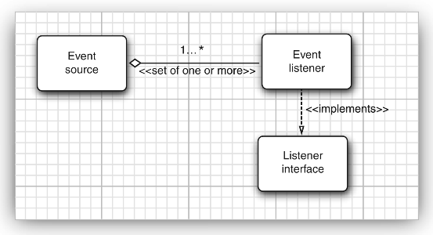
11.1 Basics of Event Handling
Event source (button, window, ...) produces events.
Event object (ActionEvent, WindowEvent, ...) carries information about an event.
Event listener contains code that reacts to events.
Add event listener to event source:
Listener object implements appropriate listener interface:
Example: how to specify a listener
***********************************************
ActionListener listener = new MyListener();
JButton button = new JButton("OK");
button.addActionListener(listener);
class MyListener implements ActionListener
{
public void actionPerformed(ActionEvent event)
{
// code reaction to button click
}
}
************************************** //Fig: relation b/n event handling classes and interfaces

Slide 5
11.1 Basics of Event Handling

Slide 6
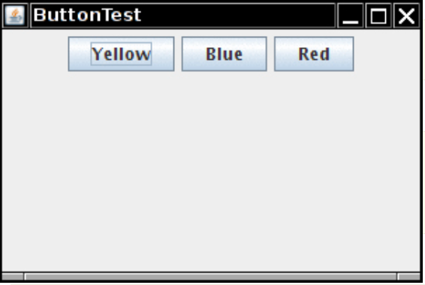
11.1.1 Example : Handling Button Clicks
Create a JButton object:
JButton yellowButton = new JButton("Yellow"); // label as string
JButton blueButton = new JButton(new ImageIcon("blue-ball.gif")); // icon
Add the buttons to a JPanel, and add the panel to the frame:
JPanel buttonPanel = new JPanel();
buttonPanel.add(yellowButton);
buttonPanel.add(blueButton);
frame.add(buttonPanel);
Add a listener to each button:
class ColorAction implements ActionListener { . . . }
. . .
yellowButton.addActionListener(new ColorAction(Color.YELLOW));
blueButton.addActionListener(new ColorAction(Color.BLUE));

Slide 7
Listing 11.1 : button/ButtonFrame.java
package button;
import java.awt.*;
import java.awt.event.*;
import javax.swing.*;
/* A frame with a button panel */
public class ButtonFrame extends JFrame
{
private JPanel buttonPanel;
private static final int DEFAULT_WIDTH = 300;
private static final int DEFAULT_HEIGHT = 200;

Slide 8
Listing 11.1 : button/ButtonFrame.java
public ButtonFrame()
{
setSize(DEFAULT_WIDTH, DEFAULT_HEIGHT);
// create buttons
JButton yellowButton = new JButton("Yellow");
JButton blueButton = new JButton("Blue");
JButton redButton = new JButton("Red");
buttonPanel = new JPanel(); // from previous slide
// add buttons to panel
buttonPanel.add(yellowButton);
buttonPanel.add(blueButton);
buttonPanel.add(redButton);

Slide 9
Listing 11.1 : button/ButtonFrame.java
// add panel to frame
add(buttonPanel);
// create button actions to handle the event ( use non-static inner class)
ColorAction yellowAction = new ColorAction(Color.YELLOW);
ColorAction blueAction = new ColorAction(Color.BLUE);
ColorAction redAction = new ColorAction(Color.RED);
// Registration: associate actions(event handlers) with buttons( GUI element)
yellowButton.addActionListener(yellowAction);
blueButton.addActionListener(blueAction);
redButton.addActionListener(redAction);
} // end of ButtonFrame constructor ( previous slide)

Slide 10
Listing 11.1 : button/ButtonFrame.java
/* Event handler: An action listener that sets the panel's background color */
private class ColorAction implements ActionListener
{
private Color backgroundColor;
public ColorAction(Color c)
{
backgroundColor = c;
}
public void actionPerformed(ActionEvent event)
{
buttonPanel.setBackground(backgroundColor);
}
} // end of inner class: ColorAction
} // end of outer class: ButtonFrame

Slide 11
Summary: Relation between, event source(GUI) , event object and event handler
1) Declare specific GUI class (event source): e.g. JTextField (java.swing)
2) Identify specific user action: e.g. presses Enter Key in a JTextField
3) Identify specific event that is generated: e.g. ActionEvent (java.awt.event package)
4) Declare specific event handler (inner class) to process the event: e.g. TextFieldHndler
Note: the invent handler should implemt specific event listener interface implemented.
e,g. ActionListener ( java.awt.event package).
Register event handler to GUI components to invoke the actionPerformed() method :
Note: in the following figure, S stands for specific
S:User action
(4)
S:Event
object(5)
S: Add
GUI
to Frame
(1)
S: implement
Event Handler for GUI event(2)
S: Event Listener
Interface
Register
Event handler
to GUI(3)
ID
JVM

Slide 12
11.1.2. Specifying Listeners Concisely by lambda expression
Use lambda expressions:
exitButton.addActionListener( event -> System.exit(0) );
If you need actions with parameters, use a helper method instead of a listener class:
public void makeButton(String name, Color backgroundColor)
{
JButton button = new JButton(name);
buttonPanel.add(button);
button.addActionListener(
event -> buttonPanel.setBackground(backgroundColor));
}
Then call:
makeButton("yellow", Color.YELLOW);
makeButton("blue", Color.BLUE);
Older code used anonymous inner classes:
exitButton.addActionListener( new ActionListener()
{
public void actionPerformed(ActionEvent event) { System.exit(0); }
} );

Slide 13
Listing 11.2 : plaf/PlatFrame.java
package plaf;
import javax.swing.JButton;
import javax.swing.JFrame;
import javax.swing.JPanel;
import javax.swing.SwingUtilities;
import javax.swing.UIManager;
/* A frame with a button panel for changing look-and-feel */
public class PlafFrame extends JFrame
{
private JPanel buttonPanel;
public PlafFrame()
{
buttonPanel = new JPanel(); // next slide

Slide 14
Listing 11.2 : plaf/PlatFrame.java
UIManager.LookAndFeelInfo[] infos = UIManager.getInstalledLookAndFeels();
for (UIManager.LookAndFeelInfo info : infos)
makeButton( info.getName(), info.getClassName() );
add(buttonPanel);
pack();
} // end of PlafFrame() constructor
/* Makes a button to change the pluggable look-and-feel.
* @ button name and className is the name of the look-and-feel class */
private void makeButton(String name, String className)
{
// add button to panel
JButton button = new JButton(name);
buttonPanel.add(button);

Slide 15
Listing 11.2 : plaf/PlatFrame.java
// set button action
button.addActionListener( event ->
{
try // button action: switch to the new look-and-feel
{
UIManager.setLookAndFeel(className);
SwingUtilities.updateComponentTreeUI(this);
pack();
}
catch (Exception e)
{
e.printStackTrace();
}
} );
} // end of makeButton () method of a PlafFrame class
} // end of PlafFrame class

Slide 16
11.1.4. Adapter Classes
Windows send out events in multiple situations:
When the window is opened or closed
When a window is minimized or restored
When a window becomes inactive or active
When the user wants to close the window
WindowListener interface has a separate method for each of them:
void windowOpened(WindowEvent e);
void windowClosing(WindowEvent e);
void windowClosed(WindowEvent e);
. . .
Suppose you just want to intercept only windowClosing() method.
Extend WindowAdapter instead of implementing WindowListener:
class Terminator extends WindowAdapter
{
public void windowClosing(WindowEvent e)
{
if (user agrees)
System.exit(0);
}
}
Install listener: frame.addWindowListener( new Terminator() );

Slide 17
11.1.4. Adapter Classes
public interface WindowListener
{
void windowOpened(WindowEvent e);
void windowClosing(WindowEvent e);
void windowClosed(WindowEvent e);
void windowIconified(WindowEvent e);
void windowDeiconified(WindowEvent e);
void windowActivated(WindowEvent e);
void windowDeactivated(WindowEvent e);
} *********************************************************
// option 1:Programmer implement only one method
class Terminator extends WindowAdapter {
public void windowClosing(WindowEvent e) {
if (user agrees)
System.exit(0);
}
}
// option 2: Programmer implement all abstract methods
class Terminator implements WindowListener
{
public void windowClosing(WindowEvent e)
{
if (user agrees)
System.exit(0);
}
public void windowOpened(WindowEvent e) { }
public void windowClosed(WindowEvent e) { }
public void windowIconified(WindowEvent e) { }
public void windowDeiconified(WindowEvent e) { }
public void windowActivated(WindowEvent e) { }
public void windowDeactivated(WindowEvent e) { }
}

Slide 18
11.2. Actions (java.swing.Action interface)
Programs commonly provide multiple ways to activate the same action(command).
User can choose a certain function via a menu, button on a toolbar, or a keystroke.
suppose blueAction is an action listener whose actionPerformed () method changes
the background color to blue
we can attach the same object as a listener to several event sources
The color change command will be handled in a uniform way.
Javax.swing.Action (interface) attach one command with multiple event sources.
Action interface extends the ActionListener interface.
A toolbar button labeled “Blue”
blueAction
Listener:
A menu item labeled “Blue”
A keystroke Ctrl+B

Slide 19
11.2. Actions (java.swing.Action interface
The Action interface has the following methods:
void actionPerformed(ActionEvent event)
void setEnabled(boolean b) // help us to enable or disable the action
boolean isEnabled() // to check that currently the action is enabled or disabled
void putValue(String key, Object value) // to store name/value pairs
Object getValue(String key) // to retrieve name/value pairs
void addPropertyChangeListener(PropertyChangeListener listener) // to notify change
void removePropertyChangeListener(PropertyChangeListener listener) // to notify change
AbstractAction class implements all methods of Action interface except actionPerformed().

Slide 20
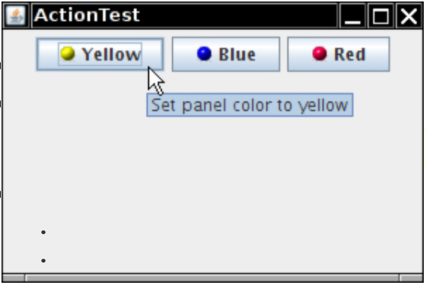
11.2. Actions (java.swing.Action interface)
Action interface combines listener code and action properties.
Predefined name/value pairs for Action Interface
Properties/ values
NAME/ name of action to be displayed
SMALL_ICON/ place to store small icon on button
SHORT_DESCRIPTION/ for tooltips
MNEMONIC_KEY/ for underlined characters in menus)
Examples:
yellowAction.setEnabled(false); // disable
yellowAction.putValue(Action.SHORT_DESCRIPTION, "Set panel color to yellow");

Slide 21
Keyboard Commands
We want to add action object to keystrogges
Produce Keystroke object:
KeyStroke ctrlYKey = KeyStroke.getKeyStroke("ctrl Y");
Normally, keystrokes are sent to the component that has focus.
To override this, use input map that maps keystrokes to action map keys:
InputMap imap = panel.getInputMap(JComponent.WHEN_ANCESTOR_OF_FOCUSED_COMPONENT);
imap.put(ctrlYKey, "panel.yellow");
Map the action map key to the action:
ActionMap amap = panel.getActionMap();
amap.put("panel.yellow", yellowAction);

Slide 22
Listing 11.3 action/ActionFrame
package action;
import java.awt.*;
import java.awt.event.*;
import javax.swing.*;
/* A frame with a panel that demonstrates color change actions. */
public class ActionFrame extends Jframe
{
private JPanel buttonPanel;
private static final int DEFAULT_WIDTH = 300;
private static final int DEFAULT_HEIGHT = 200;
// continue next slide

Slide 23
Listing 11.3 action/ActionFrame
public ActionFrame()
{
setSize(DEFAULT_WIDTH, DEFAULT_HEIGHT);
buttonPanel = new JPanel();
// constructing an object of the action class to define actions (from inner class)
Action yellowAction = new ColorAction("Yellow", new ImageIcon("yellow-ball.gif"), Color.YELLOW);
Action blueAction = new ColorAction("Blue", new ImageIcon("blue-ball.gif"), Color.BLUE);
Action redAction = new ColorAction("Red", new ImageIcon("red-ball.gif"), Color.RED);
// construct button from action object and add them to panel
buttonPanel.add(new JButton(yellowAction));
buttonPanel.add(new JButton(blueAction));
buttonPanel.add(new JButton(redAction));
// continue next slide

Slide 24
Listing 11.3 action/ActionFrame
// add panel to frame
add(buttonPanel);
// for actions triggered by keystrokes: associate the Y, B, and R keys with names
InputMap imap = buttonPanel.getInputMap(JComponent.WHEN_ANCESTOR_OF_FOCUSED_COMPONENT);
imap.put( KeyStroke.getKeyStroke("ctrl Y"), "panel.yellow“ ); //
imap.put(KeyStroke.getKeyStroke("ctrl B"), "panel.blue");
imap.put(KeyStroke.getKeyStroke("ctrl R"), "panel.red");
// associate the names with actions
ActionMap amap = buttonPanel.getActionMap();
amap.put("panel.yellow", yellowAction);
amap.put("panel.blue", blueAction);
amap.put("panel.red", redAction);
} // end of ActionFrame() constructor

Slide 25
Listing 11.3 action/ActionFrame
public class ColorAction extends AbstractAction
{
public ColorAction(String name, Icon icon, Color c)
{
putValue(Action.NAME, name);
putValue(Action.SMALL_ICON, icon);
putValue(Action.SHORT_DESCRIPTION, "Set panel color to " + name.toLowerCase());
putValue("color", c);
}
public void actionPerformed(ActionEvent event)
{
Color c = (Color) getValue("color");
buttonPanel.setBackground(c);
}
} // end of inner class : colorAction
} // end of outer class: Action Frame

Slide 26
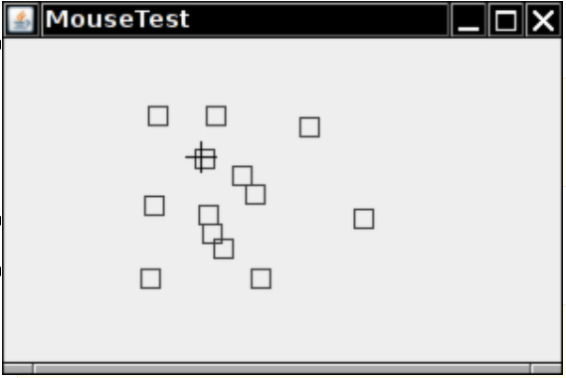
11.3. Handling Mouse Events
Mouse events are not handled explicitly if the user clicks a button.
However, a user wants to draw with mouse, we have to handle mouse move, click and drag events
MouseListener reports on mouse events in a component.
When user clicks a mouse button, three listener methods are invoked :
void mousePressed(MouseEvent event)
void mouseReleased(MouseEvent event)
void mouseClicked(MouseEvent event)
MouseAdapter implements all methods to do nothing.
MouseEvent reference has methods describing the event:
int getX() // to get x-cor of mouse pointer
int getY() // to get y-cor of mouse pointer
int getClickCount() // to identify single/double/triple clicks
To test the mouse click, and keyboard modifier of mouse event:
if ((event.getModifiersEx() & InputEvent.BUTTON3_DOWN_MASK) != 0)
MouseMotionListener tracks movement with mouseMoved and mouseDragged methods.
Component can change cursor shape:
comp.setCursor(Cursor.getPredefinedCursor(Cursor.CROSSHAIR_CURSOR));

Slide 27
Listing 11.4 mouse /MouseFrame.java
package mouse;
import javax.swing.*;
/ * A frame containing a panel for testing mouse operations*/
public class MouseFrame extends Jframe
{
public MouseFrame()
{
add(new MouseComponent());
pack();
}
}

Slide 28
Listing 11.5 mouse /MouseComponet.java
package mouse;
import java.awt.*;
import java.awt.event.*;
import java.awt.geom.*;
import java.util.*;
import javax.swing.*;
/* A component with mouse operations for adding and removing squares */
public class MouseComponent extends JComponent
{
private static final int DEFAULT_WIDTH = 300;
private static final int DEFAULT_HEIGHT = 200;
private static final int SIDELENGTH = 10;
private ArrayList<Rectangle2D> squares;
private Rectangle2D current; // the square containing the mouse cursor

Slide 29
Listing 11.5 mouse /MouseComponet.java
public MouseComponent()
{
squares = new ArrayList<>();
current = null;
addMouseListener(new MouseHandler()); // inner class
addMouseMotionListener(new MouseMotionHandler()); // inner class
}
public Dimension getPreferredSize()
{
return new Dimension(DEFAULT_WIDTH, DEFAULT_HEIGHT);
}
public void paintComponent(Graphics g)
{
Graphics2D g2 = (Graphics2D) g;
// draw all squares
for (Rectangle2D r : squares)
g2.draw(r);
}

Slide 30
Listing 11.5 mouse /MouseComponet.java
/**
* Finds the first square containing a point.
* @param p a point
* @return the first square that contains p
*/
public Rectangle2D find(Point2D p)
{
for (Rectangle2D r : squares)
{
if (r.contains(p)) return r;
}
return null;
}

Slide 31
Listing 11.5 mouse /MouseComponet.java
/**
* Adds a square to the collection.
* @param p the center of the square
*/
public void add(Point2D p)
{
double x = p.getX();
double y = p.getY();
current = new Rectangle2D.Double(x - SIDELENGTH / 2, y - SIDELENGTH / 2, SIDELENGTH,
SIDELENGTH);
squares.add(current);
repaint();
}

Slide 32
Listing 11.5 mouse /MouseComponet.java
/* Removes a square from the collection.
@param s the square to remove */
public void remove(Rectangle2D s)
{
if (s == null) return;
if (s == current) current = null;
squares.remove(s);
repaint();
}
private class MouseHandler extends MouseAdapter // inner class
{
public void mousePressed(MouseEvent event)
{
// add a new square if the cursor isn't inside a square
current = find(event.getPoint());
if (current == null) add(event.getPoint());
}

Slide 33
Listing 11.5 mouse /MouseComponet.java
public void mouseClicked(MouseEvent event)
{
// remove the current square if double clicked
current = find(event.getPoint());
if (current != null && event.getClickCount() >= 2) remove(current);
}
} // end of inner class: MouseHanndle
private class MouseMotionHandler implements MouseMotionListener // inner class
{
public void mouseMoved(MouseEvent event)
{
// set the mouse cursor to cross hairs if it is inside a rectangle
if (find(event.getPoint()) == null) setCursor(Cursor.getDefaultCursor());
else setCursor(Cursor.getPredefinedCursor(Cursor.CROSSHAIR_CURSOR));
}

Slide 34
Listing 11.5 mouse /MouseComponet.java
public void mouseDragged(MouseEvent event)
{
if (current != null)
{
int x = event.getX();
int y = event.getY();
// drag the current rectangle to center it at (x, y)
current.setFrame(x - SIDELENGTH / 2, y - SIDELENGTH / 2, SIDELENGTH, SIDELENGTH);
repaint();
}
} // end of method
} // end of inner class
} // end of outer class

Slide 35
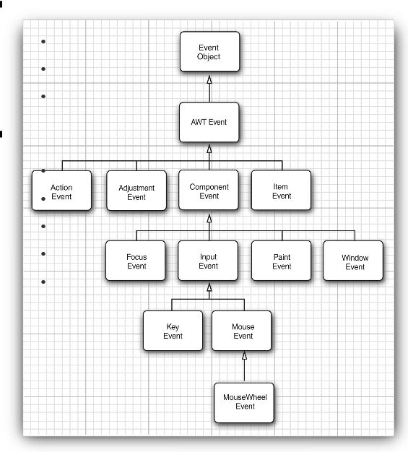
11.4. AWT event hierarchy: Semantic versus low-level Events
Semantic events are meaningful to application programmers:
ActionEvent : like button, menu, ...
AdjustmentEvent: like scrollbar
ItemEvent : like list, box
Low-level events come from input sources:
KeyEvent
MouseEvent
MouseWheelEvent
FocusEvent
WindowEvent
Swing Event

Slide 36
AWT Interfaces that listen the events
ActionListener (button, menu item, combo box, text field, timer)
AdjustmentListener (scroll bar)
ItemListener (combo box)
FocusListener (component)
KeyListener (component)
MouseListener, MouseMotionListener, MouseWheelListener (component)
WindowListener, WindowFocusListener, WindowStateListener (window)
Many more, some very technical: PopupMenuListener, TreeWillExpandListener

Slide 37
AWT adapter classes
For AWT listener interfaces which has many abstract methods, there
are adapter class that implements all the methods in the interface to do nothing.
Interfaces which have only a single method have no adapter classes.
The following are commonly used adapter classes:
FocusAdapter
MouseMotionAdapter
KeyAdapter
WindowAdapte
MouseAdapter

Slide 38
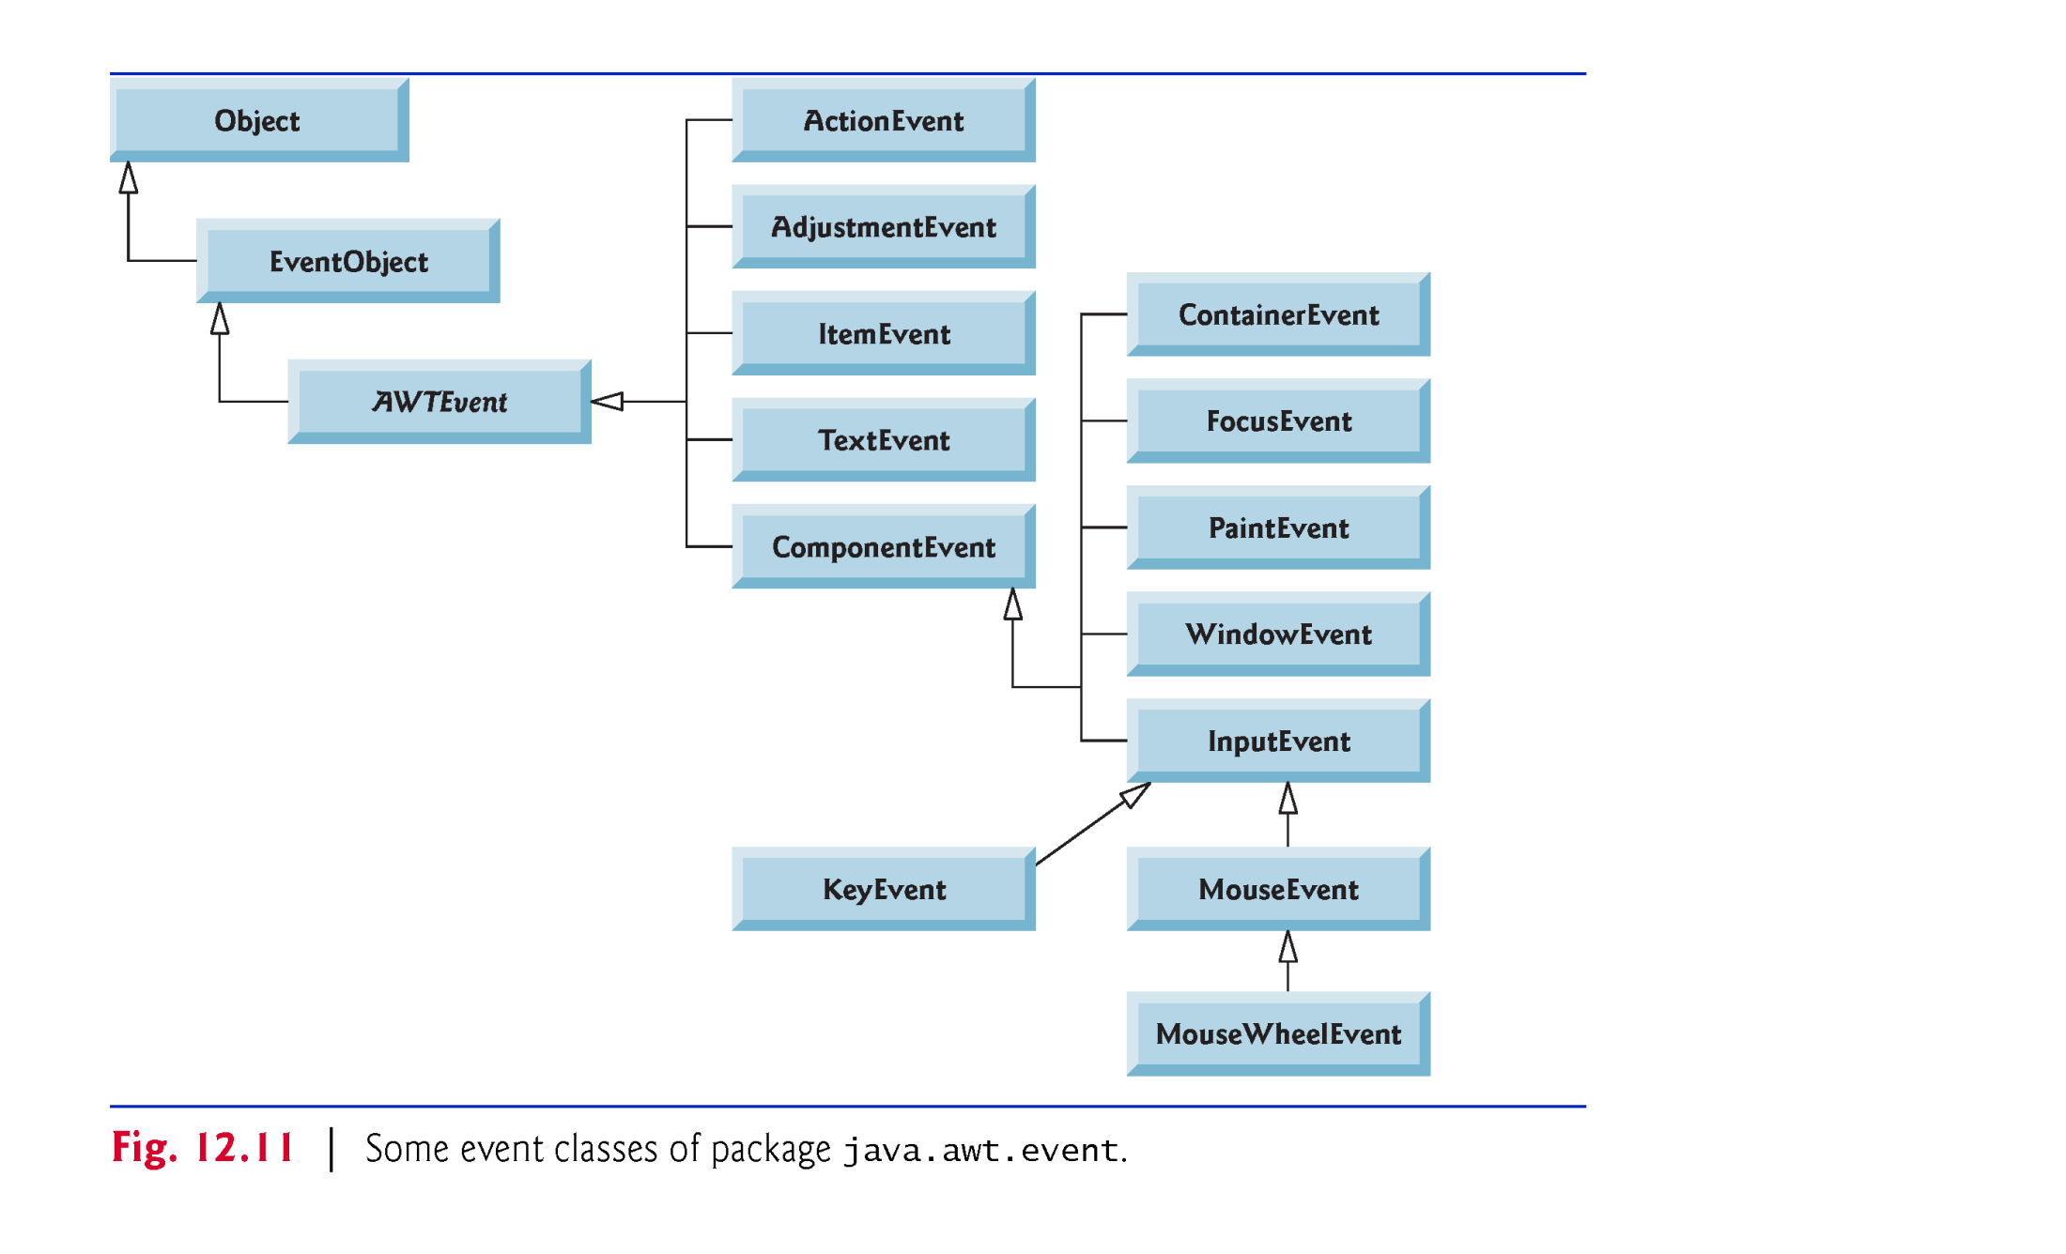
Summary: Hierarchy of Event Class in Java
SwingEvent

Slide 39
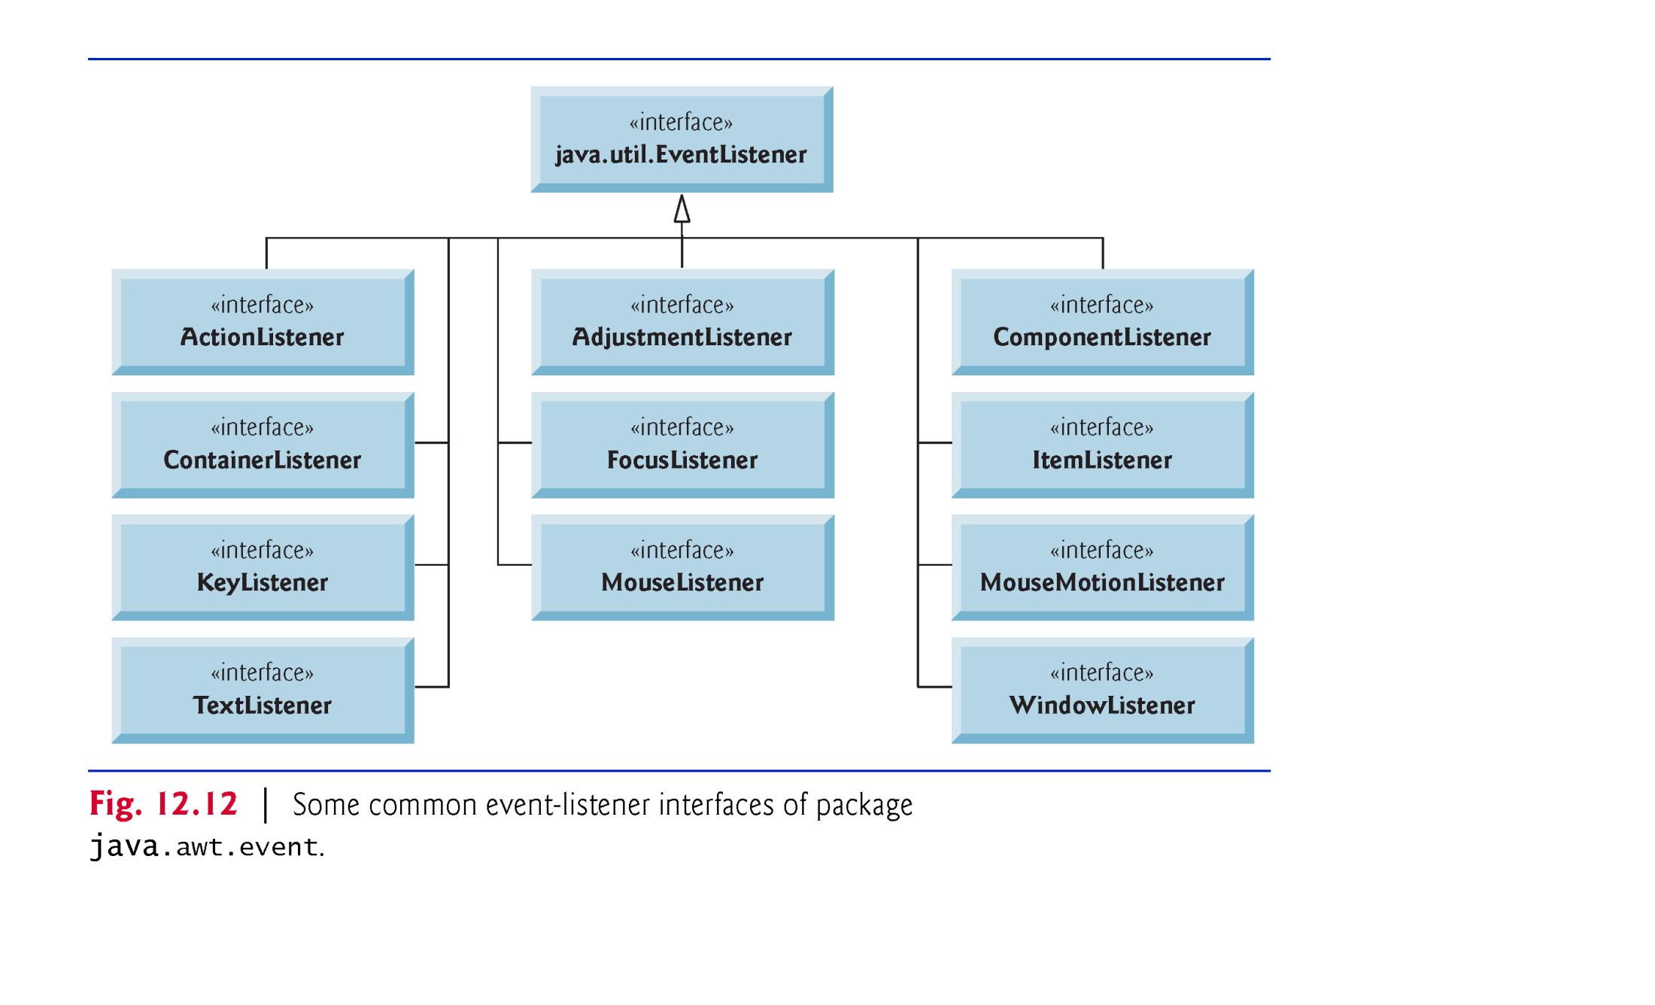
Summary: Hierarchy of Event Listener Interface corresponding to Event Class

