Slide 1
Chapter 12: User Interface Components with Swing
Understand how Swing uses the
model-view-controller design pattern

Slide 2
12.1 Swing and The “Model-View-Controller ” Design Pattern
A user interface component has three characteristics:
Its content (current selected value, entered text, ...)
Its visual appearance (color, size, ...)
Its behavior (reaction to events)
Hence, we need to implement three separate classes for each user interface component :
The model, which stores the content. Model is pure data with no visual appearance.
The view, which displays the content(data)
The controller, which handles user input events(AWT Events)
The MVC design pattern specifies precisely how these three objects interact
For a button, content is a set of flags that tells whether the button is currently
pushed in or out
For a text field, the content is a string object that holds the current text.
This is not the same as the view of the content because if the content is larger than
the text field, the user sees only a portion of the text displayed( see next slide)

Slide 3
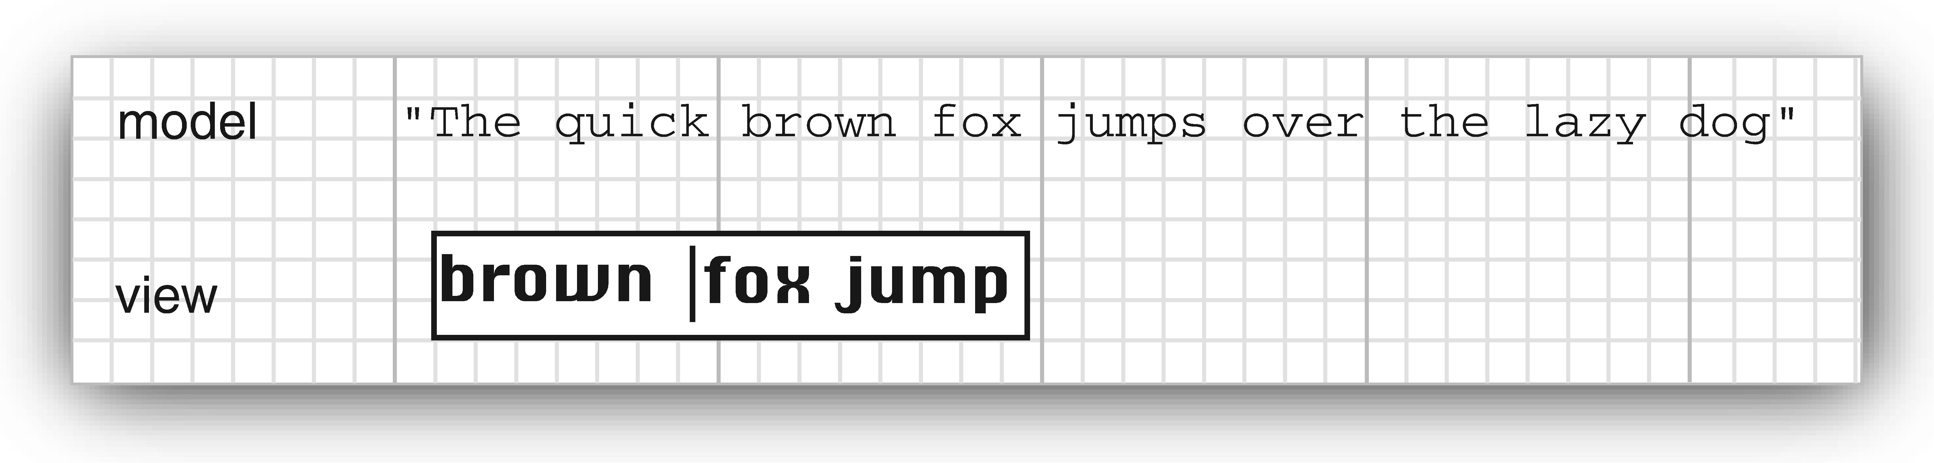
12.1 Swing and The “Model-View-Controller ”Design Pattern
Fig: Model and View of a text field

Slide 4
Fig: Interactions among model, view, and controller objects.
The controller handles user-input events.
Then it decides whether to translate these
events into changes in the model or the view.
Example 1: if the user presses a character
key in a text box, the controller calls
“insert character” command of the model.
The model then tells the view to update itself. The view never knows why the text changed.
Example 2: if the user presses a cursor key, the controller may tell the view to scroll.
Scrolling the view has no effect on the
underlying text, so the model never knows that this event happened.
Programmers don’t need to think about MVC because each user interface component has a wrapper class that wrappers its model and view

Slide 5
12.2.3. A Model-View-Controller Analysis of Swing Buttons
In previously, we used buttons without considering their controllers, models, or views.
For example: In Swing library, many types of buttons have :
a) ButtonModel interface and
b) DefaultButtonModel class that implements this interface.
Note that DefaultButtonModel class is used for push buttons, radio buttons, checkboxes, and menu items.
However, each of these button types has different views and controllers.
Example: the JButton is a wrapper class inheriting from JComponent that holds
BasicButtonUI object as its view
ButtonUIListener object as its controller.
DefaultButtonModel object as its model
Generally, each Swing component has an associated view object that ends in UI.
However, not all Swing components have dedicated controller objects.

Slide 6
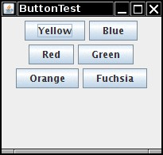
12.2. Introduction to Layout Managers:
How to arrange user interface components
in a window ?
Unlike Visual Basic, JDK has form designer to arrange them.
In Swing, we lay out user interfaces by writing our own code.
No declarative layout.
However, IDEs provide visual GUI builders
Generally, components are placed inside containers, and
a layout manager determines the positions and sizes of
the components in the container.
Hence, each container has a default layout manager.
Default layout for JPanel container is FlowLayout.
we can override default layout manager: Fig: Panel with 6 buttons
panel.setLayout(new GridLayout(4, 4));

Slide 7
Fig: Inheritance Hierarchy of the “Component” Class

Slide 8
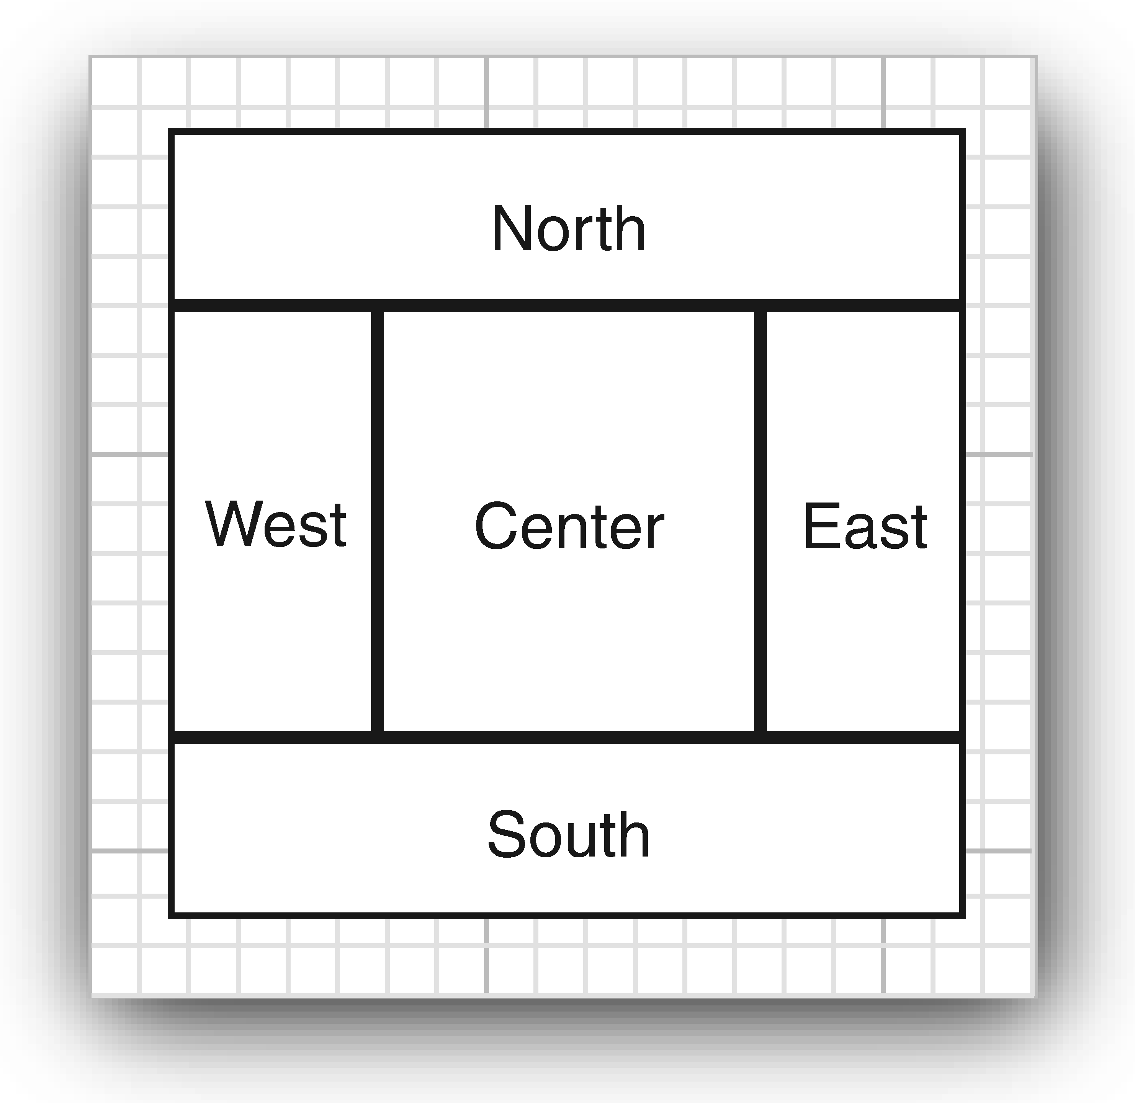
12.2.1 Border Layout Manager
It is a default layout manager for the content pane of every JFrame.
Five named areas:
frame.add(panel, BorderLayout.NORTH);
This layout expans size of the panel to fill the entire area.
Caution: Don't put a button directly into an area.
frame.add(yellowButton, BorderLayout.SOUTH); // don't
Put buttons into a JPanel, and add the panel.

Slide 9
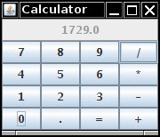
12.2.2. Grid Layout
Grid layout arranges all components in rows and columns:
panel.setLayout(new GridLayout(4, 4));
panel.add(new JButton("1"));
panel.add(new JButton("2"));
Components grow to fit the entire cell.
If row or column count is zero, an arbitrary number of components can be added:
toolbar.setLayout(new GridLayout(1, 0));
Can achieve simple layouts by nesting panels with border layout, flow layout, grid layout.

Slide 10
Listing 12.1 calculator /CalculatorPanel.java
package calculator;
import java.awt.*; // java.awt.EventQueue class queues events.
import javax.swing.*;
public class Calculator
{
public static void main(String[] args)
{
EventQueue.invokeLater( ( ) ->
{
CalculatorPanel frame = new CalculatorPanel();
frame.setTitle("Calculator");
frame.setDefaultCloseOperation(JFrame.EXIT_ON_CLOSE);
frame.setVisible(true);
});
}
}

Slide 11
Listing 12.1 calculator /CalculatorPanel.java
package calculator;
import java.awt.*;
import java.awt.event.*;
import javax.swing.*; // javax.swing.Jpanel
/* A panel with calculator buttons and a result display. */
public class CalculatorPanel extends JPanel
{
private JButton display; // to display the result
private JPanel panel; // second panel inside panel
private double result; // to store calculated value
private String lastCommand; // operation type
private boolean start;
// next slide

Slide 12
Listing 12.1 calculator /CalculatorPanel.java
public CalculatorPanel()
{
setLayout(new BorderLayout()); // inherited method
result = 0;
lastCommand = "=";
start = true;
// add the display
display = new JButton("0");
display.setEnabled(false);
add(display, BorderLayout.NORTH); // add button to panel
ActionListener insert = new InsertAction(); // see next slide: inner class by programmer
ActionListener command = new CommandAction(); // inner class by programmer

Slide 13
Listing 12.1 calculator /CalculatorPanel.java
// add the buttons in a 4 x 4 grid
panel = new JPanel();
panel.setLayout(new GridLayout(4, 4));
// addButton() method: by programmer
addButton("7", insert); // see next slide
addButton("8", insert);
addButton("9", insert);
addButton("/", command);
addButton("4", insert );
addButton("5", insert );
addButton("6", insert);
addButton("*", command);
addButton("1", insert);
addButton("2", insert);
addButton("3", insert);
addButton("-", command);
addButton("0", insert);
addButton(".", insert);
addButton("=", command);
addButton("+", command);
add(panel, BorderLayout.CENTER);
} // end of constructor :CalculatorPanel()

Slide 14
Listing 12.1 calculator /CalculatorPanel.java
/**
* Adds a button to the center panel.
* @param label the button label
* @param listener the button listener
*/
private void addButton(String label, ActionListener listener)
{
JButton button = new JButton(label);
button.addActionListener(listener);
panel.add(button); // panel is filed of outer class
}

Slide 15
Listing 12.1 calculator /CalculatorPanel.java
/*This action inserts the button action string to the end of the display text */
private class InsertAction implements ActionListener
{
public void actionPerformed(ActionEvent event)
{
String input = event.getActionCommand();
if (start)
{
display.setText(“ "); // display refers to object of Jbutton class
start = false;
}
display.setText(display.getText() + input);
}
} // end of inner class: InesrtAction

Slide 16
Listing 12.1 calculator /CalculatorPanel.java
/* This action executes the command that the button action string denotes */
private class CommandAction implements ActionListener
{
public void actionPerformed(ActionEvent event)
{
String command = event.getActionCommand();
if (start)
{
if (command.equals ("-"))
{
display.setText(command);
start = false;
}
else lastCommand = command;
}
// continue next slide

Slide 17
Listing 12.1 calculator /CalculatorPanel.java
else
{
calculate (Double.parseDouble( display.getText( ) ) );
lastCommand = command;
start = true;
}
} // end of actionPerformd () method
} end of inner class: ActionCommnad
/* Carries out the pending calculation. @param x the value to be accumulated with the prior result. */
public void calculate(double x)
{
if (lastCommand.equals("+")) result += x;
else if (lastCommand.equals("-")) result -= x;
else if (lastCommand.equals("*")) result *= x;
else if (lastCommand.equals("/")) result /= x;
else if (lastCommand.equals("=")) result = x;
display.setText(“ " + result);
}
} // end of CalculatorPanel

Slide 18
12.3 Text inputs
How to Process text input?
Construct JTextField with default text and size:
JTextField textField = new JTextField("Default input", 20);
Read user input:
String input = textField.getText();
Use a JPasswordField to mask user input. The input is returned as a char[] array:
char[] input = passwordField.getPassword();
// Overwrite contents when you are done with it
Use labels to label input fields:
JLabel label = new JLabel("Password: ", JLabel.RIGHT); // alignment

Slide 19
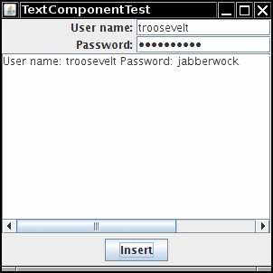
JTextArea
Construct JTextArea with number of rows and columns:
textArea = new JTextArea(8, 40);
// 8 lines of 40 columns each
Call getText/setText to read and write contents.
Enable line wrapping:
textArea.setLineWrap(true); // long lines are wrapped
Or enclose in scroll pane:
textArea = new JTextArea(8, 40);
JScrollPane scrollPane = new JScrollPane(textArea);
// Add scrollPane to container

Slide 20
Isting 12.2 text /TextComponetFrame.java
package text;
import java.awt.BorderLayout;
import java.awt.GridLayout;
import javax.swing.JButton;
import javax.swing.JFrame;
import javax.swing.JLabel;
import javax.swing.JPanel;
import javax.swing.JPasswordField;
import javax.swing.JScrollPane;
import javax.swing.JTextArea;
import javax.swing.JTextField;
import javax.swing.SwingConstants;
/ * A frame with sample text components. */
public class TextComponentFrame extends JFrame
{
public static final int TEXTAREA_ROWS = 8;
public static final int TEXTAREA_COLUMNS = 20;

Slide 21
Isting 12.2 text /TextComponetFrame.java
public TextComponentFrame()
{
JTextField textField = new JTextField();
JPasswordField passwordField = new JPasswordField();
JPanel northPanel = new JPanel();
northPanel.setLayout(new GridLayout(2, 2));
northPanel.add(new JLabel("User name: ", SwingConstants.RIGHT));
northPanel.add(textField);
northPanel.add(new JLabel("Password: ", SwingConstants.RIGHT));
northPanel.add(passwordField);
add(northPanel, BorderLayout.NORTH);

Slide 22
Isting 12.2 text /TextComponetFrame.java
JTextArea textArea = new JTextArea(TEXTAREA_ROWS, TEXTAREA_COLUMNS);
JScrollPane scrollPane = new JScrollPane(textArea);
add(scrollPane, BorderLayout.CENTER);
// add button to append text into the text area
JPanel southPanel = new JPanel();
JButton insertButton = new JButton("Insert");
southPanel.add(insertButton);
insertButton.addActionListener(event ->
textArea.append("User name: " + textField.getText() + " Password: "
+ new String(passwordField.getPassword()) + “\n"));
add(southPanel, BorderLayout.SOUTH);
pack();
} // end of constructor
} // end of class

Slide 23
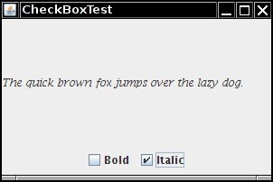
12.4 Choice Components
12.4.1 CheckBoxes
Provide label in constructor:
boldBox = new JCheckBox("Bold");
Checkbox can be unchecked or checked.
Call isSelected()/setSelected() to read/write state:
boldBox.setSelected(true);
Install an action listener:
boldBox.addActionListener(event ->
{
if (boldBox.isSelected()) . . .
})

Slide 24
Listing 12.3. checkbox/ CheckBoxFrame.java
package checkBox;
import java.awt.*;
import java.awt.event.*;
import javax.swing.*;
/* A frame with a sample text label and
check boxes for selecting font attributes. */
public class CheckBoxFrame extends JFrame
{
private JLabel label;
private JCheckBox bold;
private JCheckBox italic;
private static final int FONTSIZE = 24;

Slide 25
Listing 12.3. checkbox/ CheckBoxFrame.java
public CheckBoxFrame()
{
// add the sample text label
label = new JLabel("The quick brown fox jumps over the lazy dog.");
label.setFont(new Font("Serif", Font.BOLD, FONTSIZE));
add(label, BorderLayout.CENTER);
// this listener sets the font attribute of the label
// to the check box state
ActionListener listener = event ->
{
int mode = 0;
if ( bold.isSelected() ) mode += Font.BOLD;
if (italic.isSelected() ) mode += Font.ITALIC;
label.setFont(new Font("Serif", mode, FONTSIZE) );
};

Slide 26
Listing 12.3. checkbox/ CheckBoxFrame.java
// add the check boxes
JPanel buttonPanel = new JPanel();
bold = new JCheckBox("Bold");
bold.addActionListener(listener);
bold.setSelected(true);
buttonPanel.add(bold);
italic = new JCheckBox("Italic");
italic.addActionListener(listener);
buttonPanel.add(italic);
add(buttonPanel, BorderLayout.SOUTH);
pack();
}
}

Slide 27
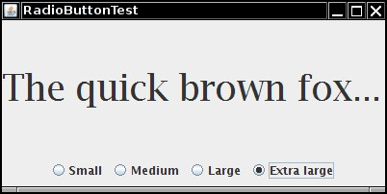
12.4.2. Radio Buttons
Use radio buttons for choosing one of several options.
Buttons must be inside a ButtonGroup:
ButtonGroup group = new ButtonGroup();
JRadioButton smallButton = new JRadioButton("Small", false);
group.add(smallButton);
JRadioButton mediumButton = new JRadioButton("Medium", true);
group.add(mediumButton);
Button group only controls the behavior of buttons.
to layout the buttons, add radio buttons to a panel.
Add action listener to each button. It is called when the option is selected.
smallButton.addActionListener(event -> label.setFont(new Font("Serif", Font.PLAIN, 8)));
Note: There is no convenient way to get the currently selected button from the ButtonGroup.

Slide 28
Listing 12.4 radioButton /RadioButtonFrame.java
package radioButton;
import java.awt.*;
import java.awt.event.*;
import javax.swing.*;
/* frame with a sample text label and
radio buttons for selecting font sizes.*/
public class RadioButtonFrame extends JFrame
{
private JPanel buttonPanel;
private ButtonGroup group;
private JLabel label;
private static final int DEFAULT_SIZE = 36;

Slide 29
Listing 12.4 radioButton /RadioButtonFrame.java
public RadioButtonFrame()
{
// add the sample text label
label = new JLabel("The quick brown fox jumps over the lazy dog.");
label.setFont(new Font("Serif", Font.PLAIN, DEFAULT_SIZE));
add(label, BorderLayout.CENTER);
// add the radio buttons
buttonPanel = new JPanel();
group = new ButtonGroup();
addRadioButton("Small", 8);
addRadioButton("Medium", 12);
addRadioButton("Large", 18);
addRadioButton("Extra large", 36);
add(buttonPanel, BorderLayout.SOUTH);
pack();
} // end of constructor

Slide 30
Listing 12.4 radioButton /RadioButtonFrame.java
/* Adds a radio button that sets the font size of the sample text.
* @param name the string to appear on the button
* @param size the font size that this button sets */
public void addRadioButton(String name, int size)
{
boolean selected = size == DEFAULT_SIZE;
JRadioButton button = new JRadioButton(name, selected);
group.add(button);
buttonPanel.add(button);
// this listener sets the label font size
ActionListener listener = event -> label.setFont(new Font("Serif", Font.PLAIN, size));
button.addActionListener(listener);
}
} // end of the class

Slide 31
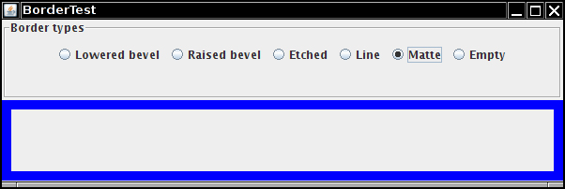
12.4.3. Borders
Usually we want to put button groups inside a panel with a border.
We can apply a border to any component that extends JComponent.
Can apply multiple decorations, like this:
Border etched = BorderFactory.createEtchedBorder();
Border titled = BorderFactory.createTitledBorder(etched, "A Title");
panel.setBorder(titled);

Slide 32
Listing 12.5: border/ BoerderFrame.java
package border;
import java.awt.*;
import javax.swing.*;
import javax.swing.border.*;
/*A frame with radio buttons to pick a border style. */
public class BorderFrame extends JFrame
{
private JPanel demoPanel;
private JPanel buttonPanel;
private ButtonGroup group;
public BorderFrame()
{
demoPanel = new JPanel();
buttonPanel = new JPanel();
group = new ButtonGroup();

Slide 33
Listing 12.5: border/ BoerderFrame.java
addRadioButton("Lowered bevel", BorderFactory.createLoweredBevelBorder());
addRadioButton("Raised bevel", BorderFactory.createRaisedBevelBorder());
addRadioButton("Etched", BorderFactory.createEtchedBorder());
addRadioButton("Line", BorderFactory.createLineBorder(Color.BLUE));
addRadioButton("Matte", BorderFactory.createMatteBorder(10, 10, 10, 10, Color.BLUE));
addRadioButton("Empty", BorderFactory.createEmptyBorder());
Border etched = BorderFactory.createEtchedBorder();
Border titled = BorderFactory.createTitledBorder(etched, "Border types");
buttonPanel.setBorder(titled);
setLayout(new GridLayout(2, 1)); add(buttonPanel); add(demoPanel);
pack();
} // end of constructor
public void addRadioButton(String buttonName, Border b) {
JRadioButton button = new JRadioButton(buttonName);
button.addActionListener(event -> demoPanel.setBorder(b));
group.add(button);
buttonPanel.add(button);
} // end
} // end of class

Slide 34
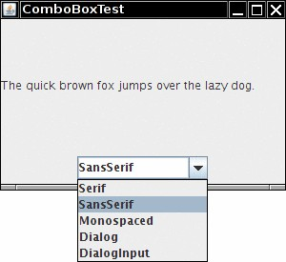
12.4.4. Combo Boxes
Use combo boxes when there are more than many choices.
Call setEditable()to allow editing of the options.
A combo box is a combination of a text field and a list of choices.
JComboBox is a generic class: JComboBox<String>, JComboBox<Integer>.
Get the selected item like this:
JComboBox<String> faceCombo = . . . ;
Object item = faceCombo.getSelectedItem();
String item = faceCombo.getItemAt(combo.getSelectedIndex()); // if not editable
An ActionEvent is fired when an item is selected:
faceCombo.addActionListener ( event ->
label.setFont ( new Font(
comboBox.getItemAt ( faceCombo.getSelectedIndex() ), Font.PLAIN, DEFAULT_SIZE) ) );

Slide 35
Listing 12.6: comboBox/ComboxFrame.java
package comboBox;
import java.awt.BorderLayout;
import java.awt.Font;
import javax.swing.JComboBox;
import javax.swing.JFrame;
import javax.swing.JLabel;
import javax.swing.JPanel;
/ * frame with a sample text label and a combo box for selecting font faces */
public class ComboBoxFrame extends JFrame
{
private JComboBox<String> faceCombo;
private JLabel label;
private static final int DEFAULT_SIZE = 24; // continue next slide

Slide 36
Listing 12.6: comboBox/ComboxFrame.java
public ComboBoxFrame()
{
// add the sample text label
label = new Jlabel ("The quick brown fox jumps over the lazy dog.");
label.setFont(new Font("Serif", Font.PLAIN, DEFAULT_SIZE));
add(label, BorderLayout.CENTER);
// make a combo box and add face names
faceCombo = new JComboBox<>();
faceCombo.addItem("Serif");
faceCombo.addItem("SansSerif");
faceCombo.addItem("Monospaced");
faceCombo.addItem("Dialog");
faceCombo.addItem("DialogInput");

Slide 37
Listing 12.6: comboBox/ComboxFrame.java
// the combo box listener changes the label font to the selected face name
faceCombo.addActionListener( event ->
label.setFont(new Font(faceCombo.getItemAt ( faceCombo.getSelectedIndex() ),
Font.PLAIN, DEFAULT_SIZE ) ) ) ;
// add combo box to a panel at the frame's southern border
JPanel comboPanel = new JPanel();
comboPanel.add(faceCombo);
add(comboPanel, BorderLayout.SOUTH);
pack();
} // end of constructor
} // end of class

Slide 38
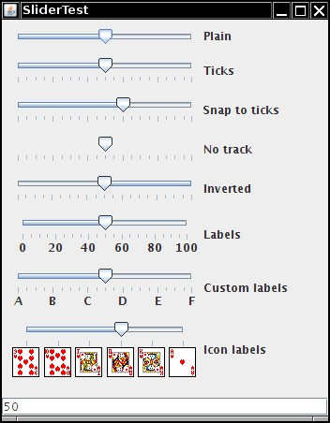
12.4.5. Sliders
Sliders offer a choice from a continuum of values:
JSlider slider = new JSlider(min, max, initialValue);
Capture slider change with a change listener:
ChangeListener listener = event ->
{
JSlider slider = (JSlider) event.getSource();
int value = slider.getValue();
. . .
};
We can show slider ticks:
slider.setMajorTickSpacing(20);
slider.setMinorTickSpacing(5);
slider.setPaintTicks(true);
slider.setPaintLabels(true);
We can supply tick labels that are arbitrary components:
Hashtable<Integer, Component> labelTable = new Hashtable<>();
labelTable.put(0, new JLabel("A"))
. . .
slider.setLabelTable(labelTable);

Slide 39
Listing 12.7: slider /SliderFrame.java
package slider;
import java.awt.*;
import java.util.*;
import javax.swing.*;
import javax.swing.event.*;
/* A frame with many sliders and
a text field to show slider values. */
public class SliderFrame extends JFrame
{
private JPanel sliderPanel;
private JTextField textField;
private ChangeListener listener;

Slide 40
Listing 12.7: slider /SliderFrame.java
public SliderFrame()
{
sliderPanel = new JPanel();
sliderPanel.setLayout(new GridBagLayout());
// common listener for all sliders
listener = event -> {
// update text field when the slider value changes
JSlider source = (JSlider) event.getSource();
textField.setText(“ " + source.getValue() );
};
// add a plain slider
JSlider slider = new JSlider();
addSlider(slider, "Plain");

Slide 41
Listing 12.7: slider /SliderFrame.java
// add a slider with major and minor ticks
slider = new JSlider();
slider.setPaintTicks(true);
slider.setMajorTickSpacing(20);
slider.setMinorTickSpacing(5);
addSlider(slider, "Ticks");
// add a slider that snaps to ticks
slider = new JSlider();
slider.setPaintTicks(true);
slider.setSnapToTicks(true);
slider.setMajorTickSpacing(20);
slider.setMinorTickSpacing(5);
addSlider(slider, "Snap to ticks");
// add a slider with no track
slider = new JSlider();
slider.setPaintTicks(true);
slider.setMajorTickSpacing(20);
slider.setMinorTickSpacing(5);
slider.setPaintTrack(false);
addSlider(slider, "No track");
// add an inverted slider
slider = new JSlider();
slider.setPaintTicks(true);
slider.setMajorTickSpacing(20);
slider.setMinorTickSpacing(5);
slider.setInverted(true);
addSlider(slider, "Inverted");

Slide 42
Listing 12.7: slider /SliderFrame.java
// add a slider with numeric labels
slider = new JSlider();
slider.setPaintTicks(true);
slider.setPaintLabels(true);
slider.setMajorTickSpacing(20);
slider.setMinorTickSpacing(5);
addSlider(slider, "Labels");
// add a slider with alphabetic labels
slider = new JSlider();
slider.setPaintLabels(true);
slider.setPaintTicks(true);
slider.setMajorTickSpacing(20);
slider.setMinorTickSpacing(5);
Dictionary<Integer, Component> labelTable =
new Hashtable<>();
labelTable.put(0, new JLabel("A"));
labelTable.put(20, new JLabel("B"));
labelTable.put(40, new JLabel("C"));
labelTable.put(60, new JLabel("D"));
labelTable.put(80, new JLabel("E"));
labelTable.put(100, new JLabel("F"));
slider.setLabelTable(labelTable);
addSlider(slider, "Custom labels");

Slide 43
Listing 12.7: slider /SliderFrame.java
// add a slider with icon labels
slider = new JSlider();
slider.setPaintTicks(true);
slider.setPaintLabels(true);
slider.setSnapToTicks(true);
slider.setMajorTickSpacing(20);
slider.setMinorTickSpacing(20);
labelTable = new Hashtable<Integer, Component>();
// add card images
labelTable.put(0, new JLabel(new ImageIcon("nine.gif")));
labelTable.put(20, new JLabel(new ImageIcon("ten.gif")));
labelTable.put(40, new JLabel(new ImageIcon("jack.gif")));
labelTable.put(60, new JLabel(new ImageIcon("queen.gif")));
labelTable.put(80, new JLabel(new ImageIcon("king.gif")));
labelTable.put(100, new JLabel(new ImageIcon("ace.gif")));
slider.setLabelTable(labelTable);
addSlider(slider, "Icon labels");
// add the text field that
// displays the slider value
textField = new JTextField();
add(sliderPanel,BorderLayout.CENTER);
add(textField, BorderLayout.SOUTH);
pack();
} // end of constructor

Slide 44
Listing 12.7: slider /SliderFrame.java
/** Adds a slider to the slider panel and hooks up the listener
* @param s the slider
* @param description the slider description */
public void addSlider (JSlider s, String description)
{
s.addChangeListener(listener);
JPanel panel = new JPanel();
panel.add(s);
panel.add(new JLabel(description));
panel.setAlignmentX(Component.LEFT_ALIGNMENT);
GridBagConstraints gbc = new GridBagConstraints();
gbc.gridy = sliderPanel.getComponentCount();
gbc.anchor = GridBagConstraints.WEST;
sliderPanel.add(panel, gbc);
}
} // end of the class

Slide 45
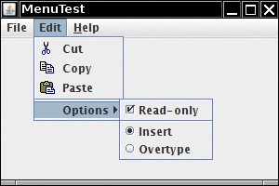
12.5. Pull down Menus
Menu terminology:
Menu bar = Bar at the top of a window with pull down menus
Menu = Rectangle with menu items and submenus.
Menu item = Selection resulting in an action.
How to build menu?
1) Create a menu bar and add to the frame:
JMenuBar menuBar = new JMenuBar();
frame.setJMenuBar(menuBar);
2) Create top-level menu and add to menu bar:
JMenu editMenu = new JMenu("Edit");
menuBar.add(editMenu);
3) Add menu items, separators and submenus to the menu object:
JMenuItem pasteItem = new JMenuItem("Paste");
editMenu.add(pasteItem);
editMenu.addSeparator();
JMenu optionsMenu = . . .; // a submenu
editMenu.add(optionsMenu);

Slide 46
Menu Item Actions
When the user selects a menu item, an action event occurs:
pasteItem.addActionListener(event -> . . .) ;
Use Action objects to describe actions that can be triggered by menus, toolbar buttons and keystrokes:
Action exitAction = new AbstractAction("Exit") // menu item text goes here
{
public void actionPerformed(ActionEvent event)
{
// action code is written here
System.exit(0);
}
};
We can add action to menu as follows
JMenuItem exitItem = fileMenu.add(exitAction);

Slide 47
12.5.2. Special Menu Items
1) Add icon to menu item:
JMenuItem cutItem = new JMenuItem("Cut", new ImageIcon("cut.gif"));
Or better, add the icon to the Action.
2) Check box menu item:
JCheckBoxMenuItem readonlyItem = new JCheckBoxMenuItem("Read-only");
3) Radio buttons menu items:
ButtonGroup group = new ButtonGroup();
JRadioButtonMenuItem insertItem = new JRadioButtonMenuItem("Insert");
insertItem.setSelected(true);
JRadioButtonMenuItem overtypeItem = new JRadioButtonMenuItem("Overtype");
group.add(insertItem);
group.add(overtypeItem);
optionsMenu.add(insertItem);
optionsMenu.add(overtypeItem);

Slide 48
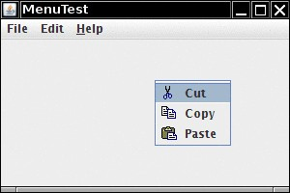
12.5.4. Pop-Up Menus
Create a menu with items as usual, but this time with a JPopupMenu on the top level:
JPopupMenu popup = new JPopupMenu();
JMenuItem item = new JMenuItem("Cut");
popup.add(item);
. . .
Pop up the menu when the right mouse button is clicked on a component:
component.setComponentPopupMenu(popup);

Slide 49
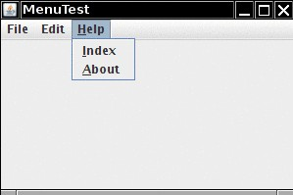
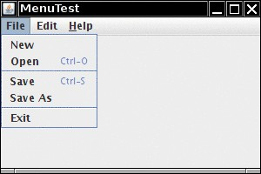
12.5.5 Keyboard Mnemonics and Accelerators
Mnemonic = Underlined character in menu:
aboutAction.putValue(Action.MNEMONIC_KEY, new Integer('A'));
Or use the setMnemonic method:
JMenu helpMenu = new JMenu("Help");
helpMenu.setMnemonic('H');
Accelerator key = Key that directly selects the action:
openItem.setAccelerator(KeyStroke.getKeyStroke("ctrl O"));
Accelerators are automatically displayed:

Slide 50
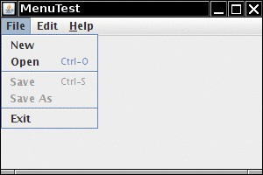
12.5.6. Enabling and Disabling Menu Items
Wec can temporarily disable a menu item:
saveItem.setEnabled(false);
Disabled items are grayed out:

Slide 51
Listing 12.8: menu /MenuFrame.java
package menu;
import java.awt.event.*;
import javax.swing.*;
/* * A frame with a sample menu bar. */
public class MenuFrame extends JFrame
{
// list of fields
private static final int DEFAULT_WIDTH = 300;
private static final int DEFAULT_HEIGHT = 200;
private Action saveAction;
private Action saveAsAction;
private JCheckBoxMenuItem readonlyItem;
private JPopupMenu popup;

Slide 52
Listing 12.8: menu /MenuFrame.java
/* A sample action that prints the action name to System.out */
class TestAction extends AbstractAction // non-static inner class
{
public TestAction(String name)
{
super(name);
}
public void actionPerformed(ActionEvent event)
{
System.out.println( getValue(Action.NAME) + " selected.") ;
}
} // end of non-static inner class

Slide 53
Listing 12.8: menu /MenuFrame.java
public MenuFrame()
{
setSize(DEFAULT_WIDTH, DEFAULT_HEIGHT); // inherit from JFrame
JMenu fileMenu = new JMenu("File");
fileMenu.add(new TestAction("New"));
// demonstrate accelerators
JMenuItem openItem = fileMenu.add(new TestAction("Open"));
openItem.setAccelerator(KeyStroke.getKeyStroke("ctrl O"));
fileMenu.addSeparator();
saveAction = new TestAction("Save");
JMenuItem saveItem = fileMenu.add(saveAction);
saveItem.setAccelerator(KeyStroke.getKeyStroke("ctrl S"));

Slide 54
Listing 12.8: menu /MenuFrame.java
saveAction = new TestAction("Save");
JMenuItem saveItem = fileMenu.add(saveAction);
saveItem.setAccelerator(KeyStroke.getKeyStroke("ctrl S"));
saveAsAction = new TestAction("Save As");
fileMenu.add(saveAsAction);
fileMenu.addSeparator();
fileMenu.add ( new AbstractAction("Exit")
{
public void actionPerformed(ActionEvent event)
{
System.exit(0);
}
} ); // end of local anonymous inner class inside constructor

Slide 55
Listing 12.8: menu /MenuFrame.java
// demonstrate checkbox and radio button menus
readonlyItem = new JCheckBoxMenuItem("Read-only");
readonlyItem.addActionListener ( new ActionListener()
{
public void actionPerformed(ActionEvent event)
{
boolean saveOk = !readonlyItem.isSelected();
saveAction.setEnabled(saveOk);
saveAsAction.setEnabled(saveOk);
}
}); // end of local Anonymous inner class inside constructor
ButtonGroup group = new ButtonGroup();
JRadioButtonMenuItem insertItem = new JRadioButtonMenuItem("Insert");
insertItem.setSelected(true);
JRadioButtonMenuItem overtypeItem = new JRadioButtonMenuItem("Overtype");

Slide 56
Listing 12.8: menu /MenuFrame.java
group.add(insertItem);
group.add(overtypeItem);
// demonstrate icons
Action cutAction = new TestAction("Cut");
cutAction.putValue(Action.SMALL_ICON, new ImageIcon("cut.gif"));
Action copyAction = new TestAction("Copy");
copyAction.putValue(Action.SMALL_ICON, new ImageIcon("copy.gif"));
Action pasteAction = new TestAction("Paste");
pasteAction.putValue(Action.SMALL_ICON, new ImageIcon("paste.gif"));
JMenu editMenu = new JMenu("Edit");
editMenu.add(cutAction);
editMenu.add(copyAction);
editMenu.add(pasteAction);

Slide 57
Listing 12.8: menu /MenuFrame.java
// demonstrate nested menus
JMenu optionMenu = new JMenu("Options");
optionMenu.add(readonlyItem);
optionMenu.addSeparator();
optionMenu.add(insertItem);
optionMenu.add(overtypeItem);
editMenu.addSeparator();
editMenu.add(optionMenu);
// demonstrate mnemonics
JMenu helpMenu = new JMenu("Help");
helpMenu.setMnemonic('H');

Slide 58
Listing 12.8: menu /MenuFrame.java
// you can also add the mnemonic key to an action
Action aboutAction = new TestAction("About");
aboutAction.putValue(Action.MNEMONIC_KEY, new Integer('A'));
helpMenu.add(aboutAction);
// add all top-level menus to menu bar
JMenuBar menuBar = new JMenuBar();
setJMenuBar(menuBar);
menuBar.add(fileMenu);
menuBar.add(editMenu);
menuBar.add(helpMenu);

Slide 59
Listing 12.8: menu /MenuFrame.java
// demonstrate pop-ups
popup = new JPopupMenu();
popup.add(cutAction);
popup.add(copyAction);
popup.add(pasteAction);
JPanel panel = new JPanel();
panel.setComponentPopupMenu(popup);
add(panel);
} // end of constructor
} // end of the outer class : MenuFrame

Slide 60
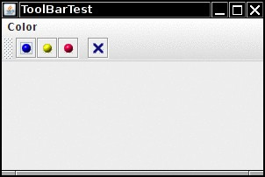
12.5.7. Toolbars
Toolbar is a Button bar for quick access to common operations.
User can move toolbars around or detach them.
Add components to the toolbar:
JToolBar bar = new JToolBar();
bar.add(blueButton);
bar.add(yellowAction); // Can also add Action objects
bar.addSeparator();
Add the toolbar to the frame:
frame.add(bar, BorderLayout.NORTH);
Add tooltip:
blueButton.setToolTipText("Blue");
yellowAction.putValue(Action.SHORT_DESCRIPTION, "Yellow");

Slide 61
Listing 12.9: toolBar /toolBarFrame.java
package toolBar;
import java.awt.*;
import java.awt.event.*;
import javax.swing.*;
/* *A frame with a toolbar and menu for color changes. */
public class ToolBarFrame extends JFrame
{
private static final int DEFAULT_WIDTH = 300;
private static final int DEFAULT_HEIGHT = 200;
private JPanel panel;

Slide 62
Listing 12.9: toolBar /toolBarFrame.java
public ToolBarFrame()
{
setSize(DEFAULT_WIDTH, DEFAULT_HEIGHT);
// add a panel for color change
panel = new JPanel();
add(panel, BorderLayout.CENTER);
// set up actions by programmer defined class called Color action: see next slides
Action blueAction = new ColorAction("Blue", new ImageIcon("blue-ball.gif"), Color.BLUE);
Action yellowAction = new ColorAction("Yellow", new ImageIcon("yellow-ball.gif"), Color.YELLOW);
Action redAction = new ColorAction("Red", new ImageIcon("red-ball.gif"), Color.RED);

Slide 63
Listing 12.9: toolBar /toolBarFrame.java
Action exitAction = new AbstractAction ("Exit", new ImageIcon("exit.gif"))
{
public void actionPerformed(ActionEvent event)
{
System.exit(0);
}
}; // end of local anonymous inner class inside constructor
exitAction.putValue(Action.SHORT_DESCRIPTION, "Exit");
// populate toolbar
JToolBar bar = new JToolBar();
bar.add(blueAction);
bar.add(yellowAction);
bar.add(redAction);
bar.addSeparator();
bar.add(exitAction);
add(bar, BorderLayout.NORTH);

Slide 64
Listing 12.9: toolBar /toolBarFrame.java
// populate menu
JMenu menu = new JMenu("Color");
menu.add(yellowAction);
menu.add(blueAction);
menu.add(redAction);
menu.add(exitAction);
JMenuBar menuBar = new JMenuBar();
menuBar.add(menu);
setJMenuBar(menuBar);
} // end of constructor

Slide 65
Listing 12.9: toolBar /toolBarFrame.java
/* The color action sets the background of the frame to a given color. */
class ColorAction extends AbstractAction // non-static inner class
{
public ColorAction(String name, Icon icon, Color c)
{
putValue(Action.NAME, name);
putValue(Action.SMALL_ICON, icon);
putValue(Action.SHORT_DESCRIPTION, name + " background");
putValue("Color", c);
}
public void actionPerformed (ActionEvent event)
{
Color c = (Color) getValue("Color");
panel.setBackground(c);
}
}
} // end of outer class: ToolBarFrame

Slide 66
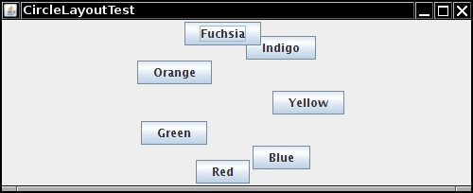
12.6.4. Custom Layout Managers
You can define your own layout managers.
Example: a lay out components along a circle or ellipse.
Implement the LayoutManger interface and override the following 5 methods:
void addLayoutComponent(String s, Component c);
void removeLayoutComponent(Component c);
Dimension preferredLayoutSize(Container parent);
Dimension minimumLayoutSize(Container parent);
void layoutContainer(Container parent);

Slide 67
Listing 12.13: circleLayout/ CircleLayout.java
package circleLayout;
import java.awt.*;
/*A layout manager that lays out components along a circle. */
public class CircleLayout implements LayoutManager
{
private int minWidth = 0;
private int minHeight = 0;
private int preferredWidth = 0;
private int preferredHeight = 0;
private boolean sizesSet = false;
private int maxComponentWidth = 0;
private int maxComponentHeight = 0;
public void addLayoutComponent(String name, Component comp)
{
}

Slide 68
Listing 12.13: circleLayout/ CircleLayout.java
public void removeLayoutComponent(Component comp)
{
}
public void setSizes(Container parent)
{
if ( sizesSet ) return;
int n = parent.getComponentCount();
preferredWidth = 0;
preferredHeight = 0;
minWidth = 0;
minHeight = 0;
maxComponentWidth = 0;
maxComponentHeight = 0;
// compute the maximum component widths and heights and
// set the preferred size to the sum of the component sizes.
for (int i = 0; i < n; i++)
{
Component c = parent.getComponent(i);

Slide 69
Listing 12.13: circleLayout/ CircleLayout.java
if (c.isVisible())
{
Dimension d = c.getPreferredSize();
maxComponentWidth = Math.max(maxComponentWidth, d.width);
maxComponentHeight = Math.max(maxComponentHeight, d.height);
preferredWidth += d.width; preferredHeight += d.height;
}
} // end of For loop
minWidth = preferredWidth / 2; minHeight = preferredHeight / 2; sizesSet = true;
} // end of setSizes()
public Dimension preferredLayoutSize(Container parent)
{
setSizes(parent); Insets insets = parent.getInsets();
int width = preferredWidth + insets.left + insets.right; int height = preferredHeight + insets.top + insets.bottom;
return new Dimension(width, height);
}

Slide 70
Listing 12.13: circleLayout/ CircleLayout.java
public Dimension minimumLayoutSize(Container parent)
{
setSizes(parent);
Insets insets = parent.getInsets();
int width = minWidth + insets.left + insets.right;
int height = minHeight + insets.top + insets.bottom;
return new Dimension(width, height);
}
public void layoutContainer(Container parent)
{
setSizes(parent);
// compute center of the circle
Insets insets = parent.getInsets();
int containerWidth = parent.getSize().width - insets.left - insets.right;
int containerHeight = parent.getSize().height - insets.top - insets.bottom;
int xcenter = insets.left + containerWidth / 2;
int ycenter = insets.top + containerHeight / 2;

Slide 71
Listing 12.13: circleLayout/ CircleLayout.java
// compute center of the circle
Insets insets = parent.getInsets();
int containerWidth = parent.getSize().width - insets.left - insets.right;
int containerHeight = parent.getSize().height - insets.top - insets.bottom;
int xcenter = insets.left + containerWidth / 2;
int ycenter = insets.top + containerHeight / 2;
// compute radius of the circle
int xradius = (containerWidth - maxComponentWidth) / 2;
int yradius = (containerHeight - maxComponentHeight) / 2;
int radius = Math.min(xradius, yradius);

Slide 72
Listing 12.13: circleLayout/ CircleLayout.java
// lay out components along the circle
int n = parent.getComponentCount();
for (int i = 0; i < n; i++)
{
Component c = parent.getComponent(i);
if (c.isVisible())
{
double angle = 2 * Math.PI * i / n;
// center point of component
int x = xcenter + (int) (Math.cos(angle) * radius);
int y = ycenter + (int) (Math.sin(angle) * radius);
// move component so that its center is (x, y) and its size is its preferred size
Dimension d = c.getPreferredSize();
c.setBounds(x - d.width / 2, y - d.height / 2, d.width, d.height);
}
}
} // end of layoutContainer() method
} // end CircleLayout class

Slide 73
Listing 12.14: circleLayout/ CircleLayoutFrame.java
package circleLayout;
import javax.swing.*;
/* A frame that shows buttons arranged along a circle. */
public class CircleLayoutFrame extends JFrame
{
public CircleLayoutFrame()
{
setLayout( new CircleLayout() );
add(new JButton("Yellow"));
add(new JButton("Blue"));
add(new JButton("Red"));
add(new JButton("Green"));
add(new JButton("Orange"));
add(new JButton("Fuchsia"));
add(new JButton("Indigo"));
pack();
}
}

Slide 74
12.7. Dialog Boxes
So fall, all user interface elements appear inside a frame window
Dialog box pops up from application window to get information from user or to give information to user.
a) Modal dialog: Must be completed before other windows become active again.
b) Modeless dialog: Stays in place for as long as needed.
Standard dialogs:
Option pane
File chooser
In custom dialogs, you need to transfer information between the dialog and the application.

Slide 75
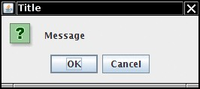
12.7.1.Option Dialogs
JOptionPane class has ready-made dialogs for a single piece of information:
showMessageDialog() shows a message and wait user to click “OK”
showConfirmDialog() gets a confirmation such as OK/Cancel.
showOptionDialog () makes user select from a set of options.
showInputDialog () gets an input string.
A the figure shows option dialog: has an icon, a message and one or more option buttons
Follow this recipe:
Choose the dialog type (message, confirm, option, input).
Choose an icon (error, information, warning, question, none, or custom)..
Choose a message (string, icon, custom component, or a stack of them).
For a confirmation dialog, choose the option type (default, Yes/No, Yes/No/Cancel, or OK/Cancel).
For an option dialog, choose the options (strings, icons, or custom components) and the default option.
For an input dialog, choose between a text field and a combo box.
Example:
int selection = JOptionPane.showConfirmDialog(parent, "Message", "Title",
JOptionPane.OK_CANCEL_OPTION, JOptionPane.QUESTION_MESSAGE);

Slide 76
Listing 12.15 and 12.16: OptionDialog Test screen

Slide 77
Listing 12.5: optionDialog/OptionDialogFrame.java
package optionDialog;
import java.awt.*;
import java.awt.event.*;
import java.awt.geom.*;
import java.util.*;
import javax.swing.*;
/ * A frame that contains settings for selecting various option dialogs. */
public class OptionDialogFrame extends JFrame
{
private ButtonPanel typePanel;
private ButtonPanel messagePanel;
private ButtonPanel messageTypePanel;
private ButtonPanel optionTypePanel;
private ButtonPanel optionsPanel;
private ButtonPanel inputPanel;
private String messageString = "Message";
private Icon messageIcon = new ImageIcon("blue-ball.gif");
private Object messageObject = new Date();
private Component messageComponent = new SampleComponent();

Slide 78
Listing 12.15: optionDialog/OptionDialogFrame.java
public OptionDialogFrame()
{
JPanel gridPanel = new JPanel();
gridPanel.setLayout(new GridLayout(2, 3));
typePanel = new ButtonPanel("Type", "Message", "Confirm", "Option", "Input");
messageTypePanel = new ButtonPanel("Message Type", "ERROR_MESSAGE", "INFORMATION_MESSAGE",
"WARNING_MESSAGE", "QUESTION_MESSAGE", "PLAIN_MESSAGE");
messagePanel = new ButtonPanel("Message", "String", "Icon", "Component", "Other",
"Object[]");
optionTypePanel = new ButtonPanel("Confirm", "DEFAULT_OPTION", "YES_NO_OPTION",
"YES_NO_CANCEL_OPTION", "OK_CANCEL_OPTION");
optionsPanel = new ButtonPanel("Option", "String[]", "Icon[]", "Object[]");
inputPanel = new ButtonPanel("Input", "Text field", "Combo box");
gridPanel.add(typePanel);
gridPanel.add(messageTypePanel);
gridPanel.add(messagePanel);

Slide 79
Listing 12.15: optionDialog/OptionDialogFrame.java
gridPanel.add(optionTypePanel);
gridPanel.add(optionsPanel);
gridPanel.add(inputPanel);
// add a panel with a Show button
JPanel showPanel = new JPanel();
JButton showButton = new JButton("Show");
showButton.addActionListener(new ShowAction());
showPanel.add(showButton);
add(gridPanel, BorderLayout.CENTER);
add(showPanel, BorderLayout.SOUTH);
pack();
} // end of constructor

Slide 80
Listing 12.15: optionDialog/OptionDialogFrame.java
/* Gets the currently selected message.
@return a string, icon, component, or
object array, depending on the Message panel selection */
public Object getMessage()
{
String s = messagePanel.getSelection();
if (s.equals("String")) return messageString;
else if (s.equals("Icon")) return messageIcon;
else if (s.equals("Component")) return messageComponent;
else if (s.equals("Object[]")) return new Object[] { messageString, messageIcon,
messageComponent, messageObject };
else if (s.equals("Other")) return messageObject;
else return null;
}

Slide 81
Listing 12.5: optionDialog/OptionDialogFrame.java
/* Gets the currently selected options.
* @return an array of strings, icons, or objects, depending on the Option panel selection */
public Object[] getOptions()
{
String s = optionsPanel.getSelection();
if (s.equals("String[]")) return new String[] { "Yellow", "Blue", "Red" };
else if (s.equals("Icon[]")) return new Icon[] { new ImageIcon("yellow-ball.gif"),
new ImageIcon("blue-ball.gif"), new ImageIcon("red-ball.gif") };
else if (s.equals("Object[]")) return new Object[] { messageString, messageIcon,
messageComponent, messageObject };
else return null;
}

Slide 82
Listing 12.15: optionDialog/OptionDialogFrame.java
/* Gets the selected message or option type
@param panel the Message Type or Confirm panel
@return the selected XXX_MESSAGE or XXX_OPTION constant from the JOptionPane class */
public int getType(ButtonPanel panel)
{
String s = panel.getSelection();
try
{
return JOptionPane.class.getField(s).getInt(null);
}
catch (Exception e)
{
return -1;
}
}

Slide 83
Listing 12.5: optionDialog/OptionDialogFrame.java
/* The action listener for the Show button shows a Confirm, Input, Message, or Option dialog
* depending on the Type panel selection. */
private class ShowAction implements ActionListener // non-static inner class
{
public void actionPerformed(ActionEvent event)
{
if (typePanel.getSelection().equals("Confirm")) JOptionPane.showConfirmDialog(
OptionDialogFrame.this, getMessage(), "Title", getType(optionTypePanel),
getType(messageTypePanel));
else if (typePanel.getSelection().equals("Input"))
{
if (inputPanel.getSelection().equals("Text field")) JOptionPane.showInputDialog(
OptionDialogFrame.this, getMessage(), "Title", getType(messageTypePanel));
else JOptionPane.showInputDialog(OptionDialogFrame.this, getMessage(), "Title",
getType(messageTypePanel), null, new String[] { "Yellow", "Blue", "Red" },
"Blue");
}

Slide 84
Listing 12.15: optionDialog/OptionDialogFrame.java
else if (typePanel.getSelection().equals("Message")) JOptionPane.showMessageDialog(
OptionDialogFrame.this, getMessage(), "Title", getType(messageTypePanel));
else if (typePanel.getSelection().equals("Option")) JOptionPane.showOptionDialog(
OptionDialogFrame.this, getMessage(), "Title", getType(optionTypePanel),
getType(messageTypePanel), null, getOptions(), getOptions()[0]);
} // end of actionPerformed() method
} end of inner class: ShowAction
} // end of outer class: OptionDialogFrame

Slide 85
Listing 12.5: optionDialog/OptionDialogFrame.java
/* A component with a painted surface */
class SampleComponent extends Jcomponent // another class within the same source file
{
public void paintComponent(Graphics g)
{
Graphics2D g2 = (Graphics2D) g;
Rectangle2D rect = new Rectangle2D.Double(0, 0, getWidth() - 1, getHeight() - 1);
g2.setPaint(Color.YELLOW);
g2.fill(rect);
g2.setPaint(Color.BLUE);
g2.draw(rect);
}
public Dimension getPreferredSize()
{
return new Dimension(10, 10);
}
}

Slide 86
Listing 12.16: optionDialog/ButtonPanel.java
package optionDialog;
import javax.swing.*;
/* A panel with radio buttons inside a titled border. */
public class ButtonPanel extends JPanel
{
private ButtonGroup group;
/* Constructs a button panel.
* @param title the title shown in the border
* @param options an array of radio button labels */
public ButtonPanel(String title, String... options)
{
setBorder(BorderFactory.createTitledBorder(BorderFactory.createEtchedBorder(), title));
setLayout(new BoxLayout(this, BoxLayout.Y_AXIS));
group = new ButtonGroup();

Slide 87
Listing 12.6: optionDialog/ButtonPanel.java
// make one radio button for each option
for (String option : options)
{
JRadioButton b = new JRadioButton(option);
b.setActionCommand(option);
add(b);
group.add(b);
b.setSelected(option == options[0]);
}
} // end ButtonPanel() constructor
/* Gets the currently selected option. @return the label of the currently selected radio button. */
public String getSelection()
{
return group.getSelection().getActionCommand();
}
} // end of ButtonPanel class

Slide 88
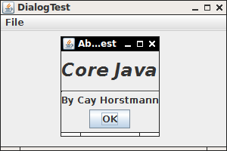
12.7.2 Creating Dialogs
Dialog extends the JDialog class:
public AboutDialog extends Jdialog // 1.
{
public AboutDialog(JFrame owner)
{
super(owner, "About DialogTest", true); //2
// add user interface elements into dialog // 3
add ( new Jlabel (
"<html><h1><i>Core Java</i></h1><hr>By Cay Horstmann</html>“ ), BorderLayout.CENTER );
. . . // add event handler
setSize(250, 150);
}
}
To display the dialog:
JDialog dialog = new AboutDialog(this);
dialog.setVisible(true);
When the user selects OK, hide the dialog:
ok.addActionListener(event -> setVisible(false));

Slide 89
Listing 12.17. dialog/DialogFrame.java
package dialog;
import javax.swing.JFrame;
import javax.swing.JMenu;
import javax.swing.JMenuBar;
import javax.swing.JMenuItem;
/* A frame with a menu whose File->About action shows a dialog. */
public class DialogFrame extends JFrame
{
private static final int DEFAULT_WIDTH = 300;
private static final int DEFAULT_HEIGHT = 200;
private AboutDialog dialog;
public DialogFrame()
{
setSize(DEFAULT_WIDTH, DEFAULT_HEIGHT);

Slide 90
Listing 12.17. dialog/DialogFrame.java
// Construct a File menu.
JMenuBar menuBar = new JMenuBar();
setJMenuBar(menuBar);
JMenu fileMenu = new JMenu("File");
menuBar.add(fileMenu);
// Add About and Exit menu items. The About item shows the About dialog.
JMenuItem aboutItem = new JMenuItem("About");
aboutItem.addActionListener (event -> {
if (dialog == null) // first time
dialog = new AboutDialog(DialogFrame.this);
dialog.setVisible(true); // pop up dialog
} );
fileMenu.add(aboutItem);
// The Exit item exits the program.
JMenuItem exitItem = new JMenuItem("Exit");
exitItem.addActionListener(event -> System.exit(0));
fileMenu.add(exitItem);
} // end of constructor
} // end of class

Slide 91
Listing 12.18. dialog/AboutDialog.java
package dialog;
import java.awt.BorderLayout;
import javax.swing.JButton;
import javax.swing.JDialog;
import javax.swing.JFrame;
import javax.swing.JLabel;
import javax.swing.JPanel;
/* A sample modal dialog that displays a message and
waits for the user to click the OK button. See next slide
*/

Slide 92
Listing 12.18. dialog/AboutDialog.java
public AboutDialog(JFrame owner)
{
super(owner, "About DialogTest", true);
// add HTML label to center
add( ew JLabel( "<html><h1><i>Core Java</i></h1><hr>By Cay Horstmann</html>"),
BorderLayout.CENTER);
// OK button closes the dialog
JButton ok = new JButton("OK");
ok.addActionListener(event -> setVisible(false));
// add OK button to southern border
JPanel panel = new JPanel();
panel.add(ok);
add(panel, BorderLayout.SOUTH);
pack();
} // end of constructor
} // end of class

Slide 93
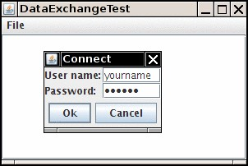
12.7.3 Data Exchange: How to move data in and out of a dialog box?
Normally, dialog box is displayed to get information from user.
Data needs to be transmitted back to the user application.
Example: user enter user name and password for online service
Make a class for the data:
public class User
{
. . .
}
Make methods for setting and getting data:
public class PasswordChooser
{
public void setUser(User u) { . . . }
public User getUser() { . . . }
. . .
}
Pop up the dialog:
public boolean showDialog()
{
JDialog dialog = new JDialog(frame, true /* modal */);
dialog.add(panel);
dialog.pack();
dialog.setVisible(true);
}

Slide 94
Listing 12.19: dataExchange/DataExchangeFrame.java
package dataExchange;
import java.awt.*;
import java.awt.event.*;
import javax.swing.*;
/* A frame with a menu whose File->Connect action
shows a password dialog. */
public class DataExchangeFrame extends JFrame
{
public static final int TEXT_ROWS = 20;
public static final int TEXT_COLUMNS = 40;
private PasswordChooser dialog = null;
private JTextArea textArea;

Slide 95
Listing 12.19: dataExchange/DataExchangeFrame.java
public DataExchangeFrame()
{
// construct a File menu
JMenuBar mbar = new JMenuBar();
setJMenuBar(mbar);
JMenu fileMenu = new JMenu("File");
mbar.add(fileMenu);
// add Connect and Exit menu items
JMenuItem connectItem = new JMenuItem("Connect");
connectItem.addActionListener( new ConnectAction() );
fileMenu.add(connectItem);
// The Exit item exits the program
JMenuItem exitItem = new JMenuItem("Exit");
exitItem.addActionListener( event -> System.exit(0) );
fileMenu.add(exitItem);

Slide 96
Listing 12.19: dataExchange/DataExchangeFrame.java
textArea = new JTextArea(TEXT_ROWS, TEXT_COLUMNS);
add(new JScrollPane(textArea), BorderLayout.CENTER);
pack();
} // end of constructor
/* The Connect action pops up the password dialog.*/
private class ConnectAction implements ActionListener
{
public void actionPerformed(ActionEvent event)
{
// if first time, construct dialog
if (dialog == null) dialog = new PasswordChooser();

Slide 97
Listing 12.19: dataExchange/DataExchangeFrame.java
// set default values
dialog.setUser(new User("yourname", null));
// pop up dialog
if ( dialog.showDialog(DataExchangeFrame.this, "Connect") )
{
// if accepted, retrieve user input
User u = dialog.getUser();
textArea.append("user name = " + u.getName() + ", password = " + (new String(u.getPassword())) + "\n");
}
} // end of actionPerformed() method
} // end of inner class
} // end of DataExchangeFrame extends

Slide 98
Listing 12.20: dataExchange/PasswordChooser.java
package dataExchange;
import java.awt.BorderLayout;
import java.awt.Component;
import java.awt.Frame;
import java.awt.GridLayout;
import javax.swing.JButton;
import javax.swing.JDialog;
import javax.swing.JLabel;
import javax.swing.JPanel;
import javax.swing.JPasswordField;
import javax.swing.JTextField;
import javax.swing.SwingUtilities;

Slide 99
Listing 12.20: dataExchange/PasswordChooser.java
/* A password chooser that is shown inside a dialog */
public class PasswordChooser extends JPanel
{
private JTextField username;
private JPasswordField password;
private JButton okButton;
private boolean ok;
private JDialog dialog;
public PasswordChooser()
{
setLayout( new BorderLayout());

Slide 100
Listing 12.20: dataExchange/PasswordChooser.java
// construct a panel with user name and password fields
JPanel panel = new JPanel();
panel.setLayout(new GridLayout(2, 2));
panel.add(new JLabel("User name:"));
panel.add(username = new JTextField(""));
panel.add(new JLabel("Password:"));
panel.add(password = new JPasswordField(""));
add(panel, BorderLayout.CENTER);
// create Ok and Cancel buttons that terminate the dialog
okButton = new JButton("Ok");
okButton.addActionListener( event ->
{
ok = true;
dialog.setVisible(false);
});

Slide 101
Listing 12.20: dataExchange/PasswordChooser.java
JButton cancelButton = new JButton("Cancel");
cancelButton.addActionListener(event -> dialog.setVisible(false) );
// add buttons to southern border
JPanel buttonPanel = new JPanel();
buttonPanel.add(okButton);
buttonPanel.add(cancelButton);
add(buttonPanel, BorderLayout.SOUTH);
} // end of constructor PasswordChooser()

Slide 102
Listing 12.20: dataExchange/PasswordChooser.java
/* Sets the dialog defaults. @param u the default user information */
public void setUser(User u)
{
username.setText(u.getName());
}
/* Gets the dialog entries. @return a User object whose state represents the dialog entries */
public User getUser()
{
return new User(username.getText(), password.getPassword());
}

Slide 103
Listing 12.20: dataExchange/PasswordChooser.java
/* Show the chooser panel in a dialog
* @param parent a component in the owner frame or null
* @param title the dialog window title */
public boolean showDialog(Component parent, String title)
{
ok = false;
// locate the owner frame
Frame owner = null;
if (parent instanceof Frame)
owner = (Frame) parent;
else
owner = (Frame) SwingUtilities.getAncestorOfClass(Frame.class, parent);

Slide 104
Listing 12.20: dataExchange/PasswordChooser.java
// if first time, or if owner has changed, make new dialog
if (dialog == null || dialog.getOwner() != owner)
{
dialog = new JDialog(owner, true);
dialog.add(this);
dialog.getRootPane().setDefaultButton(okButton);
dialog.pack();
}
// set title and show dialog
dialog.setTitle(title);
dialog.setVisible(true);
return ok;
} // end of showDialog() method
} // end of PasswordChooser class

Slide 105
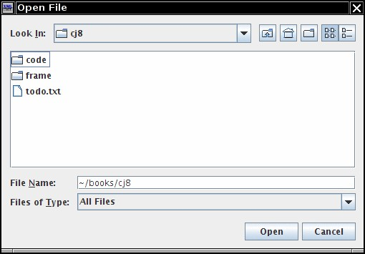
12.7.4. File Dialog Boxes
Often we want to ask a user for a file name.
1) Make a JFileChooser object and set the directory:
JFileChooser chooser = new JFileChooser(); // it is always modal
chooser.setCurrentDirectory(new File(".")); // CURRENT WORKING DIRECTORY
If you want to restrict the files, set the file filter:
chooser.setFileFilter(new FileNameExtensionFilter( "Image files", "gif", "jpg") ); // DISPLAY ON THIS FILES
TO Pop up the dialog BOX :
int result = chooser.showOpenDialog(parent);
int result = chooser.showSaveDialog(parent);
If the result is JFileChooser.APPROVE_OPTION, get the file:
File filename = chooser.getSelectedFile();

Slide 106
Listing 12.21.fileChooser/ImageViewerFrame.java
package fileChooser;
import java.io.*;
import javax.swing.*;
import javax.swing.filechooser.*;
import javax.swing.filechooser.FileFilter;
/* A frame that has a menu for loading an
image and a display area for the loaded image. */
public class ImageViewerFrame extends JFrame
{
private static final int DEFAULT_WIDTH = 300;
private static final int DEFAULT_HEIGHT = 400;
private JLabel label;
private JFileChooser chooser;

Slide 107
Listing 12.21.fileChooser/ImageViewerFrame.java
public ImageViewerFrame()
{
setSize(DEFAULT_WIDTH, DEFAULT_HEIGHT);
// set up menu bar
JMenuBar menuBar = new JMenuBar();
setJMenuBar(menuBar);
JMenu menu = new JMenu("File");
menuBar.add(menu);
JMenuItem openItem = new JMenuItem("Open");
menu.add(openItem);
openItem.addActionListener( event ->
{
chooser.setCurrentDirectory(new File("."));
// continue next slide

Slide 108
Listing 12.21.fileChooser/ImageViewerFrame.java
// show file chooser dialog
int result = chooser.showOpenDialog(ImageViewerFrame.this);
// if image file accepted, set it as icon of the label
if (result == JFileChooser.APPROVE_OPTION)
{
String name = chooser.getSelectedFile().getPath();
label.setIcon(new ImageIcon(name));
pack();
}
}); // end of local anonymous inner class
JMenuItem exitItem = new JMenuItem("Exit");
menu.add(exitItem);
exitItem.addActionListener( event -> System.exit(0) ); // local anonymous inner class

Slide 109
Listing 12.21.fileChooser/ImageViewerFrame.java
// use a label to display the images
label = new JLabel();
add(label);
// set up file chooser
chooser = new JFileChooser();
// accept all image files ending with .jpg, .jpeg, .gif
FileFilter filter = new FileNameExtensionFilter("Image files", "jpg", "jpeg", "gif");
chooser.setFileFilter(filter);
chooser.setAccessory(new ImagePreviewer(chooser));
chooser.setFileView(new FileIconView(filter, new ImageIcon("palette.gif")));
} // end of constructor ImageViewerFram();
} // end of class: ImageViewerFram

Slide 110
Listing 12.22.fileChooser/ImagePreviewer.java
package fileChooser;
import java.awt.*;
import java.io.*;
import javax.swing.*;
/* A file chooser accessory that previews images. */
public class ImagePreviewer extends JLabel
{
/* Constructs an ImagePreviewer.
* @param chooser the file chooser whose property
changes trigger an image change
in this previewer */
public ImagePreviewer(JFileChooser chooser)
{
setPreferredSize(new Dimension(100, 100));
setBorder(BorderFactory.createEtchedBorder());

Slide 111
Listing 12.22.fileChooser/ImagePreviewer.java
chooser.addPropertyChangeListener( event ->
{
if (event.getPropertyName() == JFileChooser.SELECTED_FILE_CHANGED_PROPERTY)
{
// the user has selected a new file
File f = (File) event.getNewValue();
if (f == null)
{
setIcon(null);
return;
}
// read the image into an icon
ImageIcon icon = new ImageIcon(f.getPath());
// if the icon is too large to fit, scale it
if (icon.getIconWidth() > getWidth())
icon = new ImageIcon(icon.getImage().getScaledInstance(
getWidth(), -1, Image.SCALE_DEFAULT));
setIcon(icon);
}
} ); // end of local –Anonymous inner class
} // end of constructor : ImagePreviewer()
} // end of class: ImagePreviewer

Slide 112
Listing 12.22: fileChooser/FileIconView.java
package fileChooser;
import java.io.*;
import javax.swing.*;
import javax.swing.filechooser.*;
import javax.swing.filechooser.FileFilter;
/* A file view that displays an icon for
all files that match a file filter. */
public class FileIconView extends FileView
{
private FileFilter filter;
private Icon icon;

Slide 113
Listing 12.22: fileChooser/FileIconView.java
/* Constructs a FileIconView.
* @param aFilter a file filter--all files that this filter accepts will be shown with the icon.
* @param anIcon--the icon shown with all accepted files. */
public FileIconView(FileFilter aFilter, Icon anIcon)
{
filter = aFilter;
icon = anIcon;
}
public Icon getIcon(File f)
{
if (!f.isDirectory() && filter.accept(f)) return icon;
else return null;
}
} // end of class: FileIconView

