Slide 1
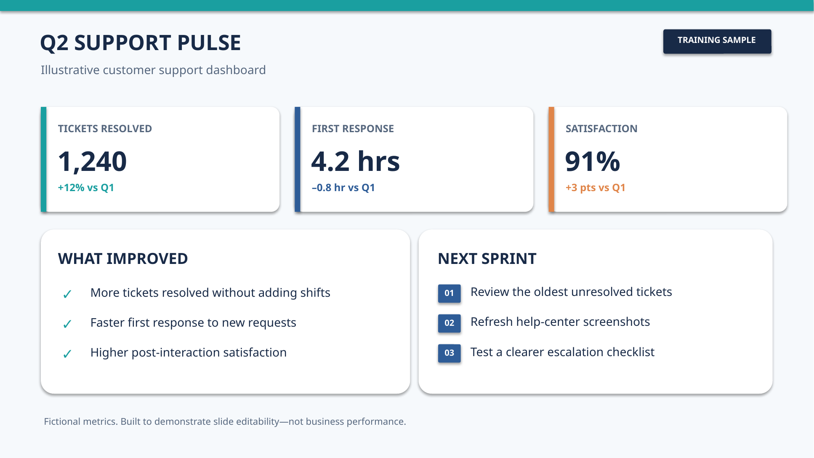

Slide 2
About this flattened PowerPoint example
Purpose
Original teaching demonstration: the file is an example, not a real ChatGPT failure.
Data
All Q2 support metrics are fabricated for this tutorial.
Editability
Slide 1 of the BEFORE deck is one embedded image. Slide 1 of the AFTER deck uses native PowerPoint text boxes and shapes.
Verification
The slide files and generated renderings were checked programmatically and rendered with LibreOffice. Microsoft desktop PowerPoint was not tested.
AI Document Makeover • Educational example

