Slide 1
Weather Forecasting Based on LSTM/ARIMA
Weather
Group07 MinsiLu, Cheng Peng, Dejin Kong, Hanli Wang, Qi Tian
25/8/2022
Machine Learning

Slide 2
01
Introduction
Topic
Data processing
CONTENTS
02
Model
ARIMA
LSTM
Comparison

Slide 3
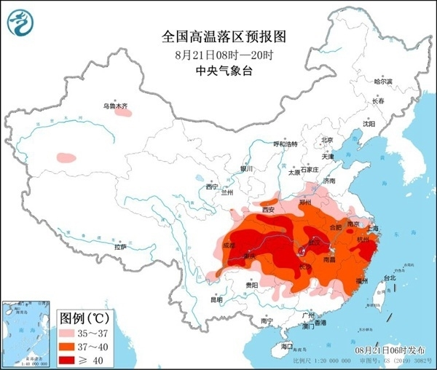
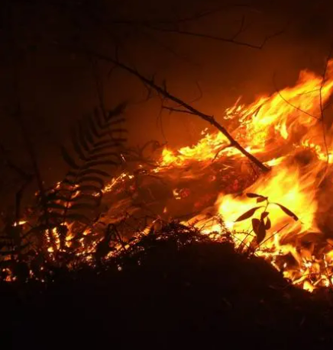
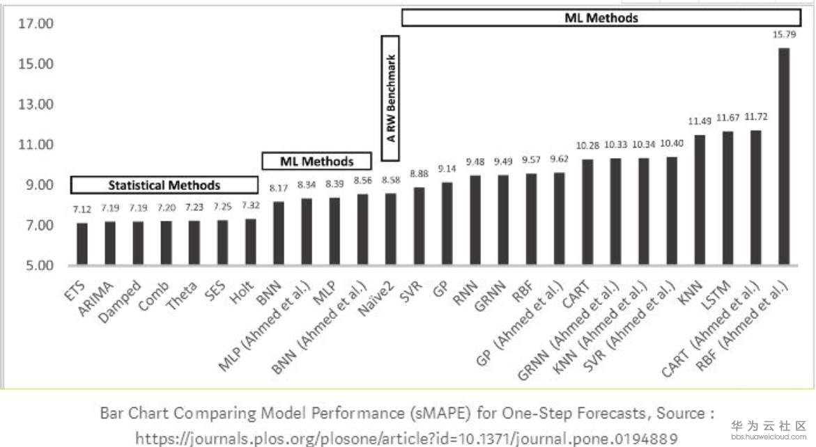
Topic
Global Warming
This year, the highest temperature in some southern cities even exceeded 40 degrees.
ARIMA
Autoregressive integrated moving average model, Applicable to non-stationary time series, its difference process can effectively convert non-stationary data to stationary data
LSTM
Long short-term memory network,
Suitable for processing and forecasting events with long intervals in time series

Slide 4
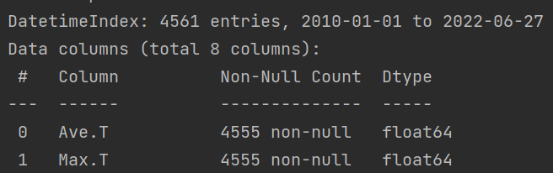
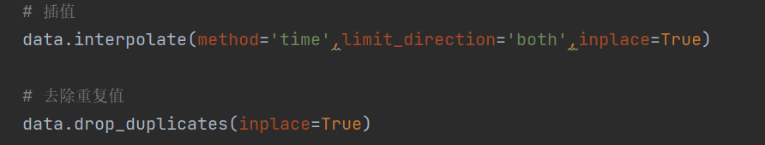
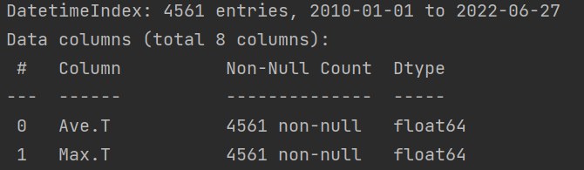

Data processing
Data missing：6 entries
Data source: www.meteomanz.com
standardization：
Make different feature variables have the same scale. Accelerated convergence when using gradient descent.
$$x^{∗}=\frac{x−μ}{σ}$$
The processed data is a standard normal distribution.
Notes:
能提高梯度下降法求解最优解，避免一些不必要的数值问题
输入变量的数量级未致于会引起数值问题吧，但其实要引起也并不是那么困难。因为tansig（tanh）的非线性区间大约在[-1.7，1.7]。意味着要使神经元有效，tansig( w1x1 + w2x2 +b) 里的 w1x1 +w2x2 +b 数量级应该在 1 （1.7所在的数量级）左右。这时输入较大，就意味着权值必须较小，一个较大，一个较小，两者相乘，就引起数值问题了

Slide 5

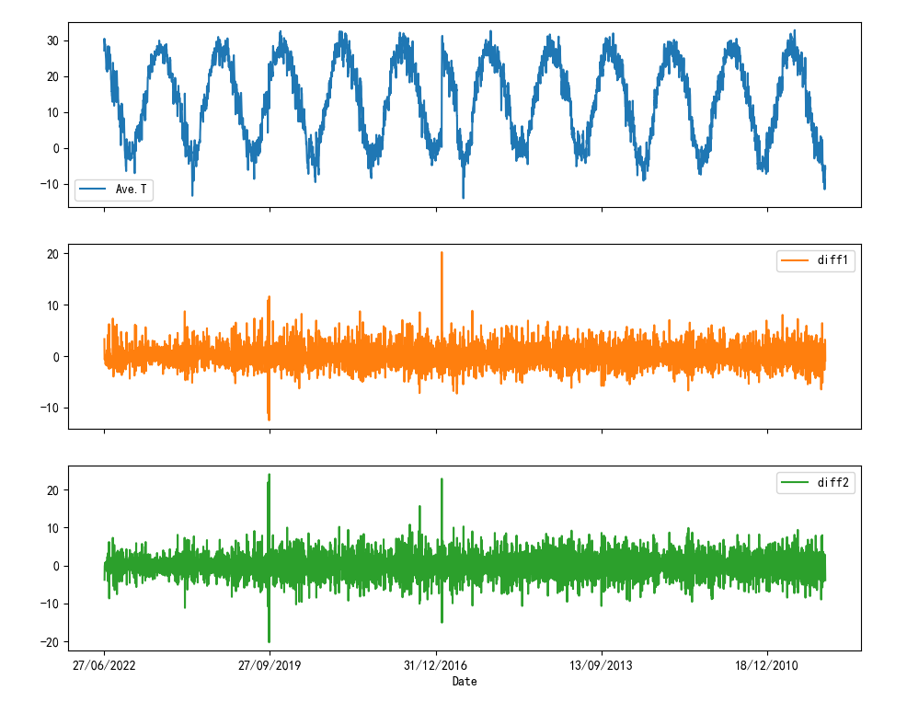
ARIMA
Difference: Find the difference between the time series at time t and t-1 to form a new series

Slide 6
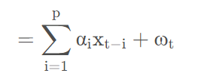

ARIMA
Autoregressive Model (AR)：
Describe the relationship between the current value and the historical value, and use the historical time data of the variable itself to predict itself.
Notes:
自相关系数

Slide 7
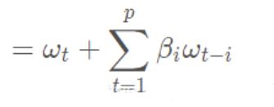
ARIMA
Moving Average model（MA）：
Describe the relationship between the current value and the error, and use the linear combination of the error to predict itself.
The starting point of MA is to observe the oscillation of the residuals by combining the residual terms, each value of yt can be thought of as a weighted moving average of the past few forecast errors
Notes:
自相关系数

Slide 8
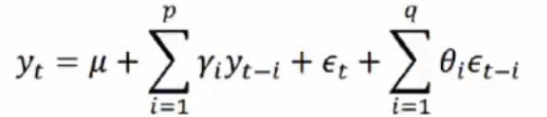
ARIMA
Autoregressive
Integrated
Moving Average
Model
The model established by transforming the non-stationary time series into a stationary time series and then regressing the dependent variable only on its lag value and the present and subsequent values ​​of the random error term.
Key: determine the 3 parameters p, d, q

Slide 9
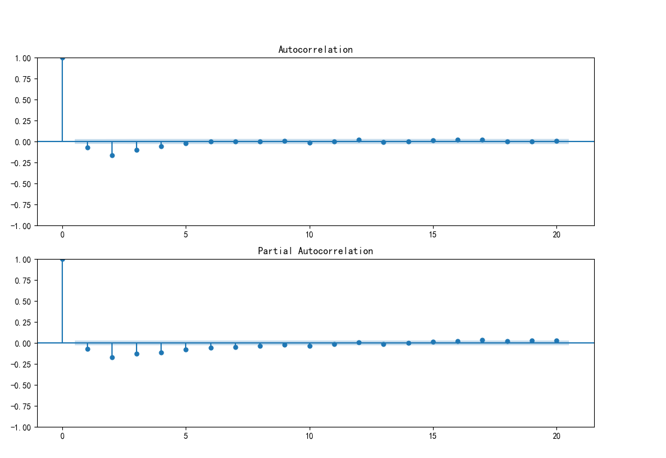
ARIMA
ACF（autocorrelation function）
PACF（partial autocorrelation function）
ACF also incorporates the effects of other variables
PACF is a strict association between two variables
Notes:
自相关系数

Slide 10
ARIMA
p looks at the PACF diagram, q looks at the ACF diagram (AIC, BIC test)
Model Checking: Residuals Test
Are the residuals of the ARIMA model normally distributed with a mean of 0 and a constant variance?
QQ plot: linear or normal distribution
Notes:
自相关系数

Slide 11
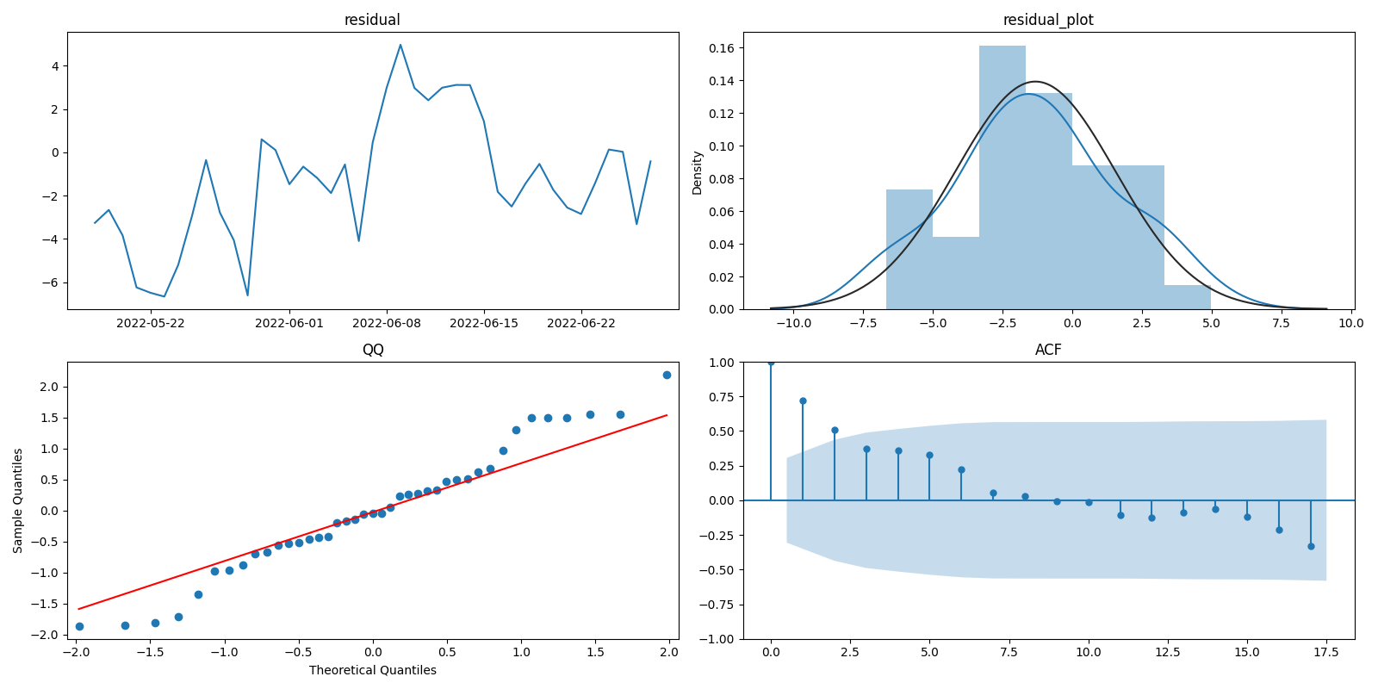

Slide 12
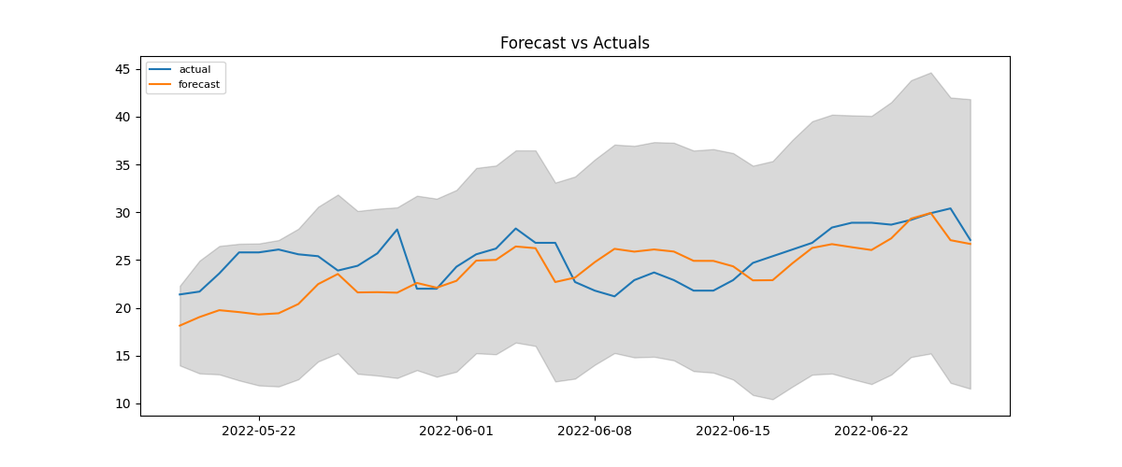
Results

Slide 13
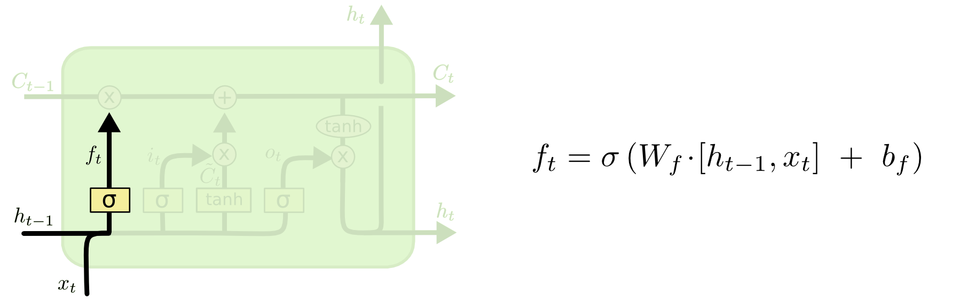
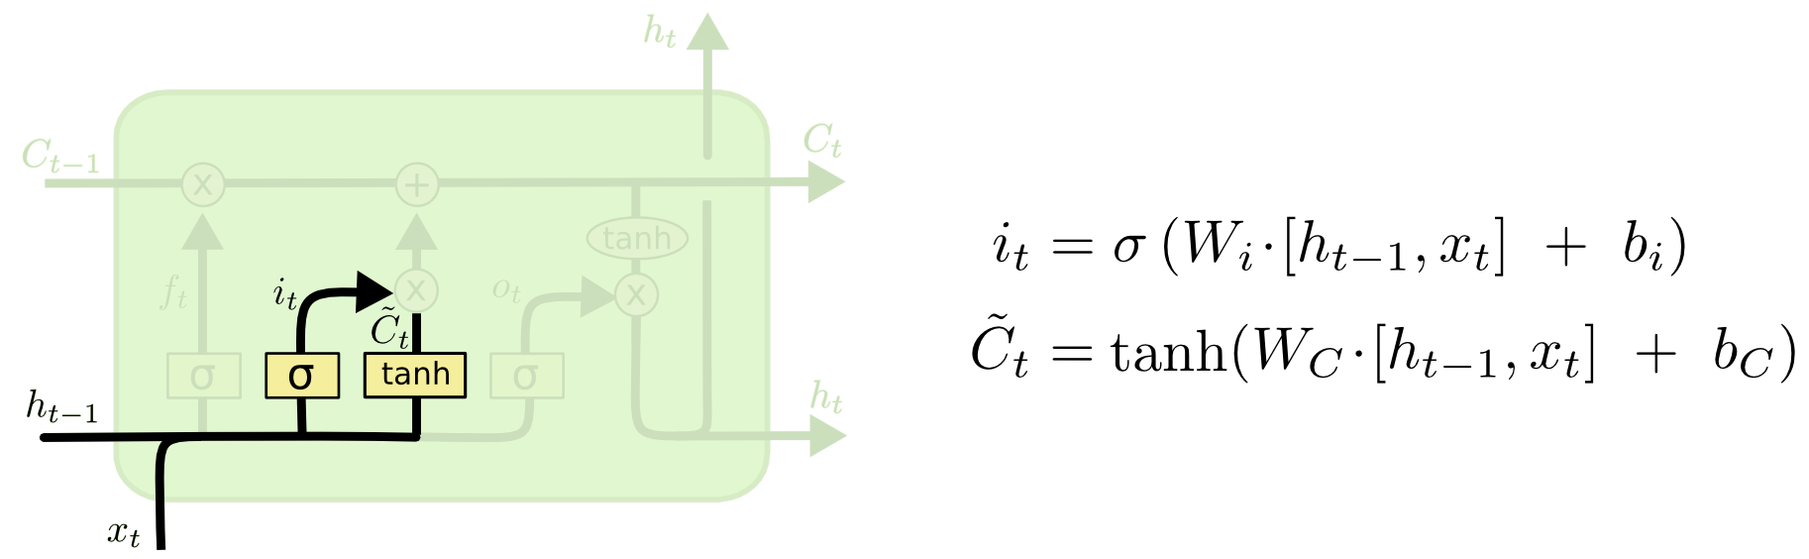
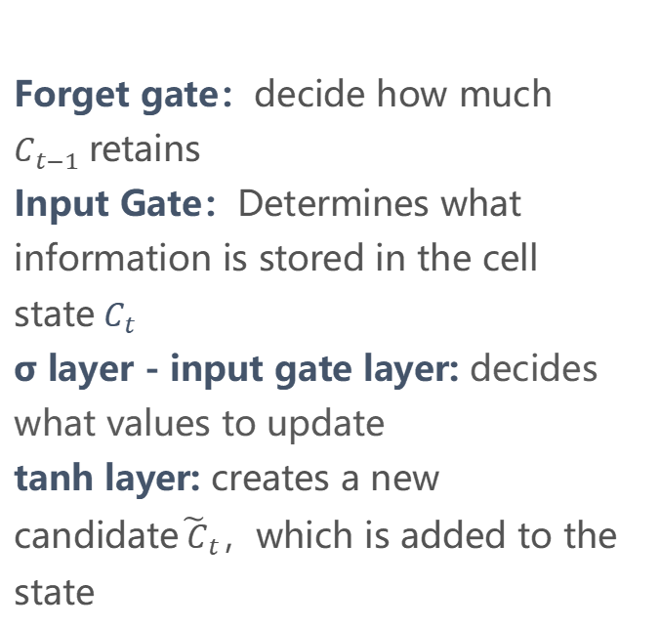
LSTM
Long Short-Term Memory
Forget gate：
Forget gate：decide how much $C_{t−1}$retains
Input Gate：Determines what information is stored in the cell state${ C}_{t}$
σ layer - input gate layer: decides what values ​​to update
tanh layer: creates a new candidate${\tilde{ C}}_{t}$，which is added to the state
Input Gate：
Notes:
输入： ℎ_t−1 和 x_t而这个决定通过一个称为遗忘门层完成。该门会读取 ℎ_t−1 和 x_t，经过σ函数处理，输出一个在 0 到 1 之间的数值f_t给每个在细胞状态 C_t−1中的数字。 0 表示信息“完全舍弃” ，而1 表示“完全保留”

Slide 14
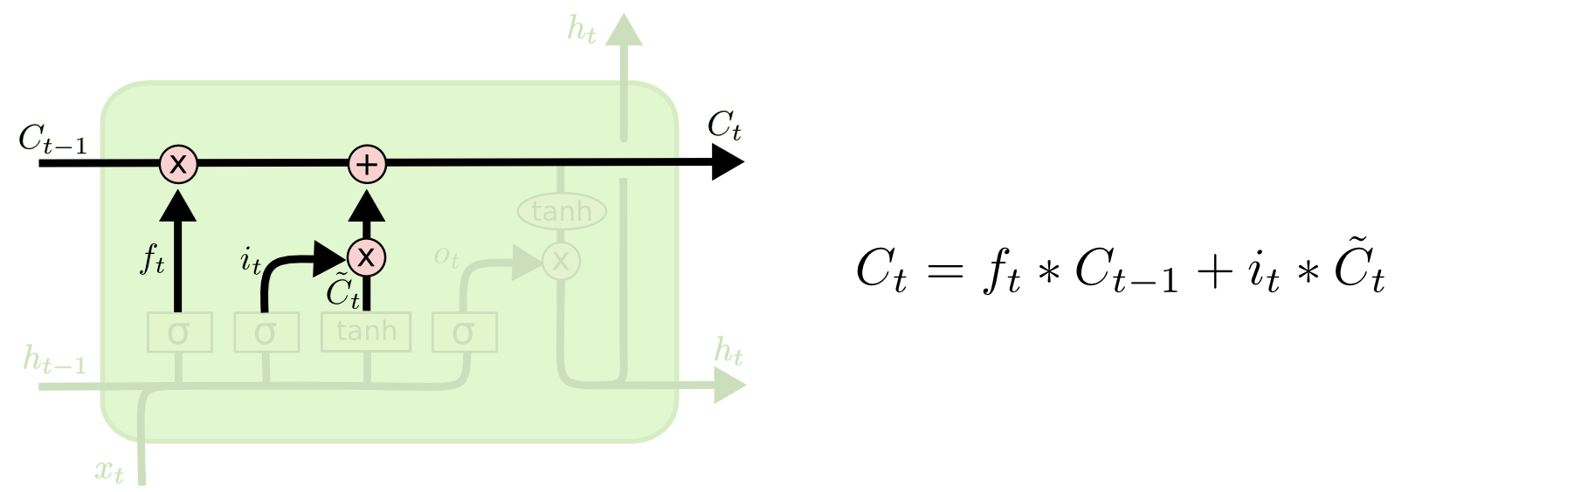
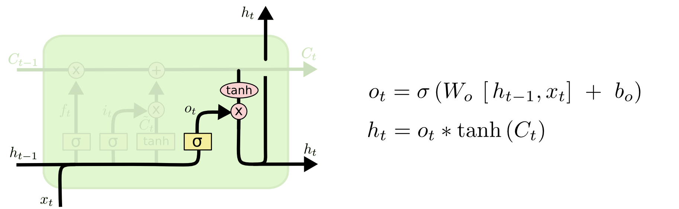
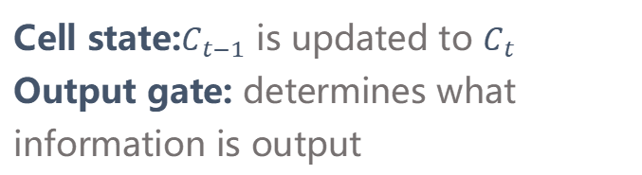
LSTM
Long Short-Term Memory
Status update：
Cell state:$C_{t−1}$ is updated to $C_{t}$
Output gate: determines what information is output
Output gate：
Notes:
输入： ℎ_t−1 和 x_t而这个决定通过一个称为遗忘门层完成。该门会读取 ℎ_t−1 和 x_t，经过σ函数处理，输出一个在 0 到 1 之间的数值f_t给每个在细胞状态 C_t−1中的数字。 0 表示信息“完全舍弃” ，而1 表示“完全保留”

Slide 15
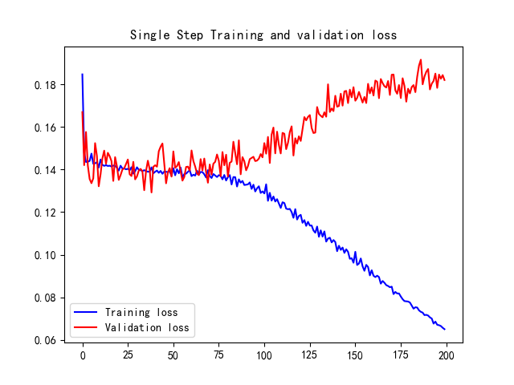
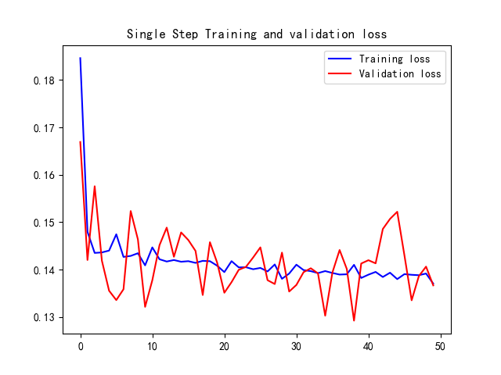
LSTM_loss
epochs = 200
epochs = 50

Slide 16
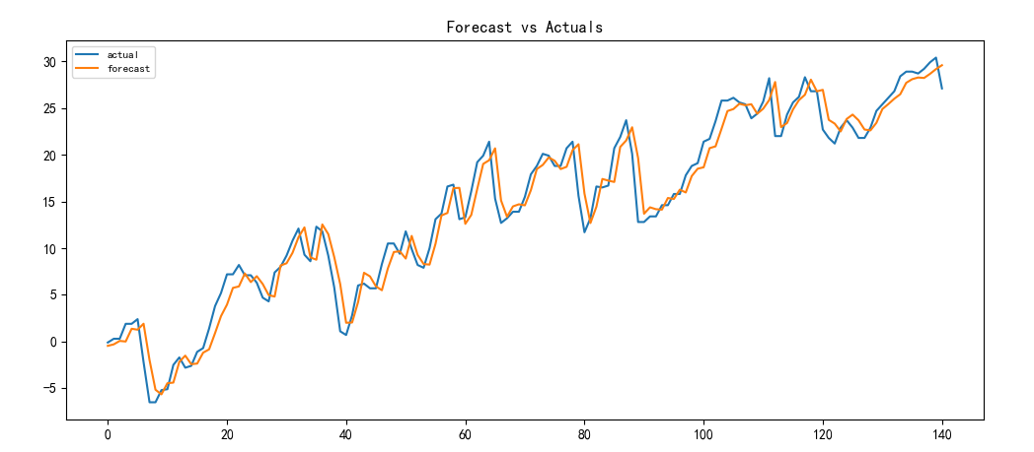
LSTM_results

Slide 17
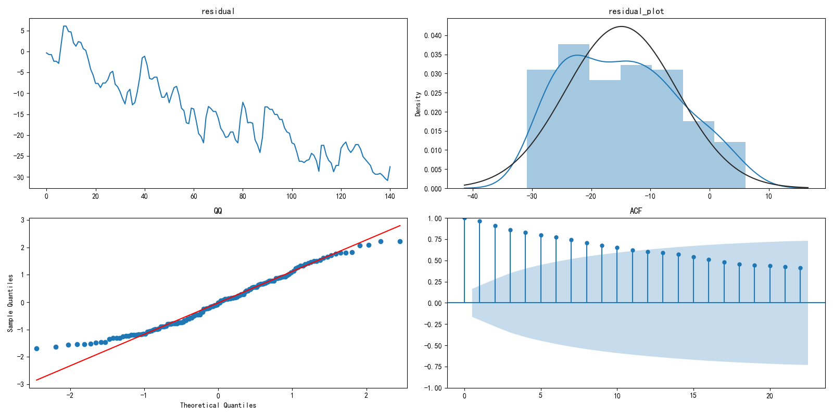
LSTM_results

Slide 18
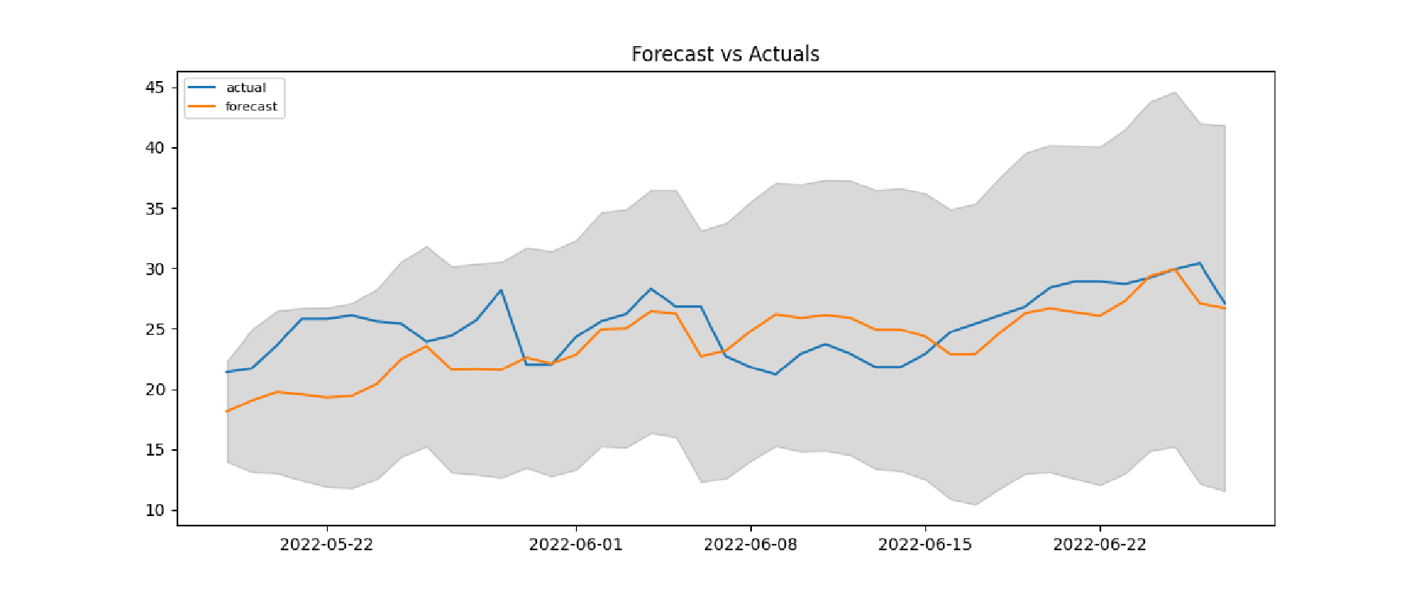
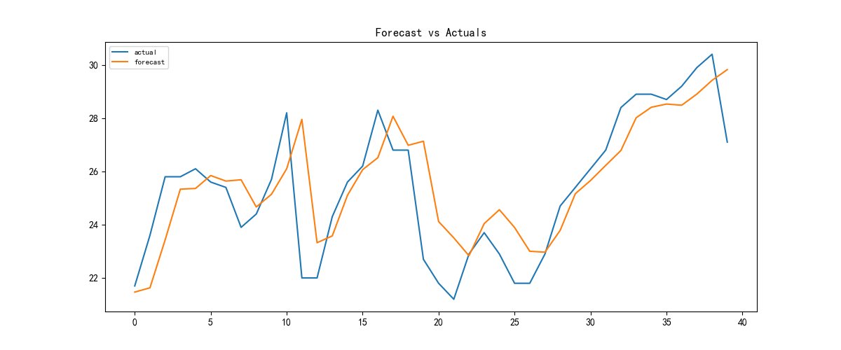
Comparison
ARIMA
LSTM
{'MSE': 9.969345864182324,
'RMSE': 3.157427095624272,
'MAE': 2.559141936706577,
'MAPE': 0.10267555639458789}
{'MSE': 2.881874188213326,
'RMSE': 1.697608373039355,
'MAE': 1.2015739631652835, 'MAPE': 0.04937994677474915}

