Slide 1
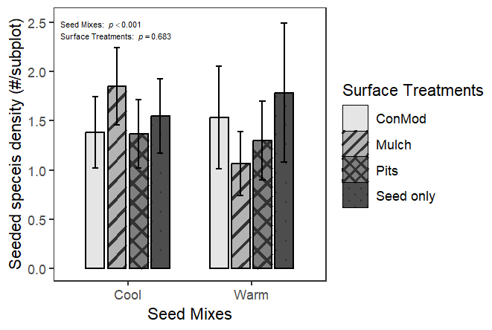
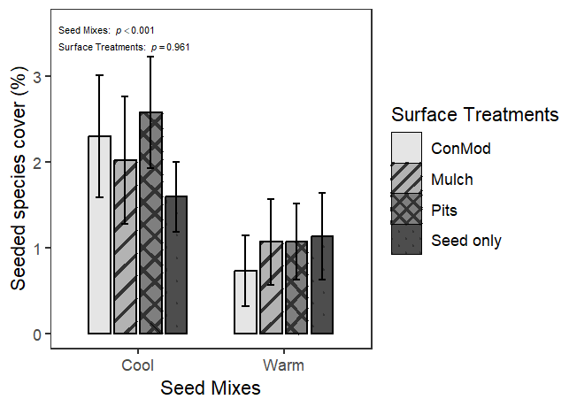
(a) Spring season 2020
(b) Spring season 2020
Seed Mix: p < 0.001 Surface: p = 0.683
Seed Mix: p < 0.001 Surface: p = 0.961

Slide 2
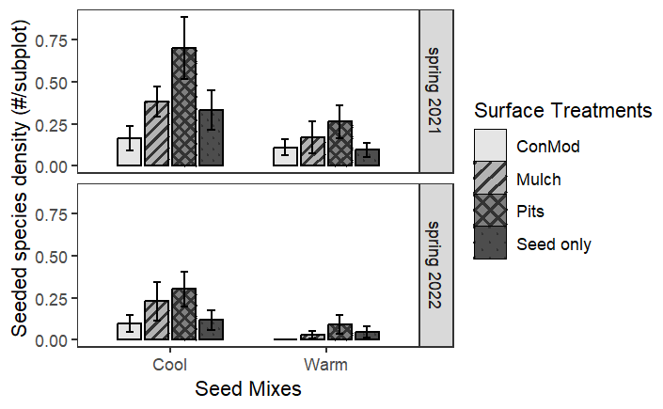
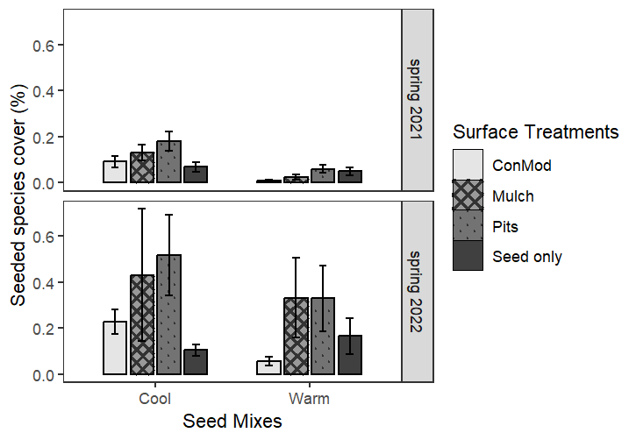
(c) Post-drought spring seasons
(d) Post-drought spring seasons
Seed Mix: p < 0.001 Surface: p = 0.001 Year: p < 0.001
Seed Mix: p < 0.001 Surface: p = 0.009 Year: p < 0.001

Slide 3
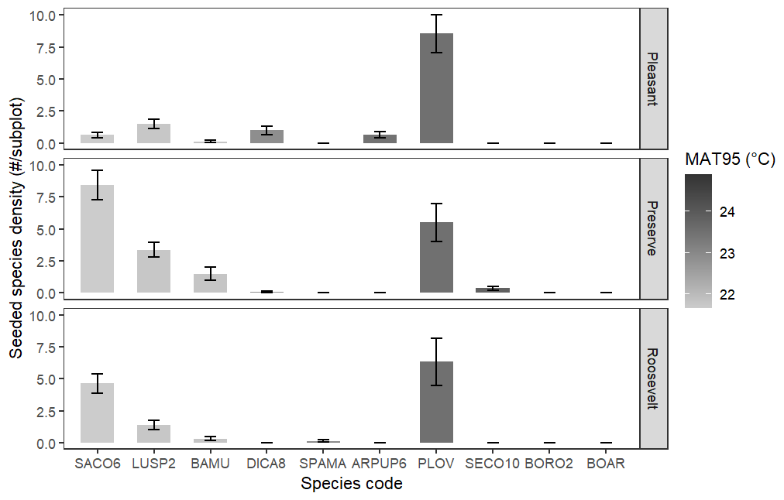
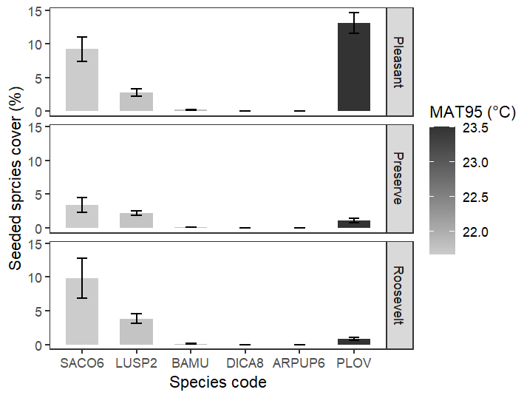
(a) Spring season 2020
(b) Spring season 2020
Site: p < 0.001 MAT95: p = 0.011 Site * MAT95: p < 0.001
Site: p = 0.026 MAT95: p < 0.001

Slide 4
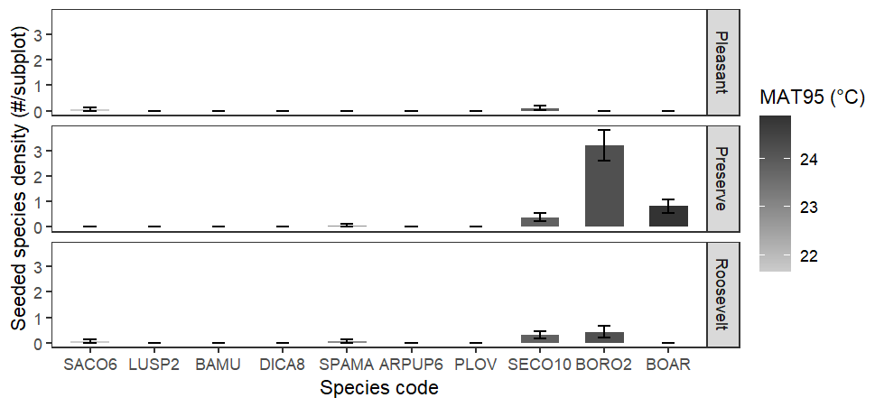
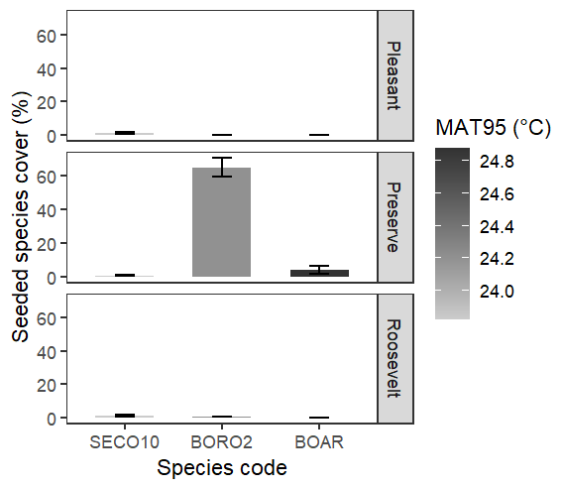
(c) Post-drought fall season 2021
(d) Post-drought fall season 2021
Site: p = 0.019 MAT95: p = 0.896 Site * MAT95: p = 0.011
Site: p < 0.001 MAT95: p = 0.006

Slide 5
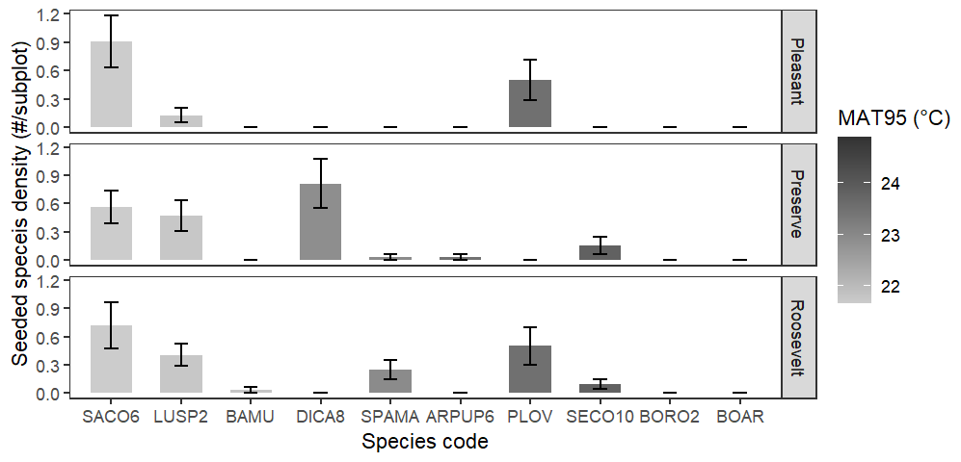
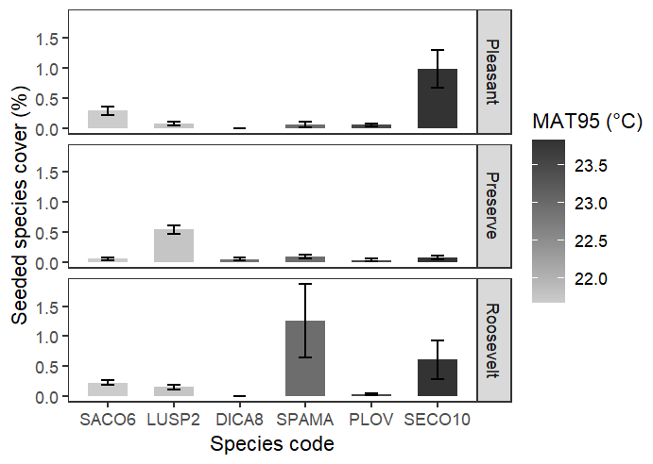
(e) Post-drought spring seasons
(f) Post-drought spring seasons
Site: p = 0.771 MAT95: p < 0.001 Site * MAT95: p = 0.737
Site: p = 0.016 MAT95: p = 0.575 Site * MAT95: p = 0.015

Slide 6
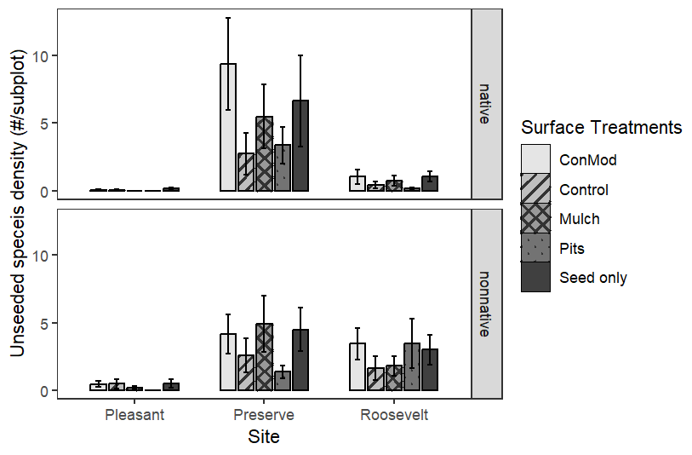
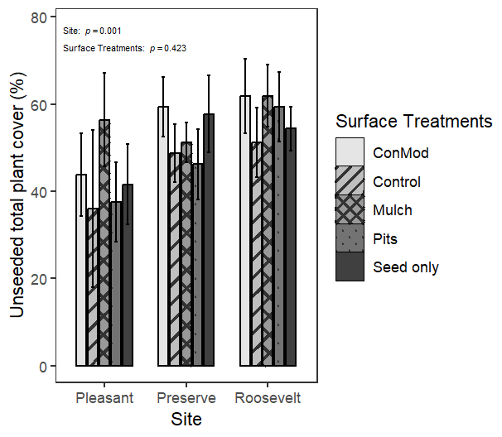
(a) Spring season 2020
(b) Spring season 2020
Site: p < 0.001 Surface: p = 0.025
Site: p = 0.001 Surface: p = 0.423
Site: p < 0.001 Surface: p = 0.864 Site * Surface: p = 0.038

Slide 7
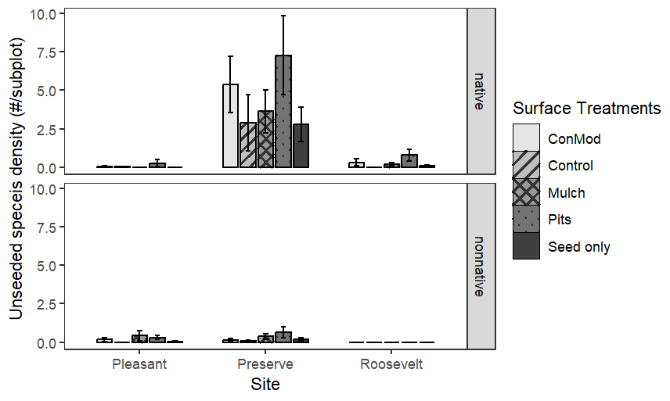
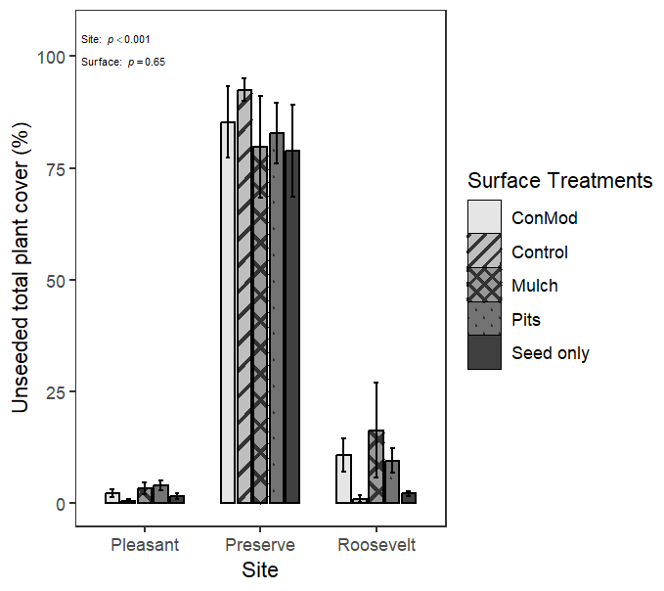
(c) Post-drought fall season 2021
(d) Post-drought fall season 2021
Site: p < 0.001 Surface: p = 0.098
Site: p < 0.001 Surface: p = 0.650
Site: p = 0.305 Surface: p = 0.024

Slide 8
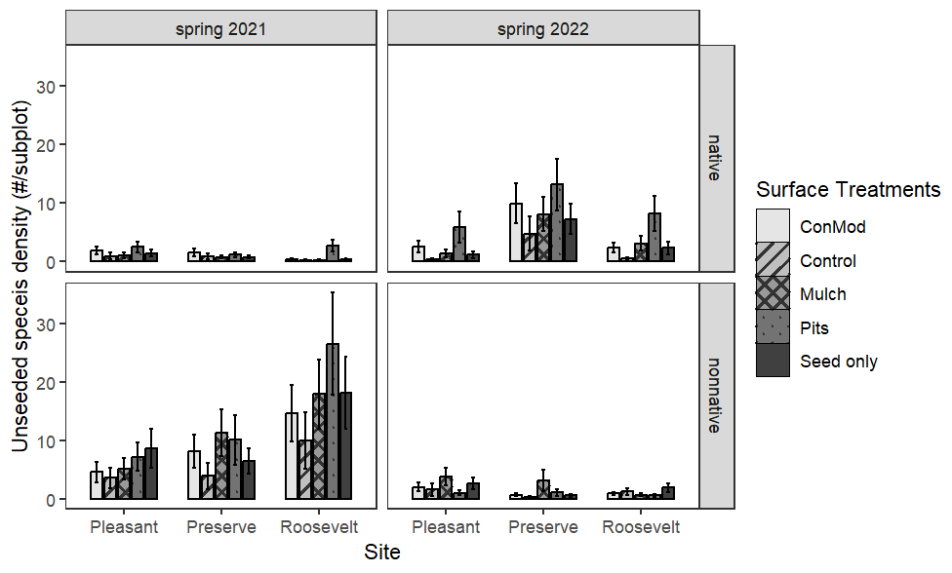
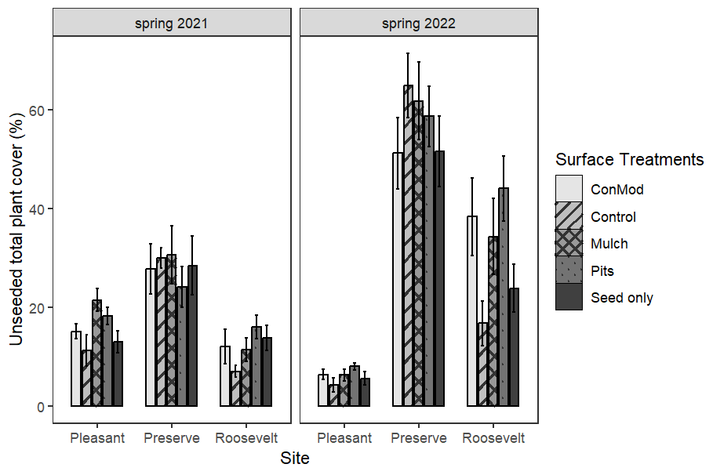
(e) Post-drought spring seasons
(f) Post-drought spring seasons
Site: p < 0.001 Surface: p < 0.001 Year: p < 0.001 Site * Surface: p = 0.007
Site: p < 0.001 Surface: p = 0.030 Year: p < 0.001 Site * Year: p < 0.001
Site: p < 0.001 Surface: p = 0.049 Year: p < 0.001

