Slide 1
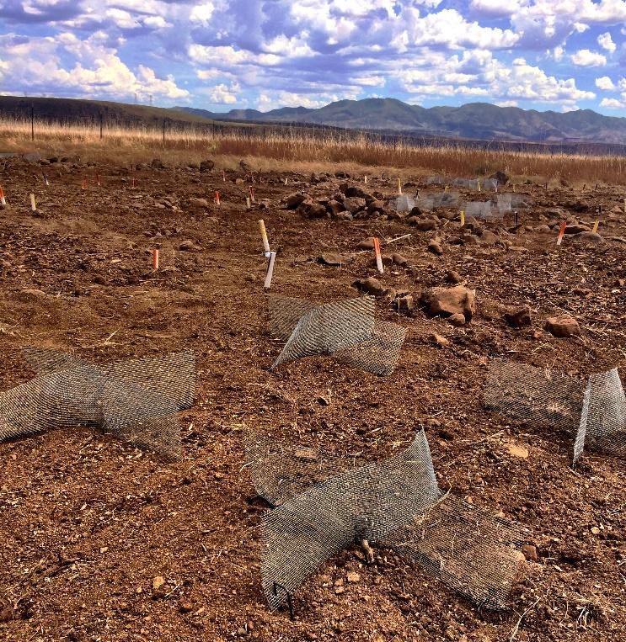
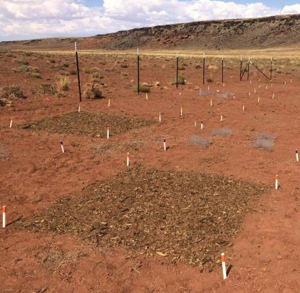
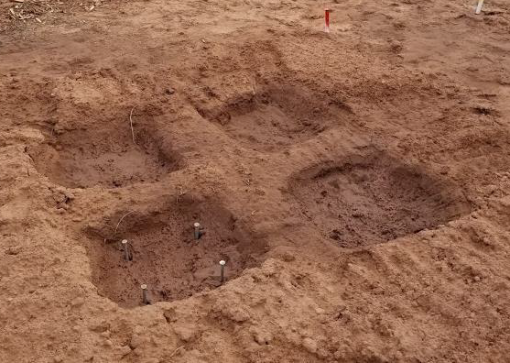
(a)
(b)
(c)
Notes:
Figure 2. RestoreNet surface treatments, including (a) seeding with Connectivity Modifiers (ConMods), (b) seeding with mulch, and (c) pitting treatment.

Slide 2
Surface Treatments and Seed Treatments Effects

Slide 3
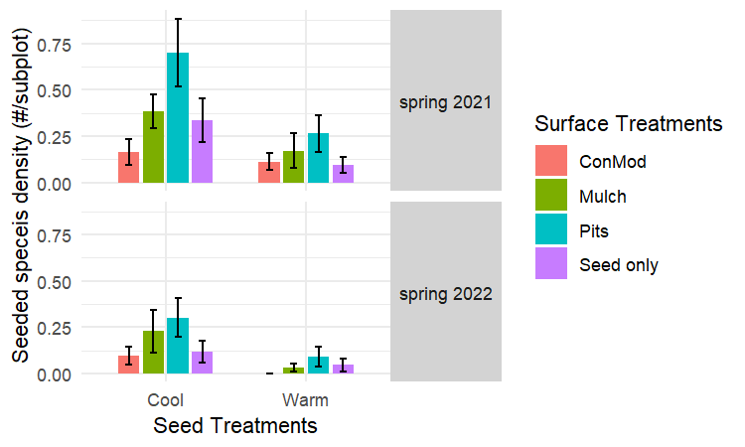
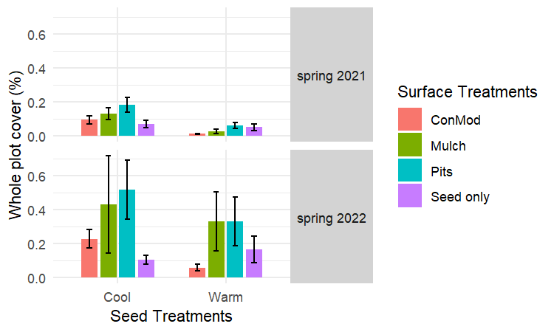
(a)
(b)
Notes:
Figure 3. Mean ± SE of subplot density (a) and whole plot cover (b) of seeded species under different seasons (spring 2021 and spring 2022), seed (cool seed mix and warm seed mix), and surface treatments (ConMod, Mulch, Pits, and Seed only) in the post-drought spring seasons (spring 2021 and spring 2022).
Size: 500 x 300

Slide 4
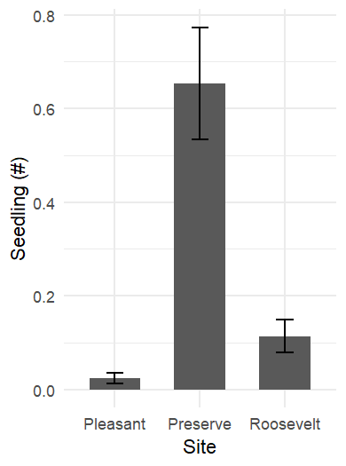
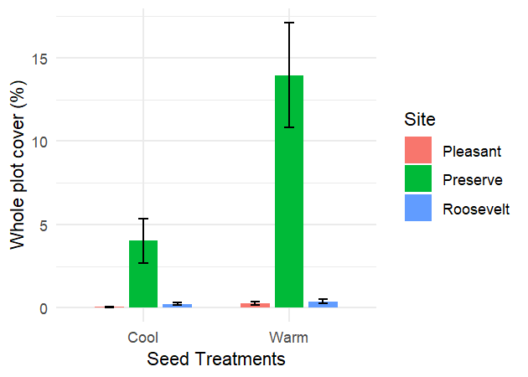
a
b
Notes:
Figure 2. Mean ± SE of subplot density (a) and whole plot cover (b) of seeded species under different sites (Pleasant, Preserve, and Roosevelt) and seed treatments (cool seed mix and warm seed mix) in the post-drought fall season (fall 2021).
Size: 420 x 300, 260 x 350
(whether add in color to a and b)

Slide 5
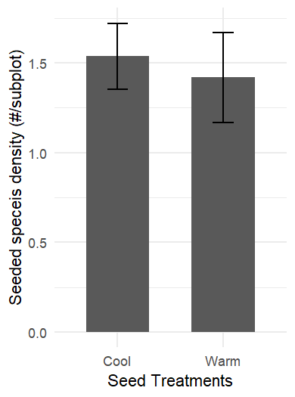
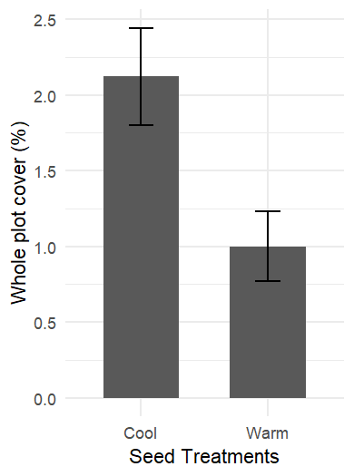
(a)
(b)
Notes:
Figure 4. Mean ± SE of subplot density (a) and whole plot cover (b) of seeded species under different seed treatments (cool seed mix and warm seed mix) in the first season (spring 2020).
Size: 260 x 350

Slide 6
Species-Specific Analysis

Slide 7
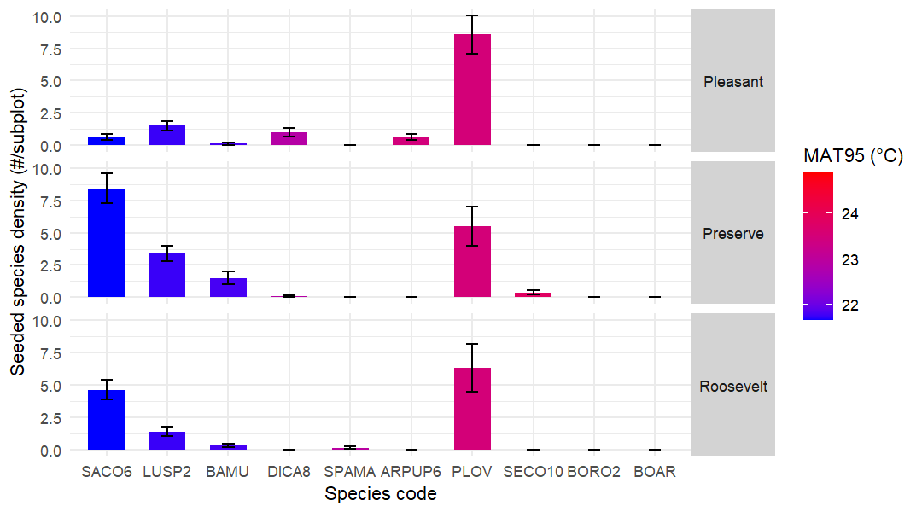
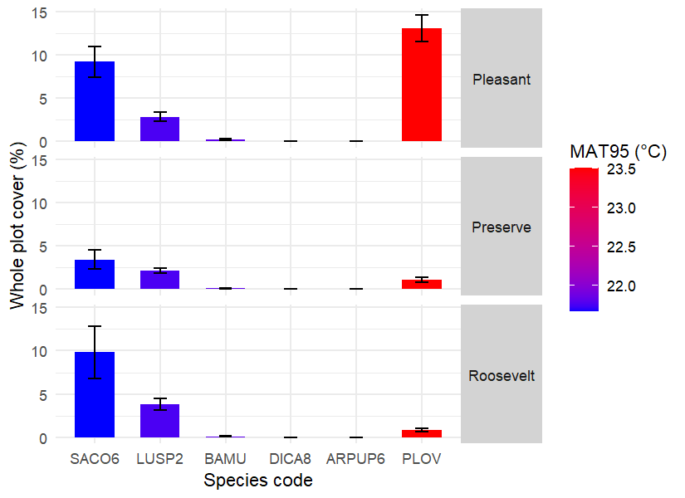
(a)
(b)
Notes:
Figure 4. Mean ± SE of subplot density (a) and whole plot cover (b) of seeded species in different sites (Pleasant, Preserve, and Roosevelt) in the first spring season (spring 2020) colored by intensity of mean annual temperature (MAT95) of habitat based on 95% of that species' global distribution.
Size: 720 x 400，550 x 400

Slide 8
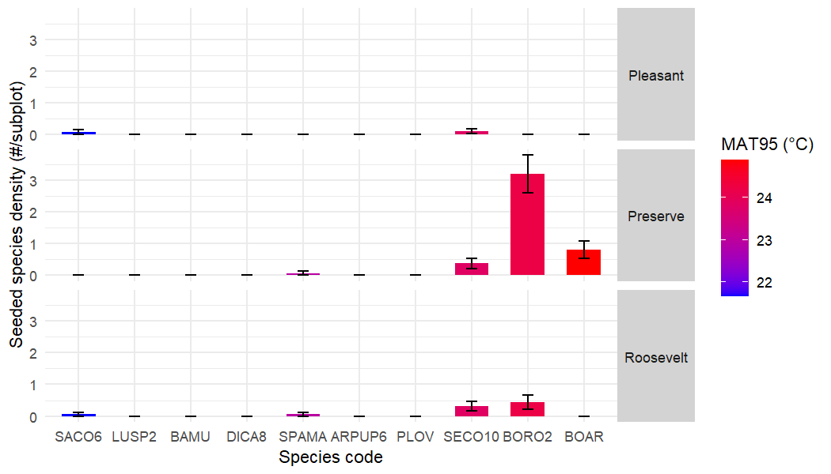
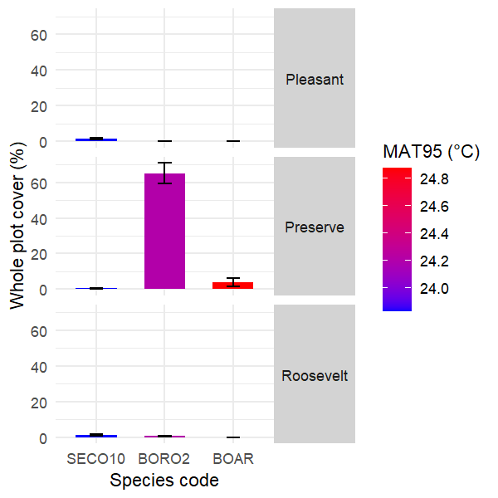
(a)
(b)
Notes:
Figure 5. Mean ± SE of subplot density (a) and whole plot cover (b) of seeded species in different sites (Pleasant, Preserve, and Roosevelt) in the post-drought fall season (fall 2021) indicated by the mean annual temperature of habitat based on 95% of that species' global distribution (MAT95).
Size: 700 x 400, 400 x 400

Slide 9
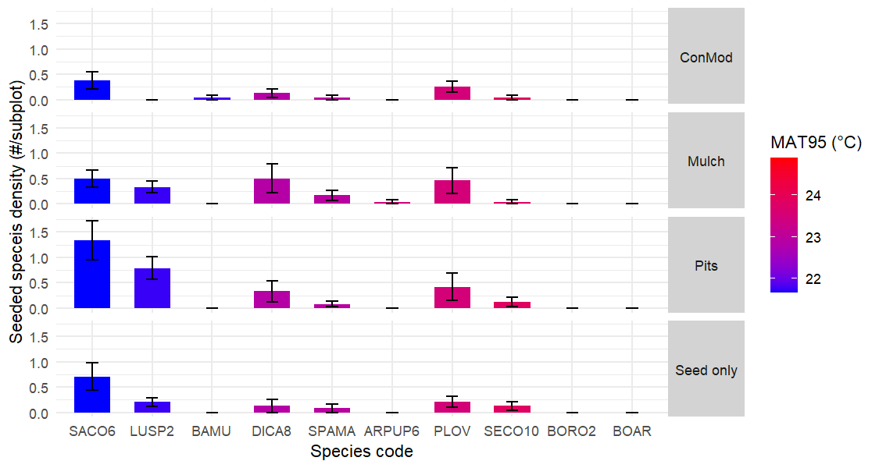
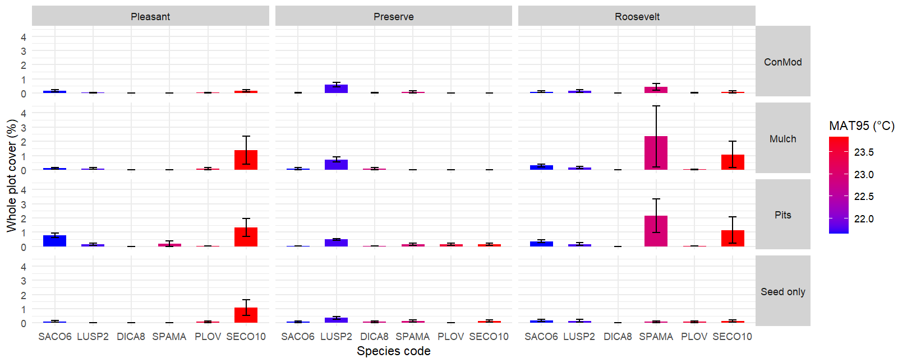
(a)
(b)
Notes:
Figure 6. Mean ± SE of plant species establishment along the gradient of mean annual temperature of habitat based on 95% of that species' global distribution (MAT95) and the surface treatment shown by (a) seedling density in subplots and (b) whole plot cover in the post-drought spring seasons (spring 2021 and spring 2022).
Size: 750 x 400, 500 x 400

Slide 10
Impact on Unseeded Plant Community

Slide 11
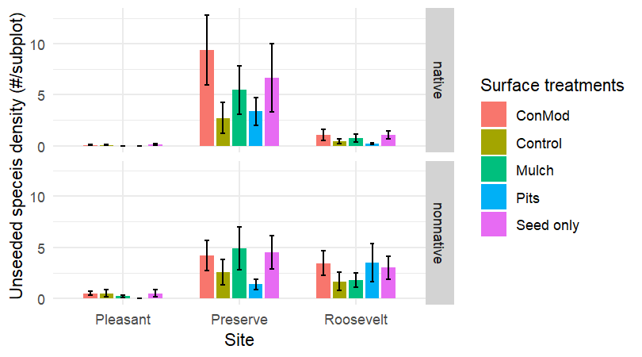
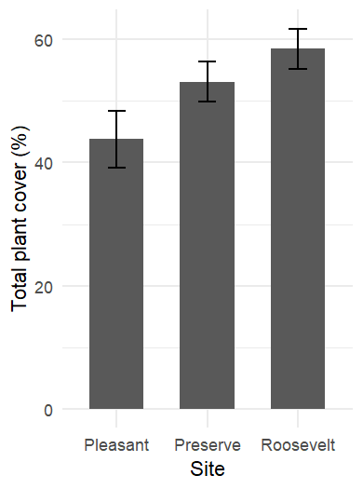
(a)
(b)
Notes:
Figure 7. Mean ± SE of subplot density by nativity (a) and whole plot total plant cover (b) of unseeded species at different sites (Pleasant, Preserve, and Roosevelt) under different surface treatments (ConMod, Mulch, Pits, and Seed only) in the first spring season (spring 2020).
Size: 540 x 300，260 x 350

Slide 12
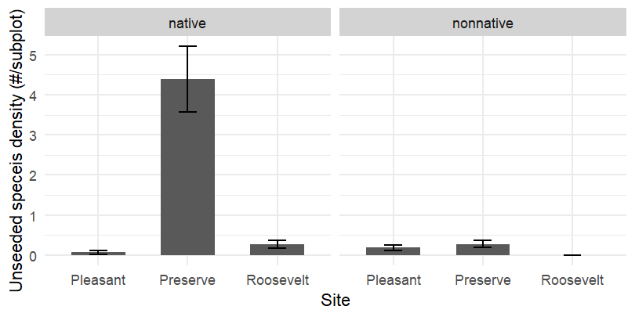
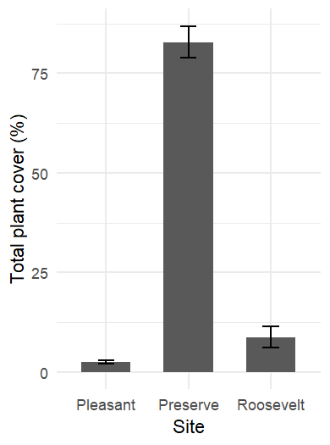
(a)
(b)
Notes:
Figure 8. Mean ± SE of subplot density by nativity (a) and whole plot total plant cover (b) of unseeded species at different sites (Pleasant, Preserve, and Roosevelt) under different surface treatments (ConMod, Mulch, Pits, and Seed only) in the post-drought fall season (fall 2021).
Size: 540 x 270，260 x 350

Slide 13
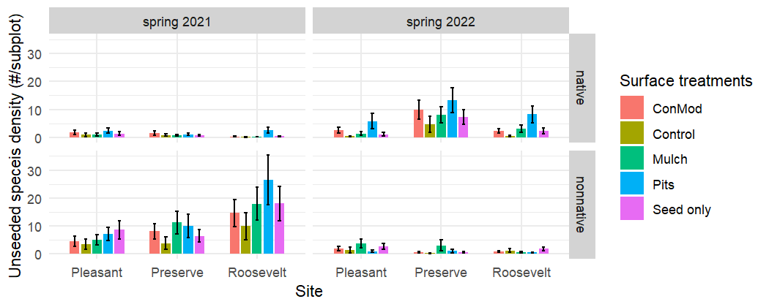
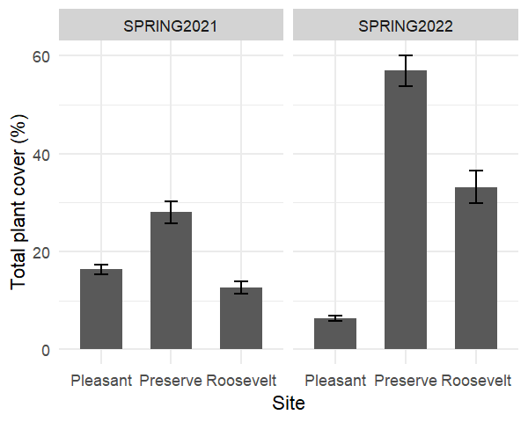
(a)
(b)
Notes:
Figure 9. Mean ± SE of subplot density by nativity (a) and whole plot total plant cover (b) of unseeded species and season (spring 2021 and spring 2022) at different sites (Pleasant, Preserve, and Roosevelt) under different surface treatments (ConMod, Mulch, Pits, and Seed only) in the post-drought spring seasons (spring 2021 and spring 2022).
Size: 700 x 280, 400 x 320

