Slide 1

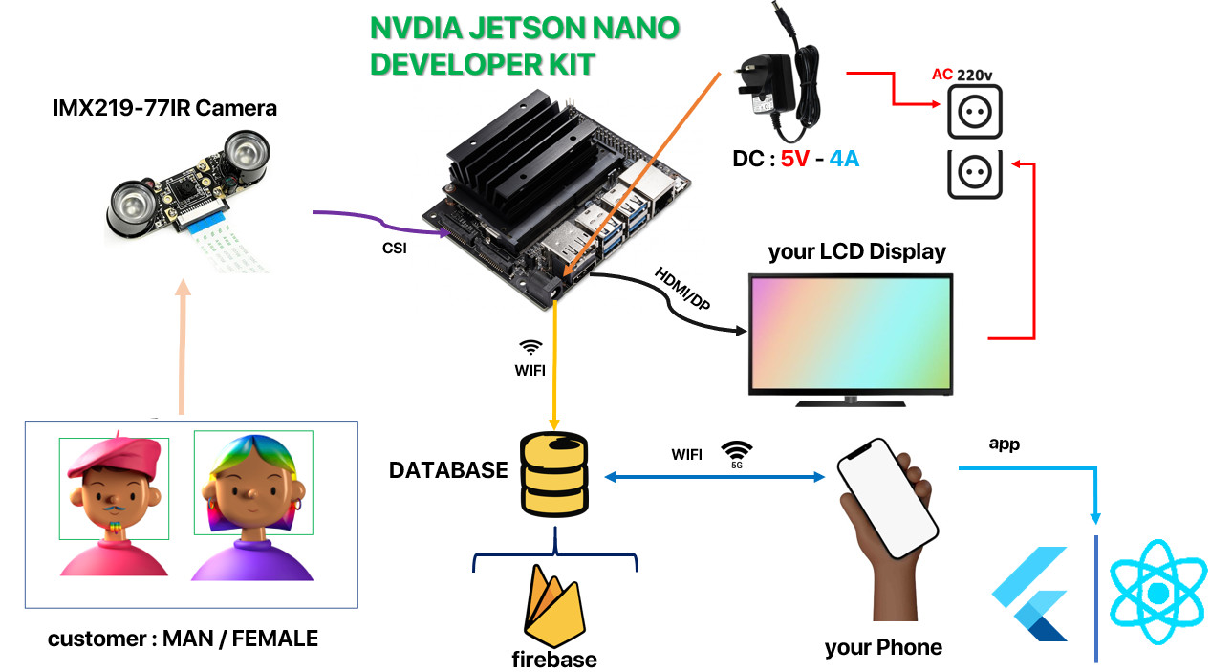
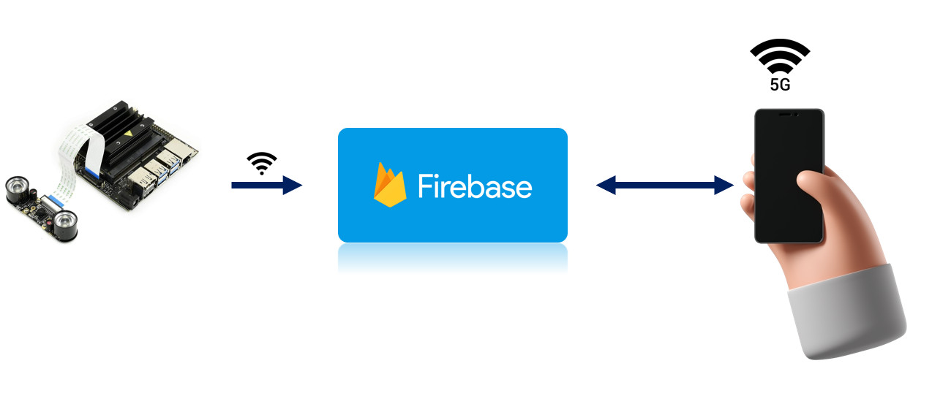



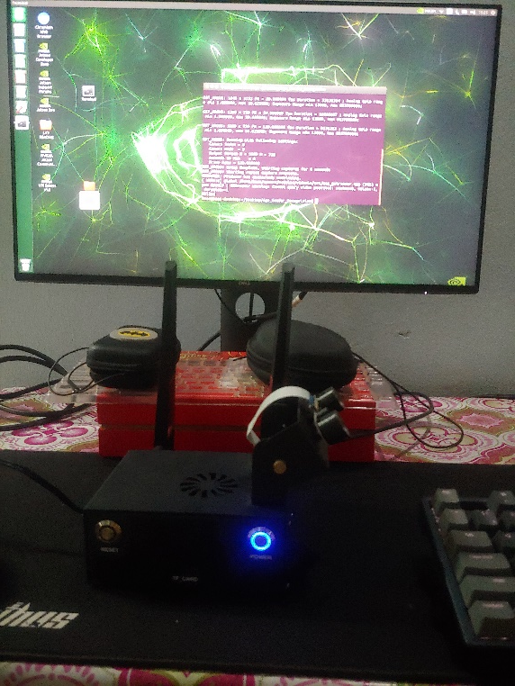
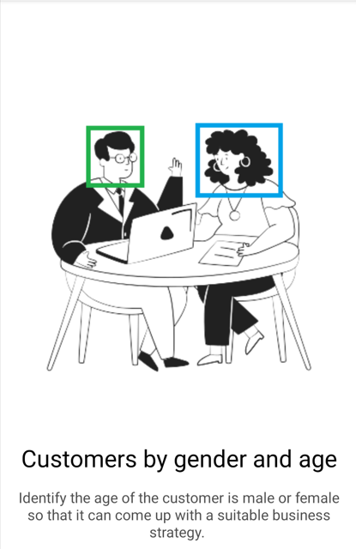

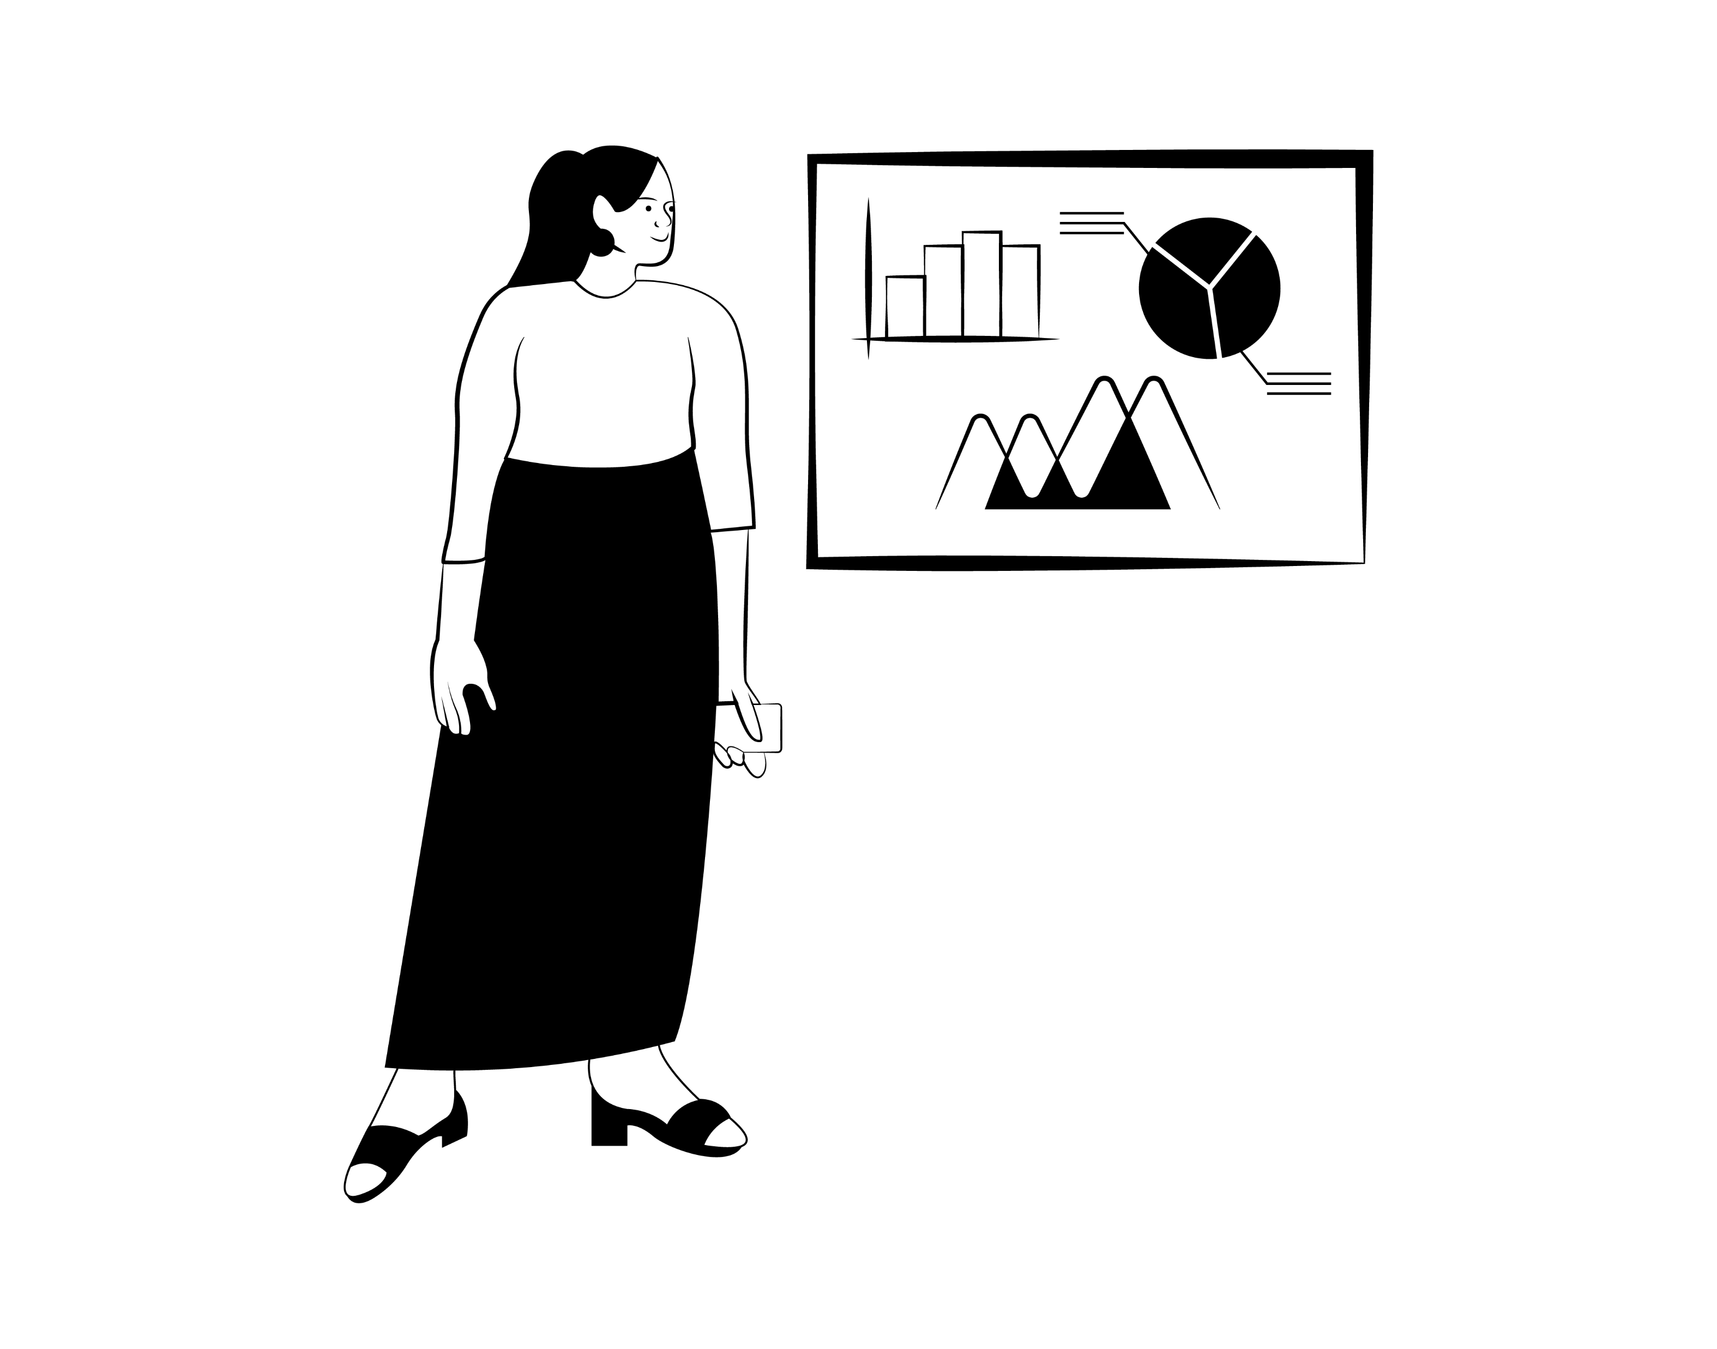
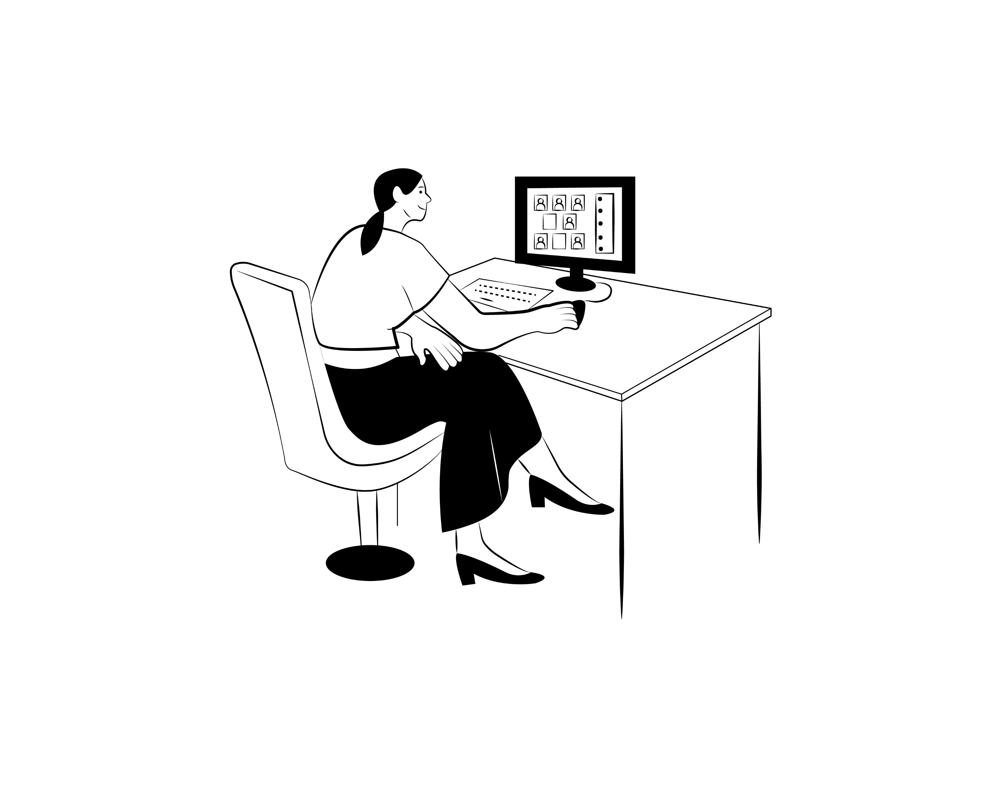
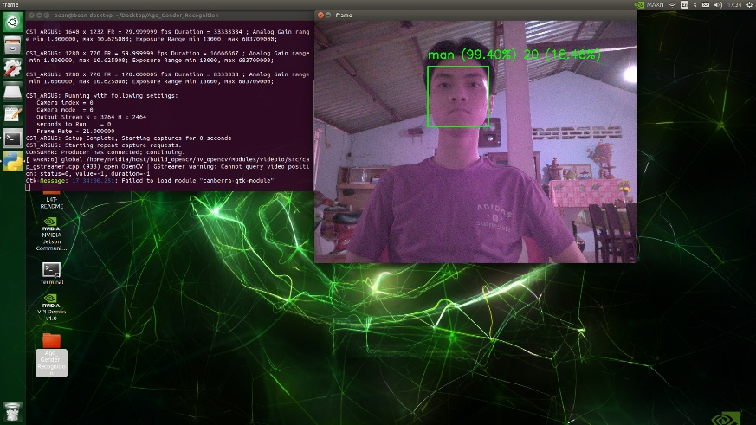
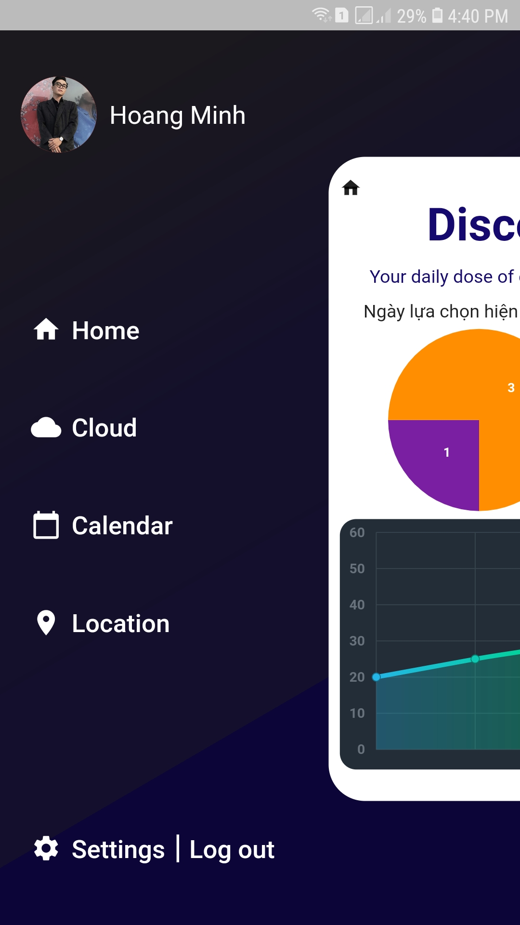
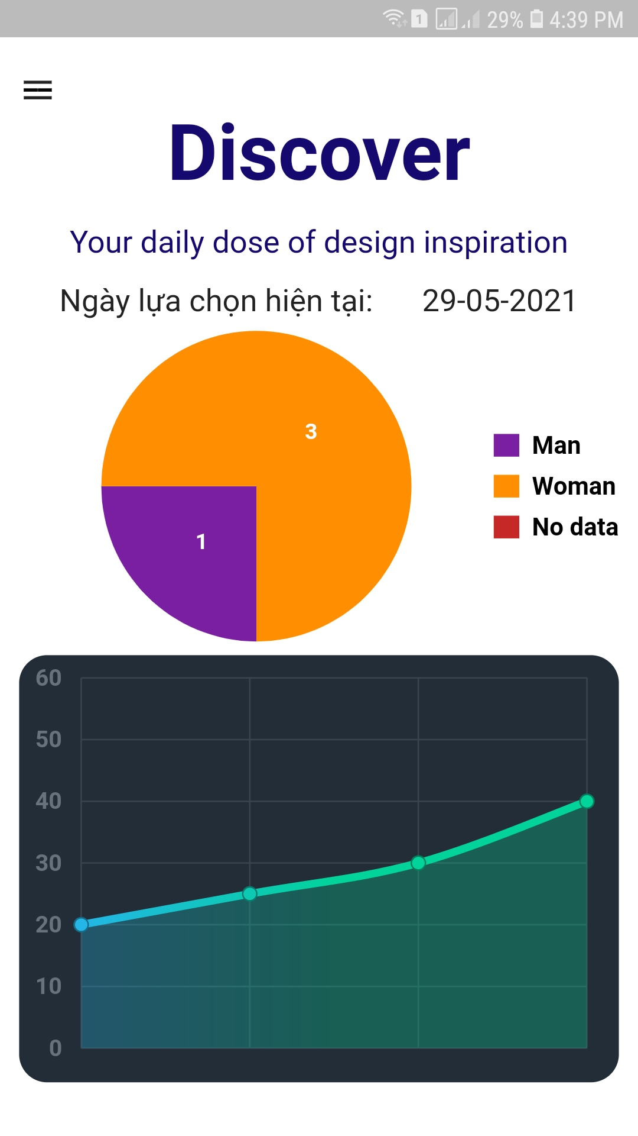
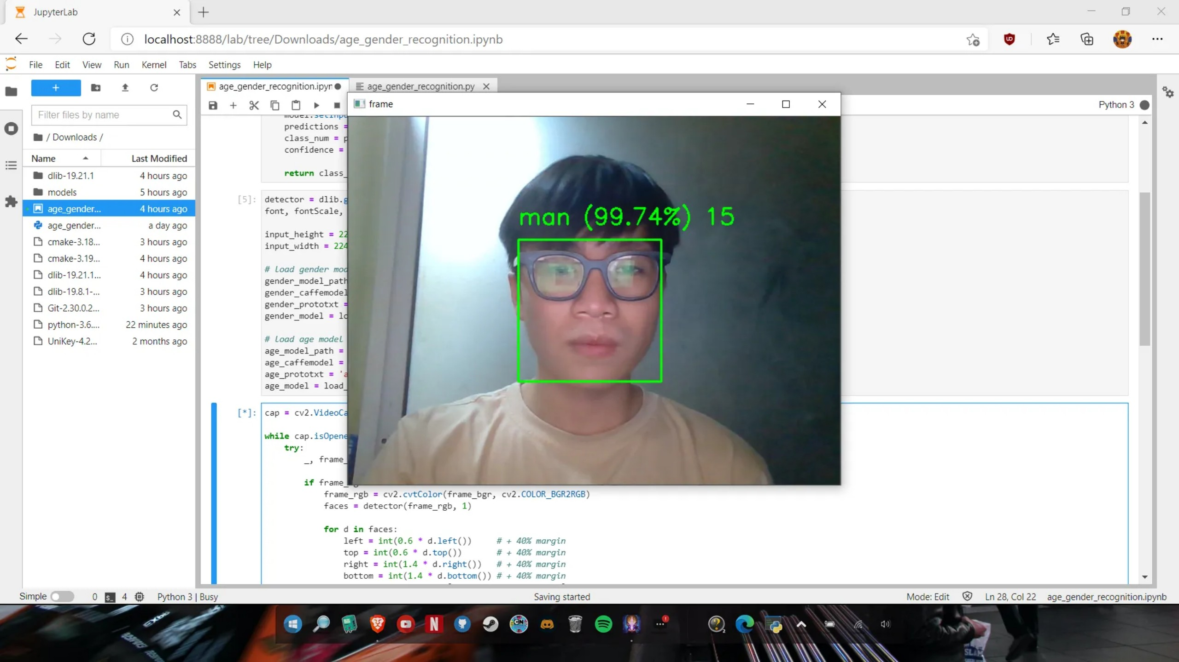
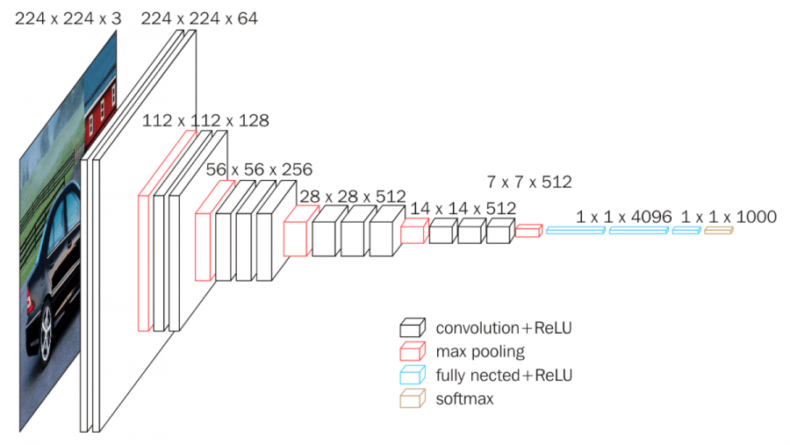
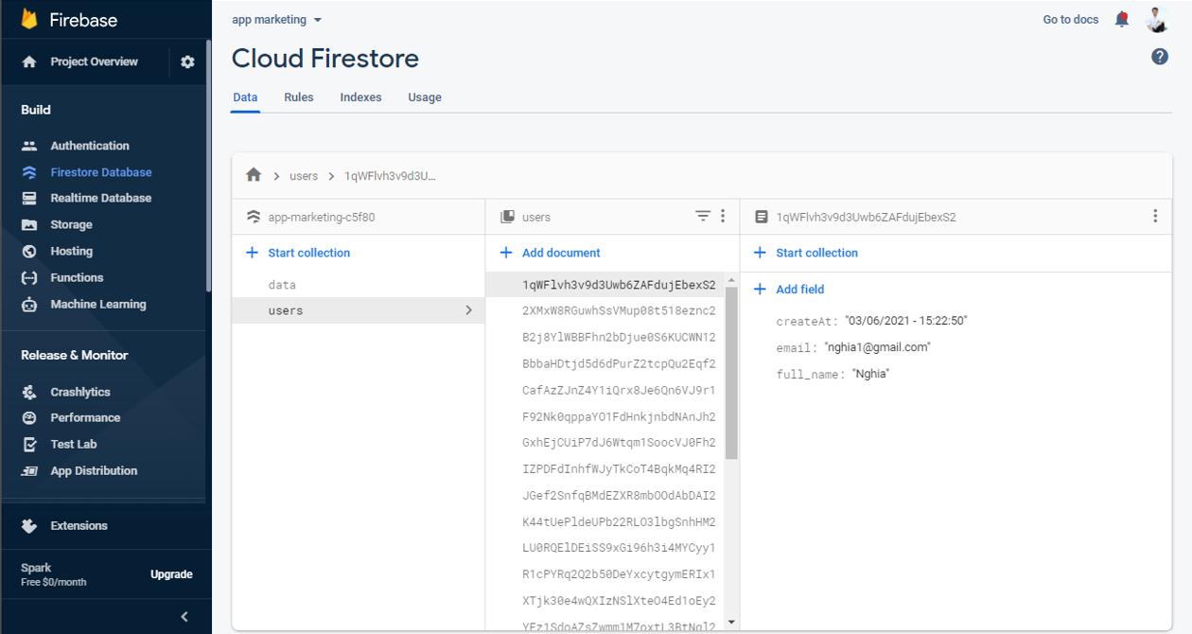
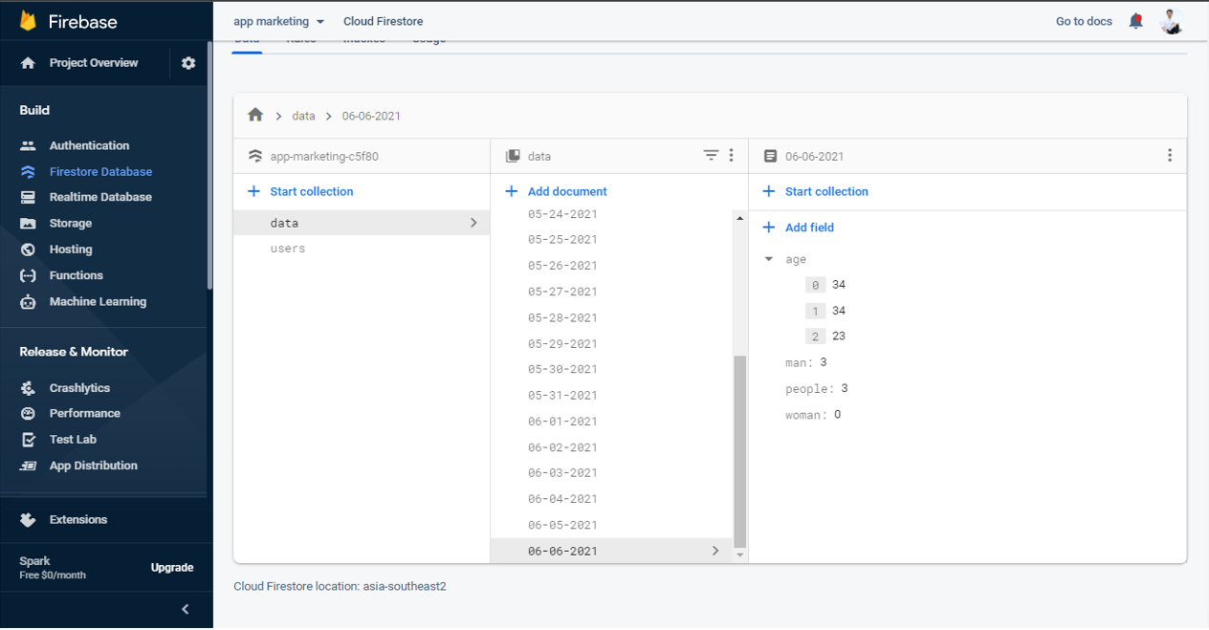


Research and design customer identification system
scoop.
Our Design Brief.
System Block
Diagram
Redesign your business into a smart experience to help make it possible for workflows to be by statistical data-defined, and from there modified mid-campaign to achieve better results.
Research question.
How to identify customers who are potential customers?
What products do they usually buy ?
What age group are the target customers?... to send automated marketing programs to the right audience (gender, age).potential customers
Research method.
Product
Hardware
Software
Online Surveys
Literature Reviews
Target users
Shop owner/Manager working at home.
Network Model – VGG16
DATABASE
References
R. T. L. V. G. Rasmus Rothe, "IMDB-WIKI – 500k+ face images with age and gender labels," [Online]. Available: https://data.vision.ee.ethz.ch/cvl/rrothe/imdb-wiki/. [Accessed 1 3 2021].
R. T. L. V. G. Rasmus Rothe, "eth_biwi_01299.pdf," [Online]. Available: https://data.vision.ee.ethz.ch/cvl/publications/papers/articles/eth_biwi_01299.pdf. [Accessed 1 3 2021].
L. Khachatryan, "lev1khachatryan/Centroid-Based_Object_Tracking: A case study: centroid based object tracking," [Online]. Available: https://github.com/lev1khachatryan/Centroid-Based_Object_Tracking. [Accessed 3 3 2021].
O. Gurbych, "Deep Learning for Age & Gender Recognition - YouTube," [Online]. Available: https://www.youtube.com/watch?v=7L6SCufzYT8&t[Accessed 2 3 2021].
S. I. Serengil, "Apparent Age and Gender Prediction in Keras - Sefik Ilkin Serengil," [Online]. Available: https://sefiks.com/2019/02/13/apparent-age-and-gender-prediction-in-keras/. [Accessed 1 3 2021].
I. Facebook, "Introduction . React Native," [Online]. Available: https://reactnative.dev/docs/getting-started. [Accessed 1 2 2021].
Google, "Flutter documentation - Flutter," [Online]. Available: https://flutter.dev/docs. [Accessed 1 2 2021].
Google, "Documentation | Firebase," [Online]. Available: https://firebase.google.com/docs. [Accessed 1 4 2021].
Conclusions & Develop
Authors:
Conclusion: The system has properly met the set demand that is to identify the age and gender of the customer, the collected data is statistically on the mobile app for customers to observe and capture information about their customers.
Develop : Developing more temperature cameras to measure temperature to warn of the Covid-19 epidemic season
Hoang Minh
Trong Nghia

