Slide 1

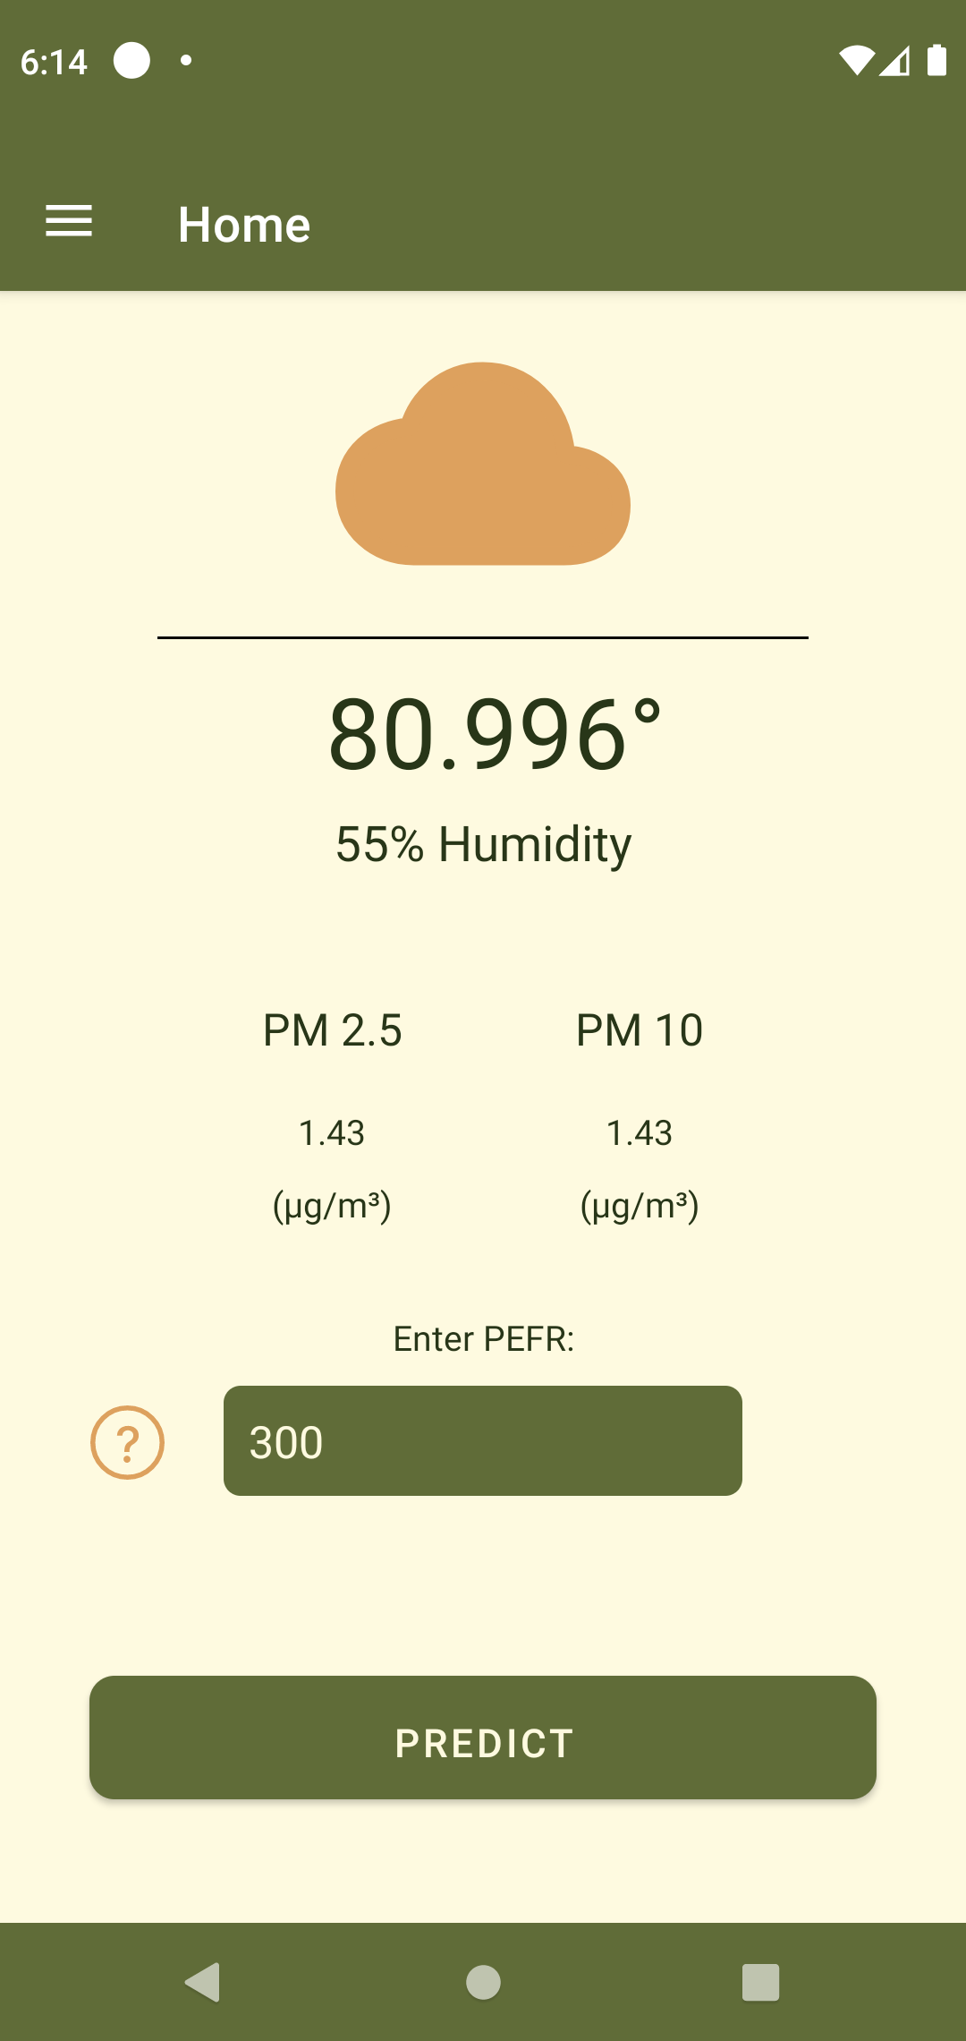
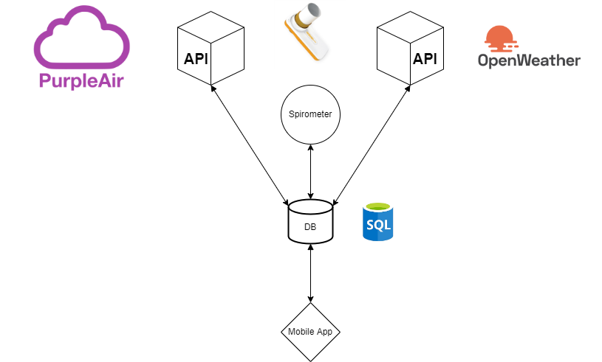
UTD Asthma Risk Prediction
Junsik Seo Chandler Odenweller Six Wires Nilay Jasapara Minsoo Mun
Goal: Create an app that collects information from the user and utilizes machine learning (ML) to accurately predict risk of asthma.
Approach: Web application information distributed via mobile app.
OpenWeather API backend
PurpleAir API backend
Spirometer
Mobile application frontend

