Slide 1
Sample Ship Cases
Please note that these cases should be consider completely independent of each other.
Slides 2 to 7, balance cases
Slides 8 to 13, transfer cases

Slide 2
Ship Balance Test Cases

Slide 3
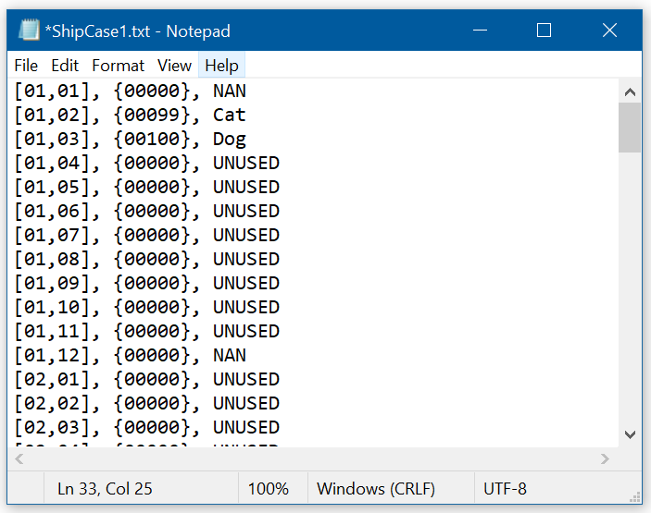
Case 1: Balance this ship
Presumably, the cheapest solution (not shown) is to move ‘Dog’ to [01,07]
Cat
Dog

Slide 4
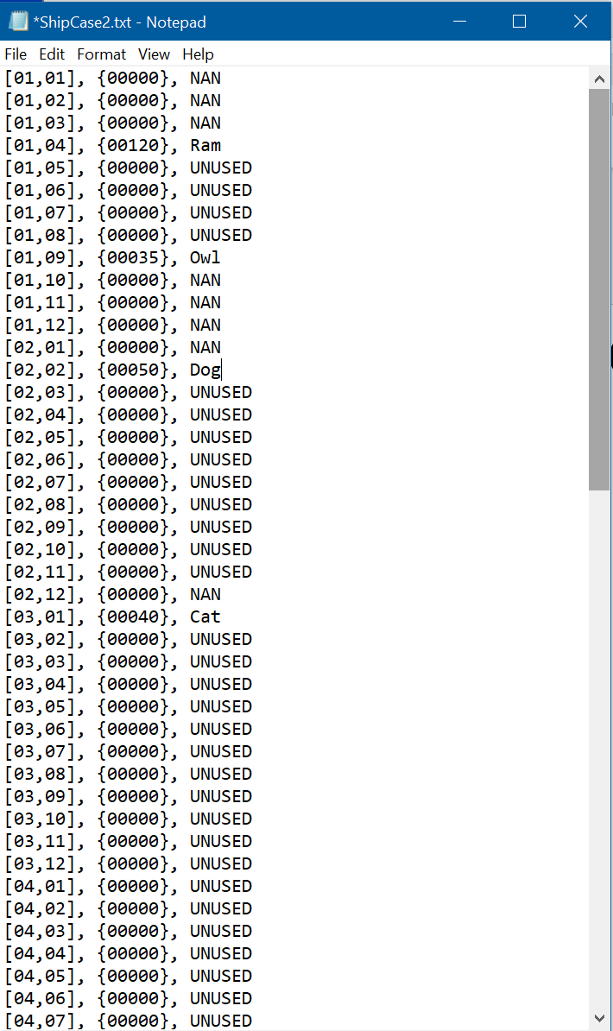
Case 2: Balance this ship
Cat
Dog
Ram
Owl

Slide 5
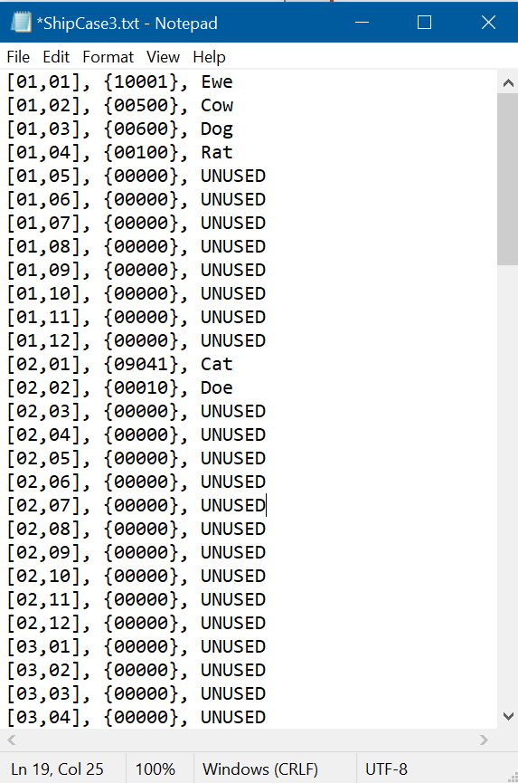
Case 3: Balance this ship
Cat
Doe
Ewe
Cow
Dog
Rat

Slide 6
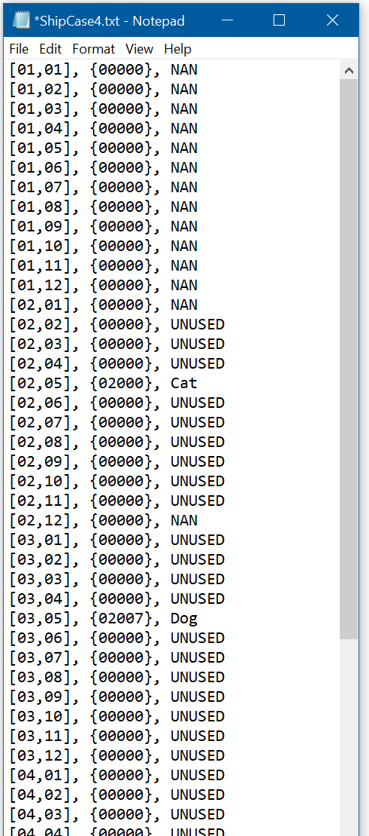
Case 4: Balance this ship
Pig
Doe
Owl
Ewe
Cow
Dog
Cat

Slide 7
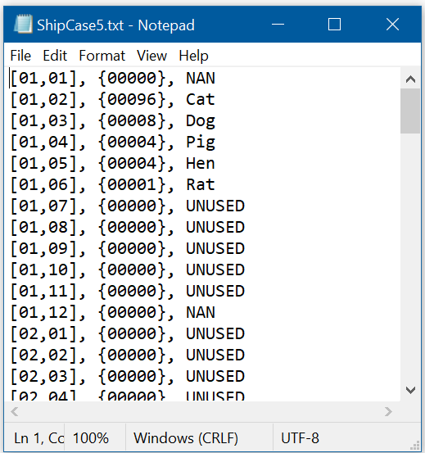
Case 5: Balance this ship
Cat
Dog
Pig
Hen
Rat

Slide 8
Ship Transfer Test Cases

Slide 9
Case 1: Unload only
Please remove caterpillar truck parts “Cat”, from ShipCase1.
Cat
Dog

Slide 10
Case 2: Load only
Please load batteries “Bat” onto ShipCase1. The weight will be 431
Cat
Dog
Ram
Owl

Slide 11
Case 3: Load and Unload (not necessarily in that order)
Please load
Batteries “Bat”, with mass 532
Rattles “Rat”, with mass 6317
Please unload “Cow”
Cat
Doe
Ewe
Cow
Dog
Rat

Slide 12
Case 4: Load and Unload (not necessarily in that order)
Please load
Natron “Nat”, with mass 2543
Please unload “Doe”
Pig
Doe
Owl
Ewe
Cow
Dog
Cat

Slide 13
Case 5: Load and Unload (not necessarily in that order) With comment to log file
Please load
Natron “Nat”, with mass 153
Rattles “Rat”, with mass 2321
Please unload “Hen”
Please unload “Pig”
When you unload Pig, imagine that the weighting scales reads 5432, much heaver than expected. At that point, the operator should write a comment to the log file “Pig weights 5432, not 4. Have unloaded as normal. The seals on the door are intact.”
Cat
Dog
Pig
Hen
Rat

