Slide 1

Arduino
hello@hybus.net

Slide 2
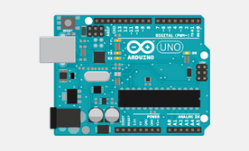
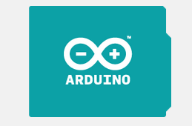
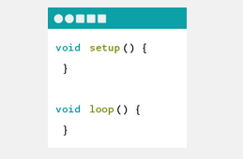
Arduino Hardware
https://www.arduino.cc/
WHAT IS ARDUINO?
Arduino is an open-source electronics platform based on easy-to-use hardware and software. It's intended for anyone making interactive projects.
ARDUINO BOARD?
Arduino senses the environment by receiving inputs from many sensors, and affects its surroundings by controlling lights, motors, and other actuators.
ARDUINO SOFTWARE?
You can tell your Arduino what to do by writing code in the Arduino programming language and using the Arduino development environment.
source : http://www.pubnub.com/blog/

Slide 3
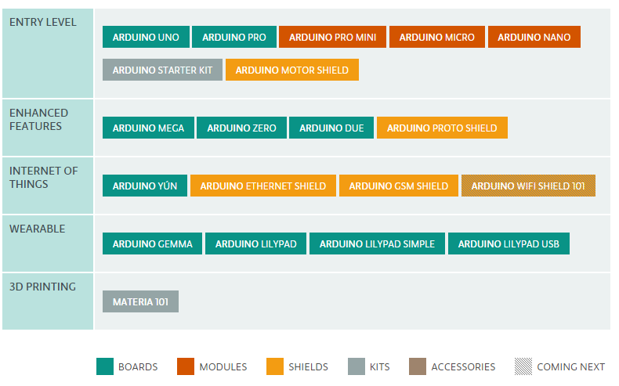
Arduino Products
official Arduino products, including Boards, Modules , Shields (elements that can be plugged onto a board to give it extra features), and Kits.
source : http://www.arduino.cc “Products”

Slide 4
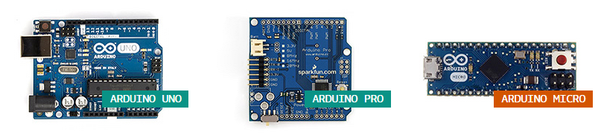
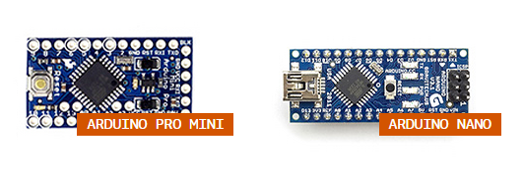
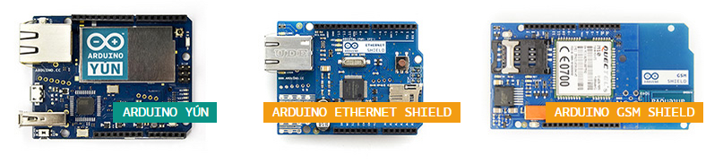
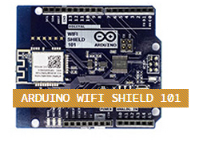
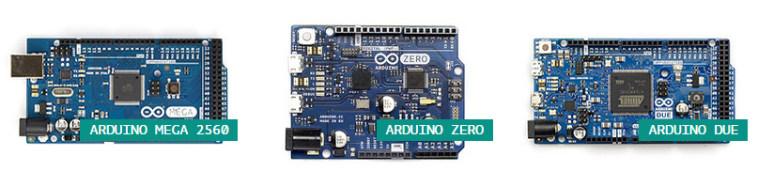
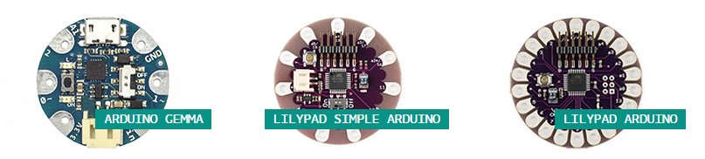
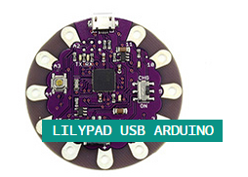
Arduino Products
source : http://www.arduino.cc “Products”

Slide 5
Arduino UNO
The Arduino Uno is a microcontroller board based on the ATmega328
It has 14 digital input/output pins (of which 6 can be used as PWM outputs), 6 analog inputs, a 16 MHz ceramic resonator, a USB connection, a power jack, an ICSP header, and a reset button.
specification
Microcontroller ATmega328
Operating Voltage 5V
Input Voltage (recommended) 7-12V
Input Voltage (limits) 6-20V
Digital I/O Pins 14 (of which 6 provide PWM output)
Analog Input Pins 6
DC Current per I/O Pin 40 mA
DC Current for 3.3V Pin 50 mA
Flash Memory 32 KB (ATmega328) of which 0.5 KB used by bootloader
SRAM 2 KB (ATmega328)
EEPROM 1 KB (ATmega328)
Clock Speed 16 MHz
Length 68.6 mm
Width 53.4 mm
Weight 25 g
source : http://www.arduino.cc “Products”

Slide 6
Arduino UNO
I/O
Serial: 0 (RX) and 1 (TX). Used to receive (RX) and transmit (TX) TTL serial data. These pins are connected to the corresponding pins of the ATmega8U2 USB-to-TTL Serial chip.
External Interrupts: 2 and 3. These pins can be configured to trigger an interrupt on a low value, a rising or falling edge, or a change in value. See the attachInterrupt() function for details.
PWM: 3, 5, 6, 9, 10, and 11. Provide 8-bit PWM output with the analogWrite() function.
SPI: 10 (SS), 11 (MOSI), 12 (MISO), 13 (SCK). These pins support SPI communication using the SPI library.
LED: 13. There is a built-in LED connected to digital pin 13. When the pin is HIGH value, the LED is on, when the pin is LOW, it's off.
Communication
TheATmega328 provides UART TTL (5V) serial communication
ATmega16U2 on the board channels this serial communication, '16U2 firmware uses the standard USB COM drivers .
The ATmega328 also supports I2C (TWI) and SPI communication.
source : http://www.arduino.cc “Products”

Slide 7
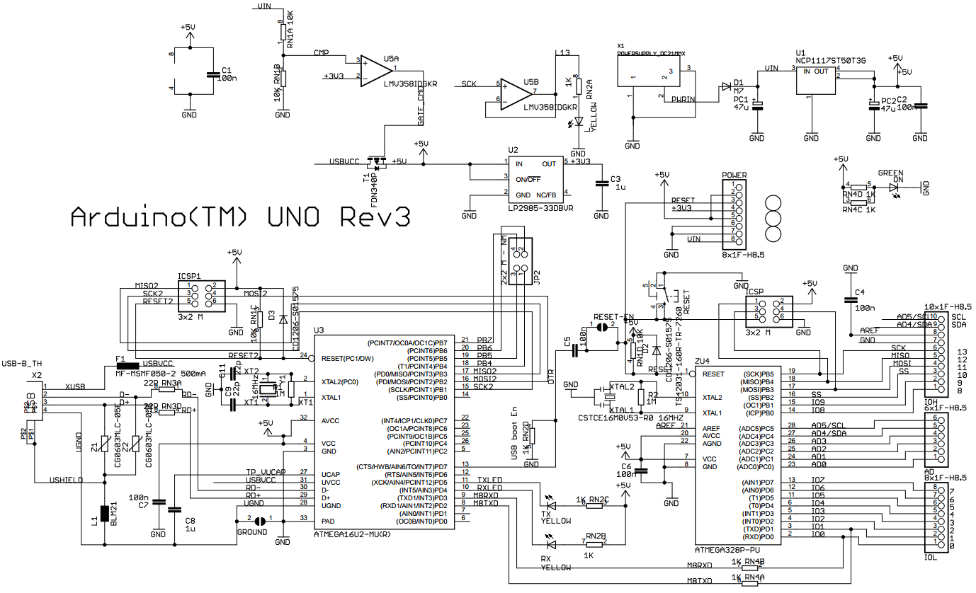
Arduino UNO schematic
source : http://www.arduino.cc “Products”

Slide 8
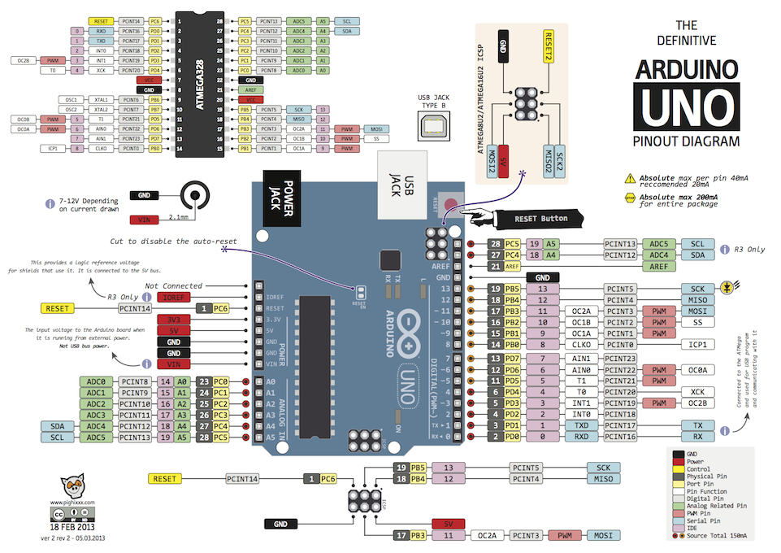
Arduino UNO Pinout

Slide 9

Download the Arduino Software
https://www.arduino.cc/en/Main/Software

Slide 10
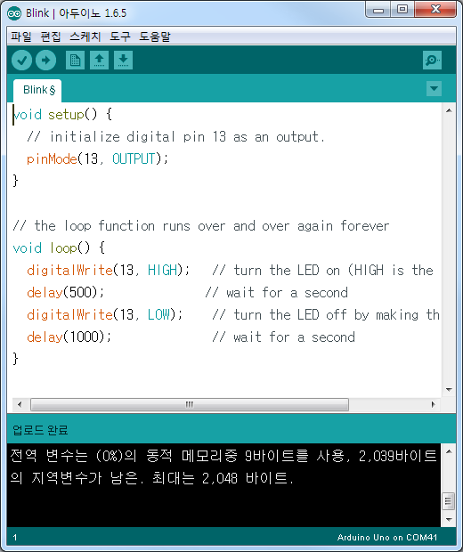
Arduino IDE
Blink Test
Sketch 실행
USB 연결
Serial Port Setting
Blink Code 작성
확인/컴파일
void setup() {
pinMode(13, OUTPUT);
}
void loop() {
digitalWrite(13, HIGH);
delay(500);
digitalWrite(13, LOW);
delay(1000);
}
Example code

Slide 11
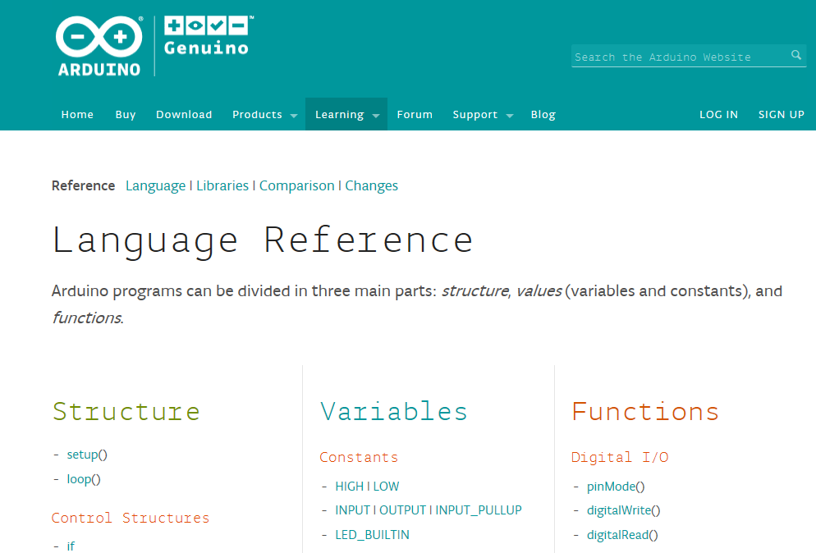
Arduino Language Reference
https://www.arduino.cc/en/Reference/HomePage

Slide 12
PWM Analog Output
void setup() {
pinMode(13, OUTPUT);
}
void loop() {
digitalWrite(13, HIGH);
delay(1);
digitalWrite(13, LOW);
delay(9);
}
void setup() {
pinMode(13, OUTPUT);
}
void loop() {
digitalWrite(13, HIGH);
delay(5);
digitalWrite(13, LOW);
delay(5);
}
Example code
Example code
※ PWM(Pulse With Modulation)
전압신호 Pulse의 비율을 이용해 전압신호의 평균 값을 출력 값으로 나타내는 것
전압의 레벨이 낮을 경우에는 pulse를 on으로 나타내는 시간을 작게, off로 나타내는 시간을 길게 하는 것

Slide 13
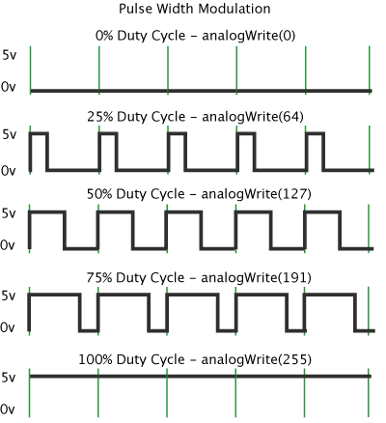
PWM Analog Output
PWM: 3, 5, 6, 9, 10, and 11. Provide 8-bit PWM output with the analogWrite() function.
PWM pulse 주기 500Hz(0.002초)
int led = 11;
int i = 0;
void setup() {
}
void loop() {
for(i=0; i<255; i++){
analogWrite(led, i);
delay(10);
}
}
Example code

Slide 14
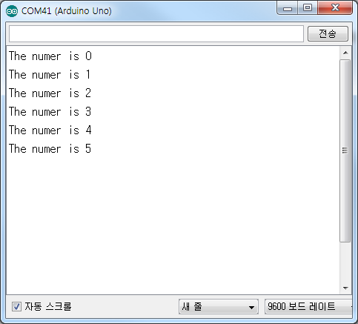
Serial Communication
void setup() {
Serial.begin(9600);
}
int number = 0;
void loop() {
Serial.print("The numer is ");
Serial.println(number);
delay(1000);
number++;
}
Example code

Slide 15
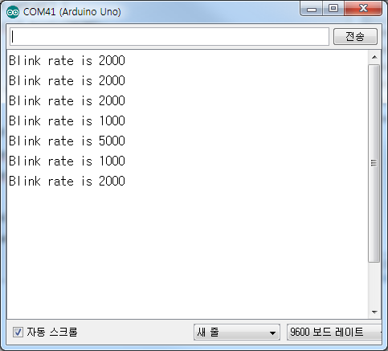
LED Blink Rate Control
int blinkrate = 0;
int ledpin = 13;
void setup() {
pinMode(ledpin, OUTPUT);
Serial.begin(9600);
}
void loop() {
if(Serial.available() > 0 ){
char ch = Serial.read();
if( isDigit(ch)) {
blinkrate = (ch - '0');
blinkrate = blinkrate * 1000;
Serial.print("Blink rate is ");
Serial.println(blinkrate);
}
}
blink();
}
void blink(){
digitalWrite(ledpin, HIGH);
delay(blinkrate);
digitalWrite(ledpin, LOW);
delay(blinkrate);
}
Example code

Slide 16
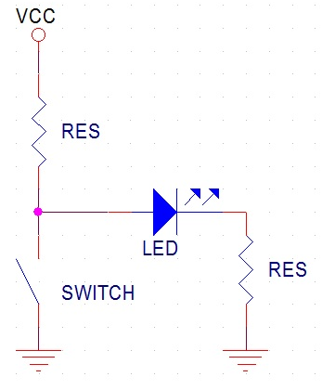
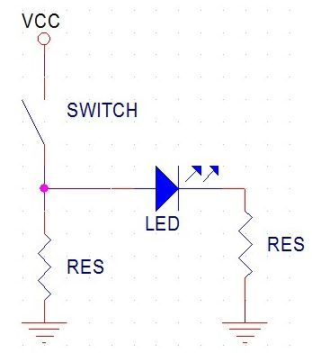
Digital Input
Floating
5V(High) 또는 0V(LOW)를 입력할 때 주변의 전가장의 상태에 따라 입력 값이 불안정하게 들어오는 부정전압 상태
Pull-up 저항
논리적으로 High레벨 상태를 유지하기 위하여 신호의 입력 또는 출력단자와 VCC전원 단자 사이에 접속하는 저항
Pull-down 저항
논리적으로 Low레벨 상태를 유지하기 위하여 신호의 입력 또는 출력단자와 GND단자 사이에 접속하는 저항
int btpin = 2;
int ledpin = 12;
int btstate = 0;
void setup() {
pinMode(ledpin, OUTPUT);
pinMode(btpin, INPUT);
}
void loop() {
btstate = digitalRead(btpin);
if(btstate ==HIGH){
digitalWrite(ledpin, HIGH);
}else{
digitalWrite(ledpin, LOW);
}
}
Example code
Pull-up
Pull-down

Slide 17
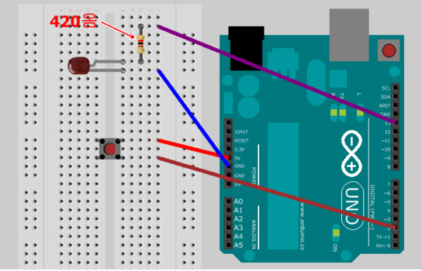
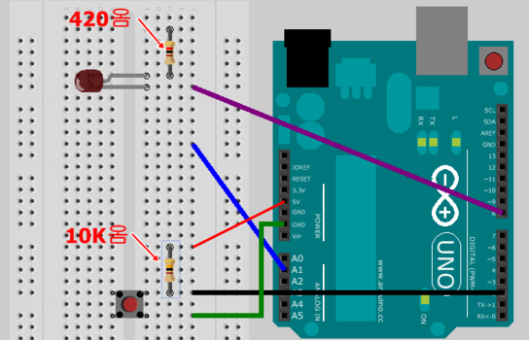
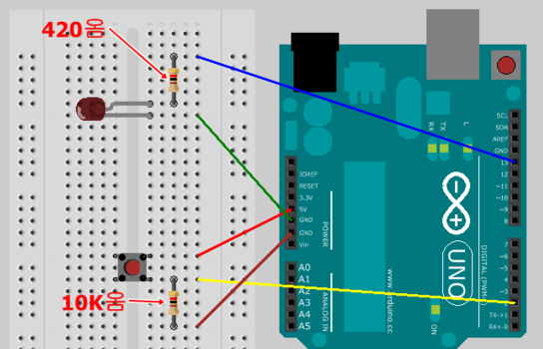
Floating
Pull-up
Pull-down

