Slide 1

Edison Start
hello@hybus.net

Slide 2
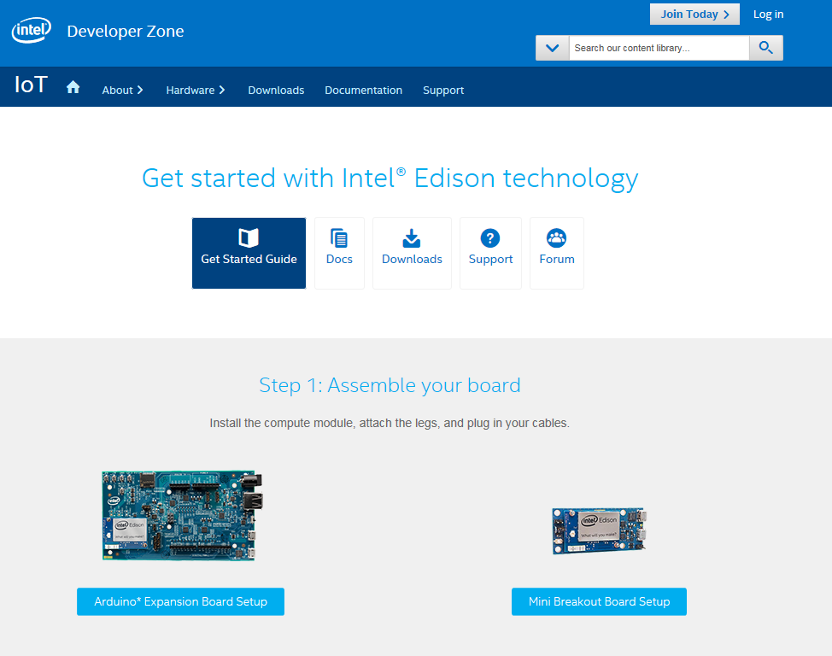
Get started with Intel Edison technology
https://software.intel.com/en-us/iot/library/edison-getting-started

Slide 3


Assemble your board
https://software.intel.com/en-us/assembling-intel-edison-board-with-arduino-expansion-board
Choose your O/S

Slide 4

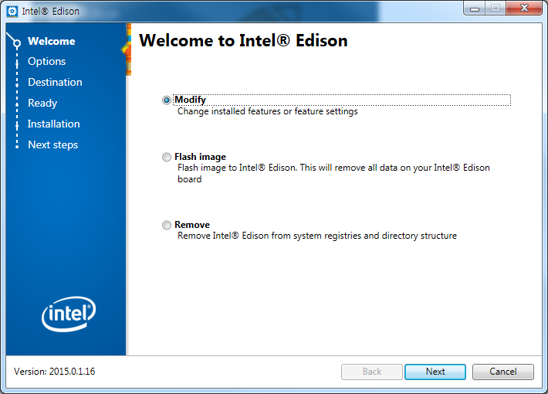
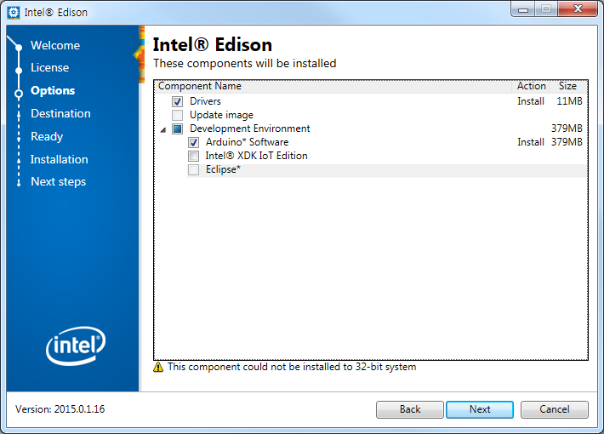
Drivers & IDE Install
Intel XDK IoT Edition
- Node.js 기반 프로젝트 생성, 수정, 관리, 삭제 기능 - 디바이스 연결 기능(시리얼, SSH 연결) - 로그 출력 기능 - 디버그 기능 - 프로그램 업로드 기능 - 앱 실행, 중지 기능

Slide 5
Port Driver
Intel Edison USB Composite Device
Intel Edison Virtual Com Port : Arduino IDE Port
USB Serial Port : Edison Serial Port
Sketch Start
Board : Intel® Edison
Port : Virtual Com Port
Blink Test
void setup() {
pinMode(13, OUTPUT);
}
void loop() {
digitalWrite(13, HIGH);
delay(500);
digitalWrite(13, LOW);
delay(500);
}
Blink Test
Example code
Sketch 실행
USB 연결
Serial Port Setting
Blink Code 작성
확인/컴파일

Slide 6
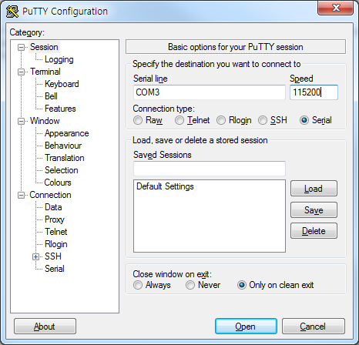
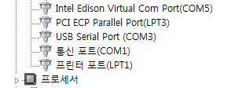
Setting up serial terminal on a OS system
1. Set up PuTTY
Download the PuTTY terminal emulator : http://the.earth.li/~sgtatham/putty/latest/x86/putty.exe
Double-click the putty.exe file you downloaded to run it.
Configure the PuTTY menu as follows:
Under Connection type, select Serial.
In the Serial line field, enter the COM# for your board, such as COM12. Note: If you did not note your COM# earlier, navigate to the Device Manager and check for an entry called USB Serial Port (not Intel Edison Virtual Com Port). The COM# is displayed next to the USB Serial Port entry, as highlighted below.
In the Speed field, type 115200
※ Mac* OS X* Setting
https://software.intel.com/en-us/setting-up-serial-terminal-on-system-with-mac-os-x

Slide 7
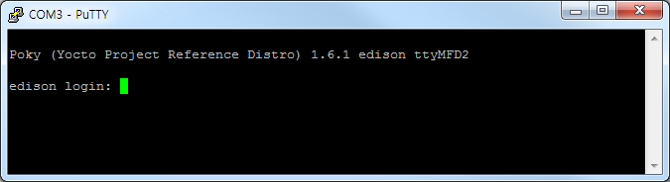
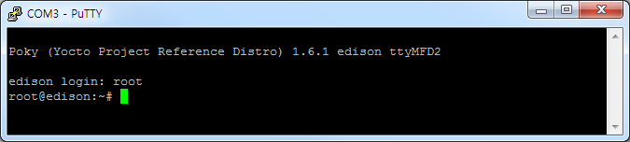
Setting up serial terminal on a OS system
1. Set up PuTTY
Open your serial terminal
When you see a blank screen, press the Enter key twice. A login prompt is displayed.
At the login prompt, type root and press Enter.
Press Enter when prompted for a password. You should see a terminal prompt
edion login : root
terminal

Slide 8
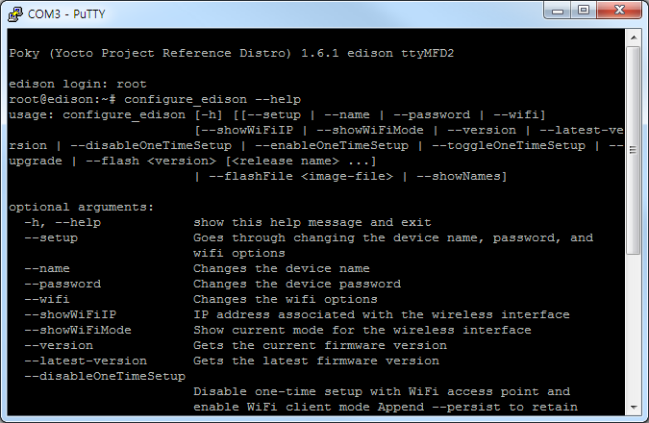
console command
1. 명령어 정보
root@edison:~# configure_edison --help
terminal

Slide 9
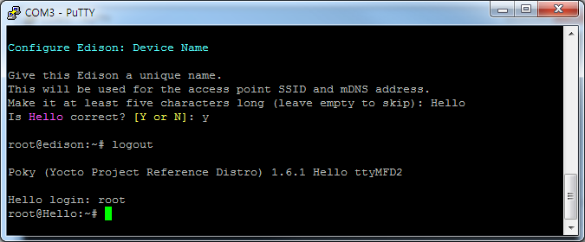
console command
2. device name setting
root@edison:~# configure_edison -–name
....
root@edison:~# logout
Hello login: root
root@Hello:~#
terminal

Slide 10
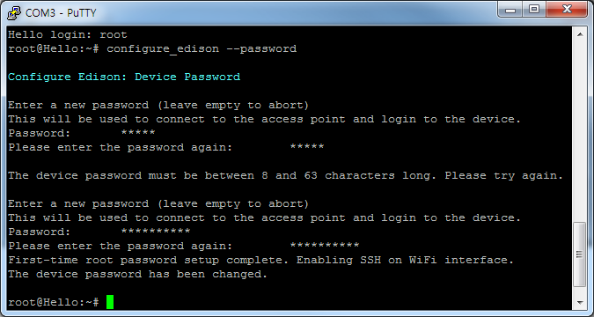
console command
3. Change Password
root@Hello:~# configure_edison –-password
terminal

Slide 11
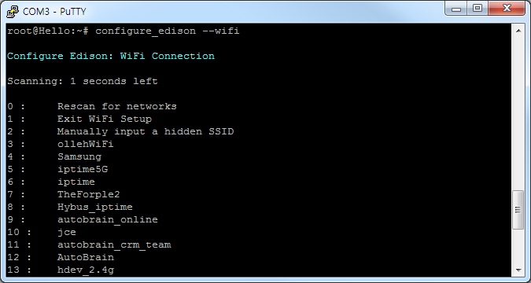
console command
4. Wi-Fi Setting
root@Hello:~# configure_edison –-wifi
terminal

Slide 12
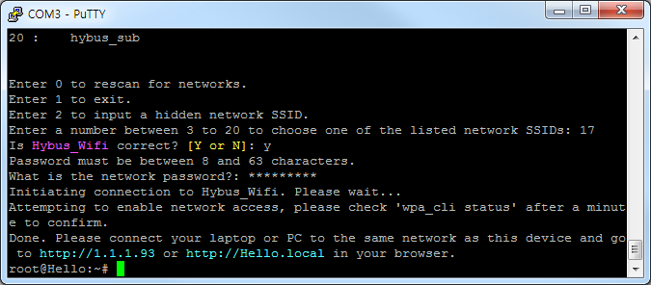
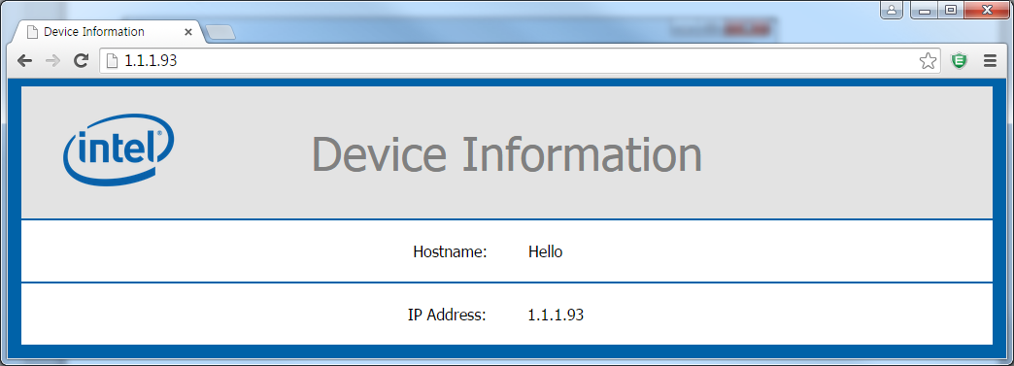
console command
4. Wi-Fi Setting

Slide 13
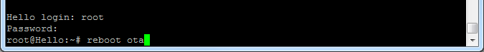
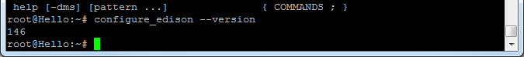
Software Update
1. Linux(Yocto) image Download
https://software.intel.com/en-us/iot/hardware/edison/downloads
2. Copy the downloaded images in Edison driver
3. 초기화 및 설치
root@Hello:~# reboot ota
root@Hello:~# configure_edison --version
terminal

Slide 14
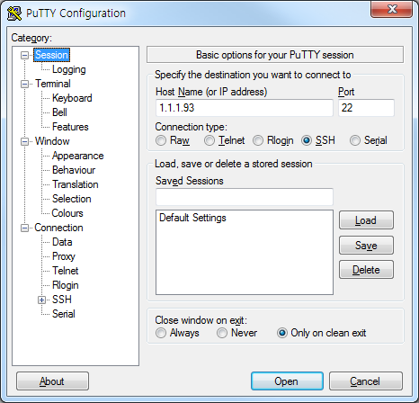
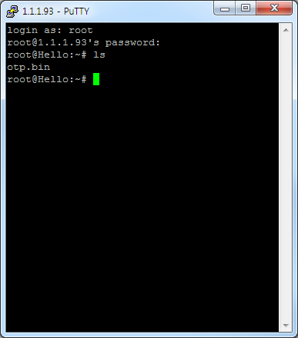
SSH(secure shell) Connection
SSH : 암호화 기법을 이용해 원격 서버에 로그인해서 명령을 수행할 때 사용하는 프로토콜
원격 컴퓨터에 안전하게 접근하기 위한 방법으로 LAN상에서 스니퍼를 당하더라도 그 내용을 쉽게 파악할 수 없다.

Slide 15
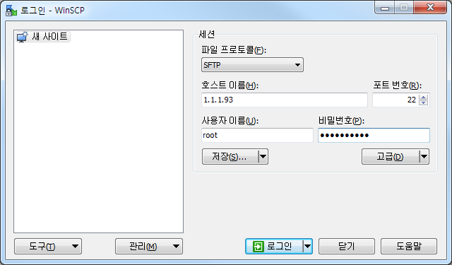
SFTP(Secure FTP) File 전송
FTP(File Transfer Protocol) : 인터넷상에서 일반적으로 사용되는 암호화되지 않는 프로토콜이다.
SFTP(Secure FTP) : 파일전송을 위해 SSH를 이용하는 FTP
1. SFTP 전송 프로그램 설치
http://winscp.net
2. 로그인

Slide 16
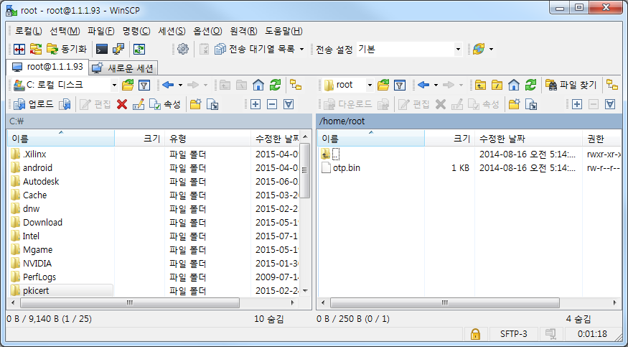
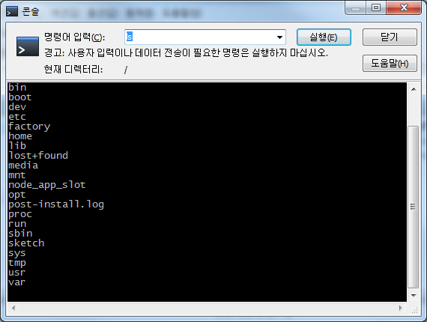
SFTP(Secure FTP) File 전송
WinSCP는 [동기화]로 없거나 바뀐 파일만 업로드 하거나 다운로드 받을 수 있다.
Text Editor, Terminal 지원

Slide 17
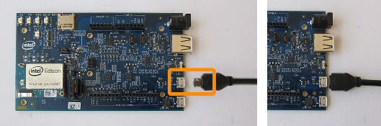
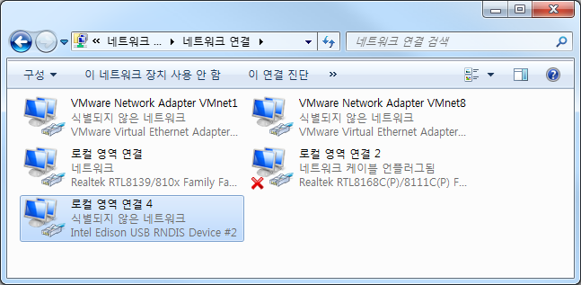
Edison board using Ethernet over USB
Note : This section contains steps to update your system's network adapter configuration with a static IP address to use Ethernet over USB.
1. Plug the micro-USB cable into the micro-USB port closest to the middle of the board.
2. Network status

Slide 18
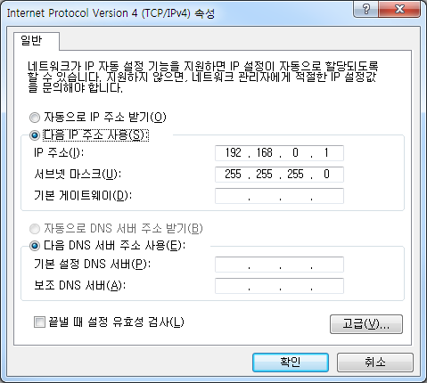
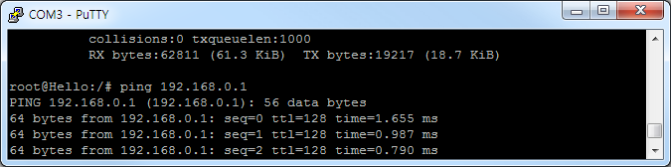
Edison board using Ethernet over USB
3. Change the IP information as follows
192.168.0.1
255.255.255.0
4. Use the ifconfig command to forward connections to the IP address through the USB cable
root@Hello:~# ipconfig
root@Hello:~# ipconfig usb0 192.168.0.2
terminal

