Slide 1
Full Flow of the Inverse Design
Near Field
Imaginary gauge field
FFT
FFT
FFT
I. Gerchberg-Saxton Phase Retrival
II. Nearfield Phase Quantization
III. Phase Modulated by Imaginary Gauge Field

Slide 2
Ring resonators implementation (15 by 15)
Site spacing: 20µm
Z= 100µm
100µm
Desired image plane
Reconstructed image plane
Sample plane

Slide 3
Gerchberg-Saxton Phase Retrieval
Site spacing: 20µm
GS loop: 1000 iterations.
100µm
100µm
Desired image plane
Sample plane
Reconstructed image plane
GS algorithm is hard to converge with the Green function.
GS is used for phase retrieval and imaginary gauge field implementation.
If we can implement the hologram with a large site spacing, then the GS is not necessary.

Slide 4
Illustration of phase tuning
Yellow dots: main sites with scatters;
Blue dots: auxiliary sites with imaginary gauge field, for phase tuning, without scatters.
…
…

Slide 5
Sparsely-spaced resonators
Site spacing: 200µm
2.5mm
2.5mm
Desired image plane
Reconstructed image plane
Sample plane

Slide 6
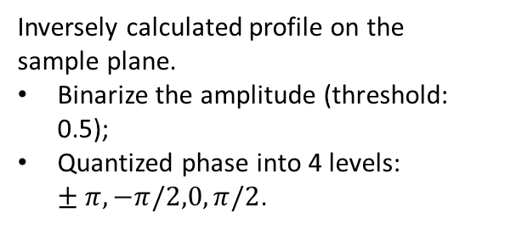
Quantization of field profile on sample plane
Site spacing: 200µm
Inversely calculated profile on the sample plane.
Binarize the amplitude (threshold: 0.5);
Quantized phase into 4 levels: $±π, −π/2,0,π/2$.
2.5mm

Slide 7
Minimum 6 by 6 ring resonators
Inverse design
Quantized

Slide 8
Minimum 5 by 5 ring resonators
Inverse design
Quantized

Slide 9
Future Plan
Phase tuning logics realized by the imaginary gauge field
Influence of random perturbations.

