Slide 1
ADS503 Group Assignment Predicting House Prices
Created By: Kevon Cambridge, Minsu Kim, Bikram Gill

Slide 2
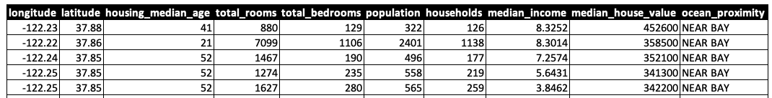
Introduction
Housing market data has been gathered, curated and studied to attempt to predict house prices and understand the underlying factors that are most likely to impact this.
Under the current economic environment and for future use, predicting house prices is a highly beneficial activity.

Slide 3
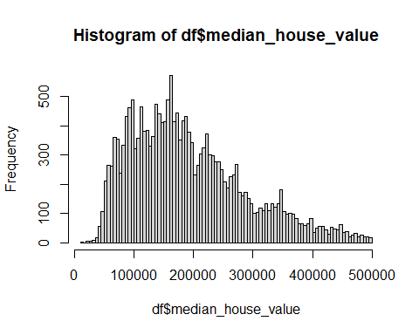
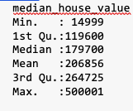
Exploratory Data Analysis
A wide variety of EDA techniques were utilized to understand the data, including data exploration/cleansing, outlier and correlation analysis, statistical tests such as ANOVA and the handling of missing values.
The key variable of interest in this data set was house prices. Information related to house prices can be summarized as below.

Slide 4
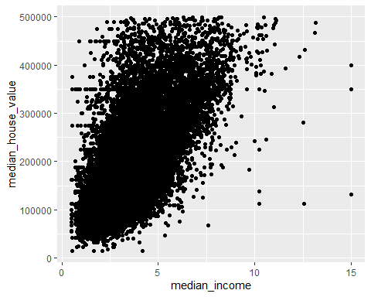
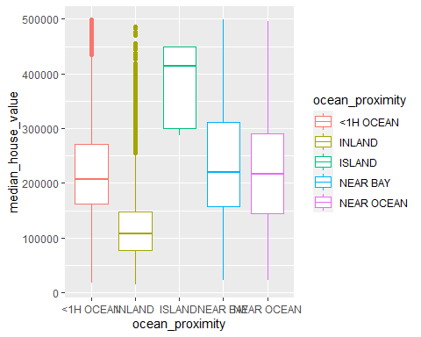
Exploratory Data Analysis
Ultimately, two key relationships were identified as the key drivers for house prices. Income level and proximity to the ocean (i.e. location) were both the largest drivers for the value of a house.
Whilst this was good to know, it also created issues when attempting to model house prices. There were realistically only two variables of interest. This created a scenario where any models created would likely be underfit and would not be able to accurately predict prices if they showed variance (which they did).

Slide 5
Model Results and Conclusion
5 different models were implemented and tested. As can be seen below and from the description in the previous slide, the models were too underfit to accurately capture the relationship for house prices (there was too much variance to capture in 2 predictors).
The next steps for this problem would be to look for better data and conduct more thorough EDA.
Model | Train MAPE | Test MAPE
Linear Regression | 28.23 | 28.81
Random Forest | 32.6 | 33.72
KNN | 27.76 | 28.58
SVM-Linear | 25.88 | 26.51
ANN | 100 | 100

