Slide 1
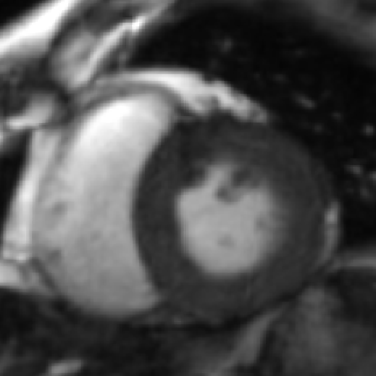
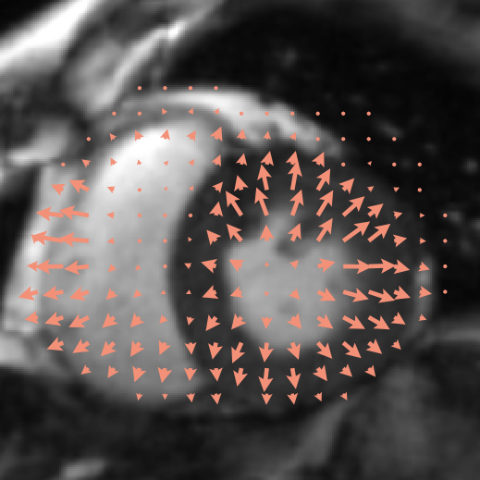
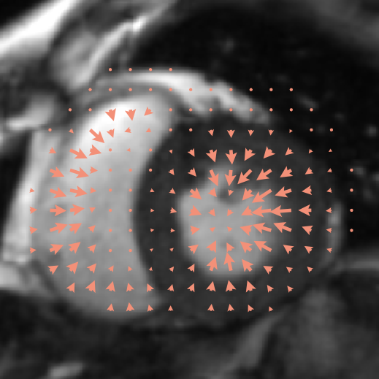
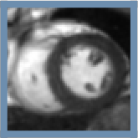
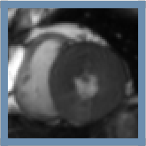
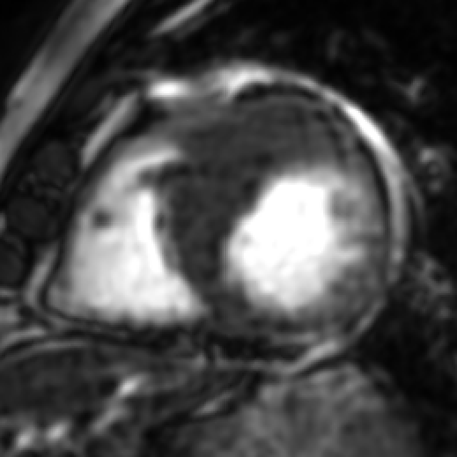
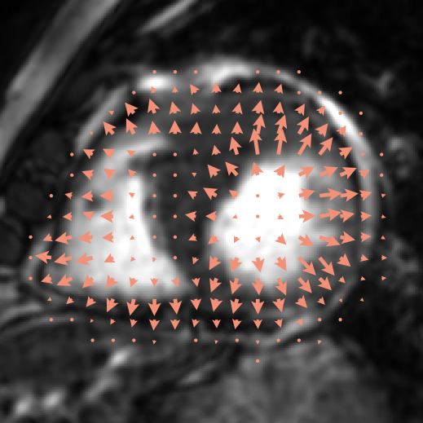
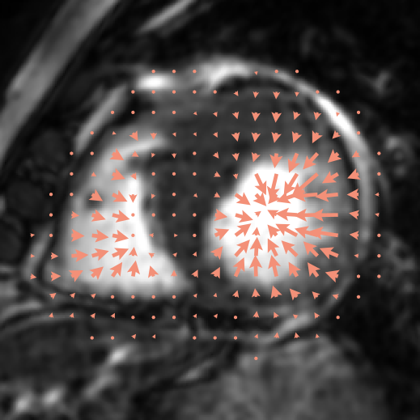
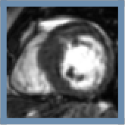
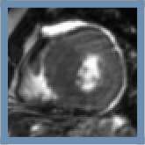
Input
ED target
ES target
AF
HRV
Notes:
reference_conditioning: rendered by _paper_figures/render_motion_edes.py (see _paper_figures/README.md). Text = native text boxes; each panel = its own PNG layer.

Slide 2
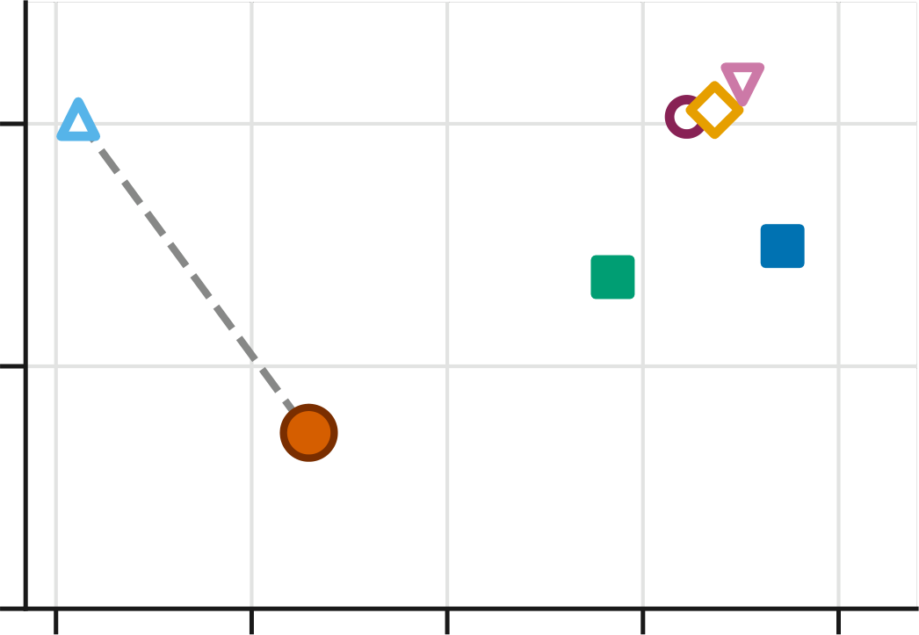
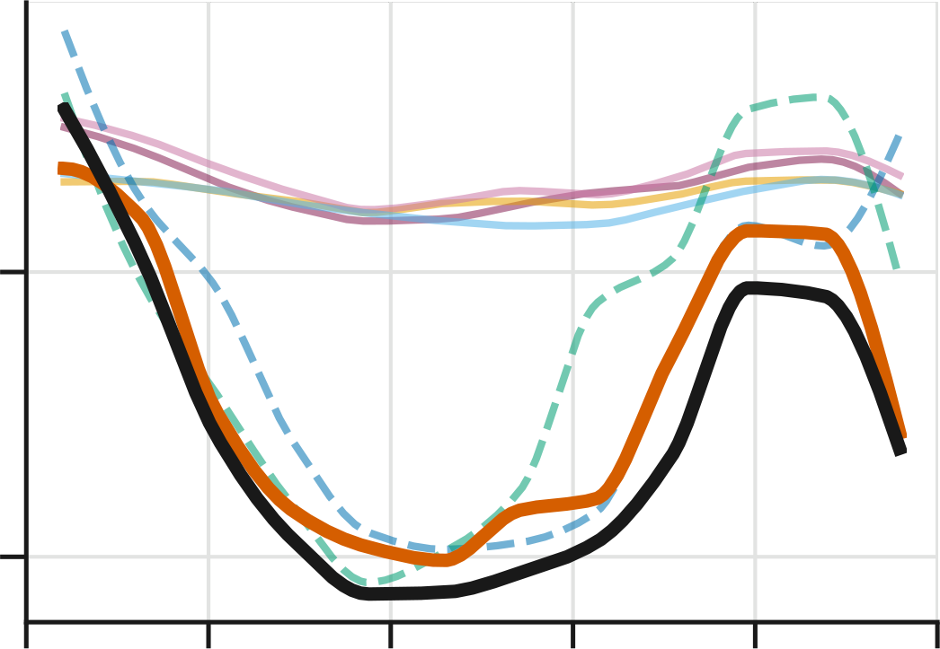
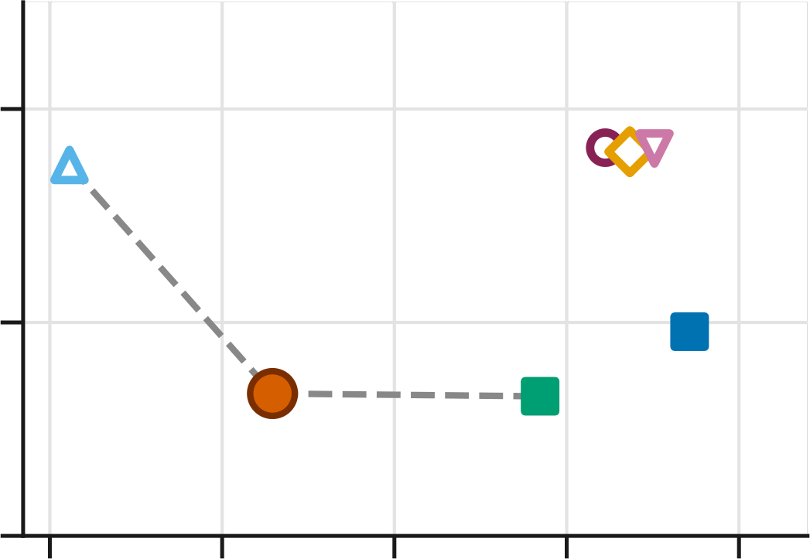
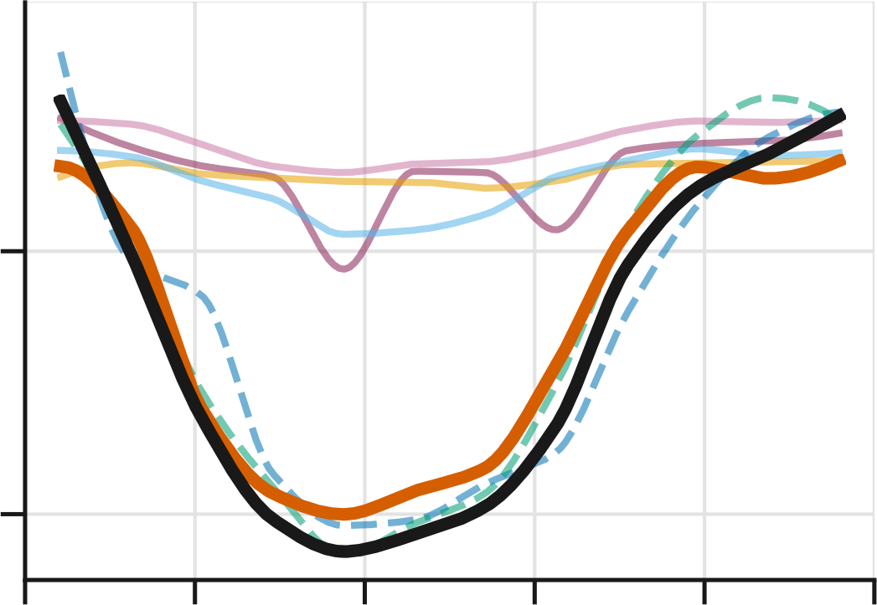
GT
Ours
CiNeVol†
Fetal CMR 4D†
Dangi et al.
NeSVoR
NiftyMIC
SVRTK
20
Dangi et al.
20
Dangi et al.
VTC err. ↓
100
100
LV volume (mL)
VTC err. ↓
LV volume (mL)
10
CiNeVol†
10
Ours
50
Ours
CiNeVol†
50
0
0
0.1
1
10
100
1000
0.0
0.2
0.4
0.6
0.8
1.0
0.1
1
10
100
1000
0.0
0.2
0.4
0.6
0.8
1.0
Runtime (s)
Acquisition time (s)
Runtime (s)
Acquisition time (s)
(a) Atrial fibrillation (AF)
(b) Heart rate variability (HRV)
Notes:
runtime_vtc_af_hrv: rendered by _paper_figures/render_vtc_2x2.py (see _paper_figures/README.md). Text = native text boxes; each panel = its own PNG layer.

Slide 3
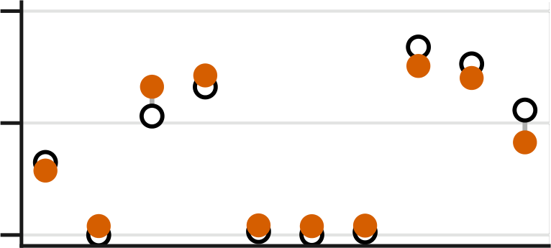
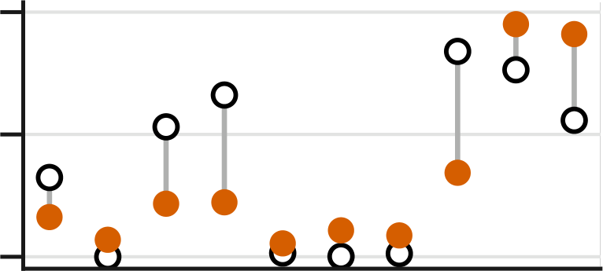
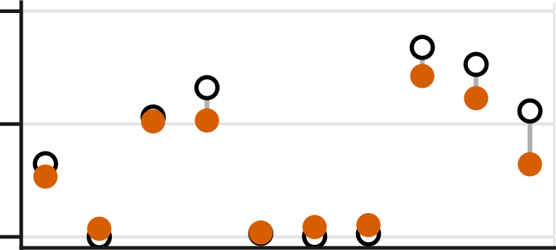
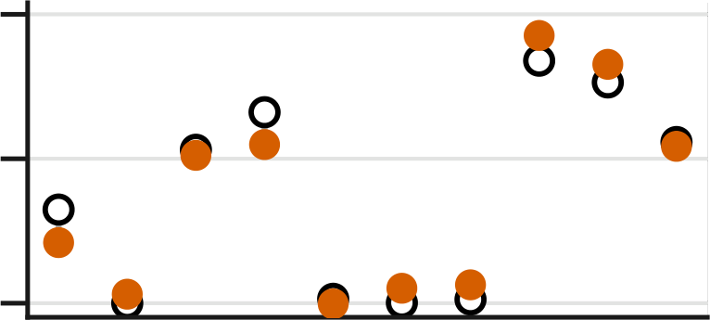
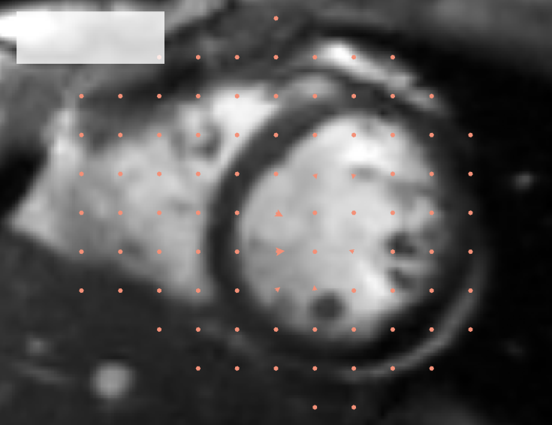
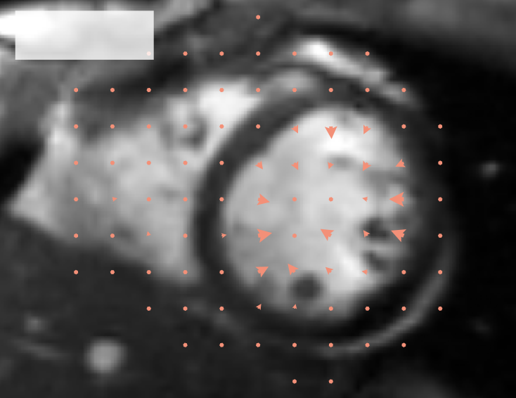
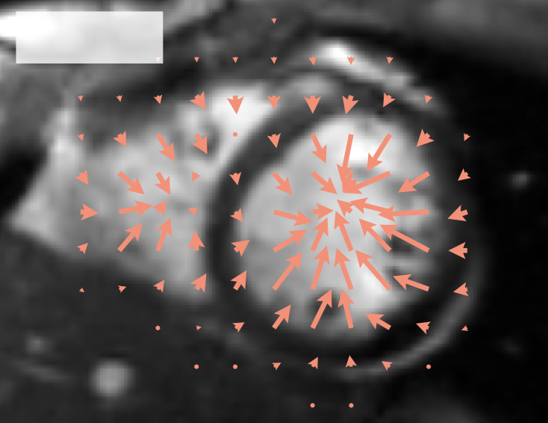
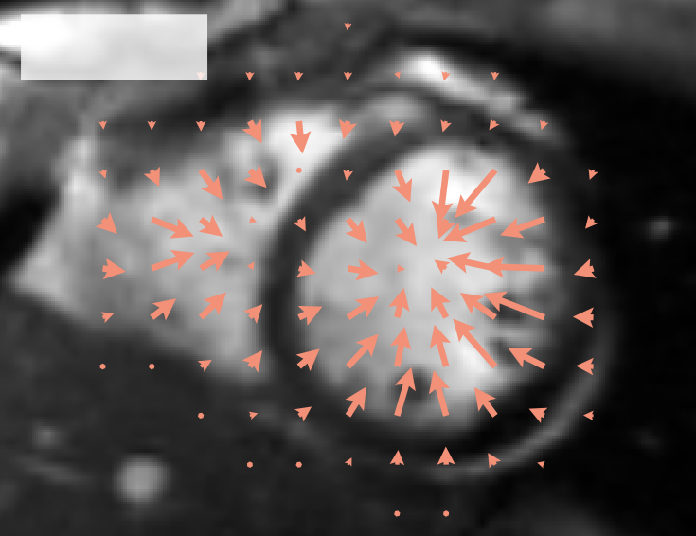
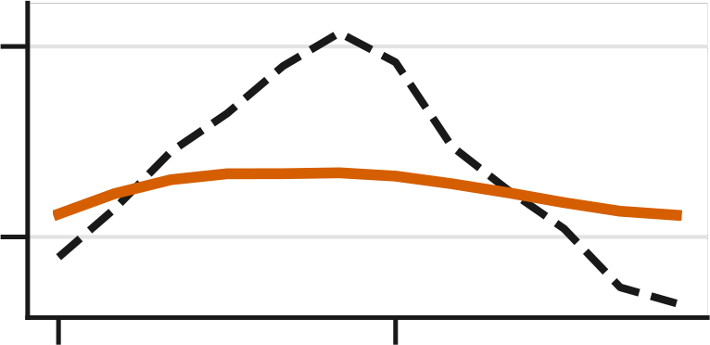
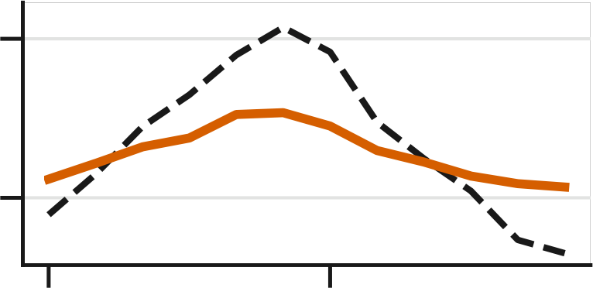
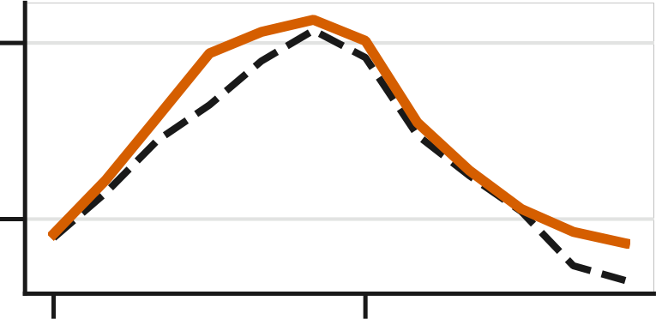
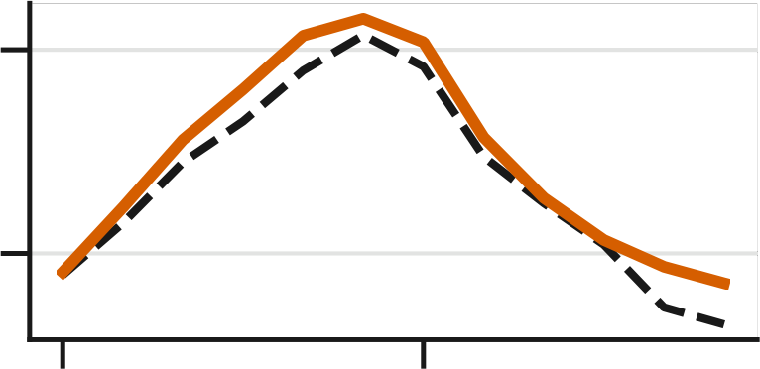
w/o ℒ_{h}
w/o ℒ_{obs}
w/o ℒ_{smooth}
Full
10
EPE 0.6 mm
EPE 2.4 mm
EPE 0.8 mm
EPE 0.6 mm
(a)
Resp. shift (mm)
5
0
slice (apex→base)
0.1 mm
0.7 mm
3.8 mm
3.5 mm
(b)
100
(c)
LV volume (mL)
50
EF 17%
EF 30%
EF 60%
EF 60%
0.0
0.5
0.0
0.5
0.0
0.5
0.0
0.5
Acquisition time (s)
Ground truth
Predicted
Notes:
ablation_motion: rendered by _paper_figures/render_ablation_motion.py (see _paper_figures/README.md). Text = native text boxes; each panel = its own PNG layer.

Slide 4

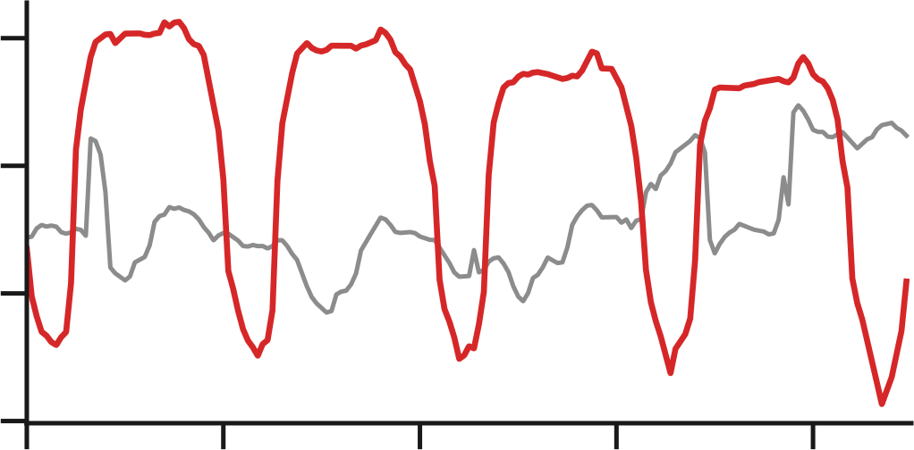


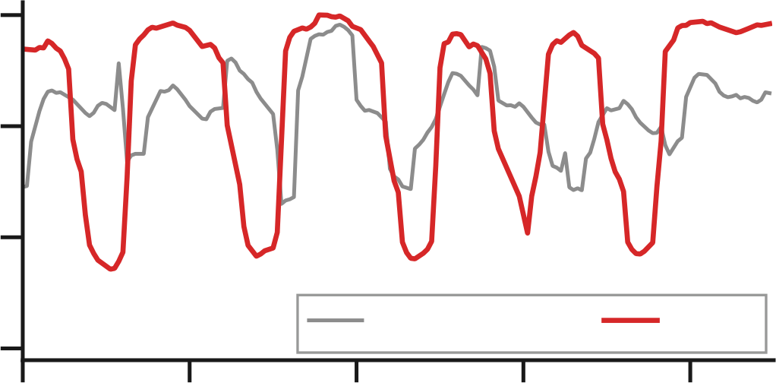

150
Naive
125
Healthy volunteer
LV vol. (mL)
Ours
100
75
200
Naive
150
AF patient
LV vol. (mL)
100
Ours
50
Naive stack
Ours
0
1
2
3
4
Time (s)
Notes:
real_rt: rendered by _paper_figures/make_rt_figure.py (see _paper_figures/README.md). Text = native text boxes; each panel = its own PNG layer.

