Slide 1
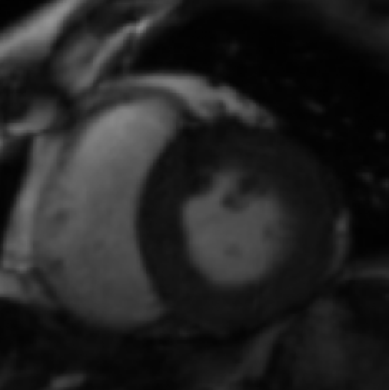
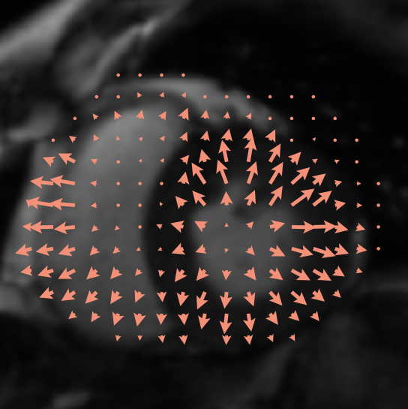
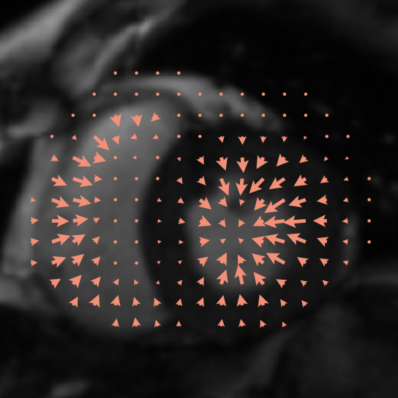
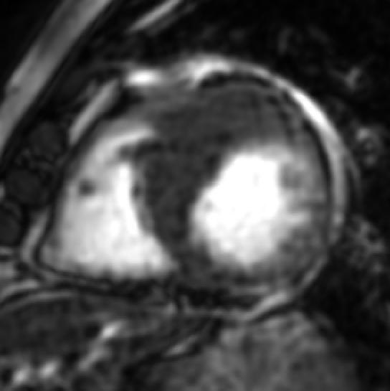
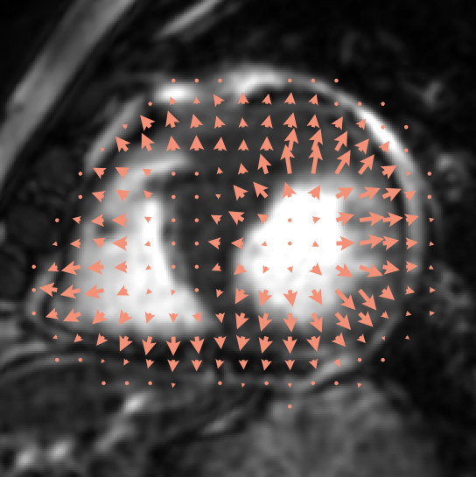
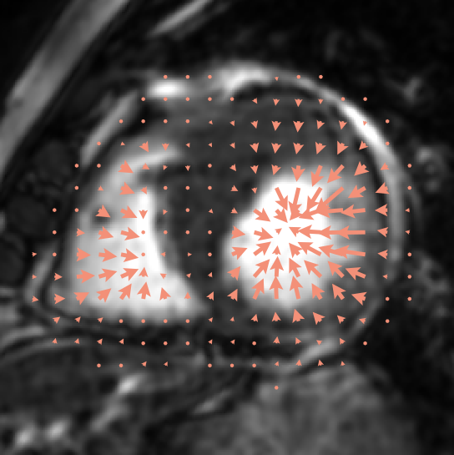
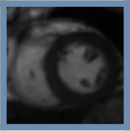
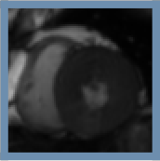
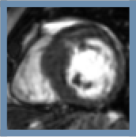
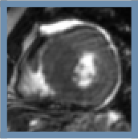
AF
HRV
Input
ED target
ES target
Input
ED target
ES target
Notes:
reference_conditioning: rendered by _paper_figures/render_motion_edes.py (see _paper_figures/README.md). Text = native text boxes; each panel = its own PNG layer.

Slide 2
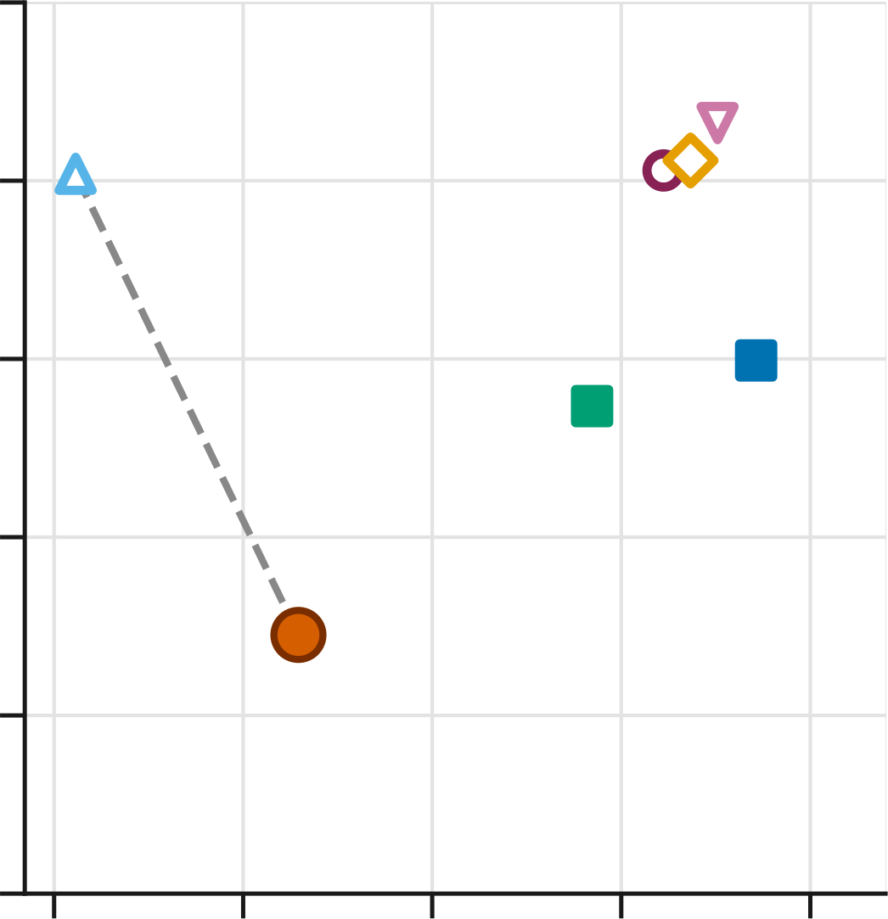
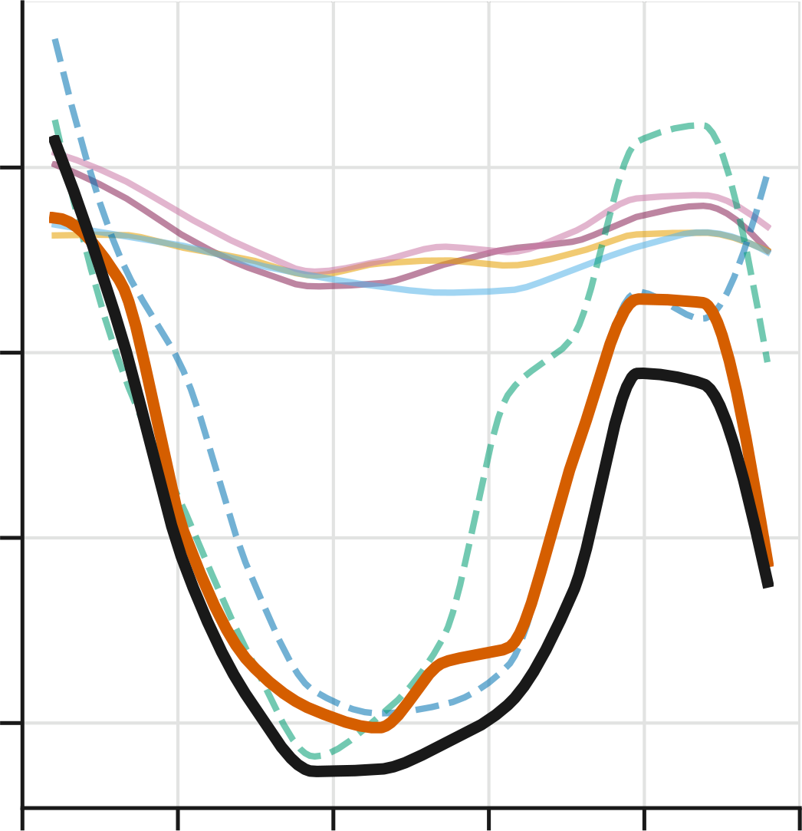
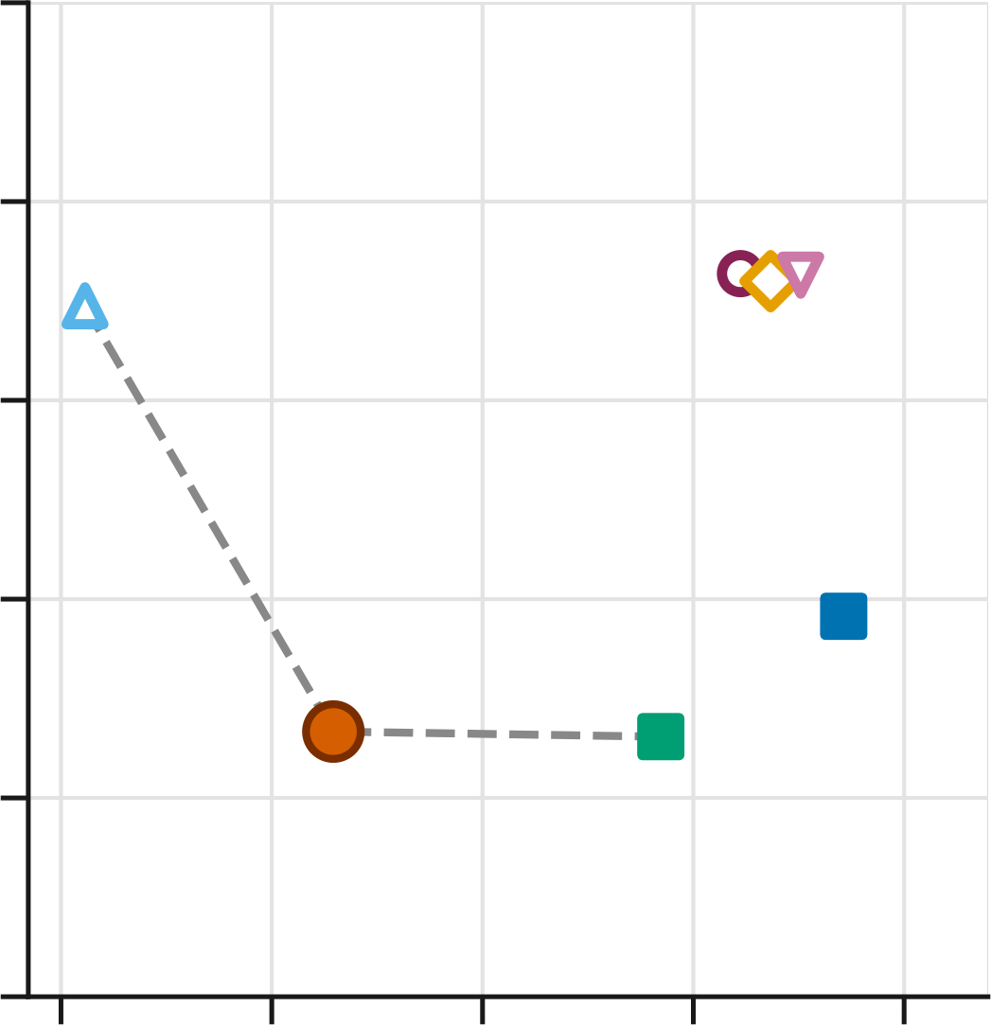
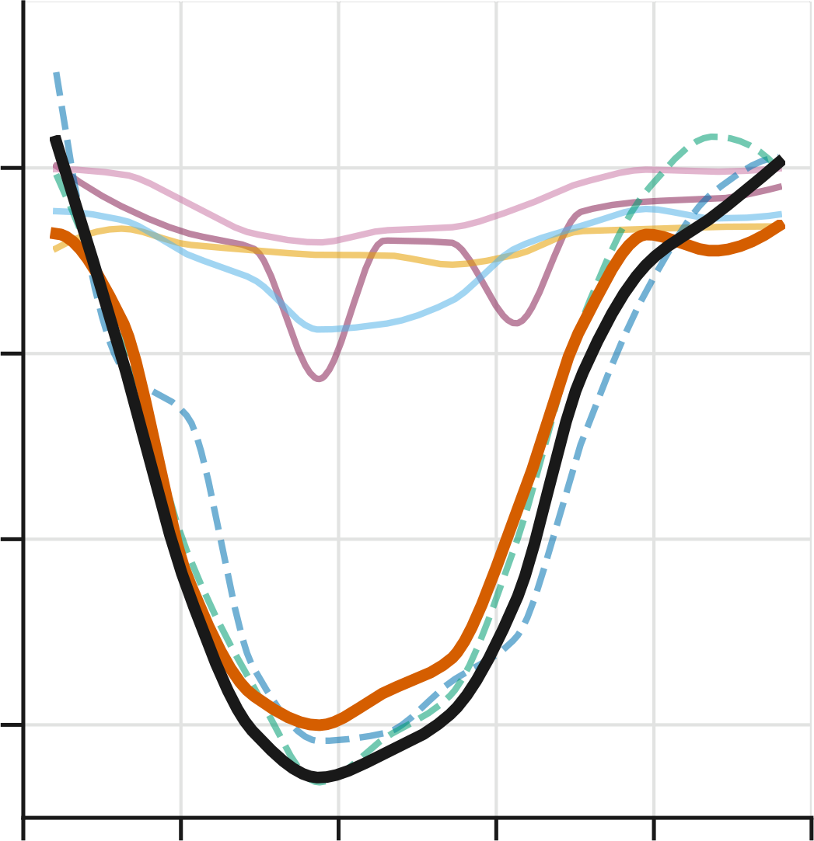
GT
Ours
CiNeVol†
Fetal CMR 4D†
Dangi et al.
NeSVoR
NiftyMIC
SVRTK
25
25
20
125
20
125
15
100
15
100
VTC err. ↓
LV volume (mL)
VTC err. ↓
LV volume (mL)
10
75
10
75
5
5
50
50
0
0
0.1
1
10
100
1000
0.0
0.2
0.4
0.6
0.8
1.0
0.1
1
10
100
1000
0.0
0.2
0.4
0.6
0.8
1.0
Runtime (s)
Acquisition time (s)
Runtime (s)
Acquisition time (s)
(a) Atrial fibrillation (AF)
(b) Heart rate variability (HRV)
Notes:
runtime_vtc_af_hrv: rendered by _paper_figures/render_vtc_2x2.py (see _paper_figures/README.md). Text = native text boxes; each panel = its own PNG layer.

Slide 3
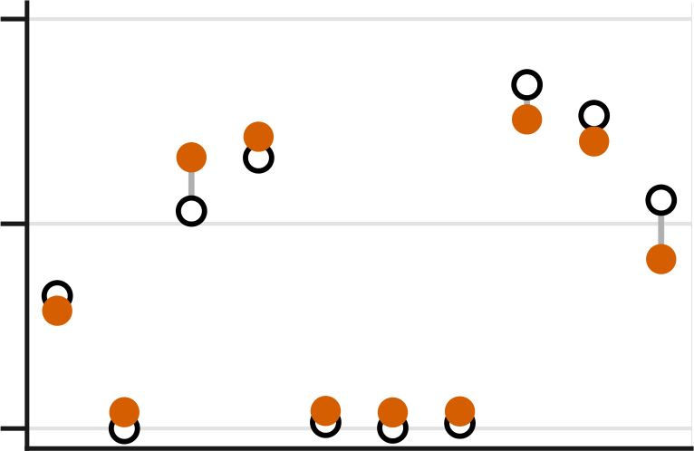
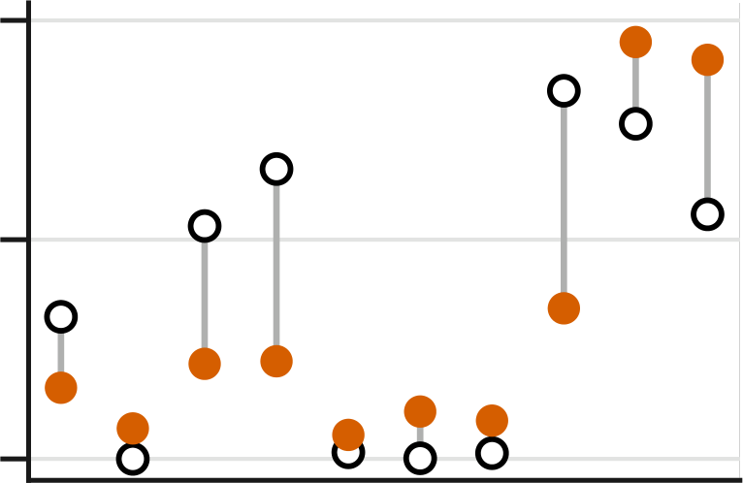
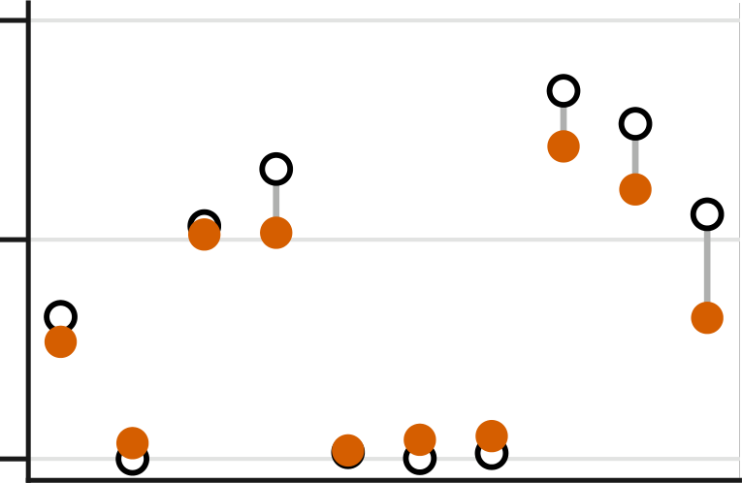
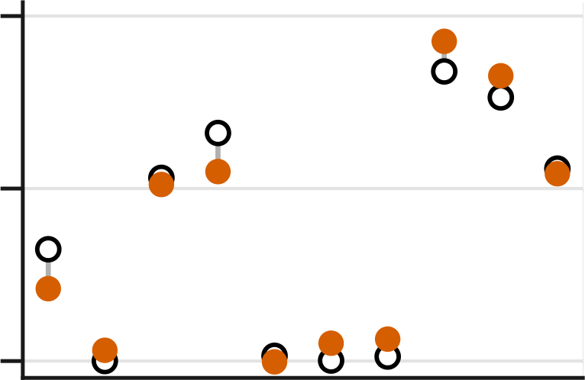
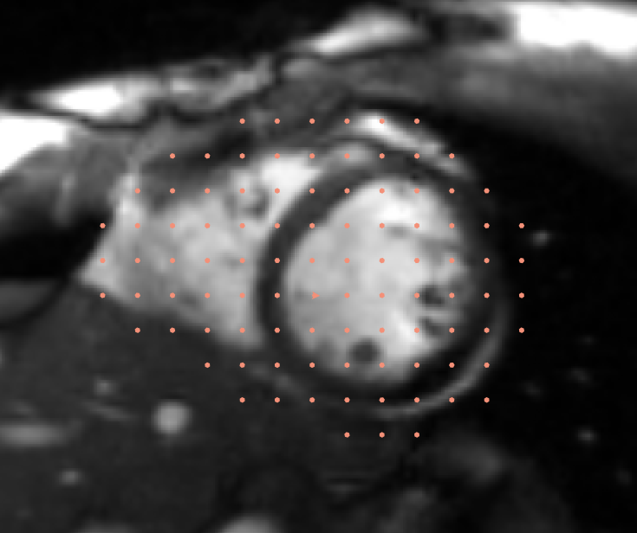
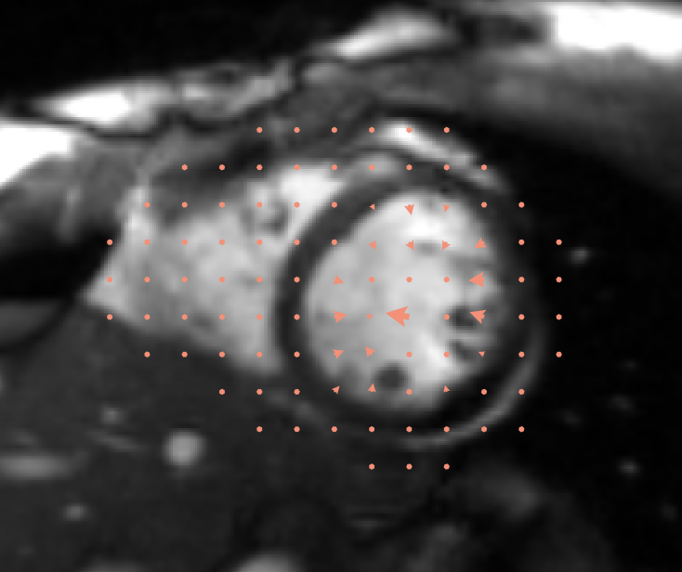
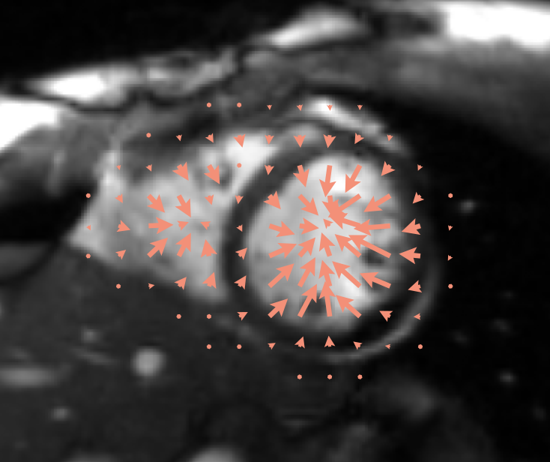

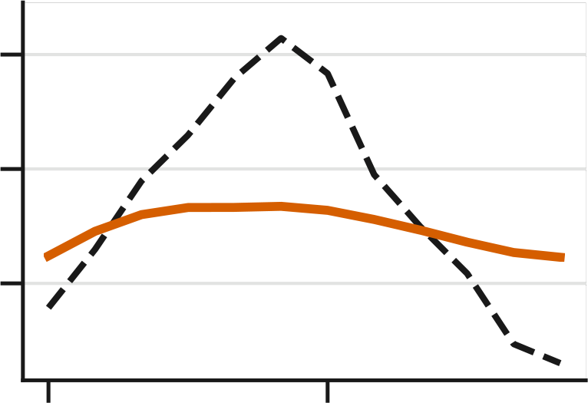
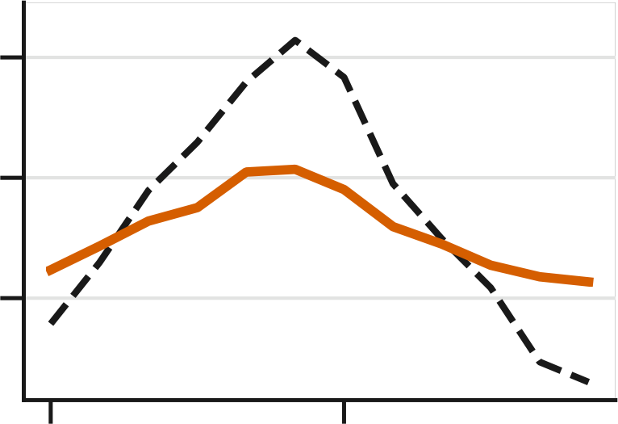
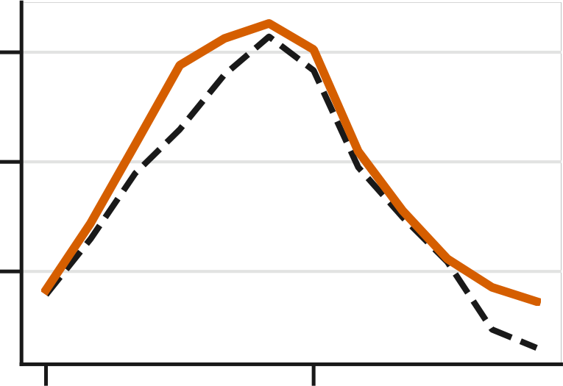
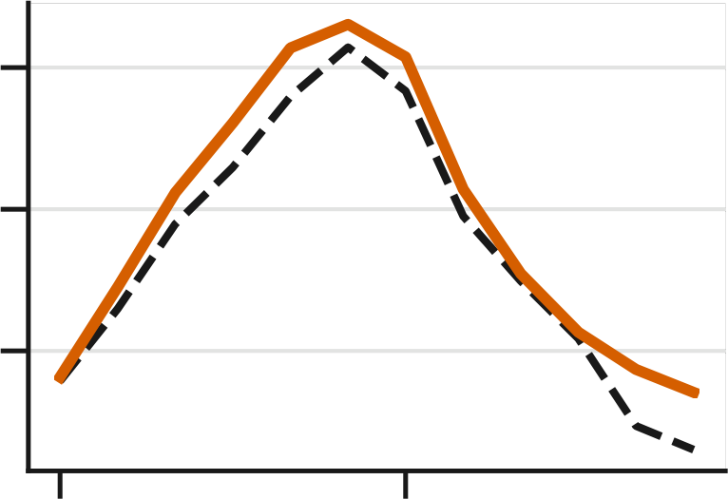
w/o cardiac-region term
w/o ℒ_{obs}
w/o ℒ_{smooth}
Full
10
EPE 0.6 mm
EPE 2.4 mm
EPE 0.8 mm
EPE 0.6 mm
(a)
Resp. shift (mm)
5
0
slice (apex→base)
0.1 mm
0.7 mm
3.8 mm
3.5 mm
(b)
100
(c)
75
LV volume (mL)
50
EF 17%
EF 30%
EF 60%
EF 60%
0.0
0.5
0.0
0.5
0.0
0.5
0.0
0.5
Acquisition time (s)
Ground truth
Predicted
Notes:
ablation_motion: rendered by _paper_figures/render_ablation_motion.py (see _paper_figures/README.md). Text = native text boxes; each panel = its own PNG layer.

Slide 4
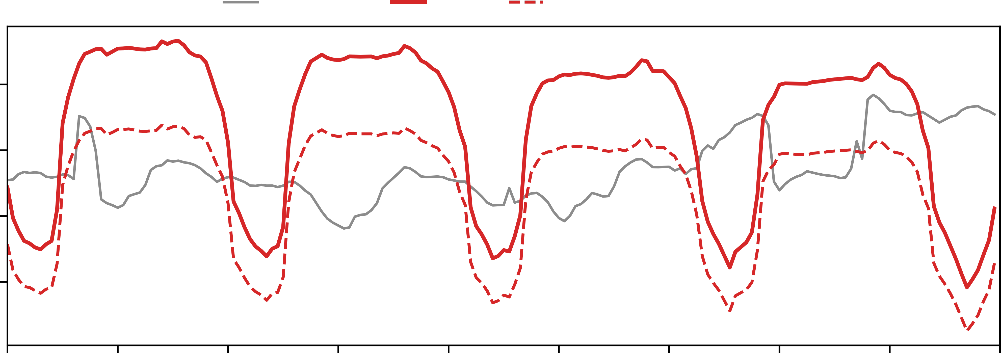
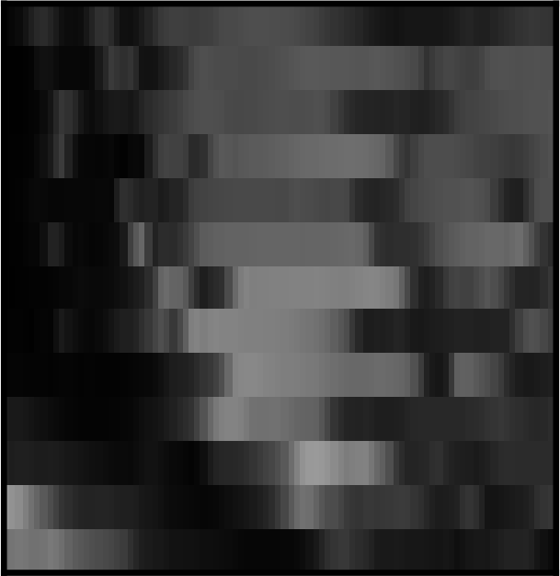

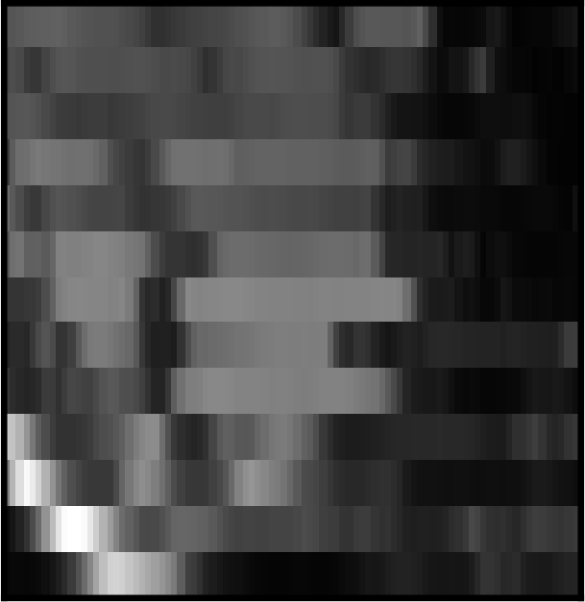
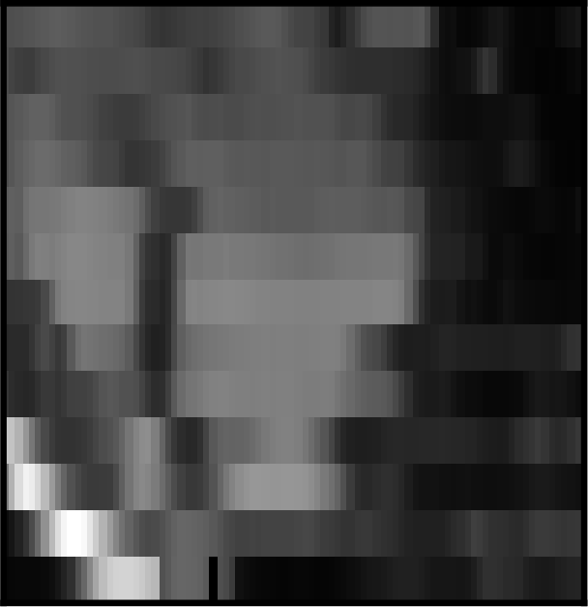


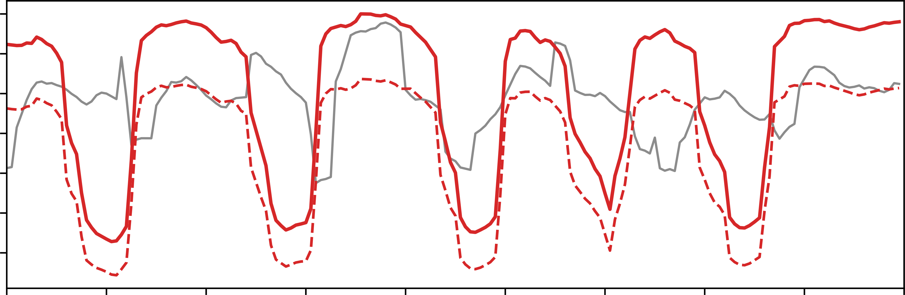


LV volume over time
Naive stack
Ours
Naive stack
Ours
Ours, reference slice excluded
140
LAX view 1
120
Healthy volunteer
LV volume (mL)
100
LAX view 2
80
200
180
LAX view 1
160
AF patient
140
LV volume (mL)
120
LAX view 2
100
80
0.0
0.5
1.0
1.5
2.0
2.5
3.0
3.5
4.0
4.5
time (s)
Notes:
real_rt: rendered by _paper_figures/make_rt_figure.py (see _paper_figures/README.md). Text = native text boxes; each panel = its own PNG layer.

