Slide 1

Project Presentation
20220848 선민수
Minsu Sun
(minus.sun@postech.ac.kr)

Slide 2
PBBS(Problem Based Benchmark Suite) v2
- Outlined in ACM SIGPLAN Symposium on Principles&Parctice of Parallel Programming (PPoPP), 2022
- Collection of over 20 benchmarks defined in terms of their IO characteristics
- Basic Building Block(SORT, HIST, ISORT, DDUP)
- Graph Algorithms(BFS, MIS, MM, MSF, SF)
- Text Processing(BWD, IIDX, LRS, SA, WC)
- Computational Geometry/Graphics(CH, DR, DT, KNN, RAY, RQ)
- Others(CLAS, NBODY)
- https://github.com/cmuparlay/pbbsbench

Slide 3
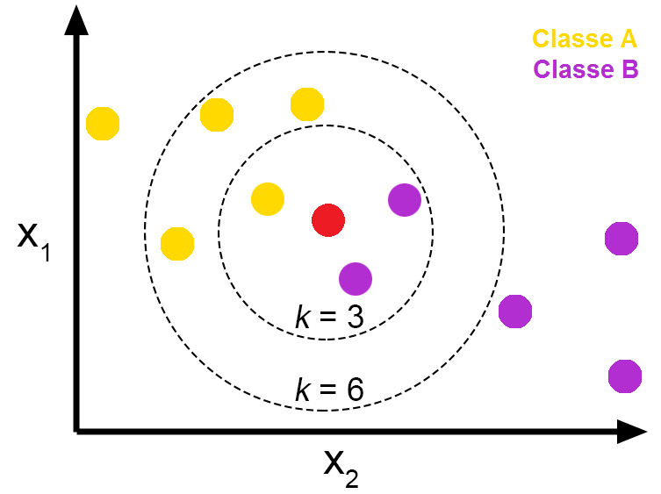
Problem Definition: KNN
- KNN(K-Nearest Neighbors)
- Find K nearest neighbors of all individual n points in d-dimensional space
- Often used in classifier or regression tasks in machine learning

Slide 4
Overview
Step 1: Calculating Distance between points
Step 2: Sorting points by distance(+ get k nearest points)

Slide 5
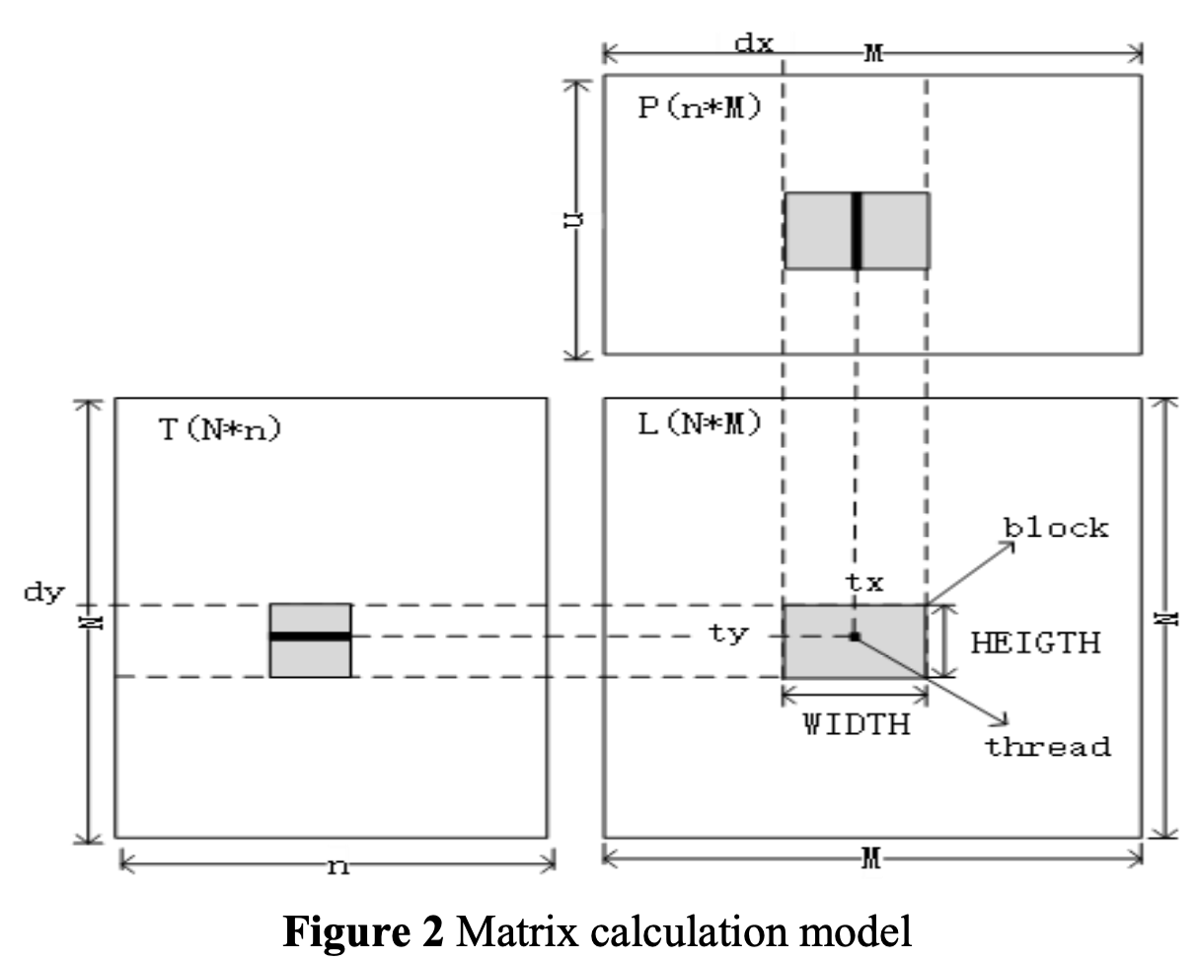
Strategy: Distance
- Naïve: calculate distance of all pairs of points in serial
- Strategy: calculate distance in the manner of matrix multiplication with tiling in parallel

Slide 6

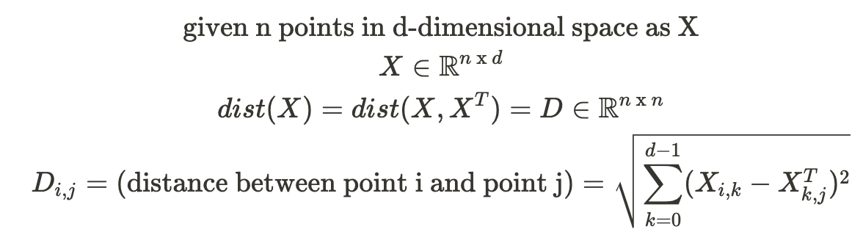
Strategy: Distance
d
n
n
n
o
d
=
n

Slide 7
Strategy: Sort
- Naïve: serial O(nlogn) sort (e.g. quick sort, merge sort … )
- Strategy: use odd-even transposition sort in parallel

Slide 8
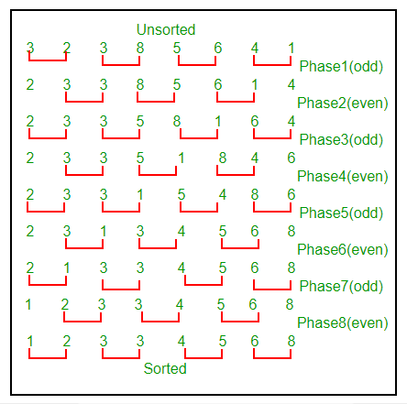
Strategy: Sort
- Variation of Bubble Sort
- n phases for data size n
- Serial: O(n^2)
- Parallel: O(n)
< Odd-Even Transposition Sort >

Slide 9
Experiment
Baseline: naïve CPU based implemented KNN
- Distance: naïve calculation in serial
- Sorting: quick sort in serial
Experiment #1: improved CUDA based implemented KNN
- Distance: matrix tiling based calculation in parallel
- Sorting: Odd-Even transposition sorting in parallel

Slide 10
Experiment
Test
- 2D points in Cube, n=1M, d=2, k=1, rounds=3
- 2D points in Kuzmin Distribution, n=1M, d=2, k=1, rounds=3
- 3D points in Cube, n=1M, d=3, k=1, rounds =3
- 3D points on Sphere, n=1M, d=3, k=1, rounds = 3
- 3D points in Cube, n=1M, d=3, k=10, rounds = 3
- 3D points in Plummer Distribution, n=1M, d=3, k=10, rounds=3

Slide 11
Progress
- Implement data loader and run script from PBBS benchmark data
- Implement baseline(naïve version)
- Working on implementing CUDA version

Slide 12
QnA

