Slide 1

Graphical Research Summary
Clinical Neuroprosthetics and Brain Interaction Lab
UT Austin
Aug. 25th, 2020

Slide 2
Contents
Research experience
Brain slice electrophysiology system (2019-2020, Korea Inst. of Sci. and Tech. – BioMicrosyst. Lab)
Segregated polymer composites modeling (2018-2019, Korea Univ. – Communication Systems Lab)
Retinal connectomics project – EyeWire (2015, Princeton Univ. – Comp. Neuroscience Lab)
My Doctoral Goal
To implement closed-loop control using noninvasive brain stimulation methods

Slide 3
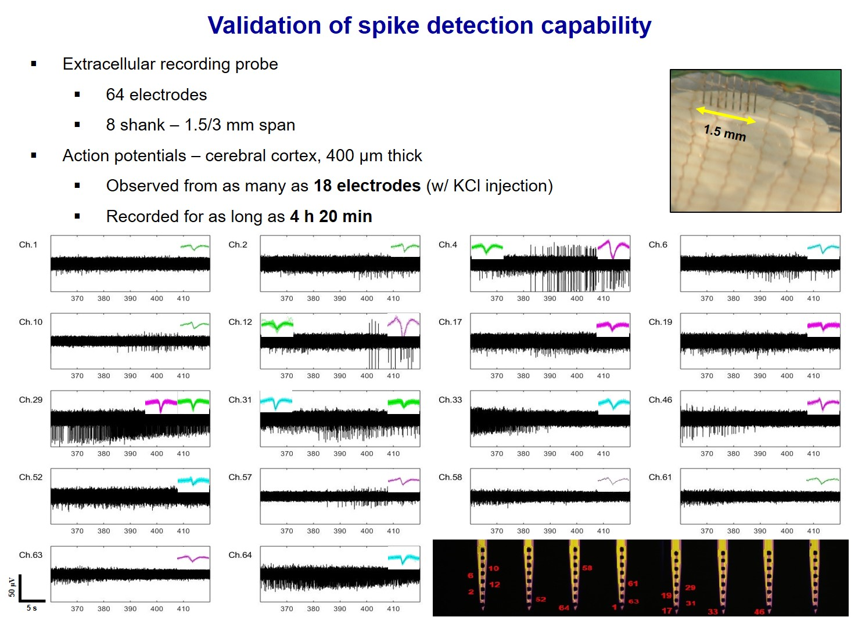
Brain slice electrophysiology system (Korea Institute of Science and Technology, 2019 – 2020)

Slide 4
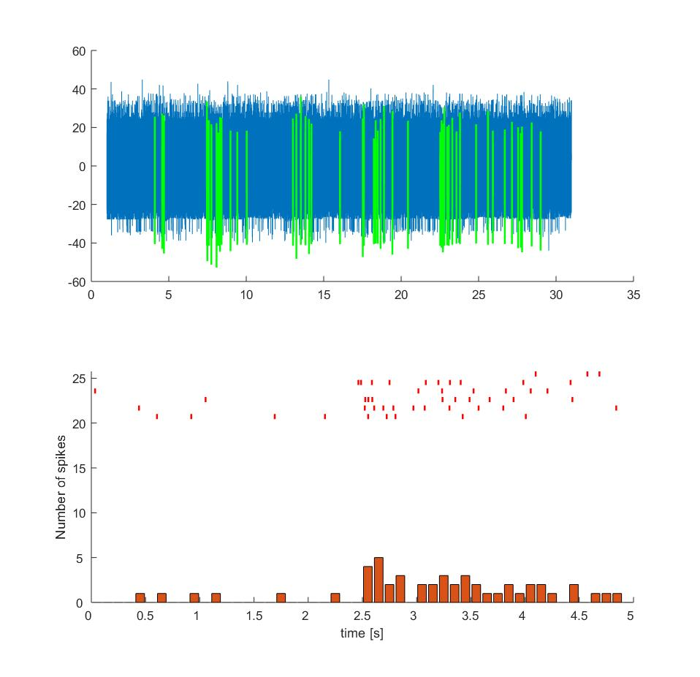
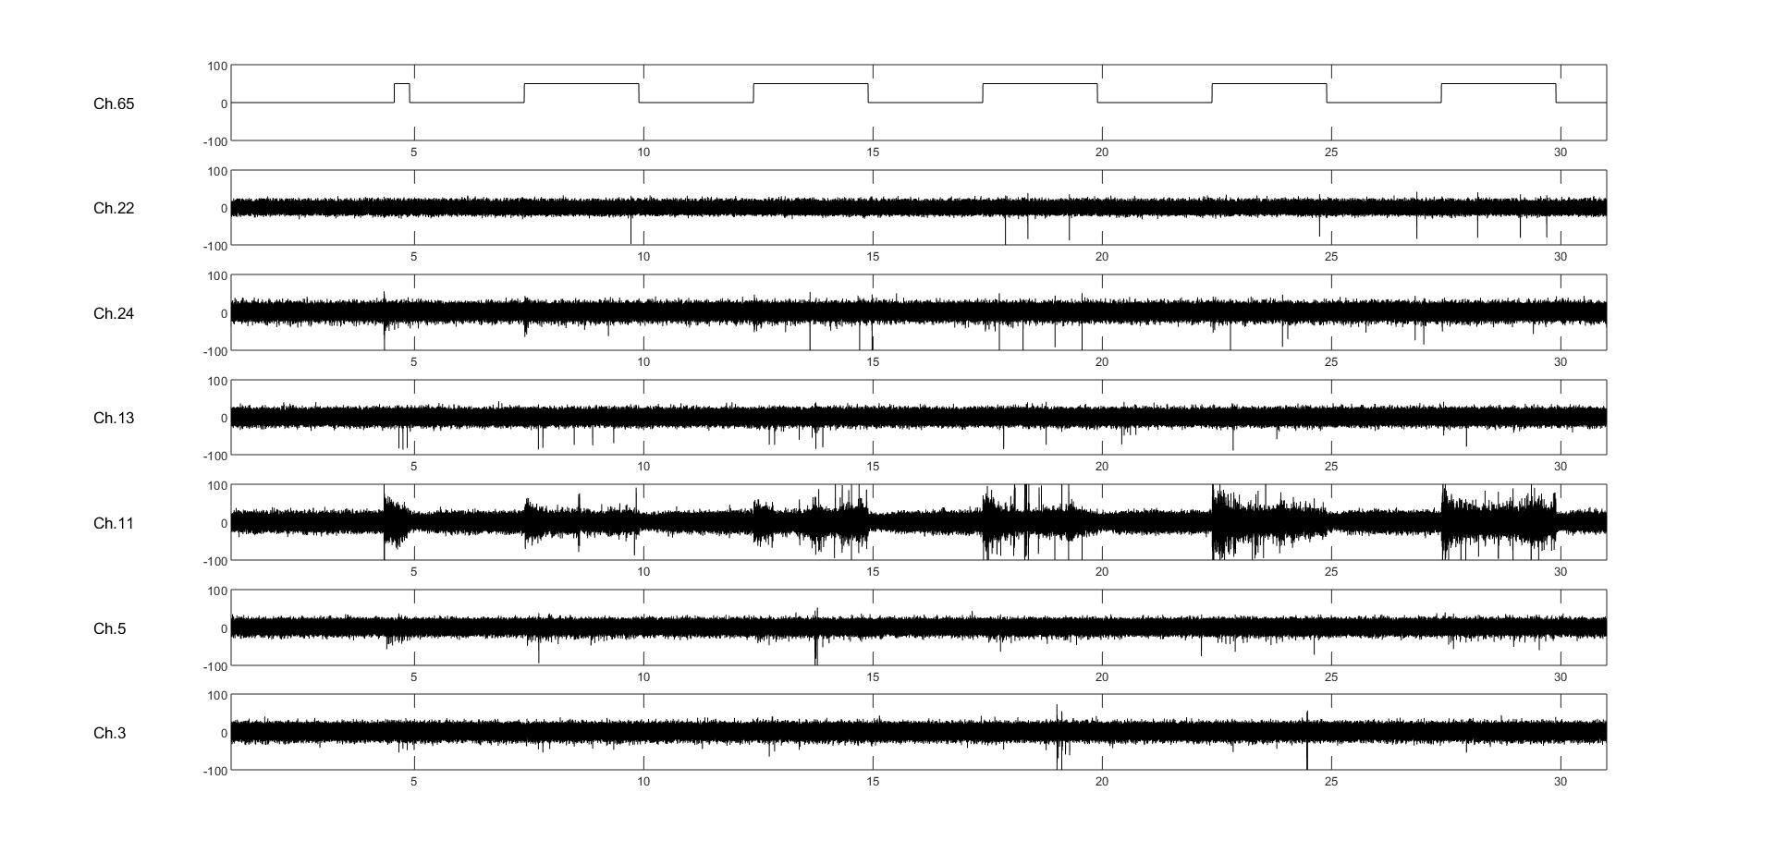
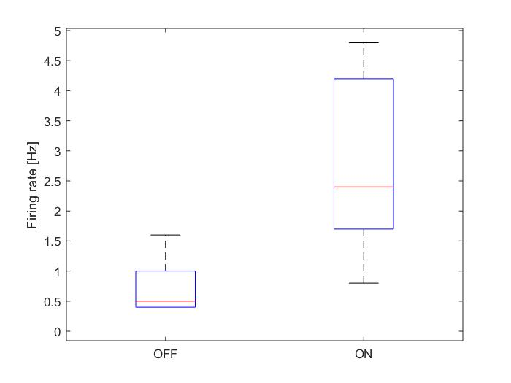
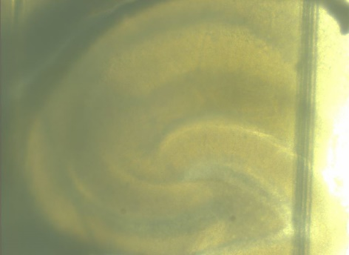
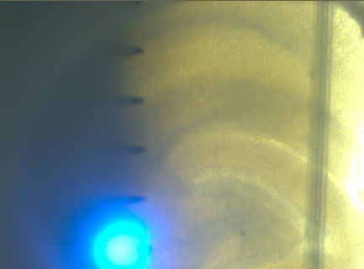
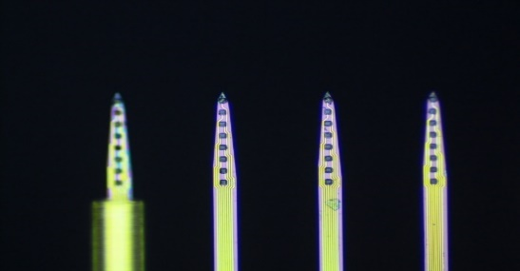
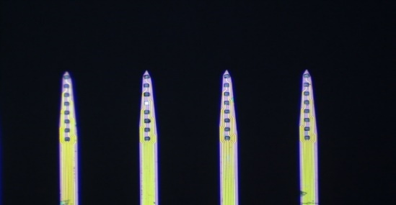
Brain slice electrophysiology system (Korea Institute of Science and Technology, 2019 – 2020)
Validation of precise targeting capacity
Targeted recording from ventral HPC (CA1 w/ Schaffer collateral stim.)
330 μm thick hippocampal slice (Thy1-ChR2-YFP)
Light
ON
ON
ON
ON
ON
OFF
ON
S1
Raster plot
S2
ON
OFF
*
S5
S2
Firing rate
HPC
S1
CA1
S5
CA2
DG
CA3
S2
S5
S1
Light

Slide 5
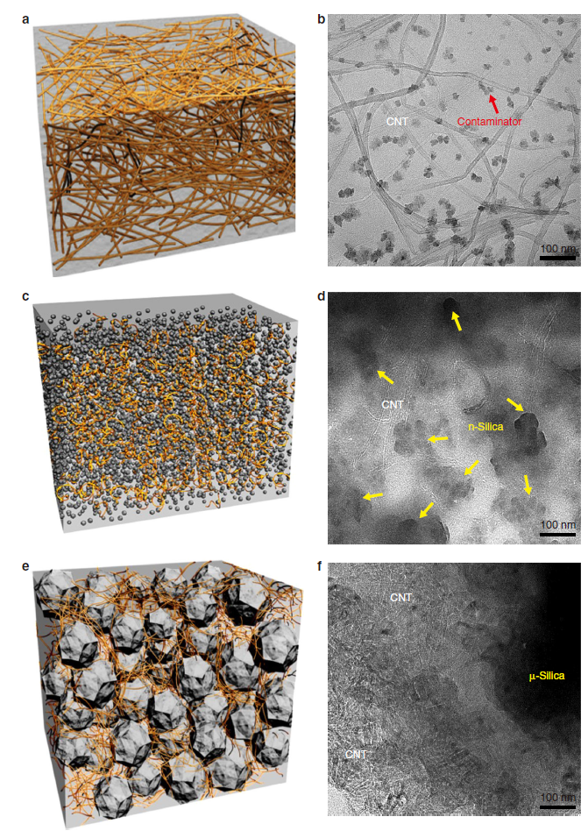
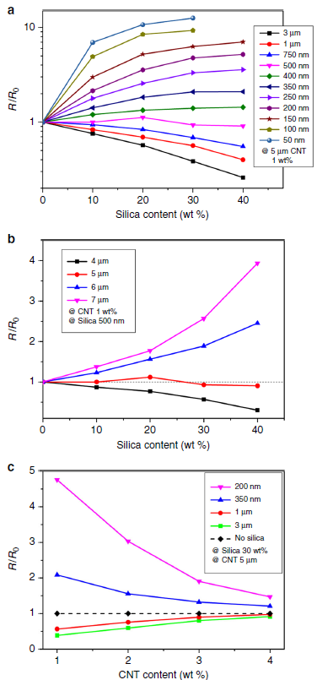
Segregated Polymer Composites Modeling (Korea University, 2018 – 2019)
Aim: to model the electrical conductance properties of polymer composites with segregated structures
Raising microscale fillers percentage – decreases conductivity due to the prevention of the interconnections between CNTs.
Raising nanoscale fillers percentage – enhances conductivity based on exclude volume theory
Our approach: simulated the polymer composite in MATLAB and measured the electrical resistivity through Monte Carlo simulation to explain the results using Voronoi geometry and percolation theory
Publication: Nature Communications (June, 2019)
My contribution: built the 3D CNT network simulator and revised the manuscript together

Slide 6
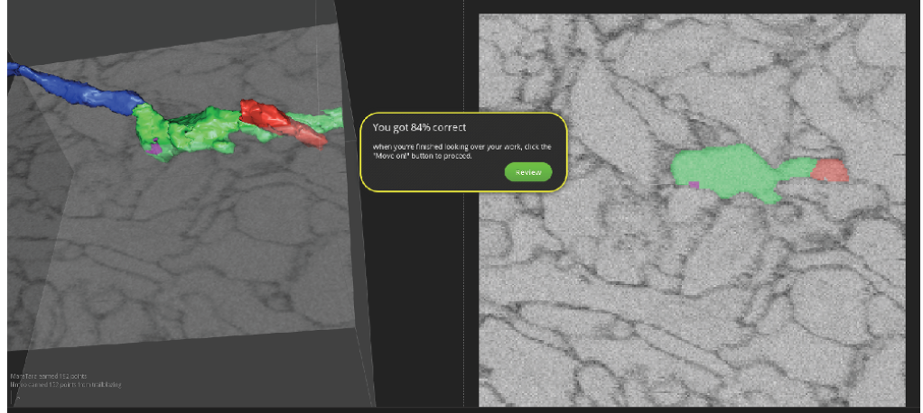
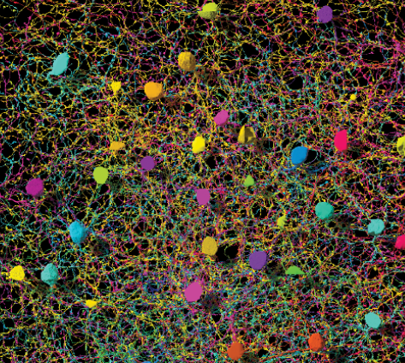
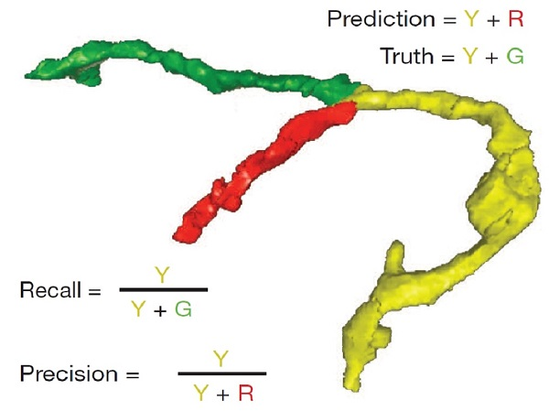
Retinal Connectomics Project – EyeWire (Princeton University, Jan – Feb 2015)
Aim: to reconstruct 3D models of neurons from electron microscopy (EM) images via machine learning and crowd sourcing
Our approach: Transform the labeling process of 2D EM images into an entertainment software to data generated by vast online users. The collected user data was used to train the deep convolutional network which classifies retinal cells.
Result: mapped structures of over 3000 retinal neurons with the help of 2.7 million participants
Details: https://blog.eyewire.org/about/
My contribution: improved the data assessment algorithm of the starburst amacrine cell by computing its stratification profile via using a support vector machine

