Slide 1
Course 내 개념
three-schema architechure
Database schema / database instance
Data model
Meta data
DDL/SDL/VDL과 DML
ERD
RDB/NDB/HDB/OODB
Concurrency control
Backup
Index
Nosql
성능
Query optimizer
read/write
기타
Data 관련 직군
DBA
Data engineer
data scientist
Bigdata
DW
Blockchain
Cloud 환경 &
DB 자동화
실무
GPU DBMS

Slide 2
https://db-engines.com/en/ranking
https://deview.kr/2018
https://datayanolja.github.io/
https://ndc.nexon.com/main
https://www.pycon.kr/2018/
기타 2018 국내 IT 컨퍼런스 일정
https://zetawiki.com/wiki/2018_%EA%B5%AD%EB%82%B4_IT_%EC%BB%A8%ED%8D%BC%EB%9F%B0%EC%8A%A4_%EC%9D%BC%EC%A0%95

Slide 3
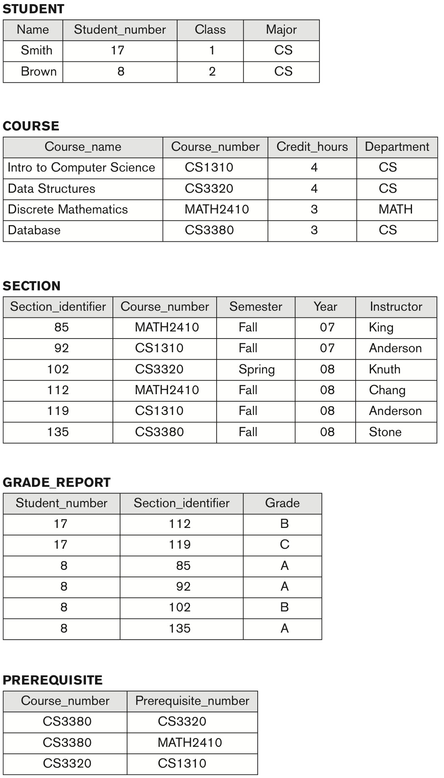
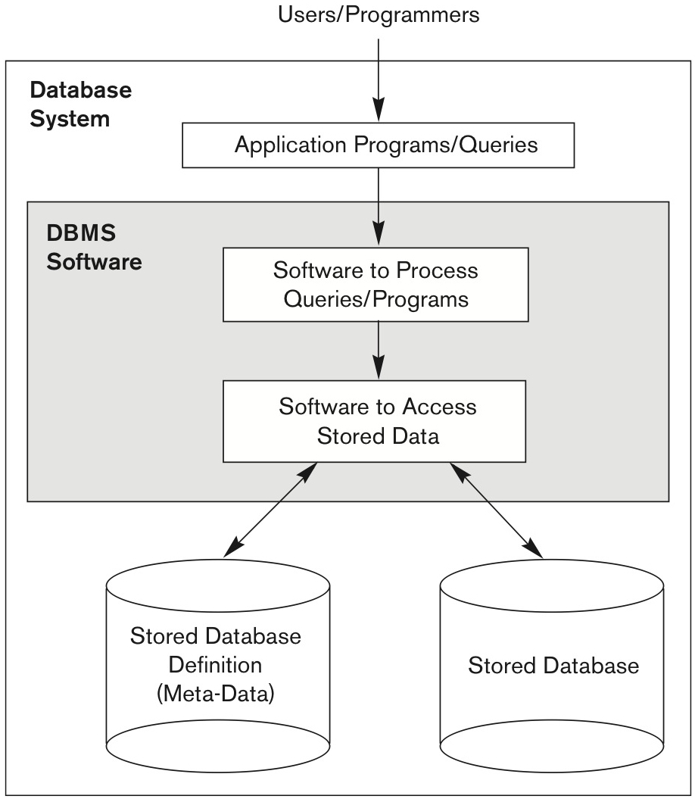
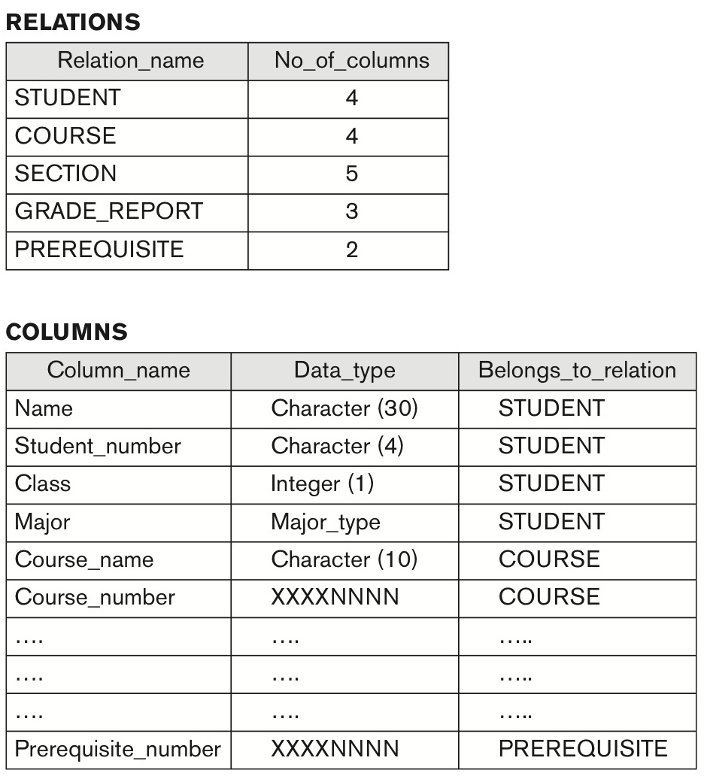

Slide 4
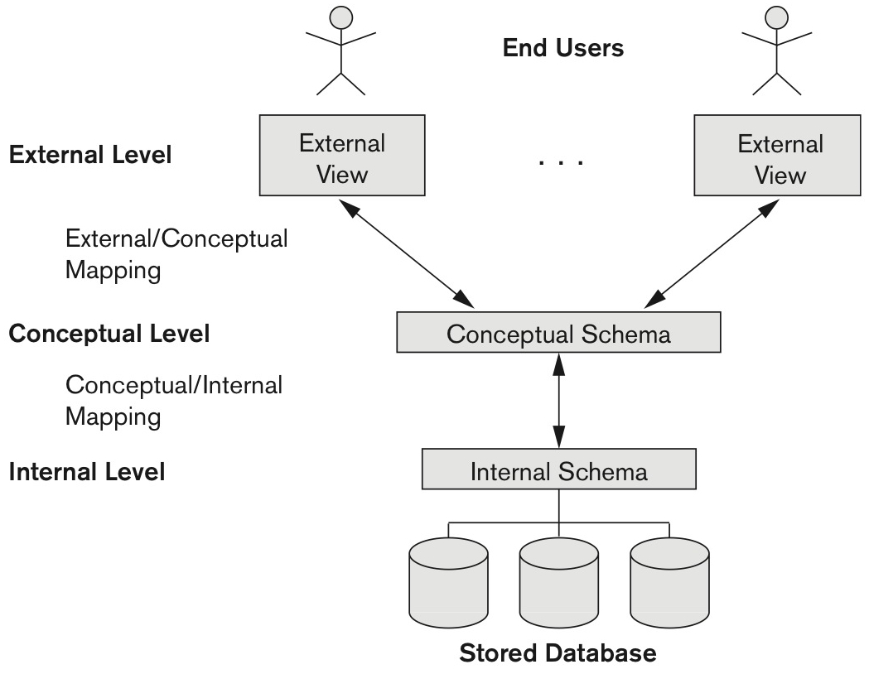
Conceptual(High-level) data model
Entity – Relationship Model
Implementation(Representational) data model
Relational Data model
network data model
hierarchical data model
Object data model
Physical(Low-level) data model
데이터 저장 방법 기술
레코드 포맷/순서

