Slide 1

鱼眼视图的源代码应用
——Visual Studio编辑器扩展
齐笑尘 082887
Notes:
Structural analysis of a steel and concrete structure. Created in Autodesk(R) Robot(TM) Structural Analysis Professional and Autodesk(R) Revit(R) Structure software products. Rendered in Autodesk(R) 3ds Max(R) software.
Expiration Date: 2099-01-01
No image credit required.

Slide 2
课题背景
软件开发是一项复杂的劳动
软件系统规模不断增大
如何提高软件开发效率？
源代码的浏览与编辑
鱼眼视图理论
Visual Studio编辑器的扩展

Slide 3
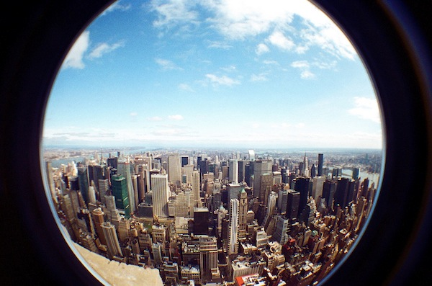
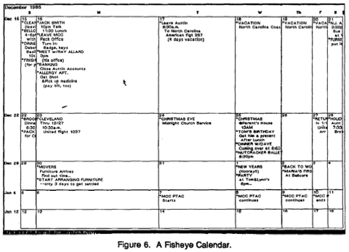

鱼眼视图
Notes:
Use this format for the discussion portion of your presentation.

Slide 4
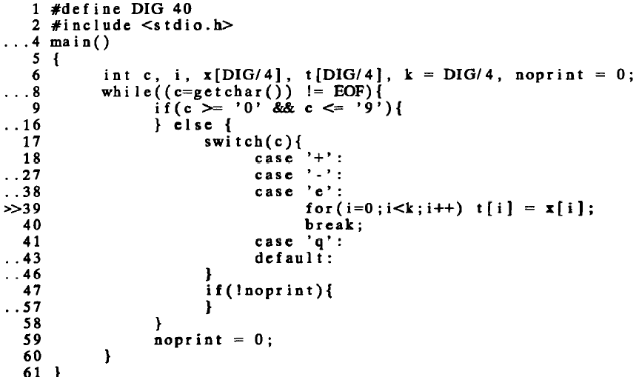
鱼眼视图和源代码展示
George W. Furnas
Notes:
Use this format for the discussion portion of your presentation.

Slide 5
<Insert an image from your demonstration here>
AEC AE Summit | Demonstration
Title of Demonstration 1
In this Demonstration we will cover the following:
Bullet point
Bullet point
Bullet point
Notes:
Use this format to introduce the demonstration portion of your presentation.

Slide 6
<Insert an image from the completed exercise here>
AEC AE Summit | Exercise
Title of Exercise 1
In this Exercise you will perform the following:
Bullet point
Bullet point
Bullet point
Notes:
Use this format to introduce the exercise portion of your presentation.

Slide 7
AEC AE Summit | Summary
Summary 1
Target Audience (address as possible)
Opportunity (address as possible)
Benefits (address as possible)
Competitive Advantages (address as possible)
Objection Handling (address as possible)
Notes:
Use this format to introduce the exercise portion of your presentation.

Slide 8
Blank Slide(s) for your presentation 2
AEC AE Summit | Presentation
Title of your Presentation Topic 2
Notes:
Use this format for the discussion portion of your presentation.

Slide 9
<Insert an image from your demonstration here>
AEC AE Summit | Demonstration
Title of Demonstration 2
In this Demonstration we will cover the following:
Bullet point
Bullet point
Bullet point
Notes:
Use this format to introduce the demonstration portion of your presentation.

Slide 10
<Insert an image from the completed exercise here>
AEC AE Summit | Exercise
Title of Exercise 2
In this Exercise you will perform the following:
Bullet point
Bullet point
Bullet point
Notes:
Use this format to introduce the exercise portion of your presentation.

Slide 11
AEC AE Summit | Summary
Summary 2
Target Audience (address as possible)
Opportunity (address as possible)
Benefits (address as possible)
Competitive Advantages (address as possible)
Objection Handling (address as possible)
Notes:
Use this format to introduce the exercise portion of your presentation.

Slide 12
Duplicate the Presentation, Demo, Exercise, Summary slides as necessary to complete the session. Sessions can have from 1 to n of these sequences.
AEC AE Summit | Presentation
Title of your Presentation Topic X
Notes:
Use this format for the discussion portion of your presentation.

Slide 13
