Slide 1
CURRENT PIPELINE | 9 NOV 2026
Connectome Brain Age: Audit, Revised Pipeline and Results
Participant-nested evaluation of DWI, signed fMRI and early fusion
Audit findings → training-only transformations → nested prediction
Matched Ridge and full-budget GINE → calibration and remaining validation
Current development results first; historical benchmarks and reconstructed attribution in the appendix.
Current source + audited aggregate runs | Updated 9 November 2026
01
Notes:
Evidence: Current source + audited aggregate runs | Updated 9 November 2026

Slide 2
CURRENT PIPELINE | 9 NOV 2026
Three points to take away
• The audit identified full-sample preprocessing, outer-score threshold selection and mixed calibration provenance.
• The revised evaluation nests preprocessing, selection and stopping within participant-level training partitions.
• Matched Ridge and completed GINE arms are available; clinical source validation and anatomical interpretation remain unresolved.
Implementation validation supports the evaluation design; it does not verify the underlying clinical data.
audit_findings.tsv; audit_to_implementation.csv; completed-run audit.json
02
Notes:
Evidence: audit_findings.tsv; audit_to_implementation.csv; completed-run audit.json

Slide 3
CURRENT PIPELINE | 9 NOV 2026
Audit findings and the implemented response
Finding | Revised behavior
Global ComBat + full-sample feature mask | Training-only QC, ComBat and scaling at every fit boundary
Threshold chosen using reported OOF scores | Choose sparsity within inner validation
Stopping and selection need separation | Separate inner stopping split; fixed-epoch outer refit
CN final predictions include in-sample fits | Evaluate held-out predictions; calibrate from training inner OOF
Unverified pairing and reconstructed attribution | Explicit pairing exclusions; original checkpoint attribution
reports/pipeline_audit/audit_findings.tsv; reports/new_pipeline/audit_to_implementation.csv
03
Notes:
Evidence: reports/pipeline_audit/audit_findings.tsv; reports/new_pipeline/audit_to_implementation.csv

Slide 4
CURRENT PIPELINE | 9 NOV 2026
The revised pipeline: fitting stays within training
1 Register
2 Split
3 Fit
4 Evaluate
Raw connectomes
Metadata evidence
Canonical participant groups
Frozen outer folds
CN training reference
Separate inner / stopping folds
Training-only QC
Additive ComBat
Scaling + selected model
Outer held-out age
Training-OOF calibration
Saved states and audits
→
→
→
No outer-test age enters feature transformation, configuration choice or early stopping.
code/brainage_pipeline/{data,splits,preprocessing,engine,calibration}.py
04
Notes:
Evidence: code/brainage_pipeline/{data,splits,preprocessing,engine,calibration}.py

Slide 5
CURRENT PIPELINE | 9 NOV 2026
Current eligible populations and matched comparison
Population | Scans | Participants | CN scans
DWI | 919 | 670 | 723
fMRI | 575 | 447 | 441
paired | 318 | 252 | 237
Matched CN performance uses 237 scans / 189 participants; the full paired registry has 318 scans / 252 participants.
reports/new_pipeline/sample_counts.csv
05
Notes:
Evidence: reports/new_pipeline/sample_counts.csv

Slide 6
CURRENT PIPELINE | 9 NOV 2026
Cross-modality pairing: conservative exclusions
575 keys
250 excluded
7 excluded
318 retained
Common scan keys
Unique source matching
Metadata agreement required
Age disagreement
Tolerance: 0.01 years
No age averaging
Insufficient paired
CN batch support
Nested fits must be feasible
252 participants
237 CN scans
Dates still require verification
→
→
→
Agreeing keys and metadata do not establish contemporaneous DWI and fMRI acquisition.
reports/new_pipeline/pairing_counts.csv; code/brainage_pipeline/data.py
06
Notes:
Evidence: reports/new_pipeline/pairing_counts.csv; code/brainage_pipeline/data.py

Slide 7
CURRENT PIPELINE | 9 NOV 2026
Inputs, transforms and notation
Symbol / object | Definition
Aᴰ, Aᶠ | Symmetric 84 × 84 DWI and fMRI connectivity matrices
xᴰ ∈ R³⁴⁸⁶ | Upper-triangle DWI edges; fixed log1p transformation
xᶠ ∈ R³⁴⁸⁶ | Upper-triangle signed fMRI edges; clipped Fisher-z transformation
b, y, g | Known acquisition batch; age target; canonical participant group
CN reference | Diagnosis defines reference eligibility; it is not an imaging predictor
Age is the supervised target; no sex, APOE or metabolic variables enter the age-prediction features.
code/brainage_pipeline/data.py; code/final/{harmonization,foldwise_fmri}.py
07
Notes:
Evidence: code/brainage_pipeline/data.py; code/final/{harmonization,foldwise_fmri}.py

Slide 8
CURRENT PIPELINE | 9 NOV 2026
Feature QC and edge reconstruction are training-only
• Apply fixed modality transforms before learning feature statistics.
• Fit feature masks on the corresponding training rows, including nonconstant and residual-variance checks.
• Fit harmonization and StandardScaler only after training-only edge selection.
• Restore graph values to their original ROI-pair positions; excluded edges map to scaled zero and cannot enter topology.
• Frozen transforms reject unsupported batches and invalid input instead of silently adapting to test data.
code/final/harmonization.py; code/brainage_pipeline/preprocessing.py
08
Notes:
Evidence: code/final/harmonization.py; code/brainage_pipeline/preprocessing.py

Slide 9
CURRENT PIPELINE | 9 NOV 2026
Harmonization: compare declared modes
• No-ComBat control retains the same training-only QC and scaling boundaries.
• Training-age mean-only ComBat estimates additive batch offsets using training ages.
• Held-out transformation requires imaging and known batch metadata, without chronological age.
• Batch-only ComBat is an available sensitivity mode; the completed matched comparisons report none versus age_mean.
• Known-batch eligibility restricts the population; this does not evaluate generalization to an unseen acquisition batch.
Reduced technical predictability is not proof that all biological variation is preserved.
code/brainage_pipeline/preprocessing.py; code/final/harmonization.py
09
Notes:
Evidence: code/brainage_pipeline/preprocessing.py; code/final/harmonization.py

Slide 10
CURRENT PIPELINE | 9 NOV 2026
Additive harmonization: fit once, apply frozen offsets
Step | Operation
Fit on training rows | Estimate training-age-adjusted γ̂[b,j] and pooled scale σ̂[j]
Mean-only adjustment | xᴴ[i,j] = x[i,j] − σ̂[j] γ̂[bᵢ,j]
Training scaling | z[i,j] = (xᴴ[i,j] − μ̂train[j]) / ŝtrain[j]
Apply to held-out rows | Reuse mask, offsets and scaler; do not re-estimate parameters
Age boundary | Training age informs offsets; test age is unnecessary for this transform
The mean-only age terms cancel during application; this formula is not the general location-scale ComBat rule.
code/final/harmonization.py::_adjust; code/brainage_pipeline/preprocessing.py
10
Notes:
Evidence: code/final/harmonization.py::_adjust; code/brainage_pipeline/preprocessing.py

Slide 11
CURRENT PIPELINE | 9 NOV 2026
Harmonization diagnostics require held-out evidence
• Compare age-prediction performance under no-ComBat and additive harmonization.
• Assess technical and sex predictability on held-out representations with training-fitted probes.
• Fit PCA to training representations and project held-out scans in a shared coordinate system.
• Inspect cohort-specific age distributions and within-cohort cBAG residual trends.
• Technical batch, cohort and biology overlap; visual mixing and probe scores alone cannot establish preservation.
code/brainage_pipeline/diagnostics.py; code/brainage_pipeline/reporting.py
11
Notes:
Evidence: code/brainage_pipeline/diagnostics.py; code/brainage_pipeline/reporting.py

Slide 12
CURRENT PIPELINE | 9 NOV 2026
Nested evaluation: outer test is reserved for scoring
Outer folds
Inner folds
Outer refit
Outer test
5 participant folds
All visits grouped
Train on CN reference
3 participant folds
Fit preprocessing anew
Select α or graph sparsity
Refit training transforms
Fit selected configuration
Use fixed GINE epochs
One held-out prediction
Frozen calibration
No selection or stopping
→
→
→
DWI, fMRI and fusion share paired observations and frozen participant folds.
code/brainage_pipeline/{splits,engine}.py; configs/ridge.json
12
Notes:
Evidence: code/brainage_pipeline/{splits,engine}.py; configs/ridge.json

Slide 13
CURRENT PIPELINE | 9 NOV 2026
GINE stopping is separate from inner validation
Early training
Stopping split
Inner refit
Outer refit
Subset of inner training
Fit own preprocessing
Optimize model weights
Participant-disjoint
Select epoch count
No inner validation access
Refit all inner training
Use selected epochs
Then score inner validation
All outer CN training
Median selected epochs
No outer early stopping
→
→
→
Maximum 250 epochs, patience 25; stored histories distinguish optimization, stopping and refit stages.
code/brainage_pipeline/engine.py; code/brainage_pipeline/gnn.py
13
Notes:
Evidence: code/brainage_pipeline/engine.py; code/brainage_pipeline/gnn.py

Slide 14
CURRENT PIPELINE | 9 NOV 2026
Ridge: a fully nested imaging baseline
• Fit a linear age predictor using transformed, training-standardized imaging edges.
• Choose α from 0.1, 1, 10, 100, 1,000, 10,000 and 100,000 using inner OOF MAE.
• Re-estimate preprocessing and Ridge on all outer CN training rows after selecting α.
• Early fusion concatenates independently standardized DWI and fMRI features.
• Evaluate raw held-out age predictions; BAG calibration is a separate downstream operation.
β̂ = argminβ ||y − Xβ − c||² + α||β||²; α is never selected from outer-test scores.
code/brainage_pipeline/engine.py; configs/ridge.json
14
Notes:
Evidence: code/brainage_pipeline/engine.py; configs/ridge.json

Slide 15
CURRENT PIPELINE | 9 NOV 2026
Graph construction: signed features and per-scan topology
Component | Current definition
Nodes | 84 ROIs; each node contains its complete standardized connectivity profile
DWI topology | Positive raw connectivity; retain per-scan top 25% or 50% of eligible edges
fMRI topology | Rank raw magnitude; retain positive and negative connections
Edge attributes | Signed transformed / standardized edge values
QC and sparsity | Training mask removes invalid edges; sparsity fraction selected by inner validation
Directionality | Each selected undirected pair becomes two directed edges for message passing
Unimodal node matrix: 84 × 84; edge attributes: one channel.
code/brainage_pipeline/gnn.py::graphs
15
Notes:
Evidence: code/brainage_pipeline/gnn.py::graphs

Slide 16
CURRENT PIPELINE | 9 NOV 2026
Current GINE architecture
Graph input
GINE layers
Readout
Age head
Node profiles
Signed edge attributes
Selected topology
MLP message updates
Batch normalization
ReLU + dropout
Global mean pooling
Optional residual skips
No max-pooling branch
Width → width/2 → 1
Training target scaling
Return age in years
→
→
→
AdamW: learning rate 5×10⁻⁴; weight decay 5×10⁻⁴; dropout 0.3; batch size 32.
code/brainage_pipeline/gnn.py::GINE
16
Notes:
Evidence: code/brainage_pipeline/gnn.py::GINE

Slide 17
CURRENT PIPELINE | 9 NOV 2026
GINE notation and capacity arms
Quantity | Definition
Message update | hᵥ′ = MLP((1 + ε)hᵥ + Σᵤ ReLU(hᵤ + E(eᵤᵥ)))
Layer output | ReLU(BN(hᵥ′) + S(hᵥ)) for residual arms; omit S otherwise
Readout / age | g = meanᵥ hᵥ; age = μtrain + σtrain × head(g)
Prespecified capacities | 1 layer × 16; 2 × 32; 3 × 64; 2 × 32 with residual skips
Within-arm selection | Capacity fixed for each ablation; select sparsity inside inner validation
Outer-score capacity comparisons are development analyses; choosing a winner needs further validation.
code/brainage_pipeline/gnn.py; configs/gine_*.json
17
Notes:
Evidence: code/brainage_pipeline/gnn.py; configs/gine_*.json

Slide 18
CURRENT PIPELINE | 9 NOV 2026
Fusion now combines modalities at the input level
DWI branch
fMRI branch
Early fusion
One predictor
Training-fit transform
Standardized profile
Modality-specific mask
Training-fit transform
Signed profile
Modality-specific mask
Ridge: concatenate edges
GINE: concatenate profiles
Union graph topology
One Ridge model or
one GINE encoder
Matched participant folds
→
→
→
Historical weighted / late Ridge and dual-encoder GNN results are retained only in the appendix.
code/brainage_pipeline/{preprocessing,gnn,engine}.py
18
Notes:
Evidence: code/brainage_pipeline/{preprocessing,gnn,engine}.py

Slide 19
CURRENT PIPELINE | 9 NOV 2026
Fusion dimensions and modality alignment
Object | Current representation
Ridge fusion vector | Concatenated retained DWI and fMRI features; width depends on training masks
GINE node input | [DWI profile | fMRI profile] ∈ R¹⁶⁸ for each of 84 nodes
GINE edge attributes | [standardized DWI value, standardized fMRI value] ∈ R²
Fusion topology | Union of per-modality selected ROI pairs; bidirectional message passing
Comparison boundary | Same observations and participant folds as the unimodal matched models
code/brainage_pipeline/gnn.py::graphs; preprocessing.py::matrix
19
Notes:
Evidence: code/brainage_pipeline/gnn.py::graphs; preprocessing.py::matrix

Slide 20
CURRENT PIPELINE | 9 NOV 2026
BAG calibration uses the outer training reference
Inner OOF
Fit age trend
Outer prediction
Apply correction
CN outer-training rows
Selected model candidate
Predict without own inner fit
BAG = prediction − age
Global and cohort trends
Record sparse-cohort fallback
Model fitted on outer train
Predict held-out scans
Keep age-model output raw
Subtract frozen age trend
Save global and cohort cBAG
No test-coefficient fitting
→
→
→
Calibration uses selected-candidate inner OOF predictions; external confirmation is still needed.
code/brainage_pipeline/calibration.py; engine.py
20
Notes:
Evidence: code/brainage_pipeline/calibration.py; engine.py

Slide 21
CURRENT PIPELINE | 9 NOV 2026
BAG and cBAG: equations and reference limits
Quantity | Definition
Raw BAG | BAGᵢ = ŷᵢ − yᵢ
Training-reference trend | Fit BAGinner-OOF = a + b × age on CN outer-training rows
Global cBAG | cBAGglobal,ᵢ = ŷᵢ − yᵢ − (aglobal + bglobal × yᵢ)
Cohort-aware cBAG | Use cohort-specific a,b when ≥10 training reference scans and age varies
Fallback / age usage | Sparse cohorts use global trend; test age is used for BAG arithmetic, not imaging transformation
Neither low pooled age correlation nor corrected BAG alone establishes a clinical biomarker.
code/brainage_pipeline/calibration.py::BiasCorrection
21
Notes:
Evidence: code/brainage_pipeline/calibration.py::BiasCorrection

Slide 22
CURRENT PIPELINE | 9 NOV 2026
Prediction and calibration provenance is auditable
• Save original outer model weights, preprocessing state and selected configuration.
• Persist training indices, participant folds, inner OOF calibration predictions and coefficients locally.
• Audit split boundaries, training-only fit indices, complete outer predictions and reconstructed cBAG arithmetic.
• Record data/source fingerprints; incompatible resume requests are rejected.
• Synthetic boundary tests validate the software; source diagnoses, dates, protocols and ROI ordering need independent evidence.
code/brainage_pipeline/audit.py; code/test_pipeline.py; completed-run audit.json
22
Notes:
Evidence: code/brainage_pipeline/audit.py; code/test_pipeline.py; completed-run audit.json

Slide 23
CURRENT PIPELINE | 9 NOV 2026
Matched Ridge: current held-out age performance
Modality | Additive MAE | 95% CI | R² | No-ComBat MAE
DWI | 6.22 | 5.59–6.90 | 0.662 | 6.29
fMRI | 7.95 | 7.15–8.77 | 0.466 | 7.89
fusion | 6.41 | 5.79–7.04 | 0.658 | 6.41
237 CN scans / 189 participants; fusion does not improve on DWI Ridge in this matched population.
reports/new_pipeline/matched_ridge/performance.csv
23
Notes:
MAE in years. Intervals: 3,000 cohort-stratified participant bootstrap draws of fixed OOF predictions; no refitting uncertainty.
Evidence: reports/new_pipeline/matched_ridge/performance.csv

Slide 24
CURRENT PIPELINE | 9 NOV 2026
Full-budget comparison: Additive harmonization
Model arm | DWI MAE | fMRI MAE | Fusion MAE
Ridge | 6.22 | 7.95 | 6.41
GINE 1x16 | 7.83 | 9.39 | 8.11
GINE 2x32 | 7.84 | 9.85 | 7.83
GINE 3x64 | 8.55 | 9.80 | 8.30
GINE 2x32_skip | 8.12 | 9.66 | 7.92
All arms use the same 237 CN scans / 189 participants and participant folds; MAE in years.
reports/new_pipeline/gine_study/ridge_gine_comparison.csv
24
Notes:
Evidence: reports/new_pipeline/gine_study/ridge_gine_comparison.csv

Slide 25
CURRENT PIPELINE | 9 NOV 2026
Full-budget comparison: No ComBat
Model arm | DWI MAE | fMRI MAE | Fusion MAE
Ridge | 6.29 | 7.89 | 6.41
GINE 1x16 | 7.48 | 9.46 | 8.05
GINE 2x32 | 7.65 | 9.99 | 7.86
GINE 3x64 | 7.94 | 9.85 | 8.17
GINE 2x32_skip | 7.62 | 10.09 | 7.45
All arms use the same 237 CN scans / 189 participants and participant folds; MAE in years.
reports/new_pipeline/gine_study/ridge_gine_comparison.csv
25
Notes:
Evidence: reports/new_pipeline/gine_study/ridge_gine_comparison.csv

Slide 26
CURRENT PIPELINE | 9 NOV 2026
GINE 2×32 versus Ridge: paired differences
Modality | ΔMAE (GINE − Ridge) | 95% fixed-OOF CI
DWI | 1.62 | 0.81–2.44
fMRI | 1.90 | 1.02–2.72
fusion | 1.42 | 0.69–2.17
Positive values favor Ridge. These intervals condition on trained OOF models; they do not include model refitting.
reports/new_pipeline/gine_study/paired_MAE_differences.csv
26
Notes:
Evidence: reports/new_pipeline/gine_study/paired_MAE_differences.csv

Slide 27
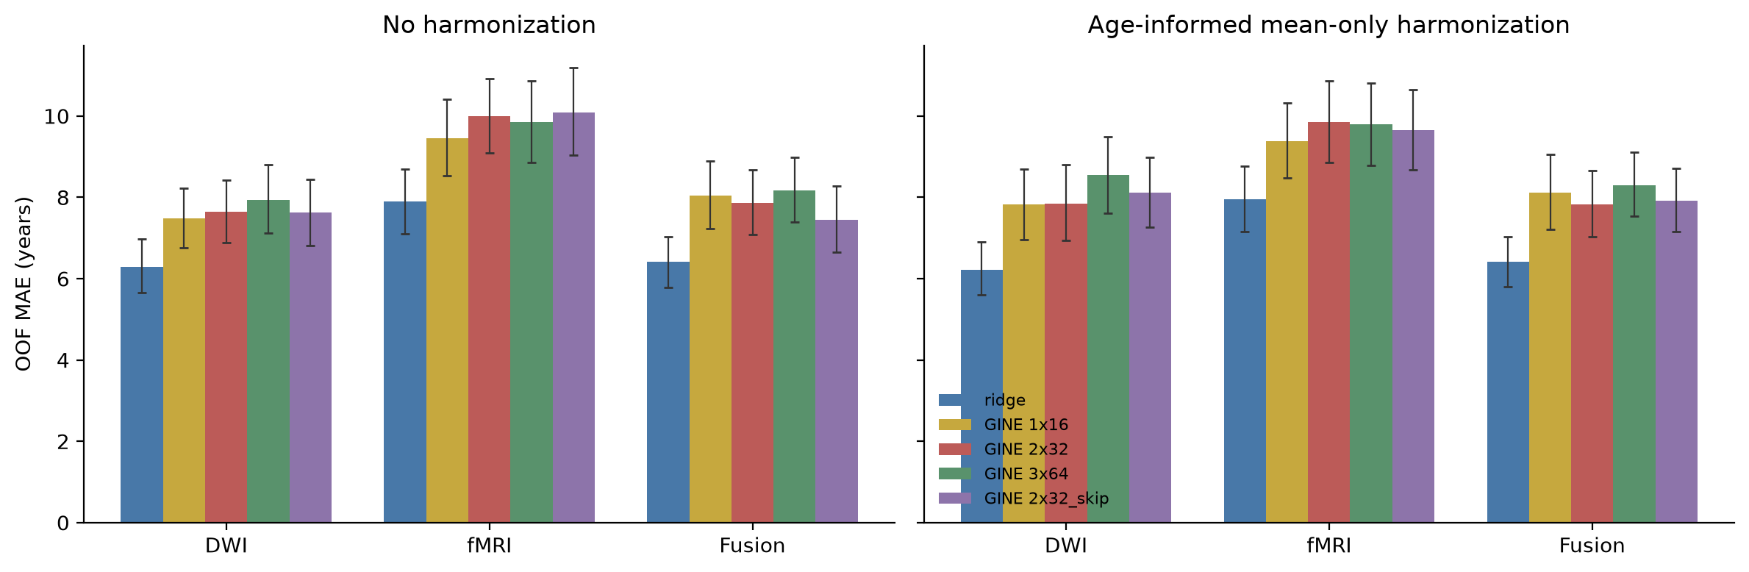
CURRENT PIPELINE | 9 NOV 2026
Capacity and residual comparisons
Report every prespecified arm; capacity selection based on these outer scores requires further validation.
reports/new_pipeline/gine_study/architecture_comparison.png; performance.csv
27
Notes:
Evidence: reports/new_pipeline/gine_study/architecture_comparison.png; performance.csv

Slide 28
CURRENT PIPELINE | 9 NOV 2026
Additive ComBat versus no ComBat: paired sensitivity
Arm | Modality | ΔMAE (additive − none) | 95% CI
ridge | DWI | -0.065 | -0.167–0.031
ridge | fMRI | 0.059 | -0.007–0.124
ridge | fusion | 0.004 | -0.109–0.118
gine_2x32 | DWI | 0.193 | -0.482–0.884
gine_2x32 | fMRI | -0.141 | -0.904–0.615
gine_2x32 | fusion | -0.032 | -0.632–0.516
No consistent accuracy gain across these contrasts; the preprocessing mode is declared rather than selected on outer scores.
reports/new_pipeline/gine_study/harmonization_paired_MAE_differences.csv
28
Notes:
Evidence: reports/new_pipeline/gine_study/harmonization_paired_MAE_differences.csv

Slide 29
CURRENT PIPELINE | 9 NOV 2026
Cohort-specific performance: DWI Ridge
Cohort | CN scans | Participants | MAE (yr) | R²
ADNI | 125 | 77 | 5.08 | 0.161
ADRC | 106 | 106 | 7.59 | 0.333
HABS | 6 | 6 | 5.91 | 0.313
Pooled performance mixes cohort age distributions; HABS has only six retained CN scans.
reports/new_pipeline/matched_ridge/performance.csv
29
Notes:
Evidence: reports/new_pipeline/matched_ridge/performance.csv

Slide 30
CURRENT PIPELINE | 9 NOV 2026
Calibration diagnostics: inspect each cohort
DWI Ridge | r(age, BAG) | r(age, global cBAG) | r(age, cohort cBAG)
Pooled | -0.613 | 0.027 | 0.022
ADNI | -0.683 | -0.339 | 0.024
ADRC | -0.814 | -0.530 | 0.101
HABS | -0.927 | -0.762 | -0.762
These are held-out residual diagnostics, not evidence of clinical validity or complete age independence.
reports/new_pipeline/matched_ridge/age_calibration.csv
30
Notes:
Evidence: reports/new_pipeline/matched_ridge/age_calibration.csv

Slide 31
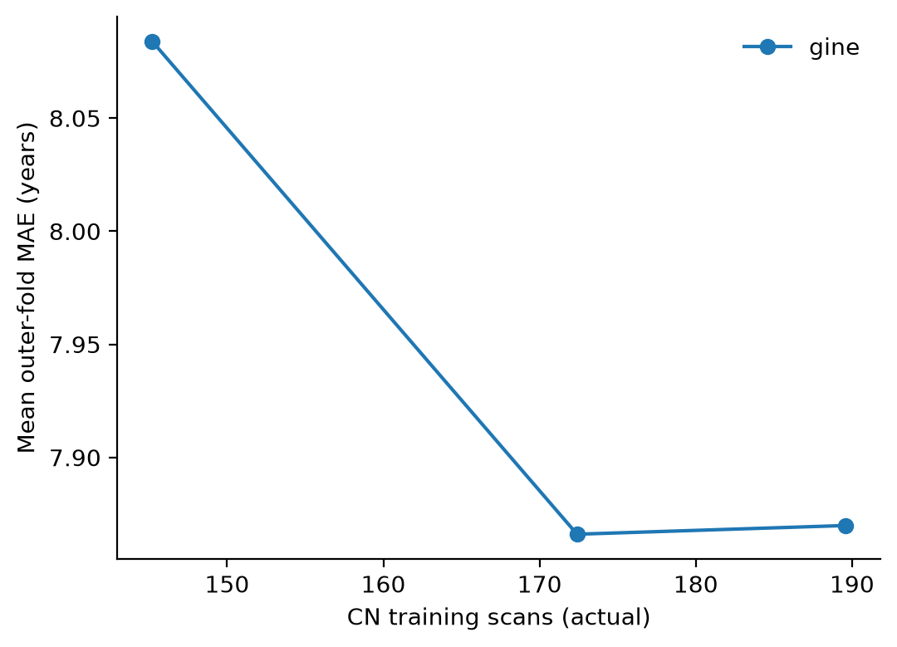
CURRENT PIPELINE | 9 NOV 2026
Training size: DWI GINE 2×32
Mean outer-fold MAE, not pooled MAE; fixed outer tests. 25%, 50% and 60% failed batch-support preflight.
gine_study/training_size_gine_2x32/training_size_metrics.csv | additive mode
31
Notes:
Evidence: gine_study/training_size_gine_2x32/training_size_metrics.csv | additive mode

Slide 32
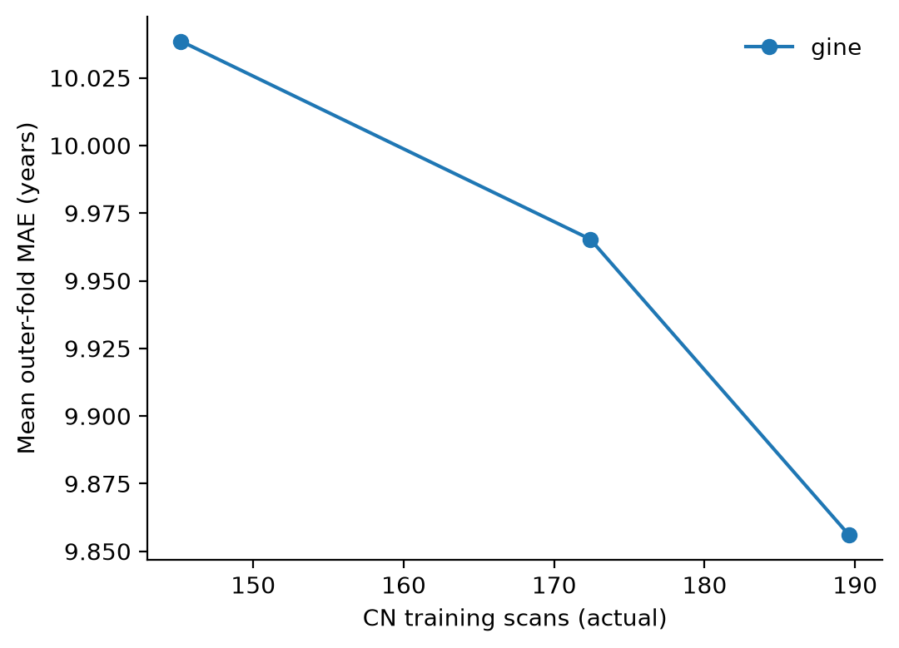
CURRENT PIPELINE | 9 NOV 2026
Training size: fMRI GINE 2×32
Mean outer-fold MAE, not pooled MAE; fixed outer tests. 25%, 50% and 60% failed batch-support preflight.
gine_study/training_size_gine_2x32/training_size_metrics.csv | additive mode
32
Notes:
Evidence: gine_study/training_size_gine_2x32/training_size_metrics.csv | additive mode

Slide 33
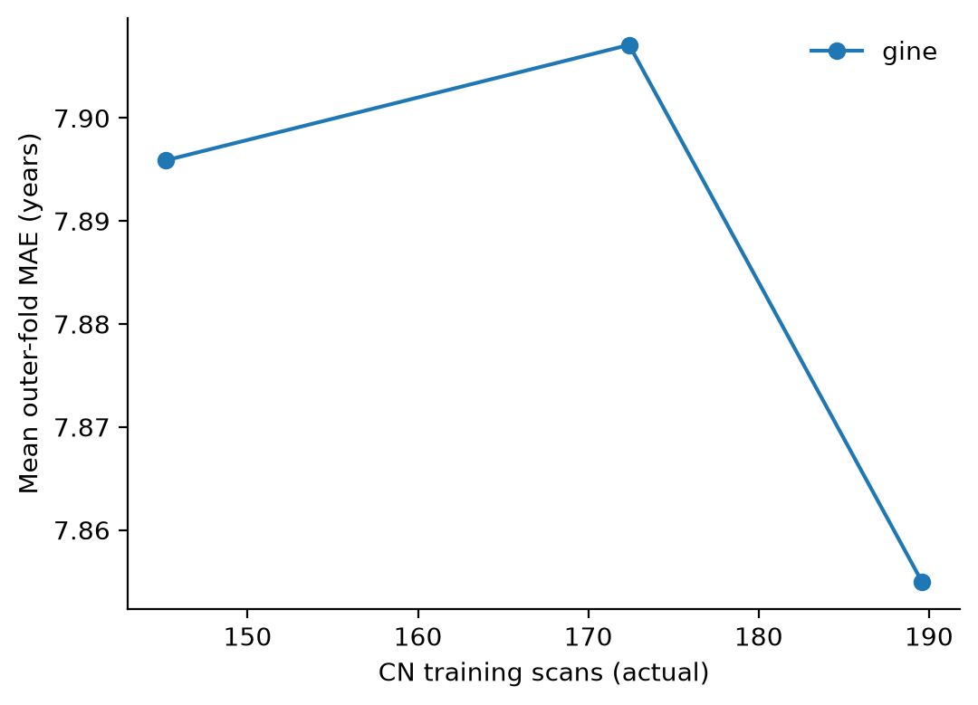
CURRENT PIPELINE | 9 NOV 2026
Training size: fusion GINE 2×32
Mean outer-fold MAE, not pooled MAE; fixed outer tests. 25%, 50% and 60% failed batch-support preflight.
gine_study/training_size_gine_2x32/training_size_metrics.csv | additive mode
33
Notes:
Evidence: gine_study/training_size_gine_2x32/training_size_metrics.csv | additive mode

Slide 34
CURRENT PIPELINE | 9 NOV 2026
Training-size comparison: Ridge and GINE 2×32
Modality | Fraction | Mean CN train scans | Ridge MAE | GINE MAE
DWI | 75% | 145.2 | 6.41 | 8.08
DWI | 90% | 172.4 | 6.24 | 7.87
DWI | 100% | 189.6 | 6.23 | 7.87
fMRI | 75% | 145.2 | 7.93 | 10.04
fMRI | 90% | 172.4 | 8.07 | 9.97
fMRI | 100% | 189.6 | 7.96 | 9.86
fusion | 75% | 145.2 | 6.51 | 7.90
fusion | 90% | 172.4 | 6.46 | 7.91
fusion | 100% | 189.6 | 6.41 | 7.85
Additive mode; arithmetic mean of five outer-fold MAEs. Fractions refer to participant groups, not scan counts.
gine_study/training_size_{ridge,gine_2x32}/training_size_metrics.csv
34
Notes:
Evidence: gine_study/training_size_{ridge,gine_2x32}/training_size_metrics.csv

Slide 35
CURRENT PIPELINE | 9 NOV 2026
Learning diagnostics: DWI additive-mode GINE
Arm | Parameters | Median epoch | Train MAE | Stopping MAE
1x16 | 1977 | 74 | 4.84 | 8.32
2x32 | 6793 | 30 | 4.94 | 8.70
3x64 | 29161 | 18 | 4.06 | 8.17
2x32_skip | 10505 | 21 | 5.16 | 8.58
Training and stopping MAEs are inner early-fit diagnostics, not outer-test performance.
reports/new_pipeline/gine_study/early_stopping_summary.csv
35
Notes:
Evidence: reports/new_pipeline/gine_study/early_stopping_summary.csv

Slide 36
CURRENT PIPELINE | 9 NOV 2026
What has completed, and what remains unverified
• Matched Ridge: 30 outer tasks; complete predictions for six modality × preprocessing combinations.
• Four full-training GINE capacity / residual arms: each completed 30 outer tasks and passed its artifact audit.
• 75% and 90% training-size runs completed for Ridge and GINE 2×32; 25%, 50% and 60% failed batch-support preflight.
• Short-budget GINE validation is software evidence and is excluded from trained-model comparisons.
• Clinical labels, acquisition dates/protocols and ROI ordering remain unverified.
Status is taken from per-run completion records, rather than older summary text.
gine_study/study_status.csv; matched_ridge and GINE run audit.json
36
Notes:
Evidence: gine_study/study_status.csv; matched_ridge and GINE run audit.json

Slide 37
CURRENT PIPELINE | 9 NOV 2026
Interpretability uses original saved outer checkpoints
Load
Verify
Compute
Interpret
Original outer weights
Exact preprocessing
Matching selected config
Held-out sample identity
Prediction consistency
Source / state provenance
Gradient × input
Node / edge sensitivity
Held-out embeddings
Numeric ROI indices first
Labels require verified order
No causal claims
→
→
→
The current method is local gradient-times-input sensitivity; archived integrated-gradient figures used reconstructed models.
code/brainage_pipeline/downstream.py
37
Notes:
Evidence: code/brainage_pipeline/downstream.py

Slide 38
CURRENT PIPELINE | 9 NOV 2026
Embeddings and anatomical labels need separate checks
• Extract embeddings from the original outer checkpoint for training and held-out observations.
• Fit the PCA basis to training embeddings separately for each fold, then project that fold’s held-out observations.
• Do not pool raw embedding coordinates across independently fitted models.
• Age, cohort, sex and verified clinical variables are overlays rather than age-prediction inputs.
• Keep ROI labels numeric until the 84-region order is verified; network assignments are not guessed.
code/brainage_pipeline/downstream.py; diagnostics.py
38
Notes:
Evidence: code/brainage_pipeline/downstream.py; diagnostics.py

Slide 39
CURRENT PIPELINE | 9 NOV 2026
Clinical analysis: implemented interface, gated inference
• Verify source diagnosis codes and the CN reference before interpreting clinical group effects.
• Confirm imaging-to-clinical visit alignment, APOE coding, diabetes definition and HbA1c units.
• The interface supports complete-case analyses with cohort, age and sex covariates, participant-cluster uncertainty and BH adjustment.
• Clinical inference requires a reviewed specification and nonpilot held-out predictions.
• Generic diabetes fields do not establish type 2 diabetes; missing definitions are not filled in by assumption.
No verified clinical association or anatomical finding is claimed from these implementation checks.
code/brainage_pipeline/clinical.py; configs/clinical_spec.json
39
Notes:
Evidence: code/brainage_pipeline/clinical.py; configs/clinical_spec.json

Slide 40
CURRENT PIPELINE | 9 NOV 2026
Limits that still determine interpretation
• This is a development reanalysis following inspection of earlier results, rather than untouched external validation.
• Known-batch eligibility and pairing exclusions produce a restricted matched population.
• Canonical IDs, diagnosis provenance, visit dates and ADRC acquisition protocols need source confirmation.
• Bootstrap intervals describe uncertainty in fixed OOF predictions and omit refitting uncertainty.
• Residual cohort effects and unverified ROI order constrain biomarker and anatomical conclusions.
code/brainage_pipeline/README.md; gine_study/README.md
40
Notes:
Evidence: code/brainage_pipeline/README.md; gine_study/README.md

Slide 41
CURRENT PIPELINE | 9 NOV 2026
Next decisions for the project
• Prioritize source verification of reference diagnosis, participant identity and imaging / clinical visit dates.
• Resolve metadata conflicts with source evidence before expanding the paired population.
• Use a prespecified validation design before choosing a final capacity or preprocessing mode from development results.
• Verify ROI ordering before attaching anatomical names to checkpoint-based sensitivity.
• Run clinical association analyses only after definitions, units and alignment have been reviewed.
Audit follow-up | source-data verification and validation priorities
41
Notes:
Evidence: Audit follow-up | source-data verification and validation priorities

Slide 42
CURRENT PIPELINE | 9 NOV 2026
Reproduction and result provenance
Artifact | Authoritative location
Current entry point | code/run_pipeline.py
Methods / configuration | code/brainage_pipeline/ and configs/
Matched Ridge aggregates | reports/new_pipeline/matched_ridge/
Full-budget study aggregates | reports/new_pipeline/gine_study/
Original audit evidence | reports/pipeline_audit/audit_findings.tsv
This editable deck builder | code/final/slides/update_comprehensive_pipeline.py
Slide tables are loaded from aggregate CSVs; historical figures below retain their original numbers.
Local runtime predictions/checkpoints stay under ignored results/final/new_pipeline/
42
Notes:
Evidence: Local runtime predictions/checkpoints stay under ignored results/final/new_pipeline/

Slide 43
CURRENT PIPELINE | 9 NOV 2026
Appendix: historical benchmarks and reconstructed attribution
• The following figures preserve the earlier full-sample harmonization and 387-CN-scan benchmark.
• They use different populations and evaluation procedures from the current 237-CN-scan matched results.
• Historical graph thresholds were compared using their reported OOF scores.
• Historical attribution used reconstructed models; it is not current original-checkpoint sensitivity.
• These archived numbers are retained for context and must not be read as updated validation results.
Original comprehensive deck snapshot retained in results/presentation/archive_before_pipeline_update_20261109/
43
Notes:
Evidence: Original comprehensive deck snapshot retained in results/presentation/archive_before_pipeline_update_20261109/

Slide 44
HISTORICAL APPENDIX | DIFFERENT POPULATION / EVALUATION | NOT UPDATED RESULTS
Historical: Dataset and site predictability decrease sharply
DWI: dataset (4 classes)
0.992
0.334
DWI: site batch (29)
0.721
0.014
fMRI: dataset (3)
0.913
0.429
fMRI: site batch (24)
0.255
0.011
0
0.2
0.4
0.6
0.8
1
Before
After
Balanced accuracy; lower technical predictability supports reduced batch information.
report_tables/Table3_harmonization.csv
44
Notes:
Balanced accuracy from saved harmonization diagnostics. Different targets use different eligible subsets. Chance references: DWI dataset 1/4; fMRI dataset 1/3; site 1/29 and 1/24. These are descriptive diagnostics after full-data harmonization.
Source files: report_tables/Table3_harmonization.csv
HISTORICAL APPENDIX: preserved original numerical results. Not current nested-pipeline evaluation. Reconstructed attribution is not current-checkpoint output.

Slide 45
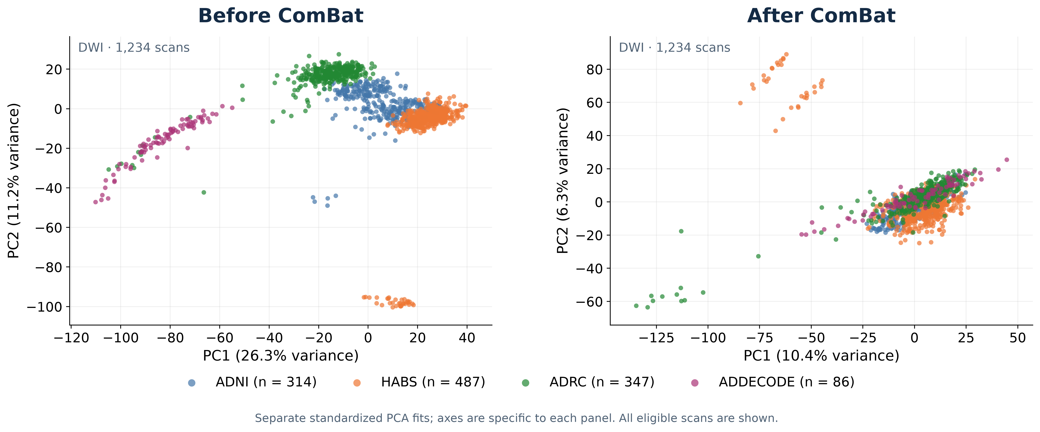
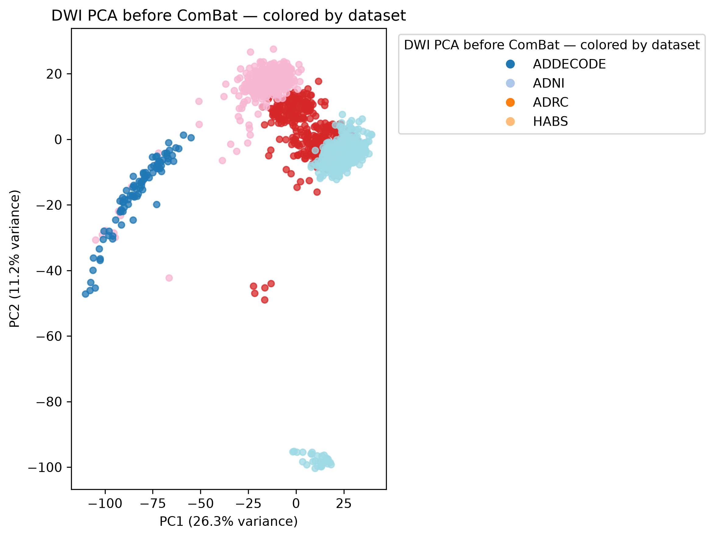
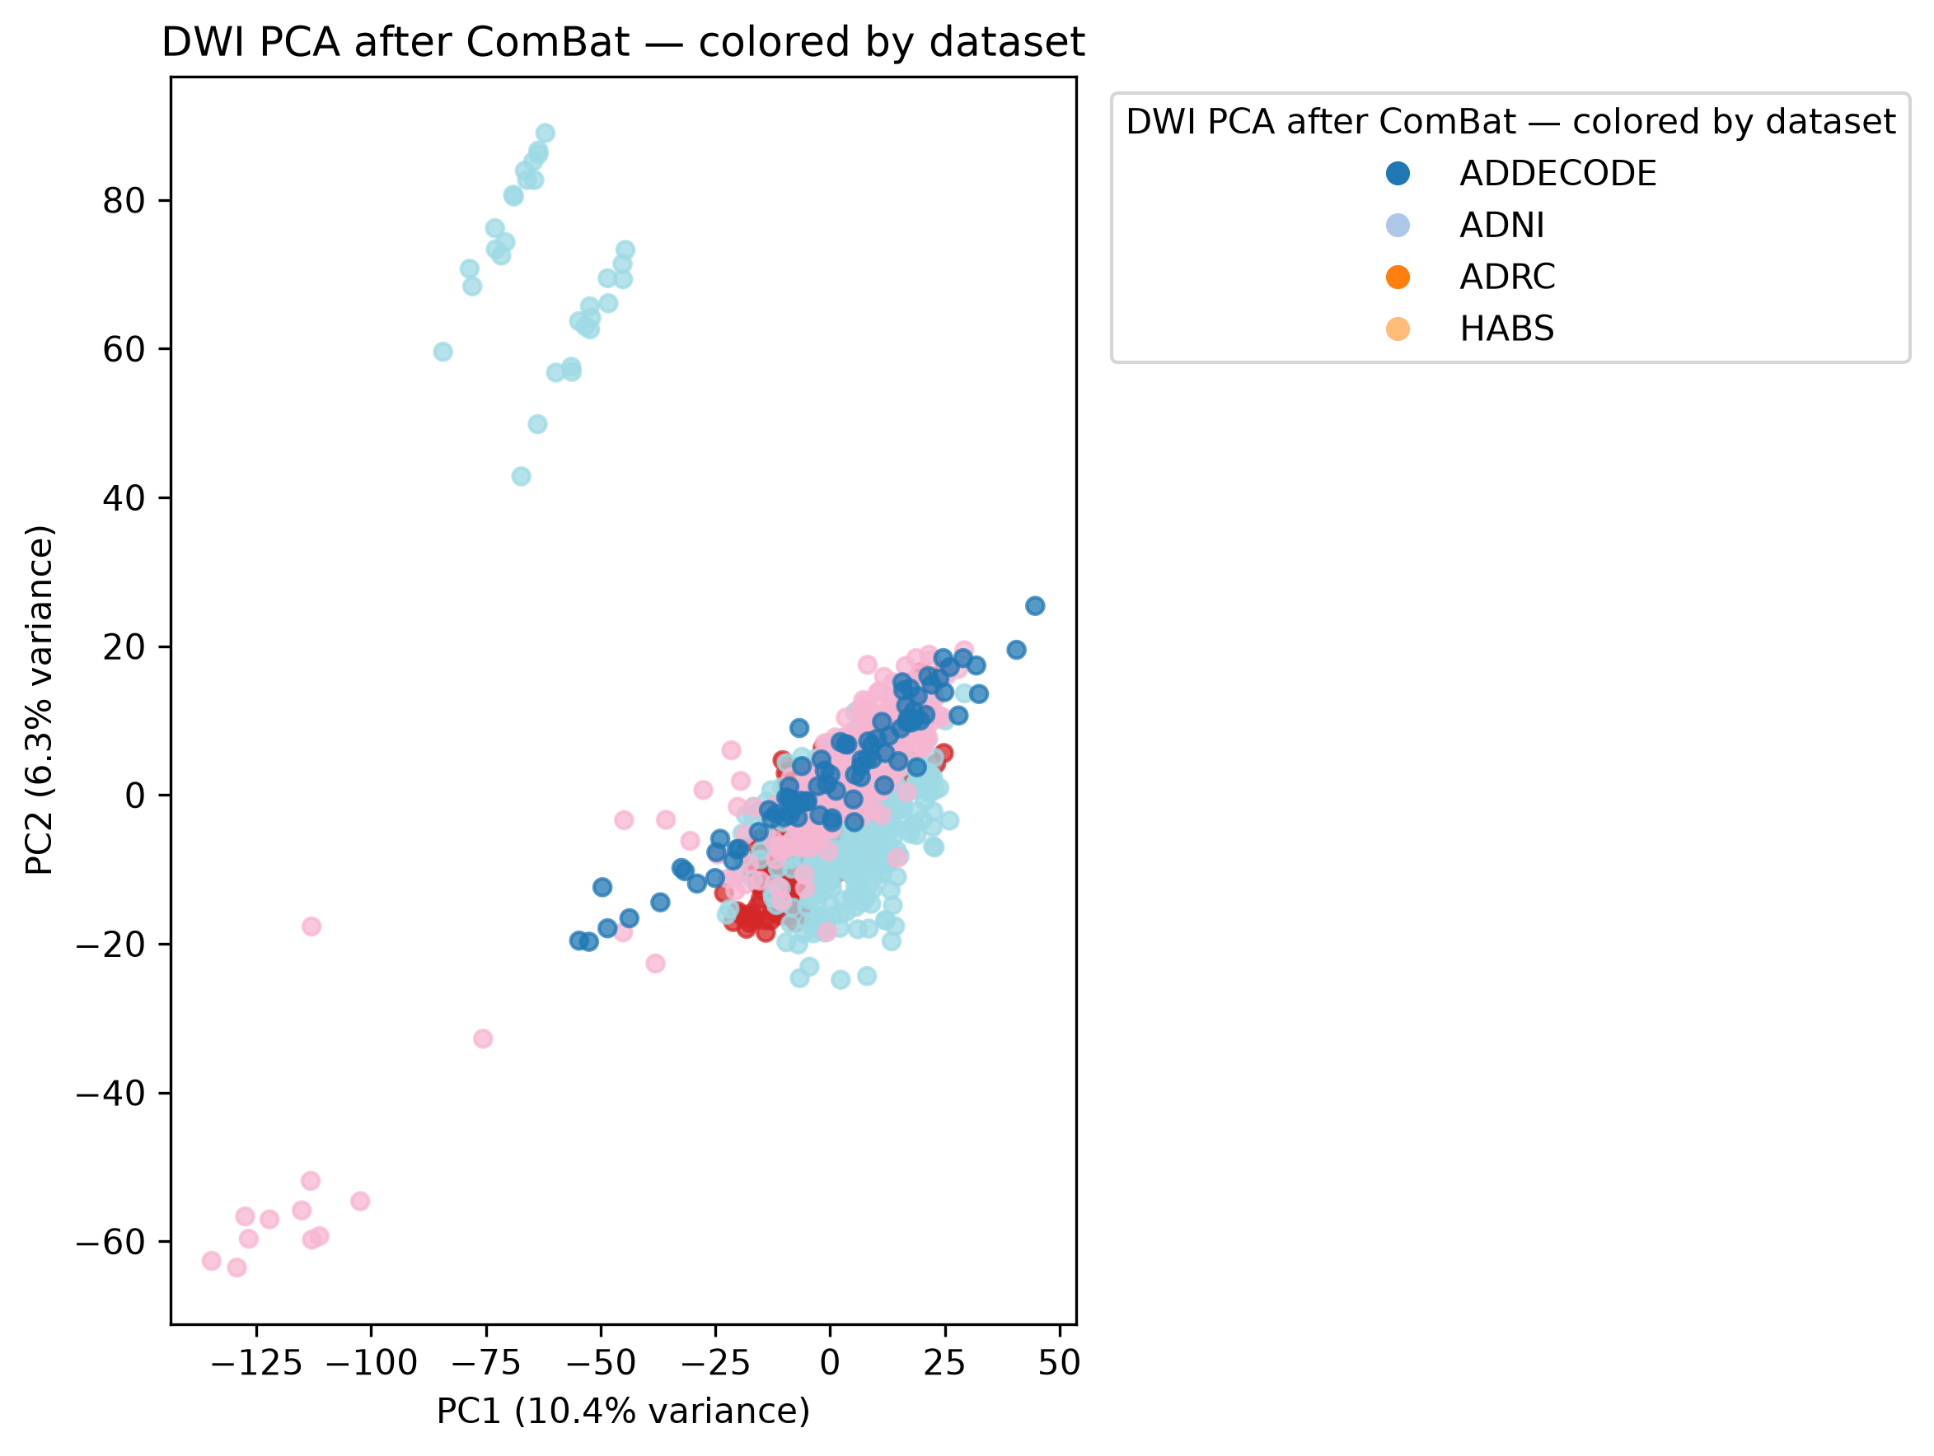
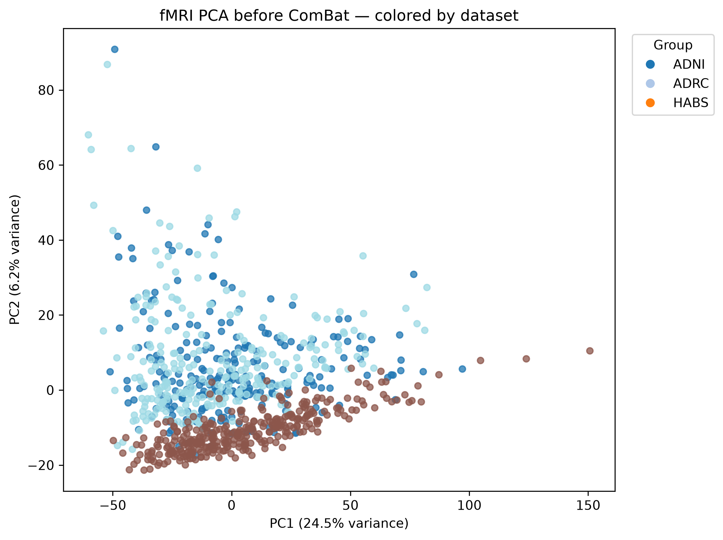
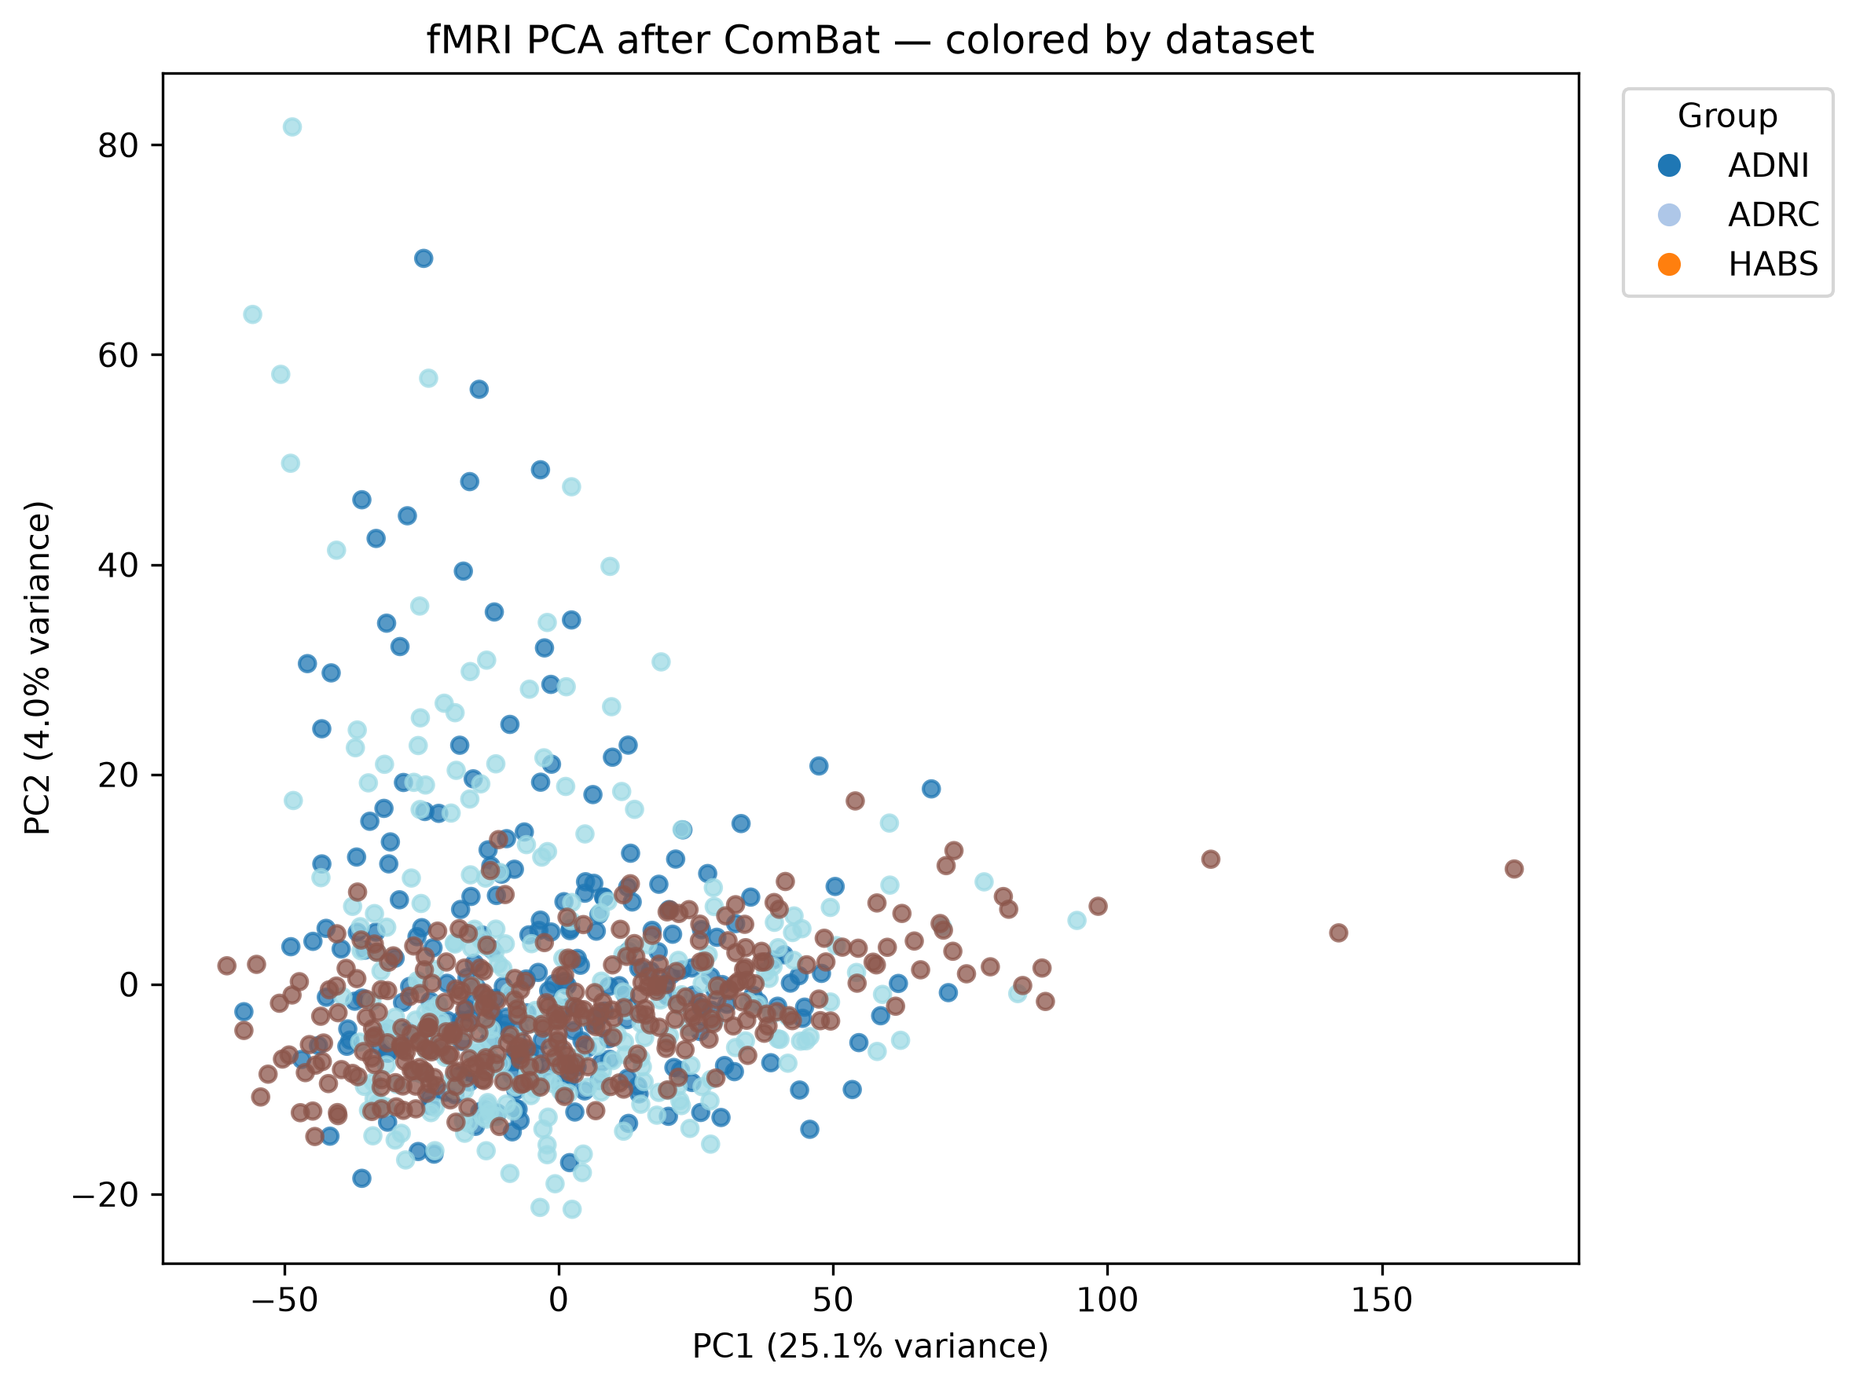
HISTORICAL APPENDIX | DIFFERENT POPULATION / EVALUATION | NOT UPDATED RESULTS
Historical: PCA by dataset: DWI
results/checks/PCA/figures/DWI_PCA_by_dataset_before_after.png
45
Notes:
Fresh rerun of the current harmonization source. Dataset colors and legend match. Before/after PCA fit independently after StandardScaler; fMRI also median-imputes. All eligible scans retained. Source: /mnt/newStor/paros/paros_WORK/avery/results/checks/PCA/figures/DWI_PCA_by_dataset_before_after.png
HISTORICAL APPENDIX: preserved original numerical results. Not current nested-pipeline evaluation. Reconstructed attribution is not current-checkpoint output.

Slide 46
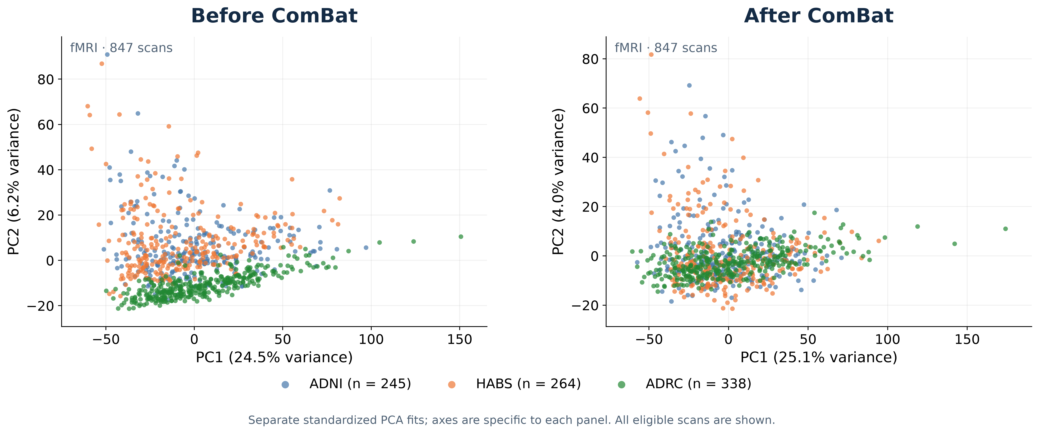
HISTORICAL APPENDIX | DIFFERENT POPULATION / EVALUATION | NOT UPDATED RESULTS
Historical: PCA by dataset: fMRI
Final fMRI run: 20261028T234533Z | results/final/fMRI/harmonization_evaluation/
46
Notes:
{
"slide": 17,
"authoritative_source": {
"path": "/mnt/newStor/paros/paros_WORK/avery/code/final/run_fMRI_harmonization.py",
"sha256": "d1a3397afe0efef959cd7e4d8aafc92c91e7b2c6fbcf559fe6377b8aff31e9f9"
},
"run_id": "20261028T234533Z",
"figure": "/mnt/newStor/paros/paros_WORK/avery/results/final/fMRI/harmonization_evaluation/fMRI_PCA_by_dataset_before_after.png",
"scans": 847,
"features": 3486,
"cohort_counts": {
"ADRC": 338,
"HABS": 264,
"ADNI": 245
},
"PCA": {
"before_combat": {
"n": 847,
"features": 3486,
"explained_variance_ratio": [
0.24497027695178986,
0.06218695268034935
],
"independent_fit": true
},
"after_combat": {
"n": 847,
"features": 3486,
"explained_variance_ratio": [
0.25122570991516113,
0.039809998124837875
],
"independent_fit": true
}
},
"method": "Before and after are independently fitted StandardScaler + PCA(2); fMRI median imputation. Same points/colors/counts as final exported results.",
"comparison": "Final features match previous run exactly; PCA distribution and percentages therefore remain unchanged."
}
HISTORICAL APPENDIX: preserved original numerical results. Not current nested-pipeline evaluation. Reconstructed attribution is not current-checkpoint output.

Slide 47
HISTORICAL APPENDIX | DIFFERENT POPULATION / EVALUATION | NOT UPDATED RESULTS
Historical: Biological signal preservation is mixed
Diagnostic | DWI before → after | fMRI before → after
Sex balanced accuracy | 0.782 → 0.766 | 0.631 → 0.640
Diagnosis balanced accuracy | 0.294 → 0.151 | 0.300 → 0.227
Age MAE (years) | 6.22 → 6.71 | 7.64 → 8.00
Age R² | 0.588 → 0.516 | 0.379 → 0.307
Sex prediction is broadly retained. Age prediction worsens and diagnosis prediction decreases; these diagnostics do not establish complete biological preservation.
report_tables/Table3_harmonization.csv
47
Notes:
Source files: report_tables/Table3_harmonization.csv
HISTORICAL APPENDIX: preserved original numerical results. Not current nested-pipeline evaluation. Reconstructed attribution is not current-checkpoint output.

Slide 48
HISTORICAL APPENDIX | DIFFERENT POPULATION / EVALUATION | NOT UPDATED RESULTS
Historical: Ridge leads the full-cohort unimodal analyses
Modality / model | CN scans | MAE (yr) | RMSE (yr) | R² | Pearson r
DWI Ridge | 916 | 5.98 | 7.89 | 0.519 | 0.724
DWI GNN (top 50%) | 916 | 7.56 | 9.61 | 0.287 | 0.537
fMRI Ridge | 642 | 7.33 | 9.49 | 0.406 | 0.637
fMRI GNN (top 10%) | 642 | 9.31 | 11.97 | 0.056 | 0.305
DWI and fMRI use different populations; compare models within each modality.
DWI_Ridge_CV_metrics.json; fMRI_Ridge_CV_metrics.json; selected GNN threshold summaries
48
Notes:
Source files: DWI_Ridge_CV_metrics.json; fMRI_Ridge_CV_metrics.json; selected GNN threshold summaries
HISTORICAL APPENDIX: preserved original numerical results. Not current nested-pipeline evaluation. Reconstructed attribution is not current-checkpoint output.

Slide 49
HISTORICAL APPENDIX | DIFFERENT POPULATION / EVALUATION | NOT UPDATED RESULTS
Historical: Graph sparsity has modality-specific effects
Top 10%
8.31
9.31
Top 25%
8.26
9.41
Top 50%
7.56
9.45
Top 75%
7.95
9.76
All positive edges
7.61
9.91
0
2
4
6
8
10
DWI (916 CN scans)
fMRI (642 CN scans)
MAE (years; lower is better)
Thresholds were selected on the reported OOF comparison; an independent estimate is still needed.
DWI_GNN_threshold_comparison.csv; fMRI_GNN_threshold_comparison.csv
49
Notes:
Source files: DWI_GNN_threshold_comparison.csv; fMRI_GNN_threshold_comparison.csv
Chart redrawn from the final selected-threshold comparison CSVs. Five thresholds, both modalities, raw CN OOF MAE. Editable native vector bars and text; standalone 400-dpi PNG and SVG are also saved.
Chart redrawn from the final selected-threshold comparison CSVs. Five thresholds, both modalities, raw CN OOF MAE. Editable native vector bars and text; standalone 400-dpi PNG and SVG are also saved.
HISTORICAL APPENDIX: preserved original numerical results. Not current nested-pipeline evaluation. Reconstructed attribution is not current-checkpoint output.

Slide 50
HISTORICAL APPENDIX | DIFFERENT POPULATION / EVALUATION | NOT UPDATED RESULTS
Historical: Paired-sample selection changes the population
Cohort | Paired scans | Evaluated CN scans | Evaluated participants
ADNI | 245 | 131 | 74
ADRC | 338 | 243 | 243
HABS | 264 | 13 | 13
Total | 847 | 387 | 330
250 HABS scans have age disagreements between modalities. Training requires ages to agree within 0.01 year; only 13 HABS scans enter this benchmark.
Visit-ID pairing is available; acquisition-date proximity has not been verified.
report_tables/Table1_samples.csv; metadata/fusion_metadata_audit_summary.json
50
Notes:
Source files: report_tables/Table1_samples.csv; metadata/fusion_metadata_audit_summary.json
HISTORICAL APPENDIX: preserved original numerical results. Not current nested-pipeline evaluation. Reconstructed attribution is not current-checkpoint output.

Slide 51
HISTORICAL APPENDIX | DIFFERENT POPULATION / EVALUATION | NOT UPDATED RESULTS
Historical: Weighted Ridge has the lowest paired-sample MAE
DWI Ridge
6.66
fMRI Ridge
8.37
Ridge early fusion
6.69
Weighted Ridge fusion
6.47
Ridge late mean
6.57
DWI GNN
9.74
fMRI GNN
9.54
GNN fusion
9.07
0
2
4
6
8
10
CN OOF MAE (years; lower is better)
Shared benchmark: 387 CN scans / 330 participants / identical outer folds.
report_tables/Table4_models_pooled.csv
51
Notes:
All values are raw CN OOF metrics from the same 387 scans and 330 participants. No significance claim is supported by these point estimates.
Source files: report_tables/Table4_models_pooled.csv
Redrawn from final pooled paired-sample results; every model uses 387 CN scans / 330 participants. Native editable vector bars; values unchanged.
HISTORICAL APPENDIX: preserved original numerical results. Not current nested-pipeline evaluation. Reconstructed attribution is not current-checkpoint output.

Slide 52
HISTORICAL APPENDIX | DIFFERENT POPULATION / EVALUATION | NOT UPDATED RESULTS
Historical: The fusion gain is modest and method dependent
Model | MAE (yr) | RMSE (yr) | R² | r
DWI Ridge | 6.66 | 8.49 | 0.620 | 0.788
Ridge early fusion | 6.69 | 8.62 | 0.609 | 0.780
Weighted Ridge fusion | 6.47 | 8.38 | 0.630 | 0.794
Ridge late mean | 6.57 | 8.48 | 0.621 | 0.799
GNN fusion | 9.07 | 11.44 | 0.311 | 0.558
Weighted Ridge improves MAE by 0.184 years (2.8%) vs DWI Ridge. Unweighted concatenation does not improve on DWI alone.
report_tables/Table4_models_pooled.csv; Weighted_Ridge/fusion_summary.json
52
Notes:
Source files: report_tables/Table4_models_pooled.csv; Weighted_Ridge/fusion_summary.json
HISTORICAL APPENDIX: preserved original numerical results. Not current nested-pipeline evaluation. Reconstructed attribution is not current-checkpoint output.

Slide 53
HISTORICAL APPENDIX | DIFFERENT POPULATION / EVALUATION | NOT UPDATED RESULTS
Historical: Pooled performance masks cohort differences
Cohort | CN scans | DWI Ridge MAE | Weighted Ridge MAE | GNN fusion MAE
ADNI | 131 | 7.15 | 6.85 | 8.91
ADRC | 243 | 6.52 | 6.39 | 9.04
HABS | 13 | 4.12 | 4.16 | 11.24
ADNI R² is negative for all paired models despite positive pooled R². HABS estimates rely on only 13 scans. These are pooled-training OOF results, not leave-one-cohort-out tests.
report_tables/Table5_models_by_cohort.csv
53
Notes:
Source files: report_tables/Table5_models_by_cohort.csv
HISTORICAL APPENDIX: preserved original numerical results. Not current nested-pipeline evaluation. Reconstructed attribution is not current-checkpoint output.

Slide 54
HISTORICAL APPENDIX | DIFFERENT POPULATION / EVALUATION | NOT UPDATED RESULTS
Historical: Archived attribution: reconstructed fusion GNN
• Integrated gradients (IG) attributes standardized node features and normalized edge attributes on held-out CN scans.
• Five reconstructed outer-fold models explain 387 scans from 330 participants.
• Reference: training-mean node features with observed diagonal retained, and zero edge attributes; graph topology stays fixed.
• Participant summaries average signed attributions across visits before taking absolute values.
• Attributions describe model behavior relative to this reference; they are not causal effects or clinical associations.
Historical results: results/explore/GNN_attribution. Not the output of the current saved-checkpoint workflow.
GNN_interpretability/METHODS.txt; analysis_summary.json
54
Notes:
Source files: GNN_interpretability/METHODS.txt; analysis_summary.json
AUDIT: Numerical results are archived reconstructed-model outputs. Current checkpoint-based attribution has not produced a verified replacement in this workspace.
AUDIT: Numerical results are archived reconstructed-model outputs. Current checkpoint-based attribution has not produced a verified replacement in this workspace.
AUDIT: Numerical results are archived reconstructed-model outputs. Current checkpoint-based attribution has not produced a verified replacement in this workspace.
HISTORICAL APPENDIX: preserved original numerical results. Not current nested-pipeline evaluation. Reconstructed attribution is not current-checkpoint output.

Slide 55
HISTORICAL APPENDIX | DIFFERENT POPULATION / EVALUATION | NOT UPDATED RESULTS
Historical: Attribution quality limits the strength of interpretation
Quality check | Observed result
IG integration steps | 64 initially; up to 512
Completeness tolerance | 0.05 years
Scans failing completeness | 6 / 387 (1.6%)
Maximum absolute IG residual | 0.119 years
Maximum difference from original OOF prediction | 13.18 years
These attributions explain reconstructed models; exact original-model attribution is not established.
Historical results: results/explore/GNN_attribution. Not the output of the current saved-checkpoint workflow.
GNN_interpretability/analysis_summary.json; reconstruction_check.csv
55
Notes:
Source files: GNN_interpretability/analysis_summary.json; reconstruction_check.csv
AUDIT: Numerical results are archived reconstructed-model outputs. Current checkpoint-based attribution has not produced a verified replacement in this workspace.
AUDIT: Numerical results are archived reconstructed-model outputs. Current checkpoint-based attribution has not produced a verified replacement in this workspace.
AUDIT: Numerical results are archived reconstructed-model outputs. Current checkpoint-based attribution has not produced a verified replacement in this workspace.
HISTORICAL APPENDIX: preserved original numerical results. Not current nested-pipeline evaluation. Reconstructed attribution is not current-checkpoint output.

Slide 56
HISTORICAL APPENDIX | DIFFERENT POPULATION / EVALUATION | NOT UPDATED RESULTS
Historical: fMRI carries larger attribution in this fusion model
Modality | Mean signed IG (yr) | Mean absolute connection IG | Occlusion error increase (yr)
DWI | -6.96 | 45.17 | 2.55
fMRI | 10.33 | 128.54 | 3.36
Larger fMRI attribution reflects this model and its reference. It does not imply superior standalone prediction. Absolute connection contributions can accumulate and cancel; they are not predicted ages or modality percentages.
Reference occlusion retains topology and may produce inputs outside the training distribution.
Historical results: results/explore/GNN_attribution. Not the output of the current saved-checkpoint workflow.
GNN_interpretability/modality_summary.csv
56
Notes:
Source files: GNN_interpretability/modality_summary.csv
AUDIT: Numerical results are archived reconstructed-model outputs. Current checkpoint-based attribution has not produced a verified replacement in this workspace.
AUDIT: Numerical results are archived reconstructed-model outputs. Current checkpoint-based attribution has not produced a verified replacement in this workspace.
AUDIT: Numerical results are archived reconstructed-model outputs. Current checkpoint-based attribution has not produced a verified replacement in this workspace.
HISTORICAL APPENDIX: preserved original numerical results. Not current nested-pipeline evaluation. Reconstructed attribution is not current-checkpoint output.

Slide 57
HISTORICAL APPENDIX | DIFFERENT POPULATION / EVALUATION | NOT UPDATED RESULTS
Historical: Top ROI attributions emphasize fMRI regions
Right pallidum
2.80
Left precuneus
2.52
Left pallidum
2.50
Right precuneus
2.46
Right entorhinal cortex
2.14
Left fusiform cortex
2.02
Left middle temporal cortex
2.01
0
0.5
1
1.5
2
2.5
3
Mean incident absolute IG (years)
Top overall rows are fMRI. Region labels follow the existing atlas audit; per-scan order is unverified.
Historical results: results/explore/GNN_attribution. Not the output of the current saved-checkpoint workflow.
GNN_interpretability/roi_importance.csv; roi_labels_with_verification_scope.csv
57
Notes:
ROI index is zero-based. Atlas naming is supported by the existing label/source audit, without per-scan regeneration. ROI importance assigns half of absolute combined connection attribution to each endpoint.
Source files: GNN_interpretability/roi_importance.csv; roi_labels_with_verification_scope.csv
AUDIT: Numerical results are archived reconstructed-model outputs. Current checkpoint-based attribution has not produced a verified replacement in this workspace.
AUDIT: Numerical results are archived reconstructed-model outputs. Current checkpoint-based attribution has not produced a verified replacement in this workspace.
AUDIT: Numerical results are archived reconstructed-model outputs. Current checkpoint-based attribution has not produced a verified replacement in this workspace.
Redrawn clearly from archived reconstructed-model attribution; names expanded for readability without changing ROI identity. All seven displayed ROIs are fMRI. This is not a new exact-checkpoint attribution result.
HISTORICAL APPENDIX: preserved original numerical results. Not current nested-pipeline evaluation. Reconstructed attribution is not current-checkpoint output.

Slide 58
HISTORICAL APPENDIX | DIFFERENT POPULATION / EVALUATION | NOT UPDATED RESULTS
Historical: Leading connections and stability offer complementary views
Connection (fMRI) | Mean |IG| (yr) | Folds in top 100
lh_precuneus ↔ rh_precuneus | 0.415 | 5/5
lh_entorhinal ↔ rh_entorhinal | 0.233 | 5/5
lh_isthmuscingulate ↔ lh_precuneus | 0.195 | 5/5
lh_inferiorparietal ↔ lh_precuneus | 0.183 | 3/5
lh_insula ↔ rh_insula | 0.170 | 5/5
Ranks describe reconstructed CN models and fixed topology; avoid biomarker claims.
Historical results: results/explore/GNN_attribution. Not the output of the current saved-checkpoint workflow.
GNN_interpretability/connection_importance.csv; connection_fold_stability.csv
58
Notes:
Source files: GNN_interpretability/connection_importance.csv; connection_fold_stability.csv
AUDIT: Numerical results are archived reconstructed-model outputs. Current checkpoint-based attribution has not produced a verified replacement in this workspace.
AUDIT: Numerical results are archived reconstructed-model outputs. Current checkpoint-based attribution has not produced a verified replacement in this workspace.
AUDIT: Numerical results are archived reconstructed-model outputs. Current checkpoint-based attribution has not produced a verified replacement in this workspace.
HISTORICAL APPENDIX: preserved original numerical results. Not current nested-pipeline evaluation. Reconstructed attribution is not current-checkpoint output.

